Slide 1
Cost-Effectiveness of Transcatheter Aortic Valve Replacement with a Self-Expanding Prosthesis Compared with Surgical Aortic Valve Replacement in High Risk Patients
Results from the CoreValve US High Risk Study
Matthew R. Reynolds, MD, MSc
For the CoreValve US Clinical Investigators
Harvard Clinical Research Institute
Saint-Luke’s Mid America Heart Institute

Slide 2
Disclosure Statement of Financial Interest
Within the past 12 months, I or my spouse/partner have had a financial interest/arrangement or affiliation with the organization(s) listed below.
Affiliation/Financial Relationship
Company
Grant/Research Support
Consulting Fees/Honoraria
Major Stock Shareholder/Equity
Royalty Income
Ownership/Founder
Intellectual Property Rights
Other Financial Benefit
Medtronic, Edwards Lifesciences
Medtronic
None
None
None
None
None

Slide 3
Background
Previous studies have shown that TAVR provides substantial clinical benefits at acceptable incremental costs for patients with symptomatic, severe aortic stenosis who are unsuitable for surgical AVR
There is less consensus about the cost-effectiveness of TAVR relative to SAVR for high-risk surgical candidates
Recently, the CoreValve US Pivotal High Risk Trial demonstrated improved 12-month survival with TAVR using a self-expanding prosthesis compared with SAVR in high-risk aortic stenosis patients
TCT 2014

Slide 4
Objectives
Quantify “in-trial” survival, quality of life, quality-adjusted survival, resource use and costs for both TAVR and SAVR through 12 months
Characterize incremental cost-effectiveness of TAVR vs. SAVR over a lifetime horizon
TCT 2014

Slide 5
Methods: Overview
Analytic Perspective
US healthcare system (2013 US dollars)
Analysis Population
All patients from As Treated trial population (N=747)
  Crossovers within this population analyzed according to their randomized grouping (ITT principle)
General Approach
In-trial (12-month) analysis with patient-level lifetime projections of life expectancy, quality-adjusted life expectancy, and costs
Primary effectiveness measure = quality adjusted life-years (QALYs); secondary measure = life years (LYs)
Future costs and benefits discounted at 3%/year
TCT 2014

Slide 6
Methods
Costs through 12 months were calculated using a combination of resource-based accounting and hospital billing data. Observed costs from the 6-12 month interval were used to project future costs
  CoreValve estimated commercial price = $32,000
  Cath lab overhead for IF-TAVR procedures; OR overhead for all other procedures
EQ-5D utilities measured at baseline, 1, 6 and 12 months and used to estimate quality-adjust life expectancy

Slide 7
Methods: Survival Projections
SAVR Group: Observed mortality (6-18 months) calibrated to age/gender matched mortality from US life tables. Life tables, with calibration factor, used to project patient-level survival beyond 12 months
TAVR Group: Hazard ratio (TAVR vs. SAVR) for survival projections derived from 6-18 month landmark analysis of trial data
  Observed hazard ratio = 0.94 (95% CI: 0.57 to 1.56)
  For base case analysis, hazard ratio assumed = 1.0
TCT 2014

Slide 8
Baseline Characteristics
Characteristic | TAVR N=390 | SAVR N=357
Age, years | 83.1 ± 7.1 | 83.2 ± 6.4
Men, % | 53.1 | 52.4
STS Predicted Risk of Mortality, % | 7.3 ± 3.0 | 7.5 ± 3.4
Logistic EuroSCORE, % | 17.7 ± 13.1 | 18.6 ± 13.0
Prior MI | 25.4 | 25.2
Prior coronary artery bypass surgery | 29.5 | 31.1
Prior stroke | 12.6 | 14.0
Home oxygen | 12.9 | 11.5
Creatinine clearance <30 cc/min | 12.0 | 11.7
Peripheral artery disease | 41.1 | 41.7
P=NS for all comparisons
TCT 2014
8

Slide 9
Index Procedure/Admission Resource Use
Resource Category | TAVR N=390 | SAVR N=357 | Difference (95% CI) | P Value
Procedure duration, min | 61±35 | 221±85 | -161 (-151 to -170) | <0.001
Room time, min | 216±62 | 315±94 | -99 (-87 to -110) | <0.001
Total hospital LOS*, days | 8.1 (6) | 12.5 (9) | -4.4 (-3.1 to -5.7) | <0.001
ICU | 3.1 (2) | 4.7 (3) | -1.6 (-0.9 to -2.3) | <0.001
Non-ICU | 5.0 (4) | 7.7 (5) | -2.8 (-1.8 to -3.8) | <0.001
Post procedure | 6.7 (5) | 11.5 (8) | -4.8 (-3.6 to -5.9) | <0.001
Total ventilator time, hr | 14.2±64.1 | 36.2±84.3 | -22.0 (-11.1 to -32.8) | <0.001
*LOS data are shown as mean (median)
TCT 2014
9

Slide 10
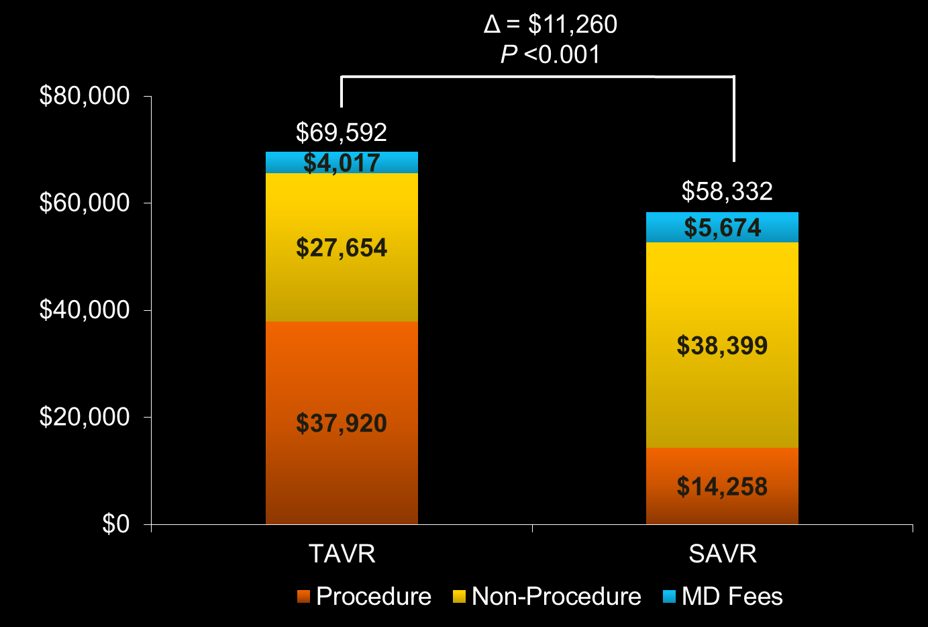
Index Admission: Costs
TCT 2014
10

Slide 11
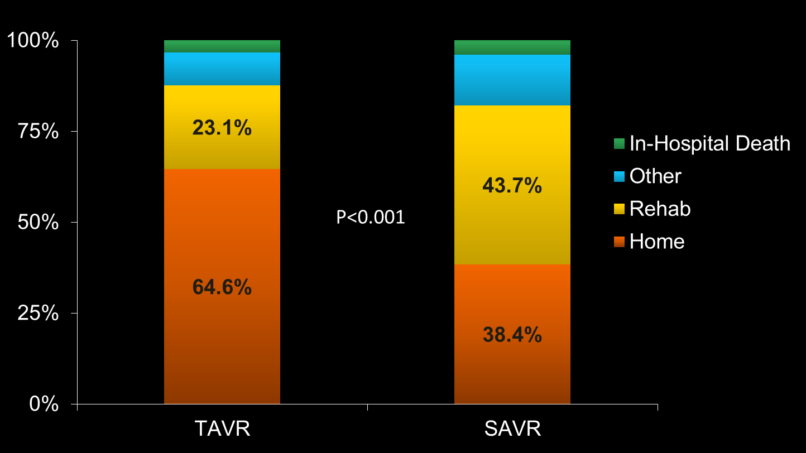
Discharge Destination
TCT 2014
11

Slide 12
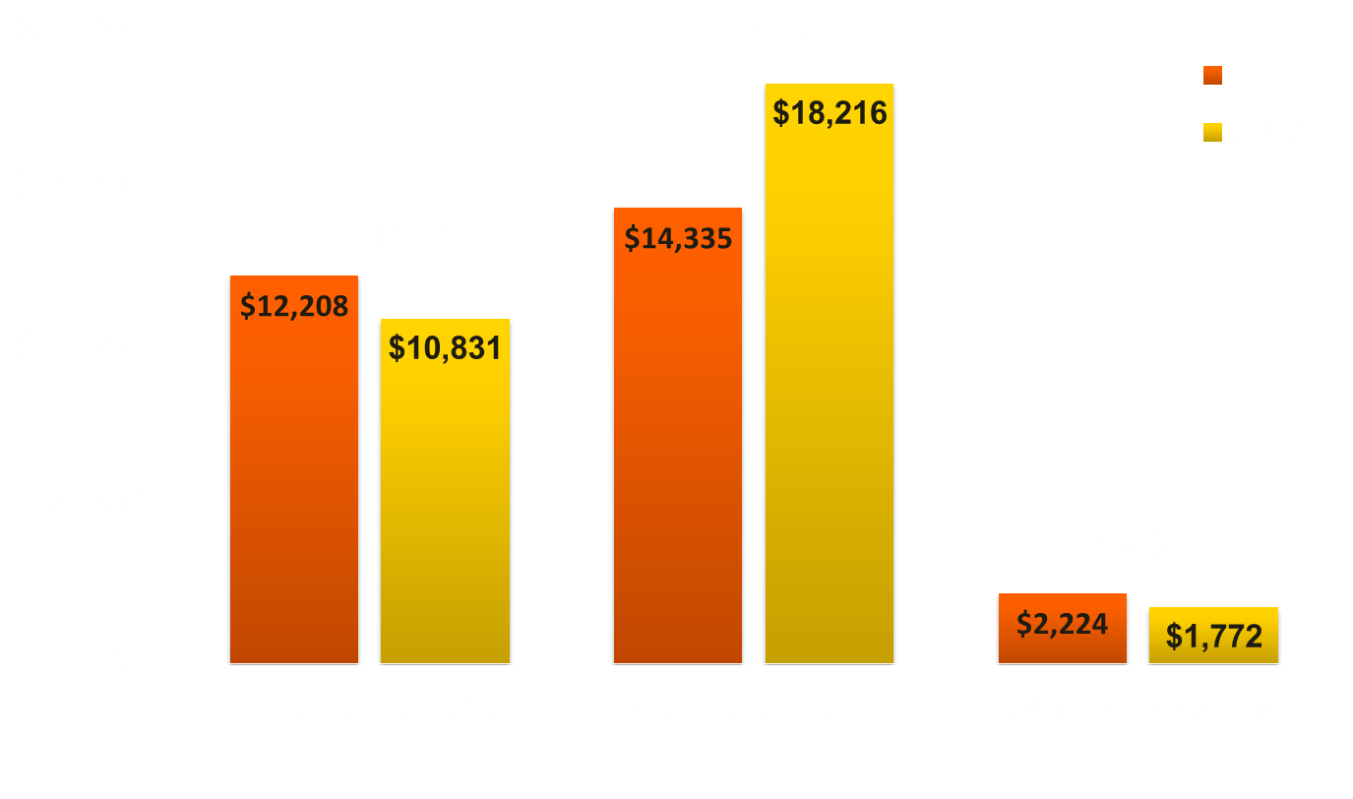
12-Month Follow-up Costs
Total F/U Costs (12 months)
TAVR $28,766
SAVR $30,819
Δ = $2053
P = 0.52
TCT 2014
12

Slide 13
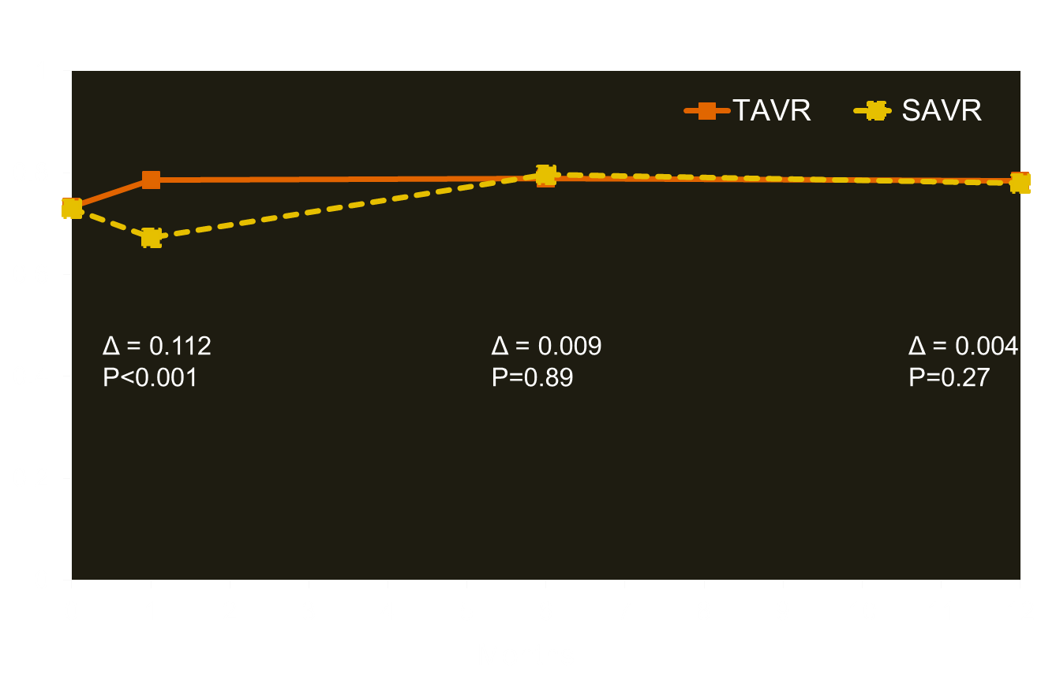
In-Trial EQ-5D Scores
TCT 2014
13

Slide 14
Projected Survival
Difference =
0.044 life years
Projected Life Expectancy:
TAVR 5.43 years
SAVR 5.12 years
Difference: 0.31 years (undiscounted)
TCT 2014

Slide 15
TAVR vs. SAVR
Cost per QALY gained, Lifetime
$150,000 per QALY
$50,000 per QALY
Δ 1-yr cost (TAVR - AVR)
Δ Costs = $13,680
Δ QALYs = 0.20
ICER = $67,059 per
QALY gained
Δ QALY (TAVR - AVR)
TCT 2014

Slide 16
TAVR vs. SAVR
Cost per LY gained, Lifetime
Δ Costs = $13,680
Δ LYs = 0.24
ICER = $57,000 per
LY gained
TCT 2014

Slide 17
Index Procedure/Admission Resource Use
Access Site
Resource Category | Iliofemoral |  |  | Non Iliofemoral
 | TAVR N=323 | SAVR N=300 | Difference | TAVR N=67 | SAVR N=57 | Difference
Procedure time, min | 62±34 | 220±81 | -158* | 56±42 | 270±102 | -172*
Room time, min | 210±58 | 314±90 | -104* | 251±58 | 324±113 | -73*
Total LOS, day | 7.6 (6) | 12.6 (9) | -5.0* | 10.4 (8) | 11.9 (10) | -1.4
Ventilator time, hr | 11±41 | 37±88 | -26.1* | 31±124 | 33±63 | -2.3
D/C to Rehab, % | 20.4 | 44.3 | -23.9* | 35.8 | 40.4 | -4.5
LOS data are shown as mean (median); *P<0.05
TCT 2014
17

Slide 18
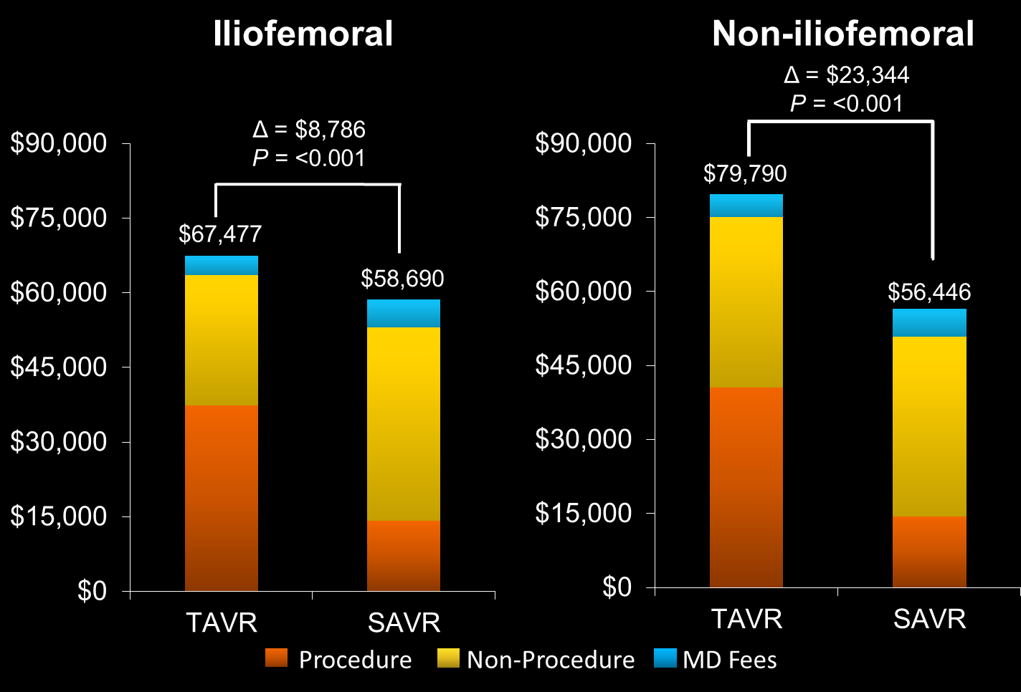
Index Costs − Access Site
TCT 2014
Notes:
18

Slide 19
Iliofemoral Group
Lifetime Cost Effectiveness
Cost per QALY
Cost per LY
TCT 2014

Slide 20
Non-iliofemoral Group
Lifetime Cost Effectiveness
Cost per QALY
Cost per LY
TCT 2014

Slide 21
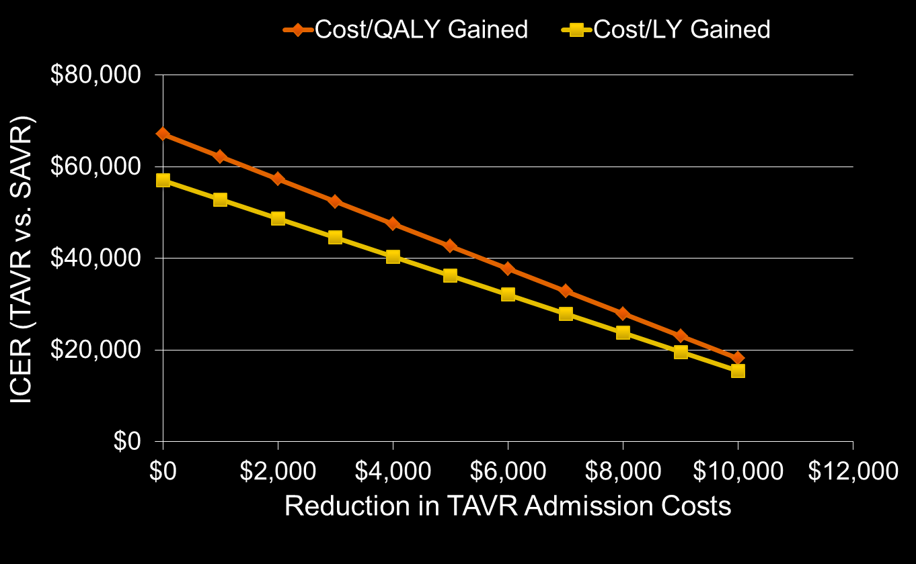
Impact of Reducing TAVR Admission Costs
TCT 2014

Slide 22
Summary of Findings
In the CoreValve US Pivotal High Risk Trial, TAVR improved 1-month quality of life and 12-month survival relative to SAVR
In projections, TAVR added ~0.24 life years and 0.20 QALYs per patient (with 3% discounting)
Index admission costs were higher with TAVR by ~$11,000 per patient, and lifetime costs were projected to be higher by ~$13,700
Projected lifetime ICERs were ~$67,000 per QALY gained and $57,000 per LY gained, and were slightly lower in the iliofemoral sub-group
TCT 2014

Slide 23
Conclusions
In this high risk population, TAVR provided meaningful clinical benefits relative to SAVR, with incremental costs considered acceptable from a US perspective
Results were slightly more favorable for patients eligible for iliofemoral access and slightly less favorable, though still acceptable, for patients not eligible for iliofemoral access. The latter group was small and their results are uncertain
With modest reductions in the cost of index TAVR admissions, the value of TAVR compared with SAVR in this patient population would become high
TCT 2014
Notes:
Work on bullet 2

