Slide 1
Randomized comparison of everolimus-eluting bioresorbable vascular
scaffolds vs. everolimus-eluting metallic stents
in patients with coronary artery disease:
3-year clinical outcomes from ABSORB China
Runlin Gao, M.D.
On behalf of ABSORB China Investigators

Slide 2
Speaker's name: Runlin Gao, MD.
I do not have any potential conflict of interest
√ I have the following potential conflicts of interest to report:
Honorarium:
Institutional grant/research support: Research grant from Abbott Vascular
Consultant:
Employment in industry:
Owner of a healthcare company:
Stockholder of a healthcare company:
Other(s):

Slide 3
Background
Previous results from ABSORB China have demonstrated that Absorb BVS is comparable to XIENCE V in safety and efficacy through 2 years.
Recent reports at 2 and 3 years from other studies have raised concerns about the long-term safety of Absorb BVS due to very late scaffold thrombosis.
Hence, it’s important to present the long-term clinical outcomes on Absorb BVS beyond 2 years from the ABSORB China RCT.

Slide 4
Study Design
Prospective, randomized, active control, open-label, multicenter trial with 480 patients from 24 sites in China
Up to 2 de novo lesions in separate native coronary arteries Lesion length ≤24 mm, RVD ≥2.5 mm - ≤3.75 mm, %DS ≥50% - <100%
1: 1 Randomization
Absorb BVS
Treat with single study device Diameters: 2.5, 3.0. 3.5 mm
Lengths: 8, 12, 18, 28 mm
XIENCE V
Treat with single study device Diameters: 2.5, 3.0. 3.5 mm
Lengths: 8, 12, 18, 28 mm
Post 1M 6M 9M
1Y 2Y
3Y 4Y
5Y
Clinical FU
Angio FU
1Y
Primary Endpoint: In-Segment Late Loss at 1 Year

Slide 5
Study Organization
Principal Investigator: Runlin Gao, MD
Co-Principal Investigators:
Yuejin Yang, MD, PhD, Yaling Han, MD, PhD, Yong Huo, MD
Study Chairman:
Gregg. W. Stone, MD
Angiographic Core Laboratory:
Beth Israel Deaconess Medical Center, Inc.
Clinical Events Committee:
CCRF (Beijing) Consulting Co. Ltd.
Data Safety Monitoring Board: CCRF (Beijing) Consulting Co. Ltd.
Sponsor:
Abbott Vascular

Slide 6
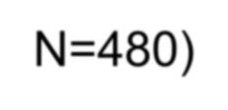
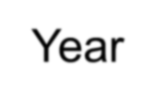
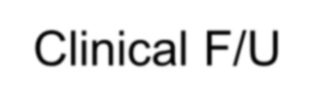
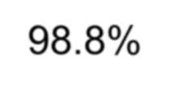
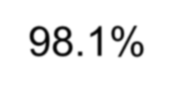
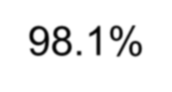
Patient Flow Chart through 3 Years (ITT)
Randomized (N=480)
Absorb BVS
(N=241)
XIENCE V (N=239)
Withdrawal (n=3) & Lost-to-f/u (n=1)
Withdrawal (n=2) & Death (n=5)
Absorb BVS (N=237)
1-Year Clinical F/U
XIENCE V (N=232)
98.8%
Withdrawal (n=1) & Death (n=1)
Lost-to-f/u (n=2) & Death (n=1)
Absorb BVS (N=235)
2-Year Clinical F/U
XIENCE V (N=229)
98.1%
Death (n=1)
Absorb BVS (N=234)
3-Year Clinical F/U
XIENCE V (N=229)
98.1%

Slide 7
Key Baseline Patient Demographics
and Risk Factors
 | Absorb BVS (N=238) | XIENCE V (N=237) | P-Value
Age, years | 57.2 ± 11.4 | 57.6 ± 9.6 | 0.65
Male | 71.8% | 72.6% | 0.86
Current tobacco use | 32.8% | 35.0% | 0.60
Hypertension | 58.8% | 60.3% | 0.74
Dyslipidemia | 42.9% | 39.2% | 0.42
Diabetes | 25.6% | 23.2% | 0.54
- Treated with insulin | 9.7% | 7.6% | 0.42
Prior coronary intervention | 10.1% | 8.0% | 0.43
Prior MI | 16.8% | 16.9% | 0.98
Unstable Angina | 65.5% | 64.6% | 0.82
AMI | 7.6% | 11.8% | 0.12
Single vessel disease | 63.0% | 56.5% | 0.15

Slide 8
Key Baseline Target Lesion Characteristics and
Procedure Information
 | Absorb BVS (L=251) (S=257) | XIENCE V (L=252) (S=259) | P-Value
Target Lesion Characteristics
LAD | 55.4% | 52.4% | 0.50
Lesion length, mm | 14.10 ± 5.05 | 13.91 ± 4.81 | 0.66
RVD, mm | 2.81 ± 0.44 | 2.82 ± 0.45 | 0.79
- <2.25 mm | 9.2% | 10.0% | 0.75
MLD, mm | 0.98 ± 0.40 | 1.01 ± 0.41 | 0.41
%DS | 65.33 ± 12.89 | 64.40 ± 12.72 | 0.41
Calcification (moderate/severe) | 17.5% | 15.5% | 0.55
Bifurcation | 50.2% | 48.6% | 0.72
ACC/AHA Lesion Class B2/C | 74.9% | 72.1% | 0.48
Procedural Information
Pre-dilatation | 99.6% | 98.0% | 0.22
Post-dilatation | 63.0% | 54.4% | 0.05

Slide 9
Clinical Composite and Component Endpoints at 3 Years
 | Absorb BVS (N=238) | XIENCE V (N=237) | P-Value
Composite Endpoints
DoCE (TLF) | 5.5% (13/236) | 4.7% (11/235) | 0.68
PoCE (DMR) | 11.9% (28/236) | 11.9% (28/235) | 0.99
TVF | 6.8% (16/236) | 6.8% (16/235) | 0.99
MACE | 6.4% (15/236) | 5.1% (12/235) | 0.56
Individual Component Endpoints
All-cause death | 0.8% (2/236) | 2.6% (6/235) | 0.18
Cardiac death | 0.4% (1/236) | 1.3% (3/235) | 0.37
All MI* | 3.4% (8/236) | 2.1% (5/235) | 0.40
TV-MI* | 2.5% (6/236) | 0.9% (2/235) | 0.28
All revascularization | 10.2% (24/236) | 8.9% (21/235) | 0.65
ID-TLR | 4.2% (10/236) | 2.6% (6/235) | 0.31
DoCE=device-oriented composite endpoint (cardiac death, TV-MI*, or ID-TLR); PoCE=patient-oriented composite endpoint (all-cause death, all MI*, or any revascularization); TVF (cardiac death, all MI*, or ID- TVR); MACE (cardiac death, all MI*, or ID-TLR); * CK-MB > 5x ULN for peri-procedural PCI MI

Slide 10
TLF through 3 Years
10
9
8
7
6
5
4
3
2
1
0
Absorb BVS XIENCE V
3-year
HR [95% CI]= 1.17 [0.52,2.60]
p=0.71 (Log rank test)
2-year
3-year
5.5%
TLF (%)
4.7%
4.7%
4.2%
0 120 240 360 480 600 720 840 960 1080 1200
Time After Index Procedure (Days)
Time (days) | 0 | 37 | 208 | 298 | 393 | 758 | 1123
Absorb BVS (# At Risk) | 238 | 235 | 234 | 233 | 229 | 226 | 221
XIENCE V (# At Risk) | 237 | 234 | 230 | 229 | 223 | 221 | 221

Slide 11
Cardiac Death through 3 Years
10
9
8
7
6
5
4
3
2
1
0
Absorb BVS XIENCE V
3-year
HR [95% CI]= 0.33 [0.03,3.15]
p=0.31 (Log rank test)
Cardiac Death (%)
2-year
3-year
1.3%
1.3%
0.4% 0.4%
0 120 240 360 480 600 720 840 960 1080 1200
Time After Index Procedure (Days)
Time (days) | 0 | 37 | 208 | 298 | 393 | 758 | 1123
Absorb BVS (# At Risk) | 238 | 238 | 238 | 237 | 237 | 235 | 233
XIENCE V (# At Risk) | 237 | 236 | 233 | 232 | 230 | 229 | 229

Slide 12
TV-MI through 3 Years
10
9
8
7
6
5
4
3
2
1
0
Absorb BVS XIENCE V
3-year
HR [95% CI]= 2.97 [0.60,14.74]
p=0.16 (Log rank test)
Target Vessel MI (%)
2-year
3-year
2.1%
2.5%
0.8% 0.8%
0 120 240 360 480 600 720 840 960 1080 1200
Time After Index Procedure (Days)
Time (days) | 0 | 37 | 208 | 298 | 393 | 758 | 1123
Absorb BVS (# At Risk) | 238 | 235 | 235 | 234 | 233 | 230 | 227
XIENCE V (# At Risk) | 237 | 234 | 231 | 230 | 228 | 227 | 227

Slide 13
ID-TLR through 3 Years
10
9
8
7
6
5
4
3
2
1
0
Absorb BVS XIENCE V
3-year
HR [95% CI]= 1.64 [0.60,4.51]
p=0.33 (Log rank test)
ID-TLR (%)
2-year
3-year
4.2%
3.4%
2.6%
2.6%
0 120 240 360 480 600 720 840 960 1080 1200
Time After Index Procedure (Days)
Time (days) | 0 | 37 | 208 | 298 | 393 | 758 | 1123
Absorb BVS (# At Risk) | 238 | 237 | 236 | 235 | 231 | 228 | 224
XIENCE V (# At Risk) | 237 | 236 | 232 | 231 | 225 | 223 | 223

Slide 14
Definite/Probable Scaffold/Stent Thrombosis at 3 Years
 | Absorb BVS (N=238) | XIENCE V (N=237) | P-Value
All (0-1095 days) | 0.9% (2/235) | 0.0% (0/229) | 0.50
Definite | 0.4% (1/235) | 0.0% (0/229) | 1.00
Probable | 0.4% (1/235) | 0.0% (0/229) | 1.00
Early (0-30 days) | 0.4% (1/238) | 0.0% (0/236) | 1.00
Late (31-365 days) | 0.0% (0/237) | 0.0% (0/232) | 1.00
Very Late (366-1095 days) | 0.4% (1/235) | 0.0% (0/229) | 1.00
1-2 years | 0.4% (1/236) | 0.0% (0/229) | 1.00
2-3 years | 0.0% (0/234) | 0.0% (0/229) | 1.00
There were 1 probable, subacute ST on day 15 and 1 definite, very late ST on day 622 in the Absorb BVS arm. Post-dilatation was not performed during the index procedure in both cases, and post-procedural MLDs revealed substantial scaffold under-expansion.
No ST occurred between 2 and 3 years.

Slide 15
Definite/Probable ST through 3 Years
10
9
8
7
6
5
4
3
2
1
0
Absorb BVS
3-year
HR [95% CI]= NA [NA]
p=0.16 (Log rank test)
XIENCE V
Def/Prob ST (%)
2-year
3-year
0.8%
0.0%
0.8%
0.0%
0 120 240 360 480 600 720 840 960 1080 1200
Time After Index Procedure (Days)
Time (days) | 0 | 37 | 208 | 298 | 393 | 758 | 1123
Absorb BVS (# At Risk) | 238 | 237 | 237 | 236 | 236 | 233 | 231
XIENCE V (# At Risk) | 237 | 236 | 233 | 232 | 230 | 229 | 229

Slide 16
Limitations
Open-label study (potential for bias)
The primary endpoint was an objective measure of in-segment late
loss analyzed by an independent angiographic core lab
Clinical events were adjudicated by an independent CEC
Non-complex patients and lesions enrolled
Study population is typical of pivotal studies for approval
Sample size not powered for clinical endpoints

Slide 17
Conclusions
ABSORB China was well conducted with high follow-up rates (98.1% at 3 years), 100% of source data monitoring, and the use of independent angiographic core laboratory, CEC and DSMB.
The favorable clinical results observed at 2 years continued at 3 years. All adverse clinical endpoint event rates at 3 years, including TLF (5.5% vs. 4.7%) and ST (0.9% vs. 0.0%), were low and comparable between the treatment arms. No ST occurred between 2 and 3 years.
Ongoing follow-up beyond 3 years in ABSORB China RCT will enable continuous assessment of clinical outcomes after bioresorption is completed after 3 years.

Slide 18
Thank you

Slide 19
Components of TLF
 |  | Absorb BVS | XIENCE V | P-Value
0-2 Years | TLF | 4.2% (10/236) | 4.7% (11/235) | 0.82
 | - Cardiac Death | 0.4% (1/236) | 1.3% (3/235) | 0.37
 | - TV-MI | 2.1% (5/236) | 0.9% (2/235) | 0.45
 | - ID-TLR | 1.7% (4/236) | 2.6% (6/235) | 0.54
2-3 Years | TLF | 1.7% (4*/235) | 0.0% (0/229) | 0.12
 | - Cardiac Death | 0.0% (0/235) | 0.0% (0/229) | 1.00
 | - TV-MI | 0.4% (1/235) | 0.0% (0/229) | 1.00
 | - ID-TLR | 1.3% (3*/235) | 0.0% (0/229) | 0.25
0-3 Years | TLF | 5.5% (13/236) | 4.7% (11/235) | 0.68
 | - Cardiac Death | 0.4% (1/236) | 1.3% (3/235) | 0.37
 | - TV-MI | 2.5% (6/236) | 0.9% (2/235) | 0.28
 | - ID-TLR | 2.5% (6/236) | 2.6% (6/235) | 0.99

Slide 20
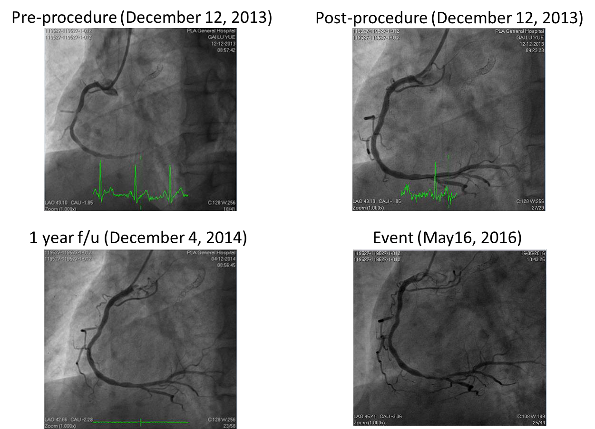
Subject 119527-1012: TV-MI (Day 886)

