Slide 1
Assessment of Coronary Near- Infrared Spectroscopy Imaging to Detect Vulnerable Plaques and Vulnerable Patients
The Lipid-Rich Plaque Study
Ron Waksman, MD on behalf of the LRP Investigators MedStar Washington Hospital Center

Slide 2
Disclosures
Advisory boards: Abbott Vascular, Amgen, Boston Scientific, Medtronic, Philips Volcano, Pi-Cardia LTD, and Cardioset
Consultant: Abbott Vascular, Amgen, Biosensors, Biotronik, Boston Scientific, Medtronic, Philips Volcano
Grant support: Abbott Vascular, AstraZeneca, Biosensors, Biotronik, Boston Scientific, and Chiesi
Speaker bureau: AstraZeneca, and Chiesi
Equity: MedAlliance, DOMed, Pi-Cardia LTD, Cardioset

Slide 3
Clinical Unmet Need
Despite optimal medical therapy and risk modifications strategies, coronary events continue to occur
Many individuals with an apparently adverse risk factor profile remain asymptomatic
The quest for detecting patients at risk for secondary cardiovascular event (cardiac death, and MI) is a high priority
The unmet need within the intravascular imaging world is for a methodology to identify in vivo vulnerable patients and plaques
Lipid Rich Plaque is associated with ACS & MI and can be detected by Near Infrared Spectroscopy (NIRS)

Slide 4
NIRS Histology Validation
Prospective validation of the chemogram to assess agreement between NIRS and histology for the detection of Lipid Core coronary plaques
NIRS-derived Lipid Core Burden Index (LCBI) validated as quantitative summary metric of chemogram
Chemogram and LCBI generated by system objectively and automatically, with little to no input from user
Chemogram and LCBI explicitly labeled by FDA for detection of lipid core
*Adapted from Gardner CM et al, JACC Card Img, 2008 Sep 1(5) 638-48

Slide 5
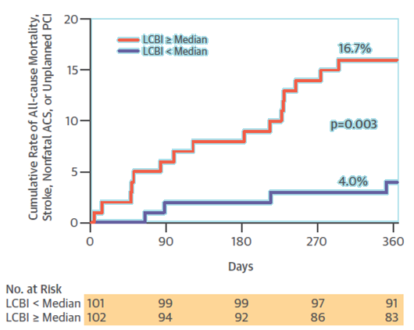
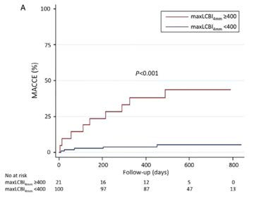
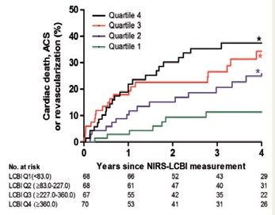
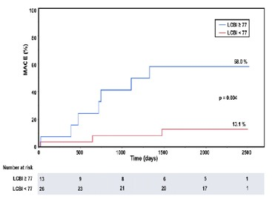
Prior Studies: NIRS Predicts Patient-Level NC-MACE
203 patients
1 yr FU
• HR=4.04
121 patients
2 yr FU
• HR=10.2
Oemrawsingh RM, et al. J Am Coll Cardiol. 2014
Madder RD, et al. Eur Heart J Cardiovasc Imaging. 2016
 |  | 239 patients 5 yr FU • HR=14.05
Danek BA, et al. Cardiovasc Revascularization Med. 2017
275 patients
4yr FU
• HR=3.22
Schuurman AS, et al. Eur Heart J. 2017

Slide 6
LRP Study Aim
Can intravascular NIRS imaging identify Vulnerable Patients and Vulnerable Plaques during a 24-month period?

Slide 7
LRP Study Endpoints
Co-primary Endpoints
Vulnerable Patient
Association between maxLCBI_{4mm}
Vulnerable Plaque
Association between maxLCBI_{4mm} segment
Key Secondary Endpoint
in all imaged arteries and future patient-level non-culprit MACE*
in a segment and incidence of future non-culprit MACE* in same
A threshold of maxLCBI_{4mm}>400 will identify patients and plaques at increased risk of a non-culprit MACE*
*Non-culprit MACE (independently adjudicated by CEC blinded to NIRS)
Cardiac death Cardiac arrest |  | Non-fatal myocardial infarction Acute coronary syndrome | • • | Revascularization by CABG or PCI Rehospitalization for progressive angina with
 |  |  | >20% stenosis progression

Slide 8
Study Flow Diagram
Feb 2014 - Mar 2016
Screen Failures:
Diagnostic only, no PCI (1356) Angiographic exclusion criteria (1045) No IVUS clinically required (707) Physician discretion (452)
Technical issues (72)
General exclusion criteria (46) Unknown (32)
Screened patients n = 5273
Excluded
Enrolled patients n = 1563
Patients with no analyzable vessels
Pts with evaluable LCBI
N* = 1552
n = 11
4mm
maxLCBI ≥ 250
maxLCBI_{4mm} < 250
Randomized to no follow up Patients = 281
4mm
Randomly assigned 1:1 to follow up*
All followed up*
Primary Endpoint Analysis population
Patients = 1271 Ware segments = 5744
*Sites were BLINDED to Non-culprit vessel chemogram
Average follow up 732 ± 27 days
Waksman R, et al. Am Heart J. 2017 Oct;192:98-104.
NCT02033694

Slide 9
LRP Study Management
Principal Investigator
Ron Waksman
European Co-Principal Investigator
Carlo DiMario
Data & Analytic Center
MedStar Cardiovascular Research Network
Rebecca Torguson, Paige Craig, Quan Zou, Paul Kolm
Clinical Events Committee
C5, Cleveland Clinic Foundation
Venugopal Menon
NIRS/IVUS Core Laboratory
MedStar Cardiovascular Research Network
Hector Garcia-Garcia
Independent Statistical Support
Harvard T.H Chan School of Public Health
James Ware, Rui Wang
DSMB
Steve Ellis, John Lachin, Robert Wilensky
Infraredx, a Nipro Company
Priti Shah, Sean Madden, James Muller*
*currently Brigham & Women’s Hospital
Study Sponsor

Slide 10
Baseline Characteristics
Variable |  | N
Age (years) | 64 ± 10.3 | 1271
Gender (male) | 69.5% | 883/1271
Diabetes | 36.7% | 464/1266
Diabetes requiring Insulin | 13% | 162/1243
Smoking, any history | 55% | 687/1249
Smoking, current | 22.6% | 282/1249
Hypertension | 80.4% | 1019/1267
Hyperlipidemia | 80.3% | 1013/1261
LDL Cholesterol (mg/dL)* | 91.7 ± 40.4 | 846
Family History of CAD | 56.1% | 637/1135
Prior MI | 23.5% | 294/1253
Prior PCI | 44.9% | 569/1267
BMI | 30.2 ± 6.5 | 1262
*aggregated

Slide 11
Clinical Presentation
60%
50%
40%
30%
20%
10%
0%
46.3%
36.8%
14.3%
2.5%
Stabilized STEMI
Non-STEMI
Unstable Angina
Stable Angina

Slide 12
Baseline Patient Imaging Results
Variable | core laboratory data | N = 1271
LM | 0.4% | 5
LAD | 90.3% | 1148
RCA | 43.0% | 546
LCX | 76.1% | 967
≥ 50mm of Eligible Vessel | 89.5% | 1137
Number of Vessels Scanned | 2.1 ± 0.5
Total Artery Length Scanned, mm | 139 ± 45.2
Total Eligible Vessel Length, mm* | 97.8 ± 43.4
MaxLCBI_{4mm} | 359.2 ± 175.1
MaxLCBI_{4mm} > 400 | 38.8% | 493
*summation of the total scanned length excluding the stented region and 5mm edges by core laboratory

Slide 13
Baseline Ware Segment Results
Variable | core laboratory data | N = 5755
LM | 0.1% | 6
LAD | 46.2% | 2656
RCA | 22.2% | 1277
LCX | 31.4% | 1807
Length, mm | 21.2 ± 9.1
MaxLCBI_{4mm} | 165 ± 177.1
MaxLCBI_{4mm} > 400 | 11.5% | 664

Slide 14
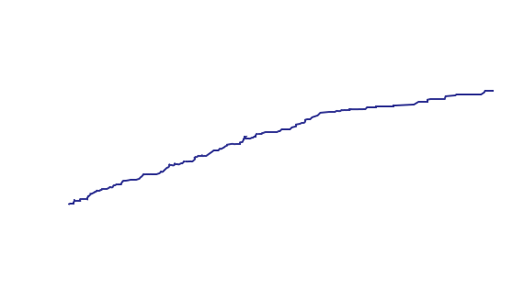
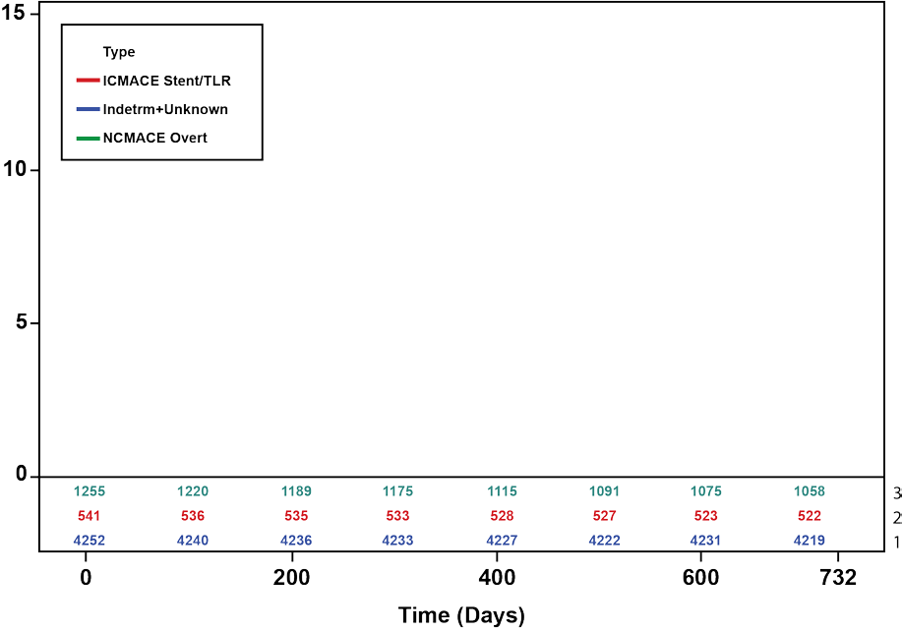
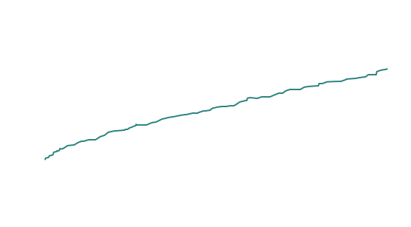
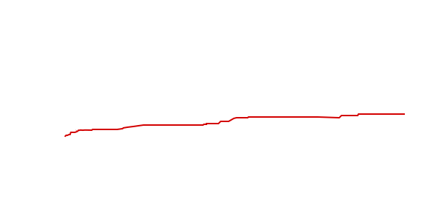
Overall Cumulative MACE Incidence
Cumulative MACE Incidence
8.8%
8.7%
2.3%

Slide 15
Adjudicated Patient Level Events: 2-years
NSCer-iMesA1CE
12.0%
10.0%
8.0%
6.0%
4.0%
2.0%
0.0%
5.3%
n=57
2.9%
n=31
2.2%
n=24
1.3%
1.2%
n=13
0.4%
0.7%
n=8
n=14
n=4
Cardiac Death
Cardiac Arrest
ACS
Non-fatal MI
Rehosp, Progressive Angina, >20% DS progression
PCI
CABG
Patients who have completed follow-up at 2 years (700 days)

Slide 16
Vulnerable Patient Level Endpoint – Results
 | HR [95% CI] | p Value | Conclusion
Primary Endpoint: maxLCBI_{4mm} as a continuous variable | 1.18 [1.05-1.32] | 0.005 | For each 100 unit increase of maxLCBI_{4mm} the risk of NC- MACE increased by 18%
Secondary Endpoint: maxLCBI_{4mm}>400 | 1.87 [1.25-2.80] | 0.003 | A patient with maxLCBI_{4mm} greater than 400 is at 87% higher risk of NC-MACE
Adjusted by age, male gender, diabetes, hypertension, smoking history, prior PCI, ACS, and renal insufficiency

Slide 17
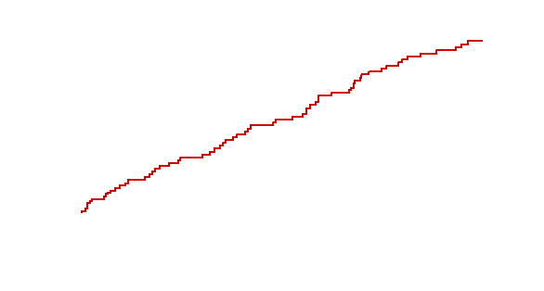
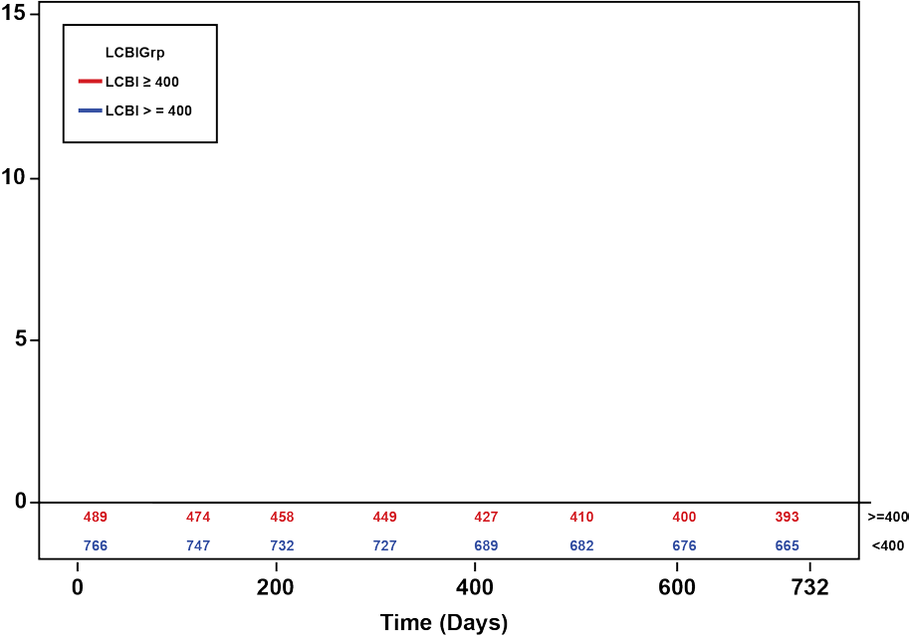
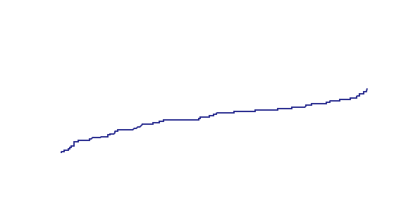
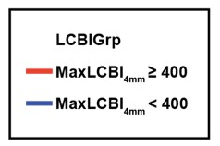
Patient Cumulative NC-MACE Incidence
Cumulative NC-MACE Incidence
Median time to event
MaxLCBI_{4mm} ≥ 400: 714 days IQR[683-745]
MaxLCBI_{4mm} <400: 721 days IQR[694-748]
p_{logrank}<0.001
<
12.6%
6.3%

Slide 18
Vulnerable Plaque Level Endpoint - Results
 | HR [95% CI] | p Value | Conclusion
Primary Endpoint: maxLCBI_{4mm} as a continuous variable | 1.45 [1.28-1.64] | <0.001 | For each 100 unit increase of maxLCBI_{4mm} the risk of NC- MACE increases by 45%
Secondary Endpoint: maxLCBI_{4mm} >400 | 4.11 [2.3-7.34] | <0.001 | A coronary segment with maxLCBI_{4mm} greater than 400 is at 411% higher risk of NC-MACE
Patient cluster adjusted via WLW methodology

Slide 19
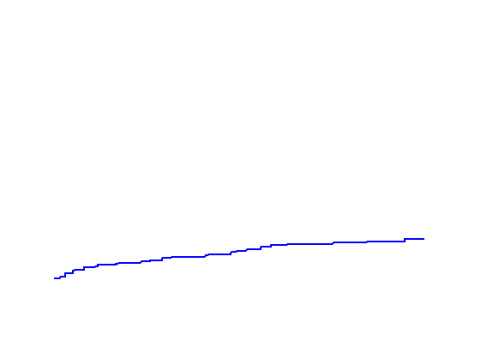
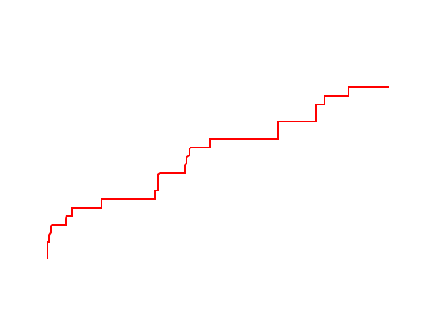
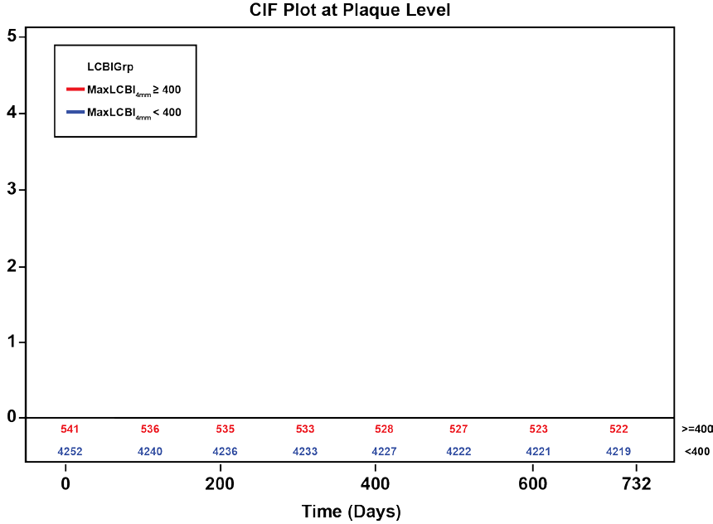
Plaque Cumulative NC-MACE Incidence
p_{logrank}<0.001
3.7%
Cumulative NC-MACE Incidence
0.8%

Slide 20
Summary
The LRP Study met both of its co-primary endpoints:
Vulnerable patient-level analysis
After adjustment, the risk of experiencing non-culprit MACE event within 24 months is 18% higher with each 100 unit increase in maxLCBI_{4mm}
Specifically, a patient with maxLCBI_{4mm} greater than 400 is at 87% higher risk than a patient with less than 400 maxLCBI_{4mm}
Vulnerable plaque-level analysis
Risk of experiencing an event in a coronary segment within 24 months is 45% higher with each 100 unit increase in maxLCBI_{4mm}
Specifically, a coronary segment with maxLCBI_{4mm} greater than 400 is at 411% higher risk than a segment with less than 400 maxLCBI_{4mm}

Slide 21
Conclusions
In stable and ACS patients who presented to the cath lab for possible PCI and were treated medically by the guidelines, nearly 9% experienced subsequent non-culprit events within 24 months.
Multi-vessel NIRS can be easily and safely performed to assess and identify vulnerable patients and vulnerable plaques.
Intravascular NIRS imaging in mildly or non-obstructive coronary arteries can be used as a tool to identify both patients and non-culprit arteries at high risk for future events and should be considered for use in patients undergoing cardiac catheterization with possible PCI.
Studies for the use of NIRS-guided therapy should be conducted to address and mitigate the high risk of these patients and arteries.

