Slide 1
Medical Therapy of Aortic Stenosis
Philippe Généreux, MD
Co-Director, Structural Heart Program, Morristown Medical Center, NJ
Interventional Cardiologist, Hôpital du Sacré-Coeur de Montréal, Canada
Director, Angiographic Core Laboratory, CRF, New York, NY
philippe.genereux@atlantichealth.org

Slide 2
Disclosure Statement of Financial Interest
Edwards LifeSciences
Consultant, Speaker Fees, Proctor, Research Grant
Boston Scientific
Research grant
Abbott Vascular
Consultant, Speaker Fees
Medtronic
Consultant, Speaker Fees
Cardiovascular System Inc.
Consultant, Speaker Fees, Research Grant
Soundbite Medical Inc.
Equity, Consultant
SIG.NUM
Equity, Consultant
SARANAS
Equity, Consultant

Slide 3
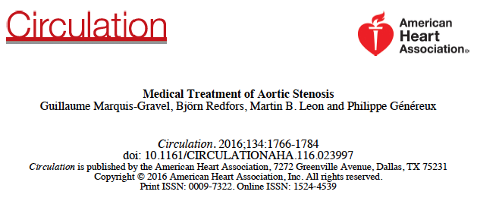
Gravel, Genereux et al. Circulation. 2016;134:1766–1784

Slide 4
Introduction
Guidelines?
Statin
Renin-angiotensin-aldosterone system inhibition
Nitrate derivatives
Phosphocalcific metabolism

Slide 5
Guidelines Class I
Hypertension in patients at risk for developing AS (stage A) and in patients with asymptomatic AS (stages B and C) should be treated according to standard GDMT, started at a low dose, and gradually titrated upward as needed with frequent clinical monitoring (51–53). (Level of Evidence: B)
Nishimura et al. J Am Coll Cardiol 2014;63:e57–185.

Slide 6
Guidelines-ref
51. O’Brien KD, Zhao XQ, Shavelle DM, et al. Hemodynamic effects of the angiotensin-converting enzyme inhibitor, ramipril, in patients with mild to moderate aortic stenosis and preserved left ventricular function. J Investig Med 2004;52:185–91.
52. Chockalingam A, Venkatesan S, Subramaniam T, et al. Safety and efficacy of angiotensin-converting enzyme inhibitors in symptomatic severe aortic stenosis: Symptomatic Cardiac Obstruction-Pilot Study of Enalapril in Aortic Stenosis (SCOPE-AS). Am Heart J 2004; 147:E19.
53. Nadir MA, Wei L, Elder DH, et al. Impact of renin-angiotensin system blockade therapy on outcome in aortic stenosis. J Am Coll Cardiol 2011;58:570–6.
Nishimura et al. J Am Coll Cardiol 2014;63:e57–185.

Slide 7
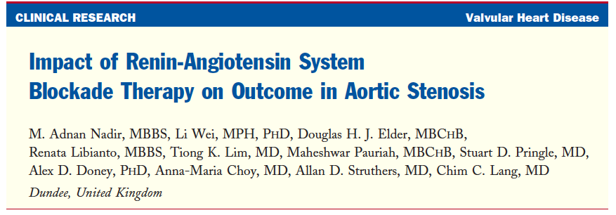
N=2,117 pts; Mean follow-up 4.2 years
-Retrospective, population-based longitudinal cohort study in Scotland
-Cox regression model and propensity score analysis were used to assess the impact of ACEIs or ARBs on all- cause mortality and CV death or hospitalizations.
-Severity of AS were ascertained by British Society of Echocardiography accredited echocardiographers at the time of scan
-Patients with AS who had at least 2 prescriptions dispensed for either an ACEI or an ARB constituted the ACEI/ARB group (cases
Nadir et al. J Am Coll Cardiol 2011;58:570–6

Slide 8
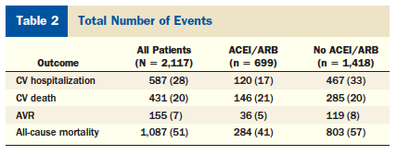
Nadir et al. J Am Coll Cardiol 2011;58:570–6

Slide 9
Nadir et al. J Am Coll Cardiol 2011;58:570–6

Slide 10
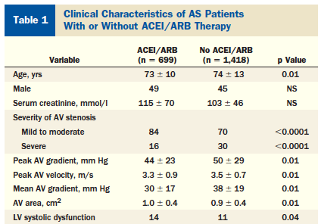
Nadir et al. J Am Coll Cardiol 2011;58:570–6

Slide 11
Guidelines-ref
51. O’Brien KD, Zhao XQ, Shavelle DM, et al. Hemodynamic effects of the angiotensin-converting enzyme inhibitor, ramipril, in patients with mild to moderate aortic stenosis and preserved left ventricular function. J Investig Med 2004;52:185–91.
52. Chockalingam A, Venkatesan S, Subramaniam T, et al. Safety and efficacy of angiotensin-converting enzyme inhibitors in symptomatic severe aortic stenosis: Symptomatic Cardiac Obstruction-Pilot Study of Enalapril in Aortic Stenosis (SCOPE-AS). Am Heart J 2004; 147:E19.
53. Nadir MA, Wei L, Elder DH, et al. Impact of renin-angiotensin system blockade therapy on outcome in aortic stenosis. J Am Coll Cardiol 2011;58:570–6.
Nishimura et al. J Am Coll Cardiol 2014;63:e57–185.

Slide 12
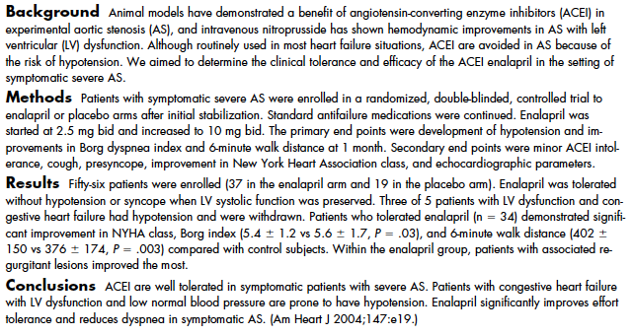
Chockalingam et al. Am Heart J 2004;147:e19

Slide 13
Guidelines
Class IIb
Vasodilator therapy may be reasonable if used with invasive hemodynamic monitoring in the acute management of patients with severe decompensated AS (stage D) with New York Heart Association (NYHA) class IV heart failure (HF) symptoms.(Level of Evidence: C)
Class III
Statin therapy is not indicated for prevention of hemodynamic progression of AS in patients with mild-to-moderate calcific valve disease (stages B to D) (54–56). (Level of Evidence: A)
Nishimura et al. J Am Coll Cardiol 2014;63:e57–185.

Slide 14
Introduction
Guidelines?
Statin
Renin-angiotensin-aldosterone system inhibition
Nitrate derivatives
Phosphocalcific metabolism

Slide 15
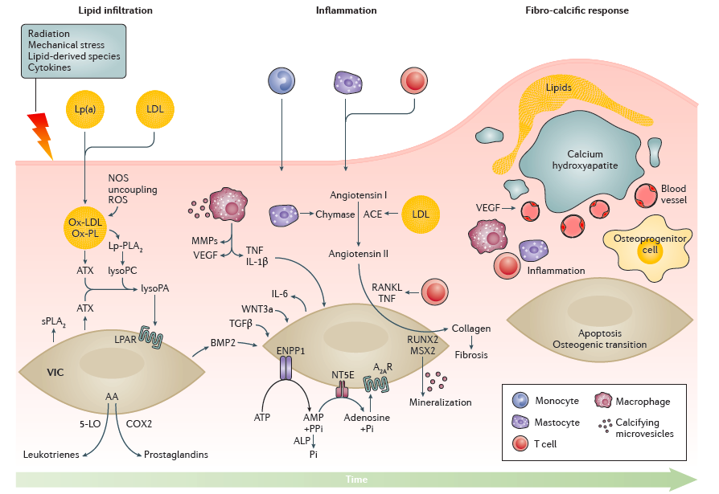
AS Pathophysiology
Lindman et al. Nature Reviews 2016

Slide 16
Valve level
Systemic level
Prevention of osteoblast-like phenotype transformation
Inhibition of macrophage infiltration
Decrease circulating levels of LDL and Lp(a)
Decrease leaflet cholesterol
Decrease leaflet thickening
Inhibition of leaflet mineralization
Therapeutic roles statins and other lipid-lowering therapy in AS
Inhibition of apolipoprotein(a) synthesis and of HMG coenzyme A reductase
Gravel, Genereux et al. Circulation. 2016;134:1766–1784

Slide 17
Summary Statin in AS
The most extensively studied drug in AS
Experimental data have shown that statin therapy reduces osteoblast activity and cholesterol deposition in valve leaflets
An association between statin use and a lower rate of aortic valve calcification or hemodynamic deterioration has been shown in most but not all observational studies
Gravel, Genereux et al. Circulation. 2016;134:1766–1784

Slide 18
Summary Statin in AS
No randomized trials were able to demonstrate reduced hemodynamic progression, reduced aortic valve calcification, or improved clinical outcomes despite successfully decreasing serum LDL concentrations
Potential issues:
Trial underpowered
Statin initiated too late in the AS process?
Statin not received for long enough period of time?
Potential Solutions:
Targeting population at risk: genetic
Different target: Niacin, antisense-specific Lp(a) inhibitors, and PCSK9 inhibitors
Gravel, Genereux et al. Circulation. 2016;134:1766–1784

Slide 19
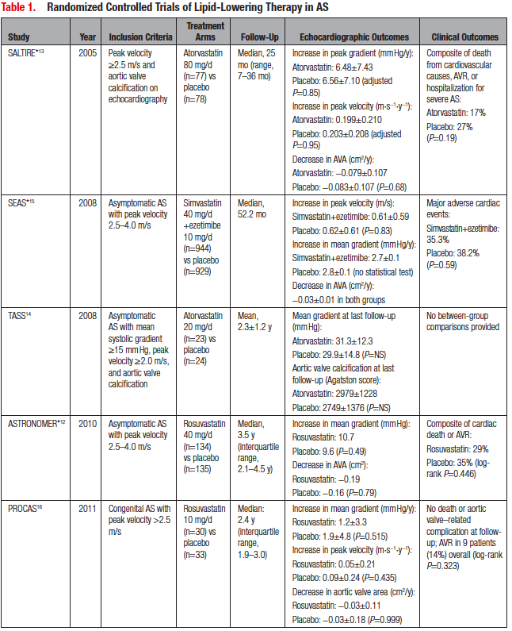
Gravel, Genereux et al. Circulation. 2016;134:1766–1784

Slide 20
Introduction
Guidelines?
Statin
Renin-angiotensin-aldosterone system inhibition
Nitrate derivatives
Phosphocalcific metabolism

Slide 21
Anti-hypertensive drugs
Traditionally, antihypertensive agents were considered contraindicated in AS.
Rationale: reduction in postvalvular cardiac afterload and systemic vascular resistance could cause severe diastolic hypotension, resulting in decreased myocardial perfusion and imbalance in myocardial supply and demand.
These beliefs have been refuted by evidence that high systemic blood pressure has an additive effect on the stenotic valve and increases cardiac afterload in AS, resulting in accelerated LV hypertrophy.
Gravel, Genereux et al. Circulation. 2016;134:1766–1784

Slide 22
Therapeutic roles of renin-angiotensin-aldosterone system inhibition in aortic stenosis
Valve level
Systemic and vascular level
Inhibition of monocyte chemotaxis
Prevention of osteoclast-like phenotype transformation and of valve mineralization
Slow AS progression
Reduce endothelial mechanical stress
Local anti-oxidative actions
Afterload reduction
Improved endothelial function
Inhibition of expression of inflammatory cytokines
Potential hypotensive events
Myocardial level
Improves reverse remodelling before and after AVR
Inhibition of hypertrophic response and diastolic dysfunction
Inhibition of myocardial interstitial fibrosis
Gravel, Genereux et al. Circulation. 2016;134:1766–1784

Slide 23
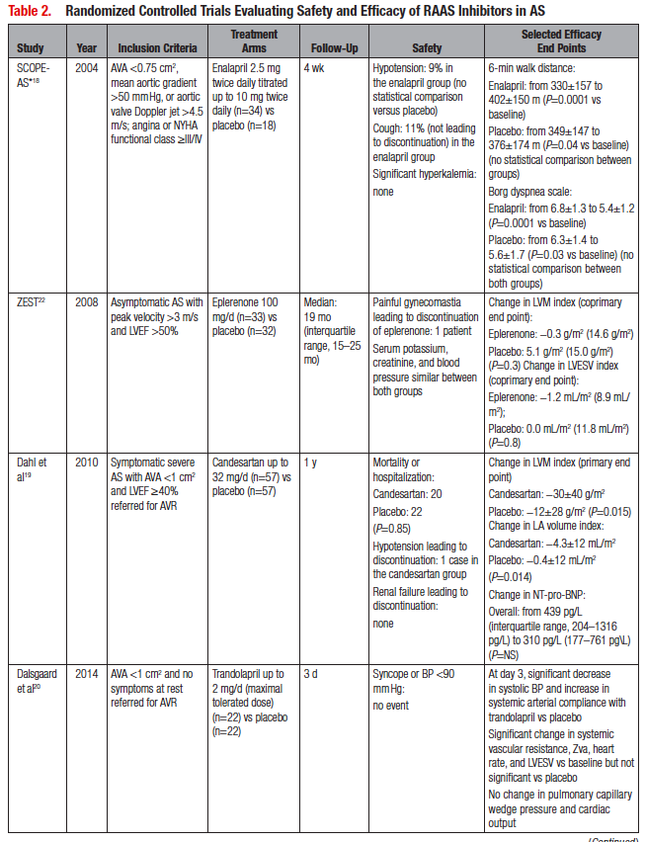
Gravel, Genereux et al. Circulation. 2016;134:1766–1784

Slide 24
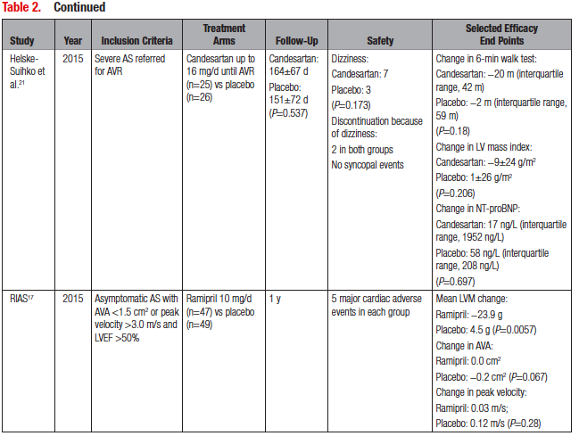
Gravel, Genereux et al. Circulation. 2016;134:1766–1784

Slide 25
SEAS trial sub-study n=1,873:
Cohort of patients with asymptomatic moderate AS
Propensity score matching ACE vs. no ACE
No sign of a safety concern with ACE inhibition over a median follow-up of 4.3 years
Slower increase in LV mass among patients who received an ACE inhibitor
No difference in all-cause mortality, cardiac death, or sudden cardiac death

Slide 26
Introduction
Guidelines?
Statin
Renin-angiotensin-aldosterone system inhibition
Nitrate derivatives
Phosphocalcific metabolism

Slide 27
Therapeutic roles of nitrate derivatives in acutely decompensated aortic stenosis
Peripheral and coronary arterial
vasodilation
Venodilation
Decrease valvulo-arterial impedance and systemic vascular resistance
Increased coronary perfusion
Preload optimization
Decrease wall stress and improve LV unloading
Increase stroke volume
Increase cardiac output
Improves endocardial
perfusion
Improves contractility and decreases pulmonary edema
Potential hypotensive adverse events
Gravel, Genereux et al. Circulation. 2016;134:1766–1784

Slide 28
Nitrates
Patients with stable AS with low LVEF and high LV end-diastolic pressure respond to nitroprusside with an improved cardiac index
Data from 2 small, prospective, clinical studies suggest that nitrates can be used in patients with AS to lower blood pressure without excessive risk of reducing cardiac output or end-organ perfusion
However no convincing data are available that support long-term nitrate treatment

Slide 29
Introduction
Guidelines?
Statin
Renin-angiotensin-aldosterone system inhibition
Nitrate derivatives
Phosphocalcific metabolism

Slide 30
Therapeutic roles for drugs targeting phosphocalcific metabolism
Gravel, Genereux et al. Circulation. 2016;134:1766–1784

Slide 31
Phosphocalcific Metabolism
Observation that lower bone density is independently associated with vascular calcification
Retrospective data have consistently shown that treatment for osteoporosis is associated with a slower rate of AS progression.
Osteoporosis
Decreased bone minerality density
Increasd vascular calcification
Biphosphonates:
Anti-inflammatory
Lipid-lowering properties

Slide 32
Future Trials?

Slide 33
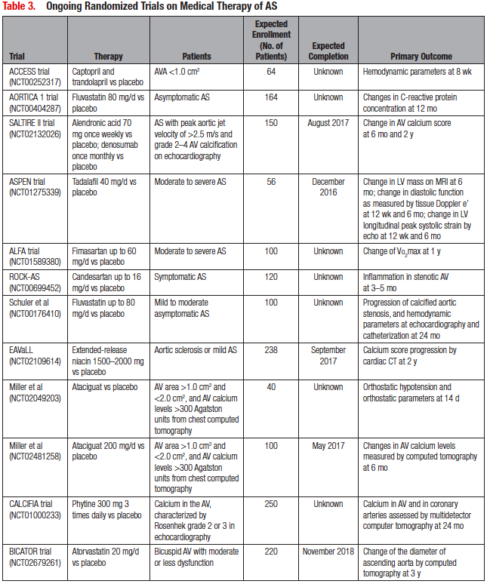
Gravel, Genereux et al. Circulation. 2016;134:1766–1784

Slide 34
Future of Medical Therapy in AS
Pre AVR
Early optimal blood pressure management
Benefit of lipid-lowering therapy early/more portent?
Phosphocalcific modulator drugs
Post AVR
Optimizing LV remodeling

Slide 35
Thank You!
philippe.genereux@atlantichealth.org

