Slide 1
Predictors of Rehospitalization Following Transcatheter Aortic Valve Replacement: Results from the CoreValve US Trial Program
James B. Hermiller Jr, MD, Sina Moainie, MD, Steven J. Yakubov, MD, Michael J. Reardon, MD, Stan Chetcuti, MD, G. Michael Deeb, MD, J. Kevin Harrison, MD and Jeffrey J. Popma For the CoreValve US Investigators

Slide 2
Presenter Disclosure Information
TCT2016
Dr. Hermiller serves:
As a Medtronic Faculty Educator
Medtronic personnel performed all statistical analyses and verified the accuracy of the data, and assisted in the graphical display of the data presented.
2

Slide 3
Background
TCT2016
TAVR patients with multiple comorbidities experience frequent readmissions following the index hospitalization.
As the patient population recommended for TAVR is broadened, the importance of quality measures, e.g. 30-day rehospitalization rates, will grow.
Discharge planning has been shown to reduce readmissions.
Defining predictors of readmission following TAVR could facilitate allocation of pre- and post-discharge care and follow-up resources.
Nombelo-Franco L, et al. JACC Cardiovasc Interv 2015; 8:1748-57. Naylor MD, et al. JAMA 1999; 281:613-20.Auerbach AD, et al. JAMA Intern Med 2016; ;176:484-49. Chandrasekhar J, Mehran R. Cath Cardiovasc Interv 2016; 87:143-144.
3

Slide 4
Objective
TCT2016
To identify predictors of aortic valve-related hospitalizations (AVH) following self-expanding TAVR to augment discharge and follow-up planning to potentially prevent readmissions.
4

Slide 5
Definitions
TCT2016
AVH was a non-elective hospital admission for AV disease-related signs and symptoms resulting in at least a 2-night stay.
Signs& Symptoms of AVD AV dysfunction – dyspnea, shortness of breath
Exercise intolerance
Dizziness/ syncope
Chest pain
Worsening heart failure
Volume overload
5

Slide 6
Methods
TCT2016
The analysis population comprised 3595 patients discharged following TAVR in the CoreValve US ER and HR Pivotal Trial & Continued Access Study.
An independent CEC adjudicated the cause for AV rehospitalizations.
Early AVH = ≤ 30 days after discharge
Late AVH = 31 to 365 days after discharge
Identified baseline characteristics, medical history, cardiac history, frailties, and disabilities and post–TAVR variables based on clinical judgment.
Univariable predictors with P ≤ 0.05 were entered into the multivariable model. Stepwise threshold for entry and exit was 0.10.
6
Notes:
If the reason for hospitalization could not be determined, it was conservatively counted as being related to the signs and symptoms of AV disease.

Slide 7
Tested Variables
TCT2016
Demographics/ Medical History
Cardiac History
Frailty/ Disability
Procedural/ Discharge
Age
Sex
BMI
Diabetes
Smoking
NIHSS
CVD/ CVA
PVD
STS severe lung disease
Hypertension
Prior TIA
STS Score >7%
Severe Charlston score
Cardiac surgery
CABG
PPI/ICD
AF/AFL
BAV
Angina
CAD
Grade III/IV LVDD
NYHA III/IV
MMSE > 24
Weight loss
Recent falls
Home O₂
Albumin <3.3 g/ dL
5M gait speed >6 s
≥ 2 Katz ADL
Assisted living
Femoral access
AKI
Major vasc comp
LTD/major bleeding
New pacemaker
Dsch hemodynamics
Dsch SCr >2mg/dL
Dsch Hgb <8 g/dL
Discharged to home
Length of stay
7

Slide 8
RESULTS
TCT2016
8

Slide 9
Baseline Characteristics
TCT2016
Characteristic, mean ± SD or % | TAVR N=3595
Age (years) | 83.1 ± 7.8
Men | 53.9
BMI < 21 kg/m² | 8.2
STS PROM > 7% | 58.3
Prior coronary artery bypass surgery | 35.4
Diabetes mellitus | 37.5
Cerebrovascular disease | 25.1
STS severe chronic lung disease | 18.9
Atrial fibrillation/ flutter | 43.8
Home oxygen | 21.3
≥ 2 Katz ADL deficits | 10.0
Falls in recent 6 months | 19.3
9

Slide 10
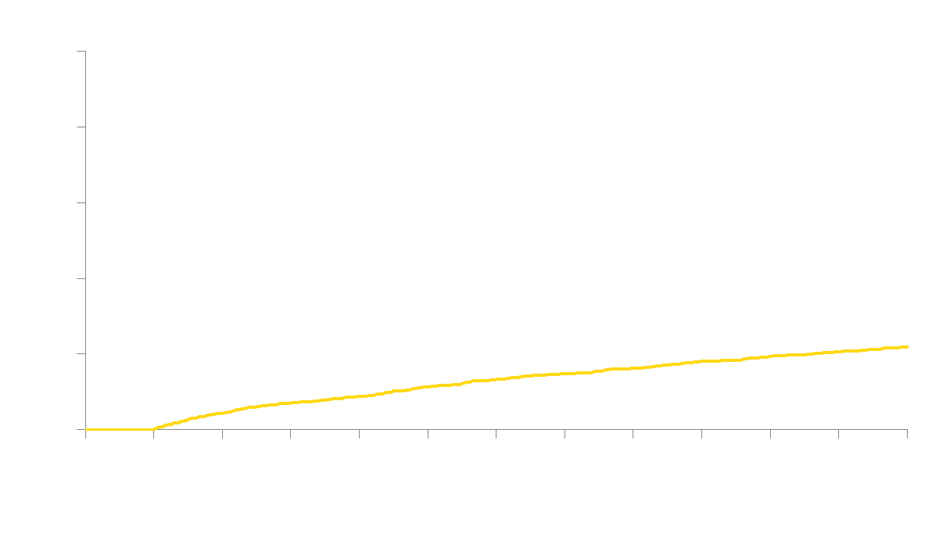
AV Disease-Related Rehospitalizations
TCT2016
AV-Disease-Related Rehospitalizations (%)
7.3
11.0
Months Post Discharge
10

Slide 11
Multivariable Predictors of Early AVH
TCT2016
Variable | Hazard Ratios (95% CI) |  |  | P Value
DischAR ≥ moderate | 2.17 (1.34, 3.52) |  |  | 0.002
NYHA Class III/IV | 2.02 (1.06, 3.85) |  |  | 0.034
Acute kidney injury | 1.80 (1.20, 2.71) |  |  | 0.005
Home oxygen | 1.60 (1.13, 2.25) |  |  | 0.008
Hx of Afib/Aflutter | 1.60 (1.17, 2.20) |  |  | 0.003
New pacemaker | 1.49 (1.07, 2.06) |  |  | 0.018
Albumin < 3.3 g/dL | 1.49 (1.02, 2.17) |  |  | 0.037
Prior CABG | 1.45 (1.05, 2.01) |  |  | 0.041
LOS (per day) | 1.02 (1.00, 1.04) |  |  | 0.025
Discharged home | 0.69 (0.49, 0.96) |  |  | 0.029
0.50
1.00
1.50
2.00
2.50
3.00
3.50
4.00
11

Slide 12
Multivariable Predictors of Late AVH
TCT2016
Variable | Hazard Ratios (95% CI) |  |  | P Value
Home oxygen | 2.20 (1.73, 2.81) |  |  | <0.001
Discharge MR ≥ moderate | 1.93 (1.47, 2.54) |  |  | <0.001
Discharge SCr > 2 mg/dL | 1.87 (1.26, 2.75) |  |  | 0.002
Unplanned weight loss | 1.65 (1.21, 2.24) |  |  | 0.001
Hx of Afib/Aflutter | 1.36 (1.08, 1.71) |  |  | 0.009
STS > 7% | 1.35 (1.05, 1.74) |  |  | 0.020
Bleeding* | 1.34 (1.06, 1.69) |  |  | 0.016
LOS (per day) | 1.03 (1.01, 1.04) |  |  | 0.002
Discharge LVEF (per 1%) | 0.98 (0.98, 0.99) |  |  | <0.001
0.50
1.00
1.50
2.00
2.50
3.00
3.50
*Life-threatening disabling or major bleeding during index hospitalization
12
Notes:
Discharge SCr > 2 mg/dL

Slide 13
Limitations
TCT2016
Retrospective post-hoc analysis
Only evaluated AV disease-related readmissions
Analysis based only on first rehospitalization
13

Slide 14
Conclusions
TCT2016
Patients with severe HF symptoms, on chronic O_{2,} and not discharged home are more likely to be readmitted early after TAVR.
The risk of late AVH was more likely to be due to comorbidities.
Reducing procedural complications, e.g. AKI, residual AR and bleeding events may reduce the risk of readmission.
Identifying those at highest risk for readmission may help triage the intensity of resources needed for post-discharge care.
14
Notes:
“trigger more aggressive follow-up

