Slide 1





Effectiveness of mHealth Based Decision Support System for Integrated Management of Chronic Conditions in Primary Care: The mWellcare Trial
Dorairaj Prabhakaran, MD, DM, MSc, FRCP, FNASc Centre for Control of Chronic Conditions
Public Health Foundation of India, India
On behalf of mWellcare Trial investigators

Slide 2
Disclosures
Grants:
Partially supported through research grant from the Wellcome Trust, UK (Grant Number 096735/A/11/Z) and from the National Institutes of Health, USA (Grant number: 5U01TW01009702, 5U2RTW01010804, 5R01HL12544204, 5R21DK10589102, and
5P20CA21029802)
Copyright:
Hold a copyright jointly with N Tandon, A Roy, A Vamadevan, and D Jindal for the mPower Heart mHealth System which has features on electronic storage of health records and electronic clinical decision support (EDS) computation.

Slide 3
Background
Chronic diseases and their risk factor burden is high in India and worldwide
Shortage of skilled healthcare providers impose huge constraints on healthcare services in India particularly in the prevention and management of Chronic Diseases
Innovative strategies such as electronic clinical decision support (EDS) and task sharing for integrated, multiple chronic condition management in primary care have not been evaluated.

Slide 4
Methods
Study design
: Cluster-randomized controlled clinical trial
Duration
: April 2016 to September 2017
: 20 Community Health Centers each in Haryana (North India) and Karnataka (South India)
: Age ≥30 years, diagnosed with:
hypertension [with SBP ≥140 mmHg and/or DBP ≥90 mmHg]
OR
type-2 diabetes [fasting blood glucose ≥140mg/dL and/or post-
prandial blood glucose ≥200mg/dL]
Study setting
Participants
Total participants enrolled: 3698
BMJ Open. 2017;7:e014851

Slide 5
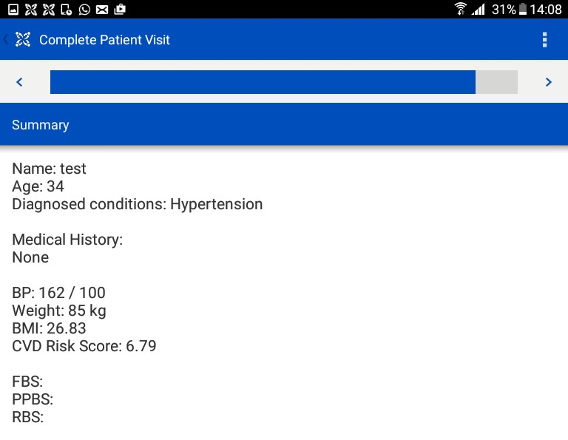
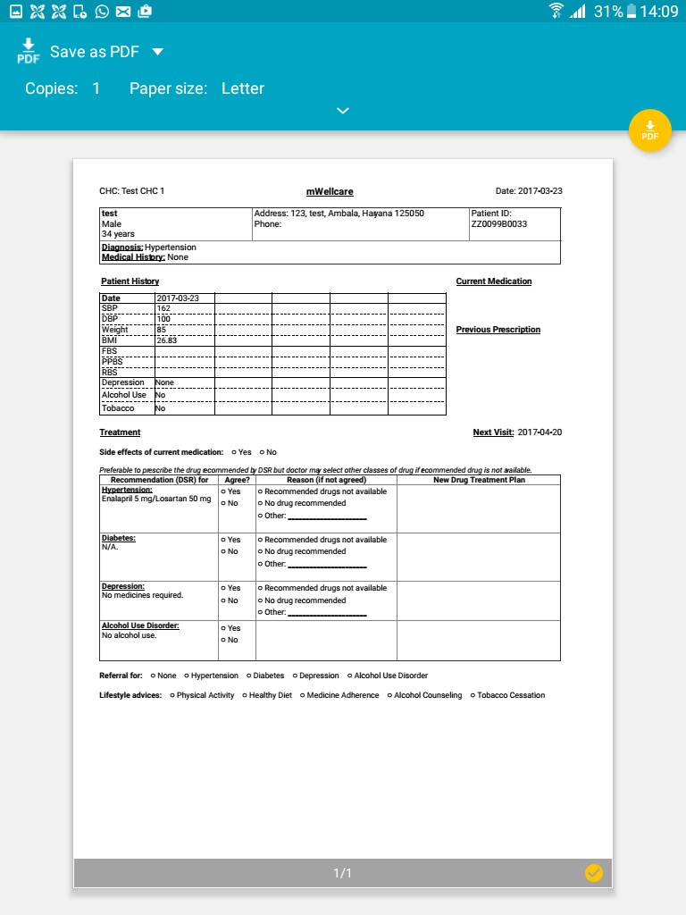
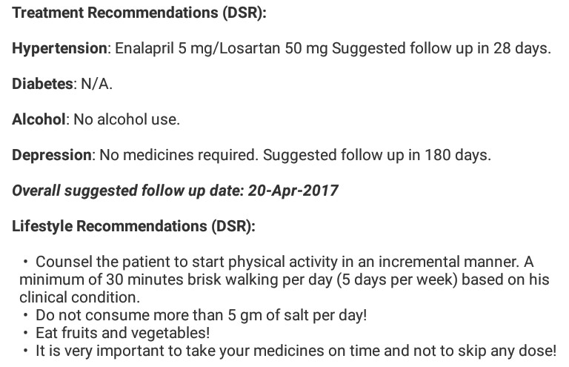
mWellcare System
An Android application, on a
tablet computer
Ability to generate tailored management plan for hypertension, diabetes, comorbid depression, alcohol and tobacco use
Capability to store health records electronically, enabling long-term monitoring and follow-up
Glob Health Action. 2018;11:1517930

Slide 6
Comparison of mWellcare and EUC
mWellcare arm | Enhanced usual care arm
Training of Physicians & NCD Nurses Clinical management guidelines Using the mWellcare system | Training of Physicians Clinical management guidelines
Charts on clinical management guidelines | Charts on clinical management guidelines
Physician either agreed with DSR or modified the treatment plan | Physicians managed patients based on their clinical judgement
NCD nurse provided lifestyle advice using the DSR prompts and pamphlets | NCD nurse provided lifestyle advice using pamphlets
Every visit detail recorded in the mWellcare system to generate longitudinal trend/summary | NCD nurse maintained registers for recording clinical parameters
SMS reminders for follow-up and medication adherence | No SMS reminders

Slide 7
Outcomes
Primary Outcomes
Between-group differences in mean change in (from baseline to one year):
o SBP among participants with hypertension
o HbA1c among participants with diabetes
Secondary outcomes
Between-group difference in mean change in (from baseline to one year):
o fasting plasma glucose
o total cholesterol
o predicted 10-year risk of CVD using recalibrated Framingham risk score
o tobacco use
o body mass index
o alcohol use
o depression score - measured only at the end of study evaluation
o alcohol use score - measured only at the end of study evaluation

Slide 8
Consort flow chart
Total clusters (CHCs) included in study, N=40
Randomised
Allocation
Allocated to EUC; N=20 clusters
Allocated to mWellcare; N=20 clusters
Participants screened for eligibility = 2130
Participants screened for eligibility = 2140
Enrolment
Eligible participants = 2021
Eligible participants = 2035
Participants refused = 25
No baseline assessment =140
Participants refused = 38
No baseline assessment =155
Participants enrolled = 1,856
Participants enrolled = 1,842
Clusters analysed = 20 Participants analysed = 1856
Participants assessed at endline = 1687 (90.9%)
Lost to follow up = 148
Migrated = 29
Refused = 86
Unable to contact = 33 Death = 21
Clusters analysed = 20
Participants analysed =1842
Participants assessed at endline = 1637 (88.9%) Lost to follow up =171
Migrated=31
Refused=84
Unable to contact=56 Death=34
Analysis

Slide 9
Baseline characteristics of key variables
Baseline characteristics | EUC arm (N=1856) | mWellcare arm (N=1842) | Standardized mean difference
Participants with hypertension, N (%) | 932 (50.2) | 906 (49.2) | -0.021
Participants with diabetes, N (%) | 625 (33.7) | 683 (37.1) | 0.071
Participants with both conditions, N (%) | 299 (16.1) | 253 (13.7) | -0.067
Age, mean (SD) | 54.5(10.9) | 55.8(11.0) | 0.086
Male, N (%) | 985 (53.1) | 1056 (57.3) | 0.159
Previous cardiovascular disease: N (%) | 161 (8.7) | 81 (4.4) | -0.274
Current tobacco user, N (%) | 325 (17.5) | 184 (10.0) | -0.152
Current alcohol user, N (%) | 229 (12.3) | 143 (7.8) | 0.222
BMI (Kg/m²), mean (SD) | 25.8 (4.6) | 26.0 (4.7) | 0.031
SBP (mmHg), mean (SD) | 157.0 (16.3) | 152.5 (14.7) | -0.238
DBP (mmHg), mean (SD) | 93.3 (10.0) | 88.8 (10.8) | -0.331
Fasting blood glucose (mg/dl), mean (SD) | 197.7 (67.0) | 185.9 (60.5) | -0.21
Hemoglobin A1c (%), mean (SD) | 9.3 (2.4) | 9.5 (2.2) | 0.049
Total cholesterol (mg/dl), mean (SD) | 191.8 (44.8) | 194.5 (45.0) | 0.061
CVD risk score (%), mean (SD) | 41.0 (21.9) | 38.5 (20.2) | -0.120
EUC arm had higher proportion of participants with tobacco use, alcohol use, and SBP

Slide 10
Primary outcomes
Outcome Variable | Mean change |  | Unadjusted |  | Adjusted *
 | EUC arm | mWellcare arm | Effect size (95%CI) | P-value | Effect size (95%CI) | P-value
SBP (mmHg) † | -12.7 | -13.7 | -1.0 (-4.6 to 2.7) | 0.607 | -0.3 (-3.9 to 3.3) | 0.869
HbA1c (%) ‡ | -0.58 | -0.48 | 0.11 (-0.24 to 0.45) | 0.563 | 0.08 (-0.27 to 0.44) | 0.660
SBP: adjusted for education, lipid lowering drugs, aspirin use, peripheral vascular disease and smoking status
HbA1c: adjusted for age, employed, anti-hyperglycemic drugs, peripheral vascular disease and alcohol use
† N=participants with hypertension; ‡ N=participants with diabetes

Slide 11
Primary outcomes by baseline subgroups
Effect on SBP
Effect on Hb1Ac
Strata
Effect [ 95%CI ] | Pval-Het 0.37983
-0.14 (-0.65 to 0.37]
0.18 [-0.28 to 0.64] | 0.87234
-0.02 (-1.29 to 1.27] 0.08 [-0.48 to 0.65]
0.40 (-0.38 to 1.18]
-0.25 (-1.18 to 0.68] -0.12 [-0.69 to 0.46]
 | 0.37934
0.18 (-0.20 to 0.55] -0.23 (-0.99 to 0.53]
 | 0.81860
0.19 [-0.56 to 0.94] 0.09 (-0.24 to 0.43]
 | 0.99472
0.12 (-0.42 to 0.66]
0.09 (-0.25 to 0.42) 0.09 (-0.28 to 0.46]
 | 0.44530
-0.04 [-0.46 to 0.38] 0.32 (-0.13 to 0.76)
0.34 (-0.30 to 0.98]
 | 0.20111
0.17 (-0.22 lo 0.57] -0.21 (-0.72 to 0.31]
0.50 [ 0.11 to 0.89) 0.12 (-0.69 to 0.92]
 | 0.96656
0.08 [-0.38 to 0.54] 0.07 (-0.29 to 0.43)
 | 0.57667
-0.13 (-0.85 to 0.59)
0.10 [-0.25 to 0.46]
-0.30 (-1.21to 0.61) | 0.43353
0.10 (-0.24 to 0.45]
0.11 (-0.24 to 0.45)
0.08 [-0.27 to 0.44)
Strata
Effect [ 95%CI I
0.88 (-5.63 to 7.40)
-1.96 (-6.43 to 2.50)
Pval-Het 0.49944
Town type
•
Town type
Village Town
•
Village
Town
Population size
>50k
20-50k
10-20k
5-10k
<5k
Type of nurse
Project nurse
NPCDCS
HTN stage
Stage2
Stage1
Diabetes Control
very_poor
likely_poor
good
Education
Up to Primary Secondary College
Age group
>59
50-59
40-49
30-39
Sex
Men
Women
Smoker
Yes
No
Alcohol drinker
Yes No
•
11
•
Population size
>50k
•
1.60 (-6.87 to 10.14)
0.56625
•
I
20-50k
10-20k
5-10k
•
-1.75 (-11.01 to 7.50)
-2.22 (-7.93 to 3.50)
-6.40 (-11.32 to -1.48)
3.44 (-7.47 to 14.36)
0.85776
-1.10 (-5.38 to 3.17)
-0.27 (-7.68 to 7.14)
0.59299
-0.08 (-4.59 to 4.42)
-1.73 (-5.63 to 2.17)
0.72894
1.73 (-5.28 to 8.74)
-1.79 (-7.31 to 3.73)
-1.13 (-4.66 to 2.40)
0.76266
-0.45 (-4.66 to 3.75)
-2.45 (-6.30 to 1.41]
-2.46 (-7.88 to 2.97)
0.36071
-0.08 (-4.56 to 4.39)
-2.27 (-6.59 to 2.05)
-2.75 (-7.70 to 2.21]
2.88 (-2.03 to 7.79)
11
^{I}
•
•
•
I
I
I I I
I •
I
<5k
I I
•^{I}1
:
Type of nurse
Project nurse
NPCDCS
HTN stage
Stage2 Stage1
Diabetes Control
very_poor
likely_poor
good
Education
Up to Primary Secondary College
Age group
>59
50-59
40-49
30-39
•
I
I
•
•
11 • I
I •
I
•
I
•
I
II
II
I
_{I} I
•
I
••
I
•
•'^{I} _{I}
_{I} I
I
I
I •
•
I
I
•
I
•
I
•
...
I
•
....
I
•
I I
•
II
I
•
Sex
::
0.93056
•_{I}•
I I
Men Women
II
-1.01 (-4.82 to 2.80)
-1.25(-5.23to 2.72)
11
••
Smoker
•
0.14676
I I
I
I
3.53 (-1.91 to 8.91)
-1.37 (-5.03 to 2.30)
^{I}1 •
Yes No
I
I
Alcohol drinker
I
I
0.47173
•
I I
Yes No
1.54 (-4.36 to 7.45)
-1.07 (-4.70 to 2.57)
: .
II
' • I
I
I
I
I
:
I I
I
Overall Unadjusted Overall Adjusted
••
-0.98 (-4.64 to 2.67)
-0.31(-3.91 to 3.29)
Overall Unadjusted Overall Adjusted
II
I
11
11
'•
I
-10 -5 0 5 10 15
-1.0 -0.5 0.0 0.5 1.0
Average change in Intervention - Average change in Enhanced Usual Care
Average change in Intervention - Average change in Enhanced UsualCare

Slide 12
Secondary outcomes
Variable | Mean change |  |  |  | Unadjusted |  | Adjusted*
 | EUC arm |  | mWellcare arm |  | Effect size (95%CI) | P-value | Effect size (95%CI) | P-value
Fasting blood glucose (mg/dl) ‡# | -22.7 |  | -15.0 |  | 7.7 (-10.3 to 25.6) | 0.416 | 8.4 (-9.6 to 26.5) | 0.372
Total cholesterol (mg/dl) | 2.0 |  | 0.1 |  | -1.8 (-6.3 to 2.7) | 0.444 | -2.5 (-7.1 to 2.0) | 0.292
CVD risk score (%) | 0.6 |  | 2.4 |  | 1.7 (-0.8 to 4.3) | 0.196 | -0.4 (-2.3 to 1.5) | 0.658
BMI (Kg/m²) | 0.08 |  | 0.16 |  | 0.07 (-0.37 to 0.52) | -0.749 | -0.05 (-0.47 to 0.37) | 0.823
Change in tobacco use (%) | -7.0 |  | -6.0 |  | 0.9 (-3.2 to 5.0) | 0.649 | -0.8 (-5.7 to 4.2) | 0.756
Change in alcohol use (%) | -3.8 |  | -2.4 |  | 1.4 (-2.6 to 5.4) | 0.480 | 0.7 (-3.7 to 5.1) | 0.741
Variables assessed only at endline
Alcohol use score | 10.0 | 9.4 |  | -0.6 (-3.3 to 2.0) |  | 0.642 | -0.6 (-3.2 to 2.1) | 0.683
Depression score | 12.4 | 10.9 |  | -1.4 (-4.2 to 1.4) |  | 0.335 | -1.6 (-4.4 to 1.2) | 0.276
* Each outcome was adjusted for a different set of variables; ‡ N=participants with diabetes; # Using capillary blood

Slide 13
Findings
We did not find an incremental benefit of mWellcare over enhanced usual care in the management of the chronic conditions studied.
Major factors that may have influenced the results include:
  presence of NCD nurses in both arms,
  training to nurses and physicians,
  charts on treatment algorithms,
  research team advocating improved drug availability
  “Hawthorne effect” due to the open-label nature of the trial
Lessons for health systems :
  Importance of task shifting/sharing at primary care for delivery of NCD care
  Ensuring availability of essential drugs, and diagnostics
  Periodic training of healthcare professionals on guideline directed care
  Feasibility of using EHR – EDS systems for chronic disease care

Slide 14
Strengths and limitations
Strengths
A well-designed cluster-randomized control trial with adequate power implemented
in typical health care system in primary care in India
Demonstrated other benefits: generation of electronic patient registry; monitoring quality of care; centrally updating clinical protocols for all users
Limitations
Inability to blind the healthcare team, assessors and participants
Enhancements in the EUC to make it ‘comparable’ with the mWellcare arm

Slide 15
Acknowledgement
Members of the Research Steering Committee:
Prof Dorairaj Prabhakaran Prof Vikram Patel
Prof Nikhil Tandon Dr Ambuj Roy Prof Pablo Perel Dr C Venkat S Ram Mr Sudhir Saxena Prof K Venugopal Dr Lars Gredsted
Dr Vikram Sheel Kumar Dr Shirshendu Mukherjee Dr Rekha Singh
Dr B G Prakash-Kumar
Investigators:
Prof Dorairaj Prabhakaran Prof Pablo Perel
Prof Vikram Patel Prof K Srinath Reddy Prof Nikhil Tandon Dr Ambuj Roy
Members of the Data Safety and Monitoring Board :
Prof Nitish Naik
Prof Sada Nand Dwivedi, Dr Unnikrishnan AG
Dr Meenakshi Sharma
This research study was supported by the Wellcome Trust (Grant Number 096735/A/11/Z)

Slide 16
THANK YOU!

