Slide 1
Randomized (n= 1201)
Allocated to PCI (n=598)
Received PCI (n=585)
Did not receive PCI (n=13)
Died before PCI (n=1)
Patient declined PCI (n=4)
PCI operator declined (n=4)
LMCA lesion not significant (n=4)
Allocated to CABG (n=603)
Received CABG (n=570 )
Did not receive CABG (n=33)
Died before CABG (n=1)
Patient declined CABG (n=15)
Not eligible for CABG (n=15)
Cross over by mistake (n=2)
Lost to follow-up (n=6)
Emigration (n=1)
Contact lost (n=2)
Withdrawal (n=3)
Lost to follow-up (n=11)
Emigration (n=0)
Contact lost (n=0)
Withdrawal (n=11)
Patients allocated to PCI in analysis (n=592)
580 received PCI
7 received CABG
Patients allocated to CABG in analysis (n=592)
567 received CABG
23 received PCI

Slide 2
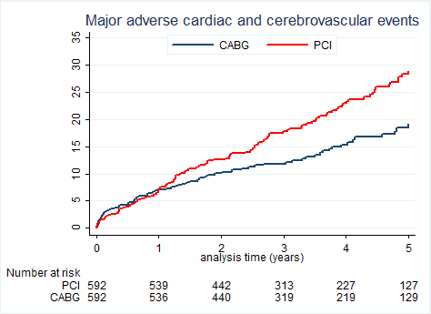
Results Primary endpoint: MACCE
28·9%
HR 1·48 (1·11–1·96); p=0·0066
19·1%
PCI did not show non-inferiority
and CABG was superior to PCI

Slide 3
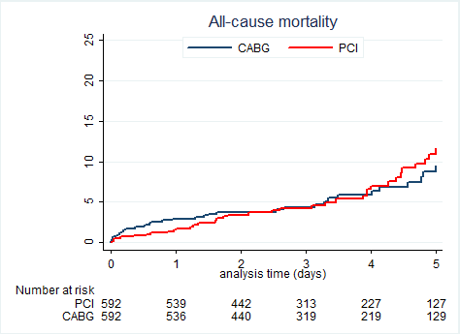
Results All-cause mortality
11.5%
HR 1·07 (0·67–1·72); p=0·77
11·6%
9.5%
9·5%

Slide 4
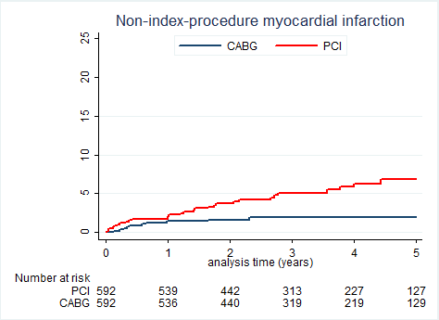
Results Non-procedural myocardial infarction
HR 2·88 (1·40–5·90); p=0·004
6·9%
1·9%

Slide 5
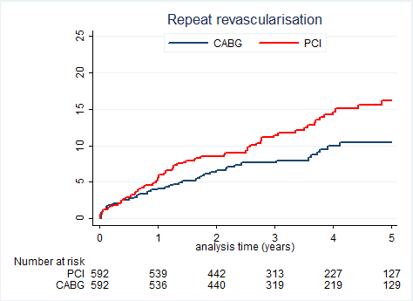
Results Total repeat revascularization
HR 1·50 (1·04–2·17); p=0·03
16·2%
10·4%

Slide 6
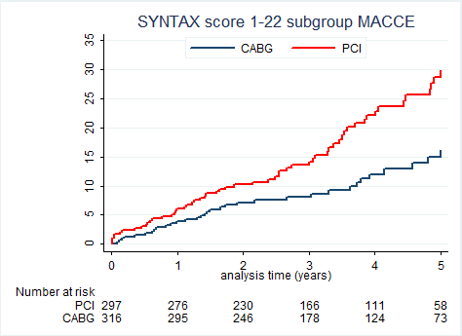
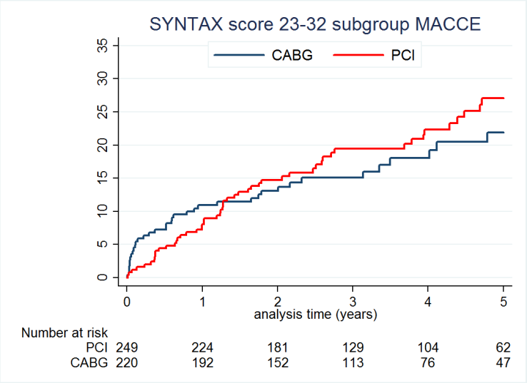
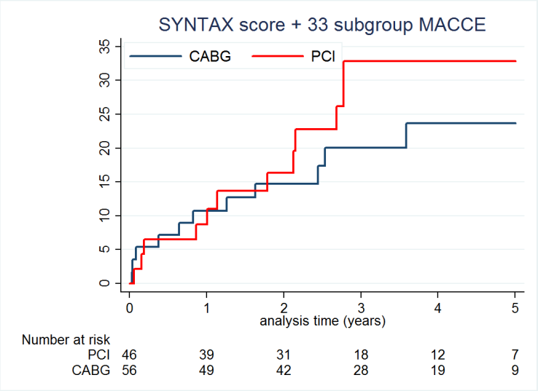
Results SYNTAX score subgroups
K-M estimates
4.9%
1.9%
HR 1·88 (1·23–2·89); p=0·0031
HR 1·16 (0·76–1·78); p=0·48
HR 1·41 (0·62–3·20); p=0·41
SYNTAX score assessed by independent corelab

Slide 7
Conclusions
PCI did not meet non-inferiority for the primary endpoint of 5-year MACCE compared to CABG
CABG was superior to PCI
PCI resulted in higher rates of non-procedural myocardial infarctions
Repeat revascularization was higher after PCI, primarily due to de novo lesions and non LMCA target lesion revascularization
All-cause mortality was similar for PCI and CABG

