Slide 1
The Evolving Landscape of Impella® vs. IABP use in the United States
Embargo 9 AM ET 11/17/19
Amit P. Amin MD MSc, John A. Spertus MD MPH, Jeptha P. Curtis MD, Nihar Desai MD MPH, Frederick A. Masoudi MD MSc, Richard G. Bach MD, Christian McNeely MD, Firas Al-Badarin MD MSc, John A. House MS, Hemant Kulkarni MD, Sunil V. Rao MD
Notes:
Thank you for the opportunity to present our results on the “The Evolving Landscape of Impella® vs. IABP use in the United States”

Slide 2
Introduction
Impella® was approved for mechanical circulatory support (MCS) in 2008, but large-scale, real-world outcomes and cost data on its use are lacking.
Our objectives were to:
1) Describe trends and variation in Impella® use across hospitals
2) Compare outcomes (in-hospital mortality, bleeding, acute kidney injury (AKI) and stroke), hospitalization costs and length of stay
a) at the time-period level: in the pre-Impella® vs. Impella® era;
b) at the hospital level: across low- vs. high-Impella® use hospitals;
c) at the patient-level: by performing comparative effectiveness analysis

Slide 3
Methods
From the Premier Healthcare Database, we analyzed 48,306 patients undergoing PCI with MCS at 432 hospitals between 1/2004-12/2016.
We analyzed the association of Impella® with outcomes and costs at three levels:
Time-period level
Hospital level
Patient level
In all association analyses, we performed propensity adjustment and used hierarchical models to account for clustering of patients by hospitals.

Slide 4
Overall Practice Patterns of IABP, Impella® and MCS devices in PCI patients
All MCS Devices
IABP
Impella
Notes:
The overall rise in MCS use after 2008 closely paralleled a concomitant rise in patients who received Impella® while the proportion of patients who received IABP remained stable or declined slightly during the post-Impella® era

Slide 5
Use of Impella® rapidly increased amongst PCI patients treated with MCS devices
Pre-Impella Era
Impella Era
Proportion receiving Impella (%)
Proportion using Impella
Year
Notes:
Within the subset of the MCS-treated patients, the proportion of Impella® utilization increased steadily, reaching 31.9% in 2016

Slide 6
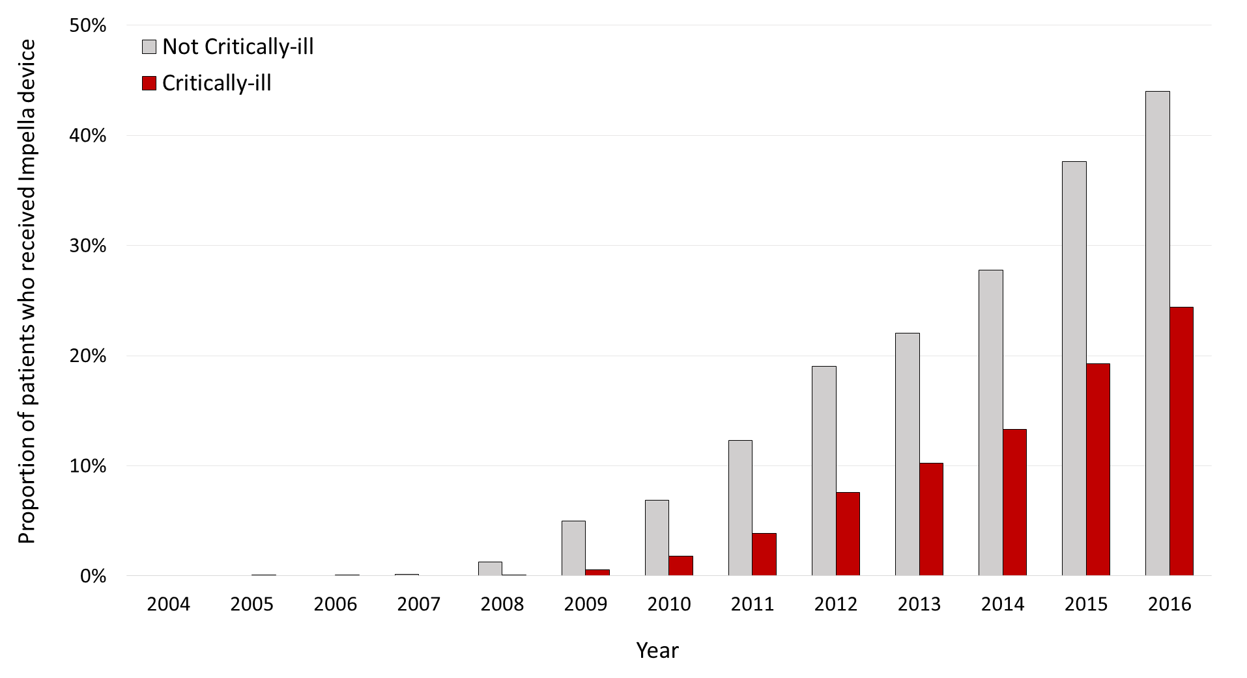
Impella® was less likely to be used in critically-ill patients
Critically-Ill patients defined as those who presented with:
cardiac arrest or
cardiogenic shock or
those requiring mechanical ventilation
Not Critically-ill
Critically-ill
Proportion receiving Impella (%)
Year
Notes:
One important point to note is that Impella was less likely to be used in the critically ill pts. Critically ill pts were described as those with cardiac arrest, cardiogenic shock or mechanical ventilation

Slide 7
Increasing Cost Trend in MCS use PCI patients, in the Impella® Era
Pre-Impella® Era

Slide 8
Decreasing Cost Trend in non-MCS use PCI
Hospital Cost ($)
Year

Slide 9
Large Variation in the Use of Impella®
~ 6-fold variation in the likelihood of receiving Impella
Median Odds Ratio (MOR)
Proportion receiving Impella (%)
Year
Hospitals

Slide 10
Large variation in outcomes among patients who received Impella® device
Outcome | Variation across hospitals (n = 4,782)
 | Median Odds Ratio (MOR)
Death | 1.71 (1.53 – 1.97)
Bleeding | 2.62 (2.24 – 3.17)
AKI | 1.53 (1.41 – 1.69)
Stroke | 1.47 (1.27 – 1.86)
 | Intraclass Correlation Coefficient (ICC, %)
Total LOS | 5.18 (3.40 – 7.80)
ICU LOS | 6.98 (4.67 – 10.31)
Total cost | 17.80 (13.93 – 22.46)
~2.5-fold variation in Bleeding across hospitals
~1.5-fold variation in AKI, Stroke and Death across hospitals
Less variation in LOS and Costs

Slide 11
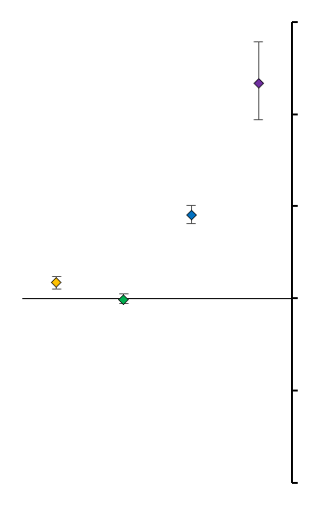
Comparison of the pre-Impella® and Impella® era for outcomes (adjusted)
Death: OR 1.17 (1.10 – 1.24), p<0.001
Bleeding: OR 0.99 (0.94 – 1.05), p=0.843
AKI: OR 1.91 (1.81 – 2.01), p<0.001
Stroke: OR 3.34 (2.94 – 3.79), p<0.001
-1.0
0
1.0
2.0
3.0
4.0
Odds Ratio → Higher with Impella era
Notes:
When comparing the pre-Impella® and Impella® era for study outcomes, we found a higher

Slide 12
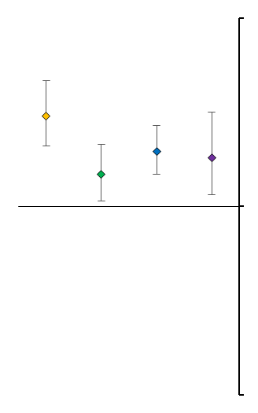
Comparison of the Highest Quartile Impella® use Hospital vs. Lowest Quartile Impella® use Hospital for study outcomes (adjusted)
Death: OR 1.48 (1.32 – 1.67), p<0.0001
Bleeding: OR 1.17 (1.03 – 1.33), p=0.015
AKI: OR 1.29 (1.17 – 1.43), p<0.0001
Stroke: OR 1.26 (1.06 – 1.50), p=0.0094
0
1.0
2.0
Odds Ratio → Higher with High Use Hospitals

Slide 13
Patient Level Comparative Effectiveness of Impella® vs. IABP (adjusted)
Odds Ratio

Slide 14
Length of Stay and Hospital Costs (adjusted)

Slide 15
Falsification Endpoint Analysis: Association of Impella with adverse outcomes unlikely to be driven by unmeasured comorbid conditions or its use in sicker patients
Other Acute Endpoints include acute diarrhea, cellulitis, deep vein thrombosis, intestinal obstruction or osteomyelitis
Notes:
we performed falsification endpoint analyses, in which endpoints not expected to be influenced by MCS choice, but would be influenced by confounding factors, were tested to assess residual bias. Unrelated but acute falsification endpoints indicative of unmeasured frailty or sickness (community-acquired pneumonia, diarrhea, cellulitis, deep vein thrombosis, intestinal obstruction and osteomyelitis) were compared between Impella® vs. IABP
acute diarrhea, cellulitis, deep vein thrombosis, intestinal obstruction or osteomyelitis

Slide 16
Limitations
Observational study and cannot rule out unmeasured confounding or selection bias.
The definition of cardiogenic shock and outcomes of death, bleeding, AKI and stroke are derived from ICD-9 codes and were not adjudicated.
Angiographic details unavailable, unable to adjust for anatomic complexity.
Costs are from the hospital perspective and limited to index hospitalization.
The clinical reasoning behind selection of Impella® use cannot be ascertained.

Slide 17
Conclusions
Impella® is increasingly being used instead of IABP to support PCI in the United States.
There exists a wide variation not only in the use of Impella® across hospitals but also in its associated outcomes across hospitals.
The associated clinical outcomes did not show any substantial improvement, while costs of hospitalization rose.
Although unmeasured confounding cannot be ruled out, when analyzed by time periods, or at the level of hospitals or at the level of patients, Impella® use was associated with higher rates of adverse events and increased costs.
These data underscore the need for defining the appropriate use of MCS in patients undergoing PCI

Slide 18
Thank you
Statisticians: Hemant Kulkarni and John House
Co-authors: John A. Spertus MD MPH, Jeptha P. Curtis MD, Nihar Desai MD MPH, Frederick A. Masoudi MD MSc, Richard G. Bach MD, Christian McNeely MD, Firas Al-Badarin MD MSc, John A. House MS, Hemant Kulkarni MD, Sunil V. Rao MD
Circulation Editors and Reviewers

