Slide 1
a Novel Cardiac Mitotrope, in Patients with Symptomatic Nonobstructive Hypertrophic Cardiomyopathy
Efficacy and Safety of Ninerafaxstat,
(Results of IMPROVE-HCM)
Martin S. Maron, MD for the IMPROVE-HCM Study Investigators
Director, HCM Center
Lahey Medical Center, Burlington, MA

Slide 2
The Unmet Treatment Need in Nonobstructive HCM
Unmet Treatment Need
50% NYHA
Class
II-III
10%
End- Stage
HF
Nonobstructive HCM
(<30 mmHg at
rest/exercise)
Beta-Blocker Calcium Channel Blocker
Heart Transplant

Slide 3
Diastolic Dysfunction in Nonobstructive HCM
LV Relaxation:
LV Distensibility:
Heavily Energy Dependent
LV Hypertrophy
Myocardial Ischemia
LV Hypertrophy
Disarray
Interstitial Fibrosis
Replacement Scar
Altered LV Diastolic Filling/Low Stroke Vol
Limiting Symptoms and Decreased Exercise Capacity

Slide 4
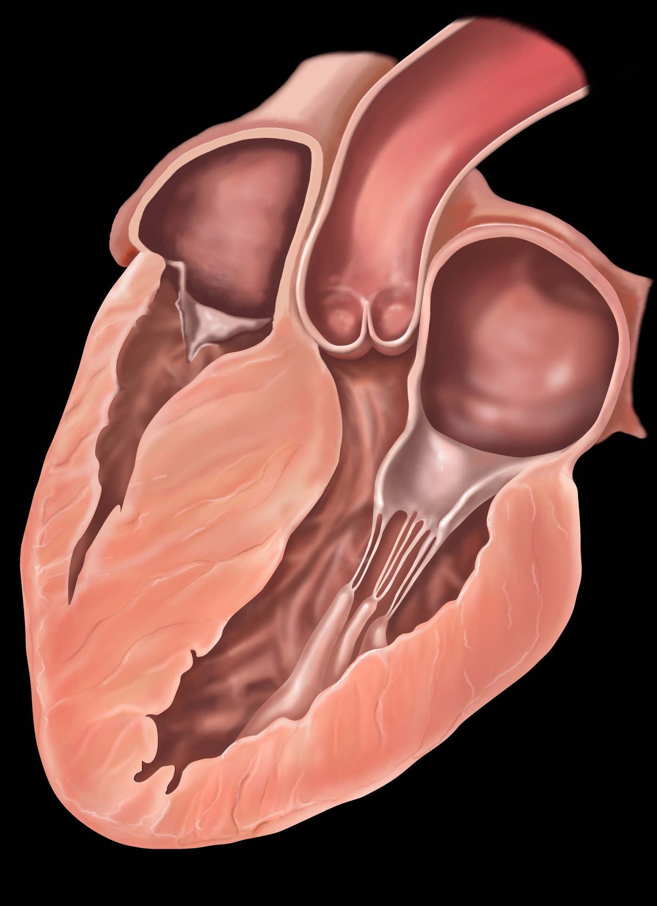
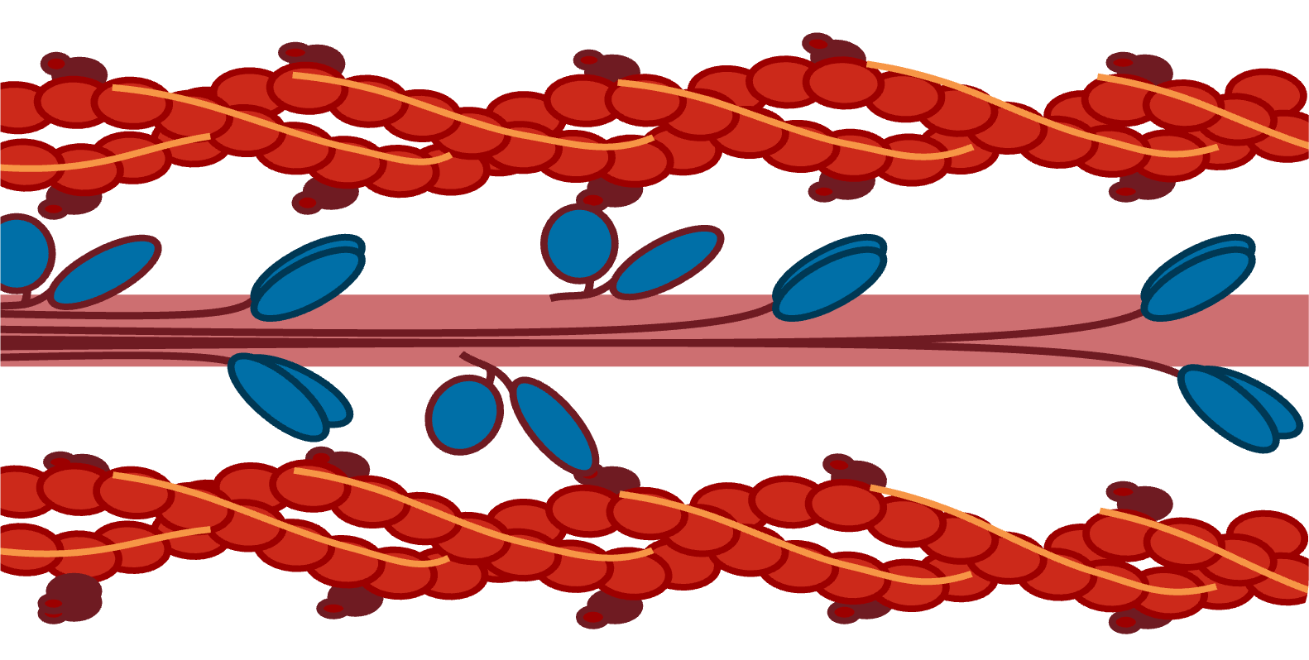
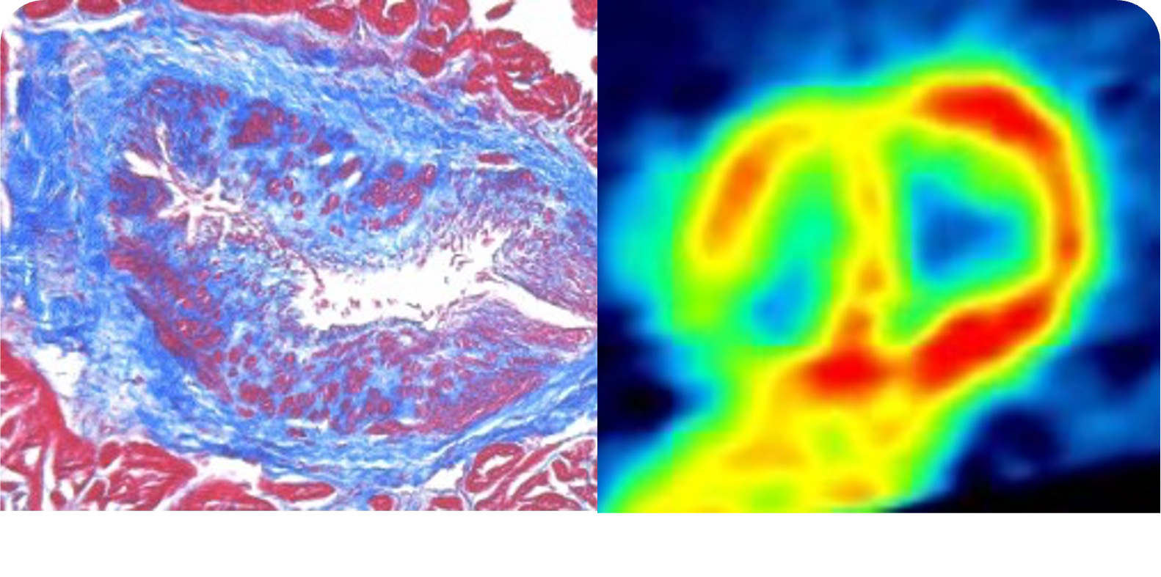
Energy Deficiency is a Primary Consequence of HCM Disease Expression
For these reasons…
Myocardial Energetics Represent an Attractive Therapeutic Target
HCM
Microvacular Ischemia
Energetic Cost of
ontraction/Relaxation ^{Exacerbates Primary E} Deficiency
Mitotropes =
Drugs that influence myocardial energetics
C
nergy
PCr/ATP Ratio

Slide 5
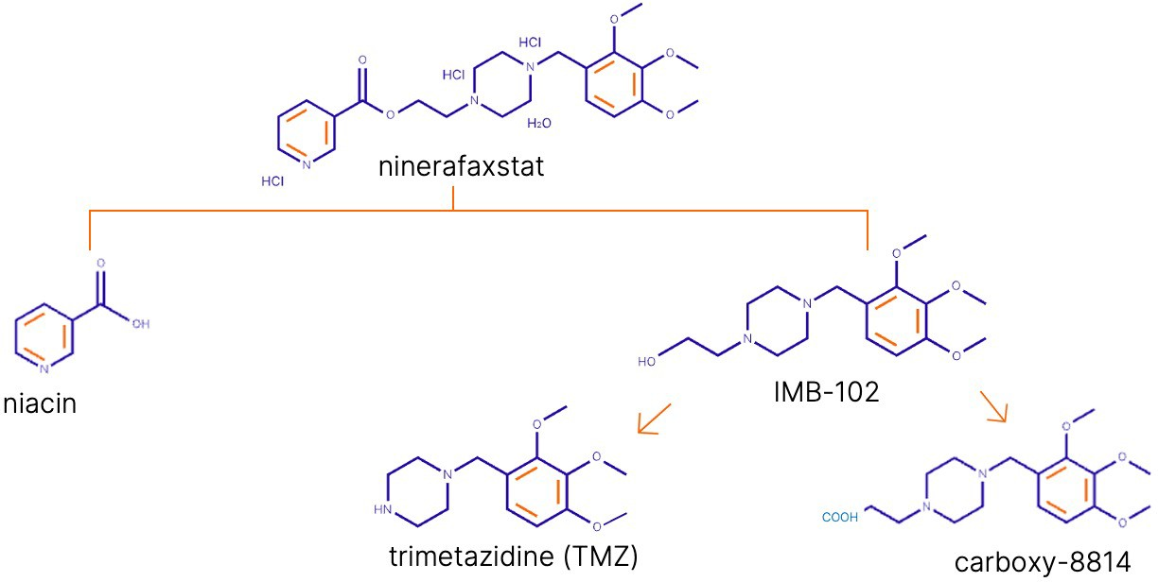
Ninerafaxstat is a Mitotrope that Influences Cardiac Energetics
Ninerafaxstat:
Partial Inhibition of Fatty Acid Oxidation No Drug Monitoring
No Hemodynamic Effect
Approved in some countries for treatment of angina
since 1970s & in current ESC treatment guidelines (Class 2a recommendation)
5

Slide 6
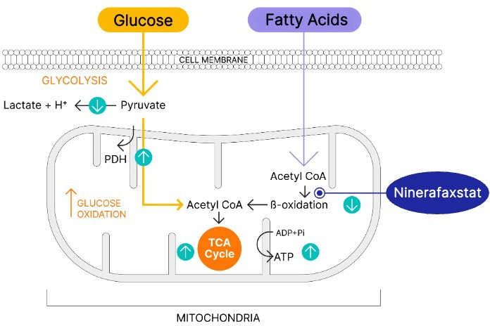
Ninerafaxstat: Mechanism of Action
Optimizes Efficiency of ATP Generation to Enhance Cardiac Function
Partial inhibition of mitochondrial fatty acid oxidation
Shift of cardiac metabolism from using fatty acids towards glucose
Recoupling glycolysis and glucose oxidation
↑ Efficiency of ATP production per molecule of O₂
Modified from Lopaschuk et al., Physiol. Rev 2010 &
Verma et al J Am Coll Cardiol Basic Trans Science 2018; 3:575-587

Slide 7
IMPROVE-HCM - Key Inclusion Criteria and Endpoints
Study Design and Endpoints
Key Inclusion Criteria
Randomized and blinded prospective trial for 12 weeks
Orally administered ninerafaxstat 200 mg MR BID vs. Placebo
Evaluating:
Safety and Tolerability
CPET Measures (pVO₂ and V_{E}/VCO₂)
KCCQ-CSS
Echocardiographic Variables
NT-proBNP
18-80 years old
LV wall thickness of ≥15 mm
LV Outflow Tract Gradient <30 mmHg at rest and with exercise
Baseline LVEF ≥ 50%
CPET:
pVO2 ≤80% predicted for age & gender
RER ≥1.05

Slide 8
IMPROVE-HCM - Clinical Trial Design
Randomization
Ninerafaxstat MR 200mg bid + SoC
End of Study
Screening
Placebo + SoC
Study Visits
Screen
Baseline
Week 6
Week 12
Week 14
Consent CPET ECHO
Labs
KCCQ-23
NYHA Class Biomarkers
KCCQ-23
NYHA Class Biomarkers ECHO
KCCQ-23
NYHA Class CPET ECHO
Biomarkers Labs
Safety Follow-up visit

Slide 9
IMPROVE-HCM – Baseline Characteristics
Characteristic | Placebo (n = 33 ) | Ninerafaxstat (n = 34)
Age (Years), Mean (SD) | 56 (13) | 58 (11)
Male, n (%) | 16 (48) | 14 (41)
NYHA Functional Class, n (%)
Class II | 20 (61) | 20 (59)
Class III | 12 (36) | 12 (35)
Maximal LV Wall Thickness (mm) Mean (SD) | 17 (4) | 17 (3)
LVEF (%), Mean (SD) | 68 (4) | 63 (5)
LA Diameter (mmHg), Mean (SD) | 36 (5) | 43 (7)
pVO2 (mL/kg/min), Mean (SD) | 20 (4) | 18 (4)
pVO2 % predicted age and gender, % (SD) | 62 (11) | 59 (9)
VE/VCO₂, Mean (SD) | 33 (5) | 31 (4)
NT-proBNP (pg/mL), Mean (SD) | 712 (1150) | 606 (634)

Slide 10
IMPROVE-HCM – Ninerafaxstat was well tolerated
Treatment Emergent Serious Adverse Events
Placebo: 2 patients (6%)
Sepsis; hypoxia (post CPET)
Ninerafaxstat: 4 patients (11%)
COVID pneumonia; CABG; pyelonephritis; abdominal abscess
≥1 Treatment-emergent adverse event
Placebo: 20 patients (61%)
Ninerafaxstat: 24 patients (71%)
Most TEAE were mild to moderate
Ninerafaxstat was associated with no significant change in LV EF, blood pressure or heart rate at Week 12

Slide 11
Efficacy of Ninerafaxstat on Heart Failure Symptom Burden by KCCQ-CSS (ITT Population)
LS mean difference = 3.2 (-2.9, 9.2) P value = 0.2
100
80
60
40
KCCQ-CSS
20
+
+
Ninerafaxstat N=29
Placebo N=31
Ninerafaxstat
BL
Week 12
Placebo
BL
Week 12

Slide 12
Efficacy of Ninerafaxstat on Heart Failure Symptom Burden by KCCQ-CSS (Patients Limited at Baseline)
≥5 Point Change in KCCQ: Clinically Meaningful
≤80 KCCQ-CSS at Baseline
NYHA Class III at Baseline
LS mean difference = 9.4 (0.3, 18.5)
P=value = 0.04
LS mean difference = 13.6 (1.4, 25.9)
P=value = 0.03
80
80
KCCQ-CCS
KCCQ-CCS
60
60
40
40
20
20
Ninerafaxstat N=18
Placebo N=17
Ninerafaxstat N=12
Placebo N=11
Ninerafaxstat
BL
Week 12
Placebo
BL
Week 12

Slide 13
Efficacy of Ninerafaxstat on Exercise Capacity by V_{E}/CO₂ (ITT Population)
≥1 Unit V_{E}/VCO₂ Slope Associated with Risk Death/Transplant
LS mean difference = -2.1 (-3.6, -0.6) P value = 0.005
50
+
+
V_{E}/VCO₂
(ITT population)
40
Placebo Corrected Decrease
Of 2 Units in V_{E}/VCO₂:
Clinically Meaningful Improvement
30
20
Ninerafaxstat N=29
Placebo N=30
Ninerafaxstat
BL
Week 12
Placebo
BL
Week 12

Slide 14
Efficacy of Ninerafaxstat on Exercise Capacity by V_{E}/CO₂ (Patients Limited at Baseline)
≤80 KCCQ-CSS at Baseline
NYHA Class III at Baseline
50
LS mean difference = -2.1 (-3.8, -0.3) P value = 0.02
50
LS mean difference = -3.0 (-4.9, -1.0) P value = 0.004
+
+
V_{E}/VCO₂
(NYHA Class III at Baseline)
V_{E}/VCO₂
(Baseline ≤ 80)
40
40
+
+
30
30
20
20
Ninerafaxstat N=18
Placebo N=16
Ninerafaxsta t N=11
Placebo N=11
Ninerafaxstat
BL
Week 12
Placebo
BL
Week 12

Slide 15
IMPROVE-HCM – pVO₂, Echocardiography and Biomarkers
 |  | Ninerafaxstat (N=34) |  | Placebo (N=33) | Treatment Effect
Variable | n (%) | Change from baseline Mean ± SD | n (%) | Change from baseline Mean ± SD | LSM difference (95% CI) | ANCOVA P Value
pVO₂ (ml/kg/min) | 29 (85.3) | 0.013 ± 2.03 | 30 (90.9) | 0.02 ± 1.91 | 0.061 (-0.99, 1.1) | 0.908
LA Size (mm) | 27 (79) | -0.09 ± 0.29 | 32 (97%) | 0.10 ± 0.31 | -0.20 (-0.35,-0.05) | 0.010
Average E/e’ | 27 (79.4) | 0.27 ±3.4 | 31 (93.9) | 0.93 ± 3.5 | -0.76 (-2..6, 1.0) | 0.398
Median NT-proBNP (ng/L) (min, max) | 29 (85.3) |  | 342 (54, 6123) |  | 98.03 (-110.19, 306.24) | 0.85

Slide 16
Conclusions
In this Phase 2 proof-of-concept study, ninerafaxstat, a novel investigational cardiac mitotrope, was safe and well tolerated in nonobstructive HCM
Treatment with ninerafaxstat was associated with significant improvement in functional capacity measured by V_{E}/VCO₂, an important and prognostic submaximal CPET variable in HCM
In those nonobstructive HCM patients limited at baseline, ninerafaxstat significantly improved limiting symptoms with favorable change in KCCQ-CCS score
These results support progression to larger Phase 3 study in symptomatic nonobstructive HCM to investigate if targeted therapy at optimizing cardiac energetics may fulfill an important unmet treatment need in this disease

