Slide 1
A Randomized Controlled Trial of PCI vs OMT in Patients with Stable Angina and Grey-Zone Fractional Flow Reserve Values
The ^{GZ}FFR Study
^{GZ}FFR Study
Barry Hennigan^{1,2,3,4}, Colin Berry ^{1,2}, Damien Collison ^{1,2}, David Corcoran ^{1,2}, Hany Eteiba², Richard Good
², Stuart Watkins ², John McClure ¹ Mitchell Lindsay², Keith G. Oldroyd ^{1,2}.
1=University of Glasgow, U.K.
2= Golden Jubilee National Hospital, Glasgow, UK 3= The Mater Private Hospital, Cork, Ireland 4=Cork University Hospital, Ireland

Slide 2
Disclosures
^{GZ}FFR Study
There was no industry involvement in any aspect of
this study
British Heart Foundation Project Grant Funding
Dr. Hennigan has received honoraria for consultancy from Philips Volcano.
Professor Berry has undertaken research, consulting and lectures for St Jude Medical based on contracts with The University of Glasgow.
Professor Oldroyd has received honoraria for consultancy and lectures
from Abbott Vascular.

Slide 3
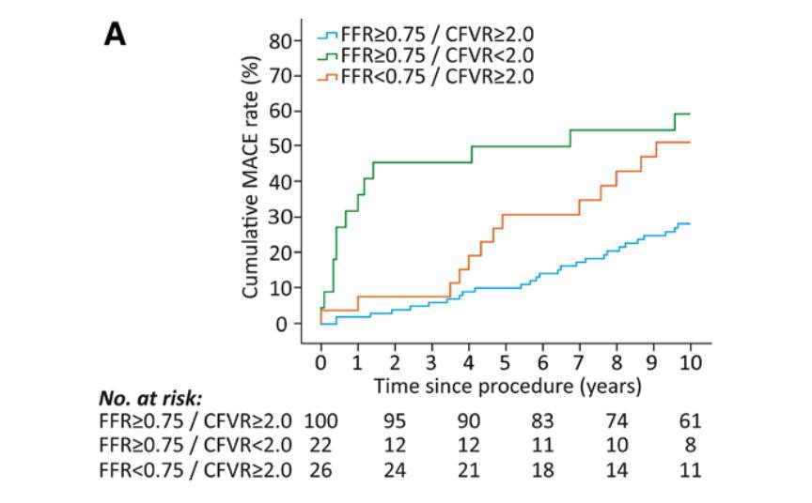
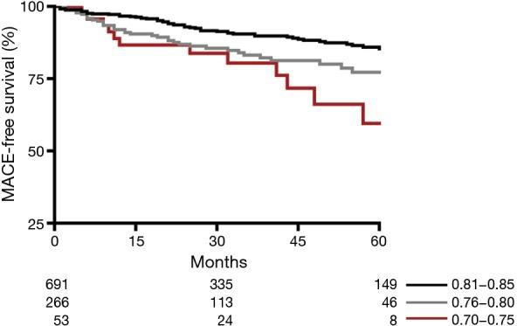
Grey Zone FFR
G
^{Z}FFR Study
FFR 0.75-0.80
PCI
OMT
FFR guidance improves clinical outcomes in patients with CHD
GZ FFR values are a common
clinical scenario
Prevalence of major ischemia?
Is deferral of PCI reasonable?
B
van de Hoef et al., CircCardiovascInterv.2014;7:301-311.
Adjedj J, De Bruyne B, Floré V, et al. Circulation 2016;133:502-8.

Slide 4
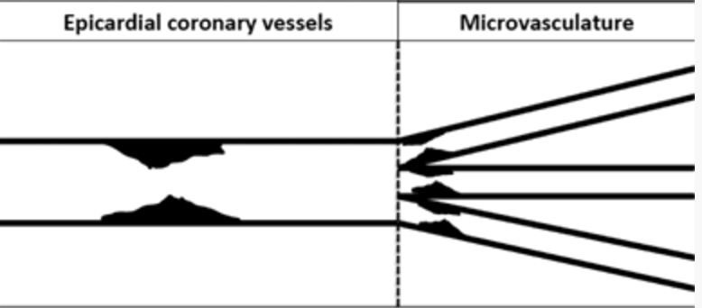
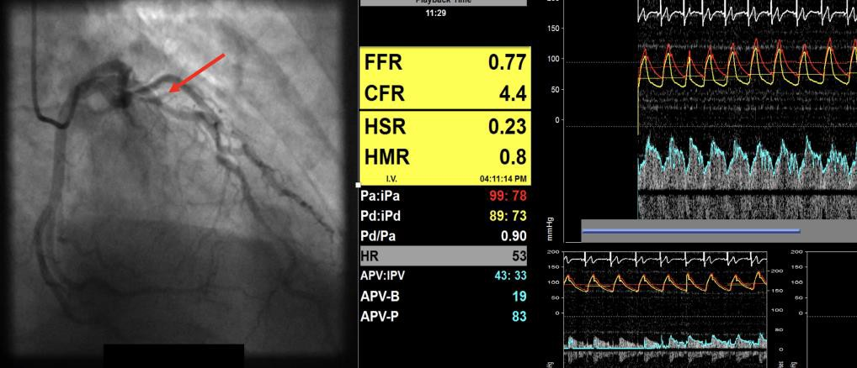
Coronary Indices in ^{GZ}FFR
^{GZ}FFR Study
FFR – hyperaemic Pd/Pa
CFVR - hAPV/bAPV
HSR = Hyperaemic trans- lesional pressure gradient/APV
>0.8 mmHg/cm per second
Piek et al Circulation. 2002;106:441-446.
FFR/HSR
HMR
--------------CFR---------------

Slide 5
Grey Zone FFR Study
^{GZ}FFR Study
Prospective single center RCT
PCI plus OMT vs OMT
110 stable patients - expected 10% dropout
One major vessel - FFR 0.75-0.82
No other PCI target vessels or residual ischemia
Exclusions: LMS, recent STEMI, unstable, C/I to FFR
Stratified randomisation: DM, age, gender
ESC guideline based medical therapy
Primary outcome measure: Angina severity by SAQ at
3/12
Null hypothesis: no difference at 3/12
80% power at 5% level of significance for a 10 point
difference in SAQ

Slide 6
^{GZ}FFR Study
Patient undergoing FFR 30-80% DS lesion
Any of the following;
LMS >50%/Tortuous anatomy/Highly calcified vessels/
<5/7 post Acute STEMI-infarct related artery?
No = proceed
Yes=Exclude
“Screening FFR”
Peripheral Adenosine 140 mcg/kg/min or
IC 100mcg RCA/ 200mcg LCA
FFR <0.75 = PCI
FFR 0.75-0.82
inclusive
FFR >0.82 =
Medical Rx
^{gz}FFR PROTOCOL
Sedate Combowire Assessment
IC measurements IV 140 mcg/kg/min
Single 210mcg/kg/min
3T Perfusion MRI
RANDOMISATION
PCI with repeat pressure/ﬂow wire within 2/52
Medical Rx
Repeat MRI in 25% of Medical patients
Repeat Perfusion MRI 1-2 months
Clinically indicated PCI
Followup 3/12+1y
FFR=Fractional Flow Reserve, Gz= greyzone, QCA=Quantitative Coronary Angiography, STEMI= ST Elevation Myocardial Infarction IMR=Index of microcirculatory resistance Pd/Pa=Resting pressure gradient,CFR= Coronary ﬂow reserve,BSR=Basal stenosis resistance index,HMR=Hyperemic microvascular resistance , MRI = Magnetic resonance imaging HiFR=Hyperemic iFR iFR=iinstantaneous wave free ratio
GzFFR Flow Chart v2.0 20/12/14

Slide 7
Combowire Physiology Data
^{GZ}FFR Study
 |  | (n) | Mean | SD | p
FFR | OMT | 41 | 0.78 | 0.02 | 0.64
 | PCI | 46 | 0.78 | 0.02
HSR (mmHg/cm/sec) | OMT | 41 | 0.54 | 0.21 | 0.12
 | PCI | 46 | 0.47 | 0.17
CFVR | OMT | 41 | 2.37 | 0.71 | 0.65
 | PCI | 46 | 2.44 | 0.77
7/93 (8%) had an “ischaemic” value of HSR (≥ 0.80)
26/93 (28%) had an “ischaemic” value of CFVR (< 2.0)

Slide 8
Stress Perfusion
MRI
^{GZ}FFR Study
Siemens Prisma 3T
Two blinded observers
16 segment AHA
3rd observer adjudicated discordant cases
Medis Workstation
MRI data - 98/104 of
the randomized cohort
PRE RANDOMISATION (n=98)
Major ischaemia 17/98 (17.4%) Any ischaemia 24/98 (24.4%)
GZFFR segments with any ischemia | 0 |  | 1 | 2 | 3 | 4
Patient number | 7 4 |  | 8 | 1 0 | 5 | 1
FOLLOW UP SCANS PCI GROUP (n=41)
Major ischaemia 3/41 (7.3%) Any ischaemia 5/41(12.2%)
Definition of Major
Ischaemia
≥2 segments ≥25% trans-mural ischemia or
≥1 segment with ≥50% trans-mural ischemia

Slide 9
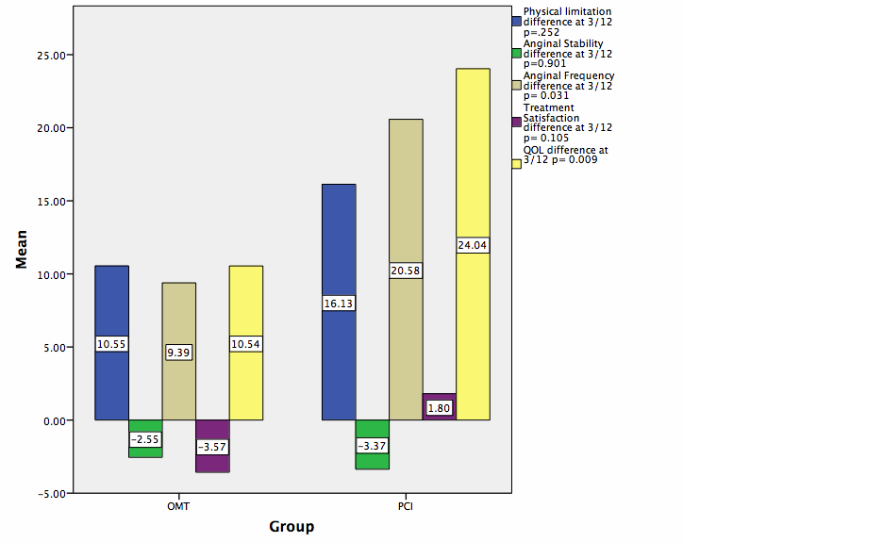
Difference in SAQ Scores at
^{GZ}FFR Study
3/12
(Primary Outcome; intention to treat;
n=100)
 | Physical Limitation, p=0.273
 | Anginal Frequency p=0.035
 | Rx Satisfaction, p=0.110
 | Quality of Life, p=0.012
Mean Difference =
Anginal Stability, p=0.909
Higher score= Better health status
3/12 score - baseline score
OMT only
(n=48)
PCI plus OMT (n=52)

Slide 10
^{GZ}FFR Study
Degree of ischaemia vs improvement in symptoms
 | Stress MRI (Any ischemia) |  | P
 | ISCHAEMIA | NO ISCHAEMIA
 | PCI plus OMT
△ QOL >10 | 8/9 | 20/38 | 0.046
 | (89%) | (53%)
 | OMT only
△ QOL >10 | 9/14 | 15/33 | 0.238
 | (64.2%) | (45.5%)

Slide 11
^{GZ}FFR PCI versus ORBITA PLACEBO SEATTLE ANGINA QUESTIONNAIRE
^{GZ}FFR Study
SAQ PARAMETER
CHANGE FROM
BASELINE
(mean+/-SD)
p VALUE
^{GZ}FFR
94% FFR 0.75-0.80
ORBITA 29% FFR > 0.80
^{GZ}FFR PCI
(“Open-label PCI”)
PHYSICAL LIMITATION
16.1
(26.1)
^{GZ}FFR
Mean FFR=0.78
SD=0.02
ORBITA PLACEBO
(Sham control PCI)
5.0 (21·2)
0.008
^{GZ}FFR PCI
(“Open-label PCI”)
20.6
(27.6)
0.030
ANGINAL FREQUENCY
ORBITA
Mean FFR=0.69
SD=0.16
ORBITA PLACEBO
(Sham control PCI)
9.6
(28.4)
^{GZ}FFR PCI
(“Open-label PCI”)
ANGINAL STABILITY
-3.4
(32.9)
 | ORBITA | ^{GZ}FFR
Age | 66 (9) | 60.5 (9)
Male | 73.0% | 76%
Diabetes | 18% | 23%
HTN | 69% | 72.1%
0.77
ORBITA PLACEBO
(Sham control PCI)
-5.1
(31.6)
Al-Lamee, R., Thompson, D., Dehbi, H.-M., Sen, S., Tang, K., Davies, J., et al. (2018). Percutaneous coronary intervention in stable angina (ORBITA) The Lancet, 391(10115), 31–40

Slide 12
Limitations
^{GZ}FFR Study
Small single centre study
Difficult to recruit
51% of patients had single vessel ^{GZ}FFR stenosis
49% of patients had bystander ^{GZ}FFR stenosis following PCI
of different vessel
Short follow-up but 2x longer than ORBITA
No sham control

Slide 13
^{GZ}FFR Study - Summary
^{GZ}FFR Study
In patients with stable CHD and GZ-FFR values…
around 30% have ischaemic CFVR
around 10% have ischaemic HSR
around 25% have ischaemia on stress MRI
PCI plus OMT compared to OMT only resulted in…
50% reduction in ischaemia on stress MRI
improvements in 2/5 SAQ domains
angina frequency and QOL
Magnitude of improvement with PCI > placebo
group of ORBITA but….NO PATIENT BLINDING
Greatest QOL improvement seen in patients with
ischaemia on stress MRI

