Slide 1

ESC Guidelines Downgraded Embolic Protection Device in SVG-PCI to Class IIa
Is It Time to Change ACC/AHA Guidelines?
Timir K Paul, MD, PhD, MPH, FACC, FSCAI
Associate Professor of Medicine
Director, Interventional Cardiology
Director, Cardiovascular Research
East Tennessee State University
Johnson City, TN
pault@etsu.edu

Slide 2

Timir Paul, MD, PhD
Financial Relationship: Investor: FlowMed Tech
I have no disclosures related to this presentations

Slide 3
Introduction
2011 ACCF/AHA PCI guidelines recommend use of embolic protection device (EPD) (level of evidence B) for saphenous vein graft (SVG) intervention when feasible as class I indication.
This guideline based on only 1 RCT, the SAFER trial published in 2002
Several studies published later on the use of EPD in SVG intervention have shown conflicting results.
A large study using NCDR CathPCI Registry data published in 2015 showed no benefits in routine use of EPD during SVG PCI.

Slide 4
Introduction
Despite modifications and newer versions, EPD use can increase procedural time and complexity and associated with procedure-related complications.
In the current era, no-reflow and peri-procedural MI during SVG PCI has decreased likely because of the use of more potent antiplatelet therapy and improved procedural techniques and stents.
Thus, the role of routine use of EPD in SVG intervention has been questioned and continues to be a matter of debate.
There is a concern about the relevance of existing randomized data to contemporary clinical practice.

Slide 5
SAFER Trial
Distal Embolic Protection Device vs Control
801 patients randomized
406 distal protection vs 395 conventional angioplasty
30-day MACE (death, MI, emergency bypass or TLR) was 9.6% vs 16.5% (EPD vs control, p =0.004)
There was no difference in death and CABG at 30 days.
Baim DS et al. Circulation 2002;105:1285-1290
Notes:
GuardWire distal protection device that compared EPD (balloon occlusion) versus no-EPD; Embolic protection with distal balloon occlusion and aspiration
FIRE Trial ( 2003) and PROXIMAL Trial (2007) also looked at 30-day MACE

Slide 6
SAFER Trial
30 day MACE

Slide 7
Limitations of SAFER Trial
Pre-dilatation: 32.3 % vs 20.6% in control vs EPD group
Reference vessel diameter: 3.44 ±0.69 vs 3.42 ±0.66 mm in EPD vs control
Aggressive post dilatation was performed in 40% vs 27.3% for control vs EPD
Mean post dilatation balloon diameter 4.2 ±0.7 (mean maximum pressure inflation pressure 13.4 ± 4.5 atm)

Slide 8
Limitations of SAFER Trial
Mean number of stents per lesion was 1.35 and 1.38 in EPD vs control (2 stents)
Only 30 days MACE
MI was defined as CK-MB > 3 times ULN
Target ACT was low as GP2b3a inhibitor was used
No preloading of DAPT (300 Plavix was used after the procedure)
No Vasodilators was used

Slide 9
Current Era
Now more potent antiplatelets (ticagrelor, prasugrel) are available
Longer stents with thinner struts are available
GuardWire balloon occlusion is not used any more
There is no study comparing currently used FilterWire vs control
Evidence showed GP2b3a inhibitor is not beneficial in SVG-PCI (Class III)

Slide 10
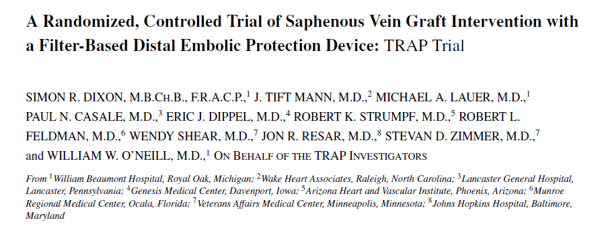
TRAP Trial
Dixon SR et al. J Interven Cardiol 2005;18:233–241

Slide 11
TRAP Trial n = 358
Designed to enroll 752 patients
Because of poor recruitment the study terminated early
MACE at 30-day TRAP device vs Control 17.3% vs 12.7 % (p =0.24)
No difference in all-cause mortality, MI and TVR at 30 days.
Due to low enrollment the study lacked sufficient power to detect a significant benefit with the device.
Dixon SR et al. J Interven Cardiol 2005;18:233–241
Notes:
TRAP distal vascular filtration system; as there was another approved distal protection device available at the same time. The trial
was designed 752 randomized patients. However, terminated the study after a total of 467 patients (358 randomized) were enrolled.

Slide 12
NCDR Cath PCI Registry
Study population
2005 -2009
49,325 patients
> 65 years
MACE (composite risk of death, MI, or repeat revascularization)
Overall EPD use 21.2%
ACS vs non ACS: 22% vs 19%
Brennan JM. Circ Cardiovascular Interv. 2015 Mar;8(3):e001403.

Slide 13
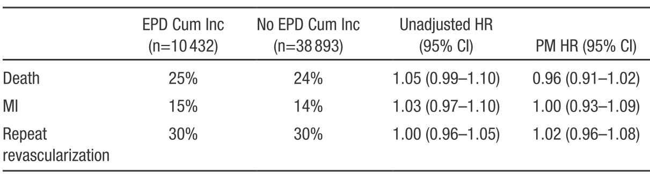
NCDR Cath PCI Registry
30-day MACE was 5.5% (P=0.1)
3-year MACE was 52%
Death 25%
MI 15%
Repeat TVR 30%
Brennan JM. Circ Cardiovascular Interv. 2015 Mar;8(3):e001403.

Slide 14
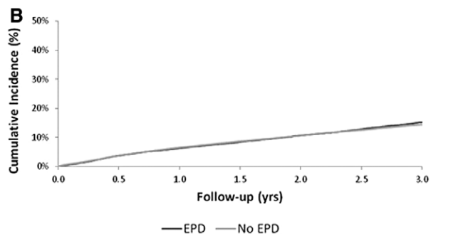
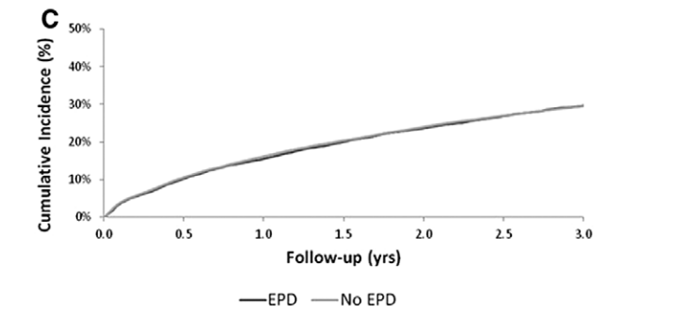
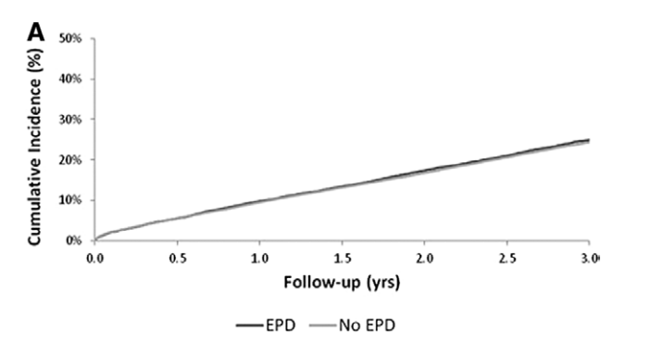
NCDR Cath PCI Registry Data
3-year outcomes
Death
Repeat revascularization
Myocardial infarction
Brennan JM. Circ Cardiovascular Interv. 2015 Mar;8(3):e001403.

Slide 15
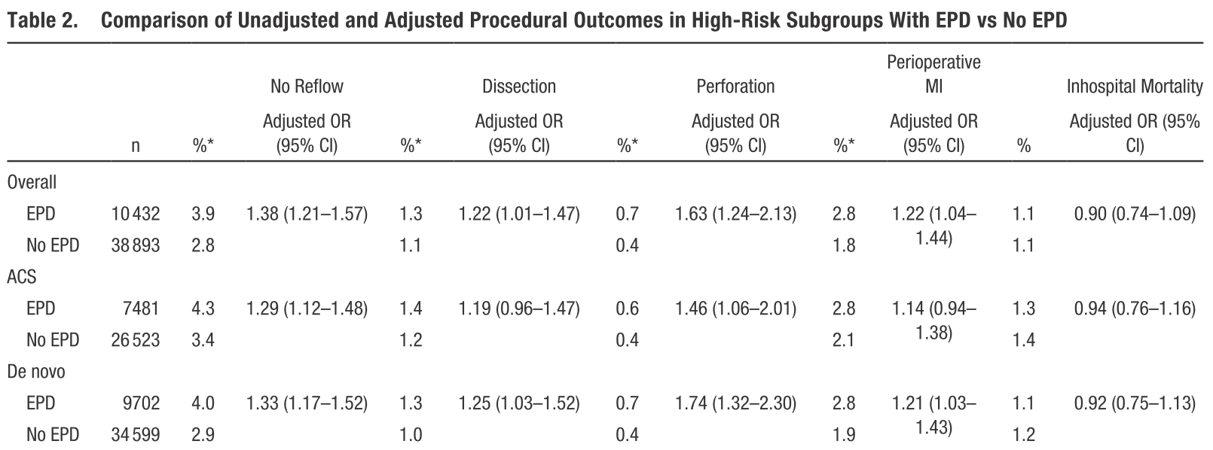
Procedural Outcomes

Slide 16
NCDR Cath PCI Registry Data
Complications Associated with EPD Use
EPD vs no-EPD
EPDs were associated with a slightly higher incidence of procedural complications
No reflow EPD vs no EPD 3.9% vs 2.8%; P<0.001
Vessel dissection (1.3% vs 1.1%; P=0.05)
Perforation (0.7% vs 0.4%; P=0.001)
Peri-procedural MI (2.8% vs 1.8%; P<0.001)

Slide 17
Conclusion
In this contemporary cohort, EPDs were used more commonly among patients with high-risk clinical indications.
Yet, there was no evidence of improved acute or long-term outcomes in routine EPD use.

Slide 18
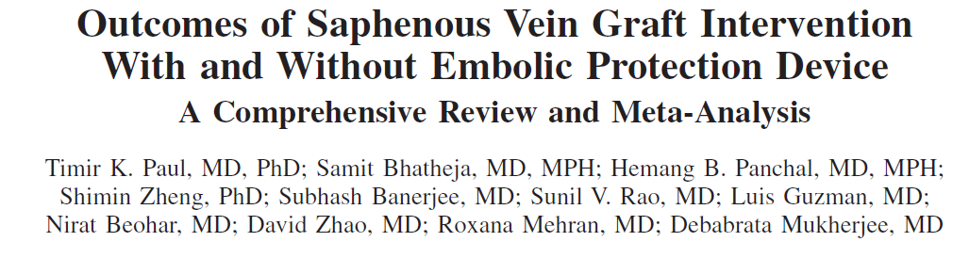
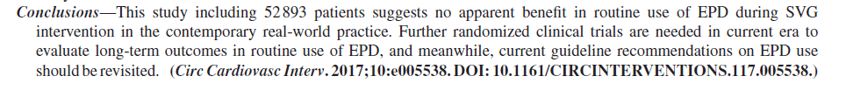
Paul TK et al. Circ Cardiovasc Interv. 2017;10:e005538

Slide 19
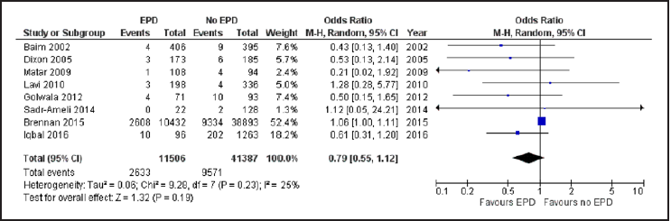
All-cause Mortality
Paul TK et al. Circ Cardiovasc Interv. 2017;10:e005538

Slide 20
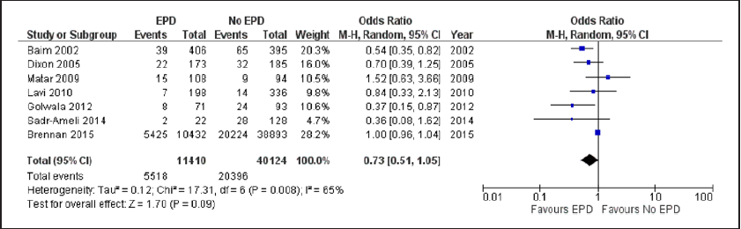
MACE
Paul TK et al. Circ Cardiovasc Interv. 2017;10:e005538

Slide 21
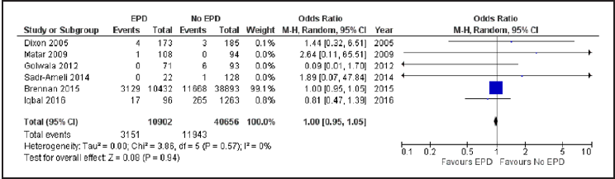
TVR
Paul TK et al. Circ Cardiovasc Interv. 2017;10:e005538

Slide 22
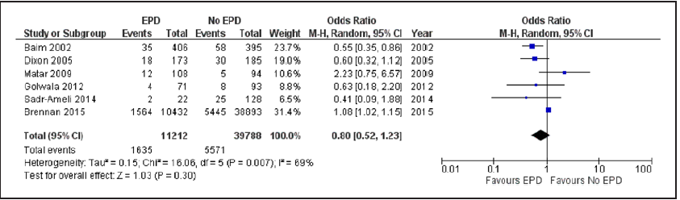
Late MI
Paul TK et al. Circ Cardiovasc Interv. 2017;10:e005538

Slide 23
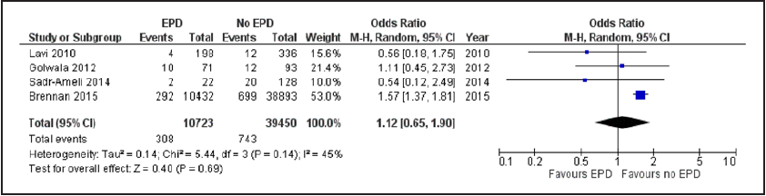
Peri-Procedural MI
Paul TK et al. Circ Cardiovasc Interv. 2017;10:e005538

Slide 24
Conclusion
The results of this study including 52,893 patients suggest that routine use of EPD during SVG PCI is not associated with a reduction in all-cause mortality, MACE, MI, or TVR.
Contrary to the expected benefit of the use of EPD, it was associated with 1.5-fold higher peri-procedural MI.
This study supports the need for re-evaluation of current guideline recommendations on EPD use during SVG PCI in the current era.
Paul TK et al. Circ Cardiovasc Interv. 2017;10:e005538

Slide 26
ESC 2018 Guidelines on Myocardial Revascularization

Slide 27
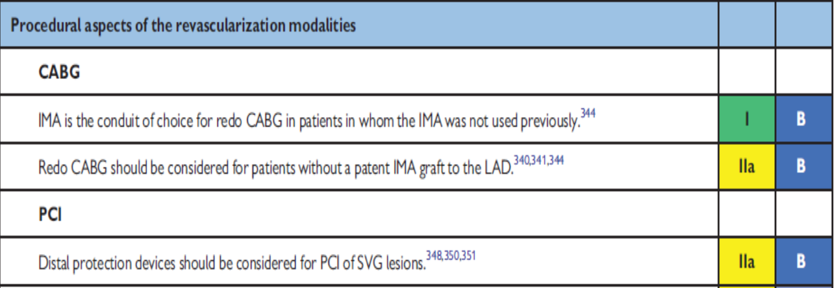
ESC 2018 Guidelines on Myocardial Revascularization

Slide 28
Technical Limitations Related to EPD use
Unsuitable anatomy for distal EPD
Aorto-ostial lesions
Lesions within 2.5 cm of distal anastomosis
Vessel diameter < 3.5 mm and > 5.5 mm
Less than 2 cm of straight vessel distal to lesions
Smaller distal vessel
Severe stenosis
Tortuous anatomy

Slide 29
Technical Issues Related to EPD use
Distal EPD can not be used in 42%-57% of SVG lesions
Despite Class I indication, overall EPD use in NCDR Cath-PCI Registry was 21.2%
Regardless of EPD use, MACE occurs in ~10% of the patients undergoing SVG PCI across studies
Brennan JM et al. Circ Cardiovasc Interv 2015;8(3):e
Mehta SK et al. Am J Cardiol 2007;100:1114-8
Mathew V et al. Catheter Cardivasc Interv 2004;63:148-151

Slide 30
Options to Minimize No-reflow in SVG-PCI Without EPD
Dual Antiplatelet (preloading)
Keep ACT high
Aggressive vasodilators (Nicardipine, Verapamil, nitropruside, adenosine)
Direct stenting
Slow and prolong inflation of stent
Stent undersizing
Higher stent/lesion length ratio
Notes:
Peri-procedural vasodilator therapy

Slide 31
Summary
A single randomized trial published in 2002 showed improved 30-day MACE when EPDs were used in SVG-PCI.
Other studies suggest no apparent benefits in routine use of EPDs in SVG-PCI in the contemporary real world practice.
Notes:
Current practice indicate that overall EPD use in SVG PCI is 21%.

Slide 32
Summary
There was no difference in MACE, death, MI and repeat revascularization at 3 year follow up in NCDR Cath PCI registry.
EPDs were associated with a slightly higher incidence of procedural complications including peri-procedural MI.
A recent comprehensive meta-analysis results showed no difference in MACE, mortality, MI and TVR.

Slide 33
Summary
2018 ESC guidelines downgraded EPD use in SVG-PCI to Class IIa.
ACC/AHA guideline recommendations should be reassessed for the use of EPDs in SVG PCI and downgraded to class IIa.
Use of EPD still be needed in high risk selected SVG -PCI.
A contemporary EPD trial would be considered with the advent of new technologies, and newer pharmacotherapies.
Notes:
Potent pharmacotherapies

Slide 34
Thank You pault@etsu.edu

