Slide 1


Transcatheter Aortic Valve Replacement for Patients with Severe Aortic Stenosis who are at Low Risk For Mortality: Interim results from the Prospective Multicenter LRT Clinical Trial
Ron Waksman, MD, on behalf of the LRT Investigators
Professor of Medicine, (Cardiology) Georgetown University
Director, Cardiovascular Research Advanced Education,
MedStar Heart & Vascular Institute, Washington DC

Slide 2

Disclosures
Within the past 12 months, I or my spouse/partner have had a financial interest/arrangement or affiliation with the organization(s):
Boston Scientific
Biotronik
Biosensors
Astra Zeneca
Medtronic Vascular
Abbott Vascular
Symetis
Med Alliance
LifeTech
Amgen
LRT was not supported by outside funding and enrolling sites self-funded all research activities

Slide 3
TAVR in Low-Risk Patients
TAVR is now the preferred therapy in AS patients
  Inoperable
  High-risk
  intermediate-risk
Secondary benefits associated with TAVR
  Reduced ICU and hospital LOS
  More rapid QOL recovery
  Lower frequency of AKI, bleeding, and post-operative AF
  Improved valve hemodynamics
TAVR is now being studied in low-risk AS patients in 3 under IDE in the USA

Slide 4
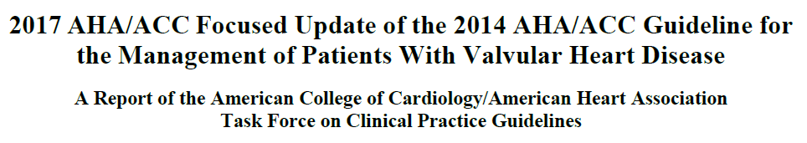
TAVR Guidelines 2018
The “New” AHA/ACC Focused Update
Severe AS Symptomatic
Surgical Risk Strata
Low
Intermediate
High
Prohibitive
TAVR FDA approved indications
SAVR
SAVR or TAVR
SAVR or TAVR
TAVR
IB
IIa B
IA
IA

Slide 5
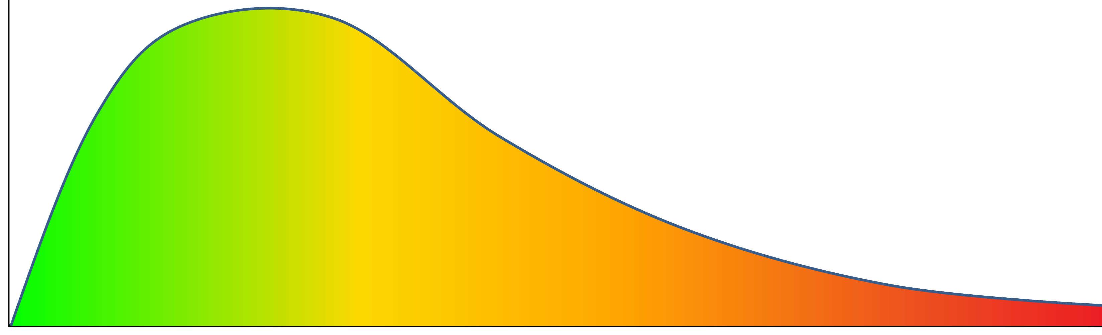
Background
Number of patients
Low
STS <3%
Intermediate
STS 3-8%
High
STS 8-15%
Extreme
STS >15%
FDA approved indications

Slide 6
LRT Study objective
To assess the safety and feasibility of Transcatheter Aortic Valve Replacement (TAVR) with commercially available valves in patients with symptomatic severe aortic stenosis who are low risk (STS score ≤3%) for SAVR

Slide 7
Low Risk TAVR (LRT Trial) Investigator-Sponsored Study
First in the USA under IDE to study low-risk pts with AS undergoing TAVR
Objective: | To assess safety and feasibility of commercially available TAVR devices in patients with symptomatic severe AS at low risk for SAVR (STS ≤3%)
Primary Endpoint: | All cause mortality at 30 days
Secondary outcomes: | Composite of major adverse events at 30 days Safety and efficacy (NYHA), echocardiographic outcomes HALT evaluation by CT or Echo at 30 days
Design: | Prospective, multicenter, registry, propensity matched to STS database for isolated SAVR
Enrollment period: | TAVR: January 2016 – February 2018
NCT02628899

Slide 8
LRT Study Design
Low Surgical Risk STS ≤ 3
1:1 Matched SAVR Patients
Bicuspid aortic valve
Heart Team Evaluation
-Eligible for transfemoral TAVR
-No high-risk surgical criteria independent of STS score
Propensity matched based on likelihood to receive TAVR or SAVR
- Low surgical risk
- Eligible for transfemoral TAVR
Outcomes extracted from STS for mortality through 30 days from the STS data
100 TAVR patients
Transfemoral TAVR
200 patients

Slide 9
Trial Administration
National Principal Investigators
Ron Waksman, MD, FACC, FSCAI (Interventional Cardiology)
Paul Corso, MD, FACS, FACC (Cardiothoracic Surgery)
MedStar Cardiovascular Research Network
Director of Clinical Research Operations
Rebecca Torguson, MPH
Project Manager
Roshni S. Bastian, MPH
Case Review Committee
Interventional Cardiology
Itsik Ben-Dor, MD
Lowell Satler, MD
Toby Rogers, MD, PhD
Kyle Buchanan, MD
Cardiothoracic Surgery
Paul Corso, MD
Christian Shults, MD
Core Laboratories
Director Echo Core Lab
Federico Asch, MD
Director CT Core Lab
Gaby Weissman, MD
Data Monitoring
Michael Astatkie
Independent Clinical Events Committee
Chairman
Hector Garcia-Garcia, MD
Database Technology
Director
Alan Monath
Data & Safety Monitoring Board
Chairman
William Weintraub, MD

Slide 10
Enrolling sites
Site | PI’s | Site Coordinators | Location
MedStar Washington Hospital Center | Ron Waksman, MD Paul Corso, MD | Michelle Deville, RN, Sosy Tartarian Petros Okubagzi, MD | Washington, DC
Miriam Hospital | Paul Gordon, MD Afshin Ehsan, MD | Elizabeth Coccio, RN | Providence, RI
Stony Brook Hospital | Puja Parikh, MD Henry J. Tannous, MD | Ruth Stein Tenzler, RN Hamad Kaif | Stony Brook, NY
Maine Medical Center | David Butzel, MD Scott Buchanan, MD | Susan Bosworth-Farrell, RN | Portland, ME
Henrico Doctors’ Hospital | Robert Levitt, MD Chiwon Hahn, MD | Kyle Narron | Richmond, VA
Foundation for Cardiovascular Medicine | Maurice Buchbinder, MD Ricardo Moreno, MD | Diane Wilkerson, RN | San Diego, CA
Sutter Health System | David Roberts, MD Michael Ingram, MD | Wynell Richardson | Sacramento, CA
St. John Medical Center | Nicholas Hanna, MD Robert Garrett, MD | Stacie Merritt, RN | Tulsa, OK
WellStar Health System | Amar Patel, MD William Cooper, MD | Barbara Ann Foster, RN | Marietta, GA
VCU Medical Center | Zachary Gertz, MD Mohammed Quader, MD | Melissa Sears, RN | Richmond, VA
Valley Hospital | John A. Goncalves, MD Sean R. Wilson, MD | Kimberly Michel, RN | Ridgewood, NJ

Slide 11

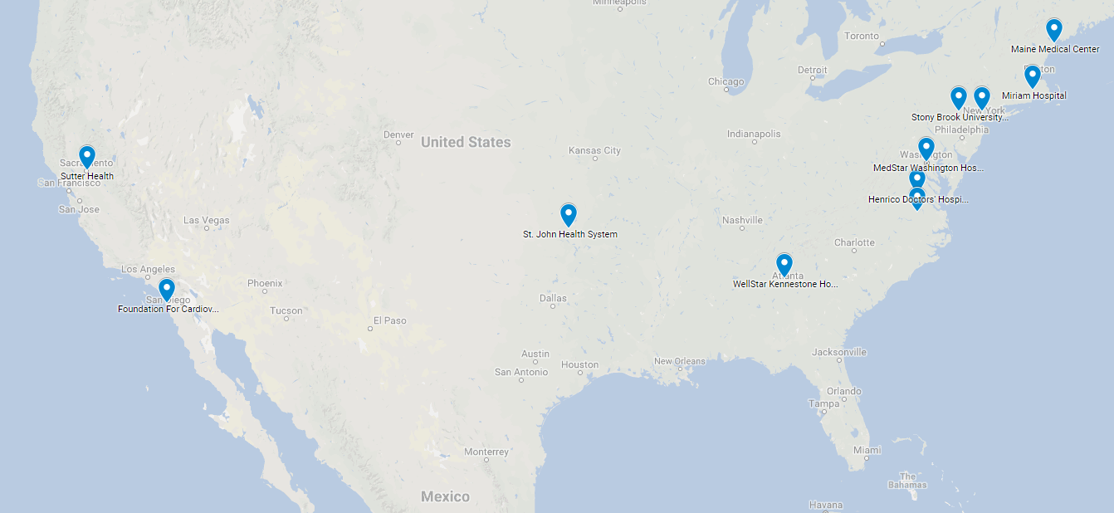
Where We Enrolled Patients
Valley Hospital
VCU Medical Center

Slide 12
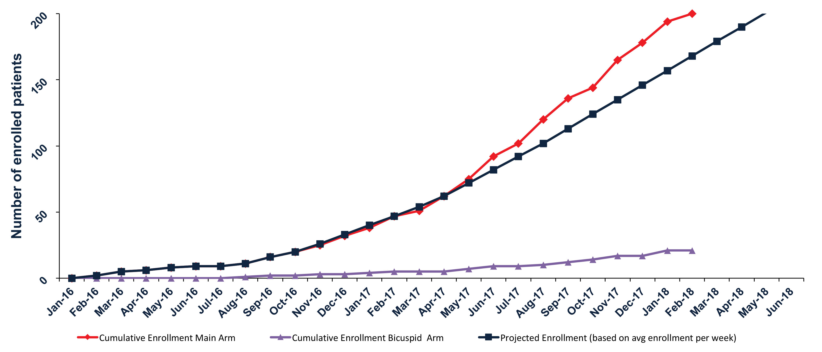
Enrollment timeline
Enrollment Complete February 2018
11 enrolling sites

Slide 13
Key Enrollment Criteria
Main inclusion criteria
Symptomatic severe aortic stenosis
Low risk according to the multidisciplinary Heart Team
STS PROM ≤ 3%
Suitable for transfemoral access with commercial TAVR device
Life expectancy ≥ 1 year
Main exclusion criteria
Frailty
Severe CAD
Severe other valve disease
Prior heart surgery
Recent stroke or MI
Severe lung disease
Severe renal failure
Porcelain Aorta
Severe Disease not captured in STS
Alternative access to femoral

Slide 14
Interim Analysis
First 125 patients Enrolled in the study
From 311 patients screened patients enrolled in the study
N=221
Excluded n=90
Not low risk n=33
Stenosis not severe n=10
Transfemoral access not feasible n=8
Other n=39
Heart Team & Clinical Review Committee
Main study arm
n=200
Bicuspid arm
n=21
Main study arm
n=125
30 day follow up
Interim results n=125
Due to the high interest in the low risk population with severe AS
undergoing TAVR and complete enrollment of the tricuspid arm,
we report here the result of the first 125 patients enrolled into the study.

Slide 15
Baseline Characteristics
Demographics | % (n) or mean ± SD
Age (years) | 74.6 ± 5.7
Male | 61.6% (77)
Baseline Characteristic | % (n) or mean ± SD
Hypertension | 84.0% (105)
Diabetes | 31.2% (39)
Hyperlipidemia | 81.6% (102)
Prior stroke or TIA | 10.4% (13)
Chronic renal insufficiency | 6.4% (8)
COPD, severe | 0.0% (0)
Atrial fibrillation or flutter | 18.4% (23)
PPM or ICD | 3.2% (4)
Peripheral vascular disease | 2.4% (3)
Prior PCI | 19.2% (24)
Prior MI | 4.8% (6)
Risk assessment | % (n) or mean ± SD
STS Score (%) | 1.9 ± 0.5
LV ejection fraction (%)* | 62.9 ± 8.5
FEV1 % | 87.1 ± 18.3
Grip Strength | 25.7 ± 9.1
6 Min Walk Test (m) | 361.4 ± 94.3
Katz Index | 5.9 ± 0.3
Porcelain aorta | 0.0% (0)
*Core lab adjudicated

Slide 16
TAVR procedure
 | % (n) or mean ± SD
General Anesthesia | 19.2% (24)
Conscious Sedation | 80.8% (101)
Transfemoral Access | 100% (125)
Pre-dilatation | 79.1% (102)
Rapid Pacing | 94.9% (122)
Fluoroscopy Time (min) | 15.8 ± 7.7
Post-dilatation | 19.4% (25)
Need for second valve | 3.2% (4)
 | % (n)
Edwards Sapien 3 | 87.2% (109)
20mm | 4.0% (5)
23mm | 21.6% (27)
26mm | 49.6% (62)
29mm | 12.0% (15)
Medtronic CoreValve, Evolut R or PRO | 12.8% (16)
23mm | 0.0% (0)
26mm | 1.6% (2)
29mm | 7.2% (9)
31mm | 1.6% (2)
34mm | 2.4% (3)

Slide 17
Primary endpoint
Zero mortality at 30 days

Slide 18
Secondary Outcomes in Hospital and 30 Days
Outcome, % | In Hospital n=125 | 30 days n=125
Death, any cause | 0% | 0%
Bleeding, Life-threatening or Major | 3.2% | 0.8%
Paravalvular leak (≥ moderate) | 0.8% | 0%
Vascular Complication, Major | 3.2% | 0.8%
Acute kidney injury (stage II+III) | 0% | 0%
Disabling Stroke | 0% | 0%
Non-disabling Stoke | 0% | 0.8%
TIA | 0% | 0%
Myocardial infarction | 0% | 0%
Coronary Obstruction* | 0.8% | 0%
Atrial fibrillation, New Onset | 3.2% | 1.6%
Pacemaker | 4.0% | 0.8%
*required CABG

Slide 19
NYHA class

Slide 20
Hemodynamics*
46.2 ±11.4
1.81 ± 0.50
0.76 ± 0.20
13.5 ± 5.0
12.3 ± 4.4
*Core lab adjudicated

Slide 21
Total aortic regurgitation*
*Core lab adjudicated

Slide 22
Adverse events thru 30 days
 | LRT | NOTION | PARTNER 2 | SURTAVI | SAPIEN 3 IR
Type of transcatheter valve | Edwards Sapien 3, Medtronic Evolut R or Evolut PRO | Medtronic CoreValve | Edwards Sapien XT | Medtronic CoreValve or Evolut R | Edwards Sapien 3
 | N=125 | N=145 | N=1011 | N=864 | N=1077
Age (years) | 74.6 ± 5.7 | 79.2 ± 4.9 | 81.5 ± 6.7 | 79.9 ± 6.2 | 81.9 ± 6.6
STS score (%) | 1.9 ± 0.5 | 2.9 ± 1.6 | 5.8 ± 2.1 | 4.4 ± 1.5 | 5.2 (4.3–6.3)
All-cause mortality | 0.0% | 2.1% | 3.9% | 2.2% | 1.1%
Disabling stroke | 0.0% | 1.4% | 3.2% | 1.2% | 1.0%
Paravalvular leak (≥ moderate) | 0.0% | 15.3%‡ | 3.7% | 3.5%* | 3.8%
Major vascular complications | 4.0% | 5.6% | 7.9% | 6.0% | 6.1%
Major and life-threatening bleeding | 4.0% | 11.3% | 10.4% | 12.2% | 4.6%
New PPM implantation | 4.8% | 34.1% | 8.5% | 25.9% | 10.2%
* Endpoint at hospital discharge ‡ Endpoint at 3 months

Slide 23
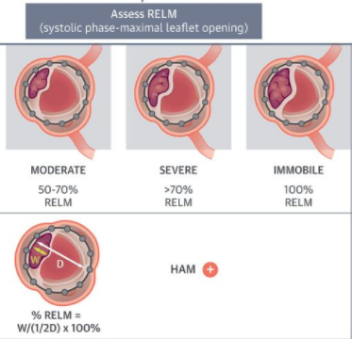
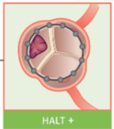
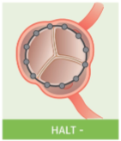
Sub-Clinical Leaflet Thrombosis
HALT: Hypo-Attenuating Leaflet Thickening
RELM: Reduced Leaflet Motion
HAM: Hypo-Attenuation affecting Motion
Any HALT + ≥ Moderate RELM = + HAM
Jilaihawi, H. et al. J Am Coll Cardiol Img. 2017;10(4):461-70

Slide 24
Subclinical leaflet thrombosis*
4D contrast enhanced CT or TEE at 30 days
4 patients did not undergo CT or TEE at 30 days
1 patient’s CT was not interpretable
Hypo-Attenuating Leaflet Thickening (HALT)
12.5% (n=15/120)
CT not interpretable for RELM (n=2/15)
Reduced Leaflet Motion (RELM)
11.0% (n=13/118)
Only mild Reduced Leaflet Motion (RELM) (n=2/13)
Hypoattenuation Affecting Motion (HAM)
9.3% (n=11/118)
*Core lab adjudicated

Slide 25
Subclinical leaflet thrombosis and antiplatelet/anticoagulation therapy*
Antiplatelet therapy only
(aspirin, thienopyridine, or DAPT)
80.8% (n=97/120)
Oral anticoagulation any
(warfarin or novel oral anticoagulant)
17.5% (n=21/120)
No antiplatelet or anticoagulation
n=2/120
Hypo-Attenuating Leaflet Thickening (HALT)
14.4% (n=14/97)
Hypo-Attenuating Leaflet Thickening (HALT)
4.8% (n=1/21)
*Core lab adjudicated

Slide 26
LRT interim analysis Summary
TAVR in low risk patients
No mortality at 30 days
No disabling stroke at 30 days
Low rates of major adverse events at 30 days
Excellent valve hemodynamics
Subclinical leaflet thrombosis
Present in low risk patients
Higher incidence with antiplatelet therapy than anticoagulation
Not associated with clinical events at 30 days

Slide 27
Conclusions
1. TAVR appears to be safe and feasible in low risk patients in the short term
2. Follow up is required to evaluate long term outcomes of TAVR in low risk patients
3. Subclinical leaflet thrombosis is present in low risk TAVR patients at 30 days but long term clinical impact is unknown
4. Full results with propensity score matched SAVR comparison will be available in the Fall of 2018

Slide 28
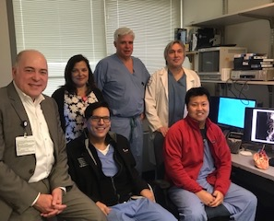
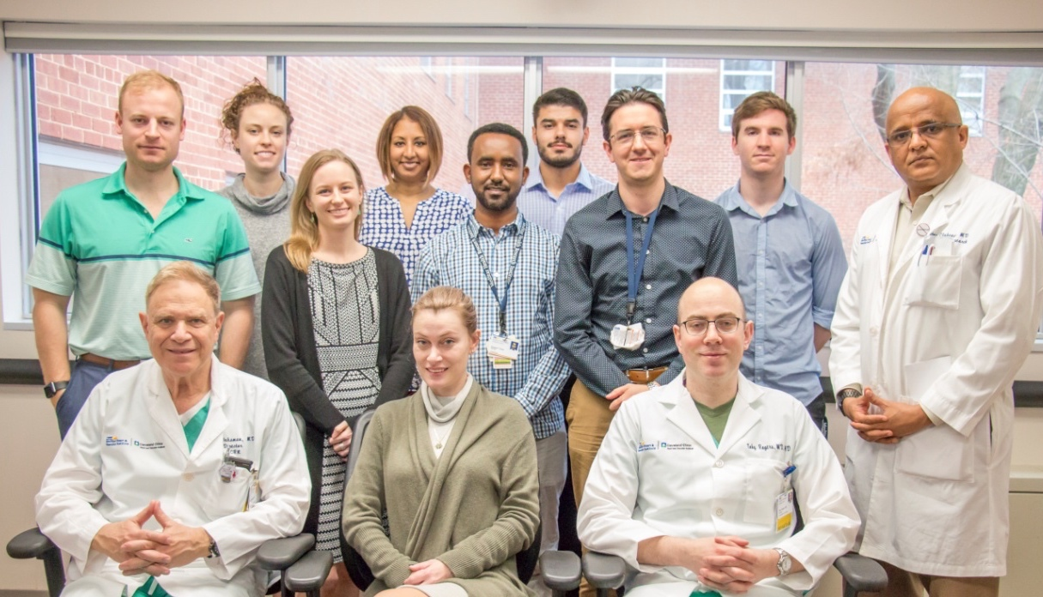
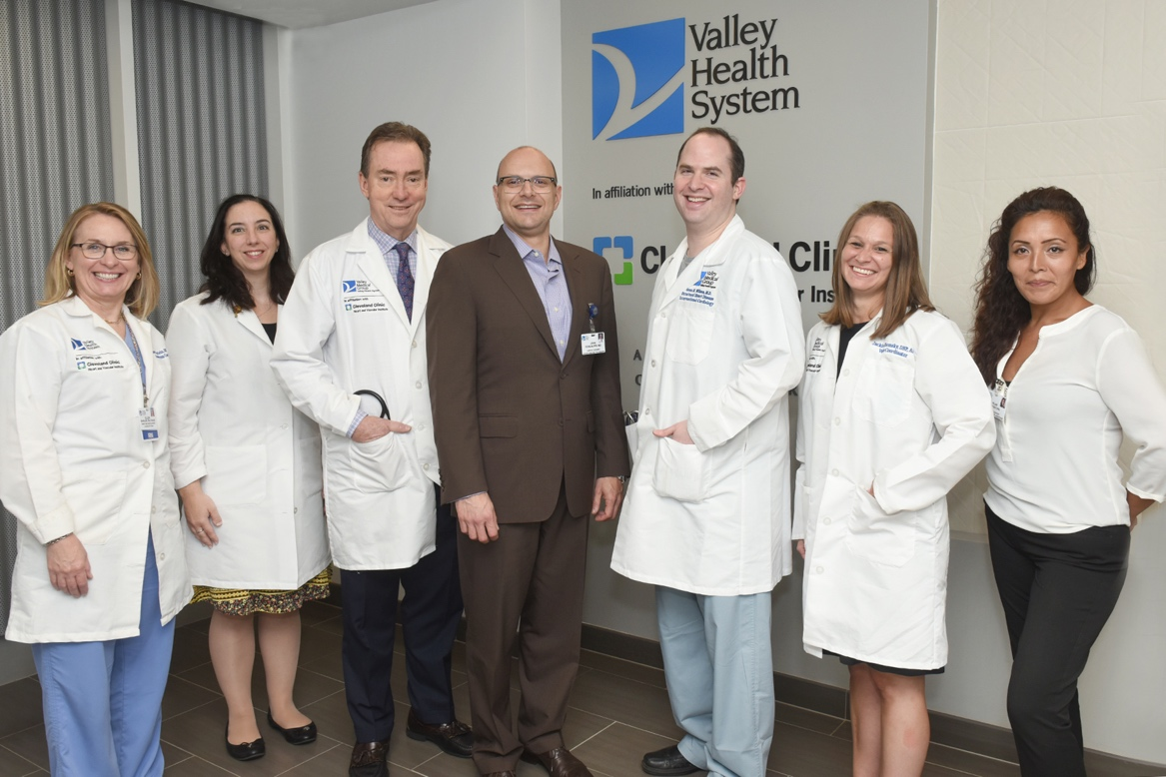

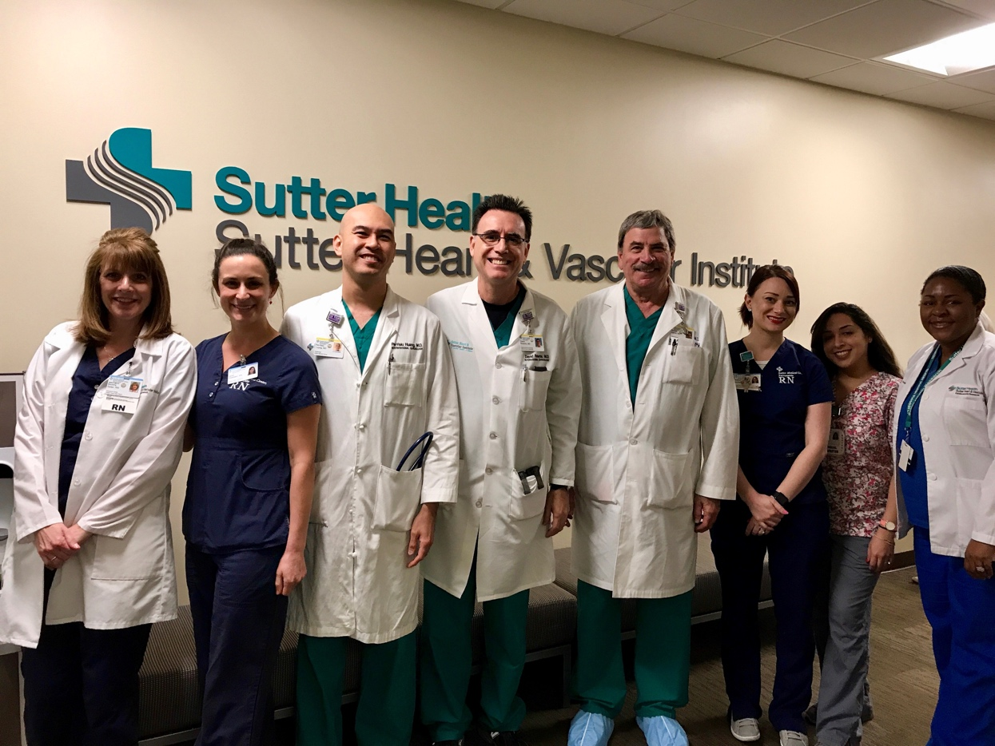
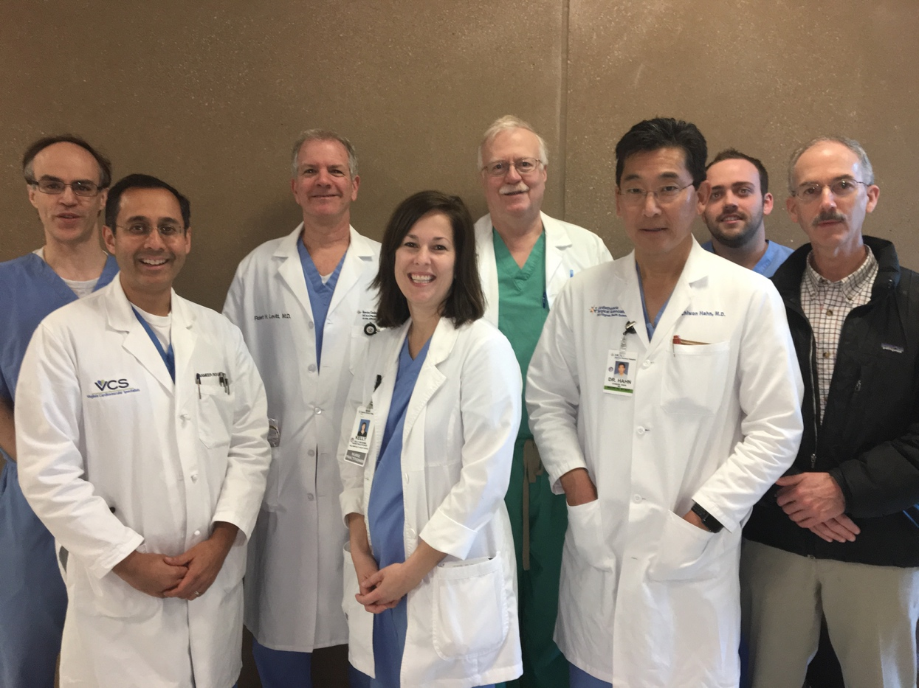

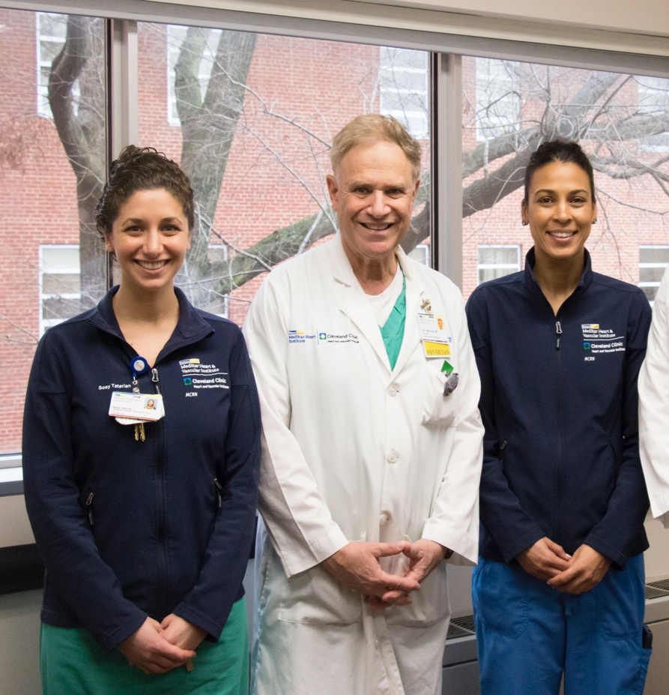
Thank you to all of the LRT patients, site personnel, and investigators who made this trial possible

