Slide 1
Screening For Peripartum Cardiomyopathies Using An AI-Enhanced Digital Stethoscope: A Randomized Clinical Trial NCT05438576

Slide 2
DISCLOSURES

Slide 3
BACKGROUND

Slide 4
BACKGROUND

Slide 5
U.S Maternal mortality Events per 100,000 live births

Slide 6
methods

Slide 7
methods

Slide 9
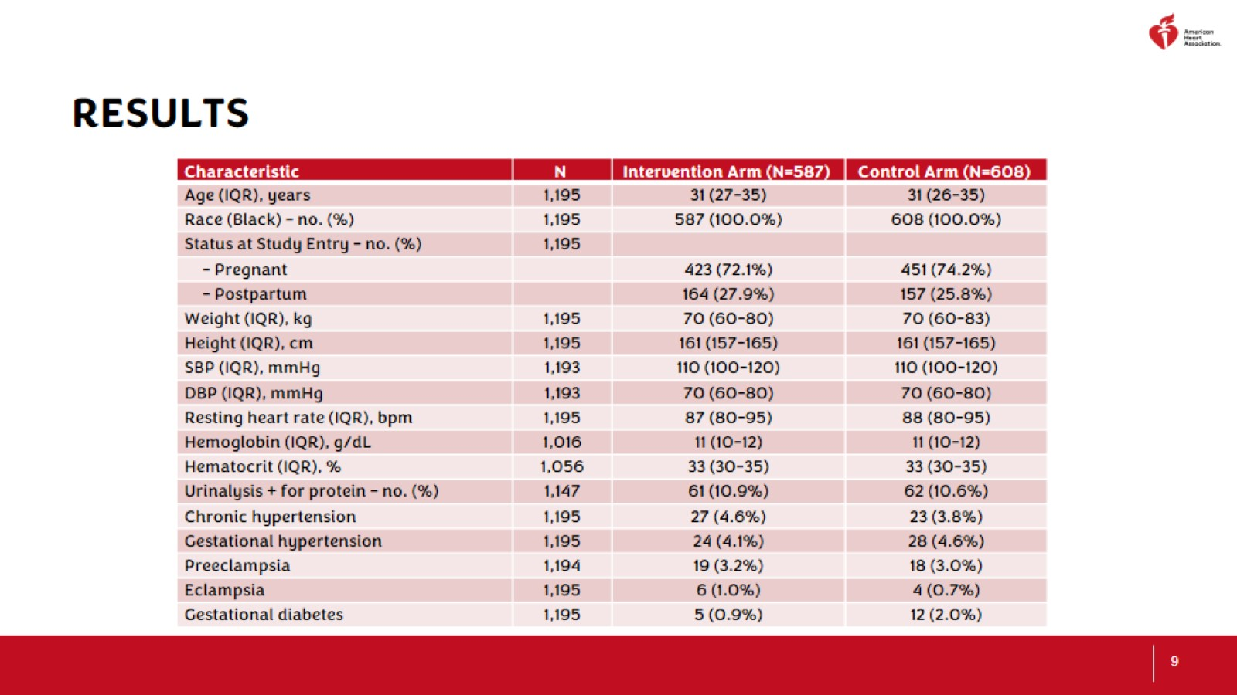

Slide 13
STRENGTHS

Slide 14
LIMITATIONS

Slide 15
conclusion

Slide 16
Thanks to our Study team

Slide 17
THANK YOU

Slide 18
EXTRA SLIDES

Slide 19
Digital stethoscope images

Slide 20
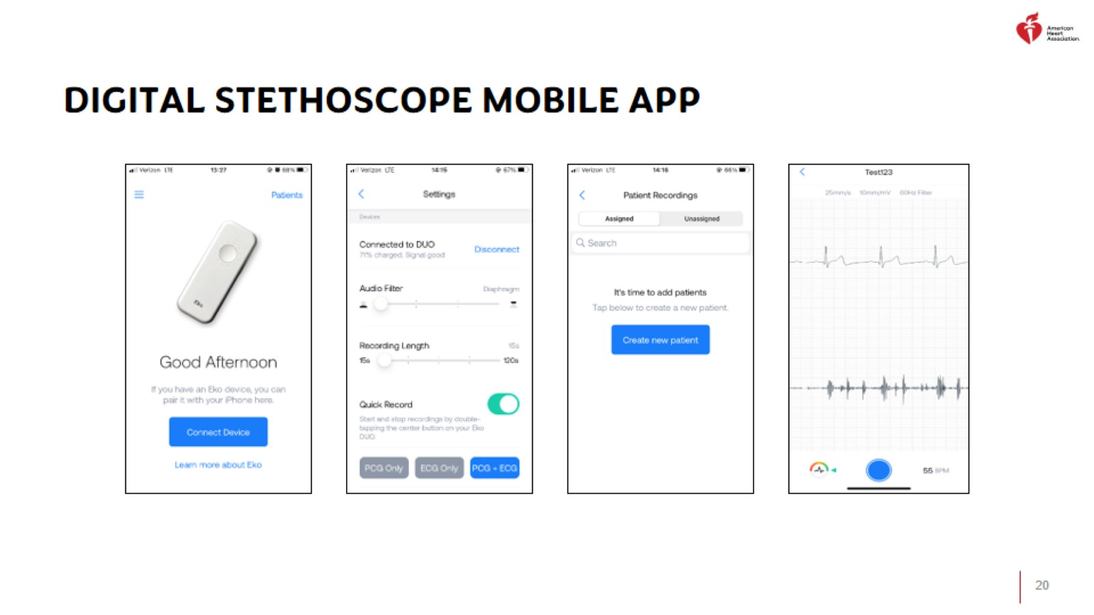
Digital stethoscope mobile app

Slide 21
Digital stethoscope mobile app

Slide 22
Digital stethoscope mobile app

Slide 23
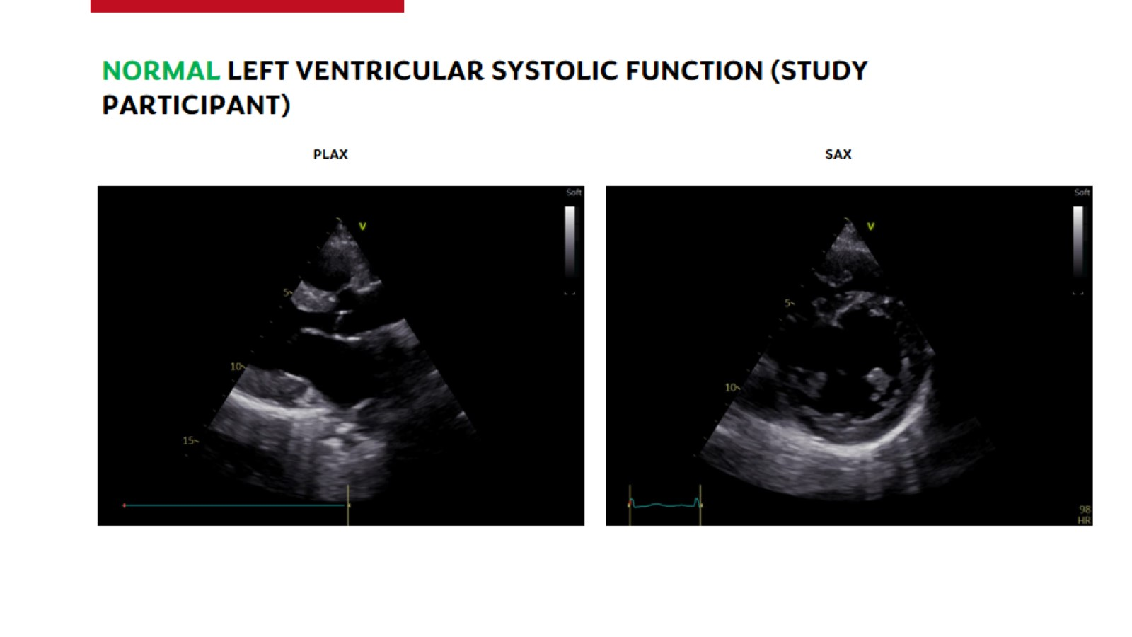
Normal Left ventricular systolic function (STUDY PARTICIPANT)

Slide 24
low Left ventricular systolic function (STUDY PARTICIPANT)

