Slide 1
TCT 2016, Washington convention center
October 30th 2016, 8:30 am-
Room 159 Level 1
Late breaking clinical trial and First report investigations Press Conf.1
ABSORB II: Three-year Clinical Outcomes from a Prospective, Randomized Trial of an Everolimus-Eluting Bioresorbable Vascular Scaffold vs. an Everolimus-Eluting Metallic Stent in Patients with Coronary Artery Disease
Patrick W. Serruys MD. PhD.¹
Bernard Chevalier MD.²
Yoshinobu Onuma MD. PhD.³
on behalf of ABSORB II investigators
1. NHLI, Imperial College London, London, United Kingdom,
2. Institut Jacques Cartier, Massy, France
3. Cardialysis, Rotterdam, the Netherlands / Erasmus university

Slide 2
Disclosure Statement of Financial Interest
Within the past 12 months, I or my spouse/partner have had a financial interest/arrangement or affiliation with the organization(s) listed below.
Affiliation/Financial Relationship
Company
Grant/Research Support
Consulting Fees/Honoraria
Abbott
AstraZeneca
Biotronik
Boston scientific
Cardialysis
GLG Research
Medtronic
Sinomedical Sciences Technology
Société Europa Digital Publishing,
Stentys France
Svelte Medical Systems
Volcano
Qualimed
St. Jude Medical

Slide 3
ABSORB II Study Design
501 subjects
Randomized 2:1 Absorb BVS:XIENCE / 46 sites (Europe and New Zealand)
Clinical Follow-Up
30d
6m
12m
24m
36m
48m
60m
QoL follow-up
Angio, IVUS follow-up
MSCT follow-up (Absorb arm only)*
Study Objective | Randomized against XIENCE control. First Patient In: 28-Nov-2011
Co-primary Endpoints 36 months | Vasomotion assessed by change in Mean Lumen Diameter between pre- and post-nitrate at 3 years (superiority) Minimum Lumen Diameter (MLD) at 3 years post nitrate minus MLD post procedure post nitrate (non-inferiority, reflex to superiority)
Treatment | Up to 2 de novo lesions in different epicardial vessels Planned overlapping allowed in lesions ≤ 48 mm
Device Sizes | Device diameters: 2.5, 3.0, 3.5 mm Device lengths: 12 (3.5 mm diameter only), 18, 28 mm
The ABSORB II study is sponsored by Abbott Vascular

Slide 4
Co-primary endpoint: in-device vasomotion in ABSORB II
Cumulative frequency distribution curves of vasomotion at 3 years
Change in mean lumen diameter
Result will be discussed in details
in the following session:
Room 207, level 2 Monday Oct. 31, 2:45-2:53 pm
“BVS at the Cusp of Complete Bioresorption: MLD and Vasomotion at 3-years in Absorb and Xience from the ABSORB II”
Absorb | n=258 | 0.047±0.109 mm
XIENCE | n=130 | 0.056±0.117 mm
Cumulative frequency
P_{superiority} = 0.49
Vasomotion (mm)

Slide 5
Co-primary endpoint: angiographic late luminal loss
Cumulative frequency distribution curves of late luminal loss at 3 years
Acute ScT (n=1)
Subacute ScT (n=1)
Late ScT (n=1)
NI Margin
Very Late ScT (n=6)
Cumulative frequency
XIENCE | n=151 | 0.250±0.250 mm
0.12
Absorb | n=298 | 0.371±0.449 mm
95%CI (0.06 – 0.19)
P _{non-inferiority} = 0.78
P _{non-inferiority} = 0.78
P _{for difference} = 0.0003
0
0.14
Late luminal loss (in-stent/scaffold) (mm)

Slide 6
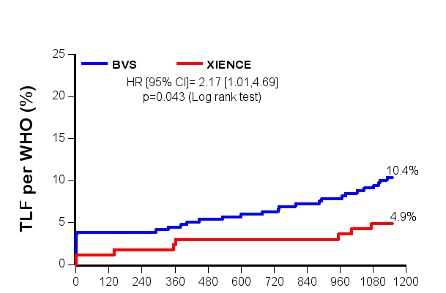
Kaplan Meier curves for Device- and Patient- oriented composite endpoints (DOCE and POCE)
Cardiac death
TV-MI
CI-TLR
All-cause death
Any-MI
Any revascularization
DOCE
POCE
24.0%
25
25
Absorb
Xience
Absorb
Xience
20
HR [95% CI]
2.17 [1.01, 4.69]
p=0.043
20
HR [95% CI]
0.86 [0.58, 1.27]
p=0.44
15
10.4%
15
Device oriented clinical endpoint (%)
Patient oriented clinical endpoint (%)
20.8%
10
10
4.9%
5
5
0
0
Time to event (days)
Time to event (days)
Three-year protocol mandated imaging triggered subsequent revascularizations, clinically indicated or not.

Slide 7
Exercise test
 | Absorb 335 patients | Xience 166 patients | p value
Participated in exercise test | 71·3% | 72·3% | 0·83
Patient without prior repeat revascularization | 60·6% | 56·0% | 0·33
Maximum heart rate (bpm) | 131·0 | 136·2 | 0·054
Peak systolic blood pressure (mmHg) | 178·1 | 181·9 | 0·30
Exercise duration (min) | 8·57 | 9·23 | 0·11
≥ 0.1 mV ST depression or chest pain | 17·3% | 11·8% | 0·23
Antianginal medication
Beta blocker | 69·5% | 65·9% | 0·55
Calcium channel blocker | 23·6% | 24·2% | 0·92
Nitrate | 18·7% | 26·4% | 0·14

Slide 8
Seattle Angina Questionnaire
angina stability, frequency, physical limitation, disease perception, and treatment satisfaction (Compliance in answering SAQ: 93% for both arms at 3 years)
Absorb
Xience

Slide 9
Conclusions 1/2
The data presented in our report are the first randomized data published after a period of observation of 3 years.
The trial did not meet its mechanistic co-primary endpoints of superior vasomotor reactivity because Xience showed unexpected vasomotion which had been hypothesised to be zero.
The trial did not meet its co-primary endpoints of non-inferior late luminal loss with respect to Xience that was found to have lower late luminal loss than Absorb.
Serial intravascular ultrasound follow-up showed a significant difference between the stable mean lumen area of Absorb as opposed to a significant loss in mean lumen area for Xience.

Slide 10
Conclusions 2/2
A higher rate of device oriented composite endpoint due to target vessel myocardial infarction largely driven by peri-procedural myocardial infarction was observed in the Absorb arm.
The incidence of very late scaffold thrombosis is a signal that warrants further careful monitoring of the patient having a clinical follow-up of longer than 2 years.
The patient oriented composite endpoint, exercise testing and anginal status (compliance: 93%) were not statistically different between both devices at 3 years with treatment satisfaction of >90% in both arms.

