Slide 1
TAVI-PM
Post-mortem observation study of TAVI
Mahir Karakas University Heart Center Hamburg
Late breaking TAVI registries

Slide 2
Conflicts of Interest
Member of the Drug Commission of the German Medical Association
Member of the Ethics Committee Hamburg/ Germany
Research grants: Vifor Pharma
Previous honoraria: Amgen, Astra-Zeneca, Novartis, Sanofi-Aventis, Vifor (2016-2018)

Slide 3
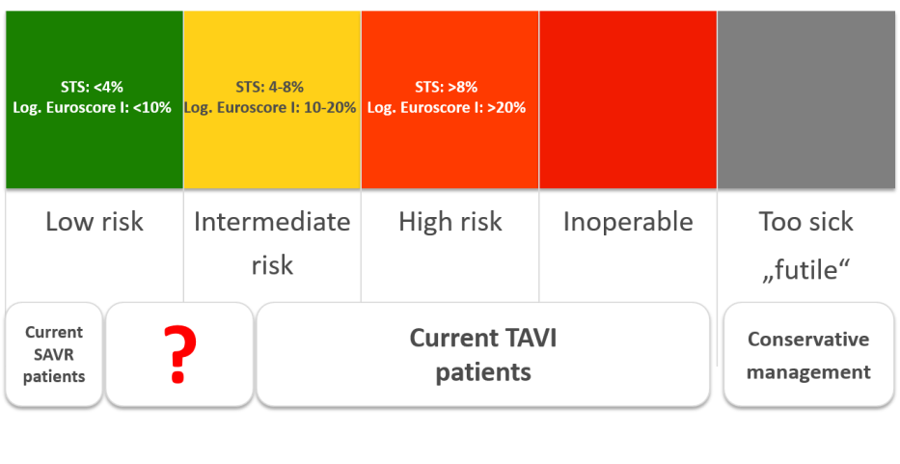
Background
TAVI proved benefit in subjects with severe and symptomatic aortic stenosis

Slide 4
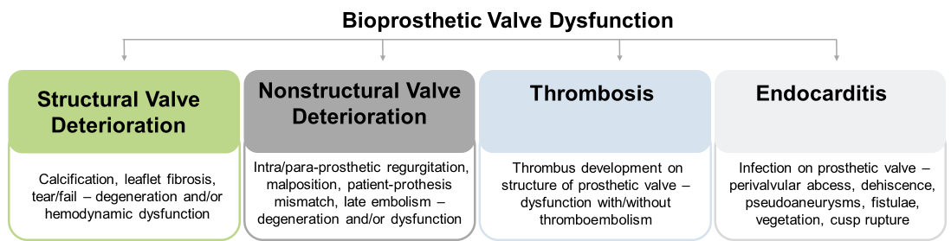
Background
Assessing long-term durability of TAVI/ SAVR – 2017 Consensus statement of EAPCI, ESC, EACTS
adapted from Eur Heart J 2017;38:3382-90

Slide 5
Objectives
To systematically explore TAVI prosthesis post mortem
To assess TAVI post mortem immunohistologically

Slide 6
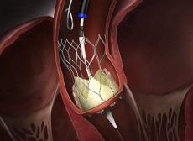
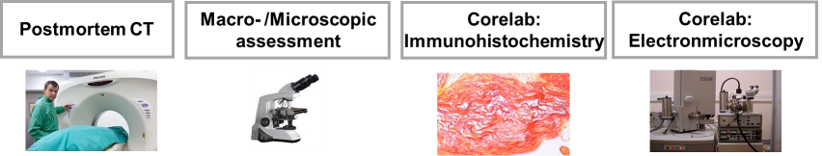
Overall study flow
451 TAVI patients (implanted 2007 – 2018) with informed consent for post-mortem, implanted or medically treated at our site
39 post mortem TAVIs examined so far

Slide 7
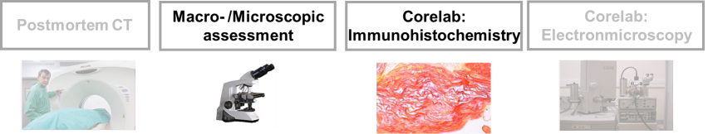
Overall study flow
451 TAVI patients (implanted 2007 – 2018) with informed consent for post-mortem, implanted or medically treated at our site
39 post mortem TAVIs examined so far

Slide 8
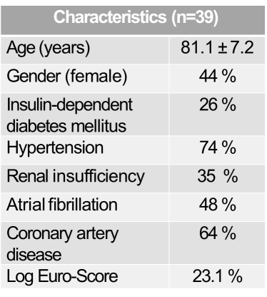
Preliminary results - Characteristics

Slide 9
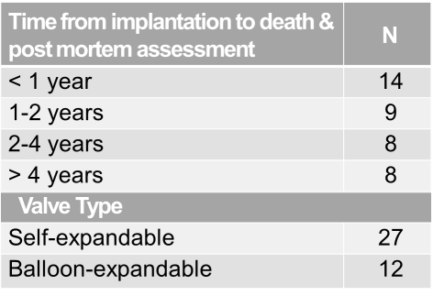
Preliminary results - Characteristics

Slide 10
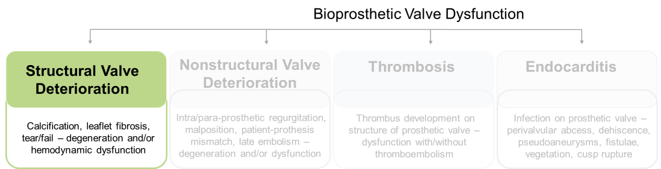
Preliminary results – Overview structural valve deterioration

Slide 11
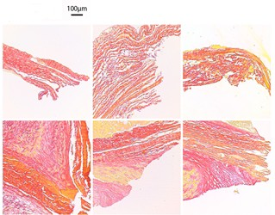
Preliminary results – structural valve deteriorations
TAVIs post-mortem: Immunohistochemistry
#1
#2
#3
#4
#5
#6
H&E (general morphology-fibrosis)

Slide 12
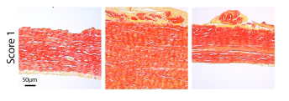
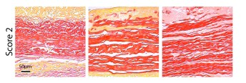
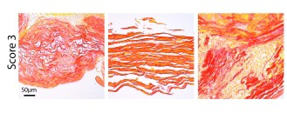
Preliminary results – Histological scoring (fragmentation/irregularity)
1 – no/low fragmentation 2 – low/high fragmentation 3 – high fragmentation

Slide 13
Preliminary results – Histological scoring (fragmentation/irregularity)
3
2
1 – no/low fragmentation 2 – low/high fragmentation 3 – high fragmentation
1
Apex
Base
Apex of leaflet
Base of leaflet
< 1 year
1-2 years
2-4 years
> 4 years

Slide 14
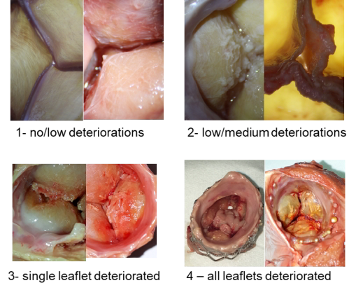
Preliminary results – structural valve deteriorations

Slide 15
Preliminary results – structural valve deteriorations
Macroscopic scoring deterioration (mean)
4
3
2
1
Apex
< 1 year
1-2 years
2-4 years
> 4 years

Slide 16
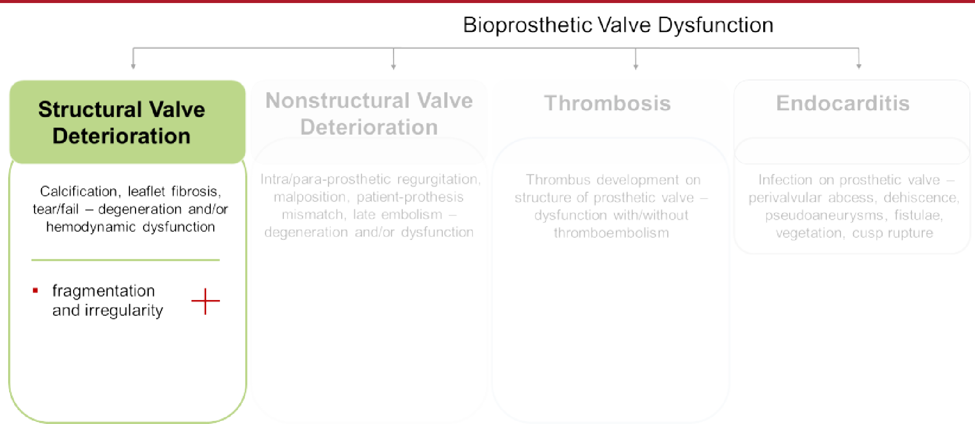
Preliminary results – Overview beyond structural valve deterioration

Slide 17
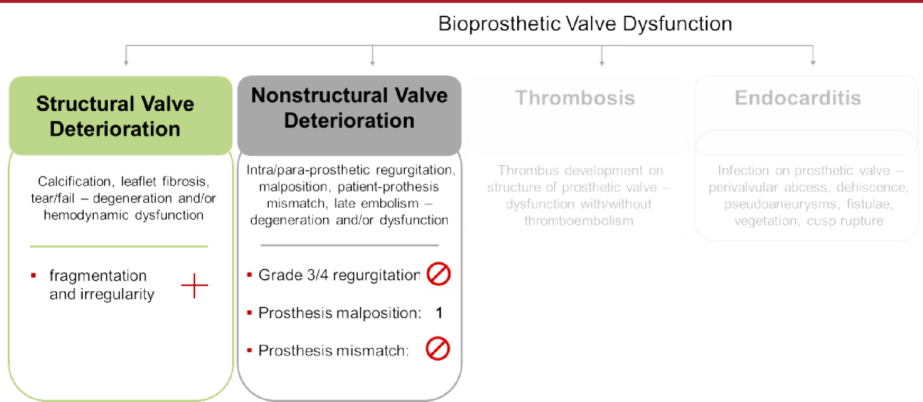
Preliminary results – Overview beyond structural valve deterioration

Slide 18
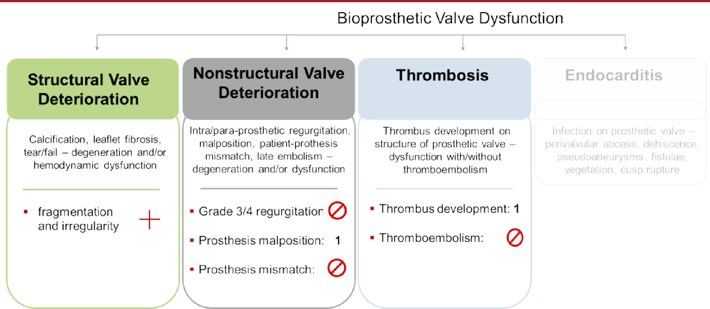
Preliminary results – Overview beyond structural valve deterioration

Slide 19
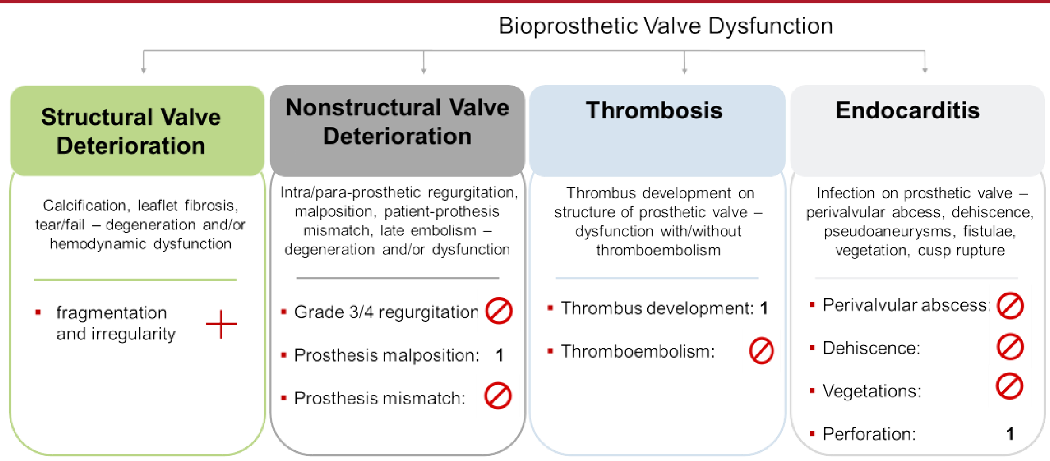
Preliminary results – Overview beyond structural valve deterioration

Slide 20
Limitations
Preliminary results and limited sample size
Hemodynamic relevance of deteriorations observed have yet to be assessed (post-mortem CT analyses and pulse-duplicator tests to follow)
Subanalyses to be performed (medication, inflammatory status)
Comparative analysis with surgical bioprosthetic valves on its way

Slide 21
Conclusion
TAVI valves show fragmentation and irregularity, confirming previous experimental in vitro reports, but this does not result in increased valve dysfunction
Possible correlation of morphological changes observed on clinical outcome remains unclear
Hemodynamic relevance of deterioration in bioprosthetic valves remains unclear
Further research, in particular comparative analyses with surgical bioprosthetic valves is needed

