Slide 1
FANTOM II: Six-Month Clinical and Angiographic Results With a Radiopaque Desaminotyrosine Polycarbonate-Based Sirolimus-Eluting Bioresorbable Vascular Scaffold in Patients With Coronary Artery Disease
FANTOM II
Dr. Alexandre Abizaid
Instituto Dante Pazzanese de Cardiologia
Sao Paulo, Brazil
On behalf of the FANTOM II investigators

Slide 2
Disclosure Statement of Financial Interest
Within the past 12 months, I or my spouse/partner have had a financial interest/arrangement or affiliation with the organization(s) listed below.
Affiliation/Financial Relationship
Company
Research Grants
Consulting Fees/Honoraria
Abbott Vascular
Boston Scientific
Elixir Medical
Medtronic
REVA Medical

Slide 3
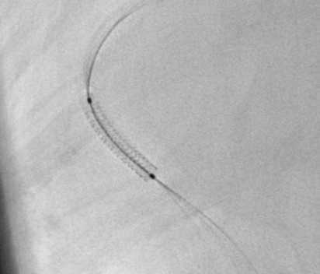
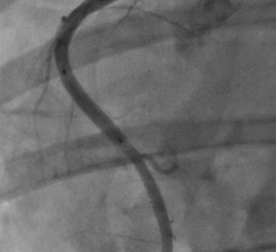
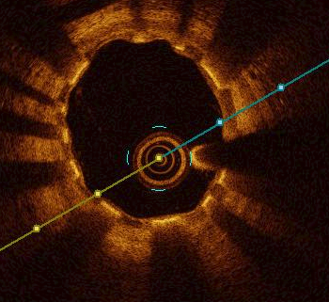
Fantom Bioresorbable Scaffold
Key Scaffold Features
Complete scaffold visibility under x-ray
Single-step continuous inflation
Clinically significant expansion range
Good radial strength at 125 µm thickness
Vasomotion restoration ~1 year (Preclinical)
No special storage or handling
Fantom® (REVA Medical) Sirolimus-Eluting Bioresorbable Scaffold
Desaminotyrosine Polycarbonate
Visibility
Deliverability
Vessel Patency

Slide 4
FANTOM II Study Investigators
Australia
Dr. Muller, Dr. Jepson, Dr. Walters
Belgium
Dr. De Bruyne
Brazil
Dr. Abizaid, Dr. Costa, Dr. Chamie, Dr. Perin
Denmark
Dr. Christiansen, Dr. Lassen, Dr. Okkels-Jensen
France
Dr. Carrié, Dr. Chevalier, Dr. Fajadet, Dr. Collet
Germany
Dr. Weber-Albers, Dr. Naber, Dr. Achenbach, Dr. Frey, Dr. Lutz, Dr. Kische, Dr. Ince, Dr. Brachman
Netherlands
Dr. Amoroso, Dr. Wykrzykowska, Dr. Daemen
Poland
Dr. Dudek, Dr. Kochman, Dr. Koltowski, Dr. Lesiak, Dr. Wojdyla

Slide 5
FANTOM II Study Design and Endpoints
Study Design
Safety and Performance Trial
2.5mm to 3.5mm vessels
Lesion length ≤ 20mm
Primary Endpoint
MACE & Late Loss at 6 Months
Secondary Endpoints
MACE all time points
Late Loss at 9 Months
Serial imaging sub-studies
Cohort A: 24 months
Cohort B: 48 months
Study Population
N= 240 Patients
28 Clinical Centers Participating
Cohort A
(117 Patients)
Cohort B
(123 Patients)
6 Mo Clinical
Follow-up (MACE)
6 Mo Clinical
Follow-up (MACE)
6 Mo Angio
(Late Loss)
OCT Sub-Study
9 Mo Angio
(Late Loss)
Includes OCT & IVUS
Sub-study @ 48 months
Annual Clinical
Follow-up (5 yrs)
Annual Clinical
Follow-up (5 yrs)

Slide 6
FANTOM II – Cohort A & B Study Overview and Baseline Characteristics
Study Population
N= 240 Patients
28 Clinical Centers
Patient Characteristics (N=240)
Patient Age (mean ± SD) | 62.7 ± 10.1
Male | 70.4%
Diabetes | 23.8%
Current/Former Smoker | 59.6%
Hypertension | 73.3%
Hyperlipidemia | 70.4%
Prior PCI | 43.8%
Prior CABG | 2.9%
Prior MI | 26.3%
Recent LVEF <40% | 0.4% (N=231)
6 & 9 Month Follow-up
Imaging
Angiographic
(cohort A N=100)
(cohort B ongoing)
OCT
(cohort A N=73)
(cohort B ongoing)
IVUS
(cohort A N=45)
(cohort B ongoing)
6 Month Follow-up
Clinical
Long Term Follow-up
Clinical
(annual through 5 years)

Slide 7
FANTOM II – Cohort A & B Lesion Characteristics and Procedural Outcomes
Lesion Characteristics
Initial Outcomes
Target Lesion Location (n=240)
LAD | 48.8% (117)
LCX | 30.8% (74)
RCA | 20.4% (49)
ACC/AHA Lesion Class (n=238)*
Type A | 19.3% (46)
Type B1 | 48.7% (116)
Type B2 | 29.4% (70)
Type C | 2.5% (6)
Acute Procedural Outcomes
Acute Technical Success ⁽¹⁾ | 95.8%
Acute Procedural Success ⁽²⁾ | 99.1%
Clinical Procedural Success ⁽³⁾ | 99.6%
Defined as successful delivery and deployment of the intended scaffold in the intended lesion without device related complications.
Defined as acute technical success (see definition above), resulting in a residual stenosis of ≤50 percent with no immediate (in-hospital) MACE.
Defined as acute procedural success (see definition above), with no MACE thirty days post-intervention and with a final diameter stenosis ≤50 percent.
*As assessed by an independent core lab

Slide 8
FANTOM II – Cohort A & B Safety Results
Components of the 6-Month Primary Endpoint (modified ITT): non-Hierarchical | N=240 N, (%)
MACE* | 5 (2.1%)
Cardiac Death | 1 (0.4%)
Target vessel MI | 3 (1.3%)
Clinically Driven TLR | 2 (0.8%)
6 Month MACE Results Timeframe | Event N, (%)
In-Hospital | 2 (0.8%) (Post Procedure MI)
30-Day Follow-up | 1 (0.4%) (MI/TLR/SAT)
90-Day Follow-up | 0 (0%)
6-Month Follow-up | 2 (0.8%) (1 cardiac death, 1 TLR)
* As adjudicated by an independent Clinical Events Committee
Note: Excludes 3 Non-Clinically Driven TLRs

Slide 9
FANTOM II – Cohort A Angiographic – QCA Results*
In-Scaffold Analysis | Baseline (n=115) | Post Procedure (n=112) | 6 Months (n=100)
RVD (mm) | 2.68 ± 0.37 | 2.75 ± 0.40 | 2.70 ± 0.36
MLD (mm) | 0.79 ± 0.29 | 2.47 ± 0.37 | 2.23 ± 0.41
Diameter Stenosis (%) | 70.3 ± 10.4 | 7.6 ± 9.7 | 15.3 ± 15.2
Acute Gain (mm) |  | 1.67 ± 0.41
Acute Recoil (%) |  | 2.9 ± 8.8
Mean LLL (mm) |  |  | 0.5 ± 0.38
Median LLL (mm) |  |  | 0.2 (-0.43, 2.62)
In-Segment Analysis
Mean LLL (mm) |  |  | 0.17 ± 0.34
Median LLL (mm) |  |  | 0.15 (-0.43, 2.47)
0.25 + 0.40
Notes: Binary restenosis at 6 months follow-up = 2.0%
Data analyzed by an independent QCA core lab (Yale Cardiovascular Research Group, New Haven, US)

Slide 10
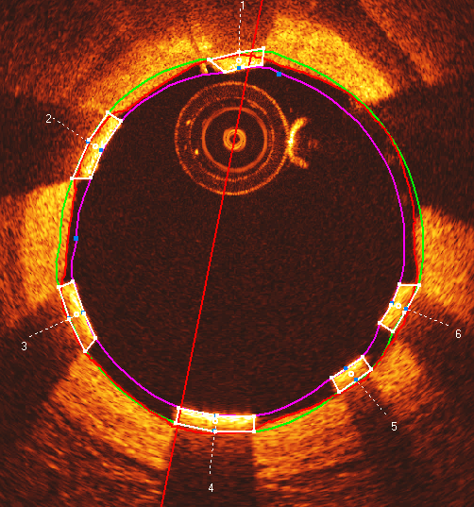
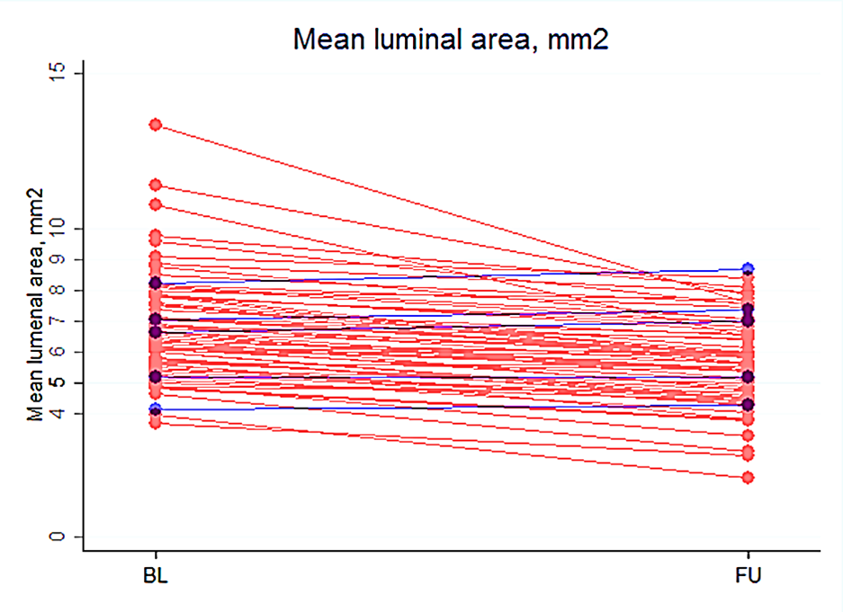
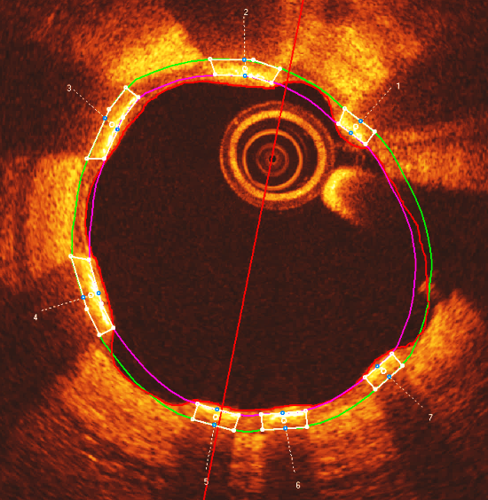
Scaffold Lumen Area
PCI Research
Aarhus University Hospital
Mean luminal area, mm²
Baseline
Follow-up
 | Baseline | Follow-up | Difference | p-value
Mean lumen area (mm²) | 6.8 (1.7) | 5.7 (1.4) | -1.1 (-1.3;-0.9) | <0.0001
Minimal lumen area (mm²) | 5.3 (1.4) | 4.4 (1.4) | -1.0 (-1.3;-0.7) | <0.0001
Mean(SD)
Reference: As presented by Jo Simonsen TCT 2016
Notes:
Descr. pics, + graph : Matched patients are interconnected
Expected due to healing response around the stented segment. This decrease in lumen area was comparable to what has been observed for both the ABSORB and the DESolve stent.

Slide 11
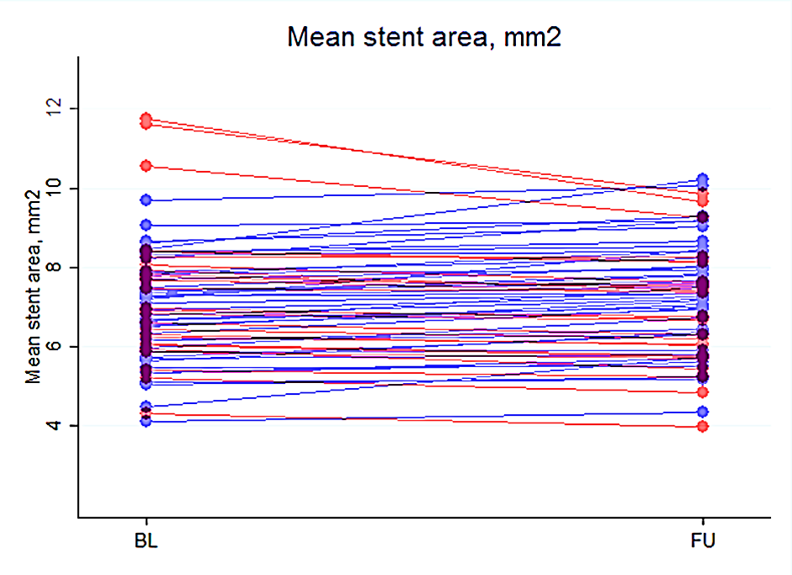
Stent Area
PCI Research
Aarhus University Hospital
Mean stent area, mm²
Baseline
Follow-up
 | Baseline | Follow-up | Difference | p-value
Mean stent area (mm²) | 7.1 (1.5) | 7.2 (1.4) | 0.1 (-0.02;0.24) | 0.12
Minimal stent area (mm²) | 5.9 (1.3) | 6.0 (1.3) | 0.1 (-0.02;0.25) | 0.08
Mean(SD)
Reference: As presented by Jo Simonsen TCT 2016
Notes:
Stent area was assessed based on the abluminal stent contour. We observed no evidence of stent area shrinkage … .
The reduction in molecular weitgh we start to see at the 6 months time point did importantly not affect the stent area.

Slide 12
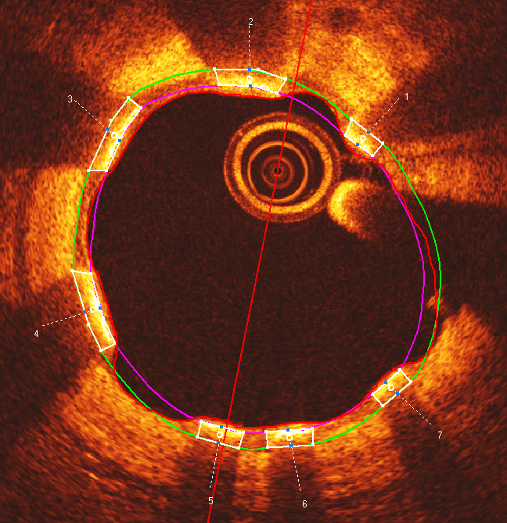
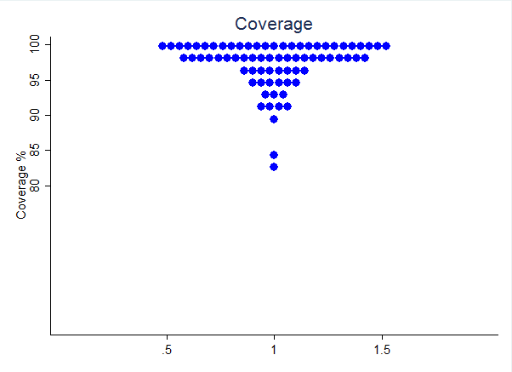
Strut Coverage
PCI Research
Aarhus University Hospital
 | Follow-up
Covered struts | 98.1% (95.9;99.4)
Median(IQR)
Reference: As presented by Jo Simonsen TCT 2016
Notes:
Strut coverage was assessed on strut level and estimated as percentage of covered struts per recording. We observed a high coverage of stent struts after 6 months.
A standard limitation of OCT it is not possible to confidently detect layers of coverage below 10-15 um. Still 98% covereage is a good result. An even better coverage cannot be excluded. The meassure hwew is OCT coverage.

Slide 13
FANTOM Program Clinical Summary
Fantom offers new and clinically important features
Radiopacity
Deliverability
Single-step inflation
No special handling requirements
Initial clinical data demonstrates
Good acute performance
Enhanced device deliverability
Minimal residual stenosis and acute recoil (3%)
Sustained performance and safety through 6 months
Low MACE Rate (2.1%)
Low late lumen loss (0.25mm)

