Slide 1
BIONICS Trial
BioNIR Ridaforolimus Eluting Coronary Stent System In Coronary Stenosis Trial
David E. Kandzari, MD
on behalf of the
BIONICS investigators

Slide 2
Disclosure
Within the past 12 months, I or my spouse/partner have had a financial interest/arrangement or affiliation with the organization(s) listed below
Affiliation/Financial Relationship Company
Grant/Research Support Abbott Vascular, Boston Scientific, Medtronic CardioVascular, Biotronik, St. Jude Medical/Thoratec, Ablative Solutions
Consulting Fees/Honoraria Boston Scientific Corporation, Medtronic CardioVascular, Micell, St. Jude Medical
Major Stock Shareholder/Equity None
Royalty Income None
Ownership/Founder None
Intellectual Property Rights None
Other Financial Benefit None

Slide 3
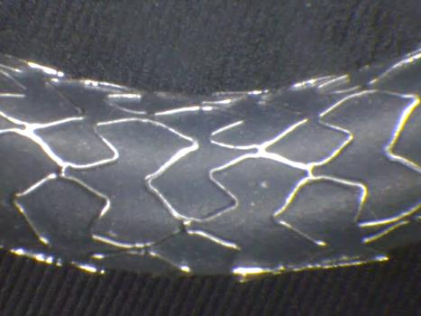
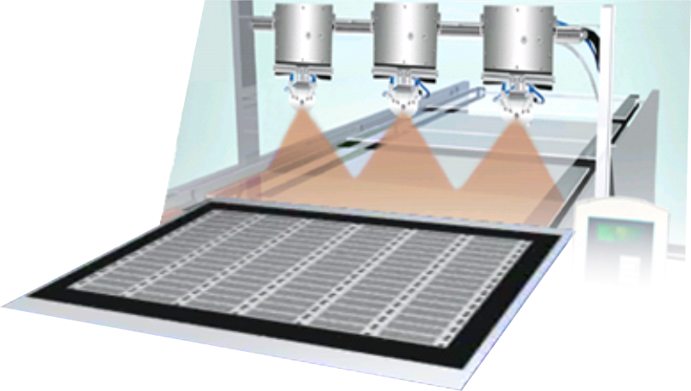
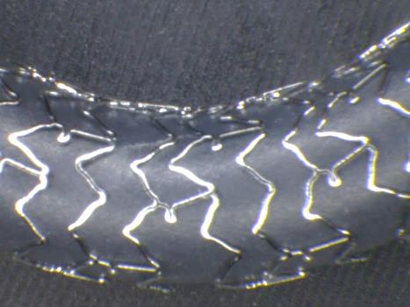
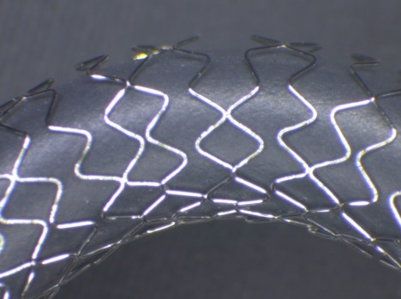
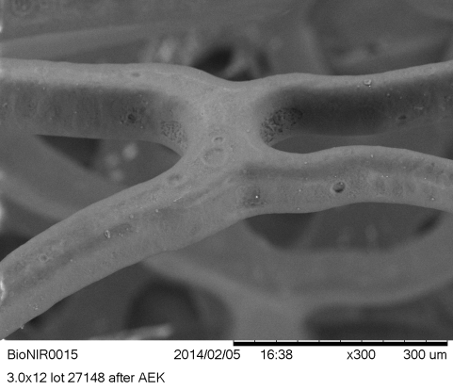
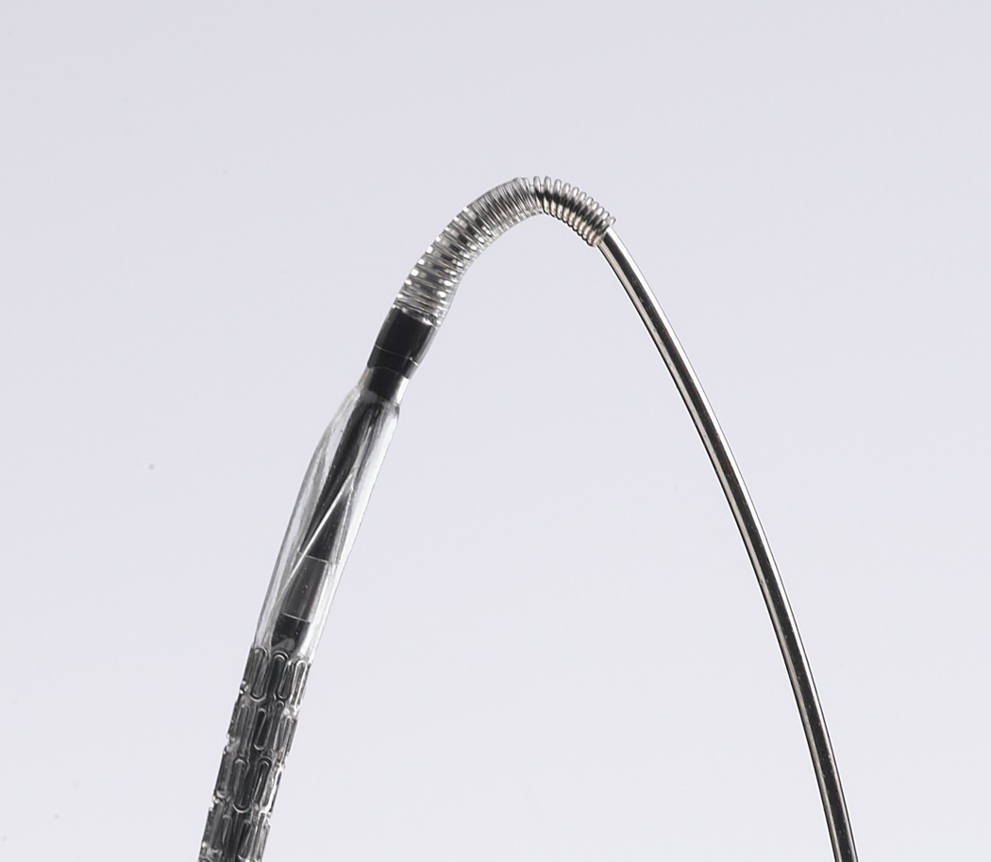
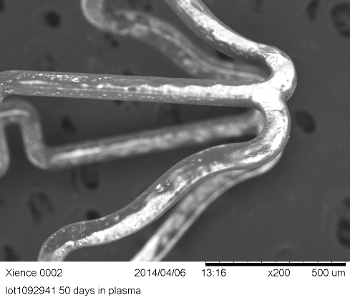
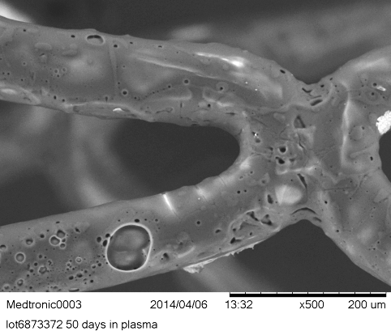
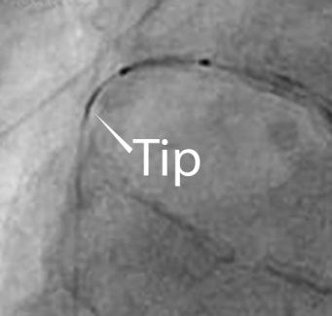
BioNIR System
Flat manufacturing: Quality & cost efficiency
Variable strut width/ frequency: Uniform dosing
BioNIR
- 80µm CoCr Wizecell design
- Ridaforolimus high therapeutic index drug
DES A
DES B
Elastomeric Polymer: Remains intact post elution
Spring tip: Pushable & visible
BioNIR
DES A
DES B
Medinol Ltd., Tel Aviv, Israel

Slide 4
BioNIR Pharmacokinetics
Drug Release
Drug Deposition
95.6%
99.6%
100
80
60
86.8%
Resolute
Percent Cumulative Release
Arterial Drug Concentration [ng/mg]
84.9%
Xience V
40
77.61%
BioNIR
BioNIR fit
20
0
0
30
60
90
120
150
180
210
240
Days
Days
Carter et al TCT 2006
Perkins et al J Interven Cardiol 2009;22:S28-S40
Yazdani et al J Invasive Cardiol 2013

Slide 5
NIREUS
Primary Endpoint 6-month angiographic late loss, N=302
100
6 Month In-Stent Late Loss
90
80
BioNIR | Resolute | P_{Noninferiority}
0.042 (0.306) | 0.030 (0.308) | <0.0001
70
BioNIR
Resolute
60
Cumulative Percent
50
40
Data represented as mm, STD
30
20
10
0
-0.8
-0.7
-0.6
-0.5
-0.4
-0.3
-0.2
-0.1
0.0
0.1
0.2
0.3
0.4
0.5
0.6
0.7
0.8
0.9
1.0
1.1
1.2
1.3
1.4
In Stent Late Loss at 6 Months
1.5
1.6
1.7
6 Month Clinical Outcomes
 | BioNIR | Resolute | P value
TLF | 1.5% (3/201) | 3.0% (3/101) | 0.39
CV Death | 0.5% (1/201) | 0.0% (0/101) | 1.00
Target Vessel MI | 1.0% (2/201) | 3.0% (3/101) | 0.23
Target Lesion Revascularization | 1.6% (3/201) | 1.0% (1/101) | 0.68
Smits, P. EuroPCR, May 2016
5

Slide 6
BIONICS – Trial Design
“More Comers” Population with
Symptomatic CAD
(eg, NSTEMI, CTO, SVG, MVD)
BioNIR Stent
N=958
76 Centers in NA, Europe, Israel
FAS*:1919 patients randomized 1:1
Resolute Stent
N=961
Noninferiority Design
(Event rate 5.8%, Delta 3.3%, Power 90%)
Primary Clinical Endpoint
Follow Up
30d
6mo
12mo
13mo
2yr
3yr
4yr
5yr
QCA & Imaging Endpoints
Primary Endpoint:
12-month target lesion failure (TLF), composite of cardiac death, target vessel MI and ischemia driven TLR
Secondary Endpoints:
  12-month MACE, TVF and individual component endpoints
  Definite/probable stent thrombosis
  Procedural success
*FAS= Full Analysis Set

Slide 7
Procedural Outcomes
 | BioNIR N=958 patients, 1275 lesions | Resolute N=961 patients, 1277 lesions | p value
Device Success | 98.3% | 99.5% | 0.004
Lesion Success | 99.9% | 99.8% | 1.00
Procedure Success | 97.7% | 97.3% | 0.57
Device success: final in-stent residual QCA diameter stenosis of <50% using the assigned device only and without a device malfunction
Lesion success: final in-stent residual QCA diameter stenosis of <50% using any percutaneous method
Procedure success: final in-stent QCA diameter stenosis of <50% using the assigned device and/or with any adjunctive devices, without the occurrence of cardiac death, Q wave or non-Q wave MI, or repeat revascularization of the target lesion during the hospital stay

Slide 8
BIONICS – Primary Endpoint
TLF at 12 months
10
p_{noninferiority}=0.0012
8
Difference=0% ( - , 1.8%)
6
5.3%
5.3%
%TLF at 12 mo.
4
2
0
3.3
(ƍ)
0
BioNIR
Resolute
Favors
BioNIR
Favors
Resolute

Slide 9
BIONICS
12 mo Key Endpoint Results
 | BioNIR N=958 | Resolute N=961 | Relative Risk | P value
Target Lesion Failure (TLF) | 5.3% (49/926) | 5.3%(49/930) | 1.00 [0.68,1.48] | 0.98
Cardiac Death | 0.5% (5/926) | 0.2% (2/930) | 2.51 [0.49, 12.91] | 0.29
TV-MI* | 3.1% (29/926) | 3.3% (31/930) | 0.94 [0.57, 1.55] | 0.81
ID-TLR | 3.0% (28/926) | 2.4% (22/930) | 1.28 [0.74, 2.22] | 0.38
Total Mortality | 1.2% (11/931) | 1.1% (10/936) | 1.11[0.47,2.59] | 0.82
* SCAI definition for periprocedural MI, Moussa et al. JACC 2013

Slide 10
BIONICS
Stent Thrombosis
 | BioNIR (N=958) | Resolute (N=961) | P value
Stent Thrombosis
Definite/Probable | 0.4% (4/921) | 0.6% (6/927) | 0.75
Definite | 0.4% (4/921) | 0.5% (5/926) | 1.00
Any Stent Thrombosis | 0.4% (4/921) | 0.8% (7/928) | 0.37
Timing of Event
Acute ST | 0.1% (1/920) | 0.1% (1/926) | 1.00
Sub-Acute ST | 0.3% (3/921) | 0.3% (3/927) | 1.00
Late | 0.0% (0/920) | 0.3% (3/927) | 0.25
12 Month DAPT Adherence: 75.1% BioNiR, 75.9% Resolute

Slide 11
Target Lesion Failure at 1 Year by Subgroups
Subgroups
12-Month TLF Rate n/N (%)
Relative Risk
[95% CI]
P value
BioNIR
Resolute
Overall
49/926 (5.3%)
49/930 (5.3%)
1.00 [0.68, 1.48]
Medically Treated Diabetes
Yes
No
0.5
22/277 (7.9%)
27/649 (4.2%)
21/264 (7.9%)
28/666 (4.2%)
1.00 [0.56, 1.77]
0.99 [0.59, 1.66]
Acute Coronary Syndrome (ACS)
ACS
No ACS
0.39
18/380 (4.7%)
31/546 (5.7%)
19/363 (5.2%)
30/567 (5.3%)
0.91 [0.48, 1.70]
1.07 [0.66, 1.75]
Sex
Male
Female
39/725 (5.4%)
10/201 (5.0%)
40/762 (5.3%)
9/168 (5.4%)
1.03 [0.67, 1.57]
0.93 [0.39, 2.23]
0.46
Age
>=65 Year
<65 Year
33/433 (7.6%)
16/493 (3.3%)
27/441 (6.1%)
22/489 (4.2%)
1.24 [0.76, 2.03]
0.72 [0.38, 1.36]
0.19
Region
North America
Outside of N. Am.
22/420 (5.2%)
27/506 (5.3%)
25/402 (6.2%)
24/528 (4.6%)
0.84 [0.48, 1.47]
1.17 [0.69, 2.01]
0.28
0.0
0.5
1.0
1.5
2.0
2.5
Favors
BioNIR
Favors
Resolute
Interaction p value: Gail-Simon test for qualitative interactions (interaction between the treatment and the subgroup variable)

Slide 12
BIONICS
Conclusions
In the present large-scale, ‘more comers’ trial, the BioNIR ridafirolimus-eluting stent was non-inferior to the Resolute stent for the primary endpoint of target lesion failure at 1 year, and resulted in low rates of target lesion revascularization and stent thrombosis
These findings endorse the safety and efficacy of BioNIR in patients representative of real world clinical practice

