Slide 1
10-Year Survival after Bypass Surgery versus
Drug-Eluting Stents: Preliminary Results of the Randomized
SYNTAX Extended Survival study “SYNTAXES”
Daniel J.F.M. Thuijs, Friedrich W. Mohr, Patrick W. Serruys, Michael J. Mack,
David R. Holmes Jr., Marie-Claude Morice, Piroze Davierwala, Thilo Noack, Milan Milojevic, Nick Curzen, A. Pieter Kappetein, Stuart J. Head,
*SYNTAXES collaborators
d.thuijs@erasmusmc.nl
Press Conference - Sept. 24th 2018

Slide 2
Disclosure Statement of Financial Interest
I, Daniel J.F.M. Thuijs, DO NOT have a financial interest/arrangement or
affiliation with one or more organizations that could be perceived as a real or apparent conflict of interest in the context of the subject of this presentation.
All TCT 2018 faculty disclosures are listed online and on the App

Slide 3
SYNTAXES – Importance
Cardiovascular disease is the number one cause of death
Worldwide, 7.4 million deaths due to coronary heart disease in 2015*
Survival curves (Kaplan Meier estimates) continued to diverge during 0 - 5 Year SYNTAX follow-up**
SYNTAXES study = 1st randomized study to present 10 year survival data after coronary artery bypass grafting (CABG) vs. percutaneous coronary intervention (PCI) with drug eluting stents
*World Health Organization ; **Mohr F.W. et al. – The Lancet 2013; 381, Issue 9867, P 629-638
Press Conference - Sept. 24th 2018

Slide 4
Endpoint
10 year All-Cause Death in patients with Three Vessel or Left Main Disease who underwent
CABG or PCI with TAXUS-stent
ClinicalTrials.gov : NCT03417050
Press Conference - Sept. 24th 2018

Slide 5
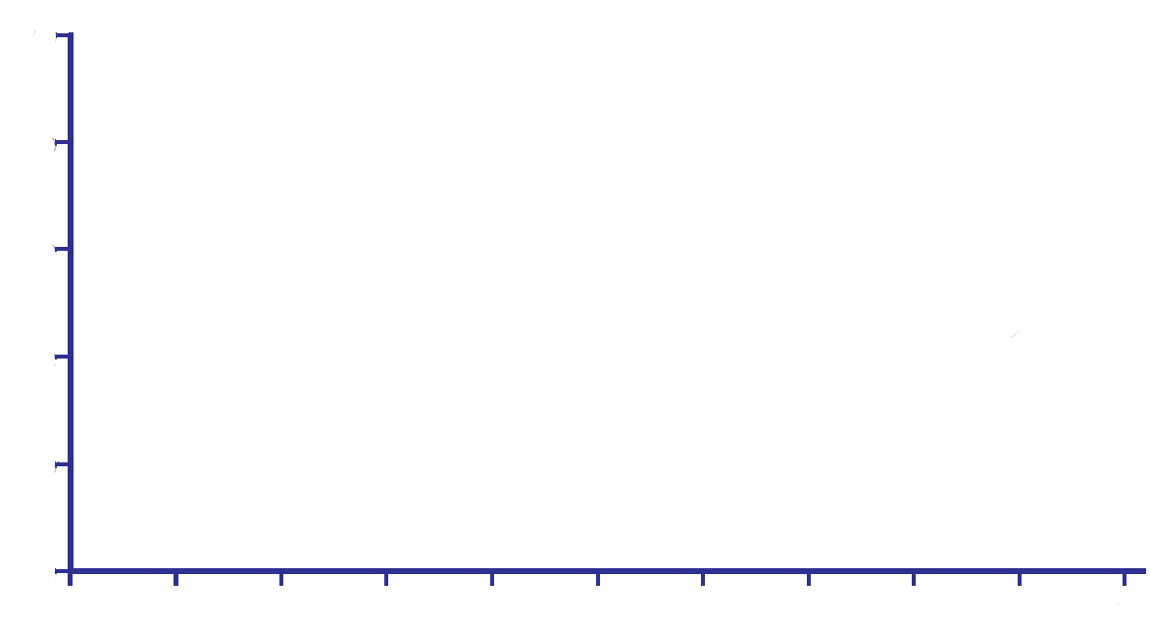
SYNTAXES 10 Year All-Cause Mortality
50
HR: 1.17, 95%CI [0.96-1.42], P = 0.11
40
Mortality (%)
29.4% PCI
25.6% CABG
30
20
10
0
1
851
859
2
831
842
3
813
822
4
788
790
5
6
7
8
9
10
Numbers at risk
CABG
PCI
Follow-up (years)
897
903
695
729
530
506
509
492
493
471
472
447
453
420

Slide 6
Three Vessel (3VD)
50
HR: 1.43, 95%CI [1.10-1.85], P = 0.007
40
Mortality (%)
30
29.2% PCI
21.9% CABG
20
10
0
1
520
516
2
510
504
3
499
488
4
486
474
5
6
7
8
9
10
Numbers at risk
CABG
PCI
Follow-up (years)
549
546
428
413
344
316
338
309
327
295
317
286
306
264

Slide 7
Left Main (LM)
50
HR: 0.89, 95%CI [0.66-1.19], P = 0.43
Cumulative Death Rate (%)
Mortality (%)
40
31.9% CABG
30
29.7%
PCI
20
10
0
1
330
343
2
319
338
3
309
331
4
300
316
5
6
7
8
9
10
Numbers at risk
CABG
PCI
Follow-up (years)
348
357
245
265
183
190
171
183
161
176
155
164
145
154

Slide 8
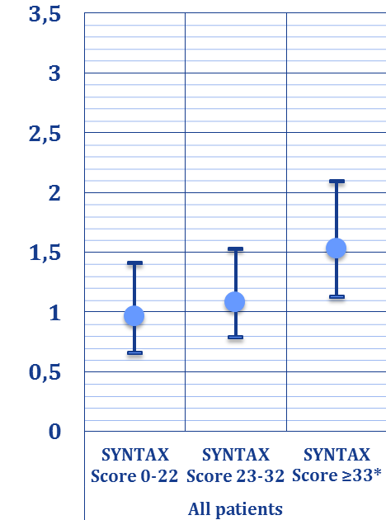
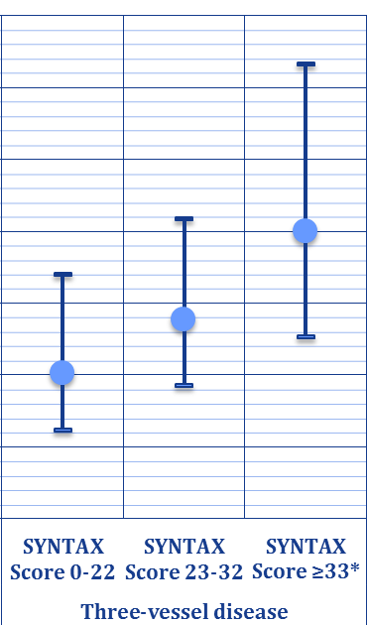
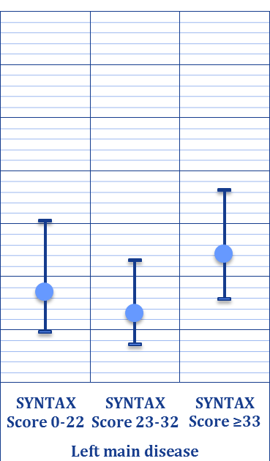
SYNTAX scores – 10 Year All-Cause Mortality
P for interaction = 0.050 P for interaction = 0.054 P for interaction = 0.25
Favors CABG
Hazard Ratios, 95% CI
Favors PCI
*significant HR
*significant HR

Slide 9
SYNTAXES – Impact
North-American + European Guidelines on Myocardial
Revascularization were based on SYNTAX study results
Delivery of care:
CABG for patients with complex three vessel disease
PCI for most patients with left main disease, and less complex
three vessel disease
Press Conference - Sept. 24th 2018

Slide 10
Take Home Message
Based on 72% of the SYNTAXES 10 Year data (n=1301):
No survival difference between CABG or PCI at 10-year
CABG provides a survival benefit in patients with 3VD
PCI had comparable survival to CABG in patients with LM-disease
The remaining 28% (n=499) survival data is currently being collected
The SYNTAXES study anticipates to be completed in 2018
Press Conference - Sept. 24th 2018
d.thuijs@erasmusmc.nl

Slide 11
Thank you and thanks to all SYNTAXES collaborators
*SYNTAXES collaborators:
Mario F.L. Gaudino, Jeremy R. Leonard, Filip Casselman , Bernard de Bruyne, Evald Høj Christiansen, Juan M. Ruiz-Nodar, Paul Vermeersch, Manel Sabaté, Olivier Darremont, P. den Heijer, Martinus Vrakking, Peter den Heijer, Istvan Preda, Robert C. Stoler, Michael J. Mack, Tamas Szerafin, John K. Buckner, Myles S. Guber, Niels Verberkmoes, Ferdi Akca, Ted Feldman, Friedhelm Beyersdorf, Benny Drieghe, Kevin Wolschleger, John Heiser, Pim van der Harst, Massimo A. Mariani, Hermann Reichenspurner, Richard Zelman, Christina Grothusen, Dariusz Dudek, George Heyrich, Victor LeGrand, Philippe Kolh, Pedro Coelho, Sara Fernandez, Javier Escaned, Reddy Guera, Alaide Chieffo, Alvise Spolaor, Maarten Jan Suttorp, Knut Endresen, Umberto Canosi, Ivan Horvath, Robert Kramer, Michael Aschermann, Inga Narbute, David Holmes, Francesco Burzotta, Ad J.J.C. Bogers, Helene Eltchaninoff, Jacques Berland, Ignacio Cruz Gonzalez, Anders Ahlsson, Matthias Corbascio, Thomas V. Bilfinger, Didier Carrie, Karl-Eugen Hauptman, Stefan James, Elisabeth Stahle, Sigrid Sandner, Günther Laufer, Irene Lang, Adam Witkowski, Harry Suryapranata, Agata Krauze, Andrzej Bochenek, David Dobies, Marc Silver, Alessandra Parlanti, Sergio Berti, Stephan Ensminger, Boris Nasseri, Giulio Stefanini, Stefan Kiesz, Bartlomiej Gora, Christian Hagl, Oliver Heyn, Richard Ingemansson, Goran Olivecrona, Christoffer Stark, Mika Laine, Nicholas Burke, Michael Mooney, Ronald A. Stine, Werner Schultz, Herko Grubitzsch, Piroze Davierwala, Thilo Noack, Phillip A. Horwitz, Jeffrey Everett, Kapil Sharma, Louis Cannon, John Talbott, Kevin Accola, Andrew Taussig, Thomas McGarry, Scott Lucas, Vinod Thourani, Didier Tchétché, Adrian Banning, Rana Sayeed, Jonathan Breeze, Anthony Gershlick, Adam de Belder, Uday Trivedi, Simon Redwood, Charles Knight, Keith Oldroyd, Zoe Nicholas, William Killinger, Peter Juni
d.thuijs@erasmusmc.nl
d.thuijs@erasmusmc.nl

Slide 12
Take Home Message
Based on 72% of the SYNTAXES 10 Year data (n=1301):
No survival difference between CABG or PCI at 10-year
CABG provides a survival benefit in patients with 3VD
PCI had comparable survival to CABG in patients with LM-disease
The remaining 28% (n=499) survival data is currently being collected
The SYNTAXES study anticipates to be completed in 2018
Press Conference - Sept. 24th 2018
d.thuijs@erasmusmc.nl

