Slide 1
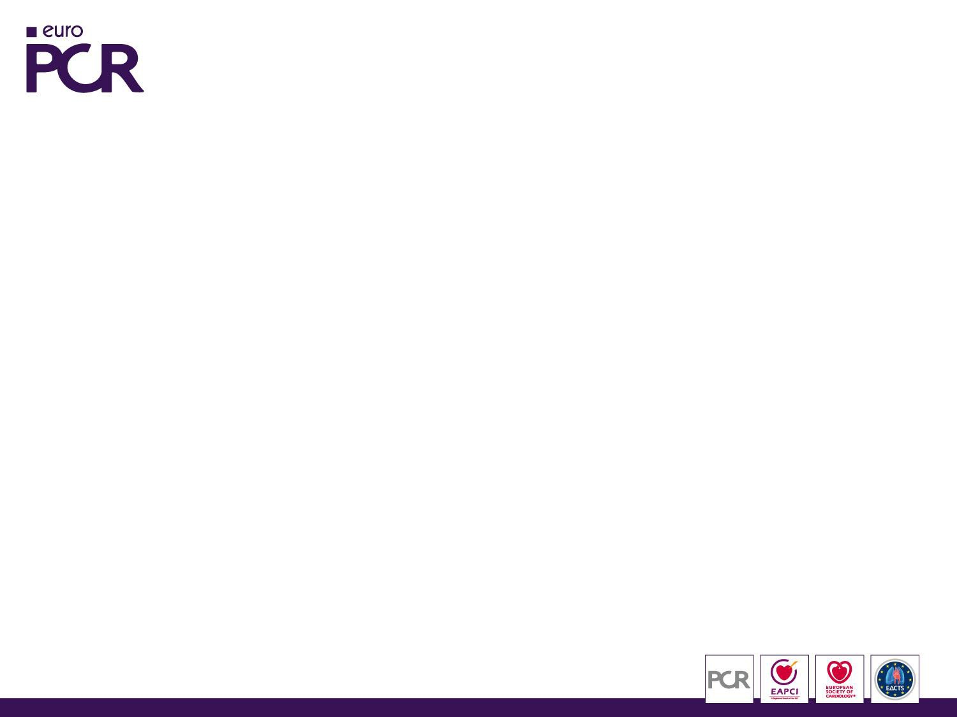

A diffusion-weighted MRI and multi-slice-CT-Study to assess predictors of cerebral embolism during transcatheter aortic valve implantation
¹Ermela Yzeiraj MD, ¹Klaudija Bijuklic MD, ²Timo Haselbach MD, ²Julian Witt MD, ²Korff Krause MD, ²Lorenz Hansen MD, ²Friedrich-Christian Riess MD, PhD, ^{1,2}Joachim Schofer MD, PhD
¹Medical Care Center Prof. Mathey, Prof. Schofer, Hamburg, Germany
²Albertinen Heart Center, Hamburg, Germany

Slide 2
Background
Transcatheter
aortic valve implantation (TAVI) is
known to be associated with a high rate of cerebral
embolism.
Cerebral
embolic protection devices are under
clinical evaluation but the indication for their use
has not yet been defined.
Aim
To identify predictive risk factors for the occurrence of cerebral ischemic lesions in patients undergoing TAVI.

Slide 3
Methods
Cardiac
contrast-enhanced multislice computed
tomography (MSCT) was performed before TAVI and volumetric quantification of calcification of the aortic valve complex (AVC) was retrospectively assessed.
Cerebral
diffusion-weighted magnetic resonance
imaging (DW-MRI) was performed 3 - 5 days after the procedure. They were analyzed to assess the presence, location, number and volume of all new ischemic lesions.

Slide 4






Methods
Among the high surgical risk patients who underwent TAVI between 2012 and 2015:
140 TAVI patients underwent MSCT and DW-MRI
85 (61%) Edwards Sapien
44 (31%) DFM
11 (8%) Lotus
Approach: - Transfemoral approach used in 137 patients (98%)
- Transaortic approach used in 3 patients (2%)
Exclusion criteria: - Use of cerebral embolic protection device
- Valve-in-Valve procedure performed

Slide 5
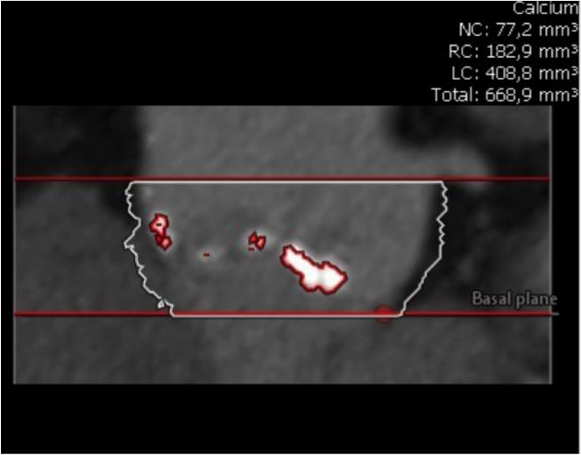
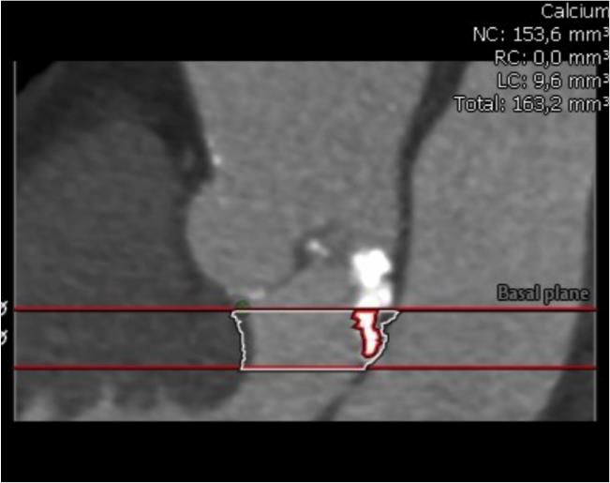
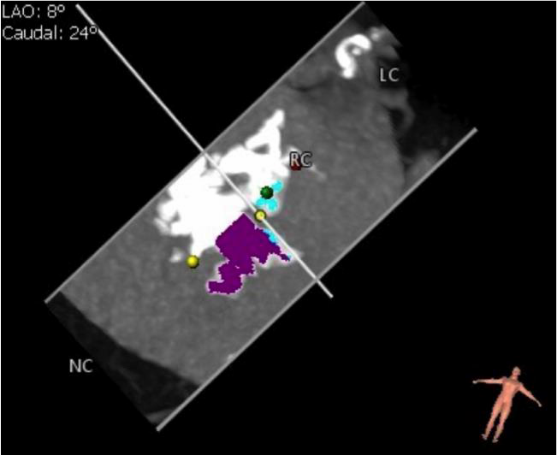
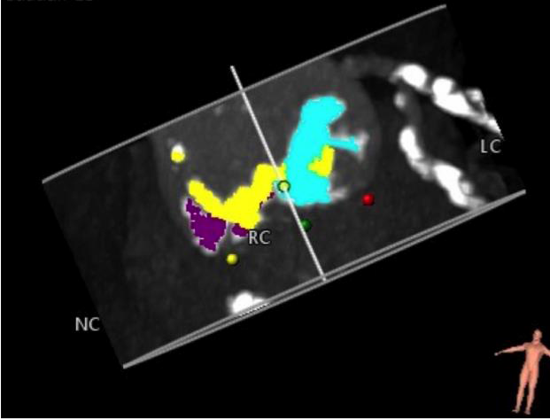
Aortic Valve Complex (AVC)
Aortic Root
LVOT
A threshold of 800 Hounsfield units was used
3mensio Medical Imaging B.V. Version 7.2.

Slide 6




Results
DW-MRI results in 140 patients who underwent TAVI
38 patients (27%) had no new cerebral ischemic lesions
102 patients (73%) had new cerebral ischemic lesions
These lesions were silent in 99% of the patients
Only one patient had a disabling stroke

Slide 7
Baseline Clinical Characteristics
New cerebral ischemic lesions
 | Variables | All patients (N=140) | Yes (N=102) | No (N=38) | p Value
 | Age, mean ± SD | 83 ± 6 | 83 ± 5 | 81 ± 6 | 0.026
 | Male sex, n (%) | 71 (51) | 53 (52) | 18 (47) | 0.244
 | Logistic EuroSCORE , mean ± SD | 19.6 ± 11.1 | 19.6 ± 10.5 | 19.7 ± 12.9 | 0.939
 | NYHA III-IV, n (%) | 104 (74) | 79 (77) | 25 (66) | 0.193
 | Hypertension, n (%) | 119 (85) | 86 (84) | 33 (87) | 0.803
 | Dyslipidemia, n (%) | 70 (50) | 46 (45) | 24 (63) | 0.148
 | Diabetes Mellitus, n (%) | 35 (25) | 23 (23) | 12 (32) | 0.468
 | Coronary artery disease, n (%) | 88 (63) | 65 (64) | 23 (61) | 0.844
 | Carotid artery disease, n (%) | 30 (21) | 19 (19) | 11 (29) | 0.125
 | Extracardiac arteriopathy , n (%) | 42 (30) | 30 (29) | 12 (32) | 0.837
 | Porcelain Aorta, n (%) | 6 (4) | 3 (3) | 3 (8) | 0.344
 | Previous PCI, n (%) | 45 (32) | 33 (32) | 12 (32) | 0.823
 | Previous CABG, n (%) | 23 (16) | 15 (15) | 8 (21) | 0.563
 | Previous Stroke, n (%) | 21 (15) | 16 (16) | 5 (13) | 0.767
 | Atrial fibrillation, n (%) | 41 (29) | 29 (28) | 12 (32) | 0.785
 | COPD, n (%) | 20 (14) | 13 (13) | 7 (18) | 0.586
 | GFR (mean ± SD) | 71 ± 28 | 71 ± 28 | 71 ± 28 | 0.970
 | Dialysis, n (%) | 2 (1) | 2 (2) | 0 (0) | 0.381

Slide 8
Baseline Echocardiographic Data
New cerebral ischemic lesions
Variables | All patients (N=140) | Yes (N=102) | No (N=38) | p Value
Max aortic gradient (mmHg), mean ± SD | 72 ± 19 | 73 ± 20 | 70 ± 18 | 0.356
Mean aortic gradient (mmHg), mean ± SD | 43 ± 12 | 43 ± 12 | 41 ± 11 | 0.422
Aortic valve area (cm²), mean ± SD | 0.72 ± 0.18 | 0.72 ± 0.18 | 0.73 ± 0.19 | 0.728
Aortic annulus diameter (mm), mean ± SD | 23 ± 2.6 | 23.3 ± 2.8 | 22.3 ± 1.8 | 0.134
LVEF (%), mean ± SD | 59 ± 10 | 58 ± 10 | 60 ± 10 | 0.476

Slide 9
Procedural Characteristics
New cerebral ischemic lesions
Variables | All patients (N=140) | Yes (N=102) | No (N=38) | p Value
Device success VARC-2, n (%) | 135 (96) | 98 (96) | 37 (97) | 1.000
All cause mortality, n (%) | 0 (0) | 0 (0) | 0 (0)
Paravalvular AR ≥ 2+/4, n (%) | 5 (3.6) | 4 (3.9) | 1 (2.6) | 1.000
Stroke and TIA, n (%) | 1 (0.7) | 1 (1) | 0 (0) | 1.000
Myocardial infarction | 0 (0) | 0 (0) | 0 (0)
Major vascular complications | 0 (0) | 0 (0) | 0 (0)
Predilatation, n (%) | 72 (51) | 54 (53) | 18 (47) | 0.574
Postdilatation, n (%) | 6 (4) | 6 (6) | 0 (0) | 0.190
Time procedure (min), mean ± SD | 64 ± 29 | 65 ± 31 | 62 ± 18 | 0.643

Slide 10

MSCT Results
Volume of calcium and its location in patients with and
without new cerebral ischemic lesions
New cerebral ischemic lesions
Variables | All patients (N=140) | Yes (N=102) | No (N=38) | p Value
Total AVC calcium (mm³), mean ± SEM | 318 ± 26 | 357 ± 33 | 214 ± 33 | 0.014
Total aortic root calcium (mm³), mean ± SEM | 300 ± 24 | 336 ± 30 | 205 ± 31 | 0.014
NCC (mm³), mean ± SEM | 135 ± 11 | 151 ± 14 | 93 ± 17 | 0.022
RCC (mm³), mean ± SEM | 86 ± 9 | 97 ± 11 | 57 ± 10 | 0.045
LCC (mm³), mean ± SEM | 79 ± 8 | 88 ± 10 | 55 ± 11 | 0.056
Total LVOT calcium (mm³), mean ± SEM | 17 ± 5 | 21 ± 7 | 9 ± 4 | 0.315
LVOT under NCC (mm³), mean ± SEM | 8 ± 3 | 8 ± 4 | 5 ± 3 | 0.668
LVOT under RCC (mm³), mean ± SEM | 1 ± 1 | 2 ± 1 | 1 ± 1 | 0.591
LVOT under LCC (mm³), mean ± SEM | 9 ± 3 | 11 ± 4 | 3 ± 2 | 0.249
Aortic annulus diameter (mm), mean ± SD | 24.5 ± 2.3 | 24.5 ± 2.4 | 24.4 ± 2.1 | 0.769

Slide 11
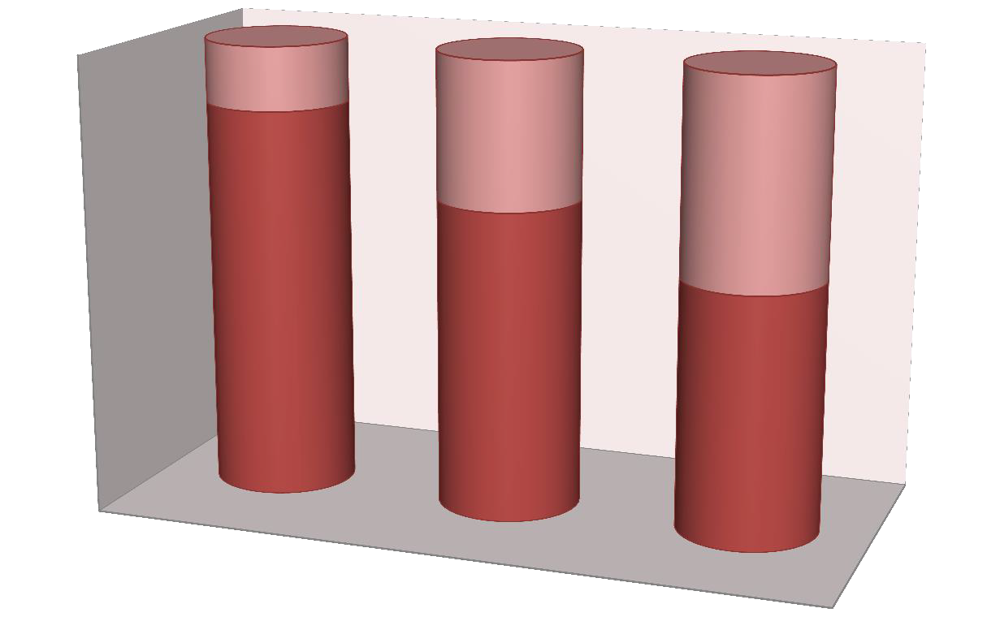
Incidence of new cerebral ischemic lesions regarding THV type (p = 0.033)
100%
14
80%
32
45
60%
86
40%
68
20% 55
0%
DFM
Edward Sapien
Lotus
No new cerebral lesions New cerebral lesions

Slide 12
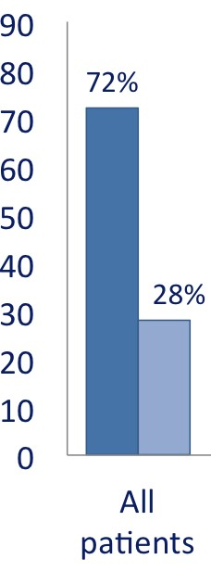
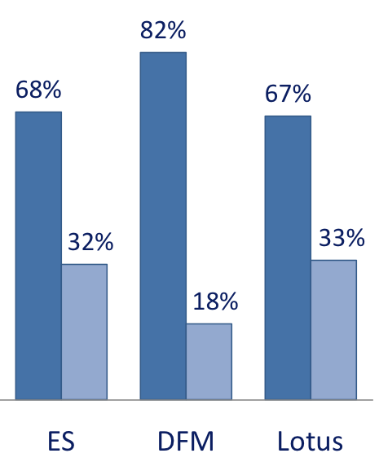
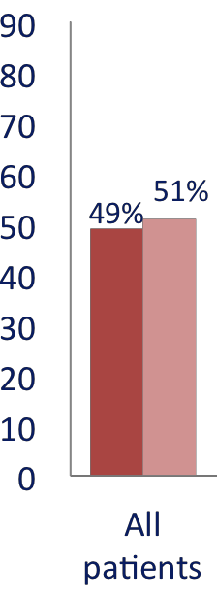
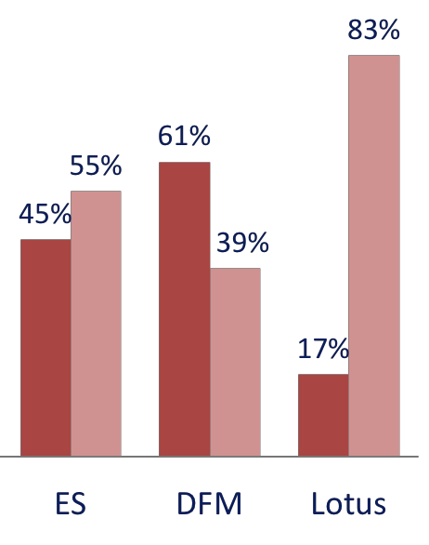
DW-MRI Results
Multiple vs Single Lesions
Bilateral vs Unilateral Lesions
P=0.039
P=0.078

Slide 13



DW-MRI Results
Lesion Number
p=0.088
Lesion Volume (mm³)
p=0.123
*4192 *4192
20
18
16
14
12
10
8
6
4
2
0
3000
19
19
2500
2000
1742
12
1500
1000
5
5
4
4
2,5
1
Lotus
424
522
500
400
112
211
2
167
184
53
1
Total
1
ES DFM
130
1
0
33
33
ES
35 42
DFM Lotus
Total
The lesion number per patient was: median 3 (IQR 1-5), range 1-19. The lesion volume per patient was: median 240 mm³ (IQR 130-424),
range 33-4192 mm³

Slide 14

Independent predictors of new cerebral ischemic lesions
Binary logistic regression analysis
Parameter | Odds Ratio | 95% CI | P Value
Valve type | 3.310 | 1.210 – 9.055 | 0.029
Age | 1.082 | 1.007 – 1.161 | 0.031
Aortic Root calcification (mm³ ) | 1.002 | 1.000 – 1.004 | 0.014
NCC calcification (mm³ ) |  |  | 0.455
RCC calcification (mm³ ) |  |  | 0.967
LCC calcification (mm³ ) |  |  | 0.305
AVC (mm³ ) |  |  | 0.730

Slide 15
Conclusions
TAVI is associated with a high rate of new cerebral embolic
lesions (73%) and the majority of them are silent (99%)
The risk of new ischemic lesions increases with age and the volume of aortic root calcification and seems to be strongly dependent on the type of valve.
These findings might help identifying patients who need a cerebral embolic protection device during TAVI

