Slide 1
Similarities and Differences in Left Ventricular Size and Function Among Races and Nationalities. WASE Normal Values Study
Federico M Asch, MD, FASE, FACC
Director, CV Core labs and Cardiac Imaging Research
MedStar Heart and Vascular Institute
MedStar Health Research Institute
Washington, DC - USA
ESC Scientific Sessions, Paris. Sept 2nd , 2019

Slide 2
Federico Asch MD FASE, PI Roberto Lang MD FASE, PI
American Society of Echocardiography Foundation,
Alliance Partners and
Global Collaborators

Slide 3
Disclosures
Personal: Research grants: TOMTEC, GE, Butterfly, Baylabs;
Advisory Board for Ultromics.
WASE has been funded by
American Society of Echocardiography Foundation
MedStar Health
University of Chicago
with in-kind donations by
TOMTEC
Medidata

Slide 4
Background
The clinical usefulness of echocardiography is based on the detection of abnormalities…
Which relies on the accurate definition of “normality”

Slide 5
Background
ASE/EACVI-recommended normal values are used world-wide but only represent normal Caucasian people from the US and Europe.
Lang R et al. ASE/EACVI Recommendations for Chamber Quantification. J Am Soc Echo 2015.

Slide 6
Adjusted by BSA and age
Lang R et al. ASE/EACVI Recommendations for Chamber Quantification. J Am Soc Echo 2015.

Slide 7
Sources for current 2D recommendations
American or European
White race
Middle age adults
Lang R et al. ASE/EACVI Recommendations for Chamber Quantification. J Am Soc Echo 2015.

Slide 8
Regional Reports from around the world
They suggest
differences in chamber size

Slide 9
Different Methods
M-mode
M-mode and Simpsons method
2D measurements
State of the art machines and techniques?
No standard analysis
or Core Lab
Single race or region

Slide 10
Area of need
Hence, there is still a need for standardizing the interpretation of cardiac measurements across different ethnic/racial groups and regions around the world

Slide 11
Aims of the WASE Study
To provide a set of “normal values” in a large cohort of healthy adult individuals (multi race, nationality) using available new imaging technologies
To understand how cardiac chamber dimensions, shape and function are similar or dissimilar among patients from different countries, races, ethnicities.
In this First WASE report, we focus on LV size and function, analyzed by 2D echo.

Slide 12
WASE study Design
Prospective, Observational, Cross-sectional, International
Prospective Enrollment of
Adult Healthy Volunteers
100 per center
Evenly distributed by age and gender
Biospecimen: Single Echocardiogram.
Standard acquisition and analysis (ASE Guidelines)
Basic clinical data
Asch FM, Lang R et al. Rationale and Design of the WASE Study. J Am Soc Echocardiogr, Jan 2019

Slide 13
Population
Exclusion Criteria
Cardiac, Lung or Kidney disease
History of (or receiving drugs for)
Hypertension*
Dyslipidemia*
Diabetes
Pregnant women
Competitive athletes
History of alcoholism
Inclusion Criteria:
≥ 18 years old
BP < 140/90 mmHg
BMI 20-30 kg/m^{2 #}
≤ mild valvular disease

Slide 14
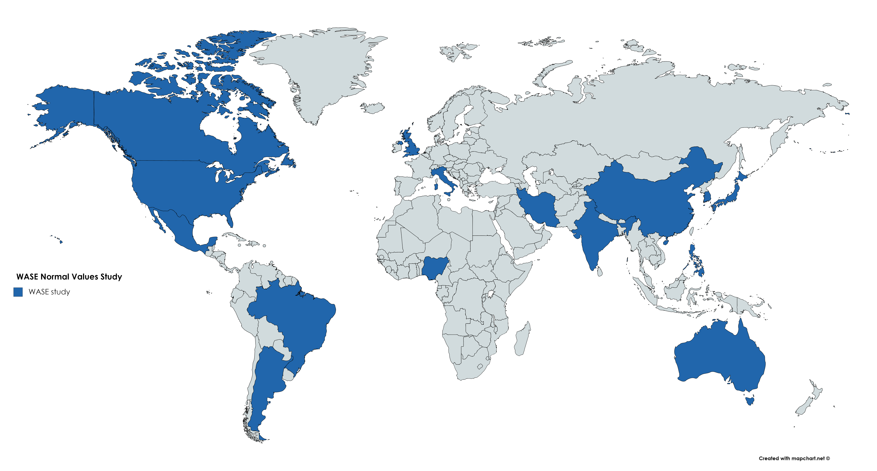
19 centers in 15 countries
Argentina,
Australia,
Brazil,
Canada,
China,
India, x2
Iran,
Italy, x2
Japan, x2
Mexico,
Nigeria,
Philippines,
South Korea,
United Kingdom
US Chicago,
US Seattle

Slide 15
Image analysis – CORE LABS
MedStar Health (2D and strain)
University of Chicago (3D)

Slide 16
2D analysis (TOMTEC) (ASE/EACVI Guidelines)
Left Ventricular Size
Left Ventricular Function
Dimensions (2D, plax)
Mass
Volumes (biplane MOD)
EF (biplane MOD)
Global longitudinal strain (2, 3, 4 ch)

Slide 17
Stats – Normal range
Includes 95% of healthy individuals, for each subgroup of data
Mean + SD x 1.96 (normal distribution)
Mean + SD x 1.96 of log-transformed (non-normal distribution)
2.5-97.5 percentile (non-normal)

Slide 18
Demographic Characteristics N=2008
Age, y.o. (median, IQ) | 45 (32 - 65)
Age group (n, %) 18-40 41-65 >65 | 854 (42.5) 653 (32.5) 501 (25.0)
Male, n (%) | 1033 (51.4)
Height, cm (median, IQ) | 167 (160 - 174)
Weight, kg (median, IQ) | 67 (58 – 77)
BSA, m² (median, IQ) | 1.76 (1.62 – 1.92)
Heart Rate, bpm (median, IQ) | 68 (60 - 75)
SBP, mmHg (median, IQ) | 120 (110 – 130)
DBP, mmHg (median, IQ) | 74 (69 – 80)

Slide 19
Race n (%) Ethnicity
White Black Asian Other (Mixed+Others) | 860 (42.8) 194 (9.7) 840 (41.8) 114 (5.7)
White (North America, Europe) White (Middle Eastern) Black Asian Hispanic Other | 605 (30.1) 162 (8.1) 196 (9.8) 839 (41.8) 202 (10.1) 4 (0.2)

Slide 20
Distribution by Country

Slide 21
Normal Ranges - Global
 | WASE |  |  | Guidelines
 | Male | Female | P value | Male | Female
LVIDd, mm | 36 - 56 | 33 - 51 | < 0.0001 | 42 - 58 | 38 - 52
LVIDd I, mm/m² | 19 - 30 | 20 - 31 | < 0.0001 | 22 - 30 | 23 - 31
LVIDs, mm | 22 - 37 | 21 - 34 | < 0.0001 | 25 - 40 | 22 - 35
LVIDs I, mm/m² | 12 - 20 | 12 - 21 | < 0.0001 | 13 - 21 | 13 - 21
IVSd, mm | 6 - 12 | 5 - 10 | < 0.0001 | 6 - 10 | 6 - 9
LVPWd, mm/m² | 6 - 11 | 5 - 10 | < 0.0001 | 6 - 10 | 6 - 9
LV Mass, g | 74 -204 | 55 - 148 | < 0.0001 | 88 - 224 | 67 - 162
LV Mass I, g/m² | 42 - 101 | 36 - 85 | < 0.0001 | 49 - 115 | 43 - 95
LVEDV, ml | 61 -165 | 47 - 122 | < 0.0001 | 62 - 150 | 46 - 106
LVEDVI, ml/m² | 34 - 80 | 31 - 70 | < 0.0001 | 34 - 74 | 29 - 61
LVESV, ml | 21 - 65 | 17 - 47 | < 0.0001 | 21 - 61 | 14 - 42
LVESVI, ml/m² | 12 - 32 | 11 - 28 | < 0.0001 | 11 - 31 | 8 - 24
LVEF, % | 57 - 68 | 58 - 69 | < 0.0001 | 52 - 72 | 54 - 74
LV GLS, % | -17 - -24 | -18 - -26 | < 0.0001 | NA | NA

Slide 22
Women smaller than men
 | WASE |  |  | Guidelines
 | Male | Female | P value | Male | Female
LVIDd, mm | 36 - 56 | 33 - 51 | < 0.0001 | 42 - 58 | 38 - 52
LVIDd I, mm/m² | 19 - 30 | 20 - 31 | < 0.0001 | 22 - 30 | 23 - 31
LVIDs, mm | 22 - 37 | 21 - 34 | < 0.0001 | 25 - 40 | 22 - 35
LVIDs I, mm/m² | 12 - 20 | 12 - 21 | < 0.0001 | 13 - 21 | 13 - 21
IVSd, mm | 6 - 12 | 5 - 10 | < 0.0001 | 6 - 10 | 6 - 9
LVPWd, mm/m² | 6 - 11 | 5 - 10 | < 0.0001 | 6 - 10 | 6 - 9
LV Mass, g | 74 -204 | 55 - 148 | < 0.0001 | 88 - 224 | 67 - 162
LV Mass I, g/m² | 42 - 101 | 36 - 85 | < 0.0001 | 49 - 115 | 43 - 95
LVEDV, ml | 61 -165 | 47 - 122 | < 0.0001 | 62 - 150 | 46 - 106
LVEDVI, ml/m² | 34 - 80 | 31 - 70 | < 0.0001 | 34 - 74 | 29 - 61
LVESV, ml | 21 - 65 | 17 - 47 | < 0.0001 | 21 - 61 | 14 - 42
LVESVI, ml/m² | 12 - 32 | 11 - 28 | < 0.0001 | 11 - 31 | 8 - 24
LVEF, % | 57 - 68 | 58 - 69 | < 0.0001 | 52 - 72 | 54 - 74
LV GLS, % | -17 - -24 | -18 - -26 | < 0.0001 | NA | NA

Slide 23
Women smaller than men
 | WASE |  |  | Guidelines
 | Male | Female | P value | Male | Female
LVIDd, mm | 36 - 56 | 33 - 51 | < 0.0001 | 42 - 58 | 38 - 52
LVIDd I, mm/m² | 19 - 30 | 20 - 31 | < 0.0001 | 22 - 30 | 23 - 31
LVIDs, mm | 22 - 37 | 21 - 34 | < 0.0001 | 25 - 40 | 22 - 35
LVIDs I, mm/m² | 12 - 20 | 12 - 21 | < 0.0001 | 13 - 21 | 13 - 21
IVSd, mm | 6 - 12 | 5 - 10 | < 0.0001 | 6 - 10 | 6 - 9
LVPWd, mm/m² | 6 - 11 | 5 - 10 | < 0.0001 | 6 - 10 | 6 - 9
LV Mass, g | 74 -204 | 55 - 148 | < 0.0001 | 88 - 224 | 67 - 162
LV Mass I, g/m² | 42 - 101 | 36 - 85 | < 0.0001 | 49 - 115 | 43 - 95
LVEDV, ml | 61 -165 | 47 - 122 | < 0.0001 | 62 - 150 | 46 - 106
LVEDVI, ml/m² | 34 - 80 | 31 - 70 | < 0.0001 | 34 - 74 | 29 - 61
LVESV, ml | 21 - 65 | 17 - 47 | < 0.0001 | 21 - 61 | 14 - 42
LVESVI, ml/m² | 12 - 32 | 11 - 28 | < 0.0001 | 11 - 31 | 8 - 24
LVEF, % | 57 - 68 | 58 - 69 | < 0.0001 | 52 - 72 | 54 - 74
LV GLS, % | -17 - -24 | -18 - -26 | < 0.0001 | NA | NA

Slide 24
Women better function
 | WASE |  |  | Guidelines
 | Male | Female | P value | Male | Female
LVIDd, mm | 36 - 56 | 33 - 51 | < 0.0001 | 42 - 58 | 38 - 52
LVIDd I, mm/m² | 19 - 30 | 20 - 31 | < 0.0001 | 22 - 30 | 23 - 31
LVIDs, mm | 22 - 37 | 21 - 34 | < 0.0001 | 25 - 40 | 22 - 35
LVIDs I, mm/m² | 12 - 20 | 12 - 21 | < 0.0001 | 13 - 21 | 13 - 21
IVSd, mm | 6 - 12 | 5 - 10 | < 0.0001 | 6 - 10 | 6 - 9
LVPWd, mm/m² | 6 - 11 | 5 - 10 | < 0.0001 | 6 - 10 | 6 - 9
LV Mass, g | 74 -204 | 55 - 148 | < 0.0001 | 88 - 224 | 67 - 162
LV Mass I, g/m² | 42 - 101 | 36 - 85 | < 0.0001 | 49 - 115 | 43 - 95
LVEDV, ml | 61 -165 | 47 - 122 | < 0.0001 | 62 - 150 | 46 - 106
LVEDVI, ml/m² | 34 - 80 | 31 - 70 | < 0.0001 | 34 - 74 | 29 - 61
LVESV, ml | 21 - 65 | 17 - 47 | < 0.0001 | 21 - 61 | 14 - 42
LVESVI, ml/m² | 12 - 32 | 11 - 28 | < 0.0001 | 11 - 31 | 8 - 24
LVEF, % | 57 - 68 | 58 - 69 | < 0.0001 | 52 - 72 | 54 - 74
LV GLS, % | -17 - -24 | -18 - -26 | < 0.0001 | NA | NA

Slide 25
WASE vs Guidelines
 | WASE |  |  | Guidelines
 | Male | Female |  | Male | Female
LVIDd, mm | 36 - 56 | 33 - 51 |  | 42 - 58 | 38 - 52
LVIDd I, mm/m² | 19 - 30 | 20 - 31 |  | 22 - 30 | 23 - 31
LVIDs, mm | 22 - 37 | 21 - 34 |  | 25 - 40 | 22 - 35
LVIDs I, mm/m² | 12 - 20 | 12 - 21 |  | 13 - 21 | 13 - 21
IVSd, mm | 6 - 12 | 5 - 10 |  | 6 - 10 | 6 - 9
LVPWd, mm/m² | 6 - 11 | 5 - 10 |  | 6 - 10 | 6 - 9
LV Mass, g | 74 -204 | 55 - 148 |  | 88 - 224 | 67 - 162
LV Mass I, g/m² | 42 - 101 | 36 - 85 |  | 49 - 115 | 43 - 95
LVEDV, ml | 61 -165 | 47 - 122 |  | 62 - 150 | 46 - 106
LVEDVI, ml/m² | 34 - 80 | 31 - 70 |  | 34 - 74 | 29 - 61
LVESV, ml | 21 - 65 | 17 - 47 |  | 21 - 61 | 14 - 42
LVESVI, ml/m² | 12 - 32 | 11 - 28 |  | 11 - 31 | 8 - 24
LVEF, % | 57 - 68 | 58 - 69 |  | 52 - 72 | 54 - 74
LV GLS, % | -17 - -24 | -18 - -26 |  | NA | NA

Slide 26
WASE vs Guidelines
 | WASE |  |  | Guidelines
 | Male | Female |  | Male | Female
LVIDd, mm | 36 - 56 | 33 - 51 |  | 42 - 58 | 38 - 52
LVIDd I, mm/m² | 19 - 30 | 20 - 31 |  | 22 - 30 | 23 - 31
LVIDs, mm | 22 - 37 | 21 - 34 |  | 25 - 40 | 22 - 35
LVIDs I, mm/m² | 12 - 20 | 12 - 21 |  | 13 - 21 | 13 - 21
IVSd, mm | 6 - 12 | 5 - 10 |  | 6 - 10 | 6 - 9
LVPWd, mm/m² | 6 - 11 | 5 - 10 |  | 6 - 10 | 6 - 9
LV Mass, g | 74 -204 | 55 - 148 |  | 88 - 224 | 67 - 162
LV Mass I, g/m² | 42 - 101 | 36 - 85 |  | 49 - 115 | 43 - 95
LVEDV, ml | 61 -165 | 47 - 122 |  | 62 - 150 | 46 - 106
LVEDVI, ml/m² | 34 - 80 | 31 - 70 |  | 34 - 74 | 29 - 61
LVESV, ml | 21 - 65 | 17 - 47 |  | 21 - 61 | 14 - 42
LVESVI, ml/m² | 12 - 32 | 11 - 28 |  | 11 - 31 | 8 - 24
LVEF, % | 57 - 68 | 58 - 69 |  | 52 - 72 | 54 - 74
LV GLS, % | -17 - -24 | -18 - -26 |  | NA | NA

Slide 27
Intercountry –LV Function
All p<0.05
Guidelines EF lower limit of normal should be raised

Slide 28
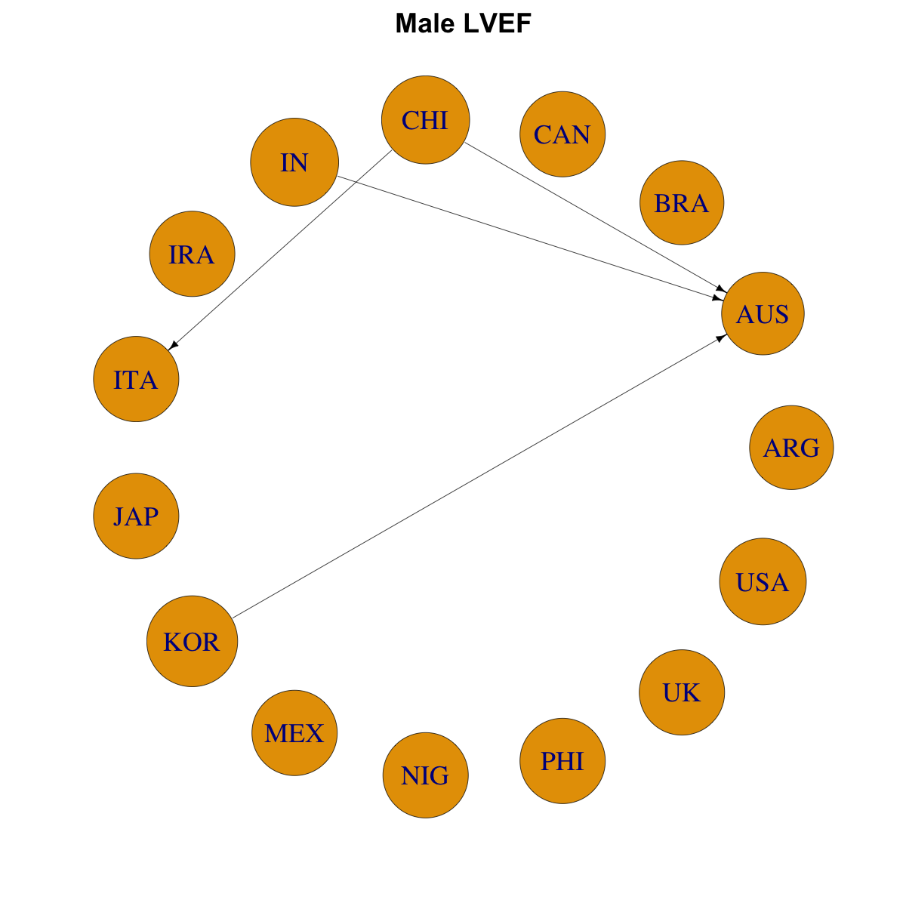
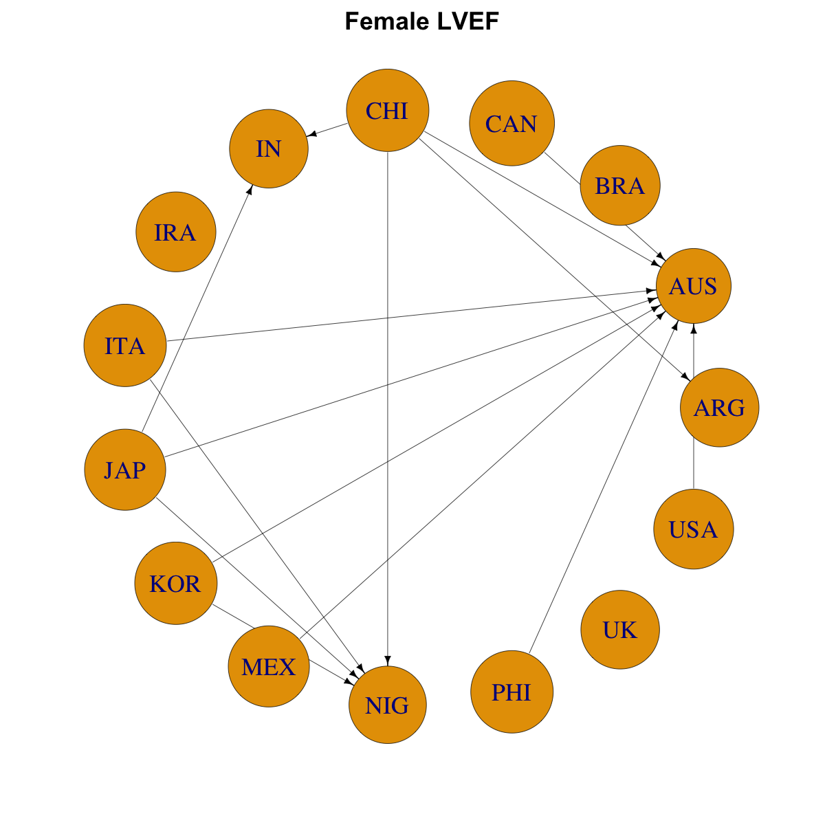
Mean EF - intercountry
Denotes intercountry statistical significance, arrow points from higher to lower

Slide 29
Intercountry –LV Size
All p<0.05
Guidelines LV volumes, dimensions and Mass index should be adjusted

Slide 30
Mean LVEDVI – intercountry comparisons
Denotes intercountry statistical significance, arrow points from larger to smaller

Slide 31
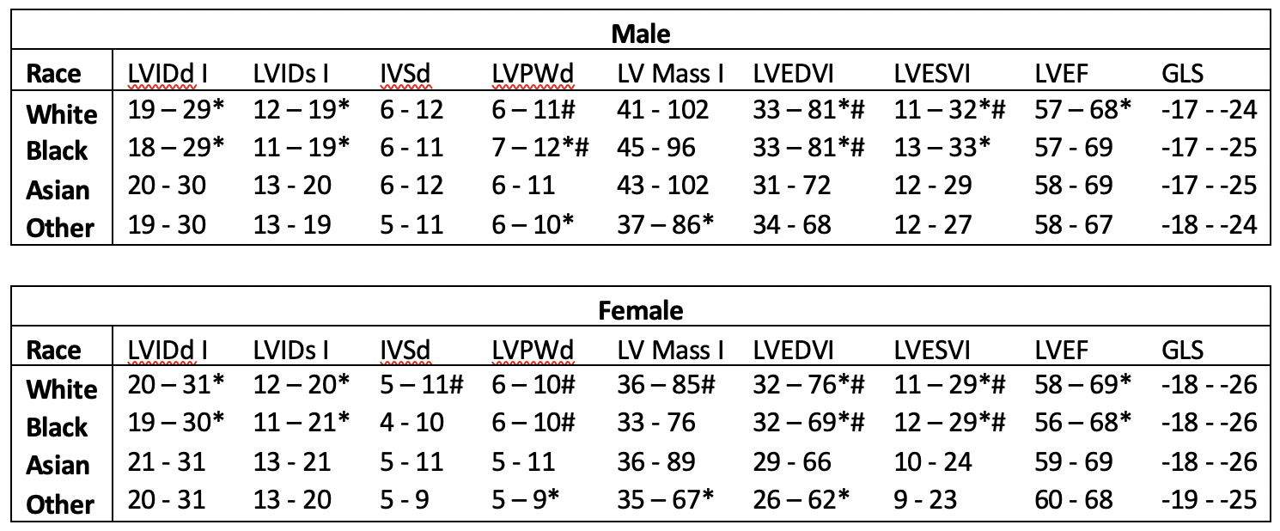
Comparison by Race
White = Black, larger than Asians and Mixed
Within each race, large inter-country variability

Slide 32
Limitations
Some regions in the world are under-represented
N per country is relatively small
GLS values may not be translated to non-TOMTEC workstations
No data on contrast echo

Slide 33
Conclusions I
WASE provides NEW normal reference values for LV size and function parameters across genders, races and countries
New normal values differ significantly from the ASE/EACVI guidelines
lower abnormality cutoff of LV EF should be adjusted upwards,
Upper limits of normal for LV volumes adjusted upwards
Indexed dimensions and mass should be adjusted downwards

Slide 34
Conclusions II
We found small differences in normal values in most parameters among subjects of different races and in different countries, which achieved statistical significance but may not be clinically relevant.
LV Size is different according to nationality and race: LV volumes MUST take into consideration race/country in addition to gender and body size.
Considering the described similarities and differences, characterization of patients based on gender, BSA and country or race should be considered to determine normality.

Slide 35
WASE Principal Investigators
• | Ricardo Ronderos, MD, FASE | Instituto Cardiovascular de Buenos Aires - Argentina
• | Gregory Scalia, MD, FASE | GenesisCare, Brisbane - Australia
• | Ana Clara Tude Rodrigues, MD | Hospital Israelita Albert Einstein, Sao Paulo - Brazil
• | Wendy Tsang, MD | University of Toronto, Toronto - Canada
• | Mei Zhang, PhD | Qilu Hospital of Shandong University - China
• | Vivekanandan Amuthan, MD, DM | Jeyalakshmi Heart Center, Madurai - India
• | Ravi Kasliwal, MD, DM, FASE | Medanta Heart Institute, Medanta - India
• | Anita Sadeghpour, MD, FASE | Rajaie Cardiovascular Medical and Research Center, Tehran - Iran
• | Eduardo Bossone MD, FASE / Rodolfo Citro MD | University of Salerno, Salerno - Italy
• | Denisa Muraru MD, FASE | University of Padova, Padova - Italy
• | Masao Daimon, MD | Tokyo University, Tokyo - Japan
• | Masaaki Takeuchi, MD, PhD, FASE | University of Occupational and Environmental Health, Kitakyushu - Japan
• | Pedro Gutierrez-Fajardo, MD, PhD, FASE | Hospital Bernadette, Guadalajara - Mexico
• | Kofo O Ogunyankin, MD, FASE | First Cardiology Consultants Hospital, Lagos - Nigeria
• | Edwin S. Tucay, MD, FASE | Philippine Heart Center, Quezon City - Philippines
• | Seung Woo Park, MD | Samsung Medical Center, Seoul - South Korea
• | Mark J. Monaghan, PhD | King’s College Hospital, London - UK
• | Karima Addetia, MD, FASE | University of Chicago, Chicago, IL - USA
• | James Kirkpatrick, MD, FASE | University of Washington, Seattle, WA - USA
Thank You
WASE Fellow: Tatsuya Miyoshi, MD - Osaka, Japan

Slide 36
Additional WASE Investigators - Thank You
Argentina: Aldo D. Prado, Centro Privado de Cardiologia, Tucumán, Argentina; Eduardo Filipini, Instituto Cardiovascular de Buenos Aires, Buenos Aires, Argentina
Australia: Agatha Kwon and Samantha Hoschke-Edwards, GenesisCare, Brisbane, Australia
Brazil: Tania Regina Afonso, Hospital Israelita Albert Einstein, Sao Paulo, Brazil
Canada: Babitha Thampinathan and Maala Sooriyakanthan, Toronto General Hospital, University of Toronto, Canada
China: Tiangang Zhu and Zhilong Wang, Peking University People's Hospital, Beijing, China; Yingbin Wang, Mei Zhang and Yu Zhang, Qilu Hospital of Shandong University, Jinan, China; Lixue Yin and Shuang Li, Sichuan Provincial People's Hospital, Sichuan, China.
India: R. Alagesan, Madras Medical College, Chennai, India; S. Balasubramanian, Madurai Medical College, Madurai, India; R.V.A. Ananth, Jeyalakshmi Heart Center, Madurai, India; Manish Bansal, Medanta Heart Institute, Medanta, Haryana, India
Italy: Luigi P Badano (currently at University of Milano-Bicocca and Istituto Auxologico Italiano, IRCCS, Milano, Italy) and Chiara Palermo, University of Padova, Padova, Italy; Eduardo Bossone (currently at Antonio Cardarelli ospital, Naples, Italy)Hospital, Naples, Italy), Davide Di Vece and Michele Bellino, University of Salerno, Salerno, Italy.
Japan: Tomoko Nakao, Takayuki Kawata, Megumi Hirokawa and Naoko Sawada MD, The University of Tokyo, Tokyo, Japan; Yousuke Nabeshima, University of Occupational and Environmental Health, Kitakyushu, Japan
Republic of Korea: Hye Rim Yun and Ji-won Hwang, Samsung Medical Center, Seoul, Republic of Korea
Nigeria: Dolapo Fasawe, First Cardiology Consultants Hospital Ikoyi, Lagos, Nigeria
TOMTEC Imaging Systems GmbH: Marcus Schreckenberg.

