Slide 1
A Randomized Comparison of Everolimus-­ Eluting Absorb Bioresorbable Vascular Scaffolds vs. Everolimus-Eluting Metallic Stents: One-Year Angiographic and Clinical Outcomes from the ABSORB China Trial
Runlin Gao, MD, Yuejin Yang, MD, PhD, Yaling Han, MD, PhD, Yong Huo, MD, Jiyan Chen, MD, Bo Yu, MD, Xi Su, MD, Lang Li, MD, Hai-Chien Kuo, PhD, Shih-Wa Ying, MS, Wai-Fung Cheong, PhD, Yunlong Zhang, MD, Xiaolu Su, MS, Bo Xu, MBBS, Jeffery J. Popma, MD, and Gregg W. Stone, MD on behalf of ABSORB China Investigators
For News Release

Slide 2
Disclosures
Runlin Gao has received a research grant
from Abbott Vascular

Slide 3
ABSORB China
Prospective, randomized, active control, open-label, multicenter study in 480 subjects enrolled from 24 sites in China
Inclusion: Up to 2 de novo lesions in separate native coronary arteries
Lesion length ≤24 mm, RVD ≥2.5 mm - ≤3.75 mm, %DS ≥50% - <100%
Exclusion: AMI, EF <30%, eGFR <30 mL/min/1.73m²,
LMCA, ostial lesion, excessive vessel tortuosity, heavy calcification,
myocardial bridge, bifurcation with side branch ≥2 mm
1: 1 Randomization
Absorb BVS Treat with single study device Diameters: 2.5, 3.0. 3.5 mm
Lengths: 8, 12, 18, 28 mm
XIENCE V
Treat with single study device Diameters: 2.5, 3.0. 3.5 mm
Lengths: 8, 12, 18, 28 mm
Primary Endpoint: In-Segment Late Loss at 1 Year
in the Per-Treatment-Evaluable (PTE) Population*
* Treated with only the study device (Absorb BVS or XIENCE V), without major pre-specified protocol deviations
Notes:
2

Slide 4
Patient Flow and Follow-up (ITT)
Randomized
(N=480)
Absorb BVS
(N=241)
XIENCE V (N=239)
Withdrawal = 3
2 = Withdrawal
Absorb BVS
(N=238)
1-Year Clinical F/U (N=475; 99.0%)
XIENCE V (N=237)
Absorb BVS
(N=208)
1-Year Angio F/U (N=407; 84.8%)
XIENCE V (N=199)
ITT = 480 subjects (Absorb BVS: 241 and XIENCE V: 239)
PTE = 460 subjects (Absorb BVS: 228 and XIENCE V: 232)

Slide 5
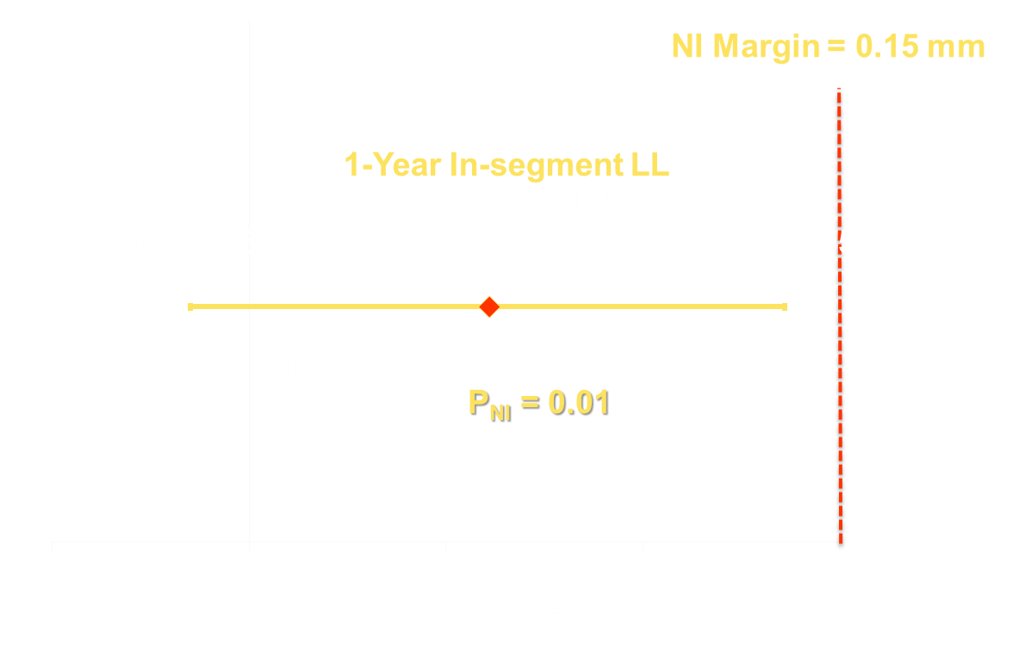
Primary Endpoint: In-Segment Late Loss at 1 Year (PTE)

Slide 6
One-Year QCA Results
 | Absorb BVS (L=251) | XIENCE V (L=252) | P-Value
RVD (mm) | 2.80 ± 0.03 | 2.82 ± 0.03 | 0.64
In-segment MLD (mm) | 2.13 ± 0.03 | 2.17 ± 0.03 | 0.46
In-device MLD (mm) | 2.27 ± 0.03 | 2.50 ± 0.03 | <0.0001
In-segment %DS | 23.5 ± 0.84 | 23.0 ± 0.92 | 0.67
In-device %DS | 18.5 ± 0.92 | 11.3 ± 0.76 | <0.0001
In-segment LL (mm) | 0.18 ± 0.03 | 0.13 ± 0.03 | 0.15
In-device LL (mm) | 0.23 ± 0.03 | 0.10 ± 0.02 | 0.0001
In-segment restenosis (%) | 3.85 ± 1.34 | 2.75 ± 1.13 | 0.53
In-device restenosis (%) | 2.88 ± 1.16 | 0.75 ± 0.56 | 0.10
QCA results are presented as least square mean ± standard error.
Notes:
5

Slide 7
One-Year Clinical Outcomes
 | Absorb BVS (N=241) | XIENCE V (N=239) | P-Value
PoCE | 8.0% (19/238) | 9.7% (23/237) | 0.51
TVF | 4.2% (10/238) | 5.9% (14/237) | 0.40
DoCE (TLF) | 3.4% (8/238) | 4.2% (10/237) | 0.62
All-cause death | 0.0% (0/238) | 2.1% (5/237) | 0.03
- Cardiac death | 0.0% (0/238) | 1.3% (3/237) | 0.12
All MI* | 2.1% (5/238) | 1.7% (4/237) | 1.0
- TV-MI* | 1.7% (4/238) | 0.8% (2/237) | 0.69
All revascularization | 6.7% (16/238) | 7.2% (17/237) | 0.85
- ID-TLR | 2.5% (6/238) | 2.1% (5/237) | 0.77
PoCE=patient-oriented composite endpoint (all-cause death, all MI, or any revascularization); DoCE=device-oriented composite endpoint; * CK-MB > 5x ULN for peri-procedural PCI MI
Notes:
6

Slide 8
One-Year Scaffold/Stent Thrombosis
 | Absorb BVS (N=241) | XIENCE V (N=239) | P-Value
All (0 - 365 days) | 0.4% (1/238) | 0.0% (0/232) | 1.0
Definite | 0.0% (0/238) | 0.0% (0/232) | 1.0
Probable | 0.4% (1/238) | 0.0% (0/232) | 1.0
Early (0 – 30 days) | 0.4% (1/238) | 0.0% (0/236) | 1.0
Late (31- 365 days) | 0.0% (0/238) | 0.0% (0/232) | 1.0
There was only one ST case reported in the Absorb BVS arm (subacute, probable)
Notes:
7

Slide 9
Summary and Conclusions
ABSORB China met its primary endpoint of non-inferiority between Absorb BVS and XIENCE V for in-segment late loss at 1 year.
Absorb BVS achieved high rates of acute device and procedural success, similar to XIENCE V.
TLF and components (cardiac death, TV-MI, ID-TLR) were low and comparable between treatment arms through 1 year.
Device thrombosis rates were very low and not statistically different.
Notes:
8

Slide 10
Journal of the American College of Cardiology
Embargo: October 12, 2015

Slide 11
Thank You

