Slide 1
Huge Rectus Sheath Haematoma Complicating Insertion of Inferior Vena Cava Filter
Amro Elnagar.MD
Lecturer of cardiology
Banha University Hospital

Slide 2
Amro Elnagar, MD
I have no relevant financial relationships

Slide 3
Learning objectives
Rectus sheath haematoma(RSH) is uncommon cause of abdominal pain but could be fatal ,especially in anticoagulated patients.
Care during femoral puncture is important to avoid laceration of inferior epigastric artery.

Slide 4
Clinical Presentation
A 69 years old female,hypertensive.
Presented with Left side iliofemoral DVT ,treatment with LMWH & Warfarin was started.
Three days later, she complained acute onset dyspnea,chest pain &hypotension .
ECG:unremarkable except for sinus tachycardia
Echo: Dilated right side with moderate plumona
Plumonary CT angiography confirmed diagnosis
of massive plumonary embolism.

Slide 5
Procedure data
We decided to insert IVC filter for prevention of recurrent pulmonary embolism.
Through right femoral vein,6F sheath was inserted ,Celect TM (COOk) was inserted .
The procedure went smoothly & patient transferred to intermediate care room.

Slide 6
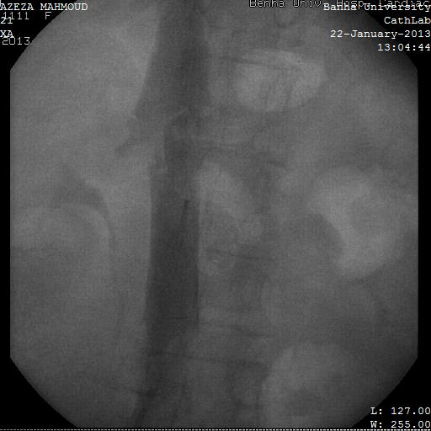

Slide 7
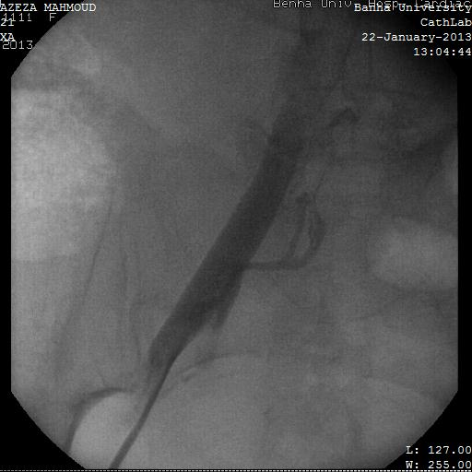

Slide 8
Two hours later,patient became hypotensive (70/40),tachypenic,tachycardic with abdominal pain & localized tenderness.
Fluid resuscitation was started, however the patient did not improved.
CBC shows decrease hemoglobin(7g/dl) & haematocrit value (24).
4 units of packed RBCs & 4 unit of plasma were given.

Slide 9
Abdominal CT with contrast revealed type III rectus sheath haematoma extending into pelvis with active bleeding into haematoma.

Slide 10
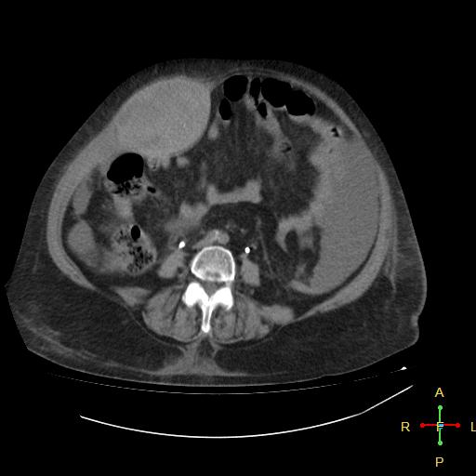
Type III rectus sheath hematoma extending into pelvis with disruption of rectus sheath inferiorly.

Slide 11
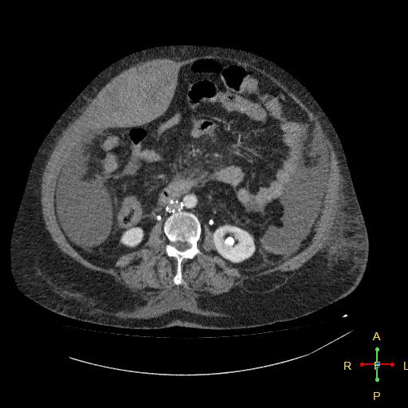
Imaging study

Slide 12
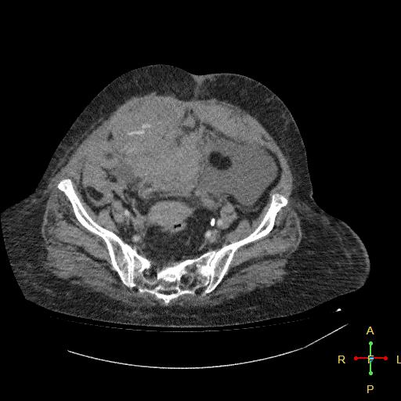

Slide 13
Discussion was made with vascular surgeons to decide whether to perform Gel Foam emblization or open surgical ligation of bleeder & evacuation of haemtoma.
Surgical ligation was done successfully with complete evacuation of haematoma.

Slide 14
The patient was discharged to home after 7 days in stable condition.

Slide 15
Take Home Message
Rectus sheath hematoma is serious complication especially in anticoagulated patients.
Laceration of inferior epigastric artery can occur during femoral puncture.
Early diagnosis & management is of paramount importance as this condition can be fatal.

