Slide 1
Direct Carotid Artery Puncture
Michael Wholey, MD MBA
Omer Gotekin, MD
Mark Wholey, MD
March 3, 2018 15:15-15:25

Slide 2
Michael Wholey, MD, MBA
Audie Murphy VA Hospital
San Antonio, TX
I have no relevant financial relationships

Slide 3
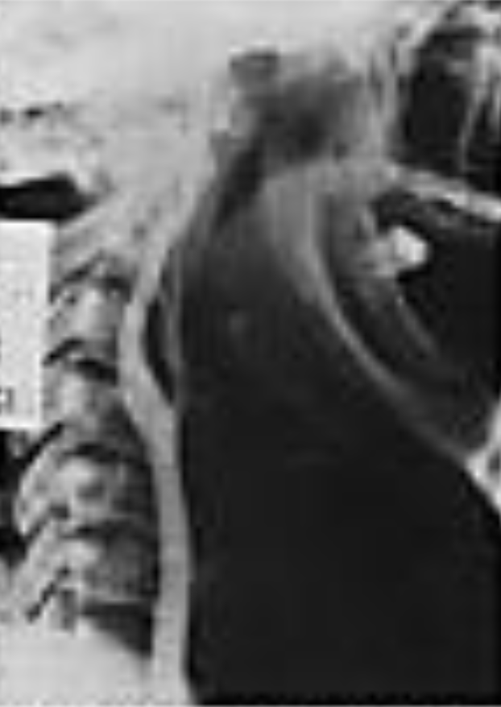
History
Direct Carotid Puncture Angiography
Loman and Meyerson 1935
Before this, 1927 carotid angiography with surgical exposure by Moniz et al

Slide 4
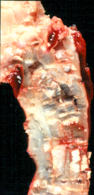
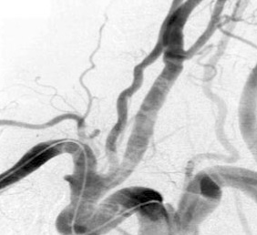
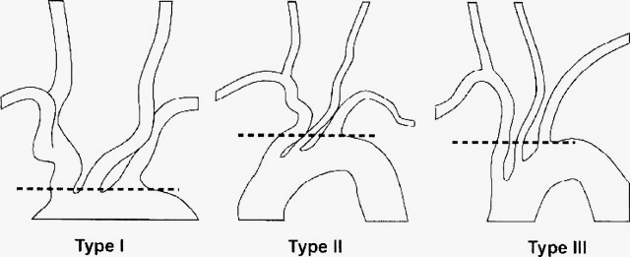
History
Carotid Developments
Carotid Stenting
Encountering difficult aortic arches
Concern for embolic debris
In the CHOICE Carotid Stent Trial, 18% of the strokes came from the aortic arch

Slide 5
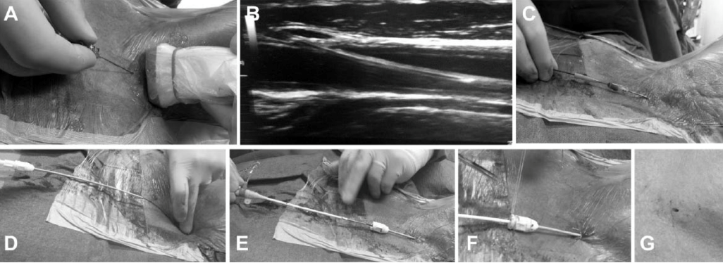
Patrice Bergeron,MD
A) Puncture of the common carotid artery (CCA) under ultrasound guidance. (B) Longitudinal view of the CCA witha guidewire inserted. (C) Placement of a 4-F introducer for delivery of the 0.035-inch guidewire to the external carotid artery. (D) Exchange of the 4-F introducer for the closure device sheath during the preclose technique. (E) Placement of a regular 6-F introducer in the closure device sheath, (F) which is then sutured to the skin. (G) Final appearance of the puncture after closure device application.

Slide 6
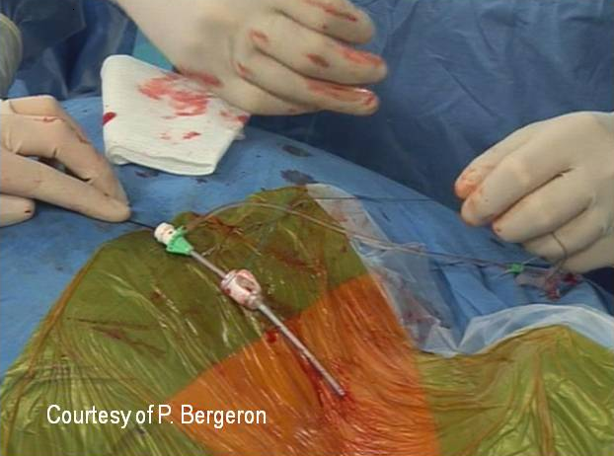
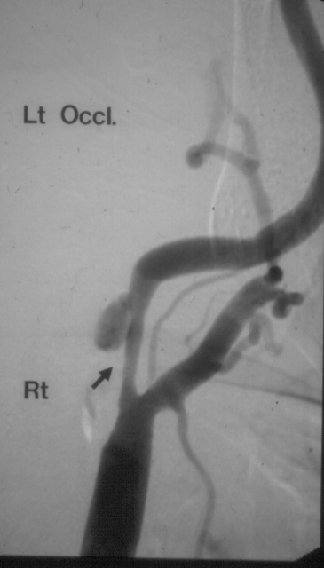
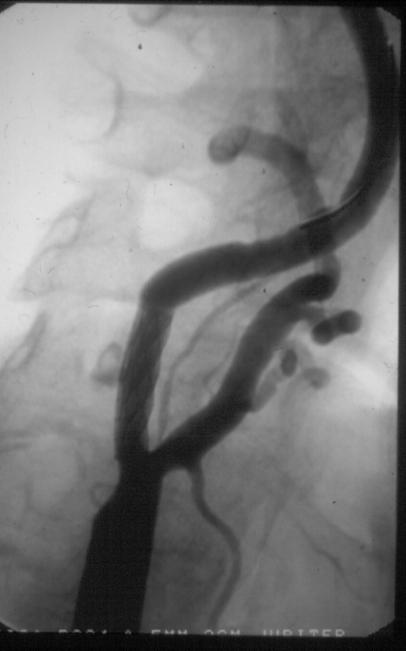
Patrice Bergeron Direct Carotid Access
1992-2009, 254 CAS were from a direct carotid access, 2 patients presented with a TIA, 1 patient developed a major stroke from hyperperfusion syndrome, and 1 patient developed monocular blindness. The stroke rate was 0.8%. No nerve palsy was observed. One cervical hematoma without life-threatening complication was observed and resolved spontaneously without surgery. Ideally Octogenarians and complex aortic arch. No major difference with CEA

Slide 7
Latest in CAS: Advent of TCAR

Slide 8
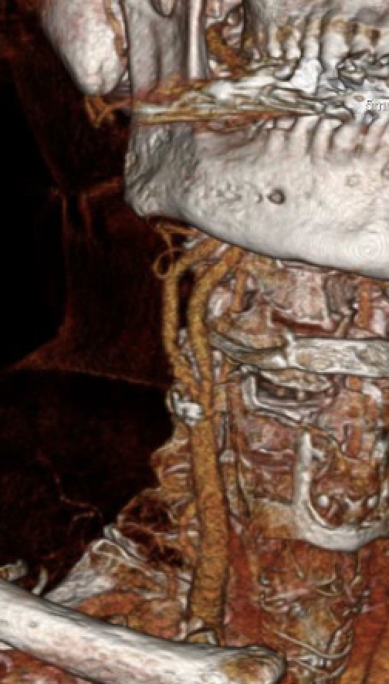
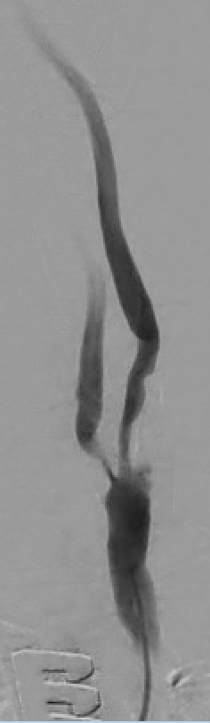
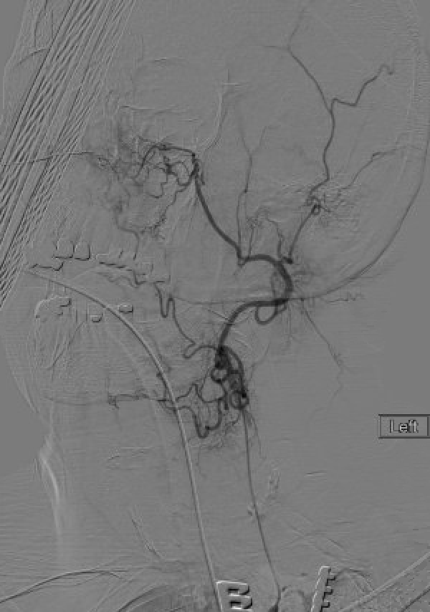
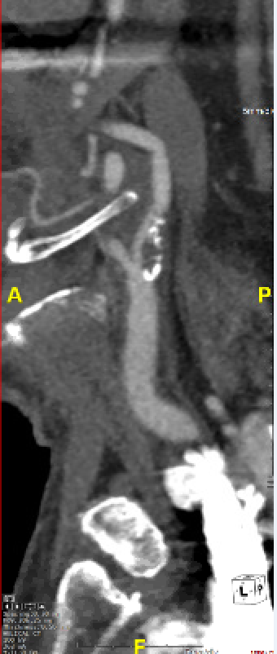
TCAR Case
Initial Access
Selecting External Carotid for support

Slide 9
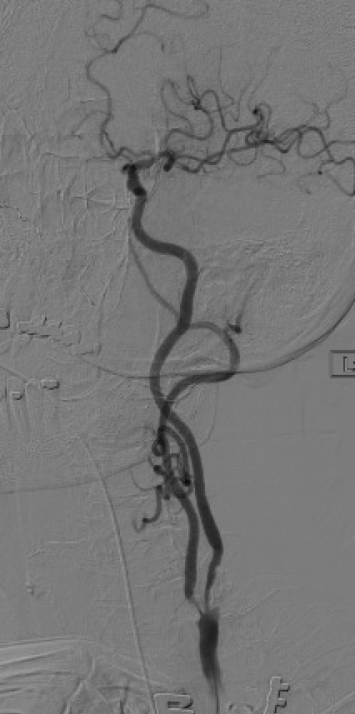
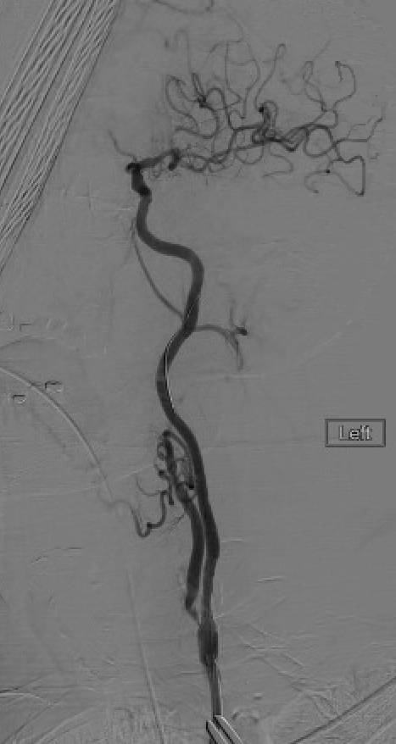
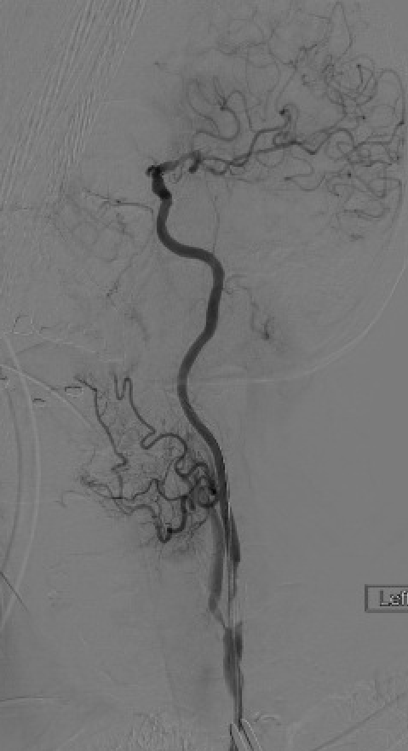
TCAR Case
Initial Angiogram
Crossing lesion with stent
Final Angiogram

Slide 10
History Repeats Itself
Return to Direct Carotid Access:
A valuable alternative to femoral access :
Selected neuroendovascular cases, when the femoral approach is impossible or contraindicated.
Treatment of acute stroke in a patient in whom common carotid artery and internal carotid artery tortuosity prevents the delivery of catheters

Slide 11
THE ISTANBUL STROKE TRIAL 2014
Mark Wholey MD
Omer Goktekin MD
Mehmet Cilinglroglu MD
Bezmialem Vaklf University Istanbul, Turkey
UPMC Shadyside, Pittsburgh, Pa

Slide 12
Case Presentation
36 year old female
Lengthy history of dilated cardiomyopathy
Pt is on coumadin with an INR of 2.37
Initially admitted to vascular surgery with episode of acute lower extremity ischemia secondary to an embolic event
During workup, pt had sudden onset of acute right-sided weakness: right-sided hemiparesis and right-sided hemianopsia
Speech difficulty with slight motor aphasia and NIH score: 18

Slide 13
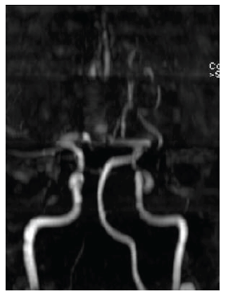
Diffusion MRI
Imaging
Early ischemic changes occurring in left lenticulostriate and periventricular site region
Left MCA
M1 occlusion is demonstrated on the TOF – MRA images

Slide 14
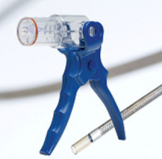
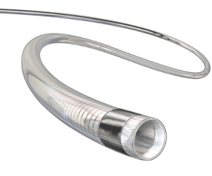
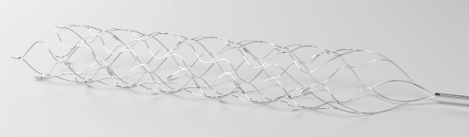
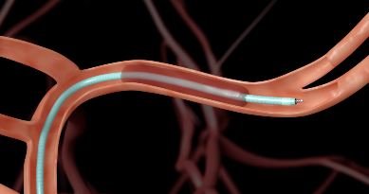
5 Fr Aspiration and Delivery catheters 25-30 cm length
Equipment
Aspire Suction System
Aspiration Catheter
(Penumbra 5Max)
Medtronics Solitaire Flow Restoration Device

Slide 15
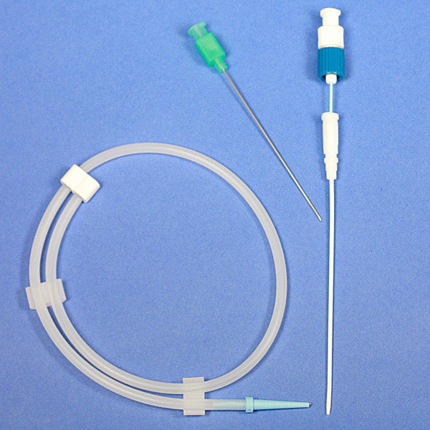
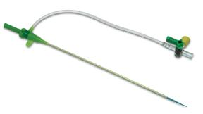
Direct Carotid Access
Gain Access with ultrasound and micropuncture set (21 gauge needle) at C-5 or C -6 Level

Slide 16
p
ECA
21 g needle at C5
ICA

Slide 17
Advance wire into ECA for support and then advance sheath into CCA

Slide 18
Ultrasound for localization at C 5 site
10 cm 6 fr SHEATH in position
At the common carotid and passed to the internal carotid
-3,000 Heparin

Slide 19
LEFT CAROTID INJECTION
TOTAL OCCLUSION Lt. M 1 DISTAL TO LENTICULO STRIATES
COLLATERAL VESSELS INTACT

Slide 20
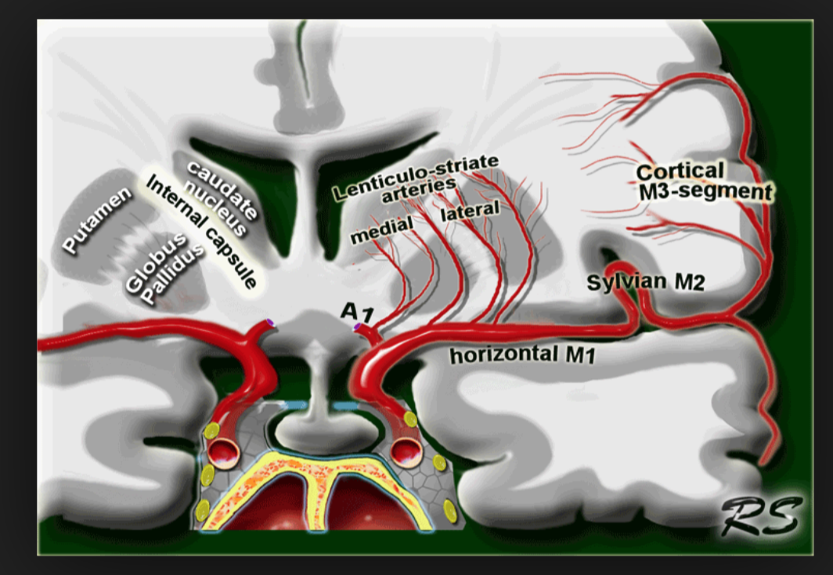
Crossing Left ICA
0.014” Whisper Wire

Slide 21
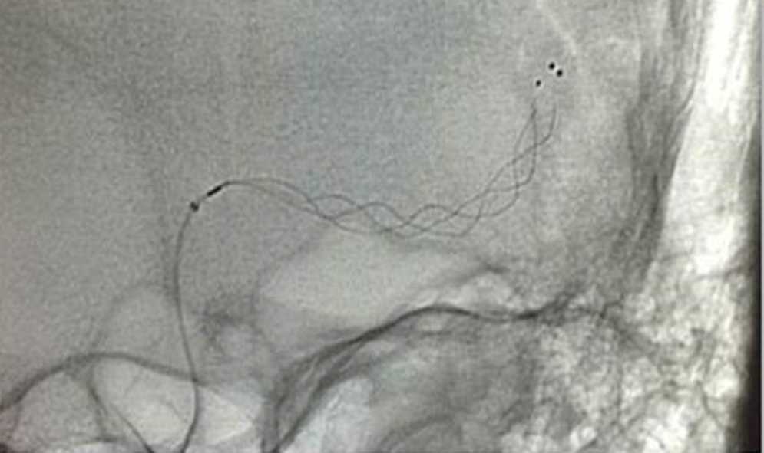
Clot Removal and Aspiration
Solitaire with clot removed
Solitaire in clot position at M1 and Proximal M2 of the Left ICA

Slide 22
Post Recanalization Images

Slide 23
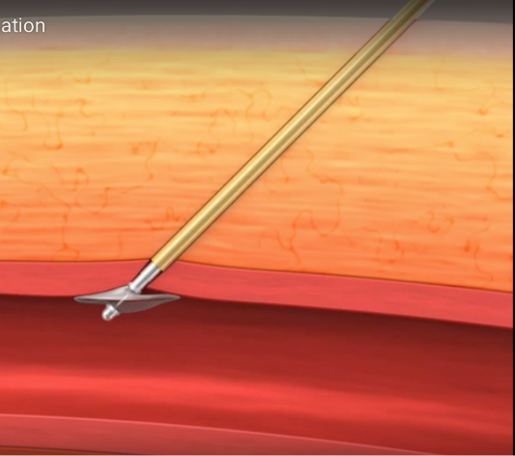
,
Total Time for Access, Aspiration, Thrombectomy and Percutaenous Closure → 30 minutes
Closure: Cardiva Boomerang/Catalyst

Slide 24
Progressive timing of entire procedure
1300
1320
1400
Direct Carotid Puncture
1415
Device Aspiration & Thrombectomy
1445
Successful Reperfusion & Percutaneous Closure
Stroke Onset
1330
Imaging Exam
Neurologic Exam

Slide 25
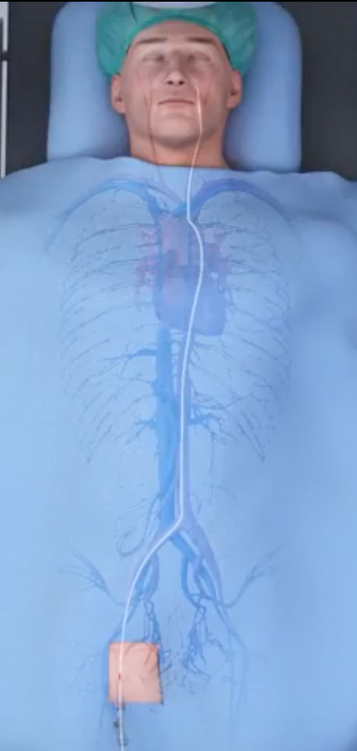
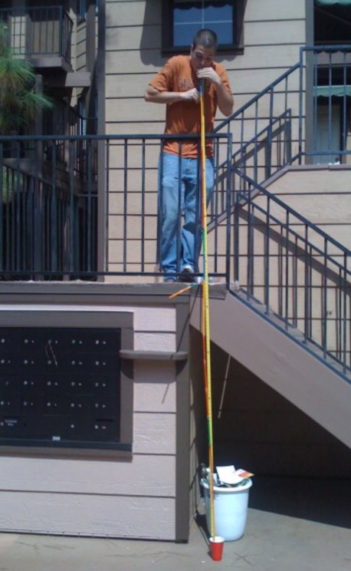
Physics
Hagen–Poiseuille equation

Slide 26
Conclusion: Direct Carotid Access for Stroke
Mechanical aspiration and thrombectomy from a transcarotid access may be a useful addition to the endovascular treatment of acute stroke
30 cm Shortened devices are more efficient
More Torque Control
Greater Suction
Avoid the aortic arch and origins of great vessels
Reduced procedure time

Slide 27
Conclusion: Direct Carotid Access for Carotid Stenting
Offers new potential for treatment
Vascular Surgery oriented with current devices
Do we really need a cutdown?
Embolic risks still there, but hopefully reduced

Slide 28
Conclusion
Disadvantages of Direct Carotid Access
Radiation Dose
Hands close proximity to the image intensifier
(Re) Education of physicians
Risk of Closure Devices
Difficulty in anticoagulation

