Slide 1



MeRes-1 Study:
Three-year clinical and two-year multimodality imaging outcomes of thin- strut sirolimus-eluting bioresorbable vascular scaffold in patients with coronary artery disease
Dr. Praveen Chandra
MD, DM, FACC, FESC, FSCAI, FAPSIC
Chairman- Interventional Cardiology Medanta-The Medicity, India
On Behalf of MeRes-1 Investigators

Slide 2
Potential Conflicts of Interest
Speaker's name : Praveen Chandra
☑ I have the following potential conflicts of interest to declare:
Grant/ Research support: Meril Life Sciences

Slide 3
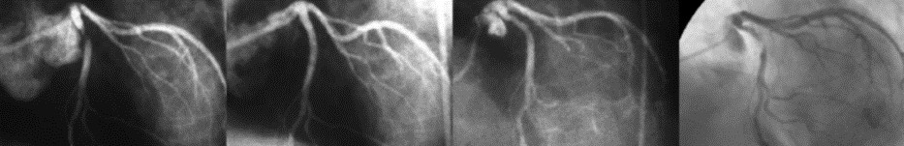
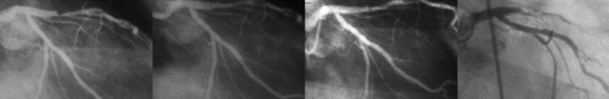
Why do we Need a New Approach for Coronary Artery Disease?
Very late adverse events after metallic stents
In-stent restenosis (at 15 years)
Pre
Post 5 years
15 years
Stent thrombosis (at 17 years)
Pre
Post
2 years
17 years
Yamaji K et al. Circ CV Int 2010

Slide 4
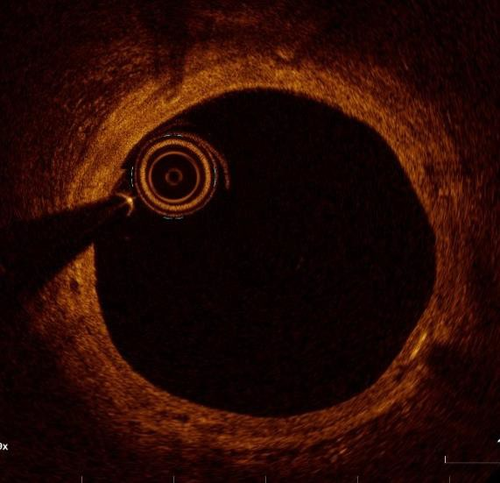
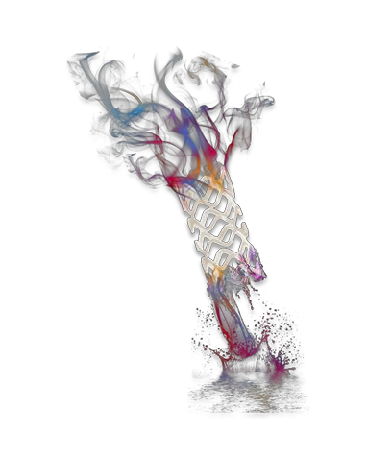
Leave no permanent implant behind – Future Tx Possibilities
The Promise of 1st Gen BVS– ‘Golden Tube’

Slide 5
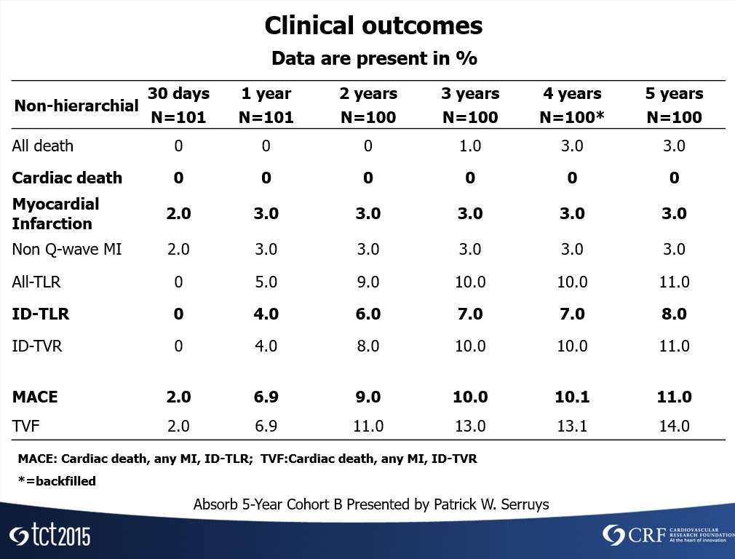
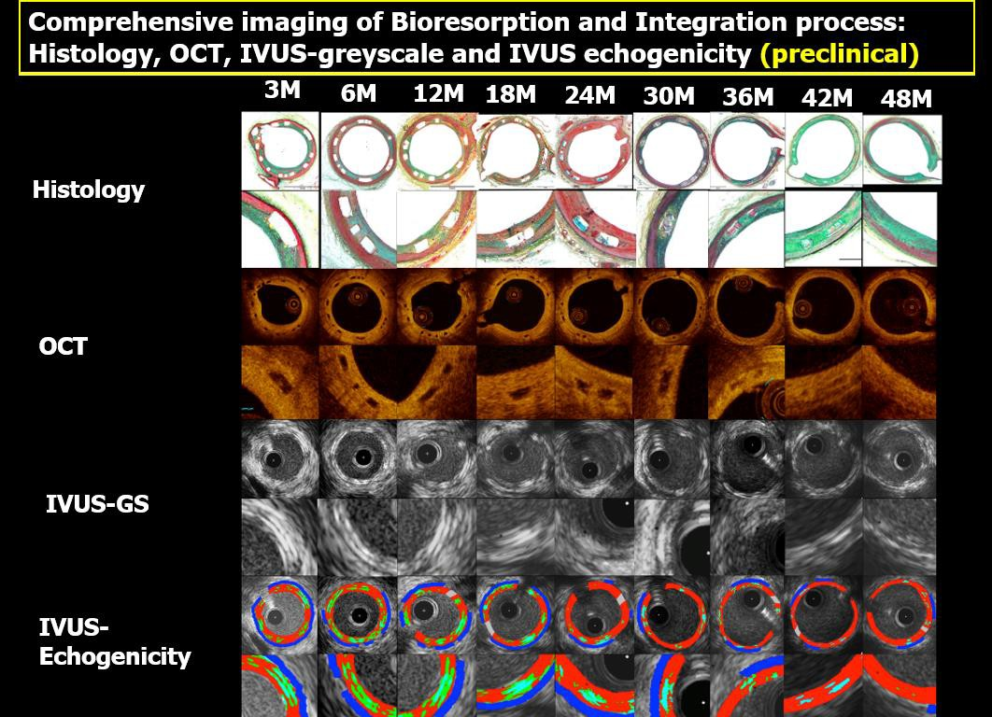
Initial Results of BVS were promising
Absorb 5-Year Cohort B Presented by Patrick W. Serruys

Slide 6
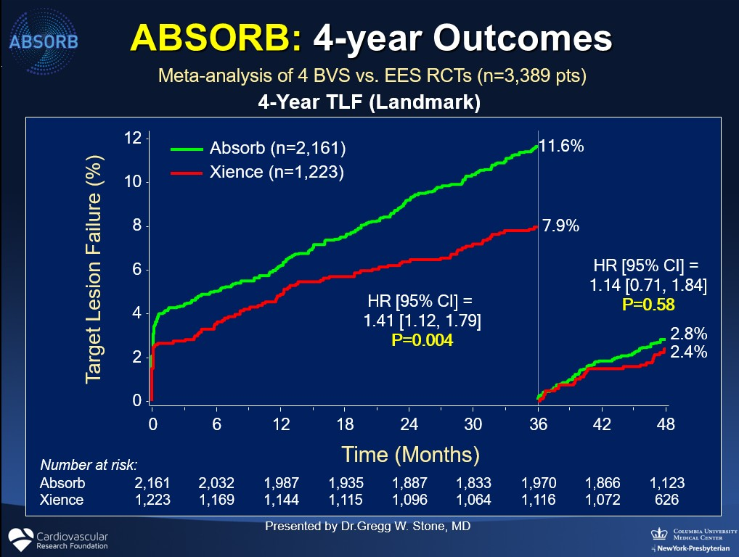
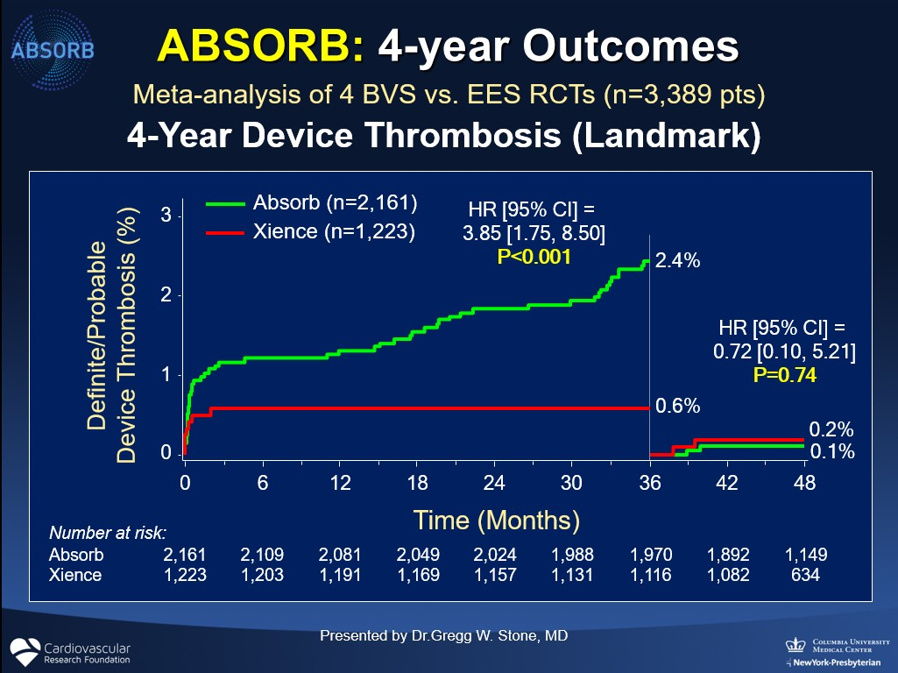
But, Reality was presenting differently & we learnt from the same
BVS specific procedures/techniques – lesion selection, dilatation, sizing
2nd Generation device required

Slide 7

What are we looking from 2nd Generation BRS?
Acute Performance + Long Term Safety and Efficacy
Reduced strut thickness, improved profile for better deliverability
Faster degradation and possibly lower Scaffold Thrombosis Large size matrix to cover multitude of morphologies Ability to treat lesions across clinical spectrum
Regular Cath-lab storage conditions & long shelf life
Source: Data on File; 3year f/up of MeRes100 in Porcine coronary arteries, CRF Skirball Centre for Innovation

Slide 8




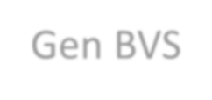




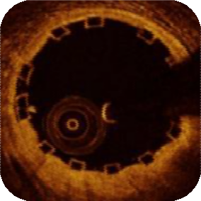

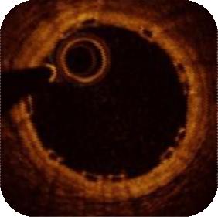








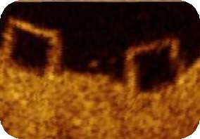
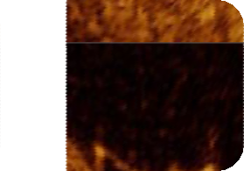








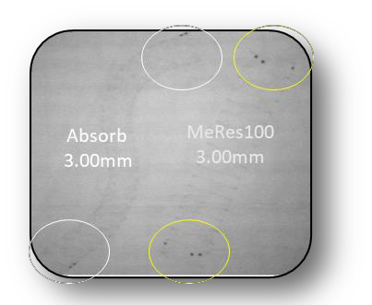









MeRes100 – The 2nd Generation BRS
Features
1st Gen BVS
MeRes100
Hybrid Geometry
Cell Design
Multi-link design platform
Absorb 150μm
MeRes100 100μm
Scaffold to
Artery Ratio
35-40%
24%
Strut Thickness
150µm
100µm
100 μm
Crossing
Profile
1.4mm
1.2mm
RO Markers
Pair of RO markers at
opposite end
Couplets of 3 RO markers
on each end
Size Matrix
14 SKUs
D 2.50-3.50 mm & L 8-28 mm
63 SKUs
D 2.50 – 4.00 mm & L 8-40 mm
Storage
Prefer Refrigeration
Cath-Lab Temperature

Slide 9
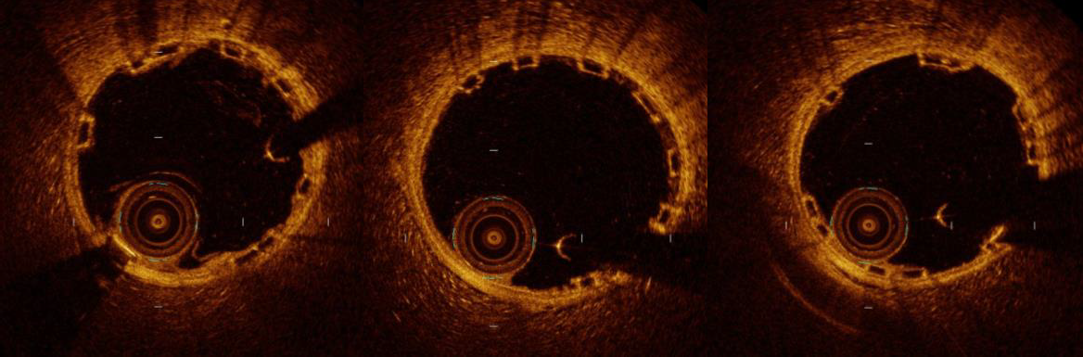
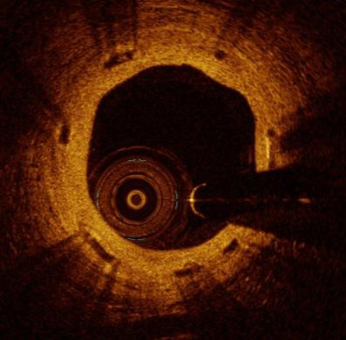
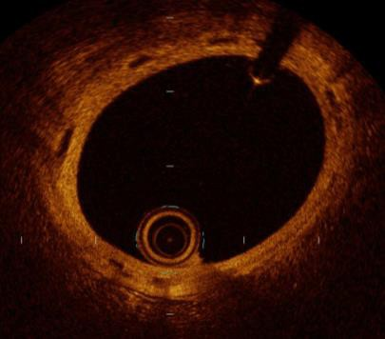
OCT images illustrating the changes of strut core
appearance at Day 0 and at 1 , 2 & 3 Years Follow-up
MeRes100 BRS: Evidence of ‘Golden Tube’
Pre-Clinical
Day 0
Day 0
Day 0
Preserved boxes
1 Year
2 Years
3 Years
Ghost scaffold
Golden tube
Source: MeRes100 in Porcine coronary arteries, CRF Skirball Centre for Innovation

Slide 10

MeRes-1 Study Design
CTRI/2015/04/005706
First-in-Human Safety and Efficacy in Patients with Single, De- novo Coronary Lesion (in up to 2 vessels) treated by a Single MeRes100 Scaffold up to 24mm length in 108 pts
Clinical follow-up
N = 108 30-days 6-months 1-year$ 2-years 3-years
*QCA, IVUS, OCT & CTA follow-up
CLINICAL FOLLOW-UP | 108 | 108 | 108 | 108 | 108
ANGIOGRAPHIC FOLLOW- UP | - | 37 | - | 37 | -
OCT FOLLOW-UP | - | 13 | - | 13 | -
IVUS FOLLOW-UP | - | 12 | - | 12 | -
CTA FOLLOW-UP | - | - | 12 | - | -
Diameters Lengths DAPT Rx
– 2.25-4.50 mm
– 13-48 mm
– 1 year
$Seth A et al., EuroIntervention 2017; 13: 415-423. *Pre-designated sites and patients consents

Slide 11
Key Eligibility Criteria
Key Inclusion Criteria Key Exclusion Criteria
Age 18-65 years
Up to 2 lesions in native arteries
1 lesion per target vessel allowed
RVD 2.75-3.50 mm
Lesion length ≤ 20 mm
Stenosis ≥ 50% & < 100%
TIMI ≥ 1
Acute MI <7 days
Creatinine ≥1.3 mg/dL
Prior revascularization
LVEF ≤ 30%
LM and/or Ostial location
Significant calcification
Bifurcation lesion (SB >2 mm)
Severe tortuosity/angulation

Slide 12
Major Endpoints
Safety
  Primary Endpoint:
    MACE at 6-month (Cardiac death, MI*, ID-TLR)
  Secondary Endpoints:
    Device & procedure success
    Scaffold thrombosis (ARC defined)
Efficacy
  QCA: Late lumen loss (in-scaffold / in-segment)
  OCT: Minimum lumen area (flow area), NIH area
  IVUS: Scaffold & lumen area, %VO
  CTA: Mean/minimal lumen, plaque & vessel area; Area stenosis;
% Cross sections with calcified, mixed & non-calcified plaque
* Definition of MI – includes all Myocardial Infarction

Slide 13
Study Organisation
PI – Dr. Ashok Seth, Fortis Escorts, New Delhi
Co-PI – Dr. Praveen Chandra, Medanta, Gurugram
Co-PI – Dr. Vinay K. Bahl, AIIMS, New Delhi
Core Labs
  Angiographic
  IVUS / OCT /CTA
Cardiovascular Research Center, Sao Paulo
Cardialysis, Rotterdam
CRO
  Data Management – JSS, New Delhi

Slide 14
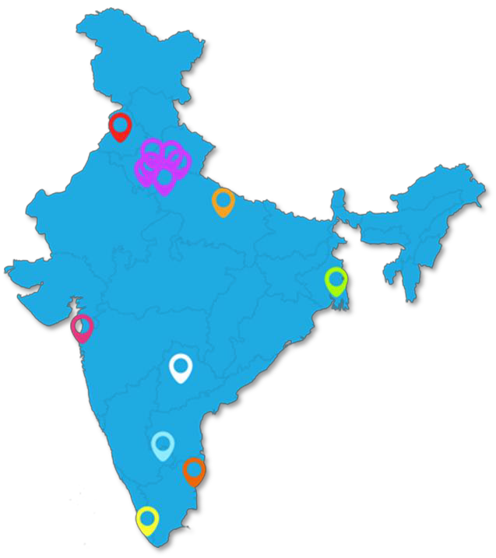
Investigating Sites
108 Patients, 13 Investigating Sites
Investigating Site | City | Investigator | # Enrolled
Jayadeva | Bangalore | Dr. C. N. Manjunath | 23
LTMG | Mumbai | Dr. Ajay Mahajan | 20
Max | New Delhi | Dr. Viveka Kumar | 13
SGPGI | Lucknow | Dr. P. K. Goel | 11
Medanta The Medicity | Gurugram | Dr. Praveen Chandra | 10
AIIMS | New Delhi | Dr. Vinay K. Bahl Dr. Sundeep Mishra | 07
Hero DMC | Ludhiana | Dr. G. S. Wander | 07
Fortis Escorts | New Delhi | Dr. Ashok Seth | 06
Apollo | Chennai | Dr. Samuel Mathew Dr. G. Sengottuvelu | 04
Sree Chitra | Trivandrum | Dr. Ajit Kumar V. K. | 03
Fortis Vasant Kunj | New Delhi | Dr. Upendra Kaul | 02
GB Pant | New Delhi | Dr. Vijay Trehan | 01
Apollo Jubilee Hills | Hyderabad | Dr. P. C. Rath | 01

Slide 15
Baseline Demographics
Clinical characteristics of the patients | n = 108
Age, Years, (mean±SD) | 50.1±8.8
Male, n (%) | 77 (71.3)
Smokers, n (%) | 18 (16.7)
Diabetes mellitus, n (%) | 30 (27.8)
Dyslipidemia, n (%) | 14 (13.0)
Hypertension, n (%) | 45 (41.7)
Previous Myocardial Infarction (>7 days), n (%) | 37 (34.3)
Clinical Presentation, n (%)
Stable Angina | 56 (51.9)
Unstable Angina | 37 (34.3)
Silent Ischemia/Asymptomatic | 15 (13.9)
Left ventricular ejection fraction, %, (mean±SD) | 50.6±9.9
^{Type B1/B2/C Lesions} 100% device and 99% procedural succes | _{s} 93.1%

Slide 16
Cumulative Clinical Outcomes up to 3-year Follow-up
Events, n (%) | In-Hospital n =108 | 6-month n =108 | 1-year n = 107 | 2-year n = 107 | 3-year n=107
Cumulative MACE | 0 (0) | 0 (0) | 1 (0.93) | 2 (1.87) | 2 (1.87)
Cardiac Death | 0 (0) | 0 (0) | 0 (0) | 0 (0) | 0 (0)
Myocardial Infarction | 0 (0) | 0 (0) | 0 (0) | 0 (0) | 0 (0)
ID-TLR | 0 (0) | 0 (0) | 1 (0.93) | 2 (1.87) | 2 (1.87)
Non-cardiac death | 0 (0) | 1 (0.93)* | 1 (0.93) | 1 (0.93) | 1 (0.93)
Scaffold Thrombosis | 0 (0) | 0 (0) | 0 (0) | 0 (0) | 0 (0)
*Death due to Aminophylline-induced anaphylactic shock. @ Myocardial Infarction defined as per WHO criteria. $ ARC defined criteria.
Sustained successful clinical outcomes up to 3 years

Slide 17
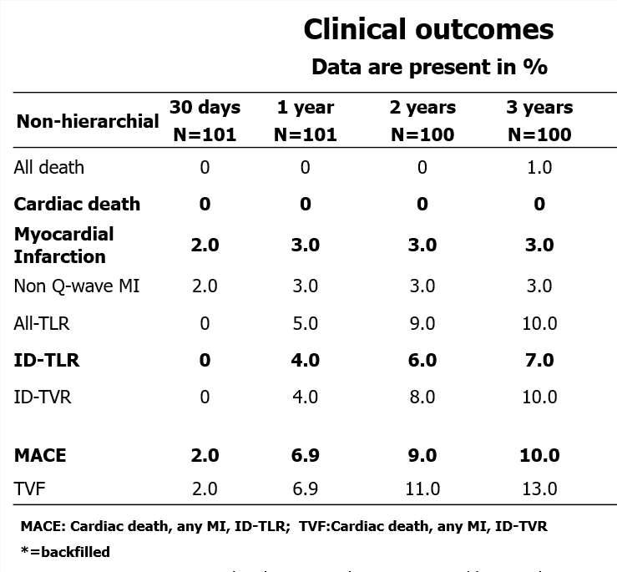
Cumulative Clinical Outcomes up to 3-year Follow-up
Events, n (%) | In- Hospital n =108 | 6-month n =108 | 1-year n = 107 | 2-year n = 107
 |  |  |  |  | 3-year n=107
Cumulative MACE | 0 (0) | 0 (0) | 1 (0.93) | 2 (1.87) | 2 (1.87)
Cardiac Death | 0 (0) | 0 (0) | 0 (0) | 0 (0) | 0 (0)
Myocardial Infarction | 0 (0) | 0 (0) | 0 (0) | 0 (0) | 0 (0)
ID-TLR | 0 (0) | 0 (0) | 1 (0.93) | 2 (1.87) | 2 (1.87)
Non-cardiac death | 0 (0) | 1 (0.93)* | 1 (0.93) | 1 (0.93) | 1 (0.93)
Scaffold Thrombosis | 0 (0) | 0 (0) | 0 (0) | 0 (0) | 0 (0)
Absorb 5-Yr Cohort-B
MeRes-1 Study

Slide 18
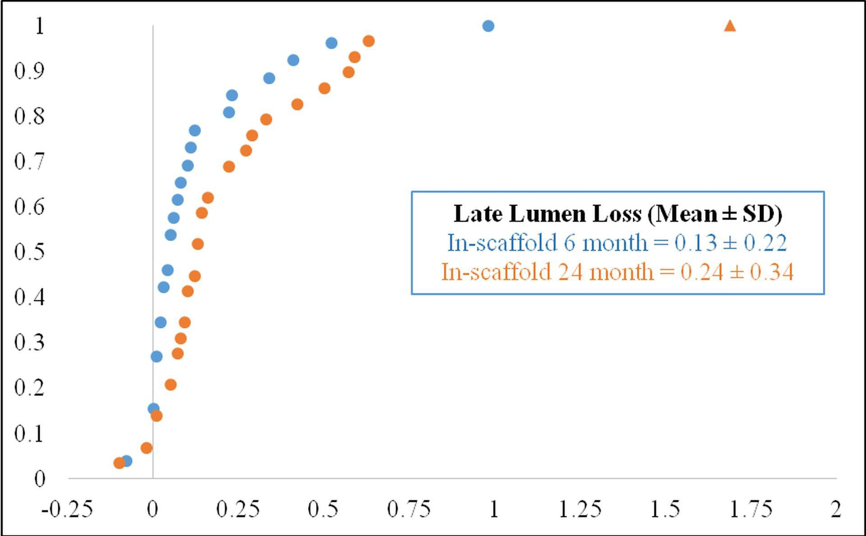
Cumulative Frequency Distribution Curve for In-scaffold Late Lumen Loss
Angio QCA – CRC, Sao Paulo, Brazil

Slide 19
Paired OCT analysis
Characteristic | Post- procedure (n=9) | 6-Month (n=9) | 2- year (n=9) | Friedman p- value
Mean flow area, (mm²) | 7.33±2.28 | 6.99±2.75 | 6.49±2.79 | 0.032
Mean lumen area, (mm²) | 7.69±2.36 | 6.99±2.75 | 6.49±2.79 | 0.008
Minimum lumen area, (mm²) | 6.59±2.12 | 4.99±1.65 | 4.29±2.00 | <0.01
Mean scaffold area, (mm²) | 8.06±2.51 | 8.64±3.05 | 8.39±3.19 | 0.121
Minimum scaffold area, (mm²) | 7.13±2.29 | 7.05±2.02 | 6.29±2.43 | 0.120
Mean strut area, (mm²) | 0.14±0.04 | 0.11±0.03 | 0.06±0.02 | 0.001
Covered struts (%) | - | 98.99±1.59 | 99.24±2.27 | 0.102
IVUS/OCT – Cardialysis, Rotterdam

Slide 20
Paired IVUS Analysis
Parameters | Post- procedure (n=10) | 6-month (n=10) | 2- year (n=10) | Friedman p-value
Mean lumen area, (mm²) | 6.17±1.28 | 6.28±1.28 | 5.47±1.50 | 0.30
Minimum lumen area, (mm²) | 5.14±1.19 | 4.88±1.05 | 4.05±1.42 | 0.741
Mean scaffold area, (mm²) | 6.20±1.27 | 6.54±1.29 | 5.94±1.34 | 0.122
Mean vessel area, (mm²) | 12.91±4.05 | 13.05±3.30 | 11.98±3.03 | 0.061
Neointimal hyperplasia area, (mm²) | - | 0.14±0.16 | 0.40±0.35 | 0.002
Volume obstruction (%) | - | 2.59±3.10 | 7.50±6.08 | 0.002
IVUS/OCT – Cardialysis, Rotterdam

Slide 21
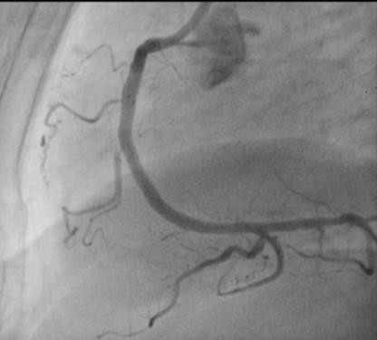
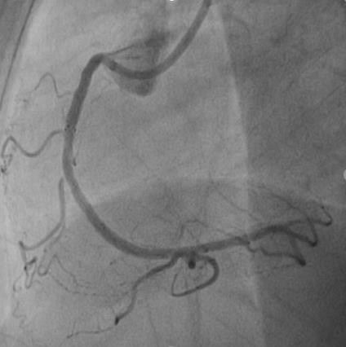
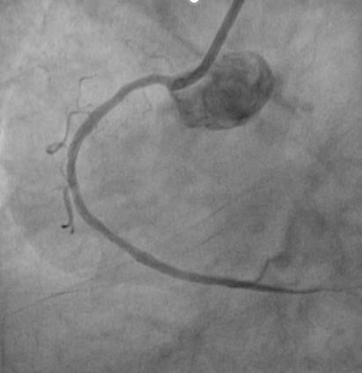
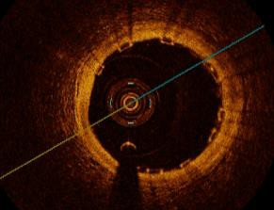
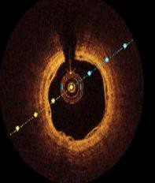
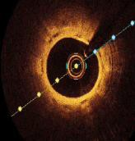
MeRes100 Case + OCT F/up out to 2yrs
47y/F | Diabetic | Hypertensive | No family history | Non-smoker | Stable angina
Post-Procedure 6-Month FU 2-Year FU
MeRes 100 3.50x19
MeRes100 3.50 x 19 mm
Post-Procedure
6-month OCT f/up
2-Year OCT f/up
Data on file at Meril Life Sciences, Pvt. Ltd.

Slide 22
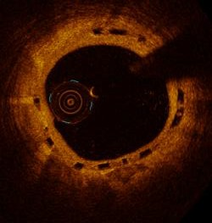
2nd Generation BRS holds promise
Absorb
MeRes100
2Y
Absorb 5-Year Cohort B Presented by Patrick W. Serruys
2Y
Data on file at Meril Life Sciences, Pvt. Ltd.

Slide 23






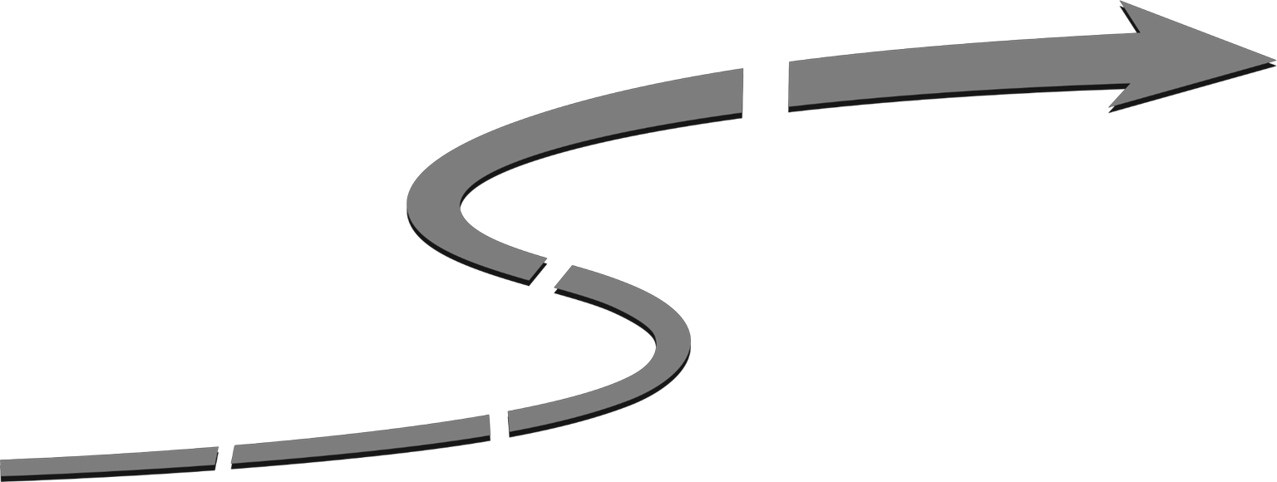

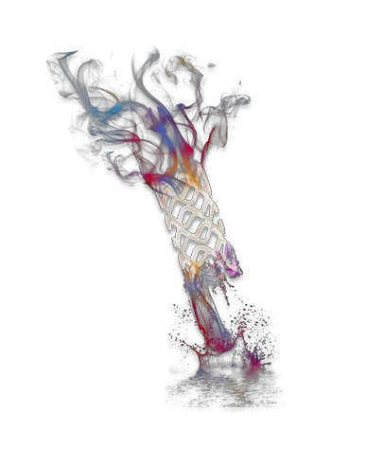



MeRes100 – Global Clinical Program
MeRes100-US/JPN⁶ (n=2,000) RCT MeRes100 Vs XIENCE
MeRes100-China⁵ (n=1,242)
RCT 242:242 MeRes100 Vs XIENCE
+ 800 MeRes100. 1 year MACE, ST
1 year MACE, ST
MeRes-Evolve⁴ (n=800) RCT MeRes100 Vs XIENCE
30 participating sites global
>5,000 Patients Global Clinical Program
MeRes100 Global³ (n=2,000) All comers, real world registry. 100 participating sites global.
MeRes-1¹ (n=108)
FiM, Single, denovo lesions. 13 Indian Sites
Excellent Clinical Safety & Efficacy | MeRes-1 N=107^ | MeRes-1 Extend N=62 ^
Follow-up | 3-year | 2-year
MACE | 2 (1.87%) | 1 (1.61%)
ST | 0% | 0%
Late Lumen Loss | 2-year 0.24± 0.34 mm | 6-month 0.18±0.31mm
MeRes-1 Extend² (n=64 Single, denovo lesions 8 Global Sites
1-2. Achieved Primary Objective 3-6. Planning phase.
^MeRes-1 One-Year Results: Seth A. et al. EuroIntervention 2017;13:415-423
^MeRes-1 Ext presented at EuroPCR’2018

Slide 24
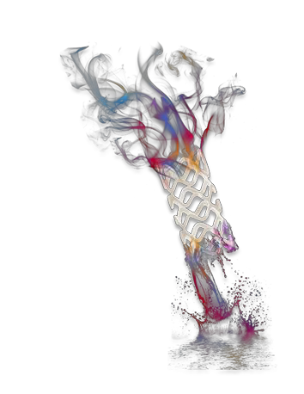
Conclusion & Future Directions
MeRes-1 trial, the 1st human evaluation of novel 2nd generation MeRes100 BRS with 100µm struts demonstrated high acute success as well as long term clinical success up to 3-year follow-up with very low MACE rate of 1.87% (2, ID-TLR) and Zero Scaffold Thrombosis (ST).
All four imaging modalities are consistent in demonstrating high efficacy of MeRes100 – BRS:
QCA at 2-years: Low late lumen loss (0.24± 0.34 mm)
OCT at 2-years: Virtually complete strut coverage (99.24%)
IVUS at 2- years: Sustained mean flow area and very low %VO (7.50%)
These encouraging results of MeRes-1 study provide the basis for further studies, using a wider range of lengths and sizes in more complex and larger patient population.

Slide 25
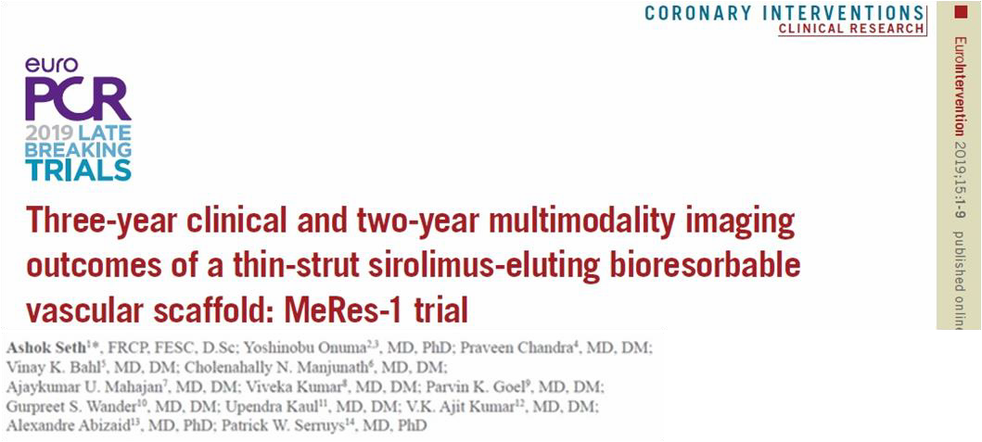
MeRes-1 trial (3 years follow-up) simultaneous publication in EuroIntervention

Slide 26

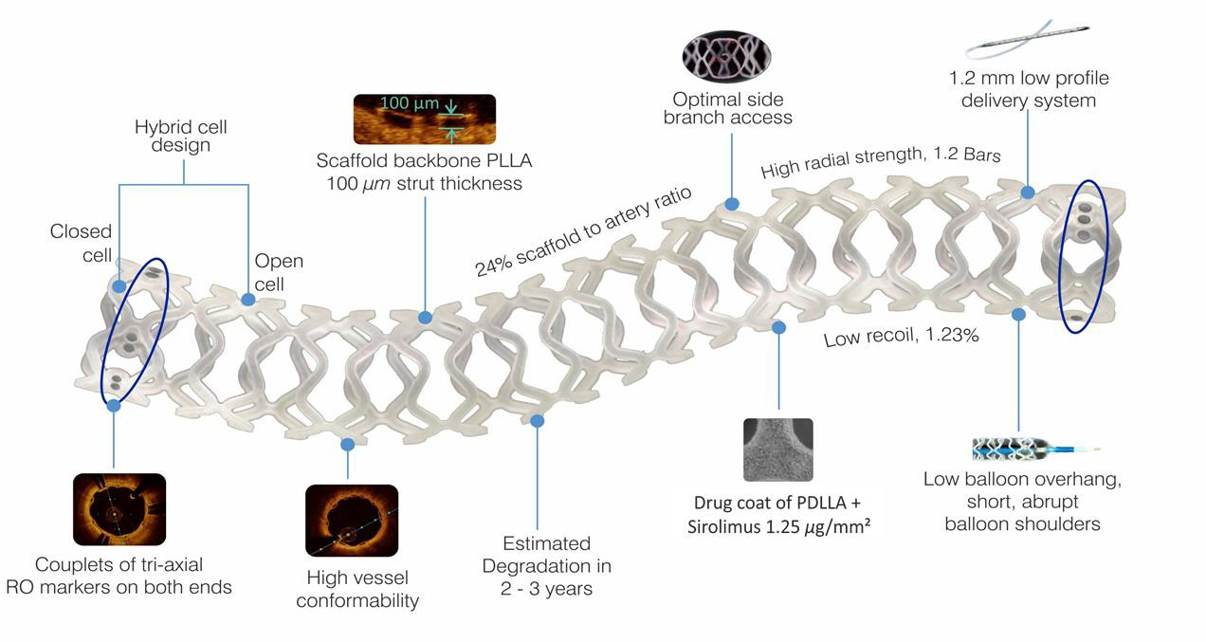
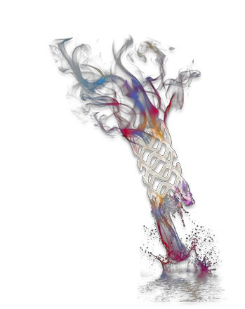
MeRes100 (100µm BRS)
Sirolimus-Eluting Bioresorbable Vascular Scaffold

Slide 27
Thank You

Slide 28
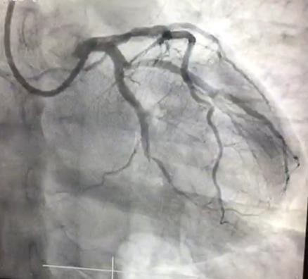
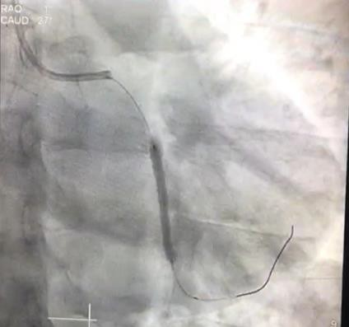
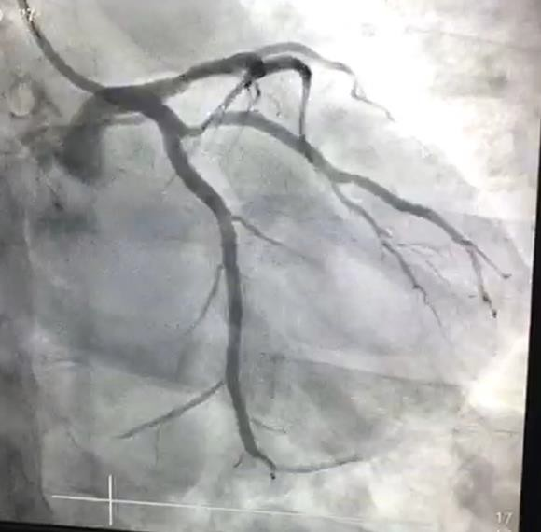
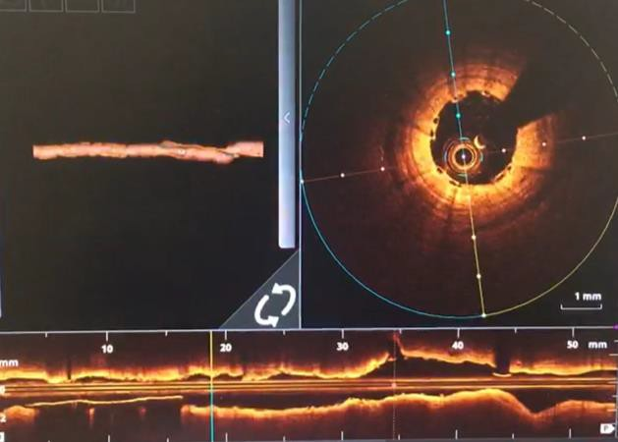
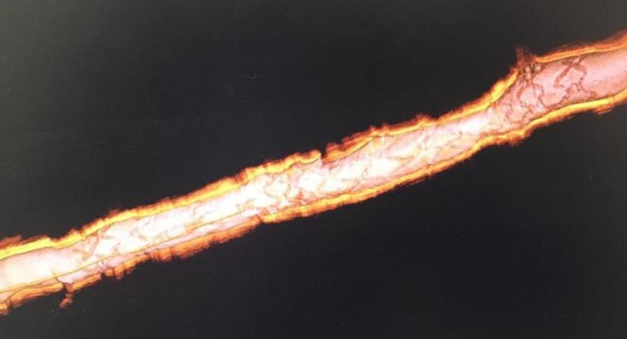
MeRes100 Case with Tapered balloon/delivery system
Pre-PCI Angio
Tapered MeRes100 deployed
Patient details:
37 Y/male with CAD
CAG: 100% Occlusion in mid LCX
Focal moderate 50% Stenosis in Prox. LAD
PCI with MeRes100 (3.0-2.5X30mm)
Post-PCI Angio
Post-PCI OCT
3D OCT View of MeRes100 post-PCI
Data on file at Meril Life Sciences, Pvt. Ltd

