Slide 1

Keys to Successful Alcohol Ablation
John S Douglas Jr MD
Emory University School of Medicine

Slide 2

John S Douglas Jr MD
I have no relevant financial relationships

Slide 3
HOCM : What Do We Know ?
Many individuals with HOCM are asymptomatic
In most symptomatic patients , medical therapy is adequate
If disabling symptoms persist , septal reduction therapies are effective
However , there are no randomized trials comparing myectomy and alcohol ablation to guide us in treatment selection and none are expected
In observational studies , 5 to 10 year symptom relief and survival are similar after ASA and myectomy
ASA and myectomy have equal status in the most recent Hypertrophic Cardiomyopathy Guideline Statement

Slide 4
Mayo Clinic: Survival Comparison
Age and Gender matched (excluding patients >80 yrs)
P=0.18
No. at Risk
Myectomy 120 113 101 86
Ablation 87 65 39 24
Sorajja, P. et al. Circulation 2008;118:131-139

Slide 5
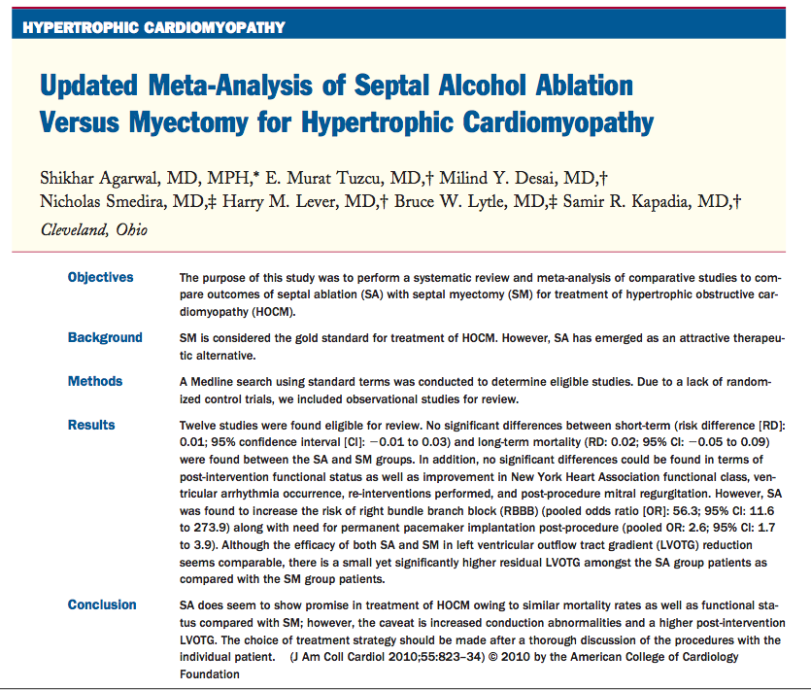

Slide 6
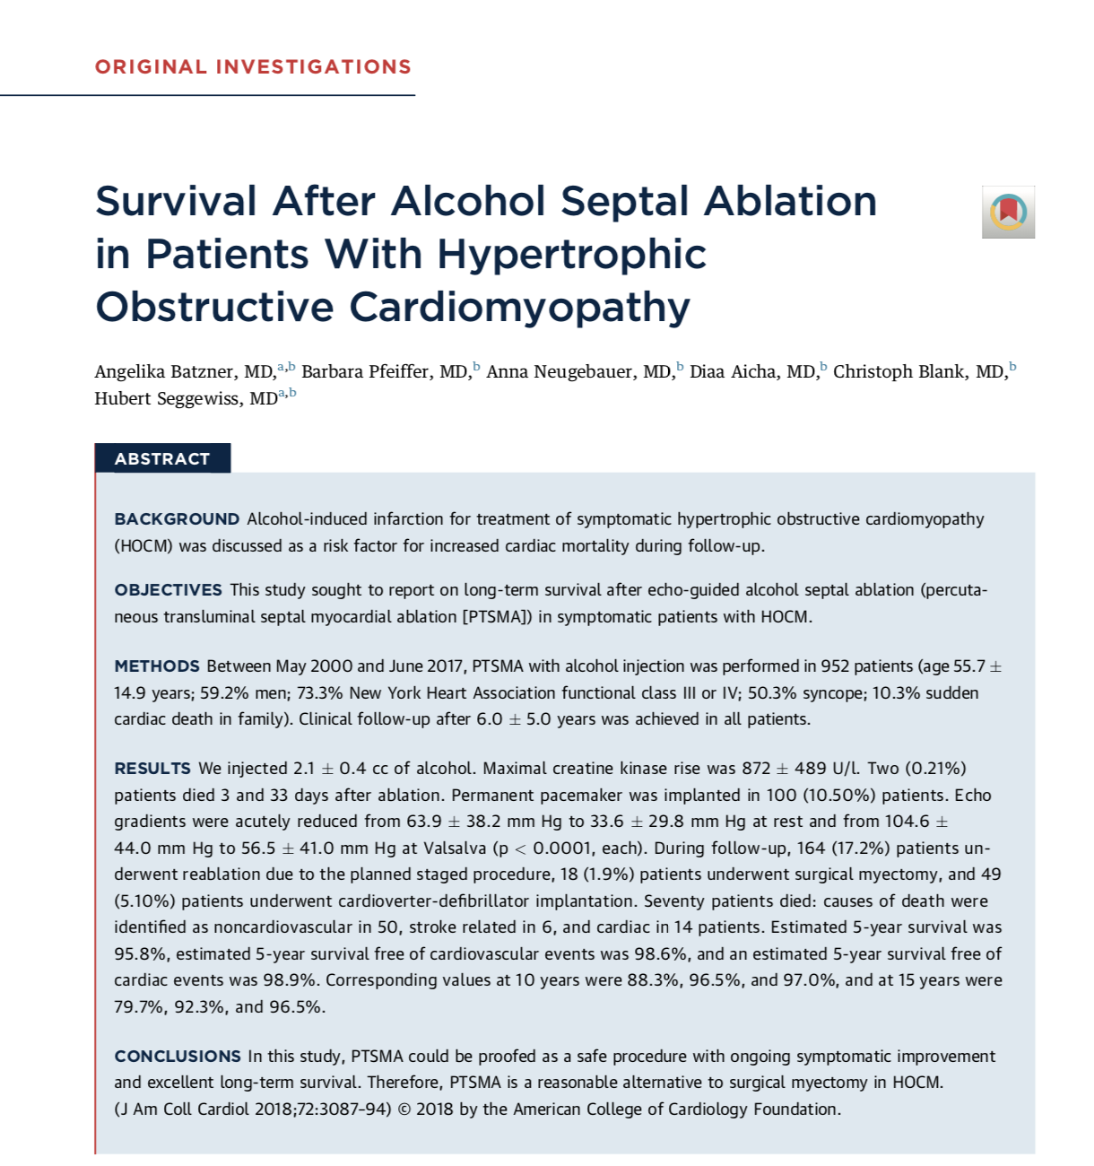
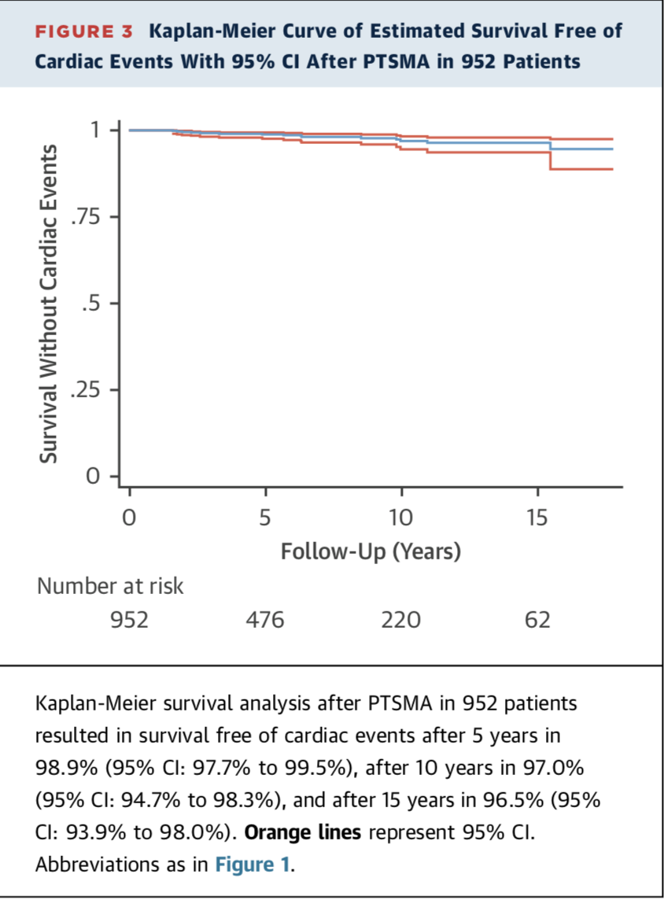

Slide 7
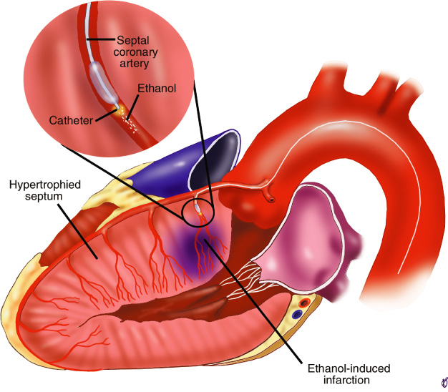

Slide 8
Procedural Challenges
The key to successful alcohol ablation is delivery of alcohol to the anterior basal portion of the septum . This is the myocardium resected by the surgeon . It may be difficult to determine when you are finished.

Slide 9
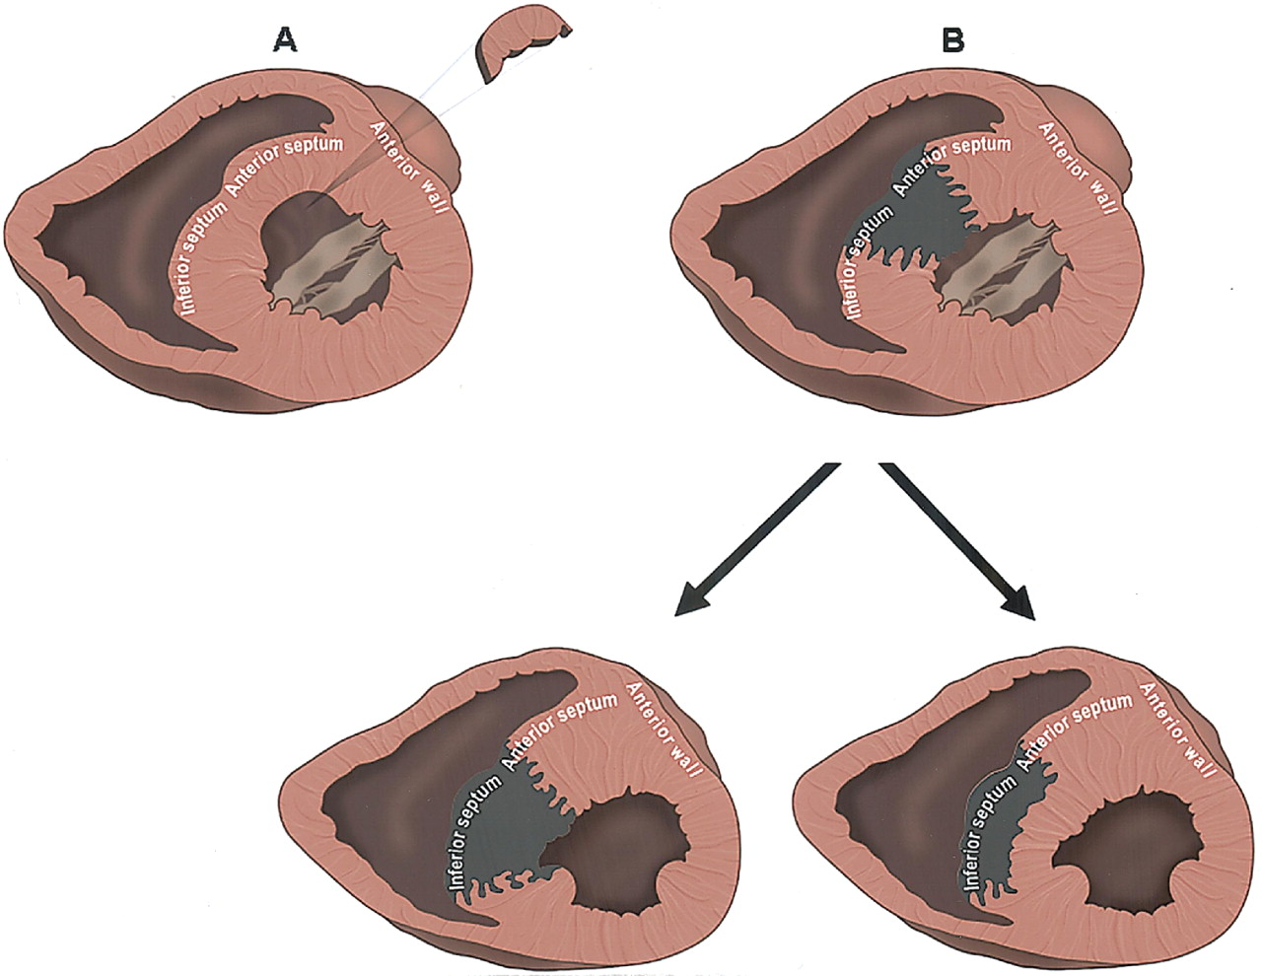
Comparison of Myectomy and Alcohol Ablation with MRI
Valeti et al JACC 2007 ; 49: 350
Notes:
In this MRI study by Valeti comparing results of myectomy and ablation , the myectony surgeon invariably resected muscle from the basal anterior septum with no residual scar formation . The mean weight of the removed tissue was 6 grams . Following alcohol ablation , the location and extent of myocardial necrosis was more variable . In 75% of pts undergoing ablation , septal necrosis was transmural and in about 20% the right side of the septum was necrosed . The mean mass of infarcted myocardium was estimated to be 16 gms . It has been observed that when the right side of the septum is infarcted relief of obstruction and symptoms is suboptimal .

Slide 10
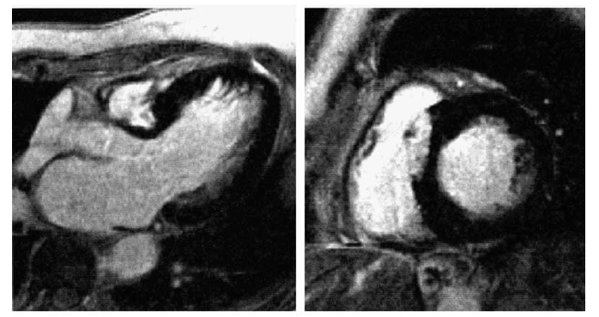
Right Sided Septal Scar

Slide 11
Current Procedural Strategy
Use myocardial contrast imaging with transthoracic echocardiography to select the septal branch supplying the SAM-septal contact point . Monitor the LVOT pressure gradient to determine when the procedure should be terminated

Slide 12
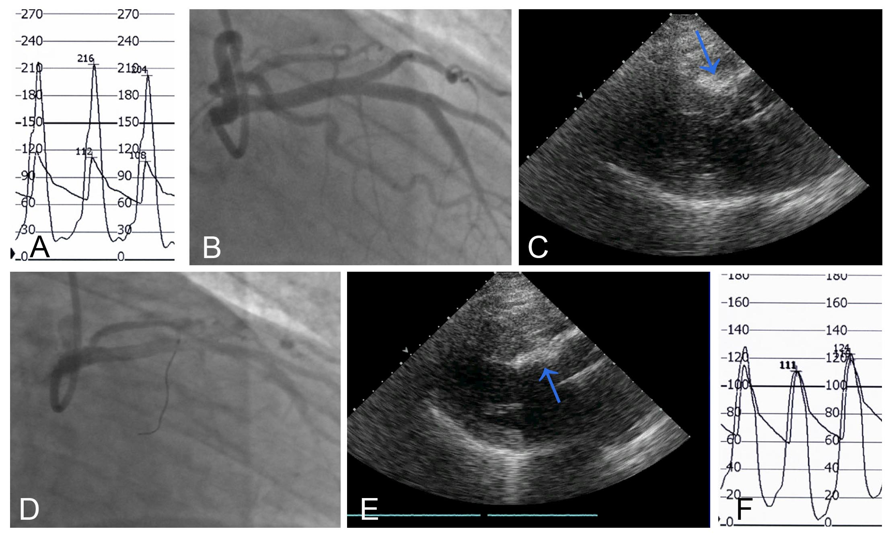

Slide 13
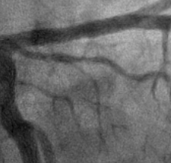
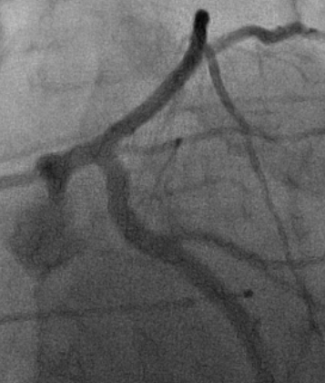
Septal Perforator Selection
Septals from ramus intermedius may supply the SAM-septal contact point
Featherstone
RAO Caudal
LAO Caudal

Slide 14
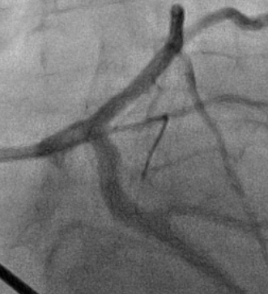
Septal Perforator Selection
Septals from ramus intermedius may supply the SAM-septal contact point
Featherstone
LAO caudal
Guidewire introduced

Slide 15
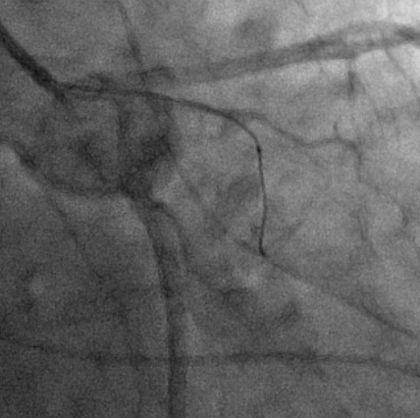
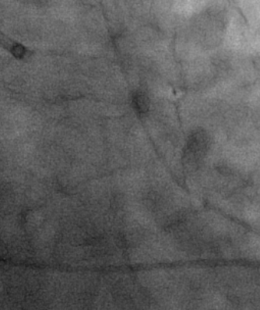
Septal Perforator Selection
Septals from ramus intermedius may supply the SAM-septal contact point
Featherstone
Balloon positioned RAO caudal view
Agitated contrast/saline mixture injected

Slide 16
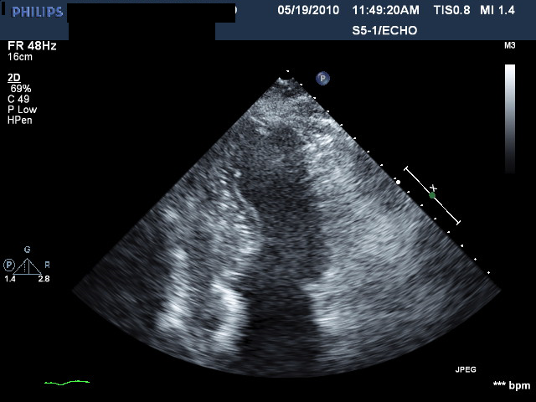
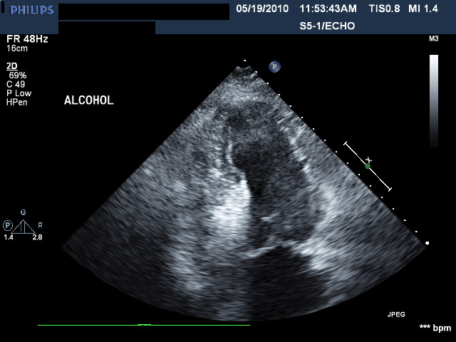
Septal Perforator Selection
Septals from ramus intermedius injected with contrast mixture
Featherston 5/19/10
Baseline Echo
Enhancement at SAM-septal Contact Point

Slide 17
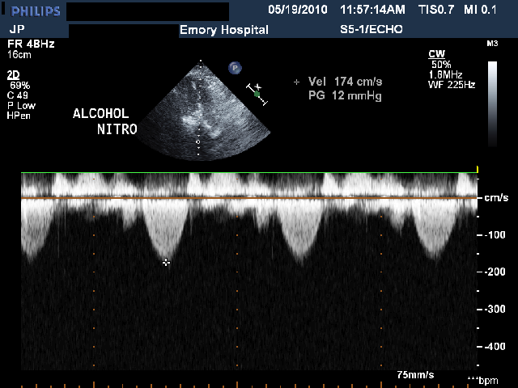
After Alcohol Injection
LVOF Gradient Reduced to Zero ( 12mm with TNG ) From Resting Gradient of 100 mm Hg

Slide 18
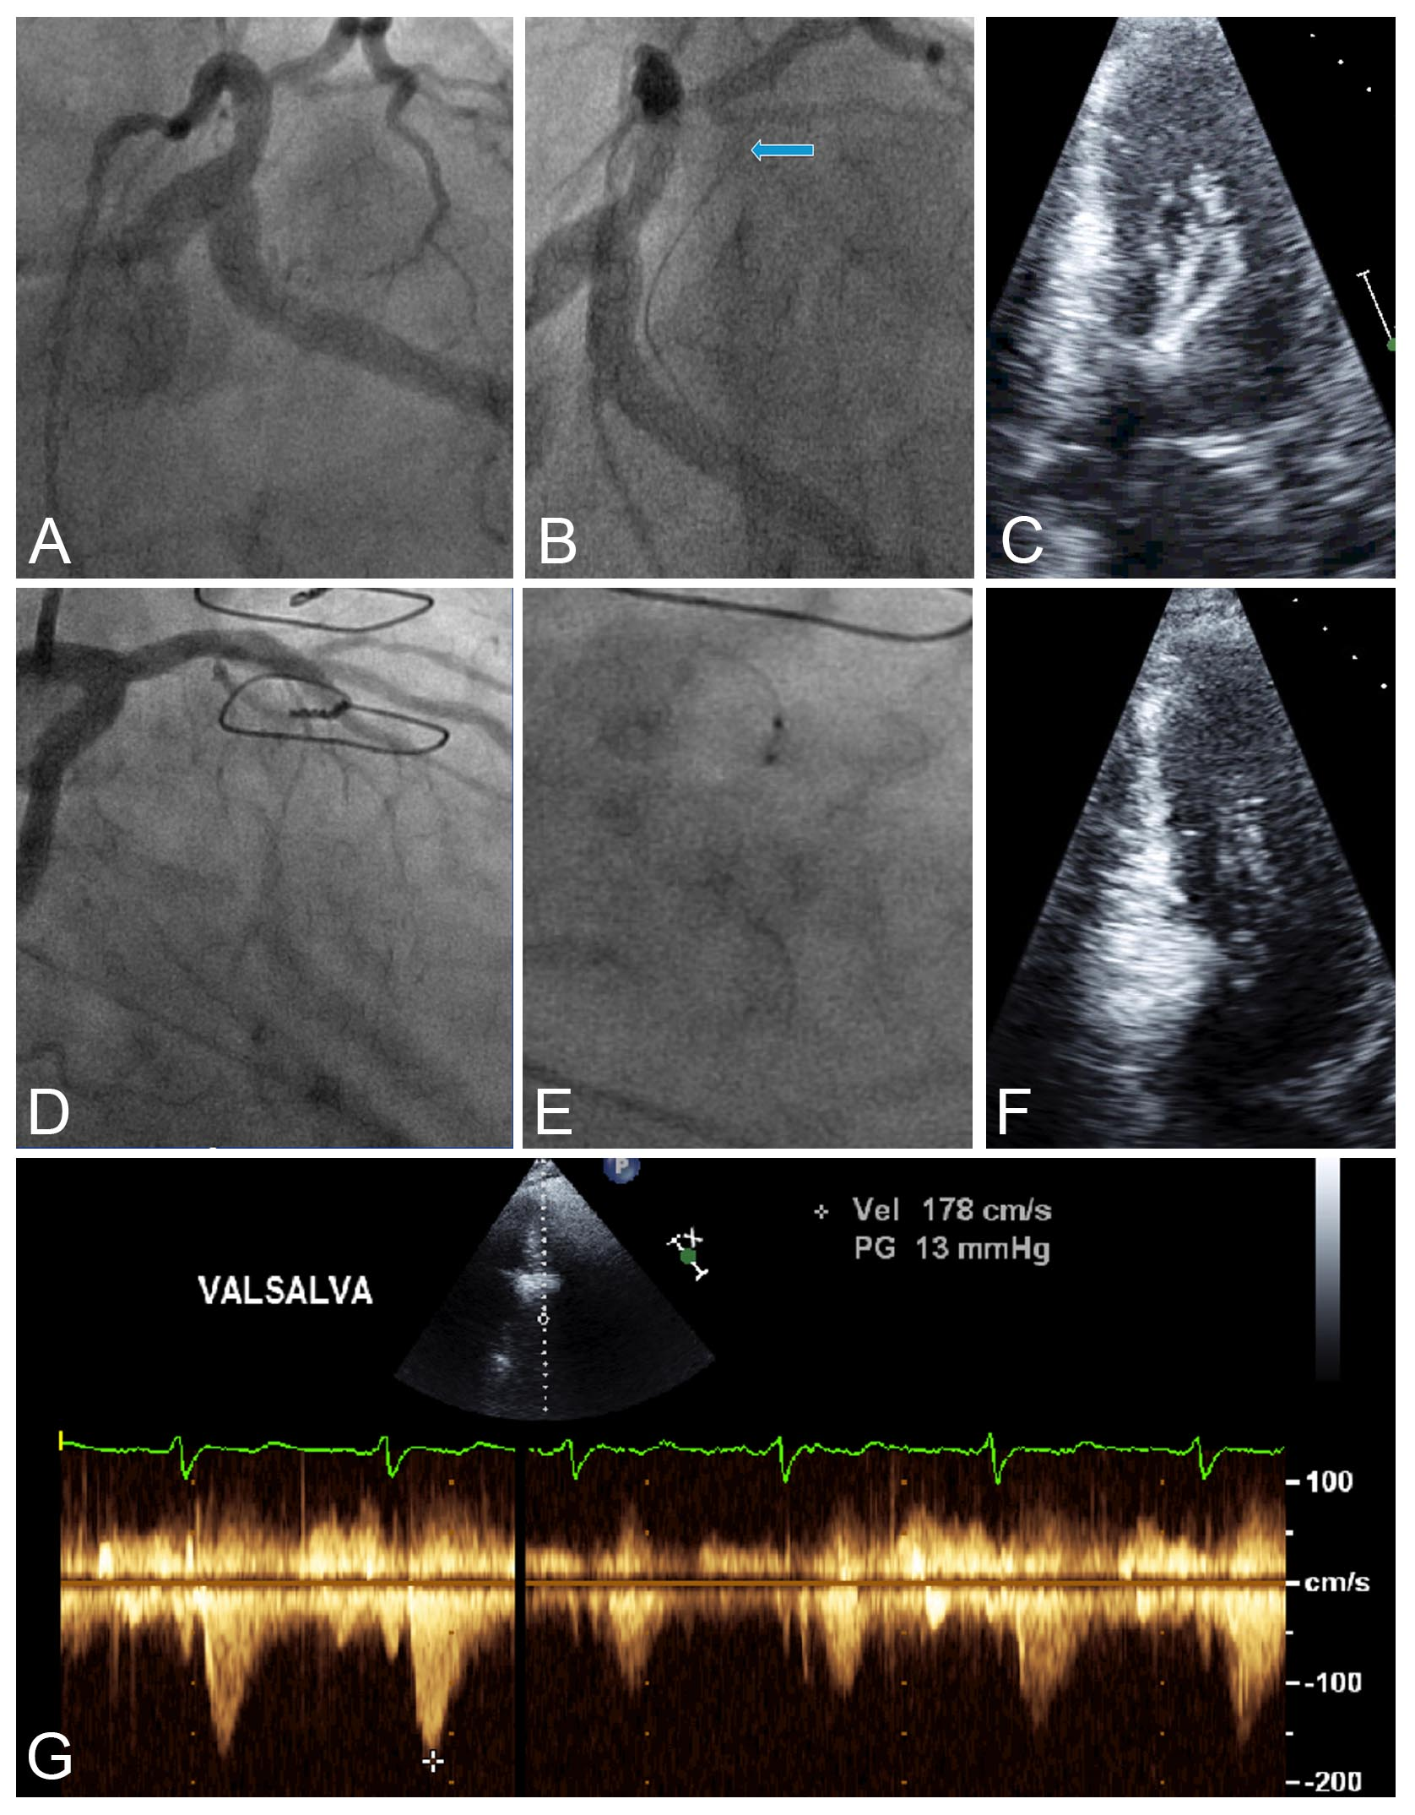

Slide 19
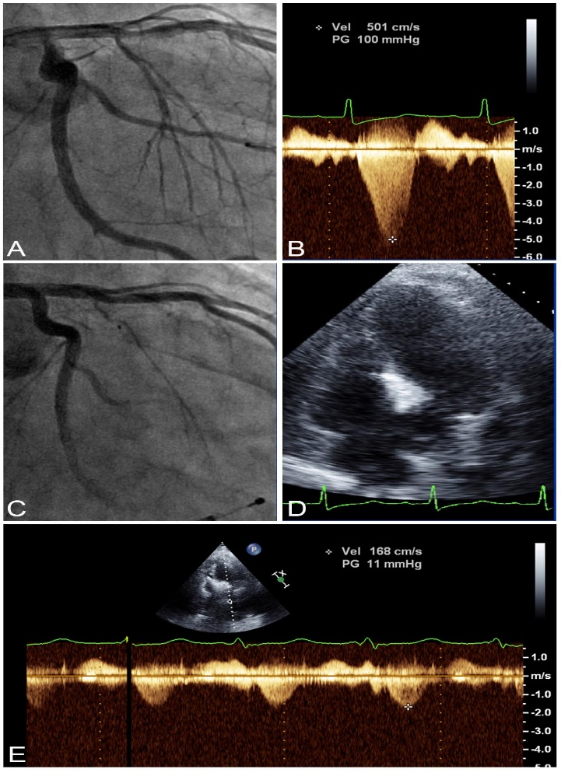

Slide 20
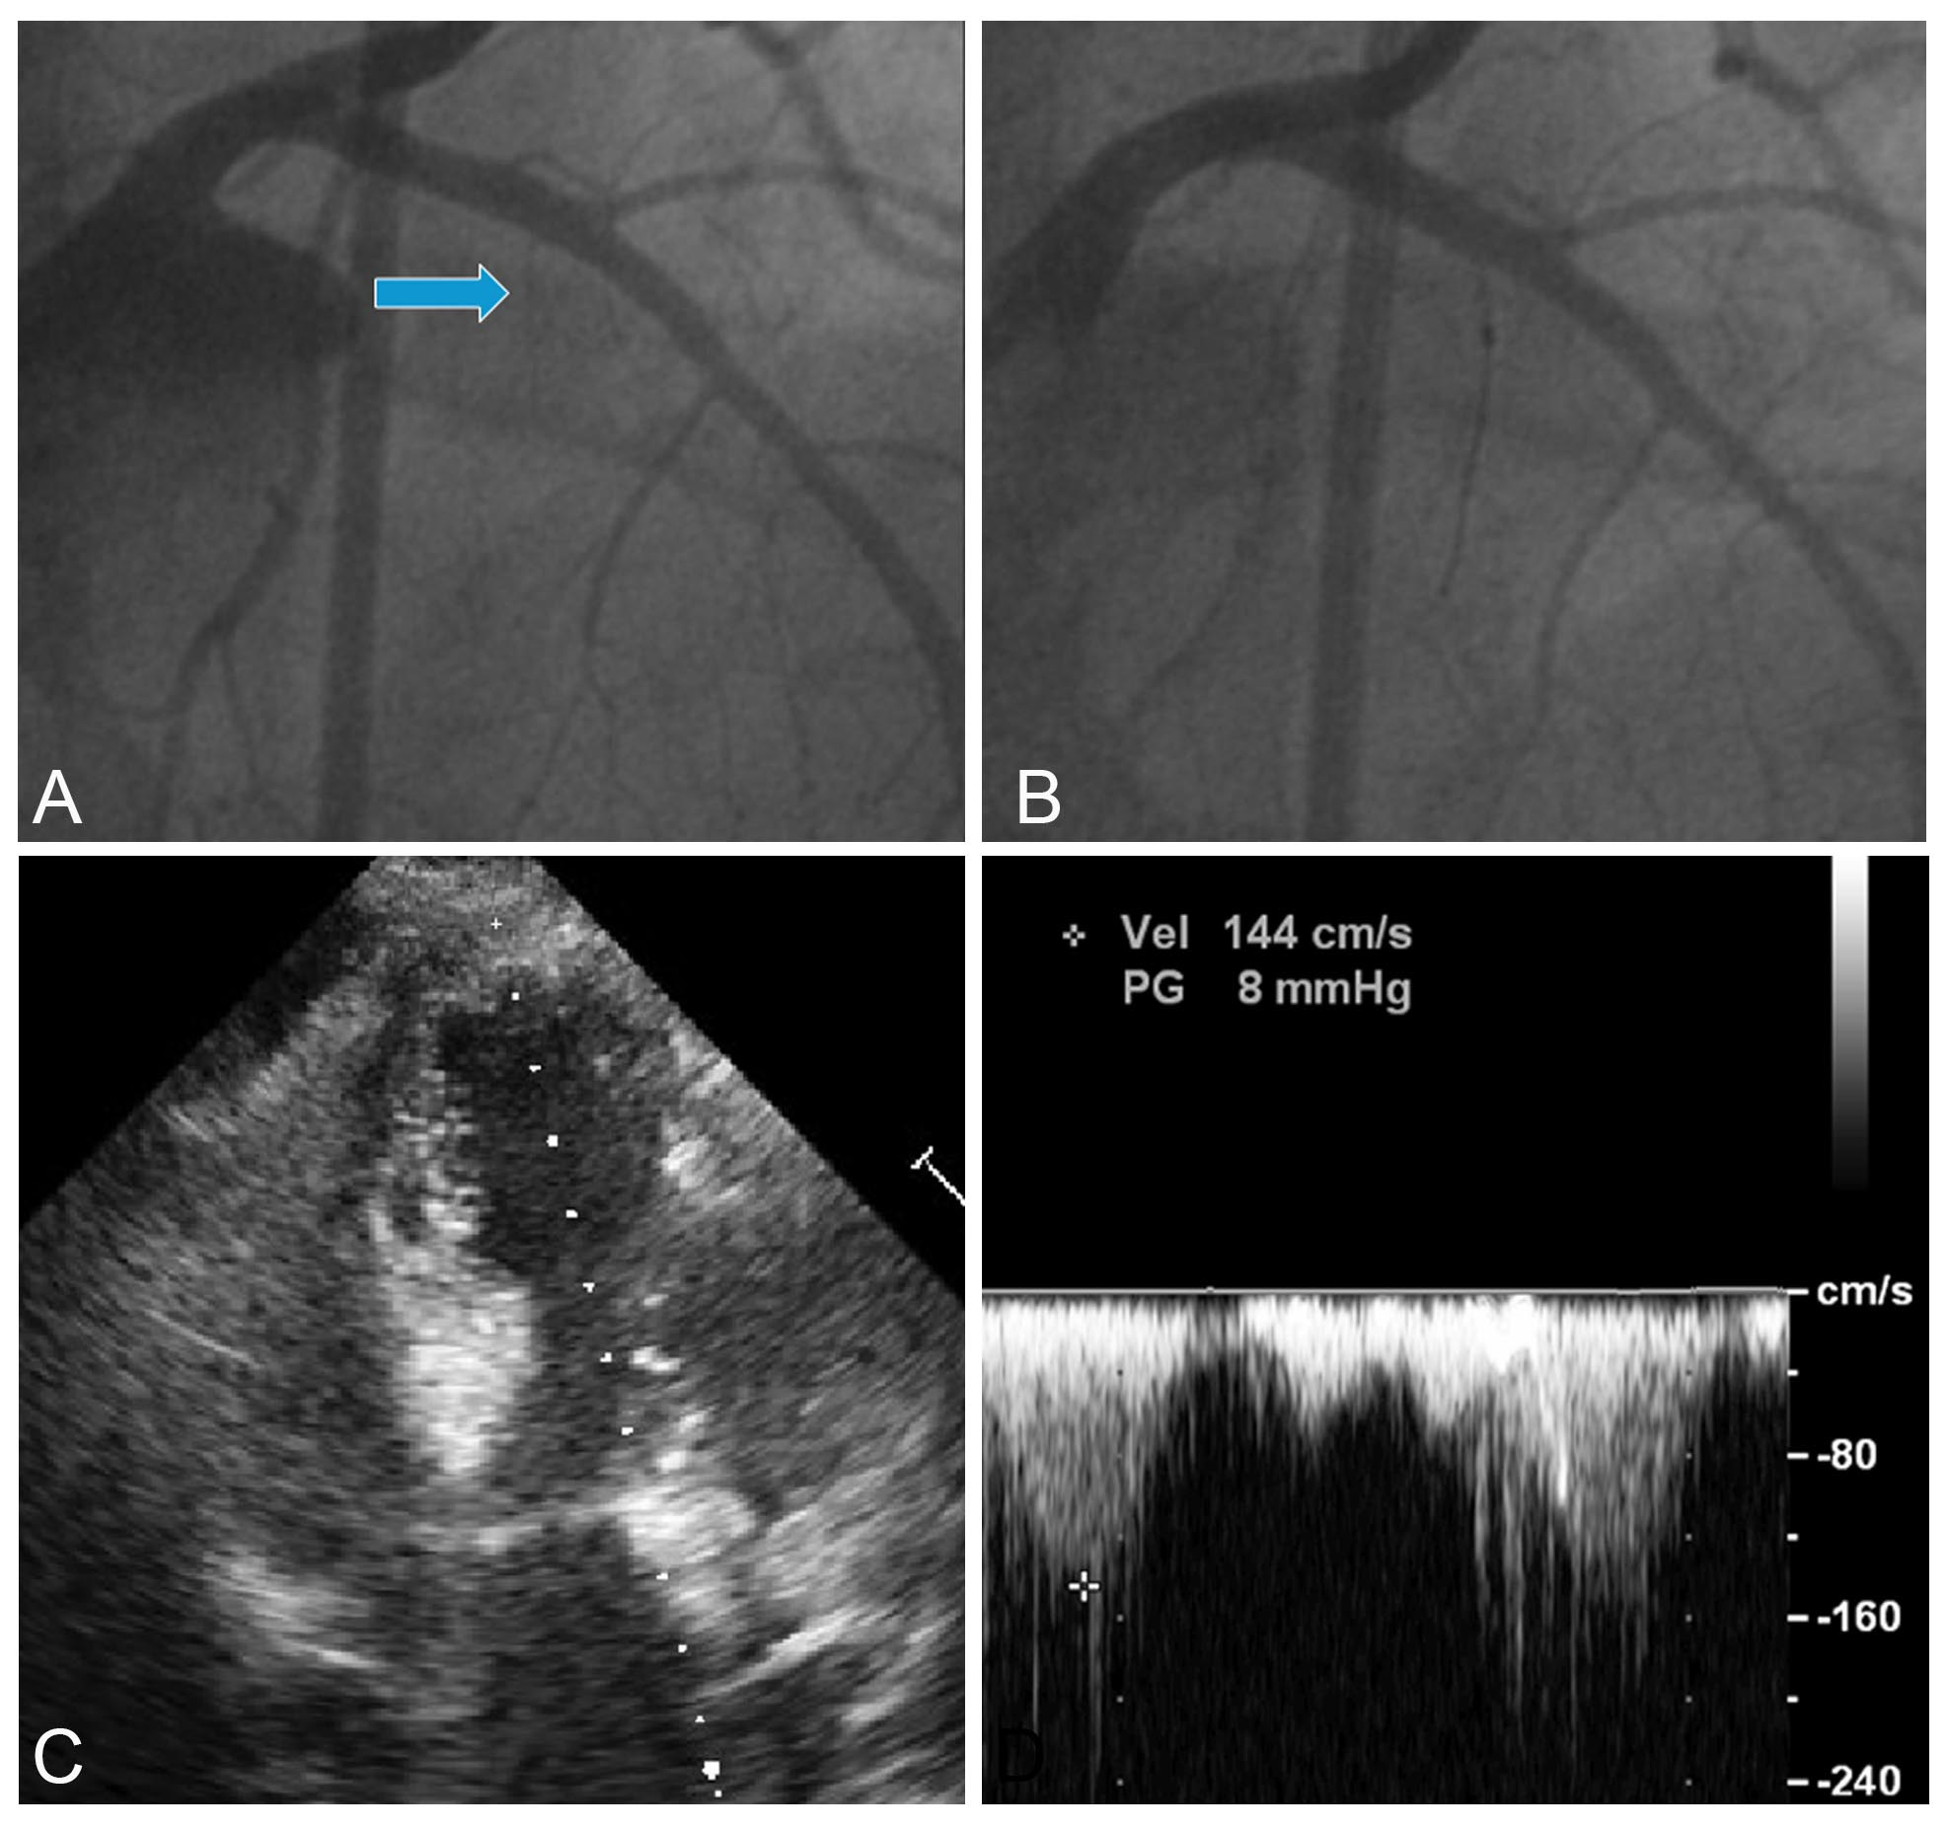

Slide 21
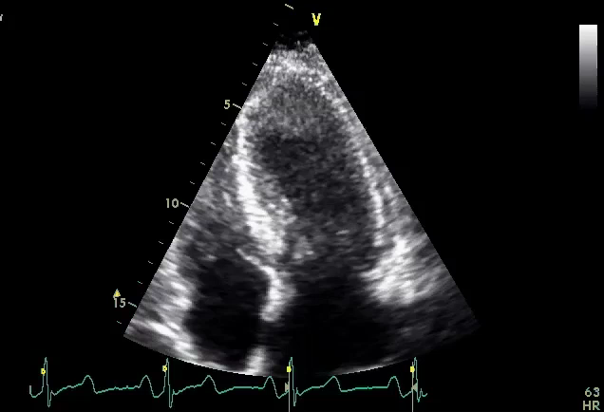
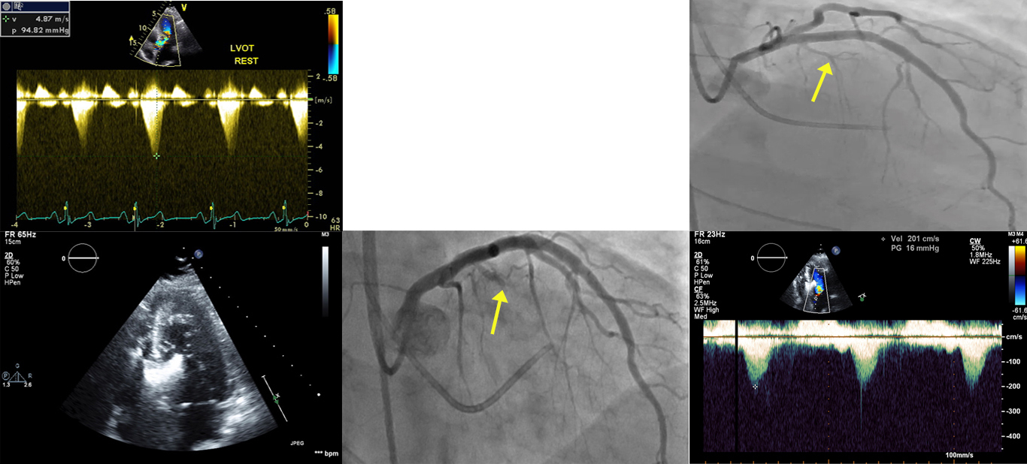
A 63 yo female with severe symptoms ; 100 mm Hg resting LVOT gradient ; 2.3 cm septum

Slide 22
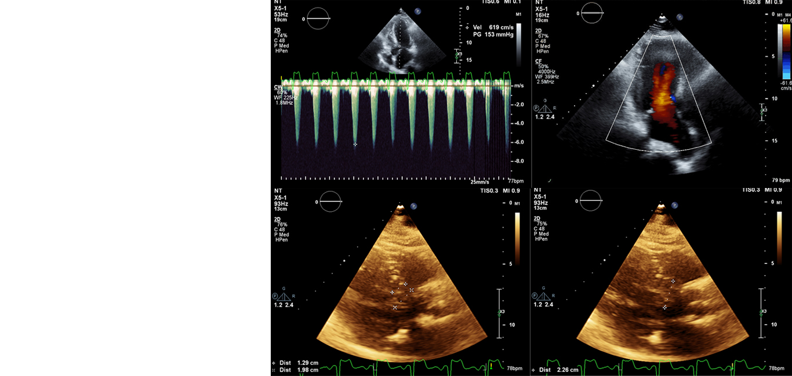
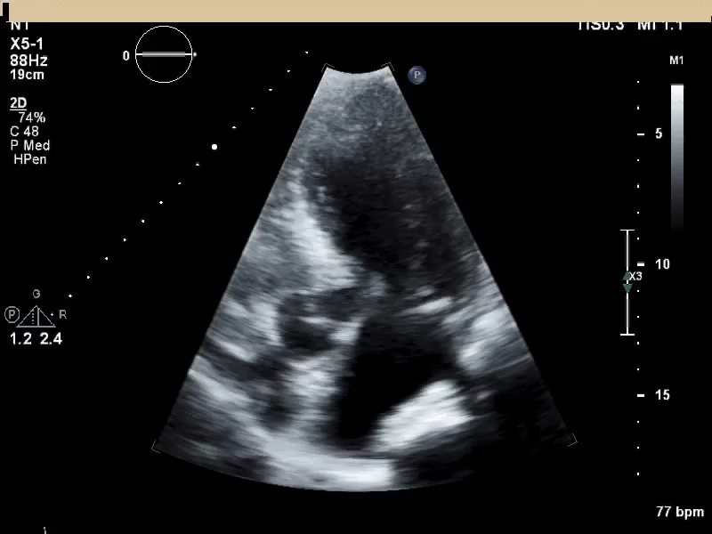
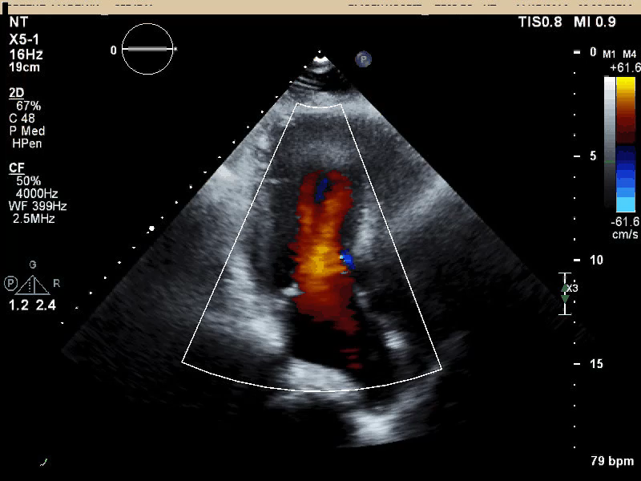
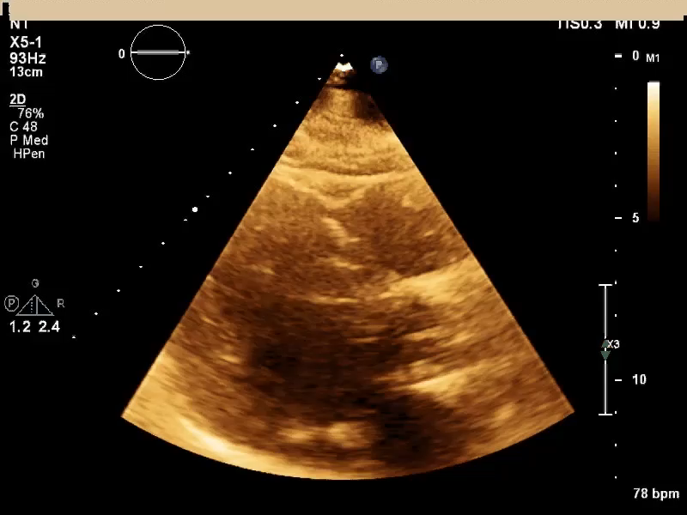
Shortness of Breath Recurred and was Progressive ; Repeat Echocardiogram : LVOT gradient > 100 mm Hg

Slide 23
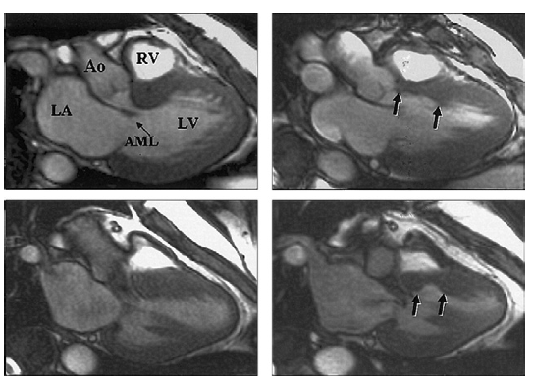
Comparison of Myectomy and Alcohol Ablation

Slide 24
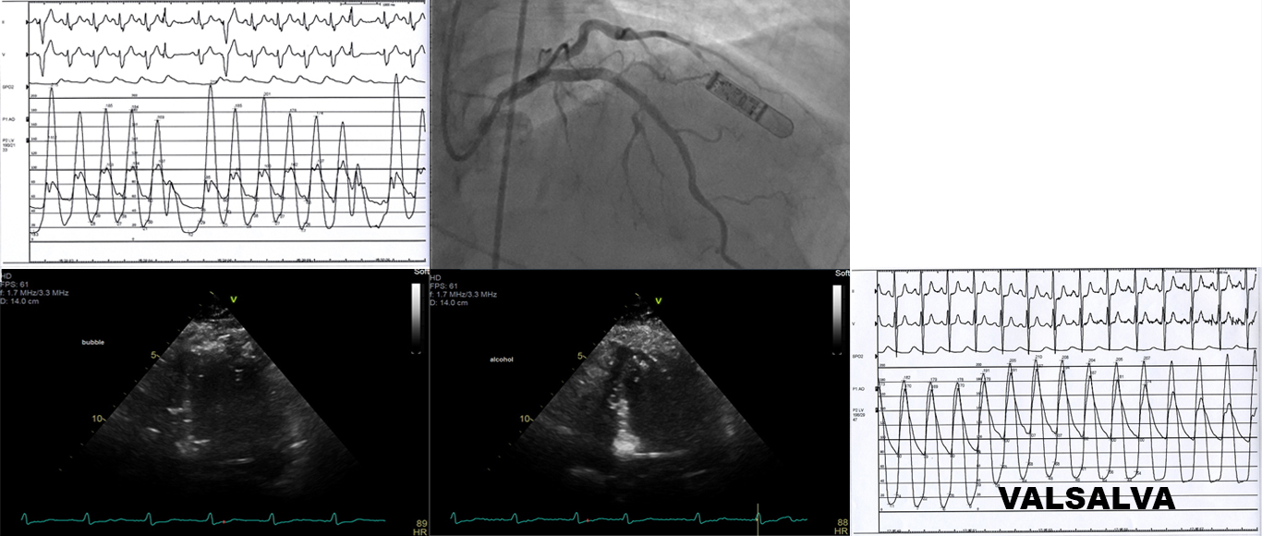
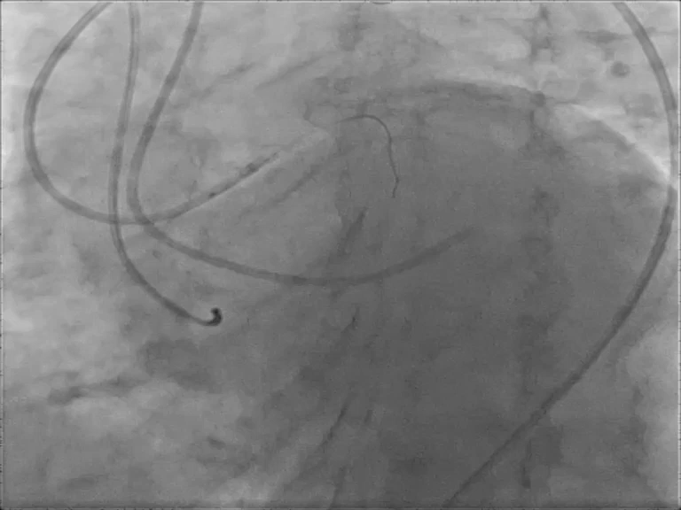
A 2nd Septal Ablation Procedure Was Performed

Slide 25
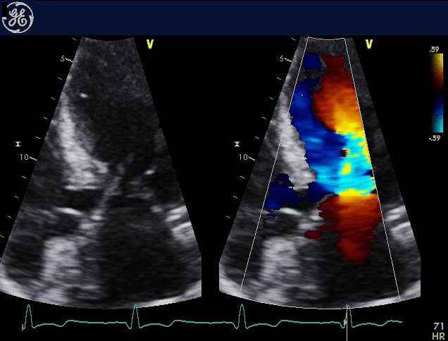
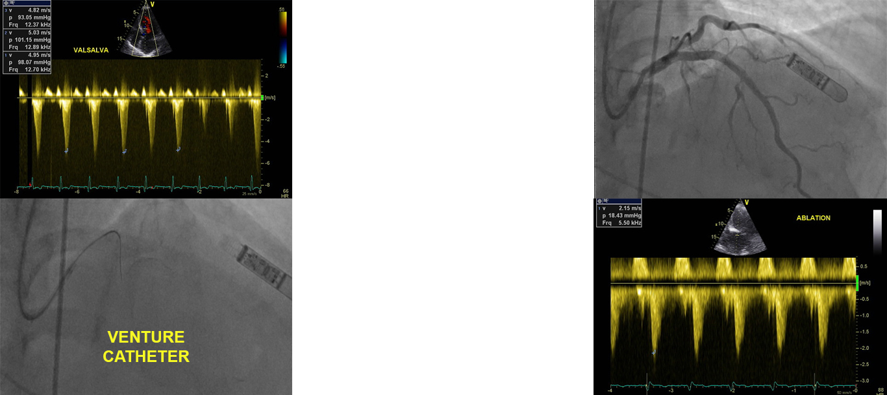
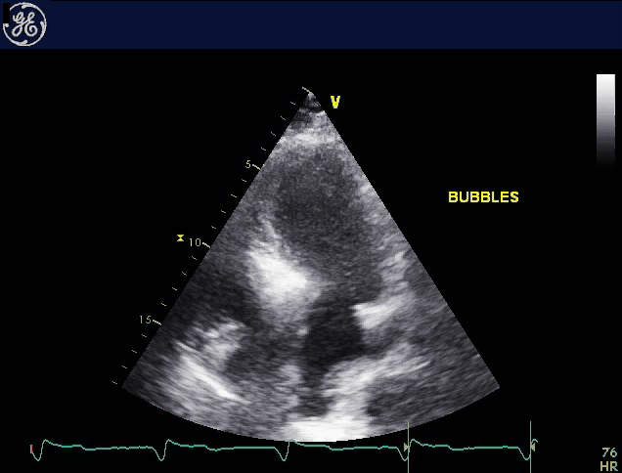
48 Hours Post Ablation ECHO Revealed a LVOT Gradient
> 90 mm Hg and a 3rd Ablation Was Undertaken

Slide 26
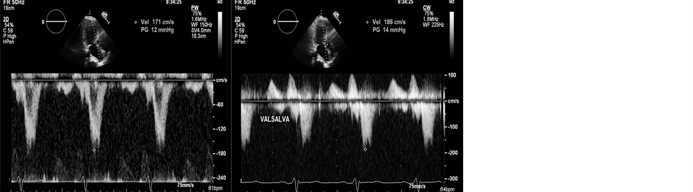
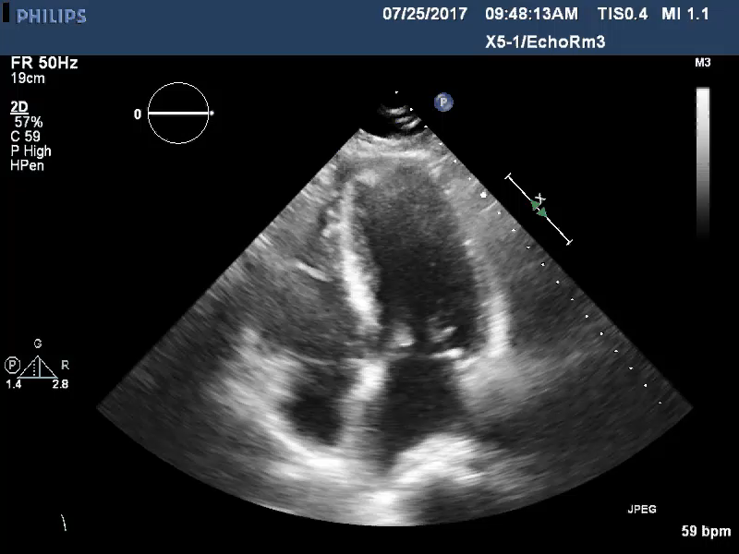
At 3 Month Followup the Patient Was Asymptomatic – Walking On Treadmill With No Problems – Feels GREAT !

Slide 27
In Summary
Alcohol septal ablation is effective in a majority of patients . However, interrogation of multiple septal arteries may be required and in some cases multiple procedures . Contrast induced septal brightening area exceeds that treated with alcohol . Intravascular volume expansion and alcohol-induced myocardial stunning both lead to reduced LVOT gradient and premature termination of alcohol ablation procedures in some patients .

Slide 28
THANK YOU

