Slide 1

Effects of dietary sodium on systolic blood pressure in middle-aged individuals:
A randomized order cross-over trial
Deepak K Gupta, MD MSCI; Associate Professor of Medicine; Vanderbilt University Medical Center

Slide 2
Effects of dietary sodium on systolic blood pressure in middle-aged individuals: A randomized order cross-over trial
Deepak K. Gupta, MD MSCI^{1,2}; Cora E. Lewis, MD, MSPH³; Krista Varady, PhD⁴; Yan Ru Su, MD^{1,2}; Meena S. Madhur, MD PhD^{1,5,6}; Daniel Lackland, DrPH⁷; Jared Reis, PhD⁸; Thomas J. Wang, MD⁹; Donald M. Lloyd-Jones, MD¹⁰; Norrina B. Allen, PhD¹⁰
¹Division of Cardiovascular Medicine, Vanderbilt University Medical Center, Nashville, TN
²Vanderbilt Translational and Clinical Cardiovascular Research Center, Vanderbilt University Medical Center, Nashville, TN
³Department of Epidemiology, University of Alabama at Birmingham, Birmingham, AL
⁴Department of Kinesiology and Nutrition, University of Illinois-Chicago; Chicago, IL
⁵Division of Clinical Pharmacology, Vanderbilt University Medical Center, Nashville, TN
⁶Division of Clinical Pharmacology, Indiana University, Indianapolis, IN
⁷Division of Translational Neurosciences and Population Studies, Department of Neurology, Medical University of South Carolina, Charleston, SC
⁸National Heart, Lung, and Blood Institute, National Institutes of Health, Bethesda, MD
⁹Department of Medicine, University of Texas-Southwestern Medical Center, Dallas, TX
¹⁰Department of Preventive Medicine, Northwestern University, Chicago, IL
Notes:
Good afternoon. On behalf of our co-authors and entire team, thank you very much for the opportunity to share our study: “Effects of dietary sodium on systolic blood pressure in middle-aged individuals: a randomized order cross-over trial.

Slide 3
Disclosures
None
Notes:
We have no disclosures.

Slide 4
Dietary sodium & blood pressure
2001
Daily Dietary Sodium | Average Systolic BP mm Hg |  | Control diet Systolic BP reduction From high- to low-sodium
~3,500 mg | ~ 133 |  | 6.7 mm Hg
~2,300 mg | ~ 131
~1,150 mg | ~ 126
Inclusion
Age ≥ 22 years
BP: 120-159 / 80-95 mm Hg
Exclusion
Anti-hypertensive med use
Diabetes
Known CV disease
Notes:
Sodium is a dietary component that substantially contributes to blood pressure. In 2001, Sacks and colleagues reported their landmark DASH-sodium trial. They included individuals with at least elevated blood pressure, while individuals using anti-hypertensive medications and those with diabetes were excluded. Compared with a standardized typical Western diet containing ~3,500 mg of sodium, the low-sodium diet of ~ 1,150 mg/day resulted in a 6 to 7 mm Hg reduction in systolic blood pressure.

Slide 5
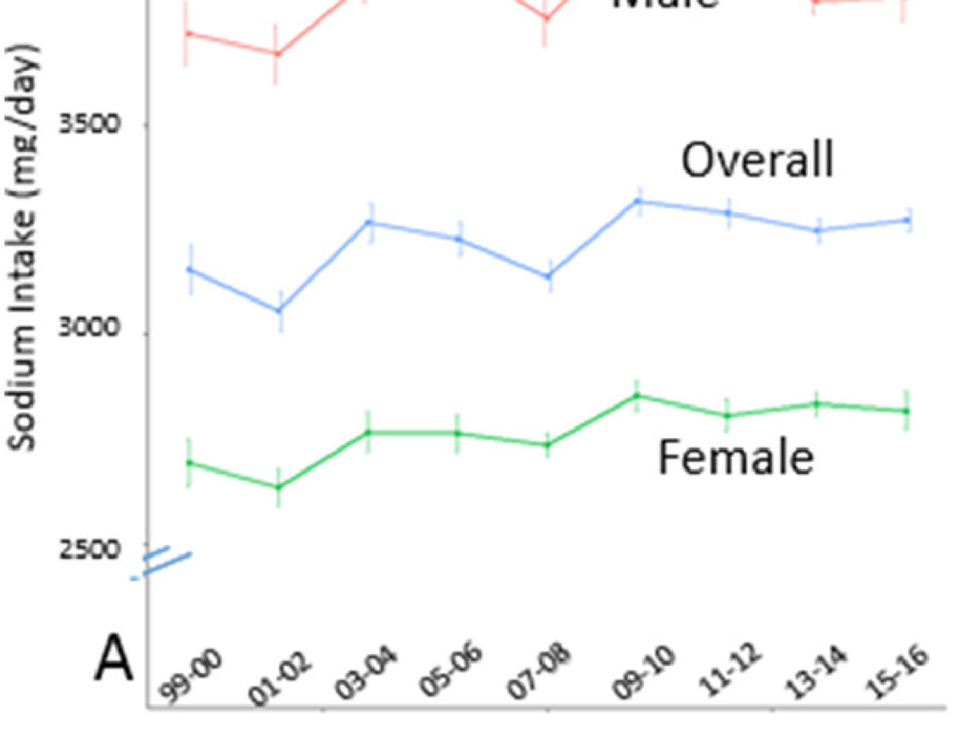
Excess sodium consumption persists
NHANES (1999-2016)
Dietary surveys
NHANES (2014)
24-hour urine sodium
~3,500 mg/day
Recommendations
 | Sodium mg/day | Salt mg/day
DHHS | 2,300 | 5,750
AHA | 2,300 | 5,750
WHO | 2,000 | 5,000
AHA-HTN | 1,500 | 3,750
Years
Adapted from Brouillard et al Amer J HTN 2019
Cogswell et al JAMA 2018
Notes:
In the 20 plus years since the DASH sodium trial, however, average daily sodium consumption in the US has remained around 3,500 mg per day whether assessed by dietary surveys or 24-hour urine sodium excretion. This exceeds the 1,500 to 2,300 mg of sodium per day recommended by the department of health and human services, AHA, and world health organization.

Slide 6
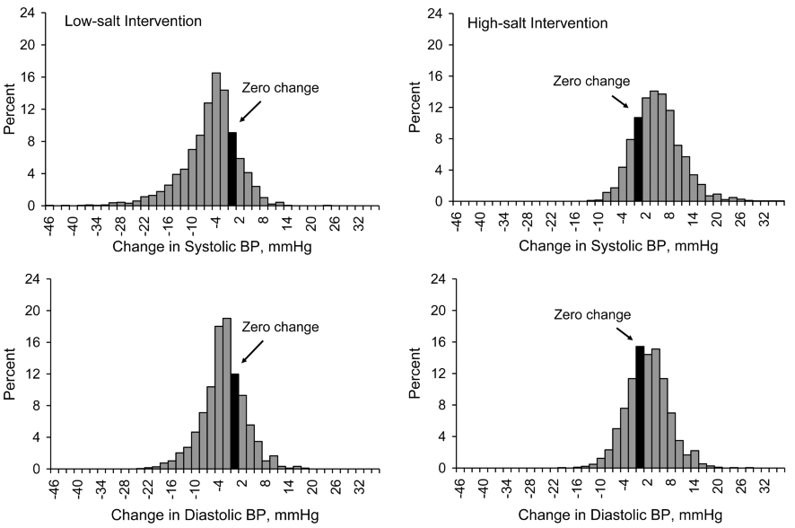
Salt-sensitivity of BP (SSBP)
GenSalt N = 1,906
Weinberger et al HTN 1986
He et al J HTN 2009
Notes:
Individual variability in the blood pressure response to dietary sodium can make determining personalized treatment responses from clinical trials challenging. The within-individual blood pressure response to variation in sodium intake, known as salt-sensitivity of blood pressure, spans a wide distribution as shown here, and has been used to define individuals who experience meaningful blood pressure differences with sodium intake reduction. Estimates suggest ~50% and ~25% of individuals with and without hypertension exhibit salt-sensitivity, respectively; however, few contemporary data exist and thresholds for defining salt-sensitivity may underestimate the impact of dietary sodium reduction on blood pressure.

Slide 7
Gaps in understanding dietary sodium & BP
How BP changes in relation to higher- or lower- dietary sodium compared with each individual’s own usual diet?
To what extent does dietary sodium reduction lower BP among individuals on treatment for hypertension? Among individuals with diabetes?
What is the association between anti-hypertensive pharmacotherapies and lessening of salt-sensitivity?
Notes:
Several other gaps in understanding the relationship between dietary sodium and blood pressure remain. These include:
How blood pressure changes in relation to higher- or lower-dietary sodium compared with each individual’s own usual diet?
To what extent does dietary sodium reduction lower blood pressure among individuals on treatment for hypertension and among individuals with diabetes?
What is the association between anti-hypertensive pharmacotherapies and lessening of salt-sensitivity?

Slide 8
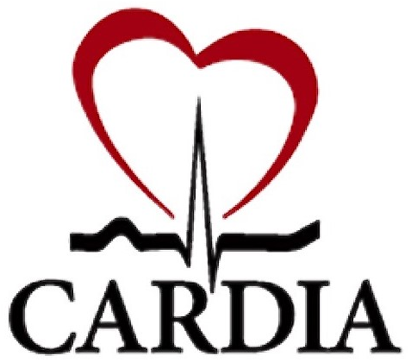





Study design: CARDIA-SSBP
2021-2023
Key Eligibility Criteria
Inclusion | 50-75 years old Willing to adhere to study protocol
Exclusion | Enrollment visit systolic BP < 90 or > 160 mm Hg or diastolic BP < 50 or > 100 mm Hg Resistant hypertension Contraindications to high-sodium (e.g., heart, renal, or liver failure) or low-sodium (e.g., orthostatic hypotension) diet or special dietary requirements (e.g., food allergies)
Notes:
To address these questions, we conducted the Coronary Artery Risk Development in Young Adults (CARDIA)-SSBP study in a contemporary community dwelling population. We included individuals with normotension through treated and untreated hypertension. Between April 2021 and February 2023, enrollment occurred in Chicago, IL and Birmingham, AL through two sources, initially the CARDIA year 35 core examination, and then an amendment in 2022 allowing for non-CARDIA participants. Key inclusion criteria were age 50-75 years while key exclusion criteria were enrollment visit systolic BP outside of 90 to 160 mm Hg or diastolic outside of BP 50 to 100 mm Hg, resistant hypertension, contraindications to high-sodium or low-sodium diet, or special dietary requirements.

Slide 9
Notes:
We used a randomized order cross-over design of one-week high- and low-sodium diets. This enabled an initial between group comparison of those individuals randomized to high or low sodium diet at just the end of the first diet week and then phenotyping each individual’s BP response to dietary sodium by performing the crossover to the opposite diet in the second week. The day before each study visit, participants wore a 24-hour ambulatory blood pressure monitor and collected a 24-hour urine sample. The high-sodium diet was achieved through a pragmatic approach where individuals’ continued their own usual diet then supplemented this with 2,200 mg of sodium per day via bullion packets. The low-sodium diet was standardized and prepared in metabolic kitchens at each study location to provide a total of 500 mg of sodium daily.

Slide 10
Recruitment, enrollment, & follow-up
232
eligible
216 attended
end-diet 1
213 attended
end-diet 2
228 randomized & attended baseline
281
Consented
296 Reviewed Consent
595 Approached
163 Excluded
49 exclusion or no longer interested
432 Potentially Eligible
Notes:
A total of 595 individuals were approached to participate, of which 281 were consented, 232 met eligibility, and 228 were randomized and attended the baseline study visit. Of these 213 attended both clinic visits following the first and second diet weeks.

Slide 11
Enrollment characteristics
Characteristic | High-sodium first N = 118 (55.4%) | Low-sodium first N = 95 (44.5%)
Age, years | 61 (56, 64) | 61 (58, 65)
Female | 76 (64%) | 63 (66%)
Race
Black | 75 (64%) | 61 (65%)
White | 39 (33%) | 31 (33%)
Enrollment source
CARDIA | 85 (72%) | 70 (74%)
Non-CARDIA | 33 (28%) | 25 (26%)
Location
Chicago | 34 (29%) | 48 (51%)
Birmingham | 84 (71%) | 47 (49%)
Hypertension | 59 (50%) | 44 (47%)
Anti-Hypertensive meds, #
0 | 59 (50%) | 50 (53%)
1 | 34 (29%) | 29 (31%)
2 | 21 (18%) | 12 (13%)
3+ | 4 (3%) | 3 (3%)
Systolic BP, mm Hg | 128 (117, 139) | 127 (119, 137)
Diastolic BP, mm Hg | 80 (73, 87) | 77 (73, 86)
Diabetes | 22 (19%) | 23 (24%)
Body mass index, kg/m² | 31.2 (27.0, 36.8) | 30.7 (26.6, 34.6)
24 hour urine volume, L | 1.47 (0.96, 2.04) | 1.54 (1.08, 2.36)
24 hour urine sodium, g | 4.57 (2.57, 5.73) | 4.88 (3.16, 6.62)
24 hour urine creatinine, g | 1.12 (0.76, 1.46) | 1.15 (0.84, 1.53)
Overall Cohort
Age 61 years (median)
65% female
64% black
48% hypertension
21% diabetes
BMI 31 kg/m² (median)
Notes:
Enrollment characteristics were well balanced according to randomized diet order as shown in the Table. Overall, the median age was 61 years, approximately 2/3 were female and 2/3 self-identified as black. Hypertension was present in approximately half of individuals and 21% had diabetes.

Slide 12
24-hour urine sodium as a measure of dietary intake
 | Usual Diet | High Sodium Diet | Low Sodium Diet
Not on anti-HTN | N = 91 | N = 89 | N = 86
Sodium, g | 4.45 (2.57, 6.93) | 5.00 (3.29, 7.56) | 1.27 (0.54, 3.82)
Potassium, g | 1.51 (1.20, 2.37) | 1.72 (1.20, 2.23) | 1.89 (1.23, 2.38)
Overall | N = 176 | N = 174 | N = 170
Sodium, g | 4.62 (2.89, 6.02) | 5.48 (3.65, 7.67) | 1.70 (0.71, 3.46)
Potassium, g | 1.51 (1.12, 2.24) | 1.66 (1.11, 2.23) | 1.73 (1.23, 2.34)
Creatinine, g | 1.13 (0.80, 1.49) | 1.02 (0.68, 1.42) | 0.96 (0.60, 1.44)
Volume, L | 1.53 (1.03, 2.17) | 1.66 (1.20, 2.36) | 1.76 (1.23, 2.31)
Data shown as median (25th, 75th percentile)
Notes:
We used 24-hour urine sodium excretion as a measure of dietary sodium intake. The individuals not taking anti-HTN medications provide an estimate of population intakes of dietary sodium. The usual diet was already very high in sodium, with a median estimate of 4.5 grams per day. The high-sodium diet raised this further to 5 grams per day, while the low sodium diet reduced this to 1.3 grams per day. Potassium intake measured by 24-hour urine excretion was similar across the usual, high, and low-sodium diets.

Slide 13
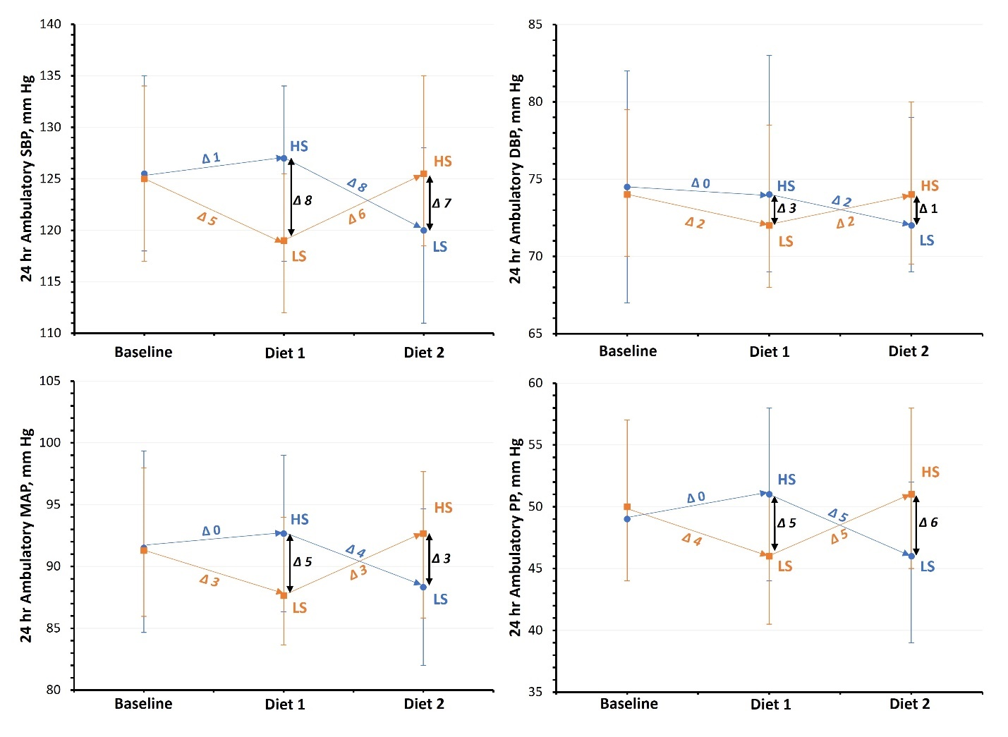
High- and low-sodium diets compared with usual-diet
P = 0.14
Adding sodium did not significantly increase systolic BP
Consuming a low-sodium diet significantly lowered systolic BP
P<0.0001
Notes:
At baseline the median systolic blood pressure was 125 mm Hg. For individuals randomized to high sodium diet first shown in blue, systolic BP did not significantly change, with a median increase of 1 mm Hg from usual to high sodium diet to 126 mm Hg. In contrast, for individuals randomized to low-sodium diet first, systolic blood pressure significantly decreased by a median of 5 mm Hg to 119 mm Hg.

Slide 14
Mean difference in systolic BP between groups randomized to high- or low-sodium diet first
8 mm Hg (95% CI: 4 – 11 mm Hg)
P < 0.0001
Notes:
Comparing the groups just at the end of the first diet week, the low sodium diet caused an average reduction in systolic BP of 8 mm Hg, as shown in the black vertical arrows, compared with high-sodium diet.

Slide 15
Consistent examining 2nd diet week
7 mm Hg (95% CI: 3 – 11 mm Hg)
P < 0.0001
Notes:
This average group difference in systolic BP between with low- compared with high-sodium diet was consistent examining just the 2nd diet week as well.

Slide 16
Mean difference in 24-hour ambulatory systolic BP across subgroups
Subgroup
Mean Difference (95% CI)
Notes:
The reduction in systolic BP with low vs. high sodium diet at the end of this first diet week was consistent across subgroups of age, sex, race, hypertension, and BMI. We also found the BP reduction with low-sodium diet was similar between individuals on and not-on anti-hypertensive medications. The magnitude of the reduction in Systolic BP with low compared with high-sodium diet was greater in individuals with higher baseline BP and diabetes, but individuals with lower baseline BP and without diabetes still had significant reductions in systolic BP.

Slide 17
Within individual salt-sensitivity of blood pressure
Notes:
Next, we examined the within individual BP response as the difference in systolic BP between high minus low sodium diet. A positive value for SSBP reflects a DECLINE in BP with low-sodium diet.

Slide 18
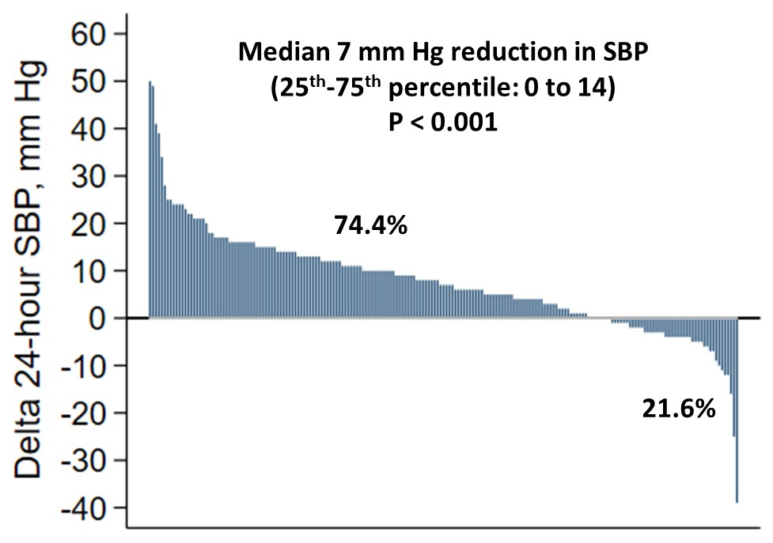
Reduction in Systolic BP with low- compared with high-sodium diet
Increase in Systolic BP with low- compared with high-sodium diet
Delta 24-hour BP calculated as high minus low-sodium diet
Notes:
In this waterfall plot displaying the within-individual change in BP between high- and low-sodium diet for each participant, the median reduction in Systolic BP was 7 mm Hg, which was highly significant. Overall, 74.4% of individuals experienced any reduction in systolic BP with low-sodium diet compared with high-sodium diet. In contrast, 21.6% of individuals saw any increase in systolic BP with low-compared with high-sodium diet.

Slide 19
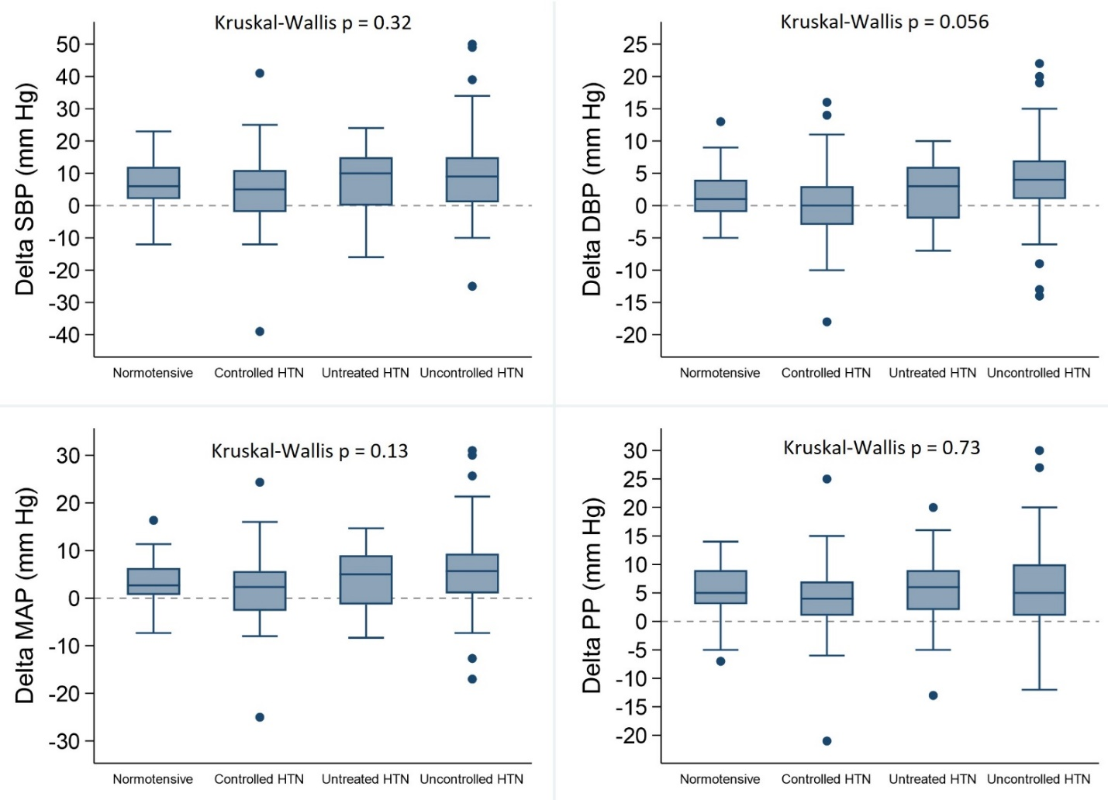
Reduction in Systolic BP with low- compared with high-sodium diet
Increase in Systolic BP with low- compared with high-sodium diet
N=49
N=39
N=50
N=61
Delta 24-hour BP calculated as high- minus low-sodium diet
Notes:
As most prior studies of the impact of dietary sodium reduction on BP excluded individuals taking anti-hypertension medications, we sought to address this gap. Using baseline 24-hour ABPM results, conventional thresholds of 130/80 for defining HTN, its control, and anti-HTN medication use, we categorized participants into 4 groups: normotensive, controlled HTN, untreated HTN, and uncontrolled HTN. We did not find a significant difference in systolic BP between the high minus low-sodium diet across the 4 groups as shown in the box plots.

Slide 20
Adverse events
Symptom/Adverse Event | High-sodium diet N = 21 (9.9%) | Low-sodium diet N = 17 (8.0%)
Headache | 6 (2.8%) | 3 (1.4%)
GI upset/vomiting | 5 (2.3%) | 3 (1.4%)
Edema/swelling | 5 (2.3%) | 0 (0.0%)
Lightheaded/dizzy | 4 (1.8%) | 2 (0.9%)
Chest discomfort/heartburn | 3 (1.4%) | 0 (0.0%)
Thirsty | 2 (0.9%) | 1 (0.5%)
Weakness/lethargy | 2 (0.9%) | 4 (1.9%)
Mouth sores | 2 (0.9%) | 2 (0.9%)
Cramping | 1 (0.5%) | 5 (2.3%)
Emergency Department visit | 1 (0.5%) | 2 (0.9%)
Diarrhea | 1 (0.5%) | 1 (0.5%)
Exertional dyspnea | 1 (0.5%) | 0 (0.0%)
Toe Pain | 1 (0.5%) | 0 (0.0%)
Bloated | 1 (0.5%) | 0 (0.0%)
Constipation | 0 (0.0%) | 1 (0.5%)
Notes:
While on high-sodium diet 9.9% of participants reported any adverse event. In contrast, while on low-sodium diet, 8% of individuals reported symptoms or adverse events. In both groups, these were generally mild and self limited. For example, on High-sodium diet, headache, GI upset, and edema were most commonly reported in 2-3% of individuals. On low-sodium diet cramping and weakness were most commonly reported in approximately 2% of individuals.

Slide 21
Limitations
Dietary non-adherence and equilibrium
Non-sodium dietary components
Sustainability of a low-sodium diet
Generalizability
Notes:
Limitations of our study should be noted. The 24-hour urine sodium excretion values were less than and more than would be expected based on the sodium content of the high- and low-sodium diets, respectively. This may be attributable to dietary non-adherence, equilibrium had not yet been obtained, or both. We cannot exclude the contribution of non-dietary components, but our results were similar even with adjustment for differences in 24-hour urinary potassium and are consistent with the systolic BP effect observed in the fully controlled DASH-sodium trial. Our one-week dietary periods cannot address the sustainability of the low-sodium diet, but the magnitude of the effect is similar to that observed of longer studies of 1-6 months duration. Our results may not be generalizable outside of our study cohort.

Slide 22
Conclusions
Compared with usual diet, sodium reduction on average significantly lowered systolic BP, whereas addition of sodium did not raise systolic BP.
The decline in systolic BP with a low-sodium diet was independent of hypertension status and anti-hypertensive medication use, generally consistent across subgroups, and did not result in excess adverse events.
For most middle-aged to elderly adults, dietary sodium reduction resulted in clinically meaningful BP lowering which was safely achieved within 1-week.
The effect of dietary sodium reduction on BP is comparable to a commonly utilized first-line anti-hypertensive medication, i.e., hydrochlorothiazide 12.5 mg daily.
Notes:
In conclusion,

Slide 23
Acknowledgements
We thank all participants and study staff for their time and invaluable contributions
Vanderbilt | Northwestern University & University of Illinois-Chicago | University of Alabama at Birmingham | Funding
Cassandra Reynolds | Sarah Al-Sharif | Kelly Hardy | NHLBI
Kelsey Tomasek | William Meder | Eli Pruett | AHA
Shi Huang | Eric Wiseman | Tania Jackson | NIH
Feng Sha | Tania Grott | Mayah Johnson
Laura Jones | Sue Giovanazzi | Bjoern Hornikel
 |  | Betty Darnell
 |  | Ciara Mitchell
 |  | Sheikilya Thomas
 |  | Trena Johnsey
 |  | Willa Sanders
Notes:
We greatly appreciate the time and invaluable contributions of participants and our study staff, who are shown here. This study was supported by the NHLBI.

Slide 24
Deepak K. Gupta, MD, MSCI; Cora E. Lewis, MD, MSPH; Krista A. Varady, PhD; Yan Ru Su, MD; Meena S. Madhur, MD, PhD; Daniel T. Lackland, DrPH; Jared P. Reis, PhD; Thomas J. Wang, MD; Donald M. Lloyd-Jones, MD; Norrina B. Allen, PhD
Effect of Dietary Sodium on Blood Pressure
A Crossover Trial
Published Online November 11, 2023
AHA Scientific Sessions
Notes:
For additional details, the manuscript is published online in JAMA simultaneous with this presentation.

Slide 25
Thank you
Notes:
Thank you very much for your interest and attention.

