Slide 1
LAA Occlusion Post Approval Studies: Opportunities for Use of Registries
David R. Holmes, Jr., M.D.
Mayo Clinic, Rochester, MN
CRT 2017
Washington, D.C.
February 2017

Slide 2
Presenter Disclosure Information
David R. Holmes, Jr., M.D.
“LAA Occlusion Post Approval Studies: Opportunities for Use of Registries”
The following relationships exist related to this presentation: Both Mayo Clinic and I have a financial interest in technology related to this research. That technology has been licensed to Boston Scientific.

Slide 3
Post-FDA Approval, Initial US Clinical Experience with Watchman Left Atrial Appendage Closure for Stroke Prevention in Atrial Fibrillation
Vivek Y. Reddy MD¹*, Douglas N. Gibson MD², Saibal Kar³, William O’Neill MD⁴, Shephal K. Doshi MD⁵, Rodney P. Horton MD⁶, Maurice Buchbinder MD⁷, Nicole T. Gordon BSEE⁸, David R. Holmes MD⁹*
*Both authors contributed equally to the development of this manuscript
¹Icahn School of Medicine at Mount Sinai, New York, NY; ²Scripps Clinic, La Jolla, CA; ³Cedars Sinai Medical Center, Los Angeles, CA; ⁴Center for Structural Heart Disease, Henry Ford Hospital, Detroit, MI; ⁵St. John’s Health Center, Santa Monica, CA; ⁶Texas Cardiac Arrhythmia Institute, Austin, TX; ⁷Foundation for Cardiovascular Medicine, La Jolla, CA; ⁸Boston Scientific Corporation, St. Paul, MN; ⁹Department of Cardiology, Mayo Clinic, Rochester, MN

Slide 4
Background
March 2015
FDA approval of left atrial appendage occlusion (LAAC) with Watchman™ device to reduce risk of stroke in NVAF
Clinical procedures initiated using following criteria
Patients met FDA clinical criteria
Local site patient consent and IRB
Physicians experienced with or trained in patient selection, as well as in procedural performance
Procedures performed with trained Watchman clinical specialist in attendance

Slide 5
Background
February 2016
CMS finalized NCD requiring all LAAC patients be enrolled in a prospective National Registry
Clinical procedures continued
August 2016
LAAC Registry certified

Slide 6
Background Issue
Outcome of patients implanted between
March 2015 (FDA approval), and
August 2016 (LAAC Registry certified by CMS)
Unknown
Formalized safety or usage data

Slide 7
Purpose
In the absence of a prospective registry from the time of FDA approval of the WATCHMAN LAAC device, we sought to analyze procedural safety data in the initial post-approval launch as reported to the manufacturer

Slide 8
Methods
March 2015 – May 2016
3,822 consecutive patients underwent LAAC with Watchman™ implantation by 382 physicians at 169 U.S. centers
50% of procedures performed by newly trained operators
Each implant was required to be performed with Watchman clinical specialist in attendance
Details of each procedure recorded on standardized forms, and events reported to manufacturer per de-identified patient data

Slide 9
Methods (cont)
Major complications
Pericardial effusion, need for urgent cardiac surgery, stroke, device embolization, and death
Reviewed independently by
Sponsors – Medical Safety Group
Authors
VR – electrophysiologist
DRH – interventional cardiologist

Slide 10
Outcomes in the Post-FDA Approval Watchman Experience
 | Post-FDA Approval Experience
Procedural Parameters
No. of Procedures | 3822
Implantation Success, % | 3653 (95.6%)
Procedure Duration, min
Median | 50 min
IQR (1st) | 36 min
IQR (3rd) | 66 min
Devices Used per Procedure | 1.38

Slide 11
Procedural Success
~50%
new operators
~70%
new operators
N=449
N=566
N=265
N=579
N=1019
N=3822
Implant success defined as deployment and release of the device into the LAA; no leak ≥ 5 mm

Slide 12
Procedure Duration
WATCHMAN FDA Panel Sponsor Presentation. Oct 2014

Slide 13
Outcomes in the Post-FDA Approval Watchman Experience N=3822
 | Post-FDA Approval Experience
Complications
Pericardial Tamponade | 39 (1.02%)
Treated with Pericardiocentesis | 24 (0.63%)
Treated Surgically | 12 (0.31%)
Resulted in Death | 3 (0.078%)
Pericardial Effusion – No Intervention | 11 (0.29%)
Procedure-Related Stroke | 3 (0.078%)
Device Embolization | 9 (0.24%)
Removed Percutaneously | 3
Removed Surgically | 6
Death
Procedure-Related Mortality | 3 (0.078%)
Additional Mortality within 7 days | 1 (0.026%)

Slide 14
Comparison of Procedural Complications Across Watchman Studies
 | PROTECT-AF | PREVAIL | CAP | CAP2 | EWOLUTION | Post-FDA Approval | Aggregate Data
Pericardial Tamponade | 20 (4.3%) | 5 (1.9%) | 8 (1.4%) | 11 (1.9%) | 3 (0.29%) | 39 (1.02%) | 86 (1.28%)
Treated with pericardiocentesis | 13 (2.8%) | 4 (1.5%) | 7 (1.2%) | n/a | 2 (0.20%) | 24 (0.63%)
Treated surgically | 7 (1.5%) | 1 (0.4%) | 1 (0.2%) | n/a | 1 (0.10%) | 12 (0.31%)
Resulted in death | 0 | 0 | 0 | 0 | 0 | 3 (0.78%)
Pericardial effusion – no intervention | 4 (0.9%) | 0 | 5 (0.9%) | 3 (0.5%) | 4 (0.39%) | 11 (0.29%) | 27 (0.40%)
Procedure-related stroke | 5 (1.15%) | 1 (0.37%) | 0 | 2 (0.35%) | 1 (0.10%) | 3 (0.078%) | 12 (0.18%)
Device embolization | 3 (0.6%) | 2 (0.7%) | 1 (0.2%) | 0 | 2 (0.20%) | 9 (0.24%) | 17 (0.25%)
Removed percutaneously | 1 | 0 | 0 | 0 | 1 | 3
Removed surgically | 2 | 2 | 1 | 0 | 1 | 6
Death
Procedure-related mortality | 0 | 0 | 0 | 0 | 1 (0.1%) | 3 (0.078%) | 4 (0.06%)
Additional mortality within 7 days | 0 | 0 | 0 | 1 (0.17%) | 3 (0.29%) | 1 (0.026%) | 5 (0.07%)

Slide 15
Comparison of Procedural Complications Across Watchman Studies

Slide 16
Summary
Following United States FDA approval, this dataset represents the first patients implanted with this novel therapy
Device usage, procedure time, and implant success rates are consistent with clinical trial results
Safety complications rates in the initial experience are consistent with clinical trial results
Cardiac tamponade and procedure-related mortality occurred in ~1% and <0.1% of patients, respectively

Slide 17
Conclusion
In the real-world post-FDA approval experience of Watchman LAAC, procedural success was high and complication rates low.
Complications were low even with ~50% of the operators being new to the procedure. This demonstrates that early procedure learnings can be transferred through rigorous training.

Slide 19
Comparison of Procedural Parameters Across Watchman Studies
 | PROTECT-AF | PREVAIL | CAP | CAP2 | EWOLUTION | Post-FDA Approval | Aggregate Data
# Procedures | 463 | 269 | 566 | 579 | 1021 | 3822 | 6720
Implantation success, % | 90.9 | 95.1 | 94.4 | 94.8 | 98.5 | 95.6 | 94.9
Procedure duration, min
Median | 51 | 52 | 46 | 55 | n/a | 50 | 50.8
IQR (1st) | 37 | 40 | 34 | 39 | n/a | 36
IQR (3rd) | 71 | 73 | 62 | 80 | n/a | 66
Devices use/procedure | 1.6 | 1.5 | 1.4 | 1.4 | 1.07 | 1.38 | 1.39

Slide 20
Background Issue
Outcome of patients implanted between
March 2015 (FDA approval), and
August 2016 (LAAC Registry confirmed)
Unknown
Formalized safety or usage data

Slide 21
Background Issue
Outcome of patients implanted between
March 2015 (FDA approval), and
August 2016 (LAAC Registry certified)
Remains unknown without formalized data on safety or usage.

Slide 22
Devices per Case¹⁻²
Average # of Devices/Implant Attempt
1 WATCHMAN FDA Panel Sponsor Presentation. Oct 2014; 2 Boersma, L.et al. EHJ; published online Jan 2016 in press

Slide 23
Device Embolization Details
Device Size | Method of Removal
21 mm | Percutaneous Snare
21 mm | Percutaneous Snare
33 mm | Surgical
33 mm | Surgical
30 mm | Surgical
24 mm | Percutaneous Snare
27 mm | Surgical
27 mm | Surgical
27 mm | Surgical

Slide 24
Device Embolization Details
Device Size | Method of Removal | Notes
21 mm | Percutaneous Snare | Lower Abdominal Aorta / Retrograde arterial removal
21 mm | Percutaneous Snare | Lodged in Abdominal Aorta / Identify at 45-day TEE visit
33 mm | Surgical | Left ventricle
33 mm | Surgical | n/a*
30 mm | Surgical | Left ventricle
24 mm | Percutaneous Snare | Retrieved during procedure; then a 2nd device was successfully placed
27 mm | Surgical | Device entangled in mitral valve
27 mm | Surgical | n/a*
27 mm | Surgical | Device entangled in aortic valve / left ventricular outflow tract
*n/a = information not available

Slide 25
Background
March 2015
FDA approval of left atrial appendage occlusion (LAAC) with Watchman™ device to reduce risk of stroke in NVAF
Clinical procedures initiated accordingly
February 2016
CMS finalized NCD requiring all LAAC patients be enrolled in a prospective National Registry
August 2016
LAAC Registry certified
Majority of procedures performed not evaluated
No formalized safety or usage data are available on the initial device patients

Slide 26
ASAP-TOO Assessment of the WATCHMANTM Device in Patients Unsuitable for Oral Anticoagulation
Notes:
26

Slide 27
WATCHMAN® Indications for Use
The WATCHMAN Device is indicated to reduce the risk of thromboembolism from the left atrial appendage in patients with non-valvular atrial fibrillation who:
Are at increased risk for stroke and systemic embolism based on CHADS2 or CHA2DS2-VASc scores and are recommended for anticoagulation therapy;
Are deemed by their physicians to be suitable for warfarin; and
Have an appropriate rationale to seek a non-pharmacologic alternative to warfarin, taking into account the safety and effectiveness of the device compared to warfarin
The WATCHMAN LAA Closure Technology is intended to prevent thrombus embolization from the
left atrial appendage and reduce the risk of life-threatening bleeding events in patients with non-valvular atrial fibrillation who are eligible for anticoagulation therapy
or who have a contraindication
to anticoagulation therapy.
US Indication
International Indication:

Slide 28
ASAP-TOO Study Design
Prospective, randomized, multi-center, global
Patients with non-valvular atrial fibrillation deemed not suitable for oral anti-coagulation therapy to reduce the risk of stroke.
Randomized 2:1 (Watchman vs Control)
Considering Group Sequential Design
Allows early looks; potential to stop early for benefit
888 subjects at up to 100 global sites
Follow-Up*
45 Day with TEE
6,18 month phone visit
12 month with TEE
Years 2-5 bi-annually
* Brain imaging required at baseline if prior stroke or TIA

Slide 29
ASAP-TOO Reasons for OAC Unsuitability
History of overt bleeding related or unrelated to oral anticoagulants:
Prior history of intracranial or subdural hemorrhage
Other clinically relevant organ bleeding
Recurrent epistaxis requiring ER visit, hospitalization or physician intervention
Increased risk of bleeding or bleeding tendencies:
Gastrointestinal lesions resulting in clinically relevant bleeding
Active inflammatory bowel disease
Peptic ulcer disease with gastrointestinal bleeding in which anticoagulation cannot be safely initiated/restarted following healing
Uncontrolled seizures
History of traumatic falls with the likelihood of recurrence
Cerebral amyloid angiopathy
Significant thrombocytopenia (defined as platelet count < 50 x 10⁹/L)
Need for lifelong dual antiplatelet therapy

Slide 30
ASAP-TOO Reasons for OAC Unsuitability (cont)
Contraindications to warfarin and/or direct OAC (DOAC)
Severe renal failure (GFR <30mL/min/1.73m³)
Allergy to the above agents
Other contraindications including:
Lifestyle or occupational bleeding risk
Poor control on warfarin and intolerance to the DOACs
Other medical or social reasons that make OACs unsuitable

Slide 31
ASAP-TOO Endpoints
Primary Effectiveness Endpoint
The time to first occurrence of ischemic stroke or systemic embolism
Primary Safety Endpoint
Same as historical WATCHMAN studies: 7-day rate of all-cause death, ischemic stroke, systemic embolism, or device- or procedure- related events requiring open cardiac surgery or major endovascular intervention such as pseudoaneurysm repair, AV fistula repair, or other major endovascular repair

Slide 32
ASAP- TOO Key Secondary Endpoints
1.The time to first occurrence of stroke (including ischemic and/or hemorrhagic), cardiovascular death (cardiovascular and/or unexplained cause) and systemic embolism
2. The occurrence of major bleeding (defined as a BARC bleeding score of ≥3)

Slide 33
ASAP–TOO Key Inclusion Criteria
The patient has documented paroxysmal, persistent, permanent or long-term/longstanding persistent non-valvular atrial fibrillation (i.e., the patient has not been diagnosed with rheumatic mitral valvular heart disease)
The patient has a calculated CHA₂DS₂-VASc score of 2 or greater
The patient is deemed by two study physicians to be unsuitable for oral anticoagulation
The patient is deemed by their physician to be suitable for the defined protocol pharmacologic regimen of aspirin and clopidogrel* therapy following WATCHMAN Closure Device implant.
Clopidogrel may be substituted with ticagrelor or prasugrel if the subject requires the medication for other indications (e.g. acute coronary syndromes treated with drug eluting stents) or if the subject has a known resistance to clopidogrel.

Slide 34
ASAP-TOO Key Exclusion Criteria
Subjects who are currently enrolled in another investigational study or registry that would directly interfere with the current study, except when the subject is participating in a mandatory governmental registry, or a purely observational registry with no associated treatments
The subject had or is planning to have any cardiac or non-cardiac invasive or surgical procedure within 30 days prior to or 90 days after the WATCHMAN implant (e.g., cardioversion, ablation, cataract surgery, endoscopy)
The subject had a prior stroke (of any cause) or TIA within the 30 days prior to enrollment
The subject had a prior BARC type 3 or 4 bleeding event within the 14 days prior to randomization
The subject has a history of atrial septal repair or has an ASD/PFO device
The subject has an implanted mechanical valve prosthesis in any position
The subject suffers from New York Heart Association Class IV Congestive Heart Failure

Slide 35
ASAP-TOO Device Group Medication Therapy
Visit Interval | Aspirin | Clopidogrel*
Discharge through 3-month visit | Yes, suggested dose: 75-100mg | Yes Suggested dose: 75mg
3-month visit through 12-month visit | Yes, suggested dose: 75-100mg | No, unless other indication
Following the 12-month visit | No, unless other indication | No, unless other indication
*Clopidogrel may be substituted with ticagrelor or prasugrel if the subject requires the medication for other indications (e.g. acute coronary syndromes treated with drug eluting stents) or if the subject has a known resistance to clopidogrel.
Patients are allowed to be on dual antiplatelet therapy (outside of the protocol required 3- months period) if indicated due to a condition other than WATCHMAN implantation.

Slide 36
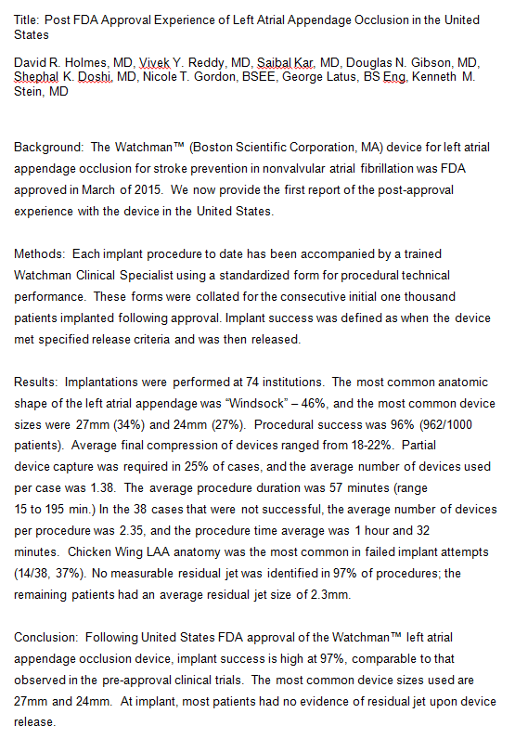

Slide 37
Background
LAAO with Watchman Device was approved by FDA in 2015 based on PROTECT AF and PREVAIL RCT’s and companion Registries
Development of PMS Registry a condition of approval planned to begin enrollment 2nd quarter 2016
Between approval but before PMS study, commercial cases continued and were entered into a procedural data base by Watchman clinical specialists using standardized forms

Slide 38
Study Objective & Timeline
Assess procedural performance in commercial cases performed after FDA approval but before PMS study
Compare procedural performance with pre FDA approval data obtained in PROTECT AF, PREVAIL RCT’s ,companion Registries (CAP1 and CAP 2) and Ewolution Registry
Commer-cial
N=3822
CAP1 N=566
CAP2 N=463
PROTECT AF N=800
PREVAIL N=463
EWOLUTION N=1025
2005
2006
2007
2008
2009
2010
2011
2012
2013
2014
2015
PROTECT AF
59 Centers
449 Procedures
CAP1
26 Centers
566 Procedures
PREVAIL
41 Centers
50 Operators (24 New)
265 Procedures
CAP2
47 Centers
579 Procedures
EWOLUTION
47 Centers
1019 Procedures
Commercial
47 Centers
1683 Procedures

Slide 39
Materials and Methods
Watchman device: self expanding nickel titanium structure ranging in diameter from 21-33 mm, covered on left atrial surface by permeable fabric cover and anchored at the LAA ostium
IFU for FDA approval identified patient selection criteria to include
High risk for stroke
Increased risk for bleeding
Able to take short term anticoagulation
Not felt to be a good candidate for long term anticoagulation

Slide 40
Patient Recruitment and Procedural Performance
3,822 consecutive patients undergoing clinically indicated Watchman placement accordingly to FDA IFU selection criteria
Informed site consent in each patient
Procedures performed by physicians trained in LAAO
Trained experienced Watchman clinical specialists in attendance in each case
Details of each procedure recorded on standardized forms

Slide 41
Procedural Performance Details
Anatomic LAA size and shape
Specific guide catheter for LAA intubation
Device size
Number of devices used and percentage of recapture attempts
Procedural success and device release
Operator assessed residual leak
Procedural duration
Acute procedural related complications

Slide 42
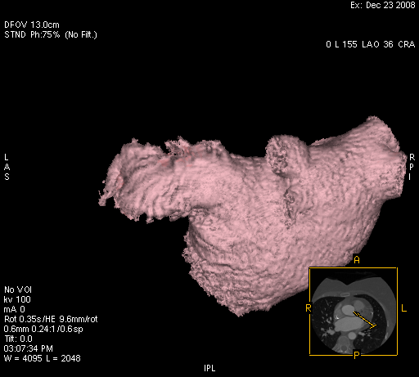
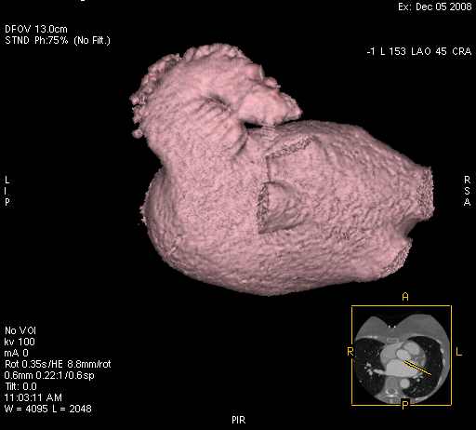
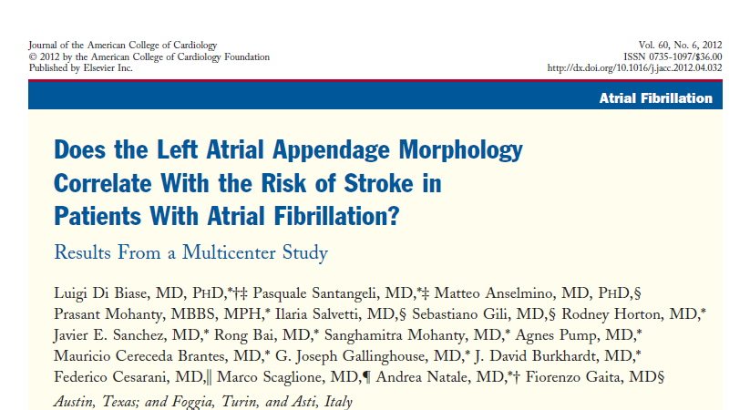
LAA by Type
 | WATCHMAN N (%)
Windsock | 730 (43)
Chicken Wing | 314 (19)
Broccoli | 297 (18)
Other | 342 (20)
Windsock
Chicken Wing
Broccoli

Slide 43
LAA & Device Sizes
Characteristic | PROTECT AF | PREVAIL | CAP1 | CAP2 | Commercial
Maximum LAA ostium, mm Diameter, mm | 21.6 ± 3.6 (457) (14.0, 37.1) | 21.4 ± 3.3 (266) (13.7, 31.6) | 21.1 ± 3.4 (551) 10.0, 36.0 | 21.01±6.01 (572) 1.4, 81.5 | 24.8 (1607) 19.4, 30
Device Size (mm) | PROTECT AF % | CAP1 % | PREVAIL % | CAP2 % | Commercial %
21 | 25.0 | 19.7 | 15.5 | 13.6 | 10.9
24 | 35.3 | 40.4 | 32.9 | 26.7 | 27.3
27 | 28.2 | 26.6 | 32.9 | 35.5 | 32.7
30 | 7.8 | 9.6 | 14.7 | 17.4 | 18.1
33 | 3.7 | 3.7 | 4.0 | 6.8 | 11.0

Slide 44
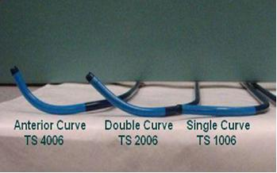
Sheath Usage
Curve | N (%)
Double | 1320 (82)
Single | 214 (13)
Anterior | 73 (5)
Preformed curve shapes guide position in LAA

Slide 45
Procedural Success
N=449
N=566
N=265
N=579
N=1019
N=1683
Implant success defined as deployment and release of the device into the LAA; no leak ≥ 5 mm

Slide 46
Devices per Case
Average # of Devices/Implant Attempt

Slide 47
Procedure Duration

Slide 48
Conclusion
Following United States FDA approval of the Watchman™ left atrial appendage occlusion device, implant success is high at 96%, comparable to that observed in the pre-approval clinical trials. The most common device sizes used are 27mm and 24mm. At implant, most patients had no evidence of residual jet upon device release.

Slide 49
Disclosures

Slide 50
Study Objective
Evaluate the acute procedural performance and complication rates for all consecutive Watchman cases performed in the U.S. since FDA approval

Slide 51
Watchman
Case by Operator (Experienced Only)
Number of Implants
Case by Operator (Inexperienced Only)
Number of Implants

Slide 52
Holmes, David Post FDA Approval Watchman, Reddy – 3578545
Color Theme
Highlight
Footnote/subdue
X-Y Axis
A
B
C
D
E
F
Row | Color | No. | %
1 | Red | 12.3 | 47
2 | Yellow | 459.2 | 26
3 | Green | 56.7 | 98
%
This is the side title color
Type first bulleted point here
Type first subpoint here
This is the highlight color
Notes
Bold & Shadow all Text
Black borders on bar graphs
Line graphs: No shadow on lines

