Slide 1
First-in-Human Clinical Study with a Novel Drug-Filled Stent: 9-Month Clinical, Angiographic, IVUS, and OCT Outcomes from the RevElution Study
Stephen G. Worthley,
on behalf of Alexandre Abizaid, Ajay J. Kirtane, Daniel I. Simon, Stephan Windecker, Sandeep Brar, Ian T. Meredith, Sharad Shetty, Ajay Sinhal, Alexandra P. Almonacid, Daniel Chamié, Akiko Maehara, Gregg W. Stone,
and the RevElution Study Investigators
Notes:
Session name: Plenary Session VI. First Report Investigations 2
Date: Monday October 31, 2016
Time: 12:00pm (= time of embargo lift)
Location: Main Arena

Slide 2
Disclosure Statement of Financial Interest
Within the past 12 months, I, Stephen Worthley, or my spouse/partner have had a financial interest/arrangement or affiliation with the organization(s) listed below.
Affiliation/Financial Relationship
Company
Grant/Research Support
Consulting Fees/Honoraria
Major Stock Shareholder/Equity
Royalty Income
Ownership/Founder
Intellectual Property Rights
Other Financial Benefit
-
St Jude Medical, Medtronic
-
-
-
-
-

Slide 3
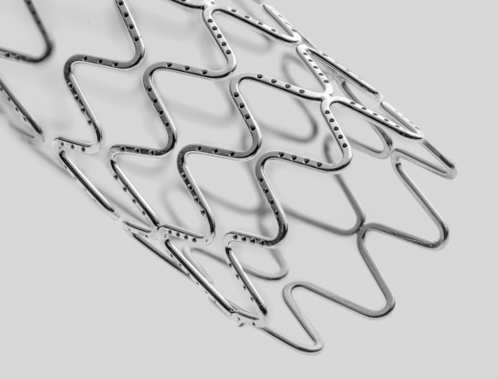
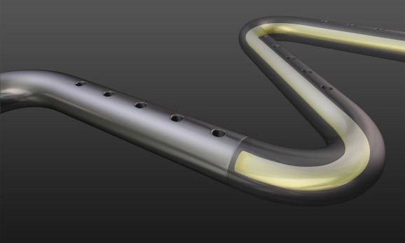
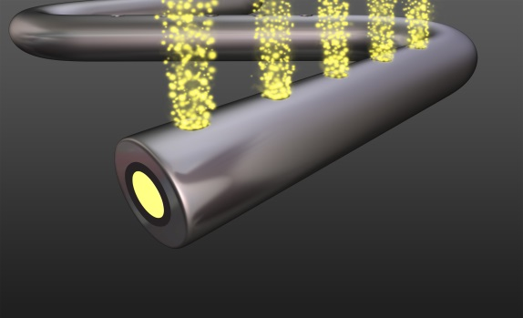
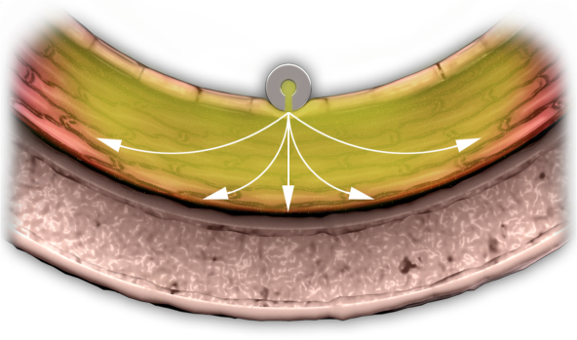
Drug-Filled Stent
Concept
The drug-filled stent (DFS, Medtronic, Santa Rosa, CA) is a novel polymer-free DES (81µm struts). Zero polymer exposure avoids adverse effects of polymer-induced inflammation and could potentially allow for a shorter DAPT duration
DFS is made from a tri-layer wire:
Outer cobalt alloy layer for strength
Middle tantalum layer for radiopacity
Core material is removed and becomes an inner lumen that is continuously coated with drug in a solid state
0.02 mm
Drug coating
Tantalum
Cobalt alloy
Drug (sirolimus) is protected and contained inside the stent
Drug releases through abluminal laser-drilled holes
Drug elution is controlled through natural diffusion via direct interaction with the vessel wall
Elution profile is controlled by the number and size of the holes, resulting in a sustained elution similar to durable polymer DES
Drug coats inner lumen
Drug elutes through abluminal holes
Uniform distribution in stented area
Notes:
Evolution of the Continuous Sinusoid Technology and Core Wire Technology using a tri-layer wire
Drug elutes through natural diffusion via direct interaction with the vessel wall
Fluid (extracellular fluid and serum elements) fills inner lumen
Drug solubilizes and diffuses with the concentration gradient (high to low)
Controlled and sustained elution profile
Elution is controlled through drug formulation, drug load, number of holes and size of holes
Drug diffuses into the tissue resulting in a uniform tissue response throughout stented area
Extended elution similar to current durable polymer DES

Slide 4
RevElution Trial
Study Design
De Novo Native Coronary Lesions
Vessel Diameter: 2.25–3.5 mm
Lesion Length: ≤ 27 mm
9 Month Cohort
N=50
N= 100 Patients
15 sites in Australia, Brazil and Singapore
24 Month Cohort
N=50
OCT Subgroup
N=30
OCT Subgroup
N=30
1 mo OCT
Subgroup N=15
3 mo OCT
Subgroup N=15
2 mo OCT
Subgroup N=15
6 mo OCT
Subgroup N=15
9 mo Angio/IVUS
N=20
9 mo Angio/IVUS/OCT
N=30
24 mo Angio/IVUS/OCT
N=30
24 mo Angio/IVUS N=20
PRIMARY ENDPOINT: In-stent late lumen loss at 9 months in 9M cohort (50 pts)
Key 2˚ Endpoints: Major Adverse Cardiac Events (MACE), Target Lesion Failure (TLF) and components
QCA / IVUS Endpoints: % diameter stenosis, in-segment late lumen loss, NIH volume and % volume obstruction
Key OCT Endpoints: Stent strut tissue coverage, neointimal tissue thickness, stent (mal)apposition, % volume obstruction and NIH tissue characterization
Pharmacokinetic Analysis: 12 PK timepoints up to 30 days will be assessed
DAPT Regimen: ASA indefinitely and clopidogrel ≥ 6 months (12 months in pts not at high risk of bleeding)
NCT02480348
CONFIDENTIAL – DO NOT DISTRIBUTE

Slide 5
RevElution Trial
Baseline Patient Characteristics
% | 9 Month Cohort N=50 pts, 56 lesions
Age, years (mean±SD) | 66.2 ± 10.1
Male | 76.0
Diabetes mellitus | 30.0
Insulin treated | 10.0
Hypertension | 76.0
Hyperlipidemia | 84.0
Current smoker | 12.0
Family history of CAD | 42.6
Prior MI | 20.0
Prior PCI | 16.0
Prior CABG | 10.0
Reason for revascularization
Unstable angina | 18.0
Stable angina | 56.0
Positive functional study | 30.0
Silent ischemia | 6.0

Slide 6
RevElution Trial
Baseline Angiographic Characteristics
% | 9 Month Cohort N=50 pts, 56 lesions
Target vessel location
LAD | 52.0
LCX | 32.0
RCA | 26.0
ACC/AHA lesion class – B2 – C | 50.0 26.8
TIMI 3 flow | 98.2
RVD (mm) | 2.70 ± 0.43
MLD (mm) | 0.97 ± 0.28
% Diameter stenosis | 63.8 ± 9.5
Lesion length (mm) | 12.85 ± 5.21
Lesions treated per patient | 1.1 ± 0.3
Radial approach | 86.0
Lesion success¹ | 100.0
Device success² | 100.0
Procedure success³ | 100.0
¹ The attainment of <50% residual stenosis of the target lesion using any percutaneous method.
² The attainment of <50% residual stenosis of the target lesion using only the DFS
³ The attainment of <50% residual stenosis of the target lesion and no in-hospital MACE.

Slide 7
RevElution Trial – Primary Endpoint
Late Loss at 9 Months
Δ = -0.10 mm
95% CI (upper one-sided)* = 0.05mm
P_{non-inferiority} <0.001
0.36 ± 0.52
In-stent late lumen loss (mm)
0.26 ± 0.28
DFS
(n=49 lesions)
Resolute ZES historical control
(n=93 lesions)
Primary endpoint met, demonstrating non-inferiority
*The CI is adjusted to propensity score, based on lesion-length, baseline RVD, age, sex, diabetes, history of MI and worst CCS Angina Class as independent variables.

Slide 8
RevElution Trial
Clinical Results at 9 Months
n = 48/50
Events (%)
One patient developed ischemia symptoms while having a CT guided lung biopsy for lung cancer. Based on elevated troponin levels, CEC adjudicated event as a NQMI.
Target lesion failure (TLF) is defined as cardiac death, target vessel MI or ischemia-driven TLR.

Slide 9
RevElution Trial
Conclusions
The Drug-Filled Stent (DFS) is a novel polymer-free DES with sirolimus residing on the inside of the stent and eluted through abluminal holes
In the first 50 patient cohort, the polymer-free DFS was safe and effective with late lumen loss non-inferior to historical control, with minimal neointima hyperplasia and 0% binary restenosis at 9 months
DFS implantation resulted in a high degree of early stent strut coverage and 0% late incomplete malapposition, indicative of rapid early healing
The TLF rate was low (2.1%) at 9 months with no stent thrombosis
DFS may avoid polymer-associated adverse vascular responses, potentially allowing for shorter duration of DAPT

