Slide 1
BATTLE trial
1 year outcomes in a multicenter randomized trial comparing MISAGO® vs.
ZILVER® PTX® for the treatment of intermediate length femoropopliteal lesions
Y. Gouëffic, A. Sauguet, P. Desgranges, P. Feugier, E. Rosset, E. Ducasse, A. Cardon, S. Rinckenbach,
J.M. Pernes, P. Commeau, P. Lermusiaux, B. Guyomarc’h, L. Bressolette, B Maurel.

Slide 2
Potential conflicts of interest
X I have the following potential conflicts of interest to report:
X◻ Receipt of grants/research support
Details: Abbott; Bard; Medtronic; Terumo; WL Gore
X◻ Receipt of honoraria and travel support
Details: Abbott; Bard; Boston Sc; Cook; Medtronic; Vycon;
Terumo; Spectranetics.

Slide 3
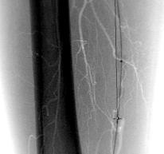
TASC A-B femoro-popliteal lesions
What is the best strategy?
Bare metal stent
Drug eluting stent
Drug coating balloon
< 15-cm
Covered stent
Bioresorbable stent…

Slide 4
Few head to head comparison between devices for FP
lesions treatment
Adapted from Katsanos, J Vasc Surg, 2014

Slide 5
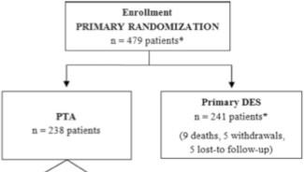
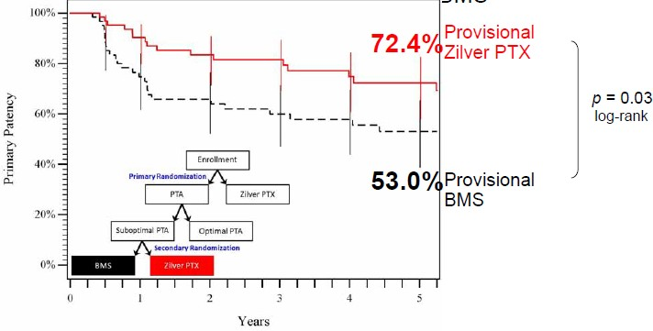
Zilver® PTX® RCT
Zilver PTX vs POBA for TASC A/B femoropopliteal lesions
At 5 years, sustained clinical, morphological and
hemodynamic outcomes
Dake, Circ Cardiovasc Interv. 2011 Dake, Circulation, 2016

Slide 6
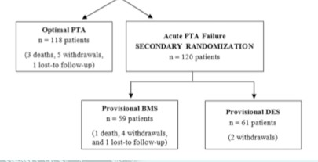
Sample size calculation of Zilver® PTX® RCT
First arm of randomization
Primary end point
12-month rates of event-free survival and patency in the primary DES and PTA groups
479 patients to include
Second arm of randomization
- Sub groups (BMS/DES; 59/61)
- Secondary endpoints
Dake, Circ Cardiovasc Interv. 2011

Slide 7
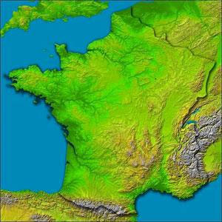
BATTLE trial
French multicentric randomized clinical trial comparing MISAGO® vs. ZILVER® PTX® for the treatment of intermediate femoropopliteal lesion
(from February 2014 to September 2018)
10 centers: Clinique d'Antony (Jean-Marc PERNES); CHU de Besançon (Simon RINCKENBACH); CHU de Bordeaux (Eric DUCASSE) ; CHU de Clermont Ferrand (Eugenio ROSSET) ; AP-HP, Hôpital Henri Mondor (Pascal DESGRANGES) ; CHU de Lyon (Patrick FEUGIER) ; CH de Bourgouin (Patrick LERMUSIAUX); Clinique Ollioules (Philippe COMMEAU) ; CHU de Rennes (Alain CARDON) ; Clinique Pasteur (Antoine SAUGUET); CHU de Nantes (Yann GOUËFFIC)
*
*
*
**
* **
* *
Nantes University Hospital - BATTLE ClinicalTrials.gov number, NCT02004951

Slide 8
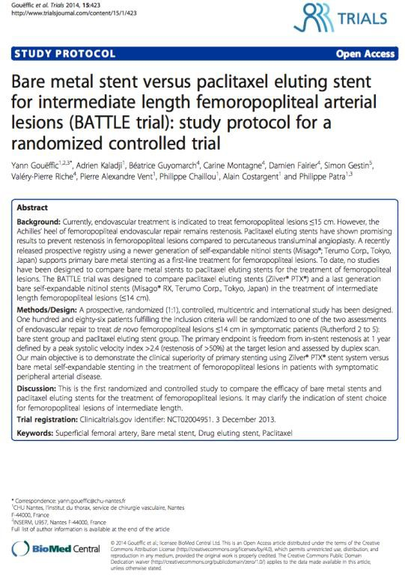
BATTLE trial protocol
Sponsor Nantes University Hospital - BATTLE ClinicalTrials.gov number, NCT02004951
Investigator initiated study
RCT and multicenter (1:1)
Rigorous data collection process, independent
Adjudication by:
Duplex ultrasound core laboratory Clinical events committee
Data safety monitoring board
Follow-up includes
1, 6, 12, and 24-month clinical assessment
1, 12 and 24-month stent x-ray
Monitoring with 100% source data verification
Gouëffic, Trials, 2014

Slide 9
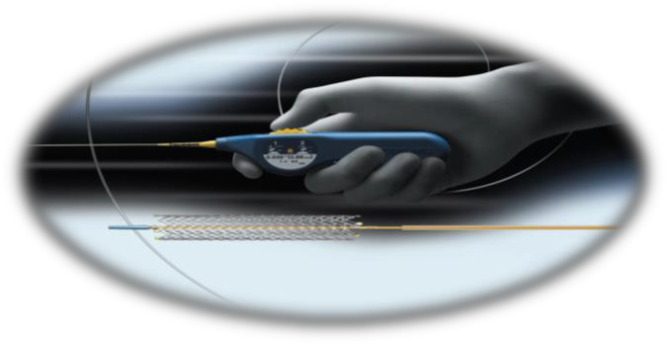
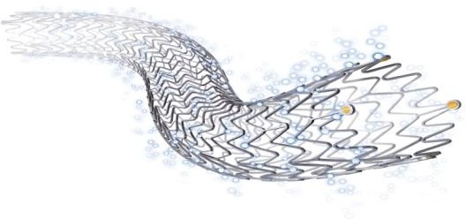
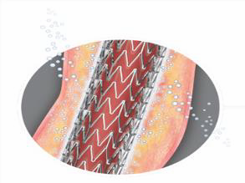
Study devices
MISAGO®
ZILVER® PTX®
- Bare nitinol stent
- Moderate radial force
- RX system
- Self expendable nitinol stent with a polymer-free paclitaxel coating
- Over-the-wire system

Slide 10
BATTLE objective
To demonstrate the clinical superiority of primary stenting using Zilver® PTX® stent system versus bare metal self-expandable stenting (MISAGO®, TERUMO) in the treatment of intermediate length femoropopliteal lesions in patients with symptomatic peripheral arterial disease (Rutherford 2-5).
BATTLE primary endpoint: freedom from in-stent restenosis @1y
Defined by restenosis of >50% and by a peak systolic velocity index >2.4 at the target lesion. Assessment by an independent core laboratory (thromboses were excluded)
We calculated that a sample of 186 patients (10% dropout included) , randomly assigned in a 1:1 ratio, with an 80% power at a 2 sided alpha level of 0.05.

Slide 11
Key eligible criteria
Main inclusion criteria
- Rutherford stages 2-5
- De novo atherosclerotic lesions (stenosis and/or occlusion) of the SFA, the proximal popliteal artery (P1), or both
- Target lesion has a length ≥2-cm and
≤14-cm
- RVD 4 to 7-mm
Main exclusion criteria
- Asymptomatic lesion
- Restenosis
- No atheromatous disease

Slide 12
BATTLE flow chart
186 were included
5 not randomized
- 4 screen failures
-1 twice randomized
181 underwent randomization
MISAGO®
85 underwent assigned Intervention (mITT*)
ZILVER® PTX®
86 underwent assigned intervention (mITT*)
78 completed
1-year follow-up**
82 completed
1-year follow-up**
*ITTm: modified intention-to-treat analysis on the primary endpoint was performed to include only patients who had undergone randomization and met the major inclusion criteria.
**6 patients were lost of FU at 1-year.

Slide 13
Baseline clinical characterisctics
 |  | MISAGO® (n= 85) | ZILVER® PTX® (n=86)
Age (y) |  | 68±12 | 71±12
Sex ♂, n (%) |  | 62 (73) | 62 (72)
Smoking, n (%) |  | 28 (33) | 20 (23)
 | Inter | ittent claudicat | on:
 | MISAGO®: | 82% / ZILVER® P | TX®: 79%
CAD, n (%) |  | 34 (40) | 27 (31)
Statines, n (%) |  | 61 (72) | 64 (74)
Antiplatelet drug, n (%) |  | 69 (81) | 71 (83)
ACE inhibitors, n (%) |  | 28 (33) | 19 (22)
Hypertension, n (%) ₅₂ ₍₆₁₎ ₅₉ ₍₆₉₎
Diabetes mellitus, n (%) ₂₂ ₍₂₆₎ ₄₁ ₍₄₈₎
Dyslipidemia, n (%) ₆₁ ₍₇₃₎ ₅₅ ₍₆₅₎
Renal failure, n (%) ₆ ₍₇₎ ₈ ₍₉₎
m
i

Slide 14
Baseline lesions characteristics
 | MISAGO® (n= 85) | ZILVER® PTX® (n=86)
Mean treated lesion length (cm) | 7.3 ± 3.9 | 7.3 ± 3.2
Reference vessel diameter (mm) | 5.8 ± 0.5 | 5.8 ± 0.6
# of patent run-off vessel
1, n (%) | 10 (12) | 13 (16)
2 or 3, n(%) | 71 (88) | 70 (85)

Slide 15
Procedural characteristics
 | MISAGO® (n= 85) | ZILVER® PTX® (n=86) | P-value
Pre-dilatation performed, n (%) | 70 (82) | 68 (80) | 0.60
Number of implanted stents, n | 102 | 117
1, n( %) | 68 (80) | 57 (66) | 0.07
2, n( %) | 17 (20) | 27 (31)
3, n( %) | 0 (0) | 2(2)
Stents localisation |  |  | -
Proximal SFA, n | 14 | 10
Mid SFA, n | 55 | 56
Distal SFA, n | 44 | 46
P1, n | 15 | 11
Mean stent length (per stent)(mm) | 91±40 (40-120) | 72±40 (40-100) | -
Mean stent length (per patient)(mm) | 90.3±38.1 (40-150) | 71.2±22.2 (40-105) | <0.001
Diameter 4/5/6/7/8, n | 0/1/75/23/3 | 1/0/87/27/0 | -
Post dilatation performed, n( %) | 72 (86) | 79 (93) | 0.14
Technical success, n( %) ^{[1]} | 85 (100) | 86 (100) | -
1- Technical success defined as achievement of a final residual diameter stenosis of <30% on the procedural completion angiogram

Slide 16
Safety outcomes through 1-year
 | MISAGO® (n= 85) | ZILVER® PTX® (n=86) | _{p}*
MACEs, n^{[1]} | 2 | 1 | 0.09
All-cause Death, n | 2 | 1 | 0.09
Limb salvage, %^{[2]} | 100 | 100 | -
Device- or Procedure-related Death, n | 0 | 0 | -
Mean hospitalization length, days± SD | 1.0 ± 1.1 | 1.3 ± 1.4 | 0.13
Rehospitalization (%) | 26 (31) | 25 (29) | 0.83
1- Major adverse clinical events (MACEs) at 12 post-procedure defined as MACEs including all deaths or major amputation 2- Limb salvage defined as freedom from major ipsilateral amputations (above the ankle) at 12 months postprocedure

Slide 17
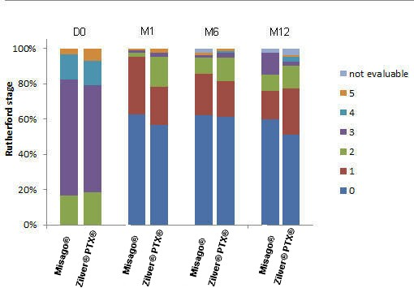
Clinical outcomes @ 12 months
P=0.73
P=0.08

Slide 18
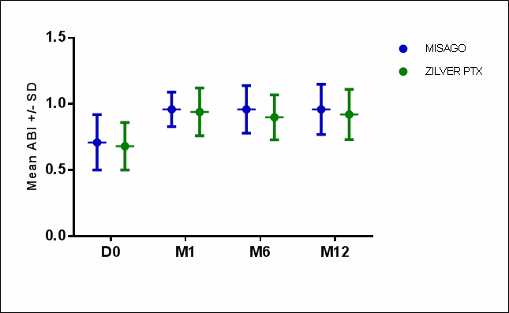
Hemodynamic outcomes @ 12 months
P=0.33
At baseline (n=157):
MISAGO®: 0,71 ± 0,21
ZILVER® PTX®: 0,68 ± 0,18
At M12 (n=141):
- MISAGO®: 0,96 ± 0,18
- ZILVER® PTX®: 0,92 ± 0,19

Slide 19
Freedom from in-stent restenosis* @ 1y
(primary endpoint)
F r e e f r o m in - s t e n t - r e s t e n o s is ( % )
1 0 0
M is a g o ®
@ 12 months:
MISAGO®: 85.7%
ZILVER® PTX®: 90.3% P=0.36
9 0
Z ilv e r ® P T X ®
8 0
7 0
Nb at risk 0 2 4
Misago® 85 80 78
Zilver®PTX® 86 82 81
6 8 10 12
78 66 66 51
79 78 74 51
0 1 2 3 4 5 6 7 8 9 1 0 1 1 1 2 1 3
F o l l o w - u p ( m o n t h s )
*Defined by restenosis of >50% and by a peak systolic velocity index >2.4 at the target lesion. Assessment by an independent core laboratory (thromboses were excluded)

Slide 20
Patency* @ 12 months
1 0 0
M is a g o ®
F r e e f r o m P a t e n c y ( % )
@ 12 months:
MISAGO®: 81.6%
ZILVER® PTX®: 84.2%
P=0.41
9 0
Z ilv e r ® P T X ®
8 0
7 0
Nb at risk | 0 | 2 | 4 | 6 | 8 | 10 | 12
Misago® | 85 | 78 | 77 | 74 | 64 | 64 | 49
Zilver®PTX® | 86 | 80 | 78 | 78 | 75 | 71 | 50
0 1 2 3 4 5 6 7 8 9 1 0 1 1 1 2 1 3
F o l l o w - u p ( m o n t h s )
Primary patency is defined as patency without any percutaneous or surgical intervention in the
treated segment or adjacent areas

Slide 21
TLR* @ 12 months
1 0 0
@ 12 months : MISAGO®: 8.9%
ZILVER® PTX®: 8.8%
P=0.91
M is a g o ®
F r e e f r o m T L R ( % )
9 0
Z ilv e r ® P T X ®
8 0
7 0
Nb at risk Misago®
0
2
4
6
8
10 12
58
Zilver®PTX®
85
79
78
76
73
71
86 82 81 81 80 75 59
0 1 2 3 4 5 6 7 8 9 1 0 1 1 1 2 1 3
F o l l o w - u p ( m o n t h s )
*Target lesion revascularization (TLR) expresses the frequency of the need for repeated procedures (endovascular or surgical) due to a problem arising from the stent (1 cm proximally and distally to include edge phenomena) in surviving patients with preserved limb.

Slide 22
Take home message
In BATTLE trial, Zilver® PTX® (COOK) paclitaxel eluting stent failed to show superiority in comparison to MISAGO® (TERUMO), a bare metal stent.
Advantages of drug eluting therapy in comparison to bare metal stent is still required to define the strategy for the treatment of intermediate length femoropopliteal lesions.

Slide 23
euro
PCR

Slide 24
Bare metal stent for TASC A-B lesions
 | Vienna | Durability | Astron | Misago 2
Stent | Absolute (Abbott) | Everflex (Medtronic) | Astron (Biotronik) | Misago (Terumo)
Design | RCT | Registry | RCT | Registry
Mean lesion length | 132±71-mm | 96.4-mm | 84-mm | 63.9-mm
Iy endopint | ISR @1y 37% vs 63% P=0.01 | ISR @1y 27.8% | ISR @1y 34.4% vs 61.1% P=0.01 | TLR @1y 10%
ISR @1y (in the BMS arm) | 37% | 27.8% | 34.4% | NA
Schillinger, NEJM, 2006; Bosiers, J Endovasc Ther, 2009; Schutle, J Endovasc Ther, 2012; Dick, Catheter Cardiovasc Interv, 2009

Slide 25
Clinical improvement* @ 12 months
1 0 0
@ 12 months : MISAGO®: 85.3%
ZILVER® PTX®: 88.6% P=0.56
C lin ic a l im p r o v e m e n t ( % )
M is a g o ®
9 0
Z ilv e r ® P T X ®
8 0
7 0
Nb at risk | 0 | 2 | 4 | 6 | 8 | 10 | 12
Misago® | 85 | 78 | 77 | 75 | 71 | 69 | 57
Zilver®PTX® | 86 | 84 | 83 | 81 | 80 | 76 | 61
0 1 2 3 4 5 6 7 8 9 1 0 1 1 1 2 1 3
F o l l o w - u p ( m o n t h s )
* Clinical improvement was defined by primary sustained clinical improvement which is defined as a sustained upward shift of 1 category of the Rutherford classification for claudicants and by wound-healing and resting pain resolution for patients in critical limb ischemia, without the need for repeated TLR in surviving patients.

