Slide 1

Cryptic cause of Dyspnea
Arun Nagabandi, MBBS¹;
Loren G Morgan, MD²;
Supawat Ratanapo, MD³.
Medical College of Georgia

Slide 2

Arun Nagabandi, MBBS¹; Loren Morgan, MD²; Supawat Ratanapo, MD³.
We have no relevant financial relationships

Slide 3
Learning objectives
Symptoms from anomalous Coronary Artery fistula’s
Percutaneous management technique

Slide 4
Clinical Presentation
73 year old female presented for evaluation of persistent dyspnea on exertion
Normal vital signs with well controlled Hypertension
Unremarkable physical exam and blood work
Normal CTA Chest, VQ scan, PFT’s and no desaturation on 6 MWT – hence referred for Coronary Angiography that revealed LAD to PA anomalous fistula

Slide 5
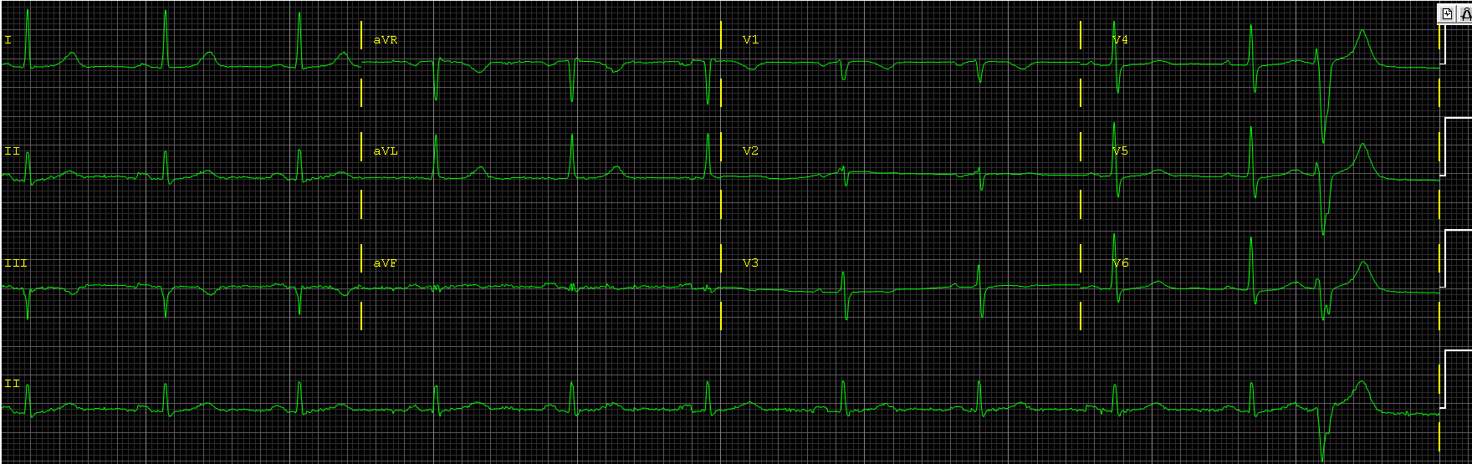
EKG

Slide 6
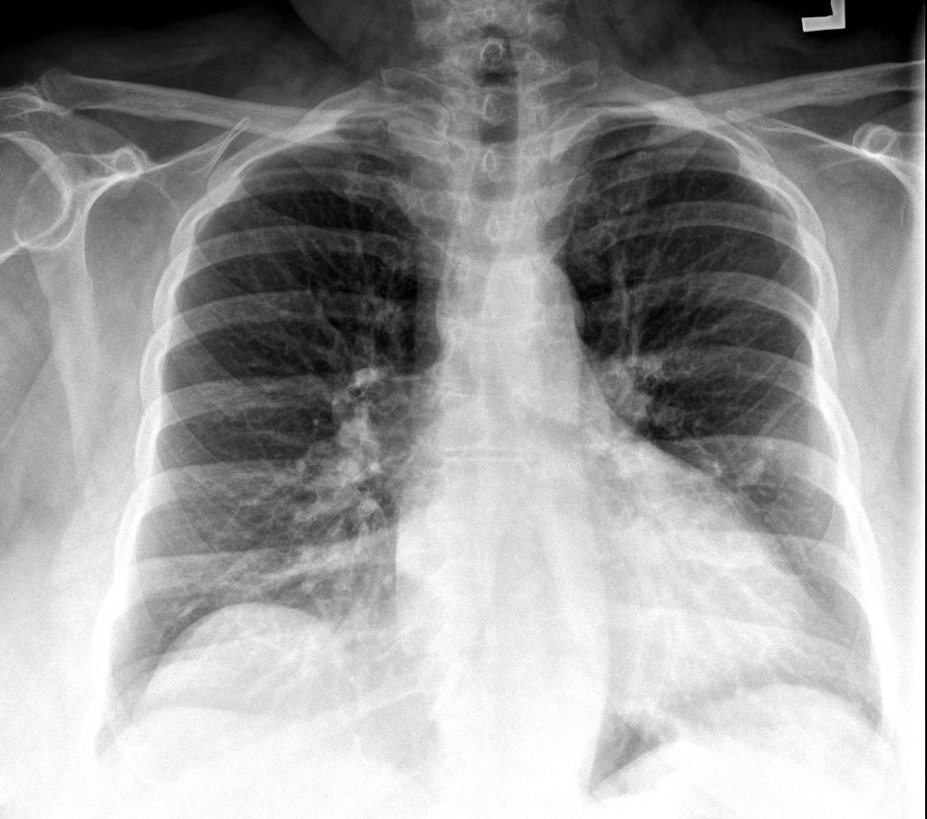
Chest X-ray

Slide 7
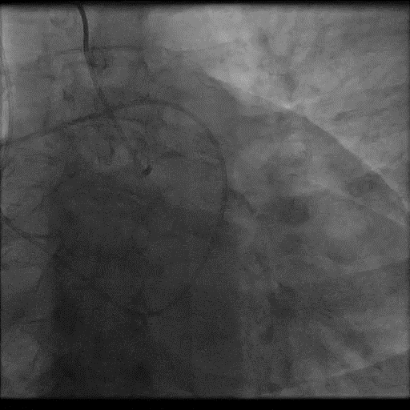
Cath video

Slide 8
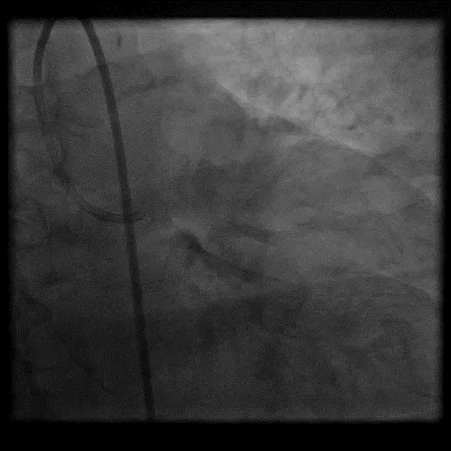
Cath video

Slide 9
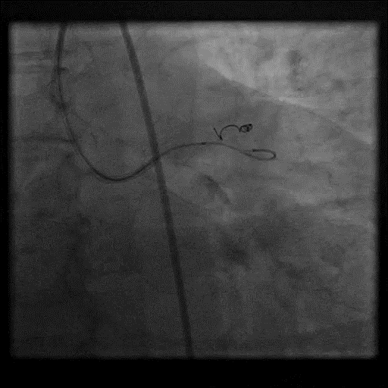
Cath video

Slide 10
Take Home Messages
Coronary artery fistula are rare but can produce various clinical symptoms like dyspnea, chest pain, palpitations – especially during activity
Surgical closure used to be the choice of procedure but now, percutaneous coil embolization is possible. It is safe and effective with good success rates

