Slide 1

An Algorithmic Approach to
Left Main Interventions
Tanveer Rab, MD
Professor of Medicine
Interventional Cardiology
Emory University School of Medicine

Slide 2

Tanveer Rab, MD,FACC,FSCAI
I have no relevant financial relationships

Slide 3
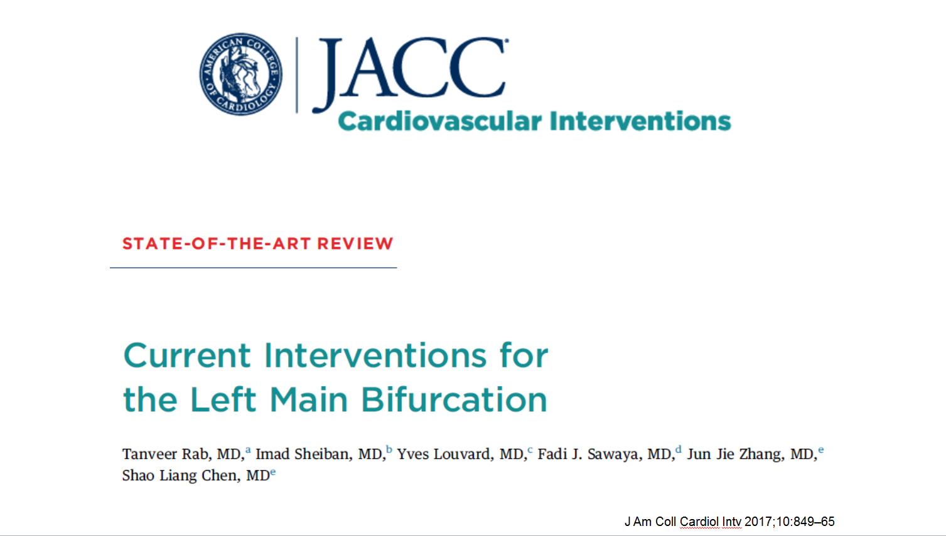

Slide 4
Criteria for LM intervention
Angiographic diameter stenosis > 70 %
or
IVUS/ OCT LM MLA < 6mm²
or
FFR < 0.80

Slide 5
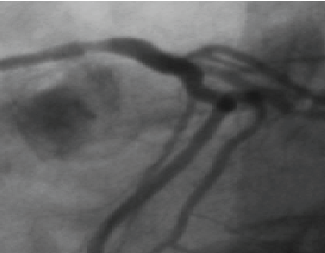
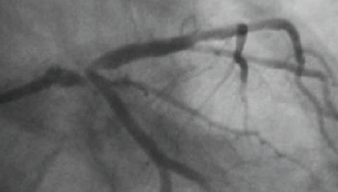
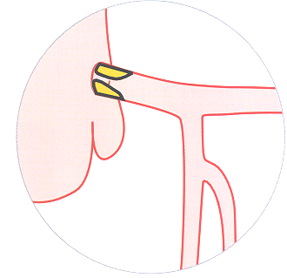
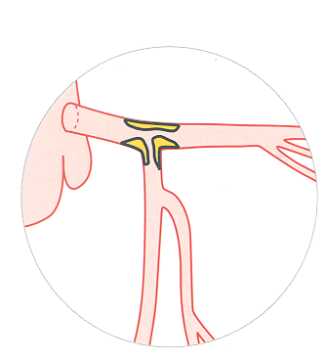
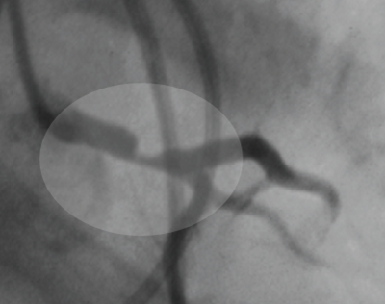
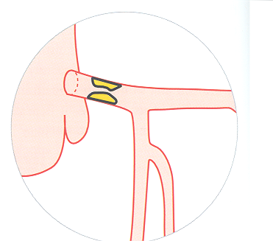
Left Main Disease: Locations
Ostium
Distal-bifurcation
80 % of LM lesions involve the bifurcation
Shaft

Slide 6
LM PCI is a Complex High Risk
Interventional Procedure
Mortality Risk for LM PCI
Elective PCI | 1.1 % (EXCEL and NOBLE)
High Risk PCI with LV support | < 9 % (USPELLA, EUROPELLA, GLOBAL CVAD)
High Risk PCI without LV support | 24 % (USPELLA, EUROPELLA, GLOBAL CVAD)
Cardiogenic Shock | 50-80 % %

Slide 7
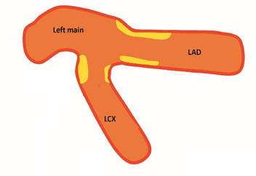
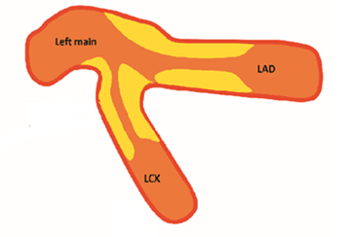
Minor criteria
1: Moderate to severe calciﬁcation
2: Multiple lesions
3: Bifurcation angle <45
4: Main vessel RVD <2.5 mm
5: Thrombus-containing lesions
6: MV lesion length >25 mm
Lesion Classification and approaches to LM PCI are determined by the
Side Branch

Slide 8
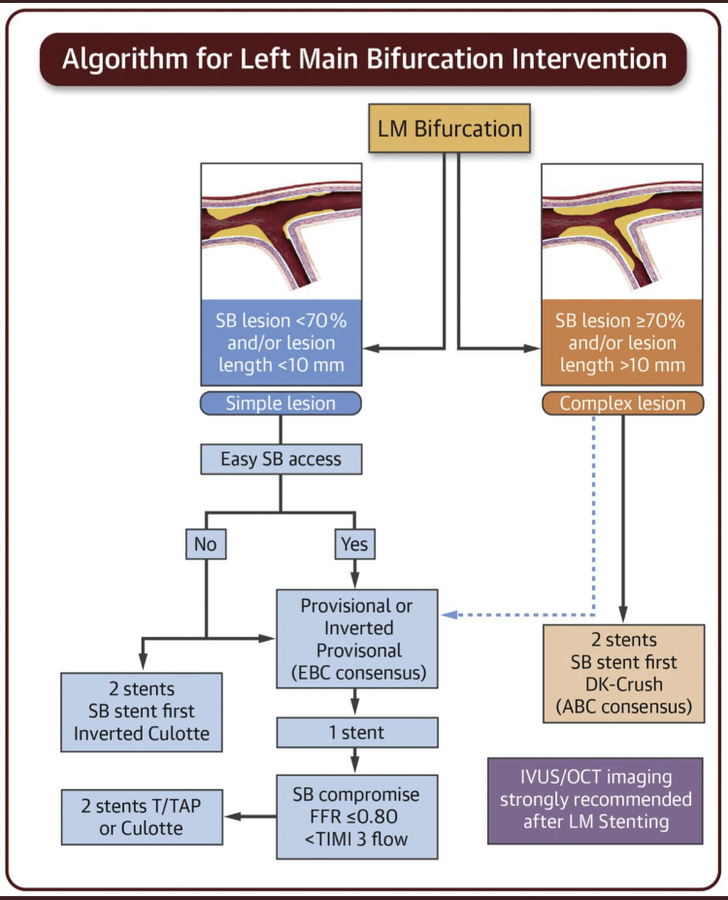
Just published in
Interventional Cardiology Clinics
(8) (2019) 131-147
Updated Algorithm

Slide 9
Stenting Techniques that have been validated through trials
Single stent or Provisional approach
Bailout to preserve patency of LCX
Conversion to two stent TAP technique
Dedicated two stent Double kiss crush or DK crush technique for the complex lesion
These techniques can be performed with
6 Fr radial access with 6 Fr guides

Slide 10
Technique: key elements
Both LAD and LCx must be wired
1
The stent is sized to the distal reference vessel i.e. the LAD
2
POT is essential
3
Imaging in all cases for stent optimization
4

Slide 11
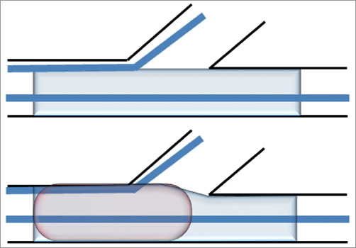
Proximal Optimization Technique (POT)
Stent sized to distal MB
Abluminal space
Balloon sized to proximal MB and tip positioned proximal to carina

Slide 12
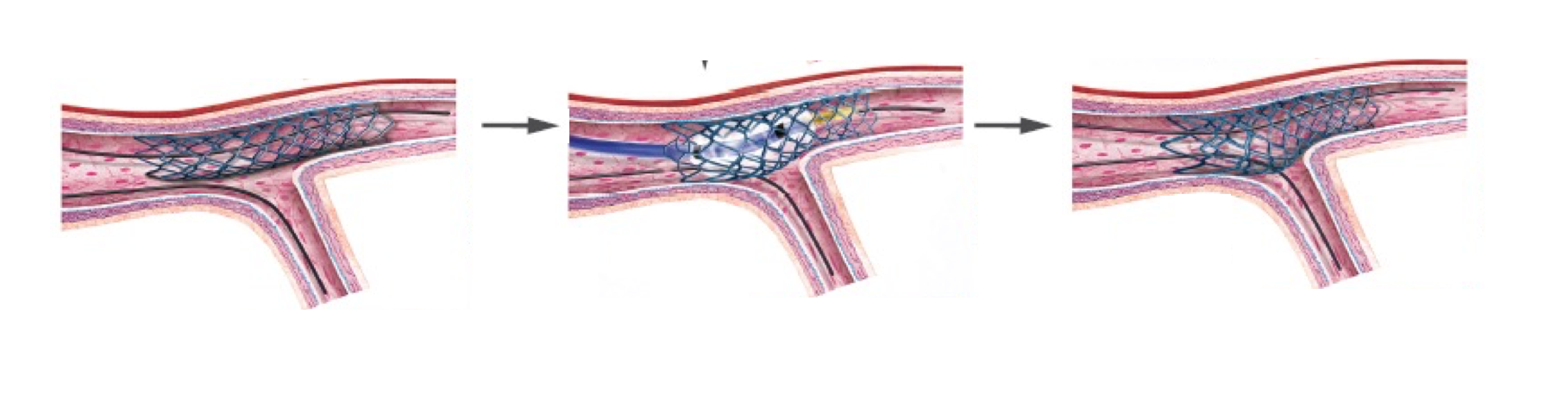
Proximal Optimization Technique (POT)

Slide 13
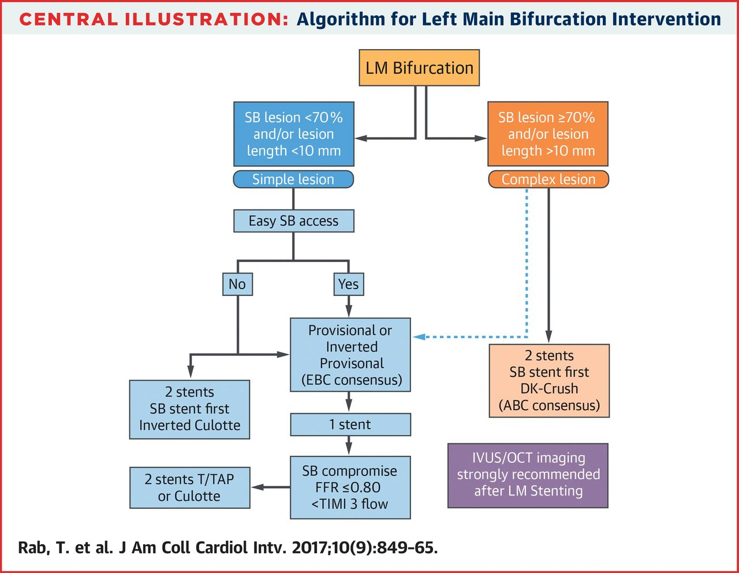

2017 American College of Cardiology Foundation
Notes:
Algorithm for Left Main Bifurcation Intervention ABC = Asian Bifurcation Club; DK = double kiss; EBC = European Bifurcation Club; FFR = fractional flow reserve; IVUS = intravascular ultrasound; LM = left main coronary artery; OCT = optical coherence tomography; SB = side branch (generally the left circumflex); TIMI = Thrombolysis In Myocardial Infarction; T/TAP = T-stenting or T-stenting and minimal protrusion.

Slide 14
75 % of cases are treated with 1 stent or
Provisional stenting

Slide 15
DK crush
Key points of the Provisional technique:
Single stent
POT
Distal wire recross
KBI
Final POT
If KBI is required:

Slide 16


Slide 19


Slide 20
Double kiss crush
(DK crush) stenting
For the intentional 2 stent technique in a complex LM bifurcation lesion, DK crush is a popular approach

Slide 21
1 or 2 stents for LM Bifurcation PCI:
Double Kissing Crush versus Provisional Stenting for True Distal Bifurcation Lesions of the Left Main Coronary Artery: The DKCRUSH-V Randomized Trial
Shao-Liang Chen, MD, Tanveer Rab, MD, Zhanquan Li, MD, Guanchang Cheng, MD, Lianqun Cui, MD, Martin B Leon, MD, Gregg W. Stone, MD
J Am Coll Cardiol 2017; 70:2605–17

Slide 22
DK crush V

Slide 24
DK crush
Key points of the DK crush technique:
Proximal wire re cross
2 stents
2 KBI inflations
2 POT

Slide 25
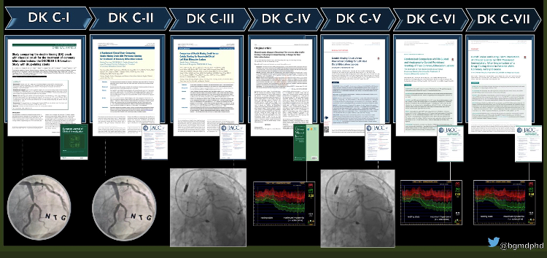
Strength of the DK crush technique
Validated through trials

Slide 26
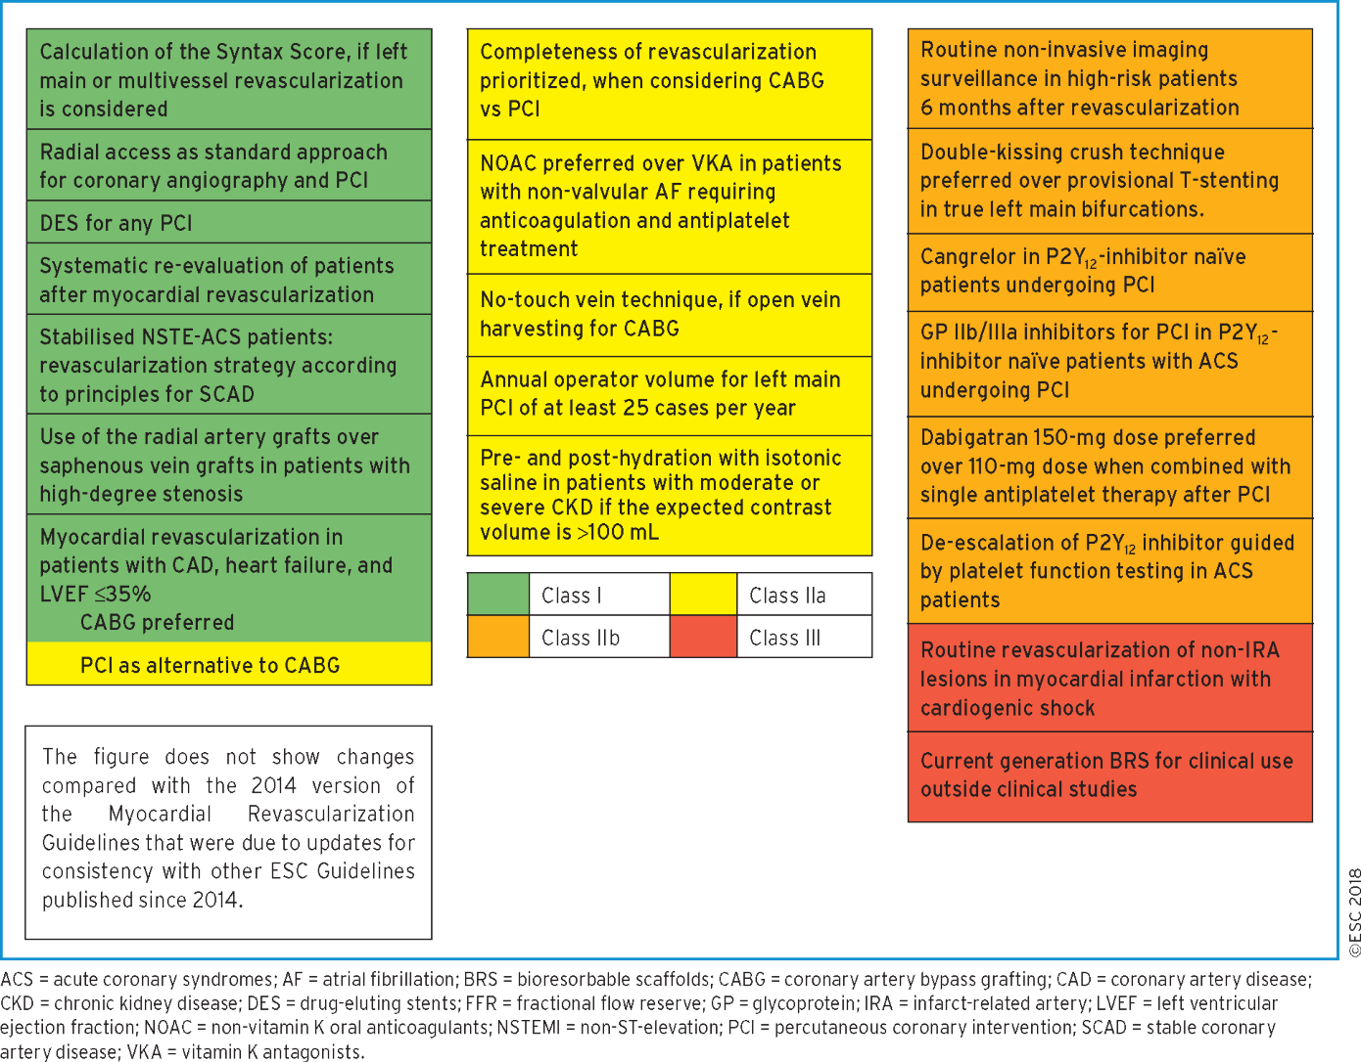
2018 ESC/EACTS Guidelines on myocardial revascularization
Notes:
Figure 1 New recommendations.
26

Slide 27
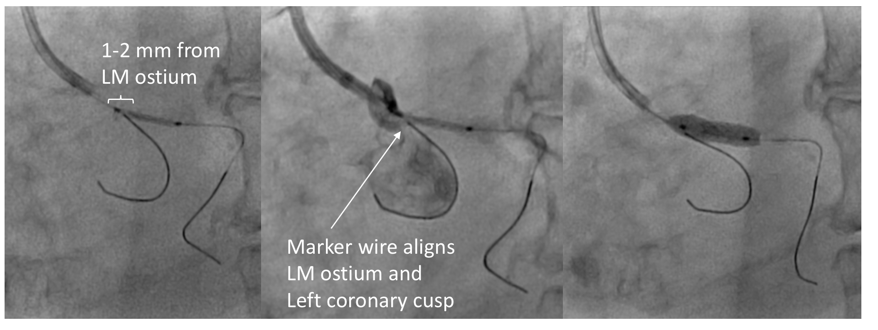
Stenting Ostial Left Main Stenosis
TLR < 4.5 % (DELTA Registry)

Slide 28
Intravascular imaging to optimize LM stenting is extremely important

Slide 29
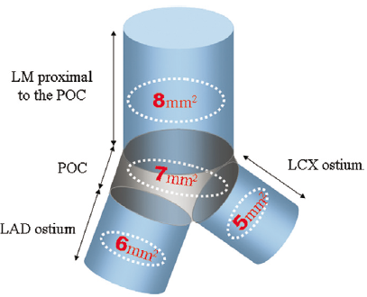
IVUS-derived minimal stent area (MSA) cut-off values for the prediction of angiographic in-stent restenosis (ISR) on a segmental basis
EXCEL update:
80 % IVUS use
MSA 12.5 mm² has best outcomes
Park S et al. J Am Heart Assoc 2012

