Slide 1
Should we perform an immediate coronary angiogram in all patients after cardiac arrest?
Wulfran Bougouin

Slide 2
Disclosure
None

Slide 3
Introduction
INTRODUCTION
PROBLEMATIQUE
METHODES
RESULTATS
DISCUSSION
CONCLUSION

Slide 4
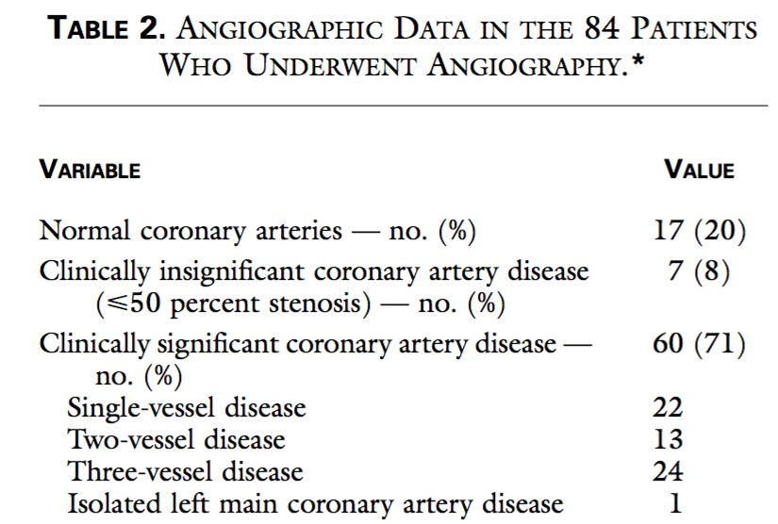
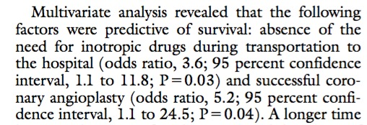
INTRODUCTION
PROBLEMATIQUE
METHODES
RESULTATS
DISCUSSION
CONCLUSION
Spaulding et al, NEJM, 1997

Slide 5
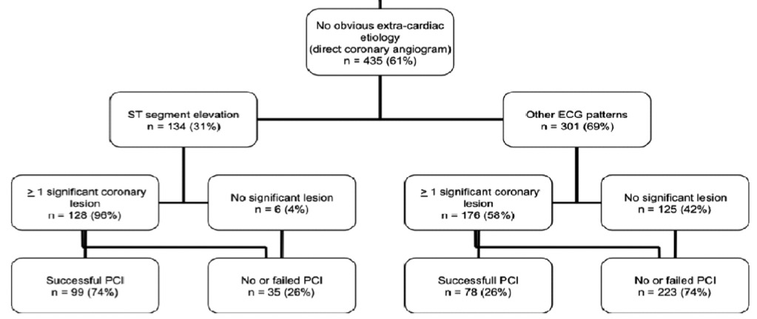
INTRODUCTION
PROBLEMATIQUE
METHODES
RESULTATS
DISCUSSION
CONCLUSION
Predict coronary occlusion ?
Dumas et al, Circ Cardiovasc Interv 2010

Slide 6
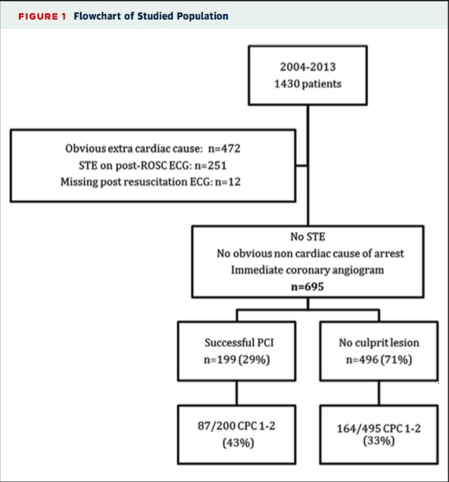
INTRODUCTION
PROBLEMATIQUE
METHODES
RESULTATS
DISCUSSION
CONCLUSION
Without ST elevation ?
Dumas et al, JACC Cardiovasc Interv 2016

Slide 7
INTRODUCTION
PROBLEMATIQUE
METHODES
RESULTATS
DISCUSSION
CONCLUSION
Guidelines
Nolan et al, Intensive Care Med 2015

Slide 8
INTRODUCTION
PROBLEMATIQUE
METHODES
RESULTATS
DISCUSSION
CONCLUSION
Coronary angiogram for all ?

Slide 9
Which patients will not benefit from coronary angiogram after cardiac arrest ?
INTRODUCTION
QUESTION
METHODES
RESULTATS
DISCUSSION
CONCLUSION

Slide 10
Methods
INTRODUCTION
PROBLEMATIQUE
METHODS
RESULTATS
DISCUSSION
CONCLUSION

Slide 11
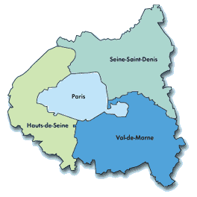
INTRODUCTION
PROBLEMATIQUE
METHODS
RESULTATS
DISCUSSION
CONCLUSION
SDEC registry
Since May 2011
OHCA > 18 y.o.
Paris and suburbs
Population : 6 828 583 (01/2018)
Bougouin et al, Intensive Care Med 2014

Slide 12
INTRODUCTION
PROBLEMATIQUE
METHODS
RESULTATS
DISCUSSION
CONCLUSION
Population
15/05/2011 to 15/05/2015
All OHCA admitted alive to hospital
Exclusion : obvious non-cardiac cause of OHCA

Slide 13
INTRODUCTION
PROBLEMATIQUE
METHODS
RESULTATS
DISCUSSION
CONCLUSION
CAHP score
Maupain et al, Eur Heart J 2016

Slide 14
INTRODUCTION
PROBLEMATIQUE
METHODS
RESULTATS
DISCUSSION
CONCLUSION
CAHP score
Maupain et al, Eur Heart J 2016

Slide 15
Results
INTRODUCTION
PROBLEMATIQUE
METHODES
RESULTS
DISCUSSION
CONCLUSION

Slide 16
INTRODUCTION
PROBLEMATIQUE
METHODES
RESULTS
DISCUSSION
CONCLUSION
1410 patients
667 CAHP < 150
(573 (86%) had CA)
469 CAHP 150-200
(311 (66%) had CA)
274 CAHP > 200
(128 (47%) had CA)
406 (61%) survived
45 (10%) survived
7 (3%) survived
368 (95%) CPC 1-2
20 (5%) CPC 3-4
37 (88%) CPC 1-2
5 (12%) CPC 3-4
6 (86%) CPC 1-2
1 (14%) CPC 3-4
18 missing
3 missing

Slide 17
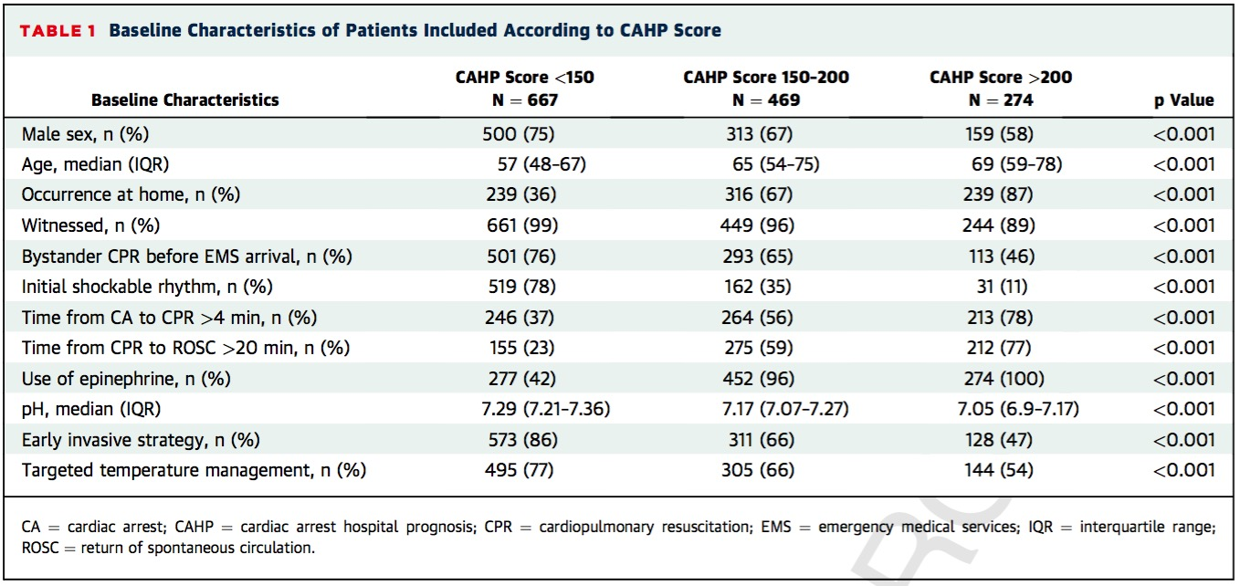
INTRODUCTION
PROBLEMATIQUE
METHODES
RESULTS
DISCUSSION
CONCLUSION

Slide 18
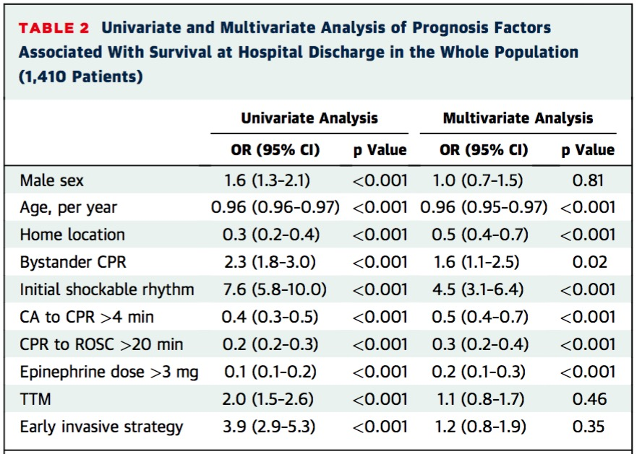
INTRODUCTION
PROBLEMATIQUE
METHODES
RESULTS
DISCUSSION
CONCLUSION

Slide 19
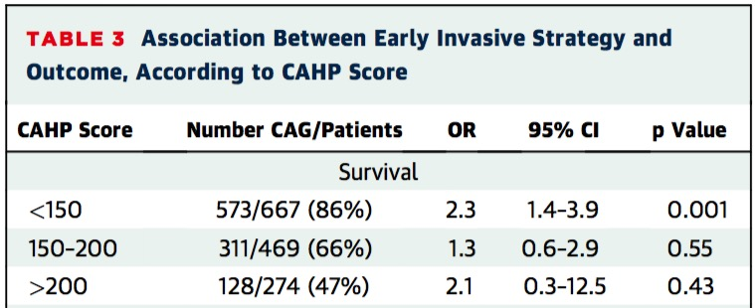
INTRODUCTION
PROBLEMATIQUE
METHODES
RESULTS
DISCUSSION
CONCLUSION
CA / Survival

Slide 20
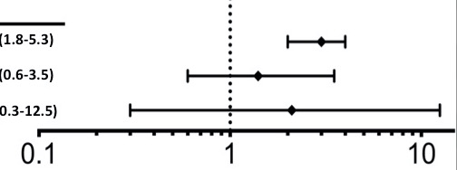
INTRODUCTION
PROBLEMATIQUE
METHODES
RESULTS
DISCUSSION
CONCLUSION
CA / CPC 1-2

Slide 21
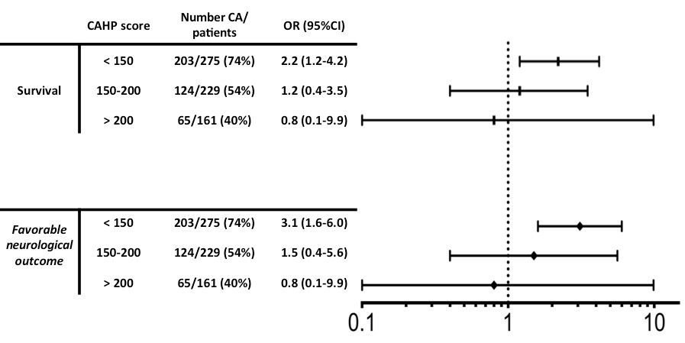
INTRODUCTION
PROBLEMATIQUE
METHODES
RESULTS
DISCUSSION
CONCLUSION
Patients without ST elevation

Slide 22
Discussion
INTRODUCTION
PROBLEMATIQUE
METHODES
RESULTATS
DISCUSSION
CONCLUSION

Slide 23
INTRODUCTION
PROBLEMATIQUE
METHODES
RESULTATS
DISCUSSION
CONCLUSION
Main Results
Association between CA and survival only for CAHP < 150
Among CAHP > 200, 47% of patients had CA
Use of CAHP score for stratification ?

Slide 24
INTRODUCTION
PROBLEMATIQUE
METHODES
RESULTATS
DISCUSSION
CONCLUSION
So CA for all OHCA ?
Etape 0
Impossible…

Slide 25
INTRODUCTION
PROBLEMATIQUE
METHODES
RESULTATS
DISCUSSION
CONCLUSION
So CA for all OHCA ?
Etape 0
Impossible…
Etape 1
CA for all !

Slide 26
INTRODUCTION
PROBLEMATIQUE
METHODES
RESULTATS
DISCUSSION
CONCLUSION
So CA for all OHCA ?
Etape 0
Impossible…
Etape 1
CA for all !

Slide 27
INTRODUCTION
PROBLEMATIQUE
METHODES
RESULTATS
DISCUSSION
CONCLUSION
So CA for all OHCA ?
Etape 0
Impossible…
Etape 1
CA for all !
Etape 2 : only if culprit lesion
CA interest
Risk of culprit lesion
(STE, troponin…)

Slide 28
INTRODUCTION
PROBLEMATIQUE
METHODES
RESULTATS
DISCUSSION
CONCLUSION
So CA for all OHCA ?
Presumed prognosis
Risk of culprit lesion

Slide 29
INTRODUCTION
PROBLEMATIQUE
METHODES
RESULTATS
DISCUSSION
CONCLUSION
So CA for all OHCA ?
Presumed prognosis
Risk of culprit lesion

Slide 30
INTRODUCTION
PROBLEMATIQUE
METHODES
RESULTATS
DISCUSSION
CONCLUSION
So CA for all OHCA ?
Presumed prognosis
Risk of culprit lesion

Slide 31
INTRODUCTION
PROBLEMATIQUE
METHODES
RESULTATS
DISCUSSION
CONCLUSION
So CA for all OHCA ?
Presumed prognosis
Risk of culprit lesion

Slide 32
INTRODUCTION
PROBLEMATIQUE
METHODES
RESULTATS
DISCUSSION
CONCLUSION
Take-Home Messages
CA for all: probably not !
Consider risk of culprit lesion, and presumed prognosis
Useful for future RCT ?

