Slide 1
BIOSOLVE-IV: Twelve-Month Outcomes With a Resorbable Magnesium Scaffold in a Real-world Setting
Stefano Galli, MD
Centro Cardiologico Monzino, Milan
On behalf of the BIOSOLVE-IV Investigators

Slide 2
Stefano Galli, MD
Research Support:
BIOTRONIK AG, Switzerland,

Slide 3
MAGMARIS (DREAMS 2G) Sirolimus Eluting Mg Scaffold
Sirolimus + PLLA (BIOlute)
150µm
6-crown 2-link design
150µm strut thickness
150µm strut width
Optimized scaffold design for
Higher bending flexibility
Higher acute radial force
Slower resorption rate: 95% at 12 months
Sirolimus drug elution & PLLA (ORSIRO BIOlute coating)
Tantalum radiopaque markers
Gained CE mark in June 2016
150µm
90-Day Faxitron, porcine explant

Slide 4
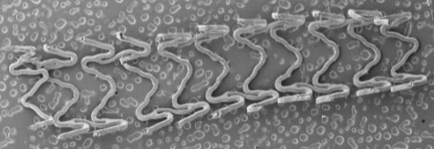
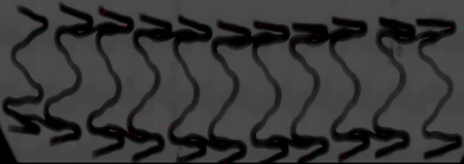
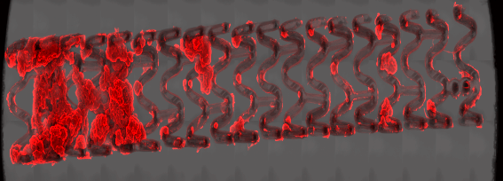
Results Shunt Study 1: Magmaris vs. Absorb vs. Orsiro
Shunt study 1: Comparison of acute thrombogenicity of Magmaris vs. Orsiro vs. Absorb
Detection of platelets and inflammatory cells by immunofluorescence
Estimation of thrombus deposition by SEM
Magmaris
Orsiro
Absorb
Photo
SEM
IF
Waksman R. et al., Circ Cardiovasc Interv 2017;10:e004762

Slide 5
Registry Design
Design
Prospective, multi-center, real world setting registry
Primary Endpoint
Target Lesion Failure (TLF) at 12 months
Secondary Endpoints (at 6 months, 1-5 years)
TLF*
Clinically Driven TLR and TVR
Cardiac Death
Target Vessel MI
Scaffold Thrombosis
Procedure and Device Success
Scaffold thrombosis at 12 months
(powered for superiority of Magmaris compared to Absorb)
Coordinating Clinical Investigators
S. Verheye, MD, Belgium – Europe
M. Lee, MD, Hong Kong – Asia Pacific
2054 patients with de novo coronary artery stenosis
6-month Clinical FUP
12-month Clinical FUP
24-month Clinical FUP
36-month Clinical FUP
48-month Clinical FUP
60-month Clinical FUP
*TLF: composite of target vessel myocardial infarction, clinically driven TLR, cardiac death and CABG

Slide 6
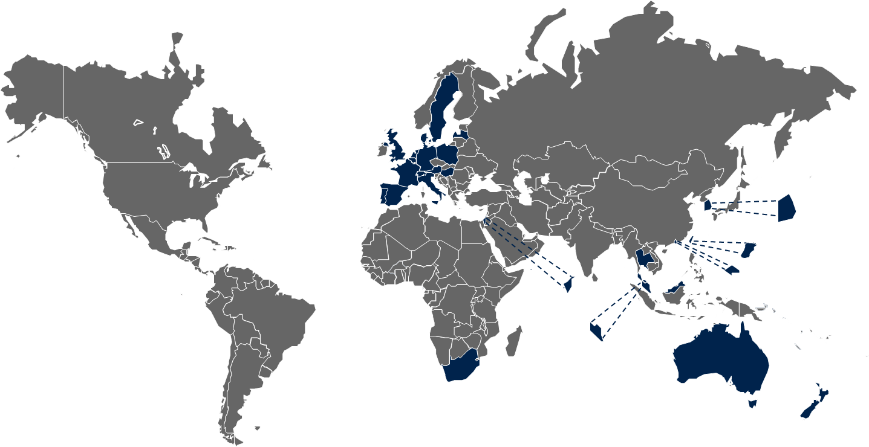
Countries and Sites
Country | Site # | Country | Site #
Germany | 41 | New Zealand | 3
The Netherlands | 9 | Poland | 3
Australia | 8 | Singapore | 3
Belgium | 8 | Spain | 3
France | 7 | Denmark | 2
Austria | 5 | South Africa | 2
United Kingdom | 5 | South Korea | 2
Portugal | 4 | Sweden | 2
Switzerland | 4 | Thailand | 2
Taiwan | 4 | Israel | 1
Hong Kong | 3 | Latvia | 1
Hungary | 3 | Malaysia | 1
Italy | 3
Over 100 sites in 25 countries

Slide 7
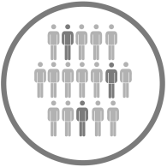
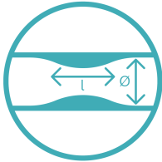
Enrollment and Registry Organization
Subjects were enrolled according to the consensus letter¹, 4Ps and Instruction for Use (IFU) requirements of Magmaris
NSTEMI subjects included in BIOSOLVE-IV
4-P Strategy:
Clinical Events Committee: Adjudication of all ADE, SAE, SADE, and USADE
Core laboratory imaging analysis of endpoint related events
25% monitoring
Patient and lesion selection
Proper scaffold sizing
Pre-dilatation for lesion preparation
Post-dilatation
¹ Fajadet et al., EuroIntervention 2016; 12:828-833

Slide 8
Patient Flow
600 subjects
N= 4 devices not implanted
N= 3 missed visits
6-month follow-up (98.3%) 590 subjects / 1 withdrawal / 2 death
N= 4 devices not implanted
N= 8 missed visits
12-month follow up (97.2%)
583 subjects / 4 death¹
¹ 1 cardiac death & 3 non-cardiac death (2 cancer, 1 COPD)

Slide 9
Baseline Patient and Lesion Characteristics
Baseline Characteristics | N (%)
Age (mean ± SD) | 61.7 ± 10.9
Male | 447 (74.5)
Hypertension | 403 (67.2)
Hyperlipidemia | 387 (64.5)
Smoking | 357 (59.9)
Diabetes mellitus | 125 (20.8)
Insulin dependent | 25 (20.8)
Non-Insulin dependent | 100 (80.0)
History of MI | 118 (19.7)
Previous percutaneous Intervention | 93 (23.3)
NSTEMI | 101 (16.8)
Lesion Location | N (%)
LAD | 325 (51.5)
LCX | 122 (19.3)
RCA | 177 (28.1)
Ramus | 7 (1.1)
Lesion Characteristics* | N (%)
Lesion length (mm ± SD) | 14.8 ± 4.2
RVD (mm ± SD) | 3.3 ± 0.3
AHA/ ACC Lesion Class B2/C | 100 (15.9)
Calcification moderate/severe | 49 (7.8)
Bifurcation lesions | 37 (5.9)
*Lesion characteristics are eyeball estimate of investigators - No core laboratory analysis

Slide 10
12 Month Complete Re-absorption after Magmaris

Slide 11
Target Lesion Failure out to 12-month
100%
25%
20%
15%
TLF¹
10%
5.1% [95%CI:3.6;7.2]
5%
0%
0
180
365
Time to Event [days]]
¹ Composite of cardiac death, target vessel myocardial infarction (TV-MI), clinically driven target lesion revascularization (CD-TLR) and CABG. Peri-procedural MI according to SCAI definition and spontaneous MI according to the Extended Historical definition
All events have been adjudicated by a clinical event committee

Slide 12
Composite Endpoints & Definite / Probable Scaffold Thrombosis out to 12-Month
100%
100%
25%
25%
20%
20%
Cardiac death
15%
15%
TV-MI
10%
10%
5%
0.2% [95% CI:0.0;1.2]
5%
1.3% [95% CI:0.7;2.7]
0%
0
180
365
0%
0
180
365
Time to Event [days]
100%
Time to Event [days]
100%
25%
25%
20%
20%
CD-TLR
Scaffold thrombosis
(definite / probable)¹
15%
15%
10%
4.6% [95% CI:3.2;6.6]
10%
5%
5%
0.5% [95% CI:0.2;1.6]
0%
0
180
365
0%
Time to Event [days]
0
180
365
Time to Event [days]
¹Two cases having early DAPT interruption at 4 and 5 days post procedure

Slide 13
Case Explanation - Scaffold Thrombosis I
NSTEMI
Index procedure – 4 days after NSTEMI
Heavily calcified RCA treatment with Magmaris
Planned MIDCAB – 5 days post-procedure
DAPT Interruption
Scaffold thrombosis & TV-MI
5 days after MIDCAB
Target vessel MI
Scaffold thrombosis
CD-TLR
Staged PCI of Cx – 9 days after thrombosis
Treatment with DES

Slide 14
Case Explanation - Scaffold Thrombosis II
NSTEMI - Index procedure
1st Obt. Mar. treatment with Magmaris
DAPT Interruption
After discharge (4 days post-procedure), discontinuation of ticagrelor
Scaffold thrombosis & TV-MI
2 days after DAPT interruption
Target vessel MI
Scaffold thrombosis
CD-TLR
1st Obt. Mar. treatment with DES

Slide 15
Case Explanation - Scaffold Thrombosis III and Cardiac Death
Index procedure
Prox. LAD treatment with Magmaris
Diffusely diseased mid and distal LAD were not treated. Severly diseased ostium not covered by scaffold.
Staged procedure – 14 days post-procedure
RIM treatment with Magmaris
RCA (bifurcation) treatment with DCB
Target vessel MI
Scaffold thrombosis
CD-TLR
Scaffold thrombosis & TV-MI
29 days post procedure
LMCA & Prox. Cx treatment with DESs
Cardiac death – 63 days post procedure

Slide 16
Magmaris Device Success and Porcedure Success

Slide 17
Magmaris Performance*
*: Sum up of very good and good assesments

Slide 18
Magmaris LAD: Angio & OCT Evaluation
PRE
POST
12 Months

Slide 19
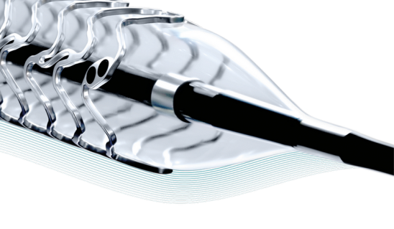
Conclusions
BIOSOLVE-IV confirms low TLF rates (5.1% at 12-month) from previous trials also in a real world setting with 92 centers in 25 countries
Excellent device success (97.1%) and procedure success (98.7%)
Very good safety profile of the scaffold up to 12-month
1* cardiac death
3* scaffold thrombosis (2 of them after DAPT interruption at 4 and 5 days post-procedure)

Slide 20
Acknowledgement
Michael Kang-Yin Lee¹ Adrian Wlodarczak², Piero Montorsi³, Johan Bennett⁴, Jan Torzewski⁵, Michael Haude⁶, Mathias Vrolix⁷, Thomas Buck⁸, Adel Aminian⁹, Rene van der Schaaf¹⁰, Amin Ariff bin Nuruddin¹¹, Marcus Wiemer¹², Gregory Starmer¹³, Bryan Ping-Yen Yan¹⁴, Jan van der Heyden¹⁵, Ralph Tölg ¹⁶, Béla Merkely¹⁷, Carsten Schwencke¹⁸, Andrejs Erglis¹⁹, Johannes Brachmann²⁰, Didier Carrié²¹, Robert Zweiker²², Ivan Horvath²³, Stephan Achenbach²⁴, Sebastian Philipp²⁵, Clemens Steinwender ²⁶, Huay Cheem Tan²⁷, Mark Webster²⁸, Nigel Jepson²⁹, Michael Nguyen³⁰, Eric Eeckhout³¹, Hans-Heinrich Minden³², Christian Valina³³, Manel Sabaté³⁴, Thomas Schmitz³⁵, Rafael Ruiz Salmeron³⁶, Werner Haberbosch³⁷, Christoph Liebetrau³⁸, Fabrizio Tomai³⁹, Holger Nef⁴⁰, René Koning⁴¹, Christopher Zeitz⁴², Gillian Jessurun⁴³, Jean Fajadet⁴⁴, Madhav Menon⁴⁵, David Erlinge⁴⁶, Angel Cequier Fillat⁴⁷, Ulf Landmesser⁴⁸, Stephan Kische⁴⁹, Marco Moccetti⁵⁰, Constantin von zur Mühlen⁵¹, Jochen Wöhrle⁵², Franz Eberli⁵³, Peter Barlis⁵⁴, Hüseyin Ince⁵⁵, Martin Neef⁵⁶, Victor Legrand⁵⁷, Dougal McClean⁵⁸, Pascal Motreff⁵⁹, Abid Assali⁶⁰, Henning Ebelt⁶¹, Evald Christiansen⁶², Guy Friedrich⁶³, Werner Jung⁶⁴, Kristof Graf⁶⁵, Graham Cassel⁶⁶, Helge Möllmann⁶⁷, Irene Lang⁶⁸, Alexander Schmeisser⁶⁹, Dirk Westermann⁷⁰, Florim Cuculi⁷¹, Iftikhar Ebrahim⁷², Bernhard Zrenner⁷³, Günter Christ⁷⁴, Carlo Trani⁷⁵, Lisette Okkels Jensen⁷⁶, Martin Winterhalter⁷⁷, Harald Darius⁷⁸, Soo Teik Lim⁷⁹, Michael Magro⁸⁰, Stefan Verheye⁸¹
¹Queen Elizabeth Hospital, Hong Kong, Hong Kong ²Miedziowe Centrum Zdrowia SA (Copper Center), Lubin, Poland, ³Centro Cardiologico Monzino, Milan, Italy, ⁴University Hospitals Leuven, Leuven, Belgium, ⁵ Klinikum Kempten Oberallgäu, Kempten, Germany, ⁶Lukaskrankenhaus Neuss, Neuss, Germany, ⁷Ziekenhuis Oost Limburg, Genk, Belgium, ⁸Klinikum Westfalen Knappschaftskrankenhaus, Dortmund, Germany, ⁹Centre Hospitalier Universitaire de Charleroi, Charleroi, Belgium, ¹⁰Onze Lieve Vrouve Gasthuis, Amsterdam, Netherlands, ¹¹Institute Jantung Negara, Kuala Lumpur, Malaysia, ¹²Johannes Wesling Klinikum Minden, Minden, Germany, ¹³Cairns Hospital, Cairns, Queensland, Australia, ¹⁴Prince of Wales Hospital, Hong Kong, Hong Kong, ¹⁵St. Antonius Ziekenhuis, Nieuwegein, Netherlands, ¹⁶Herzzentrum Segeberger Kliniken, Bad Segeberg, Germany, ¹⁷Semmelweis University, Budapest, Hungary, ¹⁸Medical Care Center Prof. Mathey Prof. Schofer GmbH, Hamburg, Germany, ¹⁹Pauls Stradins Clinical University Hospital, Riga, Latvia, ²⁰Klinikum Coburg, Coburg, Germany, ²¹Hôpital Rangueil, Toulouse, France, ²²Medical University Graz, Graz, Austria, ²³University of Pécs, Pécs, Hungary, ²⁴Friedrich-Alexander Universitätsklinikum, Erlangen, Germany, ²⁵Elbe Kliniken Stade-Buxtehude GmbH, Stade, Germany, ²⁶Kepler University Hospital, Linz, Austria, ²⁷National University Heart Centre, Singapore, Singapore, ²⁸Auckland City Hospital, Auckland, New Zealand, ²⁹Prince of Wales Hospital, Randwick, New South Wales, Australia, ³⁰Fiona Stanley Hospital, Murdoch, Western Australia, Australia, ³¹Lausanne University Hospital, Lausanne, Switzerland, ³²Oberhavel-Kliniken Hennigsdorf, Berlin, Germany, ³³Universitäts-Herzzentrum Freiburg-Bad Krozingen, Bad Krozingen, Germany, ³⁴Hospital Clinico Provincial de Barcelona, Barcelona, Spain, ³⁵Elisabeth-Krankenhaus Essen, Essen, Germany, ³⁶Hospital Virgen de la Macarena, Sevilla, Spain, ³⁷SRH Zentralklinikum Suhl, Suhl, Germany, ³⁸Kerckhoff-Klinik, Bad Nauheim, Germany, ³⁹European Hospital, Rome, Italy, ⁴⁰Universitätsklinikum Gießen, Gießen, Germany, ⁴¹Clinique Saint Hilaire, Rouen, France, ⁴²Lyell McEwin Hospital, Elizabeth Vale, South Australia, Australia, ⁴³Scheper Ziekenhuis, Netherlands, ⁴⁴Clinique Pasteur, Toulouse, France, ⁴⁵Waikato Hospital, Hamilton, New Zealand, ⁴⁶Skåne University Hospital Lund, Lund, Sweden, ⁴⁷Bellvitge University Hospital, Barcelona, Spain, ⁴⁸Charité Universitätsmedizin Berlin, Campus Benjamin Franklin, Berlin, Germany, ⁴⁹Vivantes Krankenhaus Friedrichshain, Berlin, Germany, ⁵⁰Cardiocentro Ticino, Lugano, Switzerland, ⁵¹Universitäts-Herzzentrum Freiburg-Bad Krozingen, Freiburg, Germany, ⁵²University Hospital Ulm, Ulm, Germany, ⁵³Stadtspital Triemli, Zurich, Switzerland, ⁵⁴St. Vincent's Hospital Melbourne, Victoria, Australia, ⁵⁵ University Hospital Rostock, Rostock, Germany, ⁵⁶Universitätsklinikum Leipzig, Leipzig, Germany, ⁵⁷Centre Hospitalier Universitaire de Liège, Liège, Belgium, ⁵⁸Christchurch Hospital, Christchurch, New Zealand, ⁵⁹Centre Hospitalier Universitaire Clermont-Ferrand, Clermont Ferrand, France, ⁶⁰Rabin Medical Center, Petah-Tiqva, Israel, ⁶¹Katholisches Krankenhaus St. Johann Nepomuk, Erfurt, Germany, ⁶²Århus University Hospital, Århus, Denmark, ⁶³University Hospital LKH Innsbruck, Innsbruck, Austria, ⁶⁴Schwarzwald Baar Klinikum, Villingen-Schwenning, Germany, ⁶⁵Jüdisches Krankenhaus Berlin, Berlin-Mitte, Germany, ⁶⁶Milpark Hospital, Parktown West, South Africa, ⁶⁷St Johannes Hospital, Dortmund, Germany, ⁶⁸Medizinische Universität Wien, Wien, Austria, ⁶⁹Otto-von-Guericke-Universität Magdeburg, Magdeburg, Germany, ⁷⁰Universitätsklinikum Hamburg-Eppendorf, Hamburg, Germany, ⁷¹Luzerner Kantonsspital, Luzern, Switzerland, ⁷²Unitas Hospital, Centurion, South Africa, ⁷³Krankenhaus Landshut-Achdorf, Landshut, Germany, ⁷⁴Kaiser Franz Josef Hospital, Vienna, Austria, ⁷⁵Policlinico Agostino Gemelli, Rome, Italy, ⁷⁶Odense University Hospital, Odense, Denmark, ⁷⁷SRH Wald-Klinikum Gera GmbH, Gera, Germany, ⁷⁸Vivantes Klinikum Neukölln, Berlin, Germany, ⁷⁹National Heart Centre Singapore, Singapore, Singapore, ⁸⁰Elisabeth TweeSteden Ziekenhuis, Tilburg, Netherlands, ⁸¹Cardiovascular Center ZNA Middelheim, Antwerp, Belgium

