Slide 1




Effectiveness of a Shared Decision Making Intervention for Patients Offered a
Destination Therapy Left Ventricular Assist Device for End-Stage Heart Failure:
The DECIDE-LVAD Trial
Larry A. Allen, MD, MHS
on behalf of the investigators, clinicians, patients, families, and funders
Colorado Program for Patient Centered Decisions

Slide 2

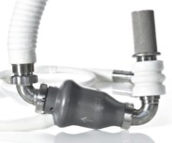

DT LVADs Involve Complex Tradeoffs
Benefits Risks/Burdens

Slide 3
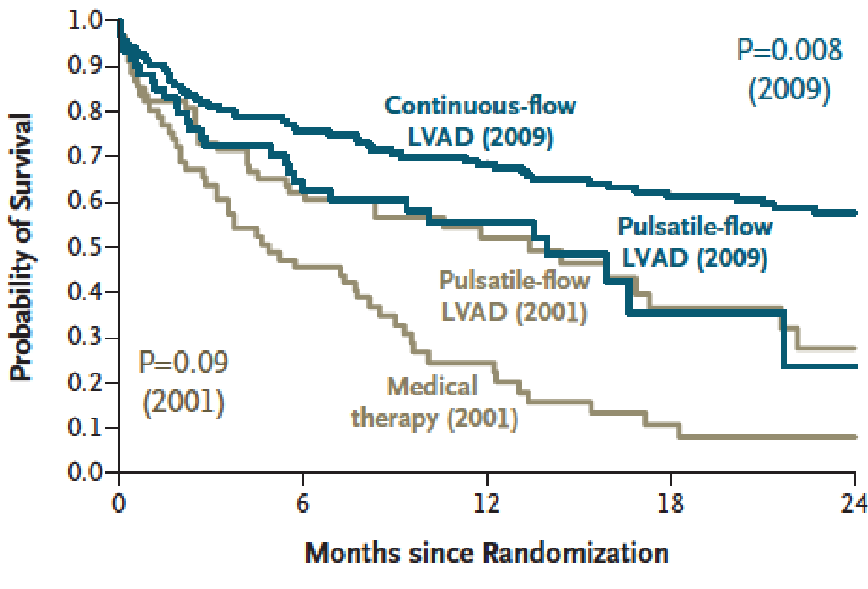

DT LVADs Involve Complex Tradeoffs
Benefits Risks/Burdens

Slide 4



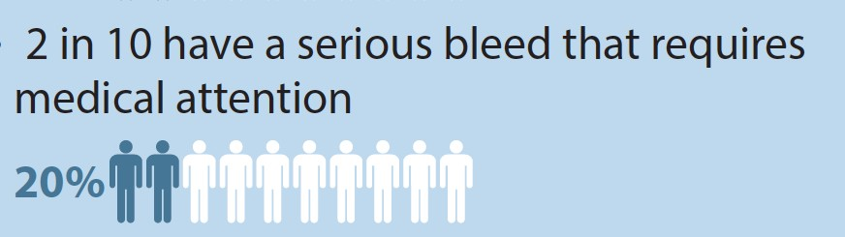
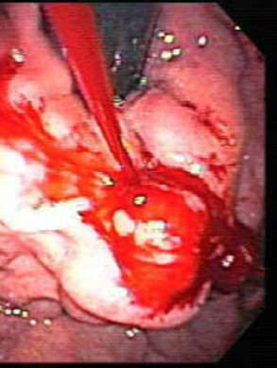
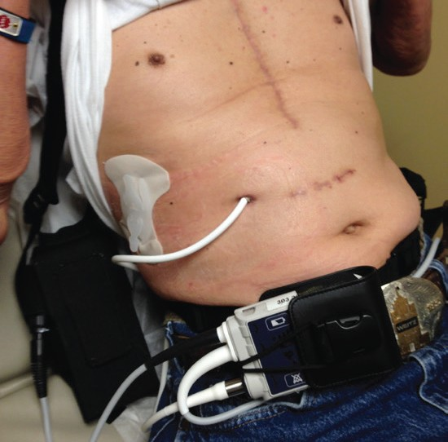
DT LVADs Involve Complex Tradeoffs
Benefits
Risks/Burdens
Driveline care,
power source management

Slide 5
DT LVADs Involve Complex Tradeoffs
Benefits Risks/Burdens
Driveline care,
power source management
Preference-Sensitive Decision

Slide 6
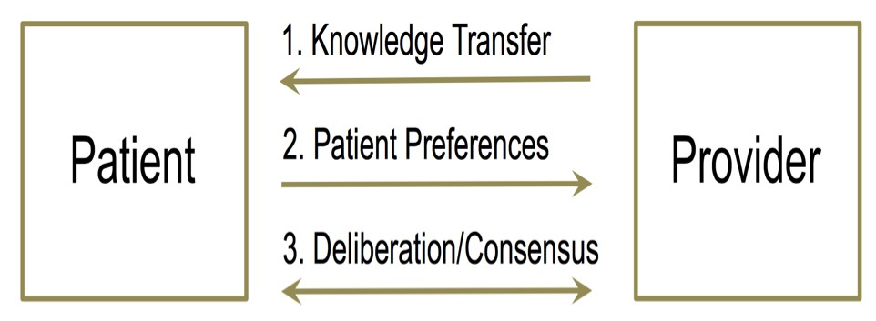

Decision Aids Standardize the Process
“A meeting between two experts”

Slide 7
Deferred to Marketing
In 2014, identified 77 LVAD educational materials…
97% discussed benefits
53% mentioned any risks
36% mentioned lifestyle considerations
1% mentioned palliative care or hospice
0% met majority International Patient Decision Aid Standards
Iacovetto, Matlock, Thompson, McIlvennan, Bradley, Larue, Allen. CircCQO. 2014;905.

Slide 9
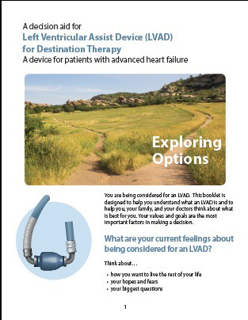
DECIDE-LVAD Trial
Test the effectiveness of a shared decision support intervention for patients considering DT LVAD consisting of:
Site-based training
Implementation of patient decision aids

Slide 10
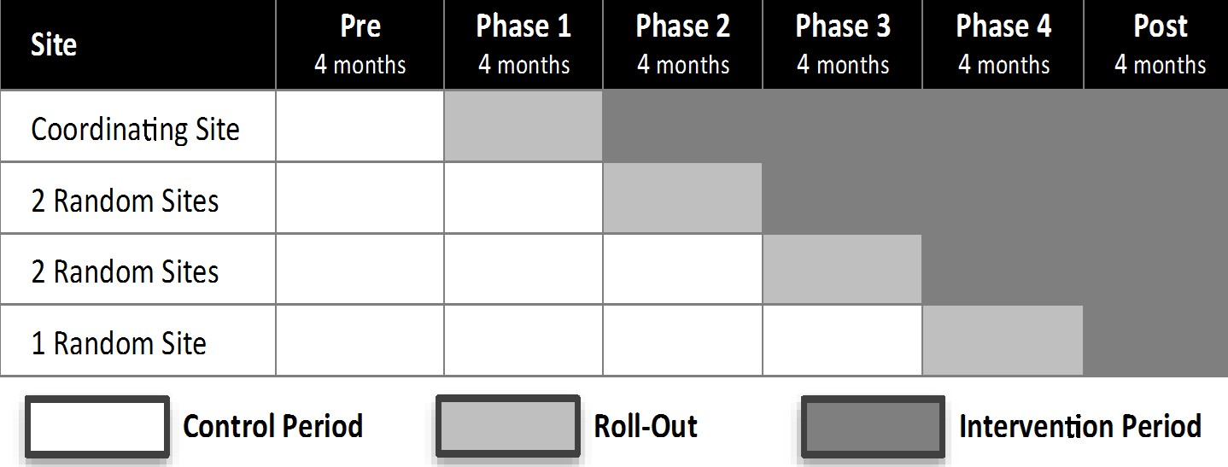
Design: 6-Site, Stepped Wedge Trial
Enrollment: June 2015 – Jan 2017

Slide 11
Patients and Data Collection
Initiation of formal
DT LVAD
evaluation
Formal DT LVAD
education
Enrollment, Baseline 1 Survey
Baseline 2 Survey
1-Month Follow-Up Survey
6-Month Follow-Up Survey
Time 0
1 month
6 months
INTERVENTION:
Incorporate Patient Decision Aids

Slide 12
Primary Outcome: DECISION QUALITY
0.7
0.6
0.5
0.4
0.3
0.2
0.1
0
Higher-Quality LVAD Decision
Option chosen optimizes values, goals, and preferences
“The extent to which medical decision making reflects the considered preferences of a well-informed patient.”
Values-Choice Concordance
An informed patient
Lower-Quality LVAD Decision
Knowledge
0% 2% 4% 6% 8% 10% 12% 14%

Slide 13
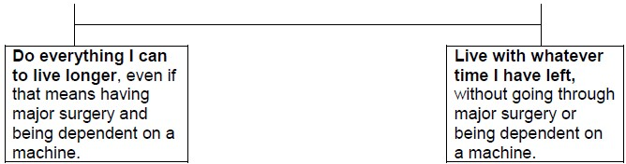
Values-Choice Concordance
Values
Choice
LVAD
No LVAD
Concordant

Slide 14
Values-Choice Concordance
Values
Choice
LVAD
No LVAD
Discordant

Slide 15
Analysis
Knowledge: linear mixed model
  Adjusted for trends over time and significant differences at baseline
Values-choice concordance: Kendall’s tau correlation coefficient
Sensitivity analyses:
  Excluding sites
  Among inpatient enrollments only

Slide 16
Participants
248 patients enrolled (from n=385 eligible; power/planned n=168)
Enrolled patients more likely to be white non-Hispanic than non-enrolled (75% vs. 64%)
 | Control (n=135) | Intervention (n=113)
Age, mean years (SD) | 63.5 (9.7) | 63.2 (10.2)
Male | 82.2% | 86.7%
White, non-Hispanic | 79.1% | 82.7%
Some college or more | 56.4% | 69.2%
On Disability | 27.6% | 32.0%
Married | 72.5% | 65.4%
Diagnosed < 2 years | 11.9% | 12.4%
Enrolled in ICU | 21.5% | 26.5%
INTERMACS 4-7 (p<0.01) | 18.3% | 44.6%

Slide 17
Intervention Delivery
Training
  All sites participated: 31-72 staff per site
Patient decision aid exposure
  88% received pamphlet decision aid
  92% received video decision aid
“Educational materials” felt to be biased in favor of LVAD
  54% of control patients
  43% of intervention patients (p=0.13)

Slide 18
Knowledge
0.7
Higher-Quality LVAD Decision
0.6
P=0.030
Values-Choice Concordance
Kendall’s Tau Correlation (at 1 month)
0.5
Intervention
Staff Education and Patient Decision Aid
Control: 59.5%→64.9%
Intervention: 59.1%→70.0%
Adjusted difference of difference: 5.5%
0.4
0.3
0.2
Control
Usual Care
0.1
Lower-Quality LVAD Decision
0
0%
2%
4% 6% 8% 10%
12%
14%
Knowledge Improvement
Percent difference, mean (baseline 1 to baseline 2)

Slide 19
Values-Choice Concordance
0.7
Higher-Quality LVAD Decision
0.6
Values-Choice Concordance
Kendall’s Tau Correlation (at 1 month)
0.5
Intervention
Staff Education and Patient Decision Aid
Control: 0.17 correlation coefficient
Intervention: 0.48 correlation coefficient
Adjusted difference of difference: 0.28
0.4
P=0.013
0.3
0.2
Control
Usual Care
0.1
Lower-Quality LVAD Decision
0
0%
2%
4% 6% 8% 10% 12%
Knowledge Improvement
14%
Percent difference, mean (baseline 1 to baseline 2)

Slide 20
Secondary Outcomes
No significant differences in:
  Concordance stated value at 1-month to actual treatment received by 6-mo
  Decision conflict
  Decision regret
  Control preferences
  Illness acceptance
  Stress
  Depression
  Quality of life

Slide 21
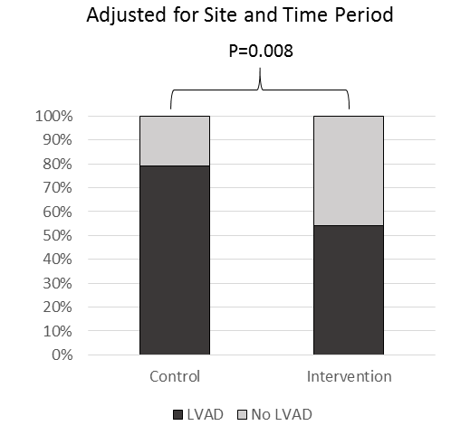
Secondary Outcomes: 6-month implant
26% decrease in patient going on to LVAD
80%
54%

Slide 22
Considerations
Strengths
Real-world look through a hybrid effectiveness-implementation design
Rare upstream capture of patients considering for DT LVAD (not just LVAD recipients)
Limitations
Stepped-wedge is a quasi-experimental design
Missing data due to death and withdrawal of patients not implanted

Slide 23
Conclusion
Formal integration of a shared decision support intervention for DT LVAD was associated with:
Improved decision quality
Reduction in implantation

Slide 24



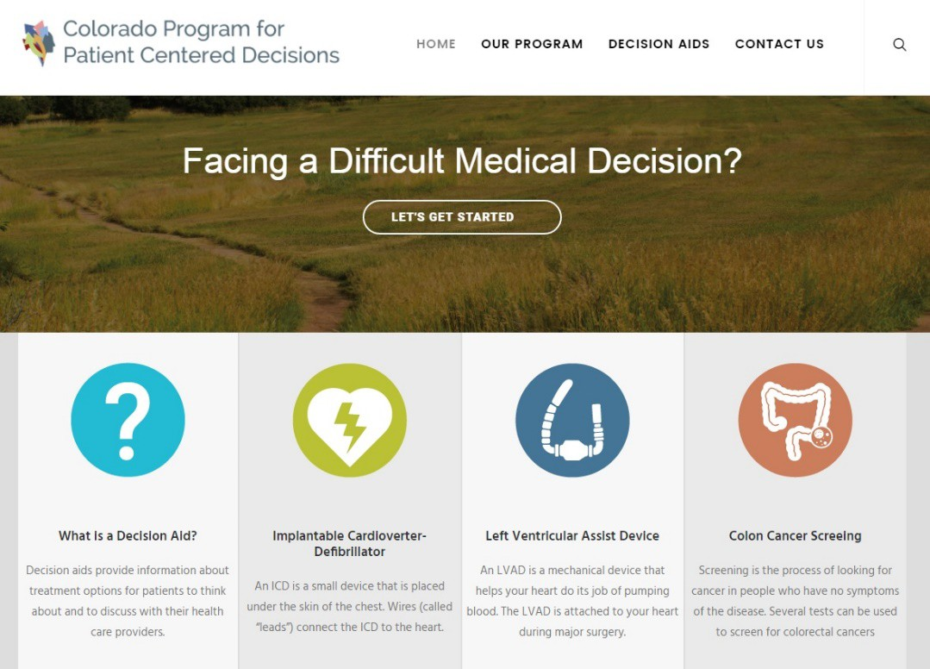



Thank You!
Trial sites
Decision aids available for free at:
http://patientdecisionaid.org/LVAD/
Funder:
Patients and caregivers

