Slide 1
30-Day Outcomes Following Implantation of a Repositionable Self-Expanding Aortic Bioprosthesis: First Report From the FORWARD Study
Stephan Windecker Department of Cardiology Bern University Hospital - INSELSPITAL Bern, Switzerland
On behalf of the FORWARD Study Investigators

Slide 2
Disclosures
Stephan Windecker receives research grants to the institution from Abbott, Biotronik, Boston Scientific, Edwards, Medtronic, and St. Jude

Slide 3
Evolut R Clinical Program
Evolut R CE
CE Mark Study (Safety and performance) N=60; single arm, 26 mm and 29 mm valves
Primary Safety EP = Death & any stroke at 30 days
Final 2-Year Follow-up
TCT.16
Evolut R US
US IDE Study (Safety and efficacy) N=241; single arm, 23 mm, 26 mm and 29 mm valves
Primary Safety EP = Death & disabling stroke at 30 days Follow-up through 5 years
1-Year Follow-up TCT.16
Evolut R FORWARD
All-Comers Trial (Safety) N=1000; single arm, 23 mm, 26 mm and 29 mm valves
Primary EP = Death at 30 days Follow-up through 3 years
Interim Results
TCT.16
Evolut R 34mm
US IDE Addendum (Safety and efficacy) N=60; single arm, 34 mm valve
Primary Safety EP = Death & disabling stroke at 30 days Follow-up through 5 years
Initial Results TCT.16

Slide 4
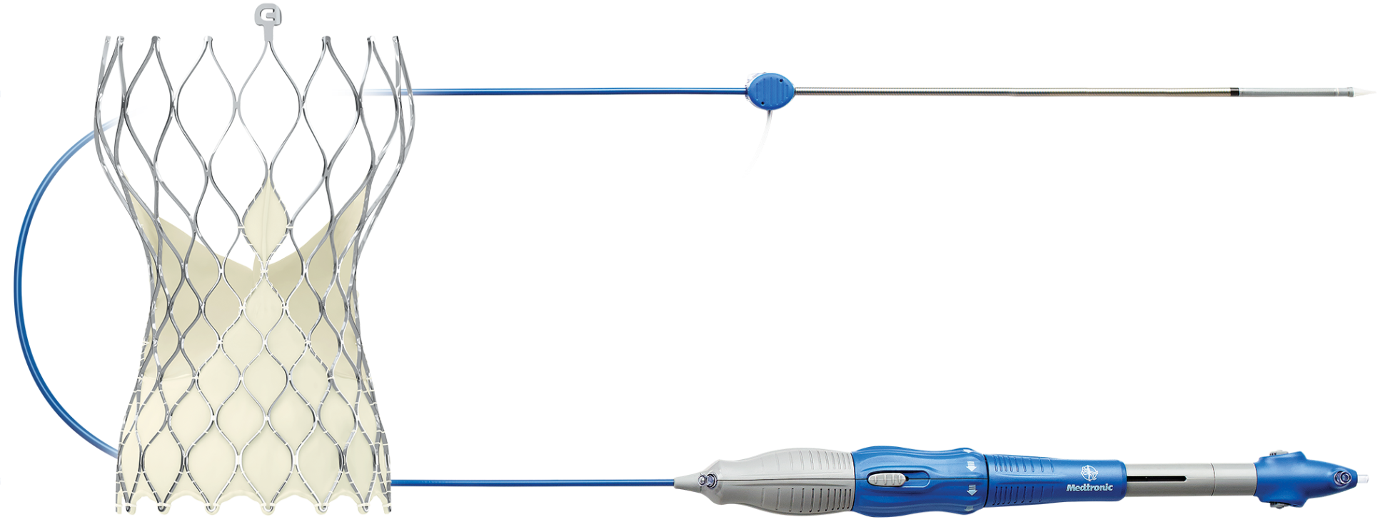
Evolut R System
Catheter Delivery System
14Fr-equivalent profile
Inline Sheath
Capsule
Loading System
Transcatheter Valve
Supra-annular design, optimized sealing

Slide 5
Evolut R FORWARD Study
FORWARD is a multicenter, prospective, single-arm, observational post-market study to evaluate safety and performance of the Evolut R system in a routine hospital setting.
Objective: To document the clinical and device performance outcomes of the Evolut R system used in routine hospital practice
Primary Endpoint: The all-cause mortality rate at 30 days
Sample Size: 1000 patients
Present Analysis: Interim 30-day results in first 300 patients

Slide 6
Secondary Endpoints
EFFICACY
Absence of procedural mortality
Correct positioning of a single prosthetic heart valve into the proper anatomical location
Absence of patient-prosthesis mismatch, mean gradient < 20 mmHg (or peak velocity < 3 m/sec), and no moderate or severe prosthetic valve regurgitation.
Hemodynamic performance at 24 hours to 7 days (discharge) and 1 year
SAFETY
VARC-II Safety Composite Endpoint and Components at 30 days post procedure
All-cause mortality , All stroke , Life-threatening bleeding, Acute kidney injury: stage 2 or 3, Coronary artery obstruction requiring intervention, Major vascular complication, and valve-related dysfunction requiring repeat procedure (BAV, TAVI, or SAVR)
Rate of new permanent pacemaker implant at 30 days post procedure

Slide 7
Inclusion and Exclusion Criteria
INCLUSION
EXCLUSION
Symptomatic native aortic valve stenosis or surgical bioprosthetic valve failure
Acceptable candidate for elective treatment with the Evolut R System in conformity with the local regulatory context
Age ≥80 years OR considered to be at high or greater risk for surgical aortic valve replacement (AVR) where high risk is defined as:
STS predicted risk of mortality ≥8%
OR
Heart team agreement of risk for AVR due to frailty or comorbidities.
Contraindication to aspirin, heparin, bivalirudin, ticlopidine, clopidogrel, Nitinol, contrast media
Mechanical heart valve in aortic position
Sepsis, including active endocarditis
Anatomically not suitable for the Evolut R system
Estimated life expectancy <1 year
Participating in another trial that may influence the outcome of this trial
Need for emergency surgery for any reason

Slide 8
Study Oversight and Participation
60 sites in 23 countries
Enrollment to date: 805
Steering Committee Members
*Eberhard Grube, University of Bonn
*Stephan Windecker, Inselspital/Universitätsspital Bern
Sabine Bleiziffer, Deutsches Herzzentrum München
Johan Bosmans, UZ Antwerp
Ganesh Manoharan, Royal Victoria Hospital Belfast
Thomas Modine, CHRU de Lille
Nicolas Van Mieghem, Erasmus MC Rotterdam
Echocardiographic Core Lab
Jae Oh, Mayo Clinic, Rochester, MN
Clinical Events Committee
Harvard Clinical Research Institute
Sponsor
Medtronic
Canada
4 sites
Europe
45 sites
Middle East & Africa
3 sites
Latin America
3 sites
Australia
5 sites
*Co-principal Investigators

Slide 9
Baseline Clinical Characteristics
Characteristic - % or mean ± standard deviation | EVOLUT R N=300
Age (years) | 82.0 ± 5.7
Female | 67.3
STS Score (%) | 5.6 ± 3.8
<4% | 43.3
4-8% | 40.0
>8% | 16.7
EuroSCORE II (%) | 5.6 ± 4.8
NYHA III/IV | 72.6
Diabetes | 30.0
Serum Creatinine >2 mg/dl | 7.4
Chronic Lung Disease (COPD) | 24.5
Cerebrovascular Disease | 14.7
Frailty | 34.1
Assisted Living | 13.2

Slide 10
Procedural Data
Characteristic - % | EVOLUT R N=300
General Anesthesia | 37.0
Iliofemoral Access Route | 98.3
Implanted Valve Size
23mm | 7.0
26mm | 40.5
29mm | 52.5
Pre-TAVR Balloon Dilation Performed | 49.0
Post-Implant Dilatation Performed | 33.4
EnVeo InLine Sheath used | 92.6
Multiple Valve (≥ 2 Implanted) | 1.3

Slide 11
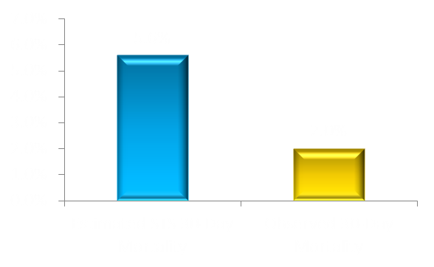
30-Day All-Cause Mortality
2.0%
No. at risk:
300 |  |  |  |  |  | 264

Slide 12
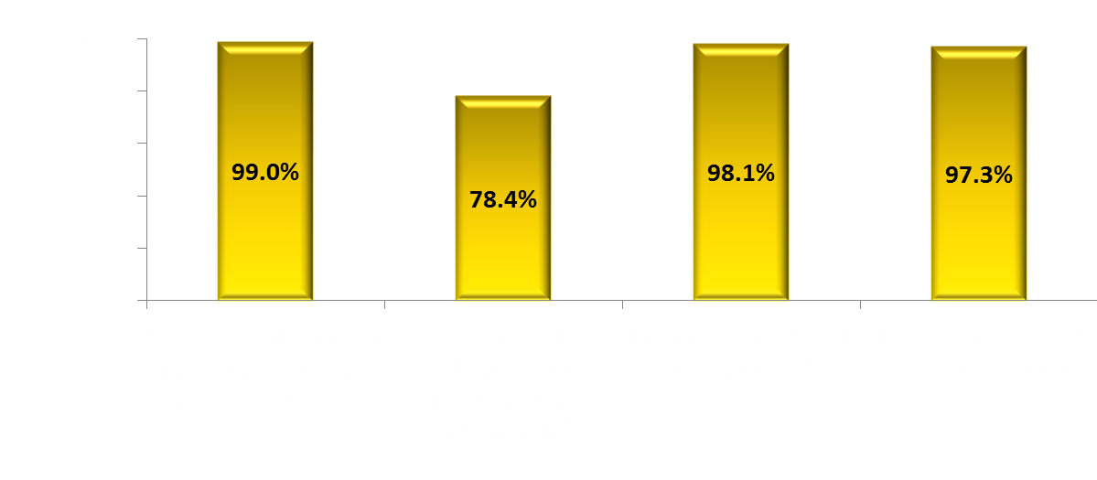
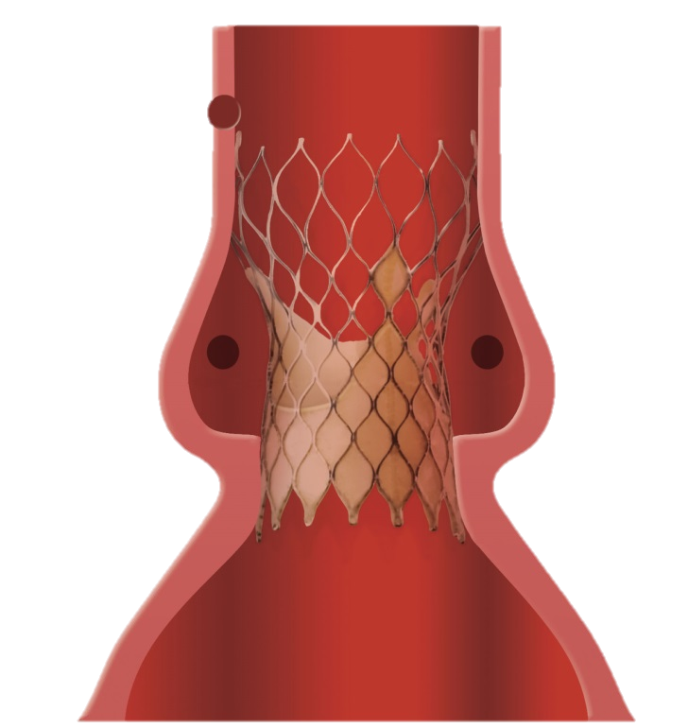
Procedural Data
Implant depth as assessed by aortography and reported by the sites:
NCS: 4.8 ± 2.7mm
LCS: 6.0 ± 2.8mm
¹Patient Prosthesis Mismatch: Defined as AVA <0.85cm²/m² for subjects with BMI <30kg/cm², or <0.7cm²/m² for subjects with BMI ≥ 30kg/cm²

Slide 13
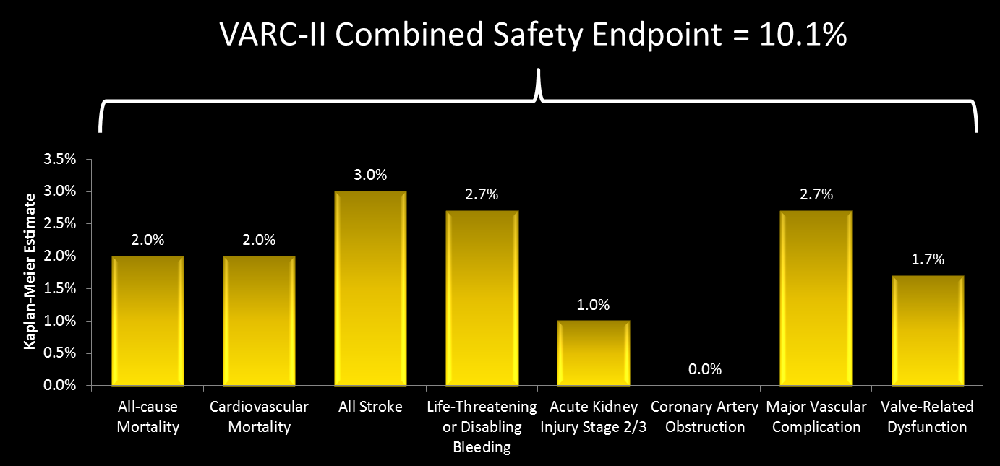
VARC-II Safety Endpoints at 30 Days
*
* Requiring repeat procedure

Slide 14
Additional 30-Day Safety Endpoints
Event, Kaplan-Meier Rate (%) | Evolut R N=300
Myocardial Infarction | 0.3
New Pacemaker¹ | 15.4
Prosthetic Valve Thrombosis | 0.0
Prosthetic Valve Endocarditis | 0.0
Valve Embolization* | 1.0
Valve Migration | 0.0
Mitral Valve Apparatus Damage | 0.0
¹Subjects with pacemaker or ICD at baseline are included in the denominator.
*per VARC II; all 3 were pop-outs

Slide 15
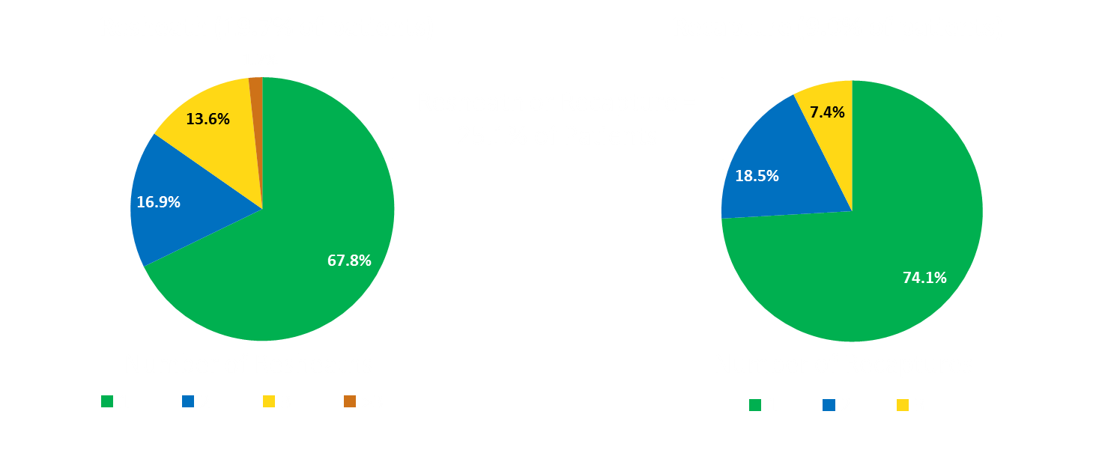
Resheath and Recapture
Patients who underwent resheath/recapture had a similar mortality rate (1.3% vs. 2.3%) and pacemaker implantation rate (13.3% vs. 16.2%) as those who did not undergo resheath/recapture.

Slide 16
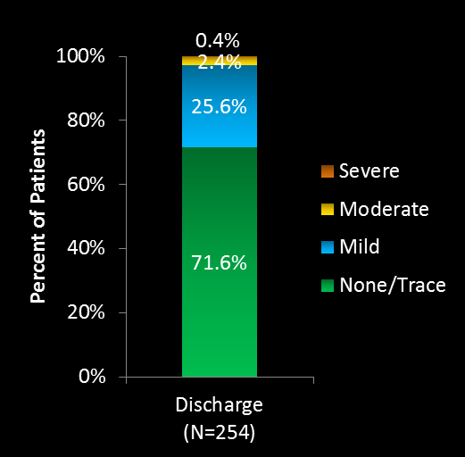
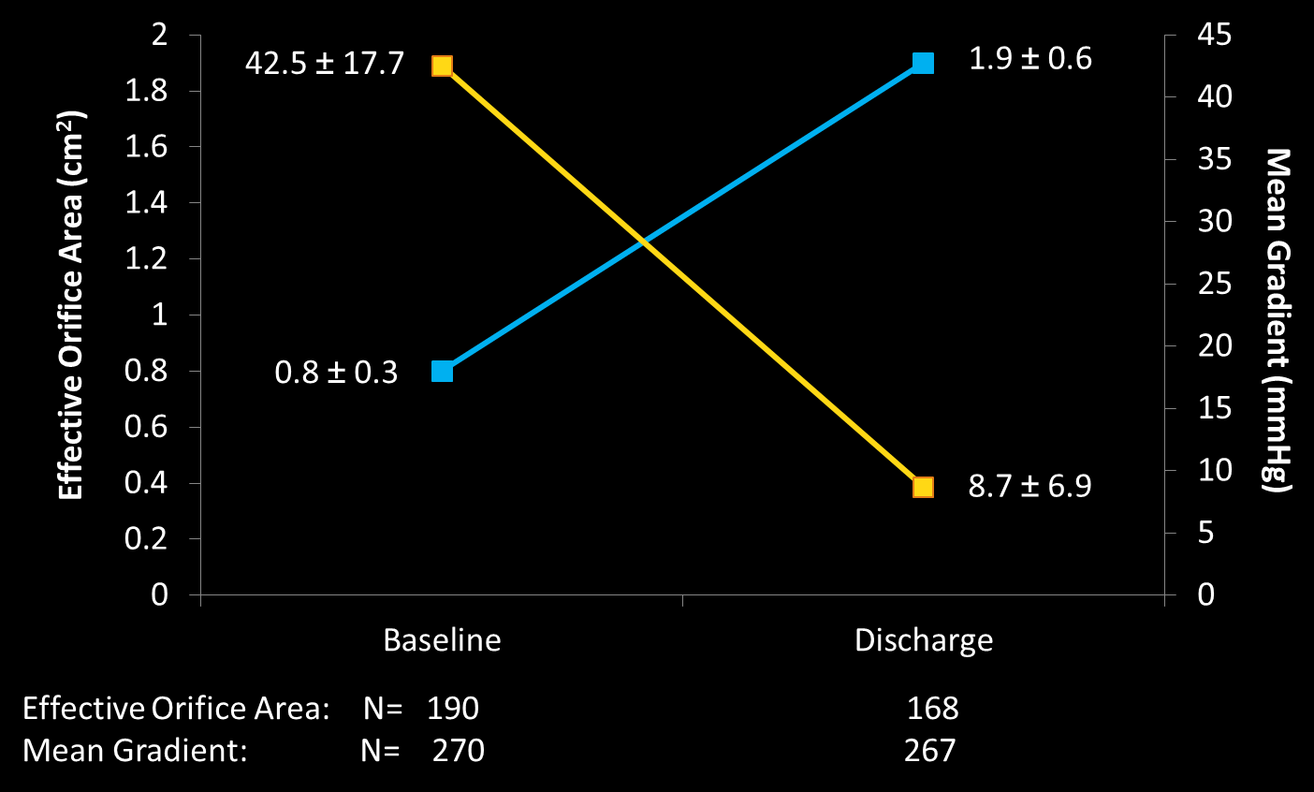
Hemodynamic Outcomes*
Valve Performance
Paravalvular Regurgitation
*Echocardiographic Core Lab

Slide 17
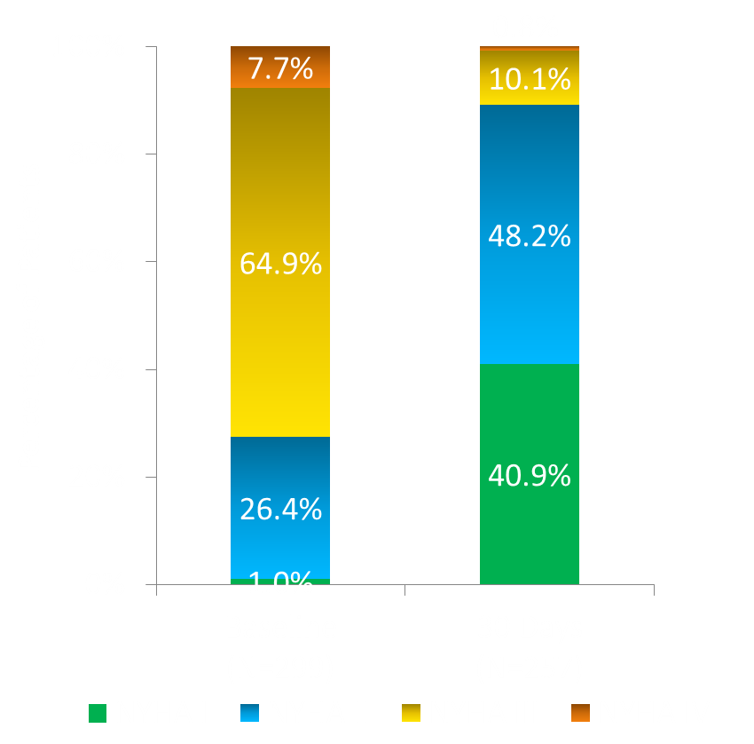
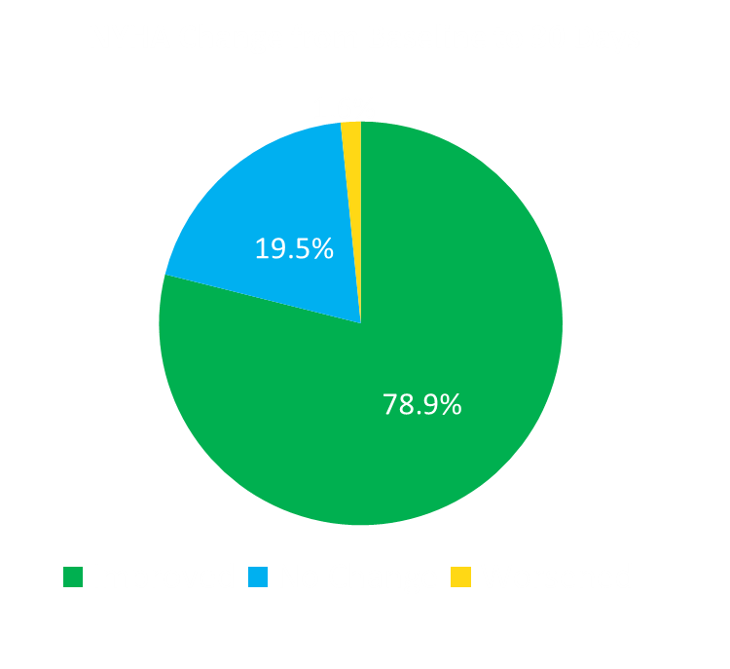
New York Heart Association Functional Class

Slide 18
Conclusions
Interim results at 30 days in this real-world, global experience with Evolut R demonstrate:
Low incidence of all-cause mortality, stroke and major vascular complications
Reduced pacemaker rate post TAVR
Excellent hemodynamic results and low rate of moderate/severe PVR
Resheath/recapture was used safely in 25% of cases
Primary endpoint for 1000 patients at EuroPCR 2017

