Slide 1
Atherectomy:
Choosing the right device!
Perwaiz M. Meraj MD FACC FSCAI
Director of Interventional Cardiology
Northwell Health
Zucker School of Medicine at Hofstra/Northwell

Slide 2
Faculty Disclosures
Relationship: Entity or Entities
  Advisory Board/Consultant/Grants or Research Support
    Abiomed, Boston Scientific, CSI, Medtronic

Slide 3
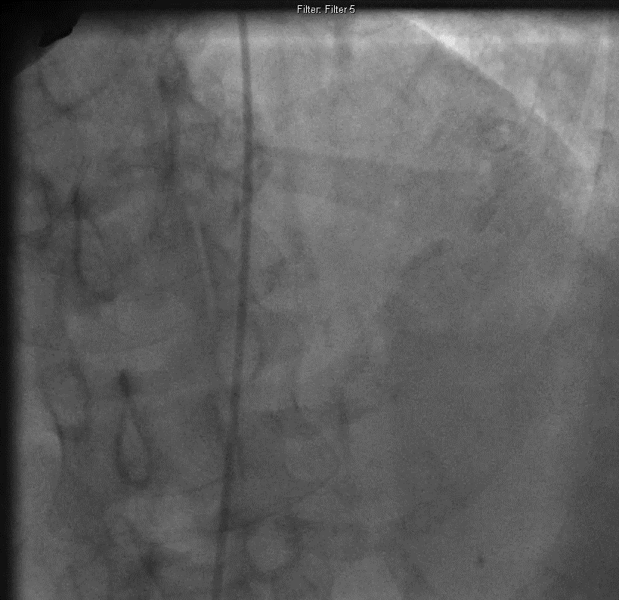
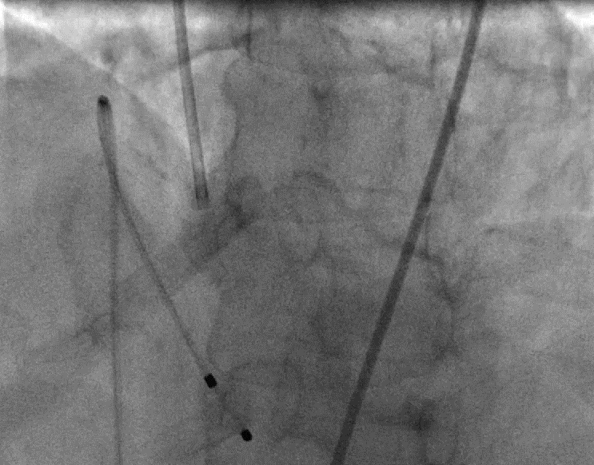

Slide 4
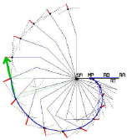
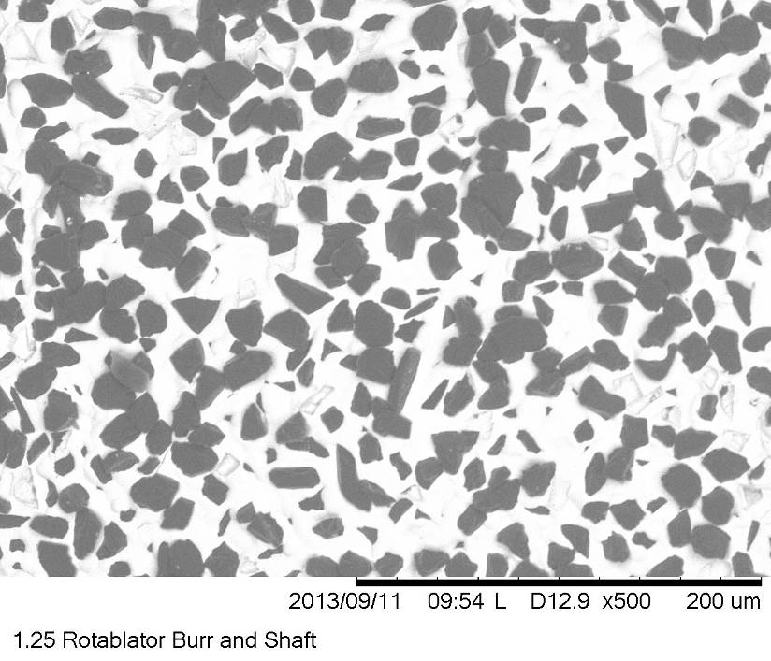
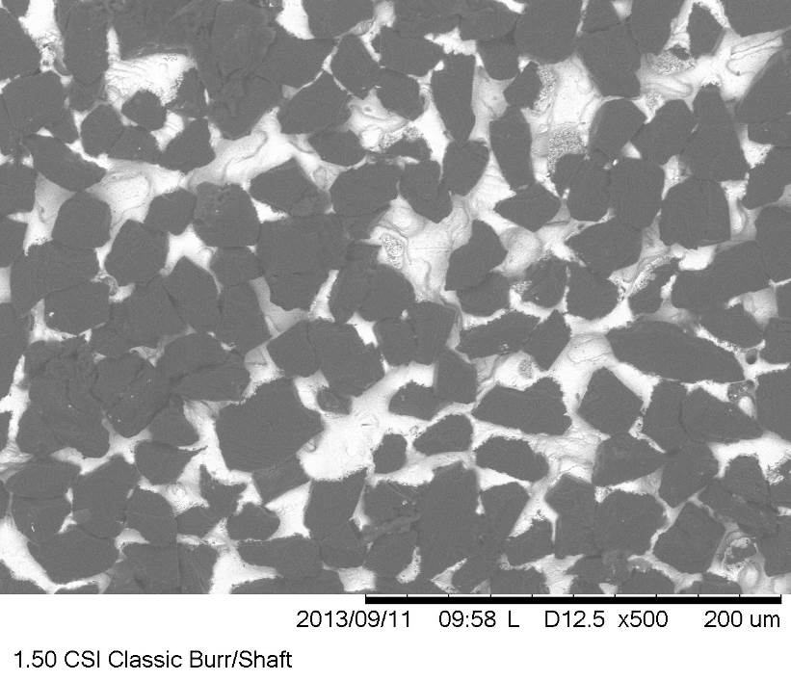
Rotational vs. Orbital Atherectomy
Rotablator®
CSI Diamondback
Burr Action | Burr spins concentrically on wire | Crown oscillates in orbital path
Lumen Sizing | Lumen size = burr size | Lumen size = f(time, speed, passes)
Grit Size
5 µ exposed diamonds
10 µ exposed cutting surface
Data presented by J. Moses at CRF Fellows 2014.

Slide 5
COAP-PCI
Meraj et al. JOIC 2018

Slide 6
Meraj et al. JOIC 2018

Slide 7
Temporal Trends: Utilization of OA and RA
Meraj et al. JOIC 2018

Slide 8
Lesion Characteristics
Separating myth from reality

Slide 9
Vessel Size
Larger the vessel
  OA is more effective while keeping the same burr size
  OA allows for maintaining the need for only 6fr sheath
Smaller the vessel
  RA is safer with smaller vessels, while being as effective
  RA engages smaller vessels better

Slide 10
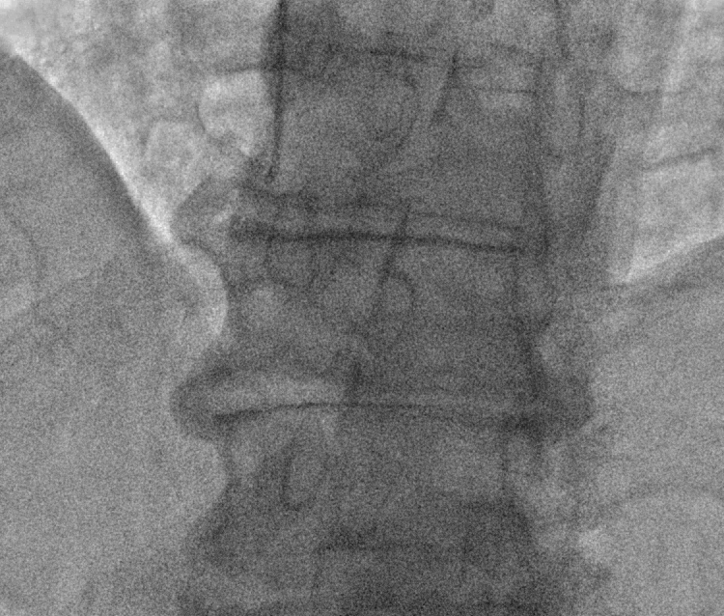
Vessel Tortuosity
More Tortuous
  RA due to its floppy wire is less prone to wire bias
  RA tracks tortuosity better, although handle with care
Less Tortuous
  RA and OA are equally effective

Slide 11
Concentric Calcium or Ostial Lesions
Very tight Concentric Calcium:
  More concentric and tight
    RA front ‘cuts’ thus engages lesions better than OA
    RA can also stall and be stuck if a pecking style in not employed
Ostial Lesions (ie. oRCA and oLM)
  RA remains the ideal choice due its concentic rotation
  OA may damage the aorto-ostial junction,
  If OA is used it can be placed past the lesion and retrograde atherectomy can be performed

Slide 12
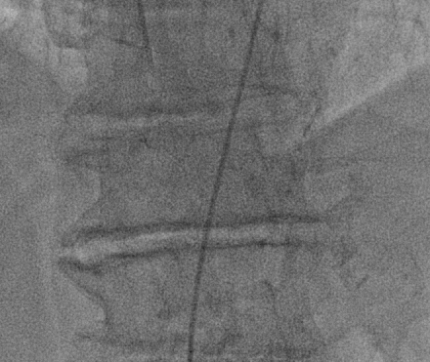
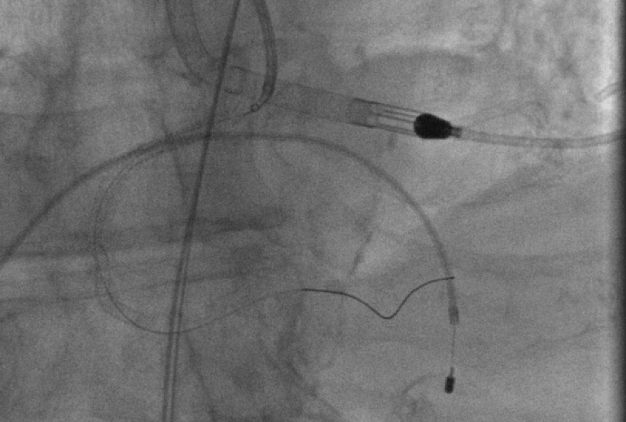

Slide 13
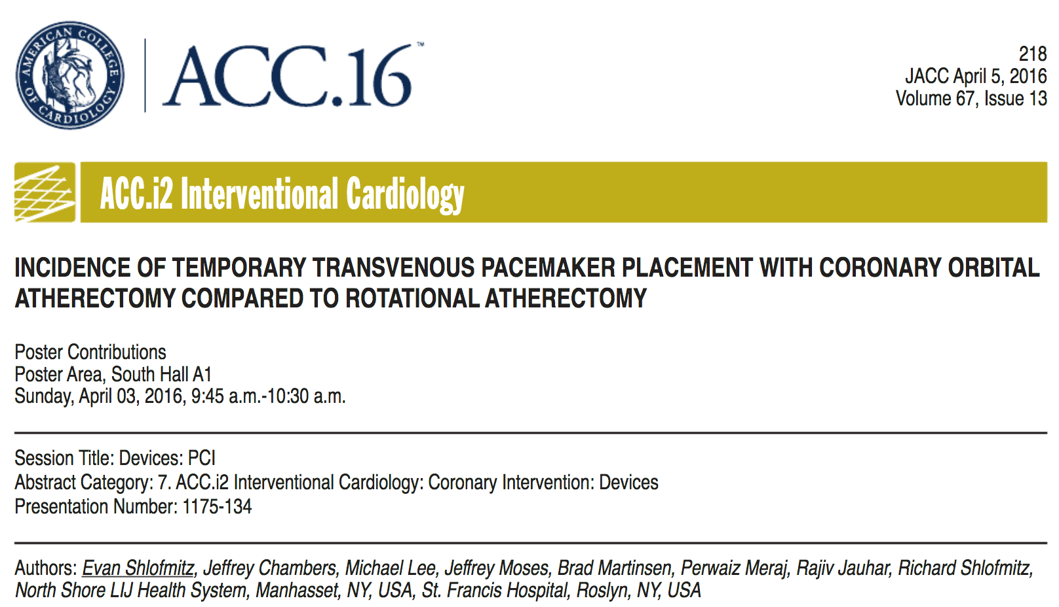
Number of TVPs Placed and Activated
(Jan 2012 – June 2015)

Slide 14
Atherectomy Action Differences
Bi-directional Atherectomy:
  Without question a huge advantage of OA
    Allows for similar atherectomy with fewer passes thus decreasing total time of case
    Eliminates the ‘stuck burr’ issue
Orbital vs. Concentric Motion
  The orbital motion may account for flow during atherectomy, theoretically decreasing no-reflow or slow-flow complications compared to RA
    May also decrease the need for TVP activation
  Though the 120k rpm speed (high speed) may be more deleterious for the reflow phenomenon

Slide 15
Prior Stents
Avoid OA if at all possible as the orbital nature may disrupt stents
  Isolated reports of unapposed struts being mangaled
  It’s a theoretical possibilty, however many have successful performed OA in stents
RA is still the ideal option as it will maintain a central location and obliterate stents if needed
  Need to maintain good technique or burr entrapment may occur
  Up-size the burr to avoid this

Slide 16
Conclusion
Lesion specific differences lend using rotational or orbital
  Tortuosity
  Size
  Presence of Stents
Concentric calcium can be difficult for orbital
  However techniques have been described
Radial or femoral: Both devices work great
Unlikely to ever see a head-to-head randomized study

Slide 17
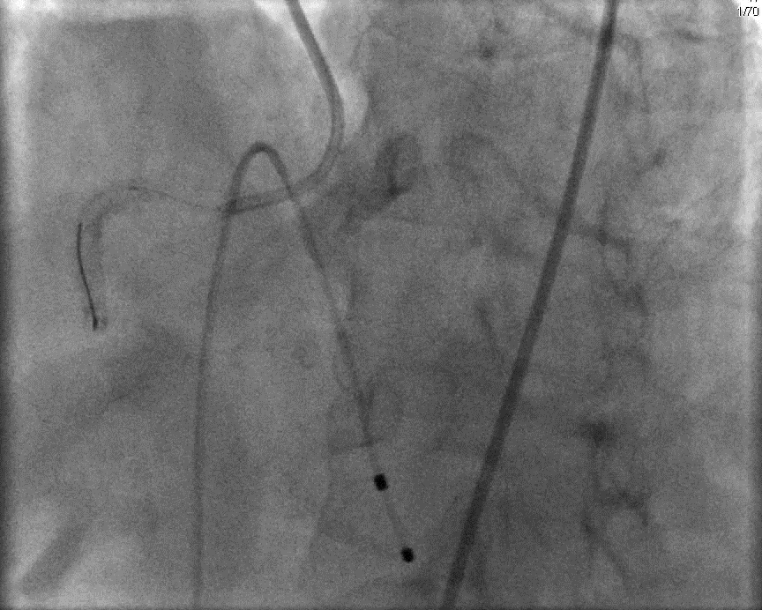

Slide 18
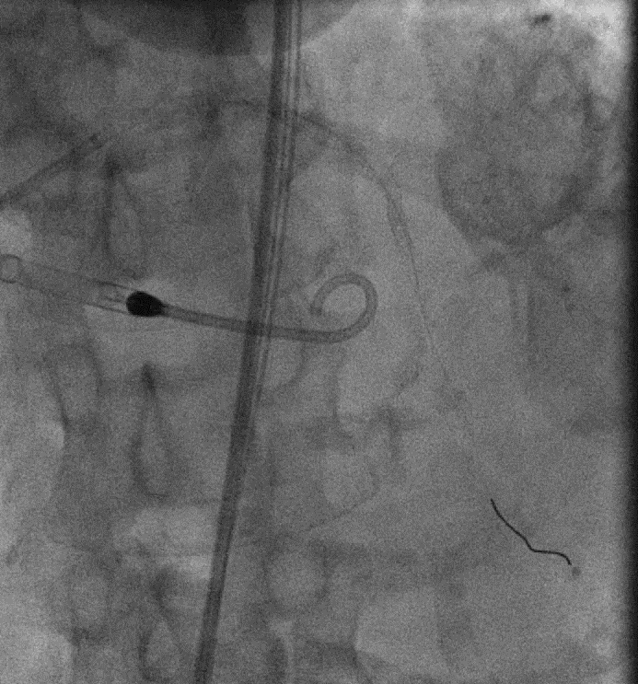
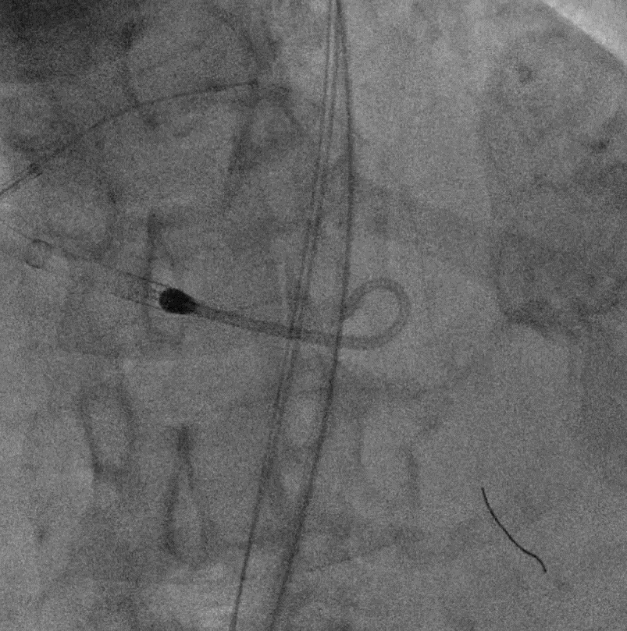

Slide 19
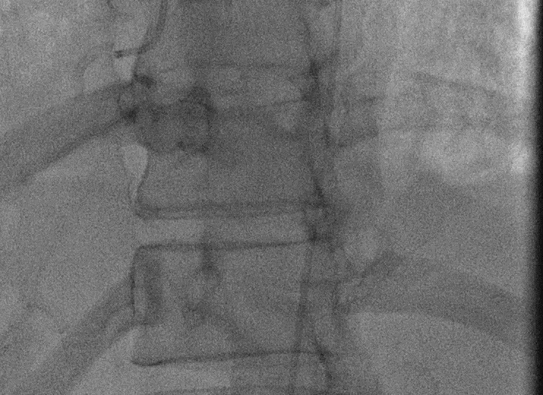
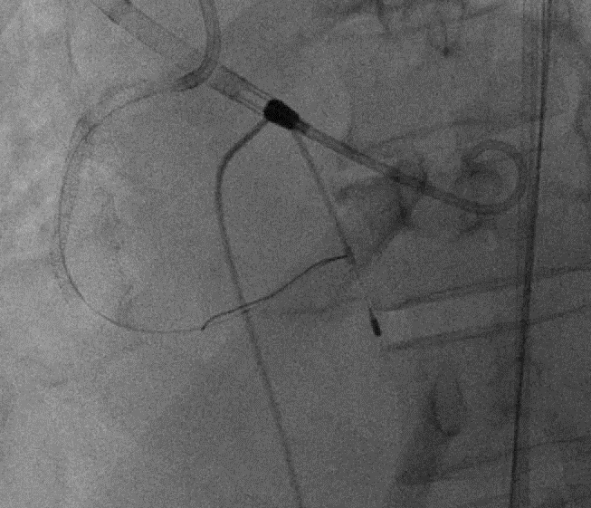
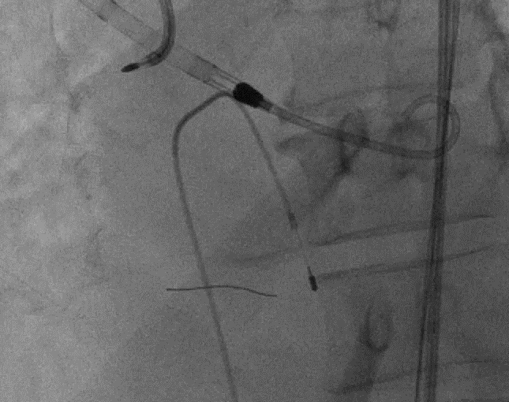

Slide 20


Thanks!
Follow on Twitter:
@PerwaizMeraj
Northwell Health
PMeraj@northwell.edu
516-562-3317

