Slide 1
BIO-RESORT (TWENTE III): A prospective, randomized, three-arm trial comparing two different biodegradable polymer-based drug-eluting stents and a durable polymer-based drug-eluting stent in all-comers with coronary artery disease
Clemens von Birgelen, MD PhD
Thoraxcentrum Twente, MST, Enschede, the Netherlands
on behalf of the BIO-RESORT Investigators

Slide 2
Disclosure Statement of Financial Interest
Within the past 12 months, I or my spouse/partner have had a financial interest/arrangement or affiliation with the organization(s) listed below.
Affiliation/Financial Relationship
Company
Personal Grant/Research Support
Consulting Fees/Honoraria
Major Stock Shareholder/Equity
Royalty Income
Ownership/Founder
Intellectual Property Rights
Other
Institutional Grant/Research Support
none
none
none
none
none
none
none
AstraZeneca, Biotronik, Boston Scientific, Medtronic

Slide 3
BIO-RESORT: Background
The permanent intravascular presence of durable polymer stent coatings has been connected to delayed arterial healing, incomplete endothelial strut coverage, neoatherosclerosis, and, occasionally, (very) late adverse clinical events.
Therefore, biodegradable polymer drug-eluting stents (DES) were developed, which leave after resorption of the coating only a bare metal stent in the vessel wall. Early devices had thick stent struts and showed in randomized clinical trials both promising findings and equivocal results.
Novel biodegradable polymer DES have very thin struts and elute established anti-proliferative drugs from thin circumferential or abluminal coatings.

Slide 4
DES and Scaffolds (Selection)
Durable Polymer DES | Biodegradable Polymer DES | Bioresorbable Scaffold
Xience/Promus CoCr/PtCr-EES | Resolute Integrity CoCr-ZES | BioMatrix/Nobori 316L-BES | Ultimaster CoCr-SES | Synergy PtCr-EES | Orsiro CoCr-SES | Absorb (BVS) PLLA-EE Scaffold
Thickness (µm) of uncoated strut
81 | 91 | 120 / 125 | 80 | 74* | 60** | 150
Distribution and thickness (µm) of polymer coating, and type of polymer
Circumferential7-8/side Fluoro-poymer | Circumfer. 6/side BioLinxTM | Abluminal ≥10 PLA | Abluminal 15 PDLLA | Abluminal 4 PLGA, PCL | Cicumfer. 4-7/side PLLA** | Circumferential 3/side PDLLA
Data from: Stefanini G. et al. Heart 2014 (doi:10.1136/heartjnl-2012-303522); Garg, S. et al. Nat. Rev. Cardiol. 2013;10:248–60; Meredith I.T., presentation at TCT 2013; Lee Y. et al. Invasive Cardiol. 2014;26(2):41-5; and manufacturers’ information (modified, extended). * Synergy‘s platinum chromium strut thickness is 74 µm for stent diameters ≤ 2.5 mm, 79 µm for stent diameters 3.0 – 3.5 mm, and 81 µm for stent diameter 4.0 mm. ** Orsiro‘s cobalt chromium strut thickness is 60 µm for stent diameters ≤ 3.0 mm, and 80 µm for stent diameters > 3.0 mm; Orsiro has an asymmetrical, conformal distribution of the PLLA coating (abluminal coating is thicker) on a very thin passive coating of silicon carbide.
Notes:
4
This is the Bulleted List slide.
To create this particular slide, click the NEW SLIDE button on your toolbar and choose the BULLETED LIST format. (Top row, second from left)
The Sub-Heading and footnote will not appear when you insert a new slide. If you need either one, copy and paste it from the sample slide.
If you choose not to use a Sub-Heading, let us know when you hand in your presentation for clean-up and we’ll adjust where the bullets begin on your master page.
Also, be sure to insert the presentation title onto the BULLETED LIST MASTER as follows:
Choose View / Master / Slide Master from your menu.
Select the text at the bottom of the slide and type in a short version of your presentation title.
Click the SLIDE VIEW button in the lower left hand part of your screen to return to the slide show. (Small white rectangle)

Slide 5
BIO-RESORT: Study Devices
Durable Polymer DES | Biodegradable Polymer DES
 |  |  |  | Synergy PtCr-EES | Orsiro CoCr-SES
Thickness (µm) of uncoated strut
81 | 91 | 120 / 125 | 80 | 74* | 60** | 150
Distribution, thickness (µm), and type of polymer
Circumferential7-8/side Fluoro-poymer | Circumfer. 6/side BioLinxTM | Abluminal ≥10 PLA | Abluminal 15 PDLLA | Abluminal 4 PLGA, PCL | Cicumfer. 4-7/side PLLA** | Circumferential 3/side PDLLA
Data from: Stefanini G. et al. Heart 2014 (doi:10.1136/heartjnl-2012-303522); Garg, S. et al. Nat. Rev. Cardiol. 2013;10:248–60; Meredith I.T., presentation at TCT 2013; Lee Y. et al. Invasive Cardiol. 2014;26(2):41-5; and manufacturers’ information (modified, extended). * Synergy‘s platinum chromium strut thickness is 74 µm for stent diameters ≤ 2.5 mm, 79 µm for stent diameters 3.0 – 3.5 mm, and 81 µm for stent diameter 4.0 mm. ** Orsiro‘s cobalt chromium strut thickness is 60 µm for stent diameters ≤ 3.0 mm, and 80 µm for stent diameters > 3.0 mm; Orsiro has an asymmetrical, conformal distribution of the PLLA coating (abluminal coating is thicker) on a very thin passive coating of silicon carbide.
Notes:
5
This is the Bulleted List slide.
To create this particular slide, click the NEW SLIDE button on your toolbar and choose the BULLETED LIST format. (Top row, second from left)
The Sub-Heading and footnote will not appear when you insert a new slide. If you need either one, copy and paste it from the sample slide.
If you choose not to use a Sub-Heading, let us know when you hand in your presentation for clean-up and we’ll adjust where the bullets begin on your master page.
Also, be sure to insert the presentation title onto the BULLETED LIST MASTER as follows:
Choose View / Master / Slide Master from your menu.
Select the text at the bottom of the slide and type in a short version of your presentation title.
Click the SLIDE VIEW button in the lower left hand part of your screen to return to the slide show. (Small white rectangle)

Slide 6
BIO-RESORT: Study Devices
Durable Polymer DES | Biodegradable Polymer DES
Xience/Promus CoCr/PtCr-EES | Resolute Integrity CoCr-ZES | BioMatrix/Nobori 316L-BES | Ultimaster CoCr-SES | Synergy PtCr-EES | Orsiro CoCr-SES | Absorb (BVS) PLLA-EE Scaffold
Thickness (µm) of uncoated strut
81 | 91 | 120 / 125 | 80 | 74* | 60** | 150
Distribution, thickness (µm), and type of polymer
Circumferential7-8/side Fluoro-poymer | Circumfer. 6/side BioLinxTM | Abluminal ≥10 PLA | Abluminal 15 PDLLA | Abluminal 4 PLGA, PCL | Cicumfer. 4-7/side PLLA** | Circumferential 3/side PDLLA
Data from: Stefanini G. et al. Heart 2014 (doi:10.1136/heartjnl-2012-303522); Garg, S. et al. Nat. Rev. Cardiol. 2013;10:248–60; Meredith I.T., presentation at TCT 2013; Lee Y. et al. Invasive Cardiol. 2014;26(2):41-5; and manufacturers’ information (modified, extended). * Synergy‘s platinum chromium strut thickness is 74 µm for stent diameters ≤ 2.5 mm, 79 µm for stent diameters 3.0 – 3.5 mm, and 81 µm for stent diameter 4.0 mm. ** Orsiro‘s cobalt chromium strut thickness is 60 µm for stent diameters ≤ 3.0 mm, and 80 µm for stent diameters > 3.0 mm; Orsiro has an asymmetrical, conformal distribution of the PLLA coating (abluminal coating is thicker) on a very thin passive coating of silicon carbide.
Notes:
6
This is the Bulleted List slide.
To create this particular slide, click the NEW SLIDE button on your toolbar and choose the BULLETED LIST format. (Top row, second from left)
The Sub-Heading and footnote will not appear when you insert a new slide. If you need either one, copy and paste it from the sample slide.
If you choose not to use a Sub-Heading, let us know when you hand in your presentation for clean-up and we’ll adjust where the bullets begin on your master page.
Also, be sure to insert the presentation title onto the BULLETED LIST MASTER as follows:
Choose View / Master / Slide Master from your menu.
Select the text at the bottom of the slide and type in a short version of your presentation title.
Click the SLIDE VIEW button in the lower left hand part of your screen to return to the slide show. (Small white rectangle)

Slide 7
BIO-RESORT: Study Devices
Durable Polymer
Resolute Integrity
CoCr – zotarolimus-eluting stent
Follow-up (days)
von Birgelen, TCT 2015
Follow-up (days)
van der Heijden, EuroIntervention, in press
TWENTE trial: 5-year follow-up
Primary Outcome von Birgelen et al. J Am Coll Cardiol 2012; 59: 1350–61
2-Year Follow-up Tandjung et al. J Am Coll Cardiol 2014; 61: 2406–16
3-Year Follow-up Löwik et al. EuroIntervention 2015; 10: 1276–9
DUTCH PEERS (TWENTE II) trial: 3-year follow-up
Primary Outcome von Birgelen et al. Lancet 2014; 383: 413–23
2-Year Follow-up Sen et al. J Am Coll Cardiol Intv 2015; 8: 889–99
3-Year Follow-up van der Heijden et al. EuroIntervention – in press
Notes:
7
This is the Bulleted List slide.
To create this particular slide, click the NEW SLIDE button on your toolbar and choose the BULLETED LIST format. (Top row, second from left)
The Sub-Heading and footnote will not appear when you insert a new slide. If you need either one, copy and paste it from the sample slide.
If you choose not to use a Sub-Heading, let us know when you hand in your presentation for clean-up and we’ll adjust where the bullets begin on your master page.
Also, be sure to insert the presentation title onto the BULLETED LIST MASTER as follows:
Choose View / Master / Slide Master from your menu.
Select the text at the bottom of the slide and type in a short version of your presentation title.
Click the SLIDE VIEW button in the lower left hand part of your screen to return to the slide show. (Small white rectangle)

Slide 8
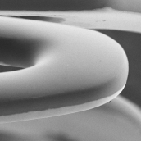
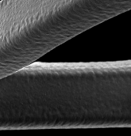
BIO-RESORT: Study Devices
 | SYNERGY | RESOLUTE INTEGRITY | ORSIRO
Coating characteristics | Biodegradable Abluminal | Durable Circumferential Symmetrical | Biodegradable Circumferential Asymmetrical
Bare strut thickness, μm | 74 (3.0 – 3.5 mm: 79, 4.0 mm stent: 81) | 91 | 60 (≥ 3.5 mm stents: 80)
Coating thickness, μm | 4 | 5.6 | 7.4 / 3.5 (ab-/luminal)
Coated strut thickness, μm (of smallest stent) | 78 | 102 | 71
Metal | Platinum-chromium | Cobalt-chromium | Cobalt-chromium
Polymer | PLGA (poly [lactic- co-glycolic acid] polymer) coating | BioLinx®, a blend of hydrophobic C10, hydrophilic C19, and poly-vinyl pyrrolidone | PLLA (poly [L-lactide] acid) (BIOlute®), on thin amorphous silicon carbide (proBIO®)
Drug | Everolimus | Zotarolimus | Sirolimus
Drug release time, mo. | 3 | 6 | 3.3
Degradation time, mo. | 4 | --- | < 24

Slide 9
BIO-RESORT: Study Devices
 | SYNERGY | RESOLUTE INTEGRITY | ORSIRO
Coating characteristics | Biodegradable Abluminal | Durable Circumferential Symmetrical | Biodegradable Circumferential Asymmetrical
Bare strut thickness, μm | 74 (3.0 – 3.5 mm: 79, 4.0 mm stent: 81) | 91 | 60 (≥ 3.5 mm stents: 80)
Coating thickness, μm | 4 | 5.6 | 7.4 / 3.5 (ab-/luminal)
Coated strut thickness, μm (of smallest stent) | 78 | 102 | 71
Metal | Platinum-chromium | Cobalt-chromium | Cobalt-chromium
Polymer | PLGA (poly [lactic- co-glycolic acid] polymer) coating | BioLinx®, a blend of hydrophobic C10, hydrophilic C19, and poly-vinyl pyrrolidone | PLLA (poly [L-lactide] acid) (BIOlute®), on thin amorphous silicon carbide (proBIO®)
Drug | Everolimus | Zotarolimus | Sirolimus
Drug release time, mo. | 3 | 6 | 3.3
Degradation time, mo. | 4 | --- | < 24

Slide 10
BIO-RESORT: Aim
To evaluate two independent hypotheses that 1-year safety and efficacy is non-inferior for:
SYNERGY vs. RESOLUTE INTEGRITY
ORSIRO vs. RESOLUTE INTEGRITY

Slide 11
Primary Endpoint and Sample Size
Primary endpoint is Target Vessel Failure (TVF) at 1-year, a composite of cardiac death, target-vessel MI, and clinically driven target-vessel revascularization.
Sample size was calculated, assuming a TVF rate of 8.5% at 1-year (based on previous trials^{1,2} and further assumptions), with the non-inferiority margin set at 3.5%.
A sample size of 3,540 randomized subjects would yield a power of at least 85% to detect non-inferiority with a one-sided alpha level of 0.025 (from 0.05 adjusted for multiple testing to 0.025), allowing for 3% loss to follow-up.
Sample size calculation was performed with PASS software (NCSS, Kaysville, UT, USA).
1. von Birgelen et al. J Am Coll Cardiol. 2012: TWENTE trial
2. Serruys et al. N Engl J Med. 2010: RESOLUTE All-comers trial

Slide 12
BIO-RESORT
All-comer patients: any patient who requires a percutaneous coronary intervention with DES implantation
Patients with any clinical syndrome, number of target lesions or vessels, any lesion length, vessel size, etc.
Inclusion criteria: Pat. ≥ 18 yrs.; PCI with DES required; informed consent; ability and willingness to comply with study procedures and follow-up
Exclusion criteria: Participation in another drug or device RCT before reaching primary EP; life expectancy < 1 year; planned surgery < 6 mo’s unless DAPT maintained; known pregnancy; known intolerance to DES, anticoagulants or antiplatelet drugs preventing DAPT
3,514 all-comers were 1:1:1 randomized to DES type and assessed
Everolimus-eluting
SYNERGY
Zotarolimus-eluting
Resolute IntegrITY
Sirolimus-eluting
ORSIRO
30 days
1 year
2 years
3 years
4 years
5 years
Investigator-initiated, multicenter, assessor and patient-blinded, three-arm, randomized, non-inferiority trial ∙
Visits to outpatient clinic, questionnaire or telephone follow-up ∙ No routine angiographic follow-up ∙
Independent monitoring and clinical event adjudication (CEC) ∙ Supervision by DSMB
Primary endpoint Target Vessel Failure at 1-year (composite of cardiac death, target vessel-related myocardial infarction, or clinically driven target vessel revascularization) to test 2 independent hypotheses that the safety and efficacy of both ORSIRO and SYNERGY is non-inferior to the reference device RESOLUTE INTEGRITY
Secondary endpoints Death ∙ myocardial infarction (MI) ∙ repeat revascularization ∙ stent thrombosis ∙ TLF, MACE, POCE
BIO-RESORT Study Sites: Thoraxcentrum Twente, Medisch Spectrum Twente, Enschede ∙ Rijnstate Hospital, Arnhem ∙ Haga Hospital, The Hague ∙
Albert Schweitzer Hospital, Dordrecht; all in the Netherlands ∙ Enrollment from December 21, 2012 to August 24, 2015 ∙
PI: C. von Birgelen, MD PhD – Thoraxcentrum Twente, MST, Enschede, the Netherlands
TWENTE III
This investigator-initiated study and its 1-year follow-up are equally funded by Biotronik, Boston Scientific, and Medtronic.

Slide 13
Study Flow Diagram
3,514 patients randomized and analyzed
(study population)*
1:1:1 randomization following stratification for diabetes mellitus
1,172 pts.
allocated to
SYNERGY
1,173 pts.
allocated to
RESOLUTE INTEGRITY
1,169 pts.
allocated to
ORSIRO
1,162 pts.
completed
1-year follow-up**
1,165 pts.
completed
1-year follow-up#
1,163 pts.
completed
1-year follow-up§
1-year follow-up data were obtained from 99.3% of the study population,
which represents 99.9% of the patients who still participated in the trial or had died.
During the first year of follow-up, 21 patients (0.6%) withdrew consent, while only
3 / 3,514 patients (< 1 ‰) were actually “lost” (i.e., could not be contacted).
* During active study enrollment, 7,928 patients were treated with DES (no data on the number of eligible patients are available).
3,545 pts. were initially randomized; 31 pts. were excluded; 3,514 pts. were analyzed and represent the study population.
** 2 patients lost to follow-up, 8 patients withdrew consent; # 1 patient lost to follow-up, 7 patients withdrew consent;
§ 6 patients withdrew consent. Monitoring and an independent clinical event adjudication (CEC) by CRO Diagram, Zwolle. Analyses were based on intention to treat.

Slide 14
Patient Characteristics
 | Synergy n = 1,172 | Resolute Integrity n = 1,173 | Orsiro n = 1,169
Age (yrs) | 64.0 ± 10.7 | 63.6 ± 10.9 | 64.2 ± 10.7
Men | 845 (72.1) | 848 (72.3) | 854 (73.1)
BMI (kg/m²) | 27.6 ± 4.2 | 27.3 ± 4.0 | 27.4 ± 4.2
Current smoker | 336/1,135 (29.6) | 354/1,143 (31.0) | 341/1,144 (29.8)
Family history of CAD | 512/1,114 (46.0) | 529/1,138 (46.5) | 516/1,120 (46.1)
Diabetes mellitus, medically treated | 203 (17.3) | 210 (17.9) | 211 (18.0)
Arterial hypertension | 520 (44.4) | 554 (47.2) | 550 (47.0)
Hypercholesterolemia | 422 (36.0) | 450 (38.4) | 463 (39.6)
Renal insufficiency* | 29 (2.5) | 33 (2.8) | 46 (3.9)
Previous MI | 192 (16.4) | 248 (21.1) | 209 (17.9)
Previous PCI | 214 (18.3) | 198 (16.9) | 214 (18.3)
Previous CABG | 91 (7.8) | 96 (8.2) | 80 (6.8)
Clinical indication
ST-elevation MI (STEMI) | 377 (32.2) | 326 (27.8) | 370 (31.7)
Non-ST-elevation MI (NSTEMI) | 247 (21.1) | 270 (23.0) | 239 (20.4)
Unstable angina | 192 (16.4) | 219 (18.7) | 209 (17.9)
Stable angina | 356 (30.4) | 358 (30.5) | 351 (30.0)
Left ventricular ejection fraction < 30% | 15 (1.3) | 18 (1.5) | 17 (1.5)
Data are frequencies (%) or mean (± SD)
* Serum creatinine level ≥ 130 μmol/L

Slide 15
Lesion Characteristics
 | Synergy n = 1,532 lesions | Resolute Integrity n = 1,580 lesions | Orsiro n = 1,551 lesions
Target lesion coronary artery
Left main | 25 (1.6) | 28 (1.8) | 23 (1.5)
Left anterior descending | 616 (40.2) | 588 (37.2) | 679 (43.8)
Left circumflex | 358 (23.4) | 395 (25.0) | 338 (21.8)
Right coronary artery | 510 (33.3) | 535 (33.9) | 485 (31.3)
Bypass graft | 23 (1.5) | 34 (2.2) | 29 (1.9)
ACC-AHA lesion class | 1,527/1,532 | 1,573/1,580 | 1,545/1,551
A/B1 | 443 (29.0) | 438 (27.8) | 407 (26.3)
B2/C | 1,084 (71.0) | 1,135 (72.2) | 1,138 (73.7)
De novo lesion | 1,488 (97.1) | 1,530 (96.8) | 1,501 (96.8)
Chronic total occlusion | 50 (3.3) | 49 (3.1) | 52 (3.4)
Instent restenosis | 30 (2.0) | 33 (2.1) | 30 (1.9)
Bifurcated lesion | 446 (29.1) | 438 (27.7) | 443 (28.6)
Aorto-ostial lesion | 100 (6.5) | 86 (5.4) | 74 (4.8)
Severe calcification | 296 (19.3) | 327 (20.7) | 317 (20.4)
Preprocedural TIMI flow grade
0 | 301 (19.6) | 266 (16.8) | 304 (19.6)
1 | 42 (2.7) | 26 (1.6) | 44 (2.8)
2 | 170 (11.1) | 187 (11.8) | 165 (10.6)
3 | 1,019 (66.5) | 1,101 (69.7) | 1,038 (66.9)
Data are frequencies (%) or mean (SD).

Slide 16
Procedural Data (Patient based)
 | Synergy n = 1,172 | Resolute Integrity n = 1,173 | Orsiro n = 1,169
Total number of lesions treated per patient
1 lesion treated | 877 (74.8) | 850 (72.5) | 853 (73.0)
2 lesions treated | 237 (20.2) | 254 (21.7) | 255 (21.8)
3 or more lesions treated | 58 (4.9) | 69 (5.9) | 61 (5.2)
Only de novo coronary lesions treated* | 1,134 (96.8) | 1,127 (96.1) | 1,124 (96.2)
At least one chronic total occlusion treated | 44 (3.8) | 48 (4.1) | 47 (4.0)
At least one bifurcation lesion treated | 415 (35.4) | 409 (34.9) | 412 (35.2)
At least one in-stent restenosis treated | 28 (2.4) | 31 (2.6) | 30 (2.6)
At least one small-vessel (RVD < 2.75 mm) tr. | 680 (58.0) | 667 (56.9) | 731 (62.5)
At least one long lesion (> 27 mm) treated | 353 (30.1) | 369 (31.5) | 351 (30.0)
Number of stents implanted per patient | 1.81 ± 1.10 | 1.90 ± 1.18 | 1.83 ± 1.15
Total stent length (mm) per patient | 32 (20-48) | 30 (22-52) | 30 (18-49)
Thrombus present** | 284 (24.2) | 249 (21.2) | 284 (24.3)
Glycoprotein IIb/IIIa antagonist administered | 207 (17.7) | 198 (16.9) | 185 (15.8)
Data are frequencies (%) or mean ± SD.
* including chronic total occlusion, but not grafts or in-stent restenosis; ** at least one thrombus-containing lesion

Slide 17
Procedural Data (Lesion based)
 | Synergy n = 1,532 lesions | Resolute Integrity n = 1,580 lesions | Orsiro n = 1,551 lesions
Preprocedural | 1,527/1,532 | 1,573/1,580 | 1,545/1,551
Lesion length (mm) | 14.59 (10.34-21.95) | 14.74 (10.65-21.92) | 14.63 (10.59-22.30)
Minimum lumen diameter (mm) | 0.71 (0.36-1.02) | 0.70 (0.42-1.02) | 0.71 (0.37-1.01)
Reference vessel diameter (mm) | 2.76 ± 0.56 | 2.76 ± 0.59 | 2.75 ± 0.56
Stenosis (lumen diameter, %) | 73.8 (62.7-86.3) | 72.5 (62.5-84.1) | 72.8 (62.2-86.3)
Procedural | 1,532/1,532 | 1,580/1,580 | 1,551/1,551
Implantation of study stents only | 1,513 (98.8) | 1,547 (97.9) | 1,523 (98.2)
Number of stents implanted per lesion | 1.34 ± 0.67 | 1.35 ± 0.66 | 1.34 ± 0.67
Total stent length (mm) per lesion | 24 (16-38) | 26 (18-38) | 22 (18-35)
Direct stenting | 342 (22.3) | 322 (20.4) | 356 (23.0)
Postdilatation | 1,190 (77.7) | 1,158 (73.3) | 1,147 (74.0)
Postprocedural | 1,526/1,532 | 1,574/1,580 | 1,547/1,551
Minimum lumen diameter (mm) | 2.23 (1.84-2.60) | 2.20 (1.84-2.59) | 2.18 (1.83-2.57)
Stenosis (lumen diameter, %) | 17.4 (13.4-22.9) | 17.3 (13.3-23.0) | 17.4 (13.3-22.9)
Acute gain in segment (mm) | 1.50 (1.06-1.99) | 1.45(1.04-1.95) | 1.46 (1.01-1.95)
Device success | 1,503 (98.5) | 1,535 (97.5) | 1,515 (97.7)
Lesion success | 1,522 (99.7) | 1,567 (99.6) | 1,542 (99.7)
Procedure success | 1,484 (97.2) | 1,526 (97.0) | 1,501 (97.0)
Data are frequencies (%) or median (IQR); plus-minus values are means ± SD.
A final residual diameter stenosis of <50% was designed as device success if achieved with assigned study stent only, lesion success if achieved with any approach, and procedure success if achieved without in-hospital major adverse cardiac events.

Slide 18
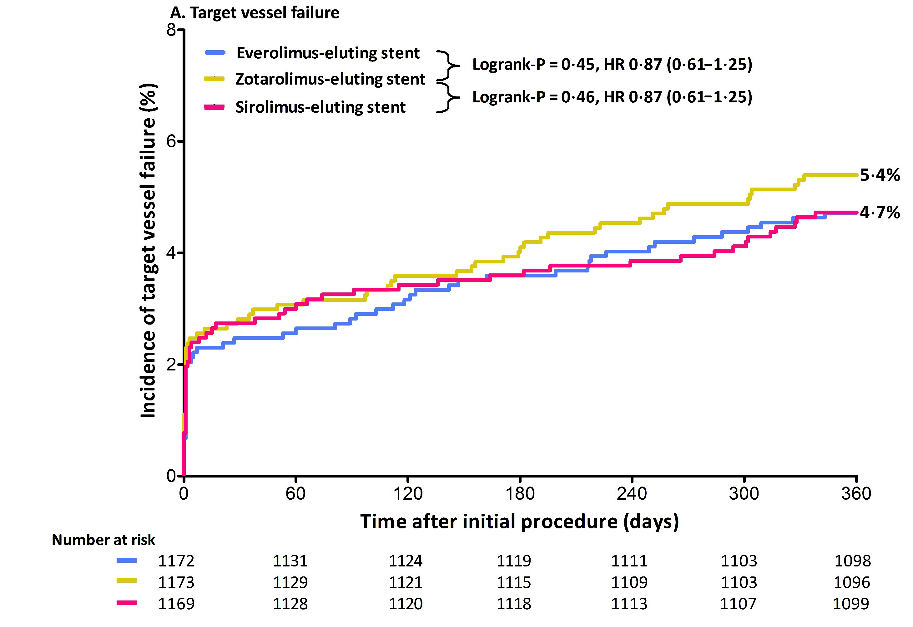
Primary Endpoint Target Vessel Failure at 1-Year Follow-Up
Synergy
Logrank-P = 0.45, HR 0.87 (0.61-1.25)
Resolute Integrity
Orsiro
Logrank-P = 0.46, HR 0.87 (0.61-1.25)
5.4%
4.7%
4.7%
Time after initial procedure (days)
Target Vessel Failure is a composite of cardiac death, target vessel-related MI, or clinically driven target vessel revascularization.
Events displayed in the graph were calculated by Kaplan-Meier methods and compared with the log-rank test.

Slide 19
Primary Endpoint Target Vessel Failure at 1-Year Follow-Up
- 1.0
- 0.5
0
0.5
1.0
1.5
2.0
2.5
3.0
3.5
4.0
4.5 %
Non-inferiority
margin 3.5 %
SYNERGY
4.7 %
RESOLUTE INTEGRITY
5.4 %
ORSIRO
4.7 %
Absolute difference = - 0.7 %
Upper 1-sided 95% CI = 0.8 %
P_{non-inferiority} < 0.0001
Target Vessel Failure is a composite of cardiac death, target vessel-related MI, or clinically driven target vessel revascularization.

Slide 20
Primary Endpoint Target Vessel Failure at 1-Year Follow-Up
Synergy
Logrank-P = 0.45, HR 0.87 (0.61–1.25)
Resolute Integrity
Orsiro
Logrank-P = 0.46, HR 0.87 (0.61–1.25)
5.4%
4.7%
4.7%
Synergy vs. Resolute Integrity: P_{non-inferiority} < 0.0001
Orsiro vs. Resolute Integrity: P_{non-inferiority} < 0.0001
Time after initial procedure (days)
Target Vessel Failure is a composite of cardiac death, target vessel-related MI, or clinically driven target vessel revascularization.
Events displayed in the graph were calculated by Kaplan-Meier methods and compared with the log-rank test.

Slide 21
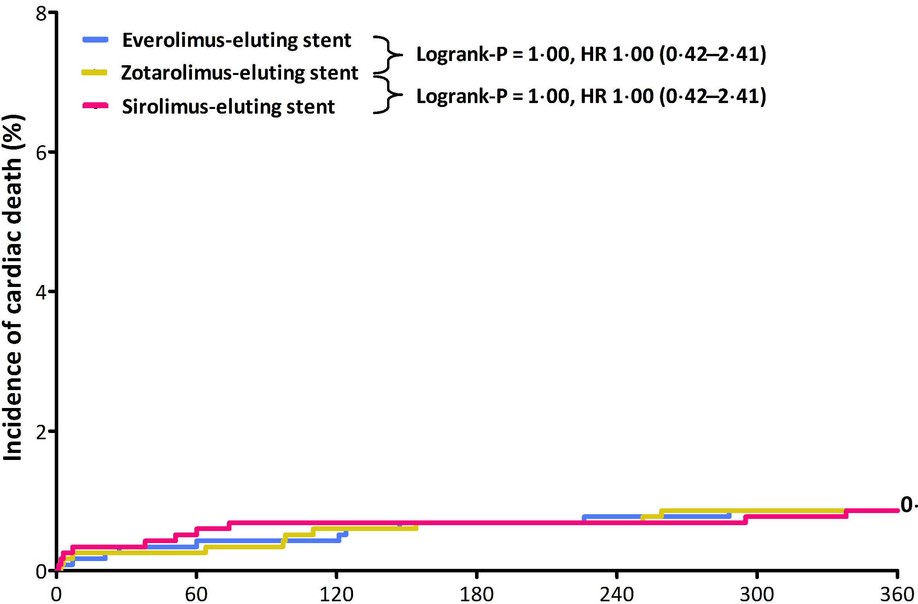
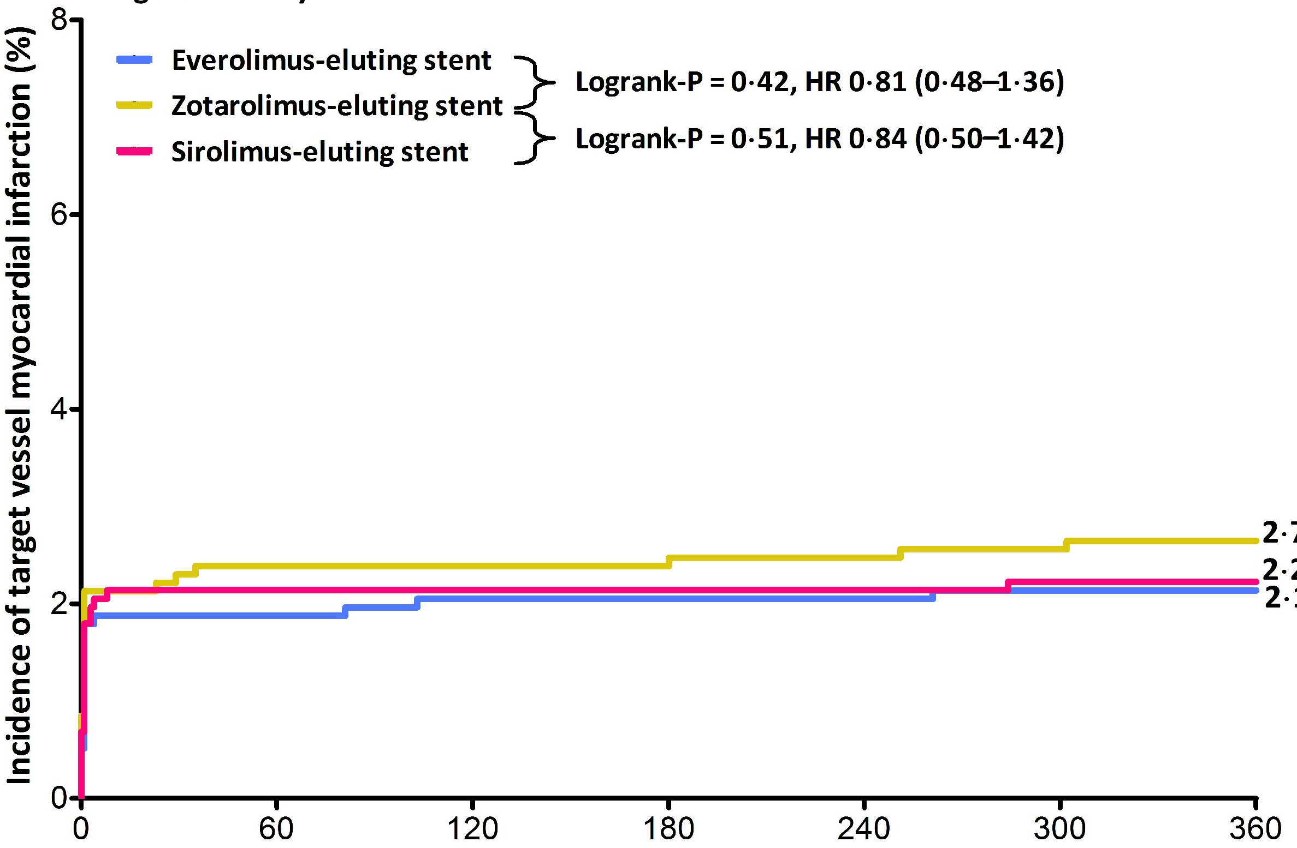
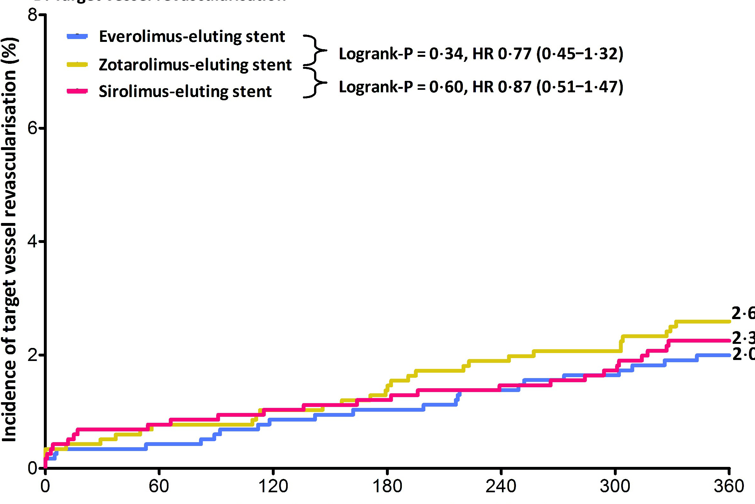
Components of TVF at 1-Year Follow-Up
Cardiac Death
At 1-year follow-up, there was
no statistically significant difference between stent groups in the components of Target Vessel Failure (TVF).
Synergy
Logrank-P = 1.00, HR 1.00 (0.42-2.41)
Resolute Integrity
Logrank-P = 1.00, HR 1.00 (0.42-2.41)
Orsiro
0.9%
Time after initial procedure (days)
TV-related MI
Clinically indicated TVR
Synergy
Logrank-P = 0.42, HR 0.81 (0.48-1.36)
Synergy
Logrank-P = 0.34, HR 0.77 (0.45-1.32)
Resolute Integrity
Logrank-P = 0.51, HR 0.84 (0.50-1.42)
Resolute Integrity
Logrank-P = 0.60, HR 0.87 (0.51-1.47)
Orsiro
Orsiro
2.7%
2.6%
2.2%
2.3%
2.1%
2.0%
Time after initial procedure (days)
Time after initial procedure (days)
Events displayed in the graphs were calculated by Kaplan-Meier methods and compared with the log-rank test.
TV-related MI was defined by the extended historical definition (Vranckx et al. (ARC), EuroIntervention 2010;5:871-4).

Slide 22
Composite Clinical Endpoints At 1-Year Follow-Up
Synergy
7.7%
Resolute Integrity
7.0%
7.5%
Orsiro
5.4%
5.2%
4.7%
4.7%
5.1%
5.1%
4.5%
4.2%
4.0%
P = 0.69
P = 0.55
P = 0.45
P = 0.46
P = 0.85
P = 0.86
P = 0.49
P = 0.84
TLF
TVF
MACE
POCE
Target Lesion Failure (TLF): cardiac death, target lesion-related MI & clinically indicated TLR. Target Vessel Failure (TVF): cardiac death , target vessel related MI & clinically indicated TVR. Major Adverse Cardiac Events (MACE): any death, any MI, clinically indicated TLR & emergent CABG. Patient-Oriented Composite Endpoint (POCE): any death, any MI, any PCI & any CABG.

Slide 23
DAPT Use
Discharge
6-Month
1-Year
97.3 %
87.6 %
85.6 %
10.8 %
10.3 %
2.0 %
DAPT
P2Y12 INH
+ VKA
DAPT
P2Y12 INH
+ VKA
DAPT
P2Y12 INH
+ VKA
n = 3,514 patients
n = 3,456 patients
n = 3,432 patients
Between stent arms, there was no significant difference in medication.
DAPT=dual antiplatelet therapy; P2Y12 INH=P2Y12 inhibitor; VKA=vitamin K antagonist.

Slide 24
Medication at 1-Year
1-Year
88.1 %
85.6 %
54.1 %
42.6 %
12.2 %
10.3 %
ASA
Clopidogrel
Prasugrel or
Ticagrelor
VKA
DAPT
P2Y12 INH
+ VKA
P2Y12 INH
n = 3,432 patients
Between stent arms, there was no significant difference in medication. Data were available of 3432 patients. ASA=acetylsalicylic acid; P2Y12 INH=P2Y12 inhibitor; VKA=vitamin K antagonist; DAPT=dual antiplatelet therapy.

Slide 25
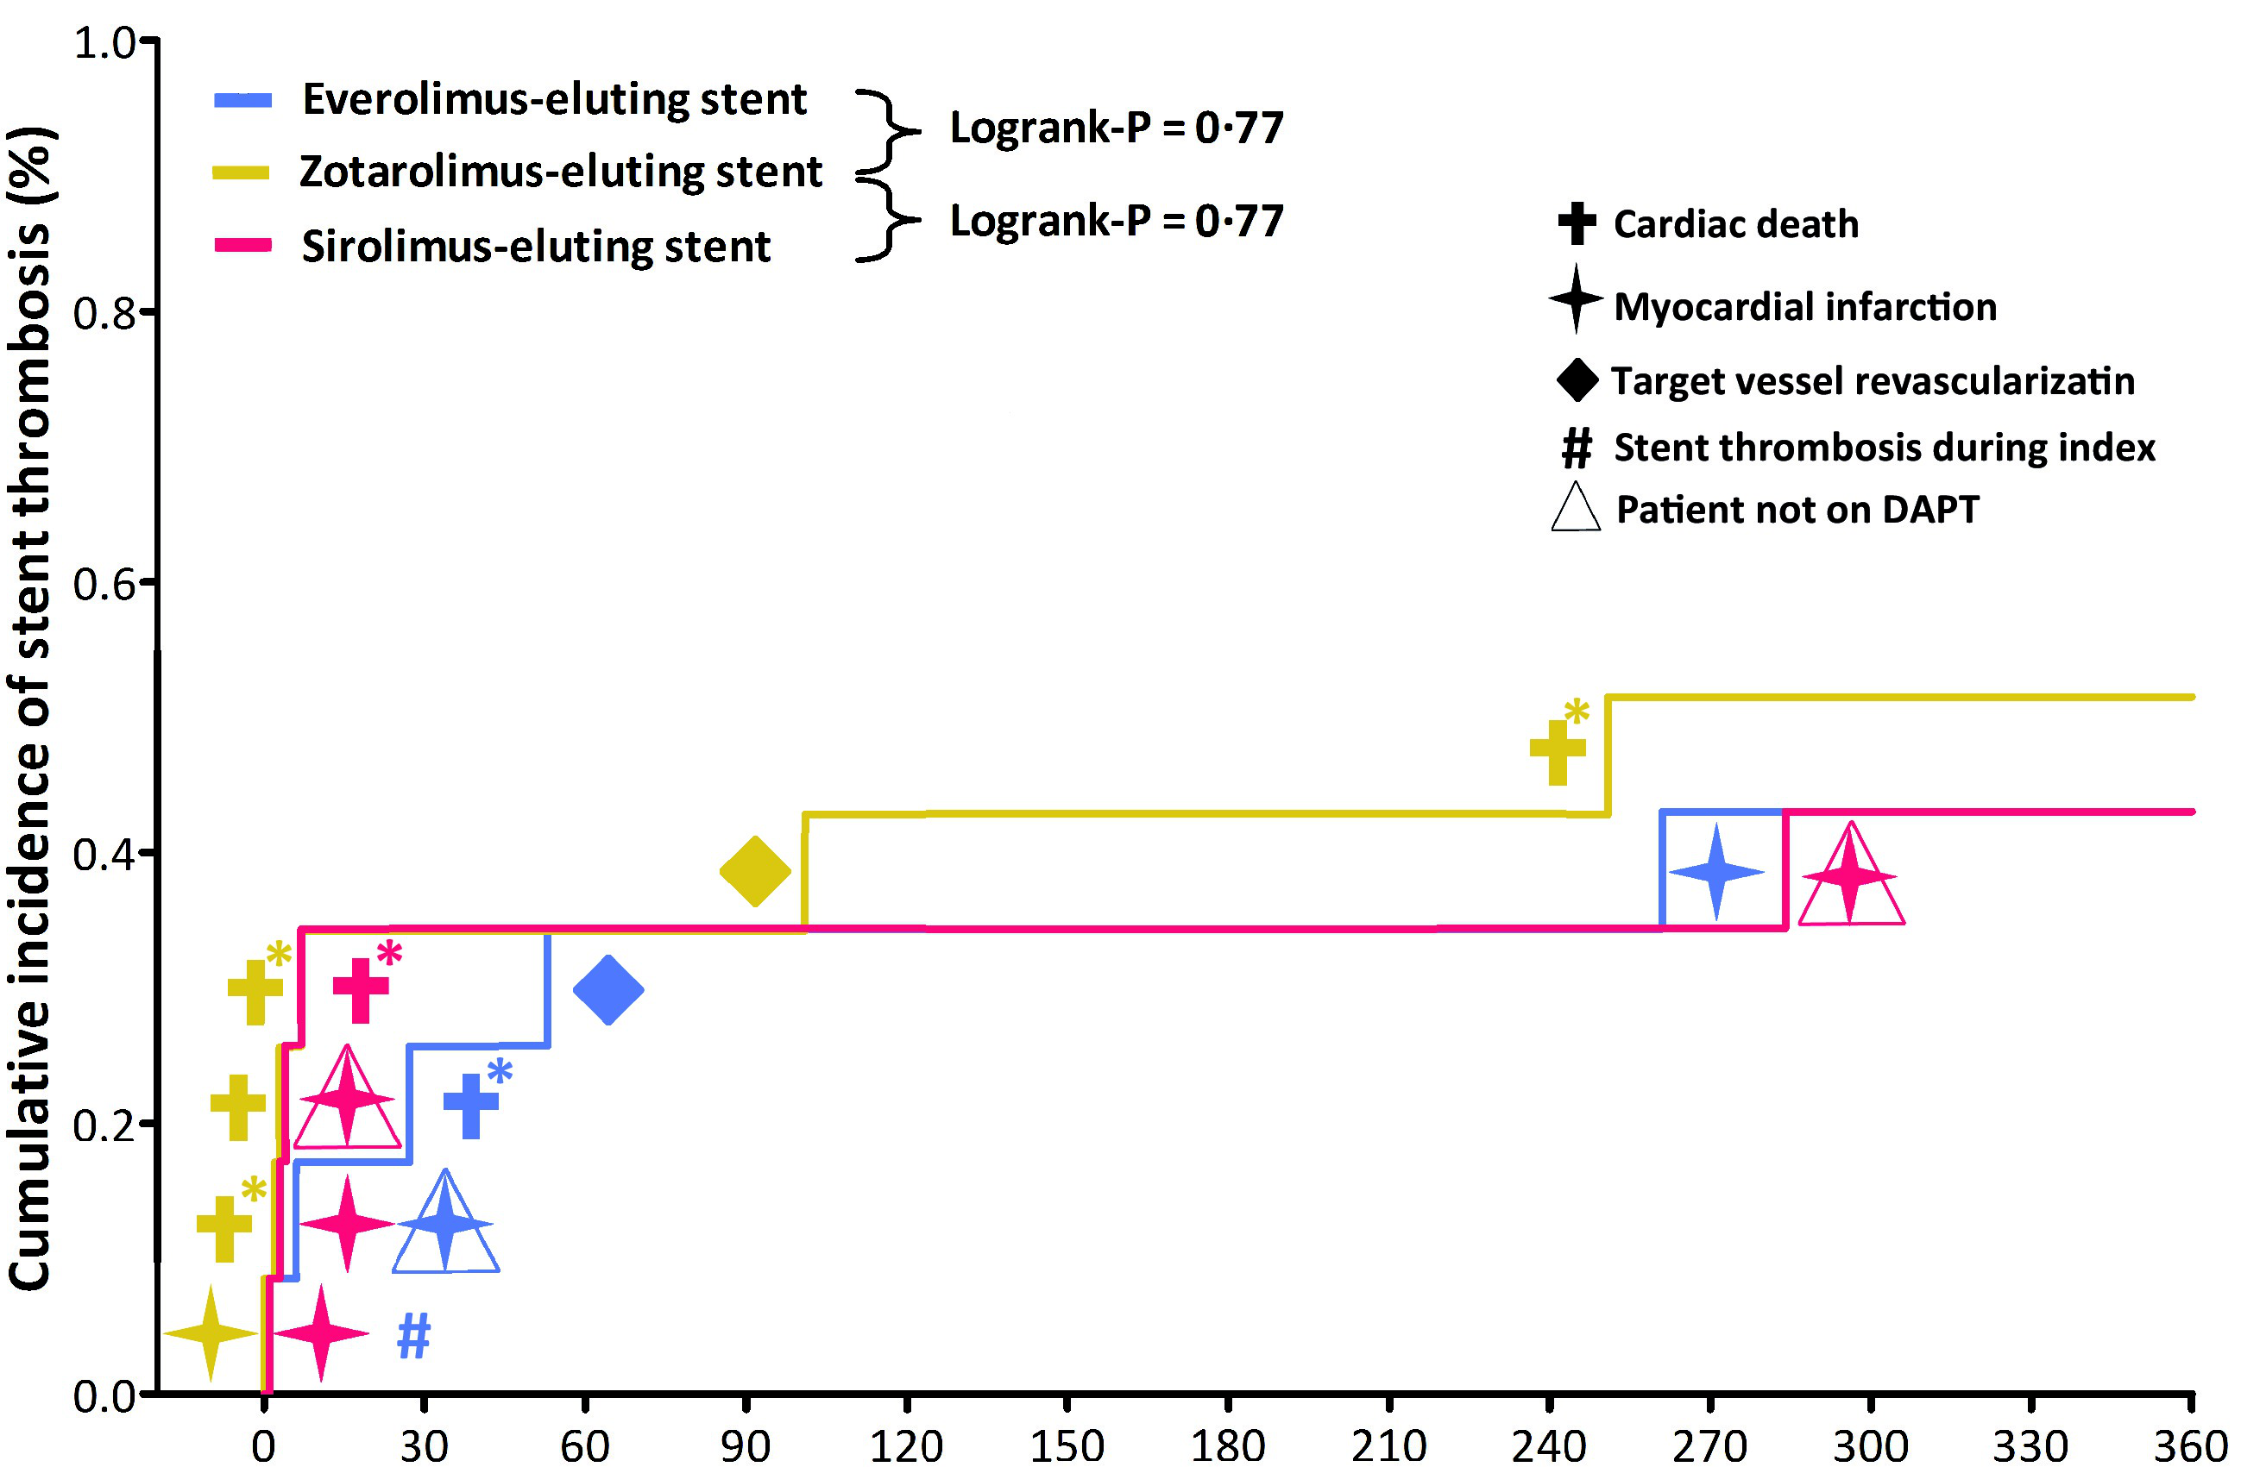
Definite or Probable Stent Thrombosis
Synergy
Logrank-P = 0.77
Cardiac Death
Resolute Integrity
Myocardial Infarction
Orsiro
Logrank-P = 0.77
Target Vessel Revascularization
#
Stent Thrombosis during index
Patient not on DAPT
A (*) signifies probable stent thromboses
(5 fatal events); all other events represent definitive stent thromboses (1 fatal event)
0.5%
0.4%
Definite ST occurred in 4 (0.3%), 3 (0.3%), and 4 (0.3%) pts., respectively (Logrank-P = 0.70, for both main comparisons).
Time after initial procedure (days)
Stent thrombosis (ST) was defined according to the Academic Research Consortium (ARC). DAPT = dual antiplatelet therapy.

Slide 26
TVF Subgroup Analysis at 1-Year
 | Synergy n = 1,172 | Resolute Integrity n = 1,173 | Forestplot | Hazard ration (95% CI) | P
Men | 40/845 (4.7) | 49/848 (5.8) |  | 0.82 (0.54-1.24) | 0.34
RVD < 2.75mm | 33/680 (4.9) | 42/667 (6.3) |  | 0.77 (0.49-1.21) | 0.25
Acute coronary syndrome | 37/816 (4.5) | 39/815 (4.7) |  | 0.97 (0.62-1.53) | 0.90
Multivessel PCI | 12/201 (6.0) | 16/220 (7.3) |  | 0.82 (0.39-1.73) | 0.59
Diabetes | 12/203 (5.9) | 17/210 (8.1) |  | 0.73 (0.35-1.52) | 0.39
Bifurcation lesion | 23/415 (5.5) | 30/409 (7.3) |  | 0.75 (0.43-1.28) | 0.29
Lesion length > 27 mm | 17/353 (4.8) | 30/369 (8.1) |  | 0.58 (0.32-1.06) | 0.07
In-stent restenosis | 2/28 (7.1) | 2/31 (6.5) |  | 1.06 (0.15-7.55) | 1.00
Left main treated | 2/25 (8.0) | 5/28 (17.9) |  | 0.45 (0.09-2.29) | 0.43
Bypass graft treated | 3/18 (16.7) | 2/30 (6.7) |  | 2.61 (0.44-15.66) | 0.35
Renal insufficiency | 2/29 (6.9) | 6/33 (18.2) |  | 0.37 (0.07-1.81) | 0.26
All | 55/1,172 (4.7) | 63/1,173 (5.4) |  | 0.87 (0.61-1.25) | 0.45
RVD=reference vessel diameter. Subgroup analysis was non-prespecified.

Slide 27
TVF Subgroup Analysis at 1-Year
 | Orsiro n = 1,169 | Resolute Integrity n = 1,173 | Forestplot | Hazard ration (95% CI) | P
Men | 38/854 (4.4) | 49/848 (5.8) |  | 0.76 (0.50-1.17) | 0.21
RVD < 2.75mm | 35/731 (4.8) | 42/667 (6.3) |  | 0.76 (0.49-1.19) | 0.22
Acute coronary syndrome | 37/818 (4.5) | 39/815 (4.7) |  | 0.97 (0.62-1.53) | 0.89
Multivessel PCI | 14/219 (6.4) | 16/220 (7.3) |  | 0.87 (0.43-1.79) | 0.72
Diabetes | 12/211 (5.7) | 17/210 (8.1) |  | 0.70 (0.33-1.46) | 0.33
Bifurcation lesion | 25/412 (6.1) | 30/409 (7.3) |  | 0.82 (0.48-1.39) | 0.47
Lesion length > 27 mm | 21/351 (6.0) | 30/369 (8.1) |  | 0.73 (0.42-1.27) | 0.26
In-stent restenosis | 0/30 (0.0) | 2/31 (6.5) |  | - | 0.49
Left main treated | 2/23 (8.7) | 5/28 (17.9) |  | 0.43 (0.08-2.23) | 0.44
Bypass graft treated | 3/22 (13.6) | 2/30 (6.7) |  | 2.08 (0.35-12.46) | 0.64
Renal insufficiency | 4/46 (8.7) | 6/33 (18.2) |  | 0.47 (0.13-1.65) | 0.31
All | 55/1,169 (4.7) | 63/1,173 (5.4) |  | 0.87 (0.61-1.25) | 0.46
RVD=reference vessel diameter. Subgroup analysis was non-prespecified.

Slide 28
Discussion 1/2
BIO-RESORT is the first randomized all-comers trial that assessed the Synergy stent, which is the only biodegradable polymer DES approved by the FDA.
This trial is the first randomized comparison of Synergy and Orsiro stents vs. Resolute Integrity.
BIO-RESORT enrolled the highest proportion of STEMI patients ever included in a randomized DES trial in all-comers.
The proportion of ACS patients is among the highest of all randomized DES trials in all-comers.

Slide 29
Discussion 2/2
The event rates were lower than expected.
Nevertheless, systematic post-procedural assessment of biomarkers, >99% follow-up, external monitoring, and the use of an independent clinical event committee suggest that in BIO-RESORT the risk of underreporting adverse events was low.
Recently, other DES trials also found lower-than-expected event rates which actually may be more representative of outcomes of current PCI, as opposed to when the study was designed.
Potentially relevant points are:
improvements in PCI equipment
more very potent P2Y12 inhibitors used (48% of pts. on-DAPT)
more radial access used (45%)
more FFR used (13%)
high proportion of ACS patients (70%) enrolled who have a lower probability of observing periprocedural MI.

Slide 30
Conclusion
Use of all three drug-eluting stents for the treatment of a complex all-comers population resulted in favorable clinical outcomes.
Very thin strut everolimus-eluting Synergy and sirolimus-eluting Orsiro stents, which have dissimilar biodegradable polymer coatings, were non-inferior to the thin strut durable polymer zotarolimus-eluting Resolute Integrity stent.
The absence of a loss of 1-year safety and efficacy with the use of the novel stents is a prerequisite before assessing potential benefits at longer term follow-up.

Slide 31
BIO-RESORT
Trial Organization
Steering Committee
C. von Birgelen, MD PhD (PI)
P. Danse, MD PhD
M. Hartmann, MD PhD
K. van Houwelingen, MD
J. Louwerenburg, MD
F. de Man, MD PhD
M. Scholte, MD
C. Schotborgh, MD
M. Stoel, MD PhD
Data Management and Follow-up
CRO CardioResearch, Enschede
J. Louwerenburg, MD
G. Linssen, MD PhD
H. Verheij
Monitoring and Organization of
Clinical Event Adjudication
CRO Diagram, Zwolle
R. Dekker
Study Centers and Local PIs
Thoraxcentrum Twente, Enschede
C. von Birgelen, MD PhD
Rijnstate Hospital, Arnhem
P. Danse, MD PhD
Haga Hospital, Den Haag
C. Schotborgh, MD
Albert Schweitzer Hospital, Dordrecht
M. Scholte, MD
Angiographic Analysis
Angiographic Core Lab of
CRO CardioResearch, Enschede
J. Jonge Poerink
I. Valkenburg
R. Wiggers-van der Leest
L. Oldenhof-Janssen
P. Zocca, MD
BIO-RESORT
Data and Safety Monitoring Board
E. Kedhi, MD PhD (chair)
M. Brusse-Keizer, PhD (statistician)
G. Mecozzi, MD (member)
Study Coordination
CRO CardioResearch, Enschede
M. Kok, MD
L. van der Heijden, MD
M. Löwik, PhD
M.K. Lam, MD PhD
H. Sen, MD PhD
K. Tandjung, MD PhD
Statistical Analysis
M. Kok, MD
L. van der Heijden, MD
C. Doggen, PhD (supervisor)
J. van der Palen, PhD (supervisor)
The investigator-initiated randomized BIO-RESORT trial was equally funded by Biotronik, Boston Scientific, and Medtronic.

Slide 32
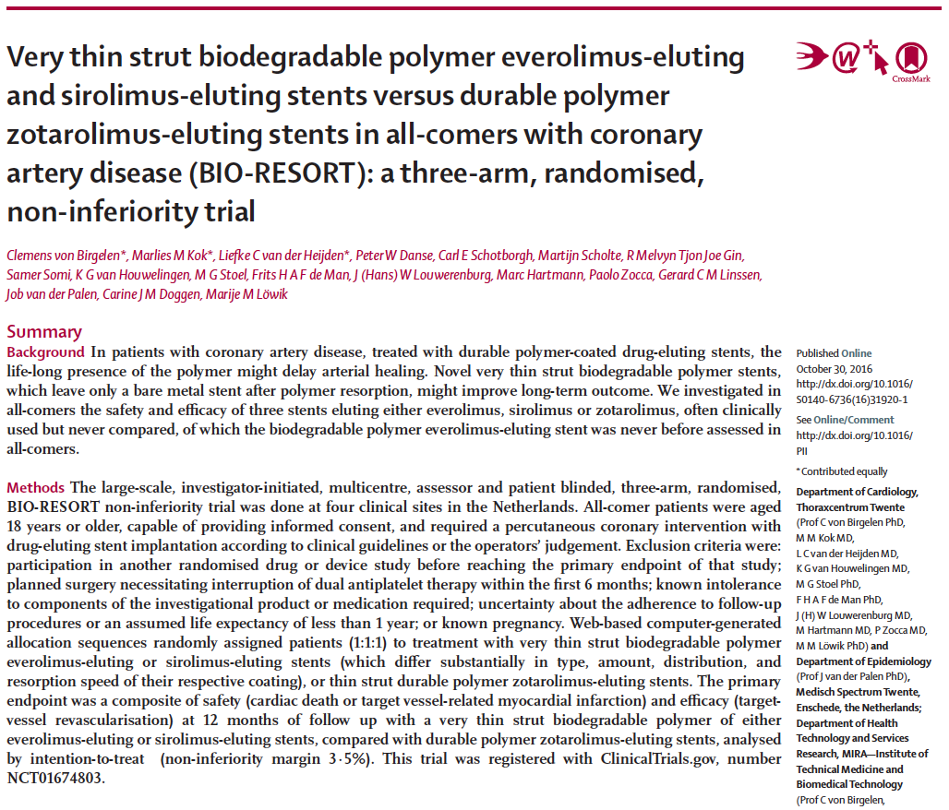
BIO-RESORT (TWENTE III)
BIO-RESORT (TWENTE III)
BIO-RESORT manuscript online available on homepage of The Lancet

