Slide 1



Non-invasive detection of coronary inflammation by computed tomography analysis of peri-coronary fat enhances cardiovascular risk prediction in 3912 individuals
The CRISP-CT study
Evangelos K. Oikonomou¹, Mohamed Marwan², Milind Y. Desai³, Jennifer Mancio¹, Alaa Alashi³, Erica Hutt Centeno³, Cheerag Shirodaria^{4,5}, John Deanfield⁶, Stefan Neubauer¹, Keith M. Channon¹, Stephan Achenbach², Charalambos Antoniades¹
¹Division of Cardiovascular Medicine, Radcliffe Department of Medicine, University of Oxford, UK.
²Department of Cardiology, Friedrich-Alexander-Universität Erlangen-Nürnberg, Erlangen, Germany.
³Cleveland Clinic Heart and Vascular Institute, Cleveland, USA.
⁴Caristo Diagnostics Ltd., Oxford, UK.
⁵Oxford University Hospitals NHS Foundation Trust, Oxford, U.K.
⁶UCL Institute of Cardiovascular Science, London, UK.

Slide 2
Declaration of interest
- Consulting/Royalties/Owner/ Stockholder of a healthcare company (Founder, shareholder and Chief Scientific Officer of Caristo Diagnostics)
• •
ESC Congress
Munich 2018 •

Slide 3
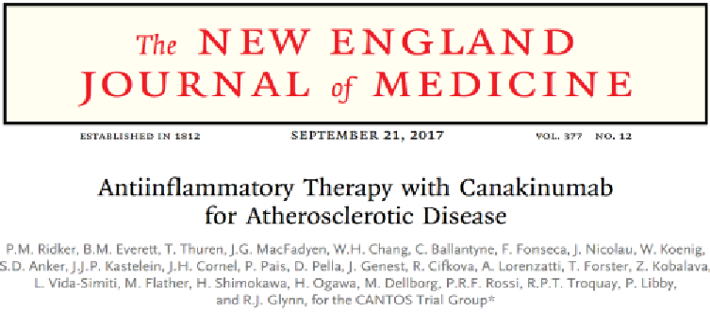
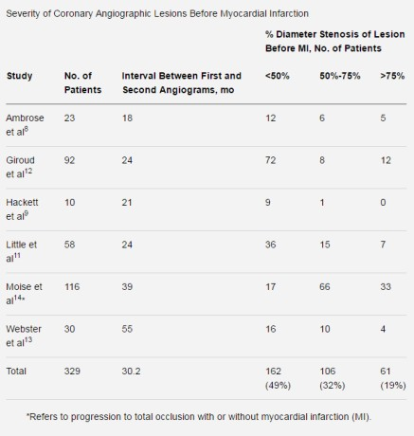





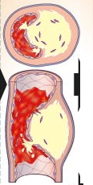
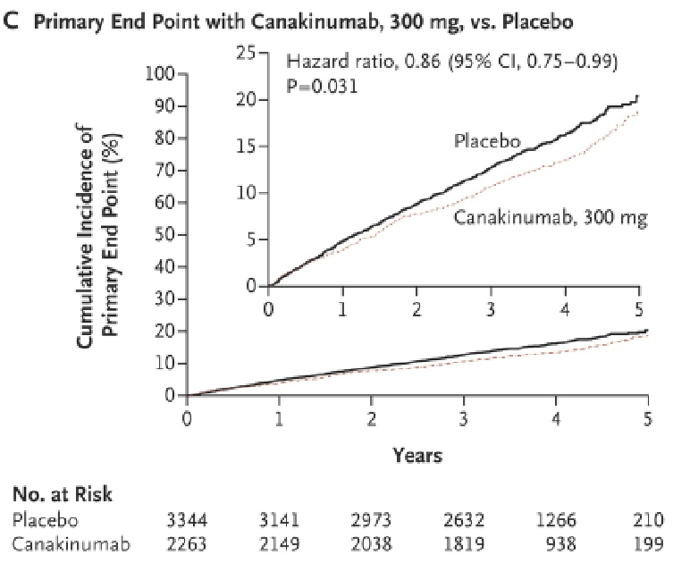

Residual cardiovascular risk: the unmet need
Normal Artery
Narrowed Artery
Blocked Artery
INFLAMMATION
Symptoms
Time
Fishbein et al. Circulation. 1996;94:2662-2666

Slide 4
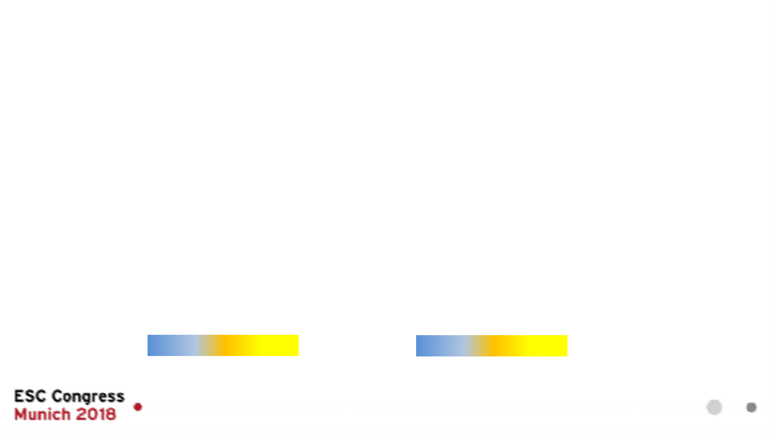
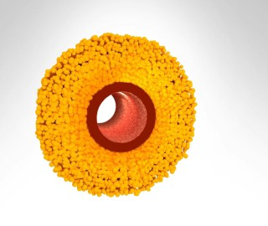
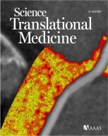

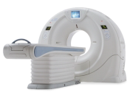
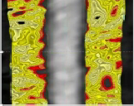
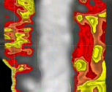

Perivascular Fat Attenuation Index (FAI): Technology detecting coronary inflammation on CCTA
Healthy, non-inflamed artery “Healthy,” inflamed artery
↓ Adipogenesis
↑Lipolysis
↑Oedema
Low FAI
High FAI
Water Fat Water Fat
Healthy
Heart “inflamed”
Antonopoulos A et al. Science Translational Medicine 2017

Slide 5
Can FAI predict cardiovascular risk?

Slide 6


The CRISP-CT study
S Achenbach
M Desai
Oikonomou E et al; Lancet 2018 (in press)

Slide 7
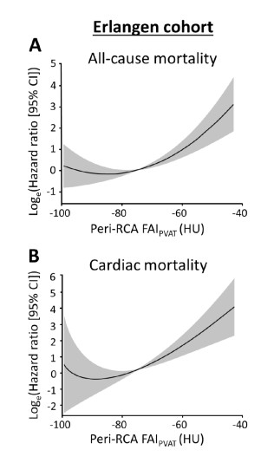
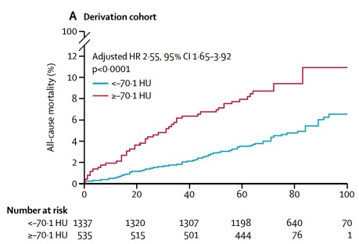
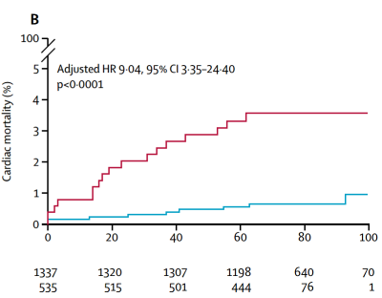

FAI has prognostic value for cardiac death
Oikonomou E et al; Lancet 2018 (in press)

Slide 8

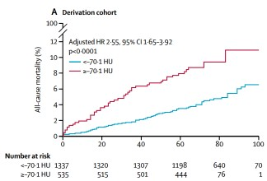
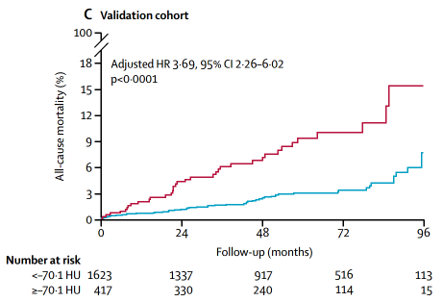
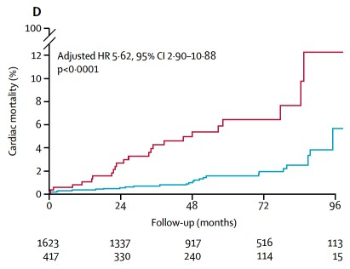

FAI has prognostic value for cardiac death
Oikonomou E et al; Lancet 2018 (in press)

Slide 9
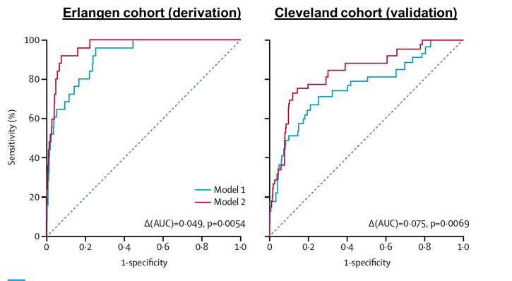
FAI improves prediction of cardiac death over and above current state-of-the-art
Model 1: age, sex, hypertension, hypercholesterolaemia, diabetes mellitus, smoker status, epicardial fat volume, modified Duke CAD index and number of high-risk plaque features on CCTA.
Model 2: Model 1 + FAI
Areas under the curve:
Derivation: 0·913 (95% CI 0·867–0·958) to 0·962 (0·940–0·983), P=0.0054
Validation: 0·763 (95% CI 0·669–0·858) to 0·838 (0·764–0·912), P=0.0069
Oikonomou E et al; Lancet 2018 (in press)

Slide 10
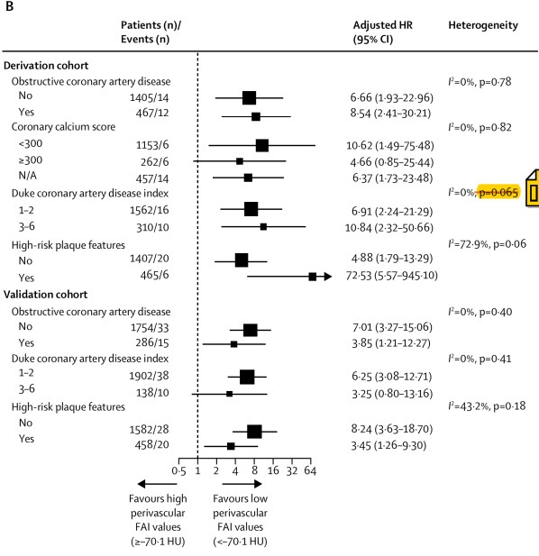
FAI predicts cardiac mortality across all risk groups
Erlangen cohort
(derivation)
p=0.65
Cleveland cohort
(derivation)
Oikonomou E et al; Lancet 2018 (in press)

Slide 11
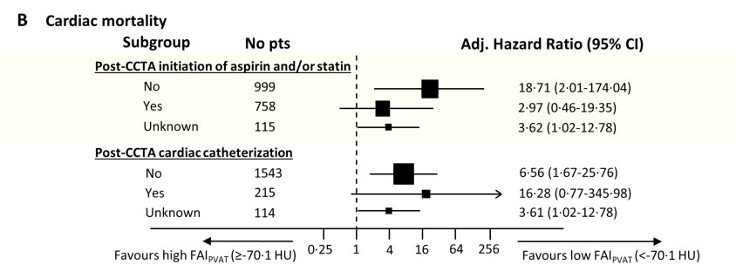
The risk identified by FAI may be modifiable by statins/aspirin
Cardiac mortality prediction in Erlangen cohort, after treatment initiation
Risk for both groups together: Adjusted HR 9.04[3.35-24.4]
Oikonomou E et al; Lancet 2018 (in press)

Slide 12
FAI: A powerful, novel technology for CV risk stratification
Biology/Science: FAI detects coronary inflammation by phenotyping perivascular fat attenuation changes in CCTA
Clinical value: FAI has a striking prognostic value for cardiac death and non-fatal AMI, over and above current risk scores and state-of-the-art interpretation of CCTA (risk modifiable?)
Potential to use in clinical practice: The FAI technology is applicable to any standard CCTA, from any scanner and with any scan settings (with appropriate weighting)
Pitfalls: FAI needs appropriate corrections for obesity, scanner type, scan settings and other technical and biological factors, so crude measurement of “mean perivascular attenuation” is of limited value in clinical practice. Consistent and validated image analysis tools will allow quality-assured delivery of FAI technology for patient benefit.

Slide 13




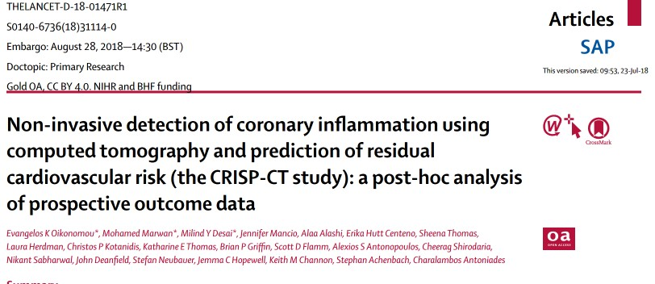
Acknowledgments
E-mail: Charalambos.antoniades@cardiov.ox.ac.uk
THE LANCET: Released 28/8/18, 14:30 BST

Slide 14
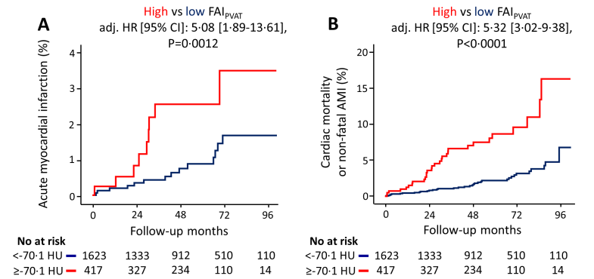
FAI predicts non-fatal myocardial infarction
Oikonomou E et al; Lancet 2018 (in press)

Slide 15
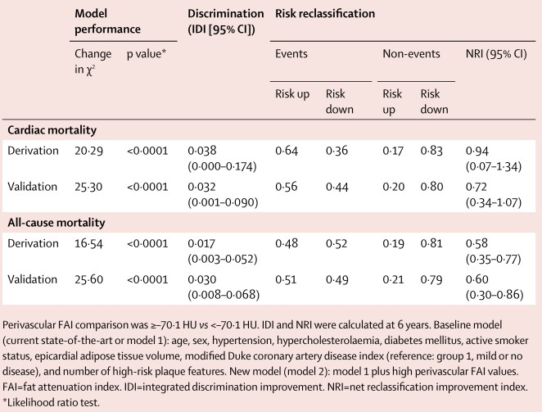
FAI leads to significant risk reclassification
Oikonomou E et al; Lancet 2018 (in press)

