Slide 1





Impact of regionalization of ST elevation myocardial infarction care on treatment times and outcomes for emergency medical services transported patients presenting to hospitals with percutaneous coronary intervention
James G. Jollis, MD
Duke University, Durham North Carolina and
The University of North Carolina at Chapel Hill
Akeem Ranmal
--------------------------------------------
EMBARGO lifts Tues., Nov.14, 3:45 p.m. PT
EMBARGO lifts Tues., Nov.14, 3:45 p.m. PT

Slide 2
Introduction
▪ There is significant variability across the United States in the timely reperfusion and mortality of patients with ST-segment elevation myocardial infarction (STEMI).
▪ Most of this variation is related to differences in the organization and delivery of emergency cardiovascular care.

Slide 3
Introduction
Building on the Accelerator-1 Project, we hypothesized that time to reperfusion could be further reduced with the addition of full-time regional coordinators supported by the study and ongoing engagement of national faculty mentorship.

Slide 4
Objective
To increase the rate of timely coronary reperfusion by organizing coordinated STEMI care on a regional basis.

Slide 5












Study
Design
Recruitment of 12 Metropolitan Statistical Regions
2015 Q2 – 2016 Q1
Goal:
Increase the
% patients reaching guideline goals
Gap Analyses - Strategic Planning - Regional Leadership Meetings
2015 Q2 – 2015 Q3
Regional Education Intervention
2015 Q2 – 2016 Q1
Focus on pre-hospital activation and common regional plans for reperfusion
12 Regions Met Study Requirements Quarterly data review, ongoing mentorship, establish and execute protocols
STUDY REQUIREMENTS
Regional Leadership Common Protocols
Hospital participation in ARG Enter all consecutive STEMI patients during the study period
21,160 STEMI Patients with Symptoms <12 Hours April 2015 – March 2017
10,730 STEMI Patients Presented by EMS Ambulance Directly to Primary PCI Hospitals
April 2015 – March 2017

Slide 6
Study Sponsored Through
Research and Educational Grants by:
AstraZeneca
The Medicines Company

Slide 7
Organization: Duke Clinical Research Institute in Collaboration with The American Heart Association
Regional Leadership*
AHA National and Affiliate Leadership Lori Hollowell
Zainab Magdon-Ismail
ReAnne Archangel Loni Denne
Ron Loomis
Molly Perini Alex Kuhn
12 US Metropolitan Regions 139 Primary PCI Hospitals*
971 EMS Agencies
Study Coordinating Center
DCRI
Central Organizing Committee
James G. Jollis, MD Christopher B. Granger, MD Mayme Lou Roettig, RN, MSN
Michele Bolles, American Heart Association
DCRI Project Team & Statistics
Lisa Monk, MSN, RN Hussein Al-Khalidi, PhD Shannon Doerfler, PhD Jay Shavadia, MD
Ajar Kochar, MD
Matthew Cantania, JD

Slide 8

Regional
Leadership
REGIONS
REGIONAL LEADERSHIP
AFFILIATION
AHA LEADERSHIP
Albany, NY
Edward Philbin, MD Michael Dailey, MD
Albany Medical Center
Meghan Carnowski Tatum Weishaupt Christine Rutan Zainab Magdon-Ismail
Cincinnati, OH
(including northern Kentucky)
Timothy Smith, MD David Kong, MD
University of Cincinnati The Christ Hospital
Jeffrey Gaylor
Alex Kuhn
Blue text indicates Regional Coordinator.
Denver and Colorado State Expansion
Jeb Burchenal, MD Fred Severyn, MD
South Denver Cardiology University of CO Health System
Cathleen Williams Julie Blakie
Loni Denne
Hartford, CT
(including all Connecticut expansion)
Richard Kamin, MD
C. Steven Wolf, MD
John Dempsey Hospital/UCONN Health Center Saint Francis Hospital & Medical Center
Alana Davis
Lisa Bemben
Zainab Magdon-Ismail
Houston, TX
James McCarthy, MD Todd Caliva
Catherine Bissell & Darryl Pile
Memorial Hermann Texas Medical Center West Houston Medical Center
SouthEast Texas Regional Advisory Council
Larry Brown Kate Ramos Loni Denne
Las Vegas, Clarke County, NV
Sean Ameli, MD Christian Young, MD
Ameli Heart Center
Southern Nevada Health District Department of Emergency Medicine
Aaron Leesch
Ron Loomis
Rea Anne Arcangel
Lexington, KY
(including all Eastern Kentucky)
Khaled M Ziada, MD Julia Martin, MD
University of Kentucky Kentucky EMS Medical Advisor
Bud Cook
Alex Kuhn
Little Rock, Central AK
Mack Hutchison Aravind Rao, MD
MEMS
CHI St Vincent/Heart Clinic Arkansas Metropolitan
Vicki Meyer Cammie Marti Loni Denne
New York City, NY
Jacqueline Tamis Holland, MD Norma Keller, MD
Glenn Asaeda, MD
Mount Sinai St. Luke's
NYC Health + Hospitals/Bellevue New York Fire Department
Sheree Murphy
Molly Perini
Zainab Magdon-Ismail
Portland, OR
Sandra Lewis, MD Saurabh Gupta, MD Jonathan Jui, MD Mohamud Daya, MD
Legacy Health
Oregon Health & Science University (OSHU) OSHU, Multnomah County EMS
OHSU, Tualatin Valley Fire & Rescue, Forest Grove Fire & Rescue, Banks Fire District 12, Washington County
Amber Hoover
Ron Loomis
Rea Anne Arcangel
Seattle-Tacoma, WA
Tom Rea, MD Michael Sayre, MD
Mickey Eisenberg, MD
University of Washington (UW) UW
UW
Jamie Emert Elizabeth Peterson Rea Anne Arcangel
Tidewater
(Including Norfolk and Virginia City, Virginia)
Monica Reed Sherwood Moore Shannon Ferguson Nelle Linz, MD
Bon Secours Heart & Vascular Chesapeake Regional Med Center Sentara
Naval Medical Center Portsmouth
Paula Feather
John Dugan

Slide 9
Organization
National Faculty
PHYSICIAN FACULTY
Peter Berger, MD—Interventional Cardiologist New York City, New York
Christopher Fordyce, MD—Cardiologist
University of British Columbia, Vancouver, BC, Canada
Lee Garvey, MD—Emergency Medicine Carolinas Medical Center, Charlotte, NC
Christopher B. Granger, MD—Cardiologist Duke University Medical Center, Durham, NC
Timothy D. Henry, MD—Interventional Cardiology Cedar Sinai Heart Institute, Los Angeles, CA
James G. Jollis, MD—Cardiologist
University of North Carolina, Rex Hospital, Raleigh, NC
Peter O’Brien, MD—Interventional Cardiology
Centra Lynchburg General Hospital, Lynchburg, VA
B. Hadley Wilson, MD—Interventional Cardiology Carolinas Medical Center, Charlotte, NC
IMPLEMENTATION FACULTY
Claire Corbett, MS, EMT-P
New Hanover Regional Medical Center, Wilmington, NC
Lisa Monk, RN, MSN
Duke Clinical Research Institute, Durham, NC
Mayme Lou Roettig, RN, MSN
Duke Clinical Research Institute, Durham, NC

Slide 10

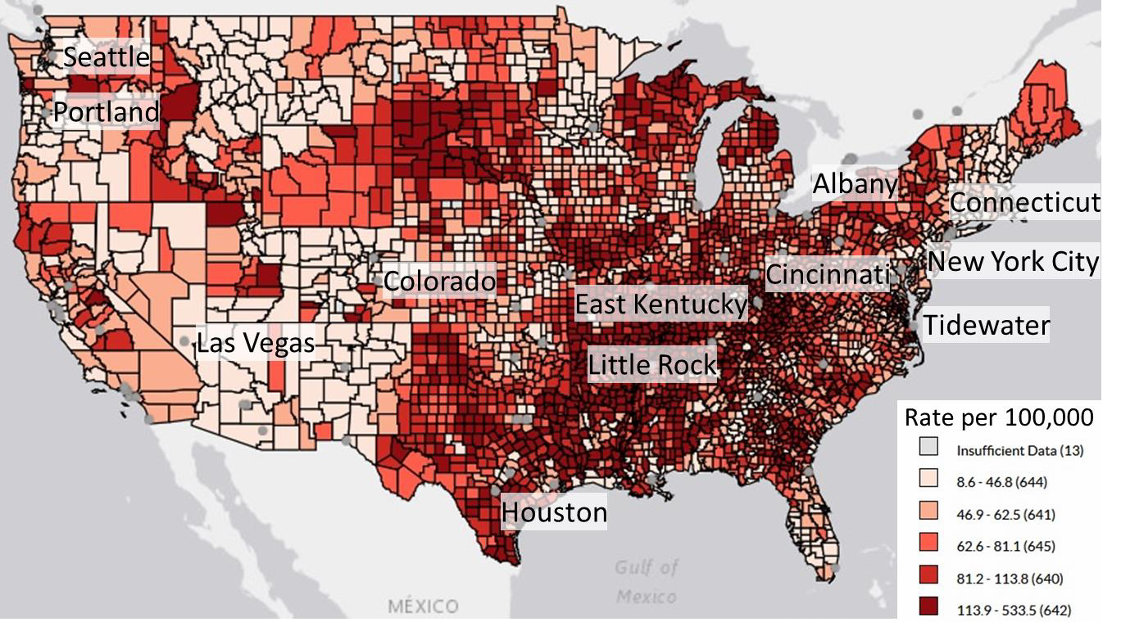
ACCELERATOR-2 Regions
Acute MI Deaths per 100,000, 35+, 2013–2015
Interactive Atlas of Heart Disease and Stroke, Department of Health and Human Services, Centers for Disease Control and Prevention; Atlanta, GA:2017
Cited 15 October 2017
https://nccd.cdc.gov/DHDSPAtlas/?state=County&ol=[10]

Slide 11

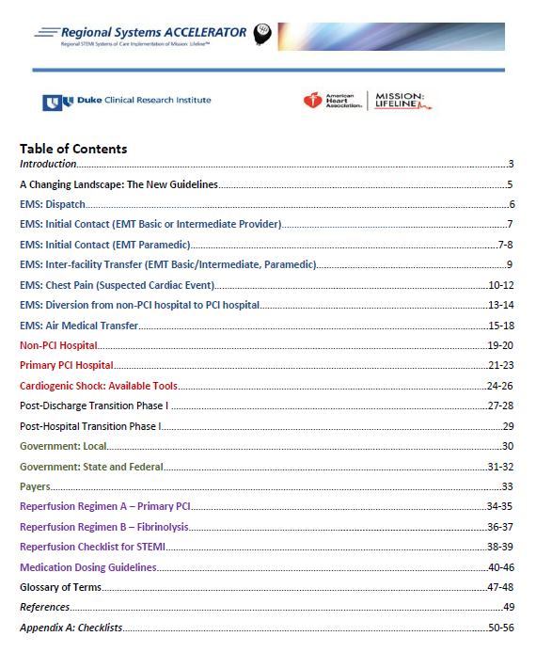
Operations
Manual
Optimal system specifications
by point of care
▪ EMS
▪ Non-PCI and PCI ED
▪ Transfer
▪ Catheterization lab
▪ Other system issues—payers, regulations
▪ Choice of PCI or lytic reperfusion regimens
https://duke.box.com/s/ks6ipcc262illo8jyethbst8bblqybcj

Slide 12
Baseline Patient Characteristics by Arrival
2015 Q2 – 2017 Q1 (all study quarters)
 | All EMS | Baseline | Final | P baseline vs. final
Number | 6,695 | 974 | 972
Age (median) | 61 | 61 | 61 | NS
Female | 27% | 29% | 26% | NS
No insurance | 9.6% | 9.1% | 9.1% | NS

Slide 13
Baseline Patient Characteristics by Arrival
 | All EMS | Baseline | Final | P baseline vs. final
Diabetes | 24% | 26% | 25% | NS
On presentation:
Cardiac arrest | 6% | 6% | 5% | NS
Shock | 6% | 6% | 6% | NS

Slide 14
Baseline Patient Characteristics by Arrival
 | All EMS | Baseline | Final | P baseline vs. final
Symptom onset to FMC (median min.) | 49 | 50 | 50 | NS
Systolic BP | 137 | 139 | 138 | NS
PCI | 100% | 100% | 100% | NS

Slide 15
In-hospital Mortality by First Medical Contact
to Catheterization Laboratory Activation Time
P<0.0001
5%
5%
4%
4%
3%
3%
2%
2%
1%
1%
0%
In-hospital mortality
4.5%
 |  |  | N=3,145
 | N=2,710
2.2%
≤ 20 minutes
> 20 minutes

Slide 16


Treatment Times
First Medical Contact to Lab Activation
100%
38%
22%
> 30 minutes
80%
22%
60%
≤ 30 minutes,
> 20 minutes
24%
40%
56%
20%
38%
Faster, better
≤ 20 minutes
P<0.00
1
0
0%
Baseline
Final

Slide 17
Treatment Times
First Medical Contact to Lab Activation
Emergency Department Dwell Time
100%
38%
22%
42%
33%
> 30 minutes
80%
22%
60%
≤ 30 minutes,
> 20 minutes
24%
24%
25%
40%
56%
20%
38%
33%
43%
Faster, better
≤ 20 minutes
P<0.00
1
P<0.00
01
0
0%
Baseline
Final
Baseline
Final

Slide 18

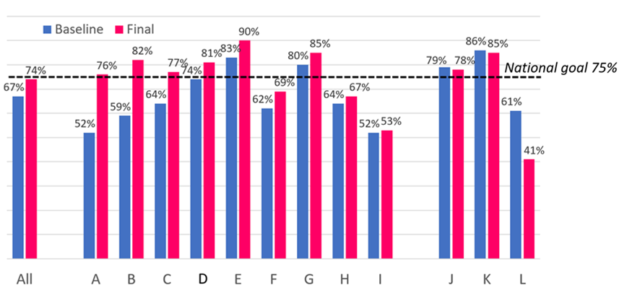
Treatment Times
First medical contact to device ≤90 minutes by region, baseline and final quarters, sorted by descending order of changes
First medical contact to device
≤90 minutes
74%
67%
Positive change
Neutral or Negative change
ALL
P<0.002
Region letter code

Slide 19
In-hospital Outcomes
Baseline vs Final
 | All EMS | Baseline | Final | P baseline vs. final
Major bleeding | 3.5% | 3.4% | 4.2% | NS
Stroke | 0.7% | 0.8% | 0.3% | NS
Cardiogenic shock | 7.4% | 7.7% | 7.6% | NS
Congestive heart failure | 5.7% | 7.4% | 5.0% | 0.03
In-hospital death | 3.4% | 4.4% | 2.3% | 0.008

Slide 20
In-hospital Mortality
Not in Accelerator-2
N=22,651; P=0.7*
In-hospital mortality
5%
4%
3%
Accelerator-2
N=6,695; P=0.019*
2%
1%
0%
Q4 2015 Q1 2016
Q2 2016
Q3 2016 Q4 2016
Q1 2017
*Adjusted P-value for trend
Mission: Lifeline Participating U.S. Hospitals

Slide 21

Conclusions
Organization of care among EMS and hospitals in 12 regions was associated with statistically and clinically significant reductions in time to reperfusion in patients with STEMI.

Slide 22
Conclusions
The relative success of this intervention compared to prior work is likely related to ongoing support by neutral mentors and full time regional coordinators.

Slide 23
Conclusions
This enhanced organization corresponded with statistically significant reductions in morbidity and mortality among patients with STEMI,
and the reduction in mortality appeared independent of temporal trends among other hospitals participating in Mission: Lifeline during the same time period.

Slide 24
Conclusions
The relatively modest improvements in treatment time compared to marked declines in mortality suggests that other factors related to regional organization possibly contributed to better outcomes.

Slide 25
Conclusions
This generalizable model of emergency cardiovascular care including regional protocols, measurement and feedback in a single common national registry, and ongoing support by regional coordinators has the potential to optimize treatment and outcomes of STEMI patients if broadly applied.

