Slide 1
PADN-5 Trial
PADN-5
Pulmonary artery denervation significantly increases 6-minute walk distance for patients with CpcPH: The PADN-5 Study
Shao-Liang Chen, MD
Hang Zhang, Juan Zhang, Mengxuan Chen, Dujiang Xie, Jing Kan, Wande Yu, Xiaobo Li, Tian Xu, Yue Gu, Jianzeng Dong, Hong Gu, Yaling Han
NCT02220335

Slide 2
Disclosure Statement of Financial Interest
I, (Shao-Liang Chen) DO NOT have a financial interest or arrangement or affiliation with one or more organizations that could be perceived as a real or apparent conflict of interest in the context of the subject of this presentation.

Slide 3
Background (1)
► The backward transmission of increased LV filling pressure results in elevated pulmonary venous pressure (IpcPH)
► Long lasting of IpcPH leads to combined pre- and post- capillary pulmonary hypertension (CpcPH, 12%-13%)
► Medications targeting PAH are not recommended for CpcPH
►Pulmonary artery denervation (PADN) has never been studied for CpcPH in a randomized study using sham-control
CpcPH was defined as mPAP≥25mmHg, PCWP>15mmHg, PVR>3WU

Slide 4
Study design
865 HF patients with recent worsening of HF
Stabilizing for ≥3 days
387 patients had a sPAP ≥ 45 mmHg by cardiac echo
112 patients were defined as CpcPH by RHC
10 did not consent
2 died
R=1:1
2 repat randomization
Sham group (n=50):
Anti-HF, sildenafil, sham-PADN
PADN group (n=48):
Anti-HF, PADN
Sildenafil dosage: (20 mg, tid x 1-week; 40 mg, tid x 6 months)

Slide 5
Endpoints
Endpoints | R | G
Primary endpoint: 6-minute walk distance | 6 months | Superiority
Secondary endpoint: PVR by RHC Clinical worsening | 6 months 6 months | - -
Safety endpoint: Suspected/fatal PE | 6 months | -

Slide 6
Baseline Data (i)
Sildenafil n = 50 |  | PADN n = 48 | P Value
Age (yrs) | 63.0±12.3 | 63.7±11.8 | 0.77
Ischemia cardiomyopathy, n (%) Hypertrophic cardiomyopathy*, n (%) Hypertension, n (%) Diabetes, n (%) HF duration, yrs, median(range) HFpEF#, n (%) HFrEF, n (%) | 8(16.0) 3(6.0) 33(66.0) 13(26.0) 3(1-12.0) 19(38.0) 31(62.0) | 5(10.4) 3(6.3) 28(56.0) 12(25.5) 2.5(1.2-12.1) 19(39.5) 29(60.5) | 0.55 1.0 0.28 0.61 0.83 0.83 0.80
* After PTSMA; # defined as LVEF≥50%

Slide 7
Baseline Data (ii)
Sildenafil n = 50 |  | PADN n = 48 | P Value
PH duration, yrs, median (range) | 1.0(0.4-9.8) | 0.85(0.3-9.5) | 0.82
Medications prior-to recruitment, n(%) |  | 33 (68.8) | 0.35
-β-adrenergic receptor blocker | 38 (76.0)
-Nitrates | 5 (10.0) | 4 (8.3) | 1.0
-Diuretics | 42 (84.0) | 43 (89.6) | 0.55
-Digoxin | 24 (48.0) | 17 (35.4) | 0.23
-ACEI or ARB | 34 (68.0) | 31 (64.6) | 0.85
NYHA class III/IV | 48 (96.0) | 46 (95.8) | 0.67

Slide 8
Echocardiographic Data
 |  | Sildenafil group |  | PADN group |  | P
 |  | Baseline | 6-month | Baseline | 6-month
sPAP, mmHg |  | 57.7±7.7 | 58.3±7.0 | 58.3±7.9 | 52.2±7.5 | 0.017
LAd, mm |  | 53.1±9.3 | 55.4±9.8 | 52.6±9.2 | 50.5±9.6 | 0.004
LVDd, mm |  | 59.8±12.3 | 60.7±12.3 | 58.4±13.1 | 57.1±13.0 | 0.019
LVEF, % |  | 44.5±16.5 | 42.3±15.7 | 43.2±15.4 | 47.9±14.3 | 0.050
 | Increase, % | No | -4.8 | No | +10.4 | 0.031
E/E’ ratio |  | 17.7±6.8 | 17.9±6.0 | 18.0±7.3 | 10.6±3.17 | 0.011
TAPSE, mm |  | 15.3±4.9 | 15.1±2.7 | 15.8±3.6 | 19.7±2.8 | 0.017
RV Tei, % |  | 0.44±0.12 | 0.45±0.10 | 0.49±0.17 | 0.38±0.11 | 0.016
RAd, mm |  | 60.4±12.4 | 59.6±10.7 | 59.7±13.5 | 58.2±11.2 | 0.561

Slide 9
Hemodynamic Data via RHC
 | Sildenafil |  | PADN group |  |  | P value
 | Baseline | 6-month | Baseline |  | 6-month
RAP, mmHg | 13.8±5.6 | 13.1±4.1 | 13.8±7.3 |  | 11.0±5.1 | 0.189
sPAP, mmHg | 56.5±15.2 | 52.4±11.3 | 58.7±19.5 |  | 44.6±19.2 | <0.001
mPAP, mmHg | 36.9±10.8 | 34.4±7.9 | 38.8±10.6 |  | 28.6±6.5 | 0.037
CO, L/min | 2.56±0.74 | 2.51±0.72 | 2.61±0.76 |  | 3.09±0.81 | 0.017
CI, L/min/m² | 1.67±0.79 | 1.72±0.64 | 1.72±0.84 |  | 2.52±0.70 | 0.035
PVR, WU | 6.25±3.23 | 6.09±2.94 | 6.38±3.19 |  | 4.18±1.51 | 0.001
PCWP, mmHg | 20.9±5.58 | 19.1±6.1 | 22.2±6.6 |  | 16.1±6.2 | 0.041
PAC, ml/mmHg | 1.96±0.65 | 1.95±0.86 | 1.92±0.86 |  | 3.9±0.96 | <0.001

Slide 10
Median= 342.5 m Range=153-543m
Mean (SD) = 344.3 (86.2) m
Median= 360 m Range = 120-620 m
Mean (SD)= 350.9 (105.9) m
P= 0.731

Slide 11
c
Median = 358 m
Range= 150-552 m vs.
Range= 136-690 m
600
ase : ase : | 17. +4.
500
All p<0.001
400
300
Net incre
% incre
5 (-138-+139) m
vs. 80 (-127-+396) m
200
9 % (quartile=11.3%) vs. 21.4 % (quartile=38.8%)
Mean (SD)= 359.4 (93.3) m vs. Mean (SD)= 434.6 (107.6) m
100

Slide 12
Conclusions
. PADN-5 trial demonstrates the benefits of PADN for patients with CpcPH
. HFpEF and HFrEF equally benefit from PADN
. No sign showing the harm of sildenafil to CpcPH

Slide 13
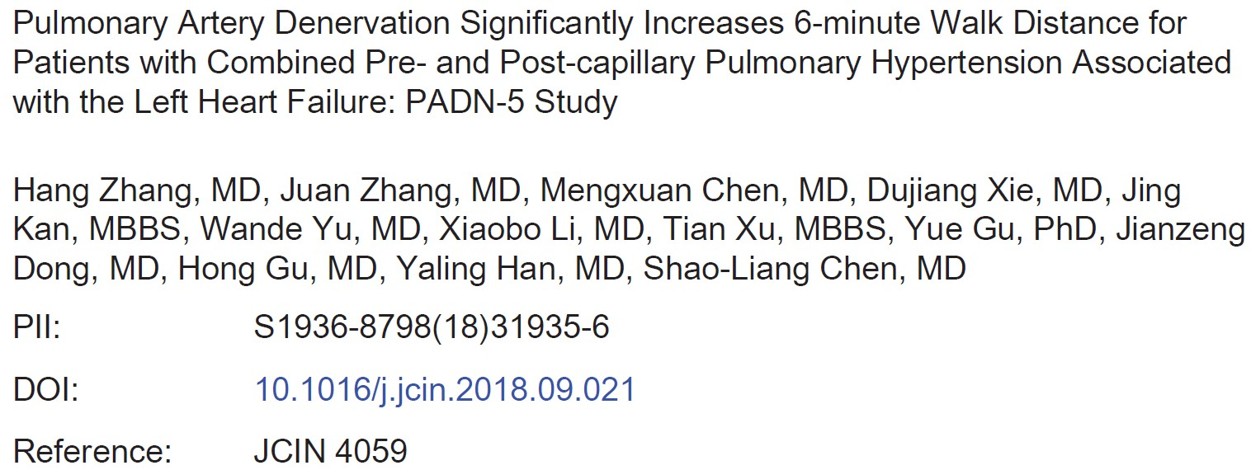
Thanks for your attention!

Slide 14
Thanks for your attention!

