Slide 1
Longest Follow-up After Implantation of a Self-Expanding Repositionable Transcatheter Aortic Valve: Final Follow-up of the Evolut R CE Study
Stephen Brecker, MD St. George’s University Hospitals, London, United Kingdom For the Evolut R CE Study Investigators

Slide 2
Evolut R Clinical Program
TCT2016
Evolut R CE
CE Mark Study (Safety and performance) N=60; single arm, 26 mm and 29 mm valves
Primary Safety EP = Death & any stroke at 30 days
Final 2-Year Follow-up
TCT.16
Evolut R US
US IDE Study (Safety and efficacy) N=241; single arm, 23 mm, 26 mm and 29 mm valves
Primary Safety EP = Death & disabling stroke at 30 days Follow-up through 5 years
1-Year Follow-up TCT.16
Evolut R FORWARD
All-Comers Trial (Safety) N=1000; single arm, 26 mm and 29 mm valves
Primary EP = Death at 30 days Follow-up through 3 years
First Results
TCT.16
Evolut R 34
US IDE Addendum (Safety and efficacy) N=60; single arm, 34 mm valve
Primary Safety EP = Death & disabling stroke at 30 days Follow-up through 5 years
First Results TCT.16
2

Slide 3
Background
TCT2016
Transcatheter aortic valve delivery systems have become smaller caliber, more easily maneuvered and the procedure is associated with lower incidence of adverse events.
The Evolut R CE Study evaluated the repositionable Evolut R transcatheter aortic valve (Medtronic, Minneapolis, MN) in patients with symptomatic aortic stenosis and heart-team assessed risk of operative mortality.
This first study in the Evolut Clinical Program has completed the final 2-year follow-up.
3

Slide 4
Methods
TCT2016
26 mm and 29 mm Evolut R
60 Patients implanted at 6 sites in Australia, New Zealand and the United Kingdom
CT measured perimeter-derived annulus sizing
Echocardiographic Core Laboratory (Mayo Clinic, Rochester, MN)
VARC-2 definitions
Initial use of the Evolut R for all investigators
4

Slide 5
RESULTS FROM THE EVOLUT R CE STUDY
TCT2016
5

Slide 6
Patient Characteristics
TCT2016
Characteristic, mean± SD or % | N = 60
Age (years) | 82.8 ± 6.1
Women | 66.7
STS PROM (%) | 7.0 ± 3.7
Logistic EuroSCORE I (%) | 20.5 ± 12.5
New York Heart Association class III or IV | 68.3
Frailty | 68.3
Any chronic lung disease | 43.3
Atrial fibrillation / atrial flutter | 38.3
Prior coronary artery bypass grafting | 28.3
Diabetes | 26.7
Peripheral vascular disease | 16.7
Pre-existing permanent pacemaker | 11.7
6

Slide 7
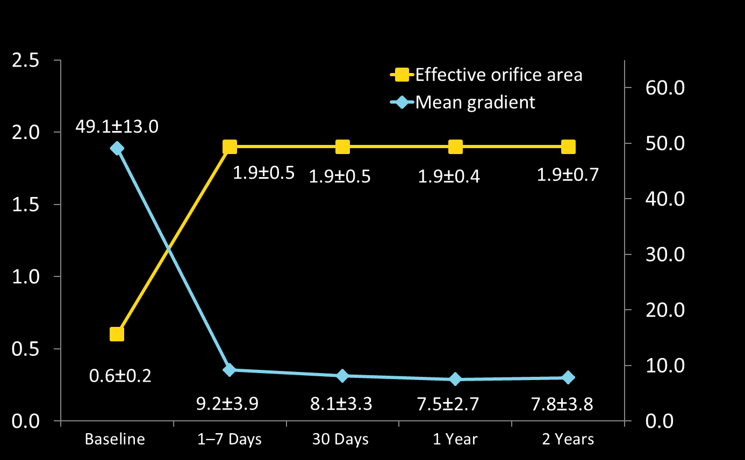
TCT2016
Valve Performance
Effective Orifice Area, cm²
Mean Gradient, mm Hg
Gradient | 60 | 60 | 57 | 47 | 38
EOA | 56 | 55 | 54 | 44 | 34
Independent core-lab adjudication
7

Slide 8
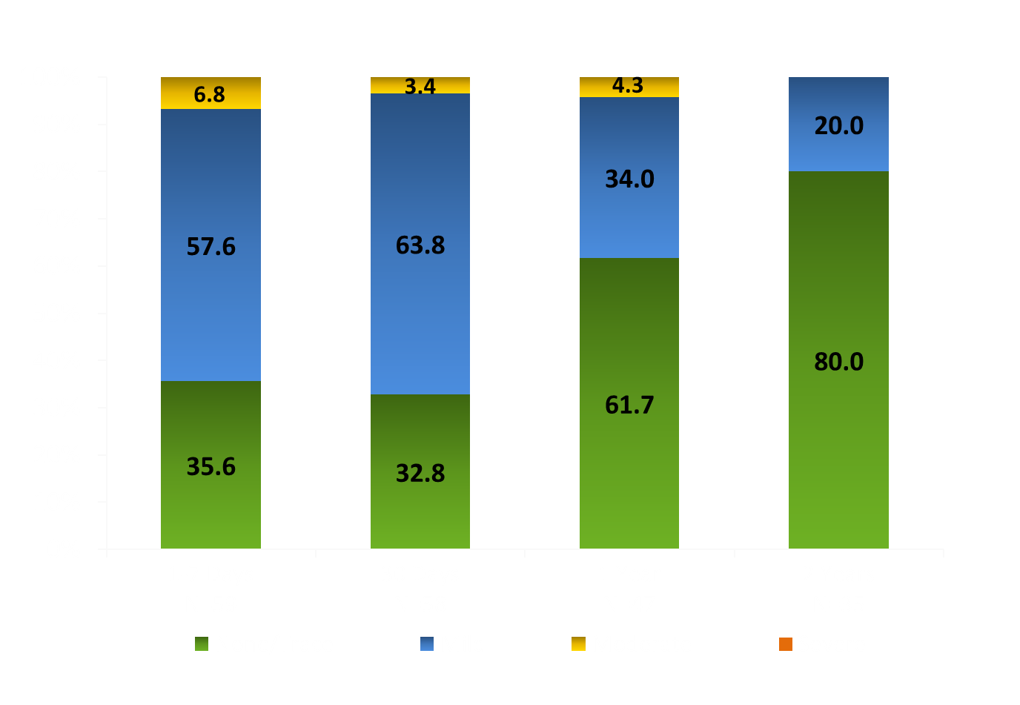
TCT2016
Paravalvular Regurgitation
Percent of Evaluable Echocardiograms
Independent core-lab adjudication
8

Slide 9
Safety Outcomes to 2 Years
TCT2016
Event, K-M rates – % (no.) | 30 Days N = 60 | 1 Year N = 60 | 2 Years N = 60
All-cause mortality | 0.0 (0) | 6.7 (4) | 23.6 (14)
Cardiovascular mortality | 0.0 (0) | 5.0 (3) | 12.4 (7)
Disabling Stroke | 0.0 (0) | 3.4 (2) | 5.3 (3)
9

Slide 10
TCT2016
Other Endpoints to 2 Years
Event, K-M rates – % (no.) | 30 Days N = 60 | 1 Year N = 60 | 2 Years N=60
Embolization or migration | 0.0 (0) | 0.0 (0) | 0.0 (0)
Endocarditis | 0.0 (0) | 0.0 (0) | 0.0 (0)
Valve dysfunction requiring repeat procedure | 0.0 (0) | 0.0 (0) | 0.0 (0)
Valve thrombosis | 0.0 (0) | 0.0 (0) | 0.0 (0)
Pacemaker | 11.7 (7) | 15.1 (9) | 15.1 (9)
No incidence of valve embolization, migration, thrombosis or valve dysfunction requiring repeat procedure through 2 years.
10

Slide 11
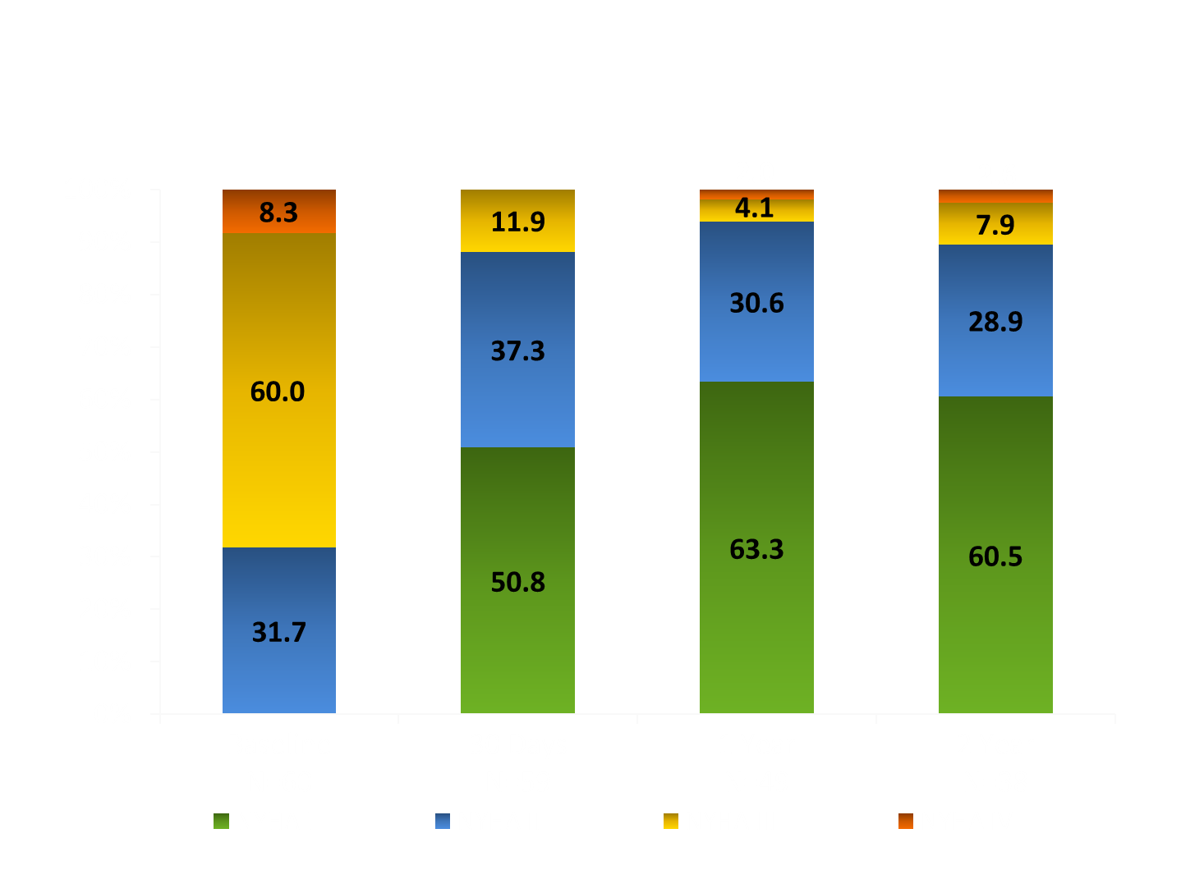
NYHA Class
TCT2016
Compared with Baseline, 81.5% Improved at 1 Year and 86.8% at 2 Years
Percent of Patients
11

Slide 12
Summary
TCT2016
The Evolut R showed positive safety and efficacy at the longest follow-up to date at 2 years.
Sustained excellent forward flow hemodynamics.
No incidence of coronary artery obstruction, valve embolization, migration, thrombosis or valve dysfunction requiring repeat procedure through 2 years.
50% of late deaths were due to non-cardiovascular causes with no late adverse events.
12

