Slide 1
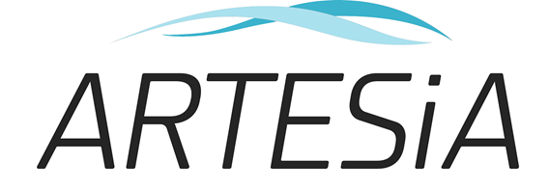
The Artesia trial Apixaban for Stroke Prevention in Subclinical Atrial Fibrillation
Professor Jeff Healey, Population Health Research Institute
McMaster University, Hamilton, Ontario, Canada
On behalf of the ARTESIA steering committee and investigators

Slide 2
DISCLOSURES
Dr. J. Healey:
Research grants and speaking fees: BMS/Pfizer Alliance, Servier, Novartis, Boston Scientific, Medtronic; Consulting: Bayer, Servier and Boston Scientific
ARTESIA study funding
Canadian Institutes for Health Research (201610PTJ-378238), the Bristol Meyers Squibb-Pfizer Alliance, the Heart and Stroke Foundation of Canada, the Canadian Stroke Prevention Intervention Network (CSPIN), Hamilton Health Sciences, the Advancing Clinical Trials (ACT) Network and the Population Health Research Institute (PHRI).

Slide 3
Subclinical AF (SCAF)
Brief (minutes-hours), asymptomatic AF
Detected only with long-term continuous monitoring
1/3 of patients with pacemakers and ICDs
2.5-fold increased risk of stroke (ASSERT, TRENDS)
Stroke risk appears lower than with clinical AF (4-5-fold)¹
Value of oral anticoagulation is unknown
¹Wolf PA, Framingham Heart Study; Stroke 1991 Aug;22(8):983-8

Slide 4
ARTESIA Study Design
Intention-to-treat population N=4012
Implanted pacemaker, defibrillator or cardiac monitor with SCAF (6 minutes – 24 hours)
AND EITHER
Age ≥ 55 years CHA₂DS₂-VASc score of ≥ 3
OR
Age ≥ 75 years,
OR
History of stroke
Apixaban
5 mg BID or 2.5 mg BID According to label
Primary endpoint: Stroke or systemic embolism
Safety endpoint: ISTH major bleeding*
1:1 randomization
Aspirin 81 mg/day
Mean follow up 3.5 ± 1.8 years
Double-blind, double-dummy treatment
* With sub-classification of presentation and clinical course
Lopes RD, et al. American Heart Journal 2017

Slide 5
Patient disposition
4012 patients randomized at 247 centers in 16 countries
99% received at least one dose of study medication
24% of patients stopped study medication due to SCAF>24 or clinical AF at median follow up of 1.5 years
35% of patients stopped study medication for other reasons
22% of patients died
2.9% withdrew or were lost to follow-up

Slide 6
Statistical Analysis
Primary efficacy analysis
Used intention to treat (ITT)
Patients censored at time of discontinuation for SCAF>24 hours or clinical AF
ITT, without censoring also performed
Primary analysis for bleeding
Used on-treatment analysis, as pre-specified

Slide 7
Baseline Characteristics - 1 | Apixaban (N = 2015) | Aspirin (N = 1997)
Age years (mean ± SD) | 76.9 ± 7.6 | 76.7 ± 7.7
Sex, % female | 35.7 | 36.5
CHA₂DS₂-VASc Score (mean ± SD) | 3.9 ± 1.1 | 3.9 ± 1.1
CHA₂DS₂-VASC ≥ 4 (%) | 60.5 | 60.8
History of Hypertension (%) | 81.5 | 81.4
History of Coronary Artery Disease (%) | 36.3 | 37.8
Peripheral Arterial Disease (%) | 8.3 | 8.3
Diabetes Mellitus (%) | 28.9 | 29.2
History of Heart Failure | 27.3 | 29.4
History of Stroke, Systemic Embolism or TIA (%) | 8.9 | 9.1
Creatinine Clearance mL/min (mean ± SD) | 70.8 ± 26.7 | 72.1 ± 30.6

Slide 8
Baseline Characteristics - 2 | Apixaban (N = 2015) | Aspirin (N = 1997)
Baseline Anti-Platelet Usage (%)
Aspirin | 57.8 | 56.9
Other Single or Dual Anti-Platelet Agents | 7.1 | 7.6
Longest episode of SCAF in past 6 months | 1.4 (0.2-4.9) hours | 1.5 (0.2-4.8) hours
No episodes (%) | 15.7 | 15.8
< 6 min (%) | 2.1 | 2.2
6 min - < 1 hour (%) | 26.6 | 24.9
1 hour – < 6 hours (%) | 33.8 | 37.2
6 hours – < 12 hours (%) | 14.2 | 13.2
12 hours – < 24 hours (%) | 7.5 | 6.7

Slide 9
Primary Outcome

Slide 10
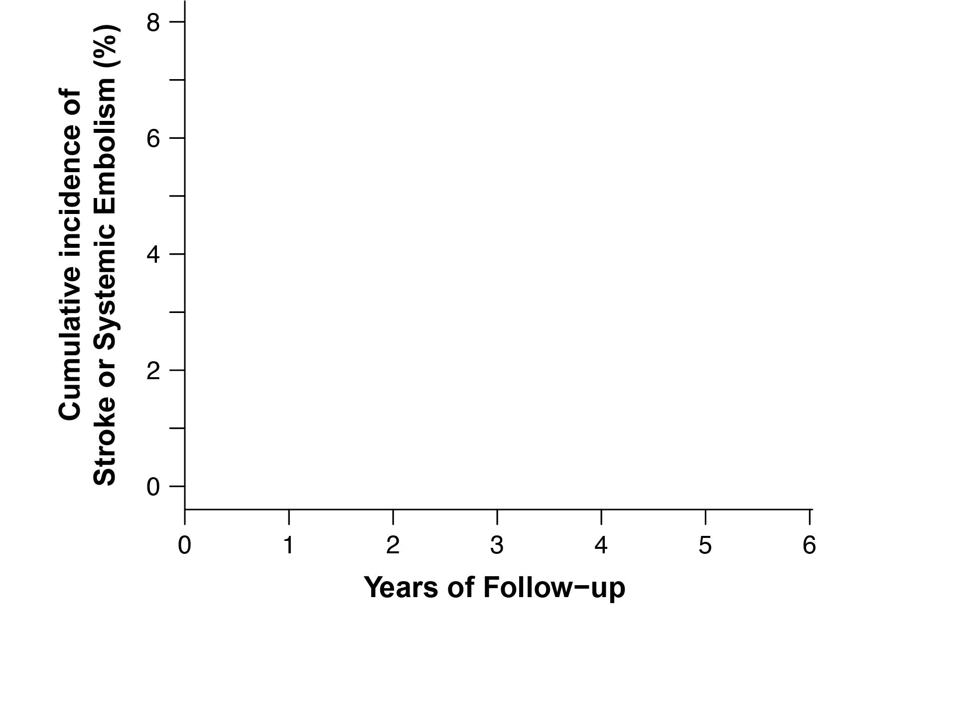
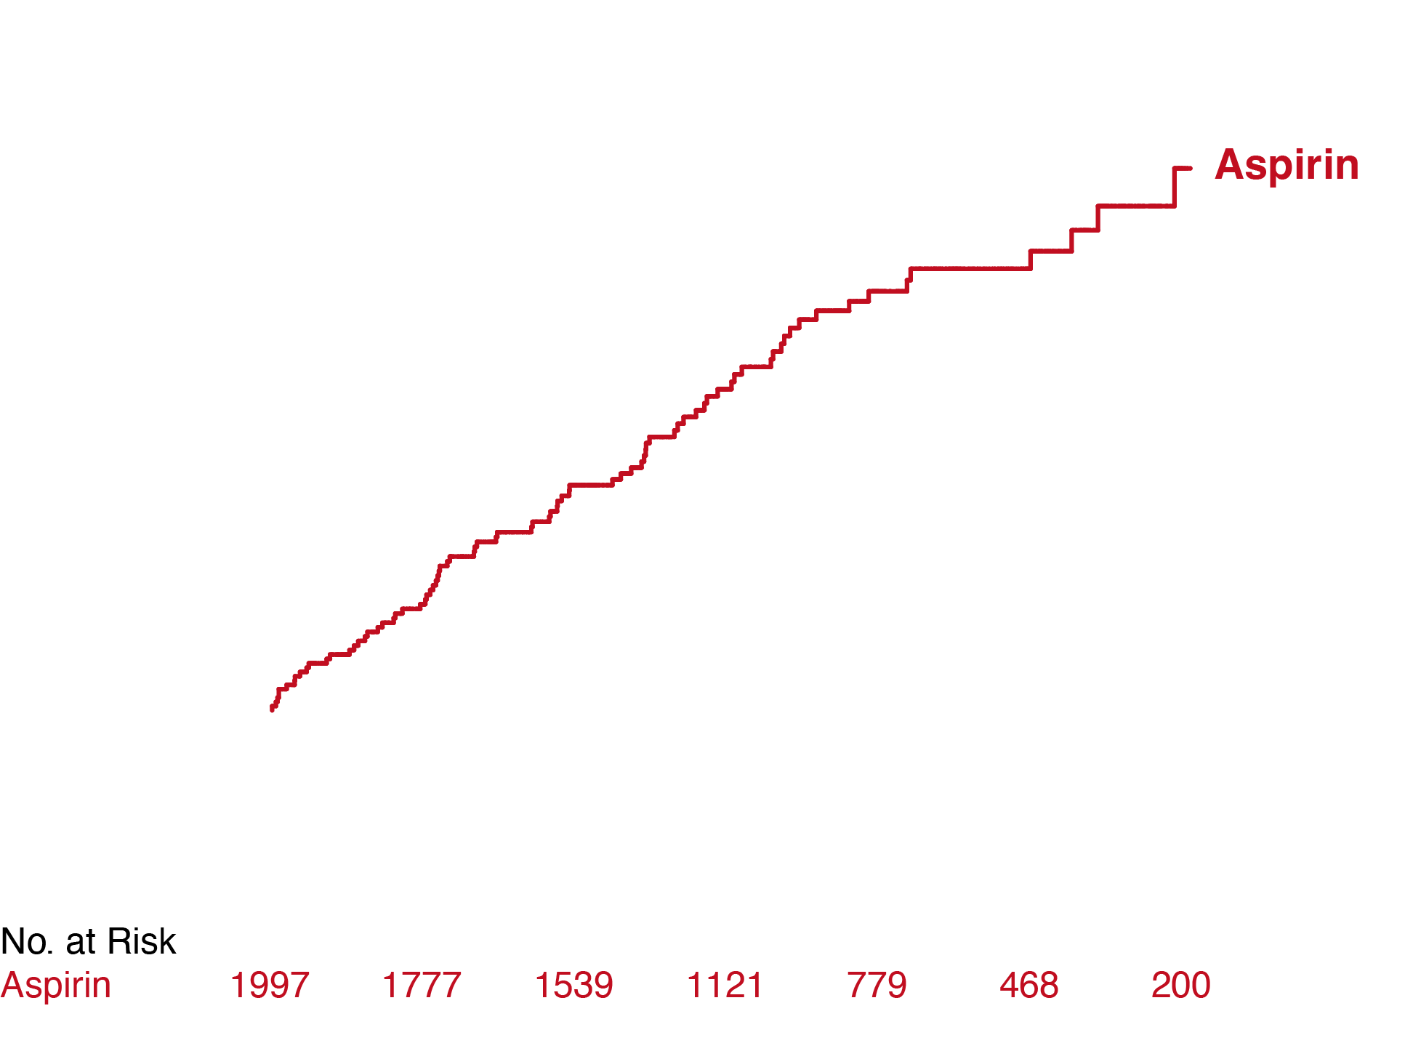
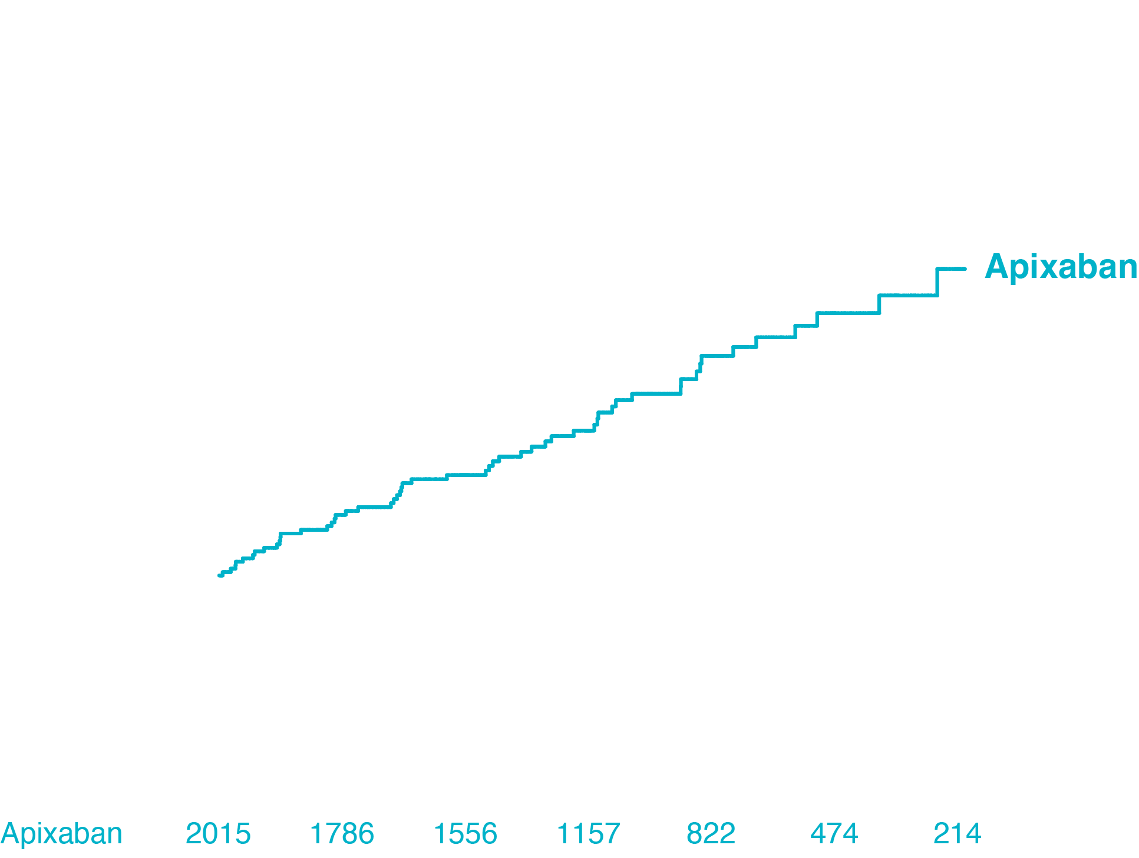
Stroke or Systemic Embolism
HR 0.63 (95% CI: 0.45-0.88) p=0.007

Slide 11
Primary Efficacy Analysis (ITT)
 | Apixaban (N = 2015) | Aspirin (N = 1997) | Hazard Ratio (95% CI) | P value
Stroke or systemic embolism n (% per year) | 55 (0.78) | 86 (1.24) | 0.63 (0.45-0.88) | 0.007
Total Stroke | 55 (0.78) | 84 (1.21) | 0.64 (0.46-0.90)
Ischemic stroke* | 45 (0.64) | 71 (1.02) | 0.62 (0.43-0.91)
Hemorrhagic stroke | 10 (0.14) | 13 (0.18) | 0.76 (0.33-1.73)
Mod. Rankin Score 0-2 | 31 (0.44) | 45 (0.65) | 0.68 (0.43-1.07)
Mod. Rankin Score 3-6 | 19 (0.27) | 37 (0.53) | 0.51 (0.29-0.88)
Cardiovascular death | 105 (1.47) | 108 (1.53) | 0.96 (0.73-1.25)
*includes stroke of unknown etiology

Slide 12
Safety Analysis: Major Bleeding (On-Treatment)
Major Bleeding (ISTH) | Apixaban (N = 2015) | Aspirin (N = 1997) | Hazard Ratio (95% CI) | P Value
Major Bleeding: n (% per year) | 86 (1.71) | 47 (0.94) | 1.80 (1.26-2.57) | 0.001
Fatal bleeding | 5 (0.10) | 8 (0.16) | 0.63 (0.20-1.91)
Symptomatic intracranial hemorrhage | 12 (0.24) | 15 (0.30) | 0.77 (0.36-1.64)
Transfusion required | 26 (0.51) | 18 (0.36) | 1.43 (0.78-2.61)
Major Bleeding (ITT) | 106 (1.53) | 78 (1.12) | 1.36 (1.01-1.82) | 0.04

Slide 13
Major Bleeding Events | Apixaban (N = 2015) | Aspirin (N = 1997)
Clinical course: n (% of major bleeds)
1 (conservative measures) | 21 (22.6) | 16 (32.7)
2 (supportive care, transfusion) | 54 (58.1) | 22 (44.9)
3 (Immediate measures needed to avoid death) | 9 (9.7) | 4 (8.2)
4 (death unavoidable) | 3 (3.2) | 6 (12.2)

Slide 14
Benefit to Risk Analysis
ITT analysis (per thousand patient-years)
4.6 fewer strokes/emboli
4.1 more major bleeds
45% of strokes on aspirin were permanently disabling or fatal
Reduced by 49% with apixaban
Fewer than 15% of major bleeds on apixaban progressed to death or required immediate measures to avoid death
Numerically fewer fatal or intracranial bleeds

Slide 15
conclusions
Apixaban reduces the risk of stroke or systemic embolism in patients with subclinical AF by 37%
Fatal and permanently disabling strokes reduced by 49%
Apixaban increases major bleeding
But no increase in fatal or intracranial bleeding was detected
Anticoagulation should be considered for patients with subclinical AF who have additional stroke risk factors

Slide 16
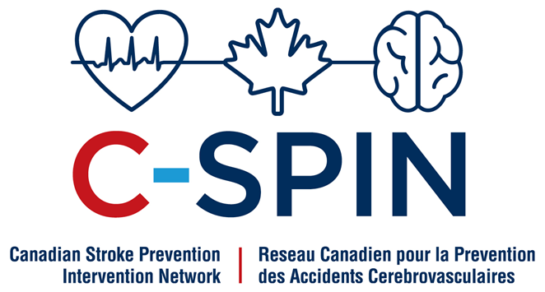
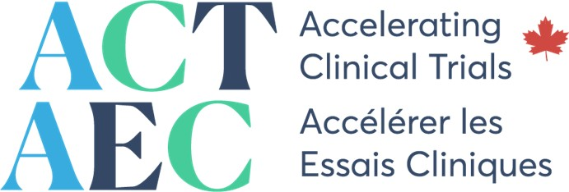
Many tHANKS!
Steering Committee. Jeff S. Healey, Renato D. Lopes, Chris B. Granger, Marco Alings, Lena Rivard, William F. McInytre, Dan Atar, David H. Birnie, Giuseppe Boriani, A. John Camm, David Conen, Julia Erath, Julia Erath, Michael R. Gold, Stefan Hohnloser, John Ip, Josef Kautzner, Valentina Kutyifa, Cecilia Linde, Philippe Mabo, Georges Mairesse, Juan Benezet Mazuecos, Jens Cosedis Nielsen, Francois Philippon, Marco Proietti, Christian Sticherling, Jorge Wong, David J. Wright, Randy Zarraga, Shelagh Coutts, Lizhen Xu, Kim Simek, Sandra Nevills, and Stuart J. Connolly. Data Safety Monitoring Committee. John Cairns (Chair), Michael D. Hill, Harry Buller, Oscar Benevente, Andrew Epstein. Adjudication Committee. Shelagh Coutts (Chair), Thalia S. Field, David J. Gladstone, Ashkan Shoemanesh, Mukul Sharma, Deborah Siegel, David Conen, William McIntyre. Top-10 Enrolling Investigators. Andrew Kaplan, Marta Pombo, Felix Ayala-Paredes, Guy Amit, Peter Leong-Sit, Claus Rinne, Francois Philippon, Taya Glotzer, Gabor Duray, Francesco Pergolini. ARTESiA participants who made the trial possible.

