Slide 1
Expanding Labeling for TAVR New Trials & New Indications
Nicolas M. Van Mieghem, MD, PhD, FESC, FACC Director of Interventional Cardiology Thoraxcenter, Erasmus MC,
Rotterdam
Notes:
10 min
8:15 – 8:25

Slide 2
Within the past 12 months, I have had a financial interest/arrangement or affiliation with the organization(s) listed below.
Affiliation/Financial Relationship
Company
Grant/Research Support & consulting Fees
Abbott, Boston Scientific, Edwards Lifesciences, Medtronic, Acist, Claret, Terumo, PulseCath, Essential Medical

Slide 3
Growing TAVR Indications

Slide 4
TAVR in Asymptomatic severe AS

Slide 5
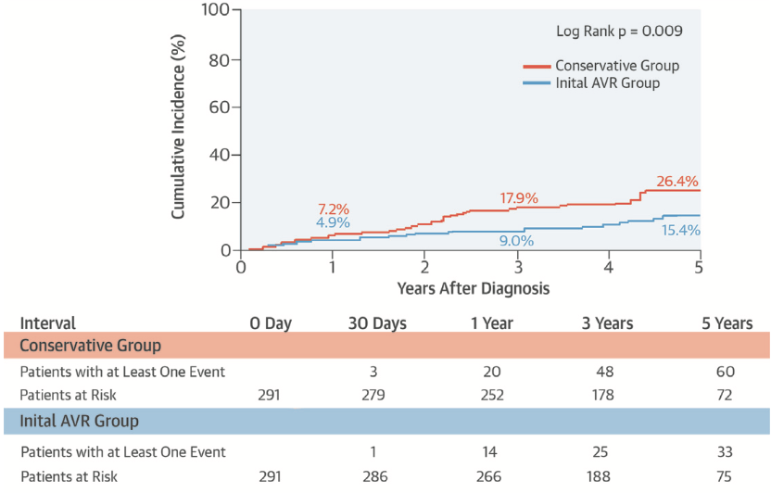
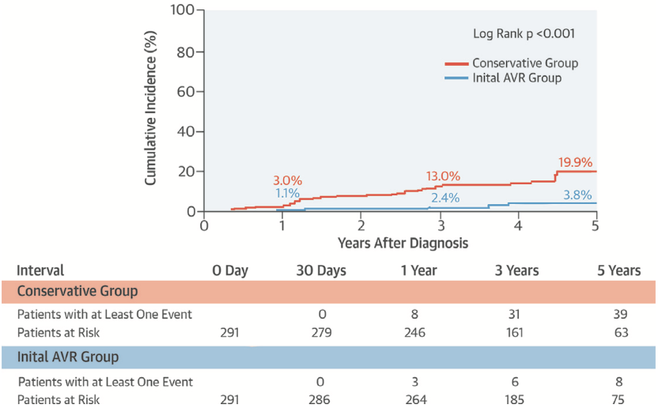
AVR in Asymptomatic severe AS
Japanese Dataset including 1808 patients, from which 291 SAVR
Propensity matched analysis in 582 patients (291 in each arm)
All cause ✜
HF Admission
Taniguchi et al. JACC 2015;66:2827-38

Slide 6
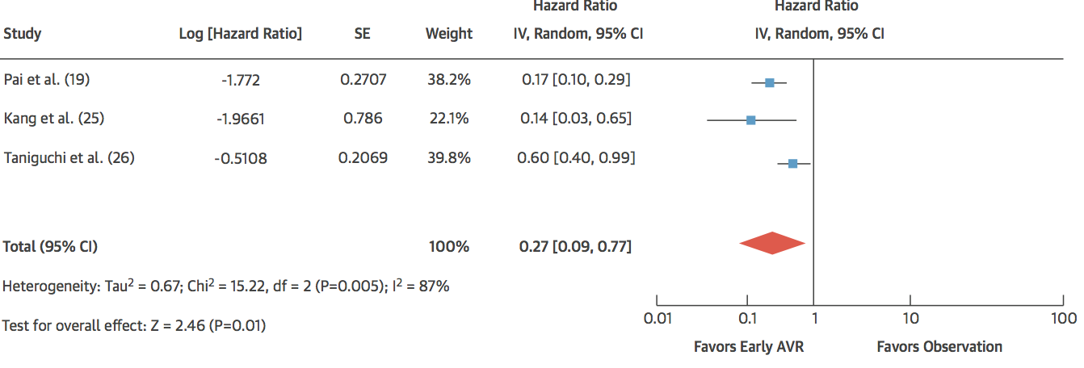
AVR in Asymptomatic severe AS Meta-analysis – Early AVR improves survival
Genereux et al. JACC 2016;67:2263-88

Slide 7
EARLY TAVR
Asymptomatic Severe AS and 2D-TTE (PV ≥4m/s or AVA ≤1 cm²)
Exclusion if patient is symptomatic, EF<50%, concomitant surgical indications, bicuspid valve, or STS >8
Treadmill Stress-Test
Stress-Test Normal
Stress-Test Abnormal
CTA and Angiography TF- TAVR eligibility
Early-TAVR Randomized Trial
Early TAVR Registry
Randomization 1:1
Stratified by STS (<3 vs >3)
TF- TAVR
Clinical Surveillance
Primary Endpoint (superiority): 2-year composite of all-cause mortality, all strokes, and repeat hospitalizations (CV)

Slide 8
TAVR in severe Bicuspid Aortic Stenosis

Slide 9
Bicuspid Aortic Valve Stenosis
FACTS:
Not exclusively in younger patients
Up to 50% of explanted aortic valves
20% in octogenarians
So far bicuspidy excluded from randomized trials
Current trends in TAVI
Lower risk
Younger patients
Longer life expectancy
(Durability)
Need for prospective research in TAVI & bicuspid AS
X

Slide 10
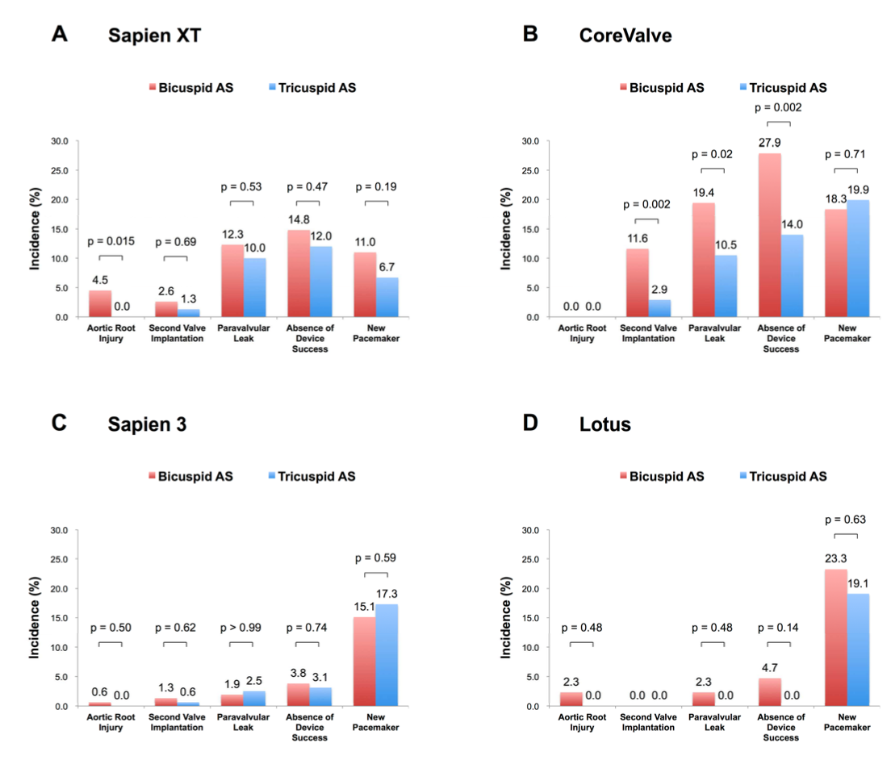
Bicuspid TAVI Impact Next Gen THV
Yoon et al. JACC 2017;69:2579-89

Slide 11
BIVOLUT X Bicuspid aortic stenosis with Evolut platform international experience
Investigator driven initiative (D. Tchetche & N. Van Mieghem)
Prospective observational multicenter registry
N = 150 consecutive patients
Aim = obtain insights in various sizing algorithms
Bicuspid AS or mixed AS-AR
Follow up
@ 30 days & 1 year: clinical examination, ECG, TTE +/- MSCT
Corelab MSCT & TTE
X

Slide 12
TAVR in Moderate AS and Heart Failure

Slide 13
Background
In Western World prevalence of Aortic sclerosis > 65 y/o = 25%
16% will progress to AS within 8 years
AS prevalence in Elderly ≅ 4%, LV dysfunction in 25%
HF affects 4% of the population, gradually increasing with age
to ≅ 15% in 70 – 80 y/o
After HF admission:
Rate for death or readmission @ 1 year = 40 - 50%

Slide 14
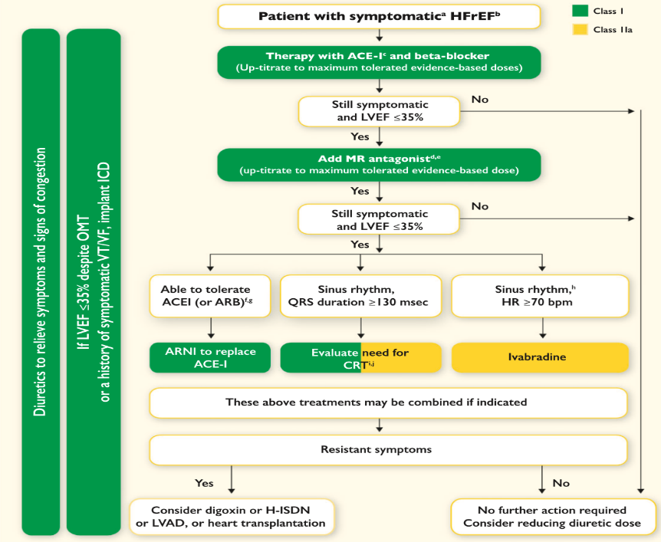
ESC Guidelines 2016
✗
✗
Afterload Reducers
✗
✗
Ponikowski et al. EHJ 2016;37:2129-2200

Slide 15
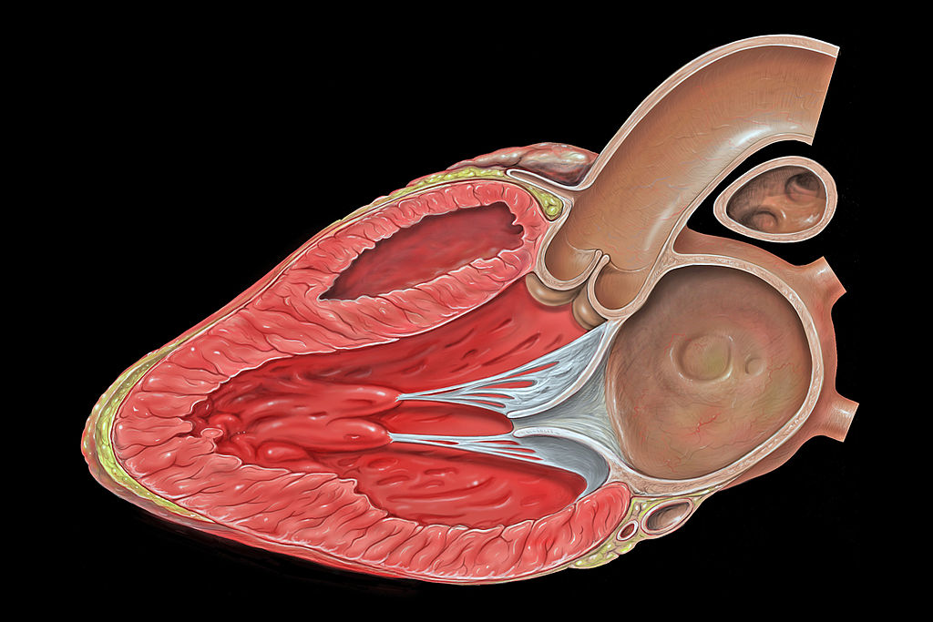
Hemodynamic Fundamentals
Target
TAVR will reduce valvular load
afterload
Valvular Load
Global Load ≅ Z_{VA} =Transaortic Mean ΔP + SBP
SVi
Arterial Load
Fixed
Elderly with decreased arterial compliance
fixed BP
no response to vasodilators
no medical options to reduce arterial load
Adapted from Pibarot P & Dumesnil JG. JACC 2012;60:169-80

Slide 16
Moderate AS & LV Dysfunction
 | N=310
Age (mean ± SD) | 72 ± 11
Male (n,%) | 75%
Coronary artery disease (n,%) | 72%
COPD (n,%) | 25%
eGFR in ml/min (mean ± SD) | 61 ± 20
Peripheral arterial disease (n,%) | 19%
Prior stroke (n,%) | 43, 14%
NYHA-class (n,%) III IV | 29% 4%
Cardiac resynchronization therapy (n,%) | 12%
Leiden University Medical Center
Quebec Heart and Lung institute
Columbia Medical University New York
Van Gils et al. JACC 2017;69:2383-92

Slide 17
Primary Composite Endpoint
Overall
Landmark Analysis
Clinical events are common (61% @ 4 yrs FU)
Most events occur within the first year
1 in 4 were NYHA 1, 42% NYHA 2!
Van Gils et al. JACC 2017;69:2383-92

Slide 18
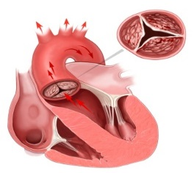
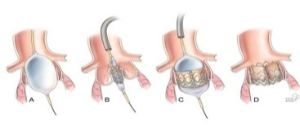
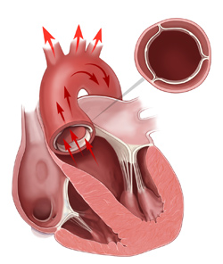
TAVR UNLOAD Concept
TAVR UNLOAD Trial
TAVR + OHFT
Follow-up:
1, 6 months
1 & 2 years
Clinical endpoints
Symptoms
Echo
QoL
LV-EF< 50%
&
Moderate AS
R
International
Multicenter
Randomized
OHFT alone
Spitzer et al. AHJ 2016;182:80-88

Slide 19
TAVR for severe Aortic Regurgitation

Slide 20
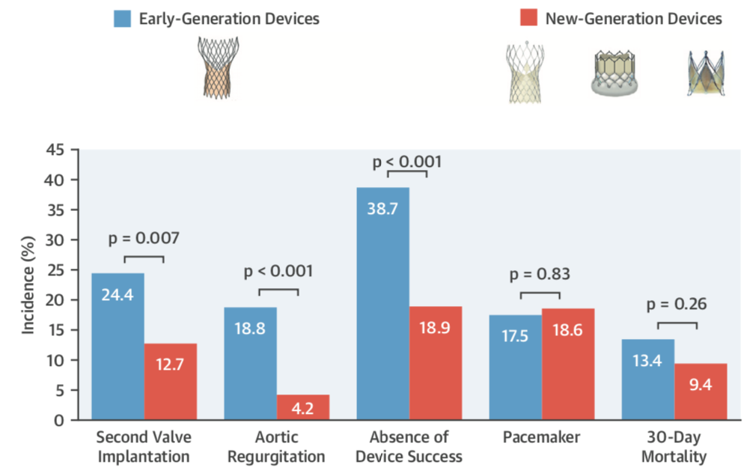
1st vs. 2nd Generation THV for severe AR
N = 331
40 centers
September 2007 – February 2017
Yoon et al. JACC 2017;70:2752-63

Slide 21
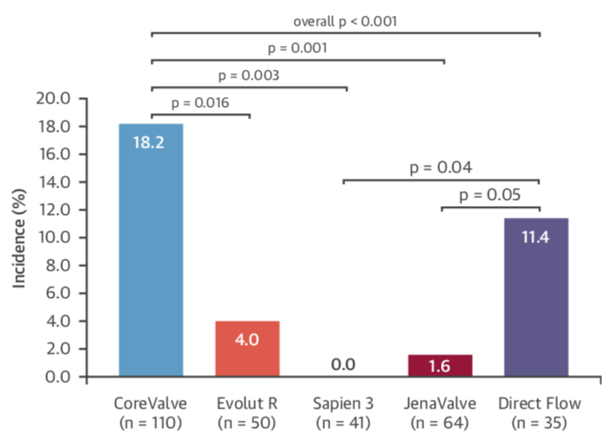
TAVI for Aortic Regurgitation
≥ Moderate AR
Yoon et al. JACC 2017;70:2752-63

Slide 22
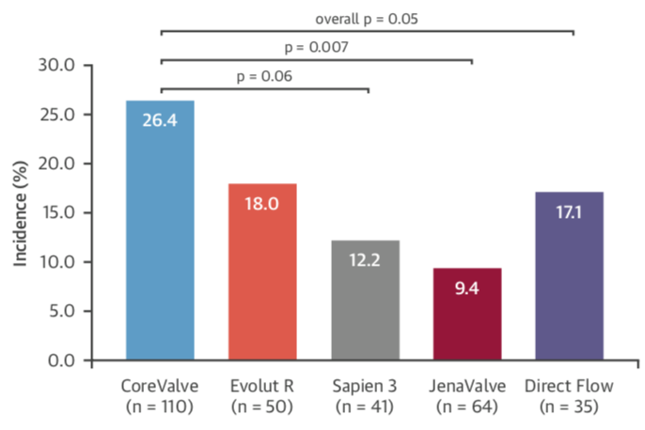
TAVI for Aortic Regurgitation
Need for > 1 THV
Yoon et al. JACC 2017;70:2752-63

Slide 23
In Conclusion
New indications for TAVR are emerging
Randomized trials are ongoing
A-symptomatic severe AS
Moderate AS and LV dysfunction
Next Generation THVs for AS seem to work in different anatomies than severe tricuspid AS
Bicuspid severe AS
Pure AR
Meticulous imaging and anatomy tailored THV selection seem mandatory

