Slide 1
Late Breaking Clinical Trials:
The Celtic Bifurcation Study
Prof David P Foley MB BCh FRCPI PhD FESC
Beaumont Hospital Dublin, Ireland
on behalf of the Celtic Bifurcation Study Investigators

Slide 2
Introduction
‘Accepted bifurcation wisdom’ – conservative
provisional approach
Based on older randomized trials with 1st generation
DES – BBC1, Nordic etc
Recommendations do not consider ischemia from large side branches OR allow for advances in techniques and platforms
Many experienced operators routinely apply the elegant
and reproducible Culotte stenting approach
Many of us have previously reported extensive favourable experience of Culottes stenting in large cohorts over the years and continue to (TRY) to convert new (and older) colleagues

Slide 3
Aim / Primary Endpoint of CELTIC
Assess efficacy of Culottes Stenting Comparing 2-connector 3rd
generation DES (Synergy) and 3-connector 2nd generation DES (Xience
9 month composite of:
Death
MI
CVA
Target Vessel Failure
Binary Angiographic Restenosis
Primarily exploratory and hypothesis generating study – estimated
event rate 10% at 9 months
Exploratory power calculation: 85 patients per group with ⍺ of 5% and 1-β of 90% to assess non-inferiority limit of 15% for Synergy vs Xience
We gratefully acknowledge unrestricted grant from Boston Scientific
Corporation

Slide 4
Investigators, Enrolment & Organisation
Prof David Foley, Beaumont Hospital Dublin, Co-CI
Dr Simon Walsh, Belfast Trust; Co-CI
King's
5
Dr Colm Hanratty, Belfast Trust; PI
Dr Stuart Watkins, Golden Jubilee Glasgow, PI
Prof Niall Mulvahill, St Vincent’s Hospital Dublin, PI
Prof Alex Chase, Morriston Hosptial Swansea, Co-PI
Dr Dave Smith, Morriston Hospital Swansea, Co-PI
Dr Nick Cruden, Edinburgh Royal Infirmary, PI
Dr Darren Mylotte, Galway University Hospitals, PI
Dr Tom Johnson, Bristol Royal Infirmary, PI
Dr Jonathan Hill, Kings College London, PI
Bristol
7
Galway
7
Edinburgh
9
Swansea
12
Beaumont
18
St Vincent's
19
Glasgow
42
51
Belfast
0
10
20
30
40
50
CRO – Data oversight, CEC, DSMB, Angiographic Core Laboratory Project Lead: Jessica Heringer
NCT 02232815

Slide 5
Indication for PCI and Medina 1,1,1 disease
Indication for 2-stent culotte strategy (operator determined) and both branches
≥2.5mm in daimeter
Randomise 1:1 Xience (n=85) vs Synergy(n=85) DES
9-month hospital visit: Angiogram and clinical follow-up
Telephone follow-up
to 2 years

Slide 6
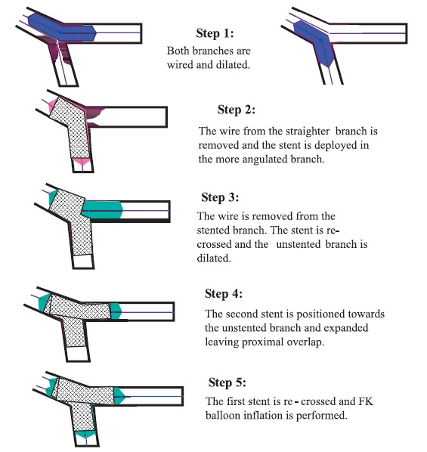
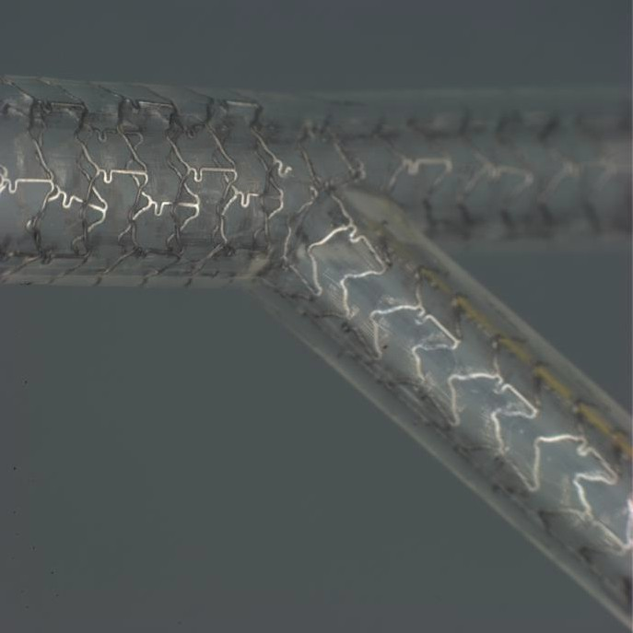
Historical Illustration of Basic
Culottes Technique
“Two-Stent Techniques for the Treatment of Coronary Bifurcations with Drug-Eluting Stents” – Hell J Cardiol 46: 1188-198, 2005

Slide 7
Culotte procedure
Initial adequate, but not excessive pre-dil of both branches
preferred
Keeping both wires in place, first stent the SB or the more angulated vessel with immediate post dil prox
Carefully retract GW and cross struts to main vessel to ensure within stent at all times
Predil thru struts (often with same balloon)
2nd stent placed covering proximally to first - ‘nails it down’
Recross into first vessel
Sequential HP post-dil NC (1:1 balloon:artery) in both branches
Kiss at nominal pressure with NC balloons
Prox proper sized HP post dil
IVUS or OCT at discretion of operator

Slide 8
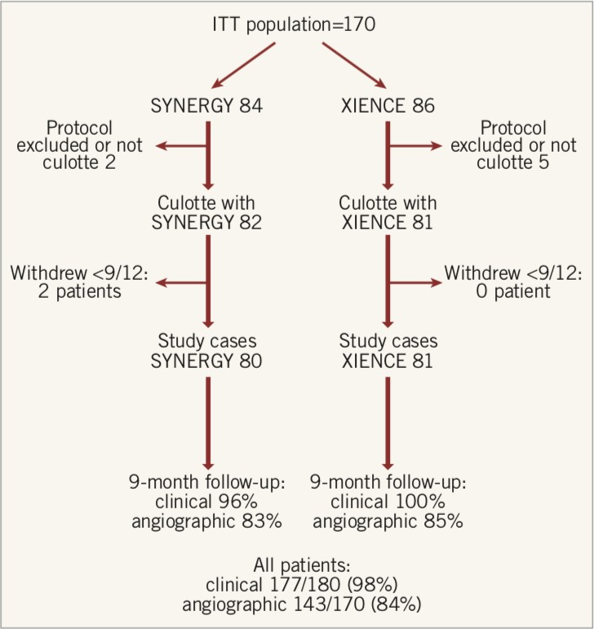
Manuscript available online at EuroIntervention
http://www.pcronline.com/eurointervention/ahead_of_print/EIJ-D-18-00346

Slide 9
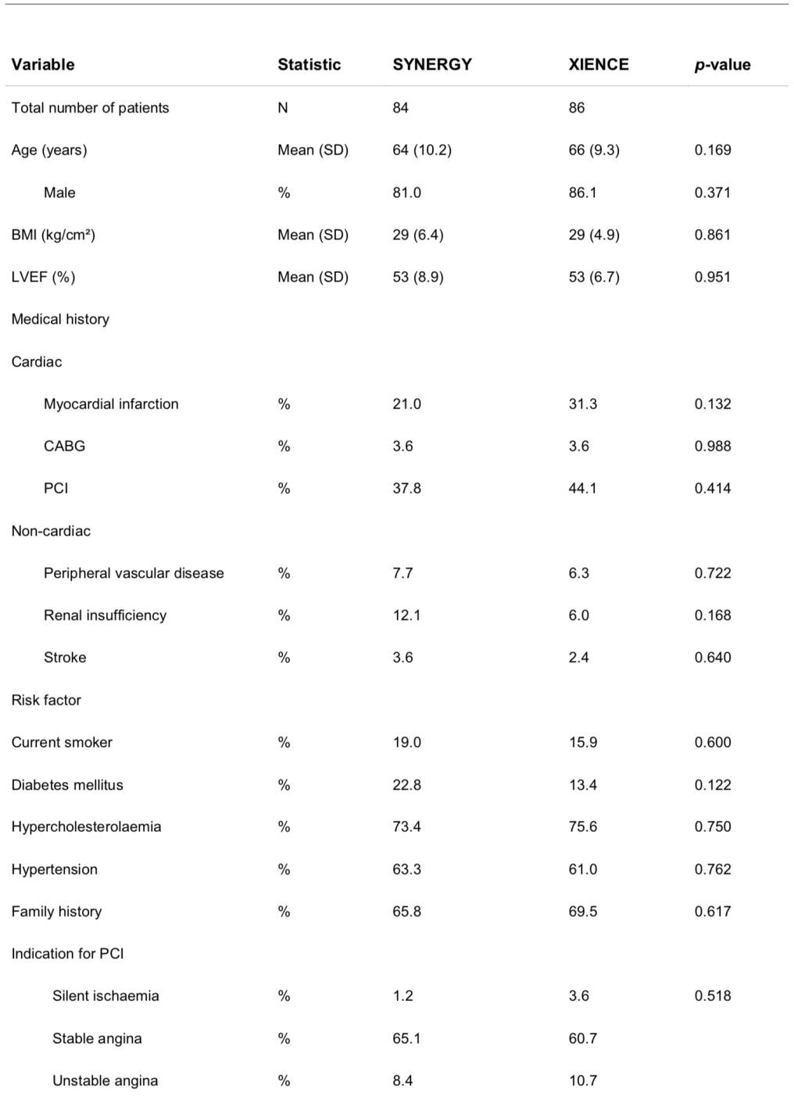
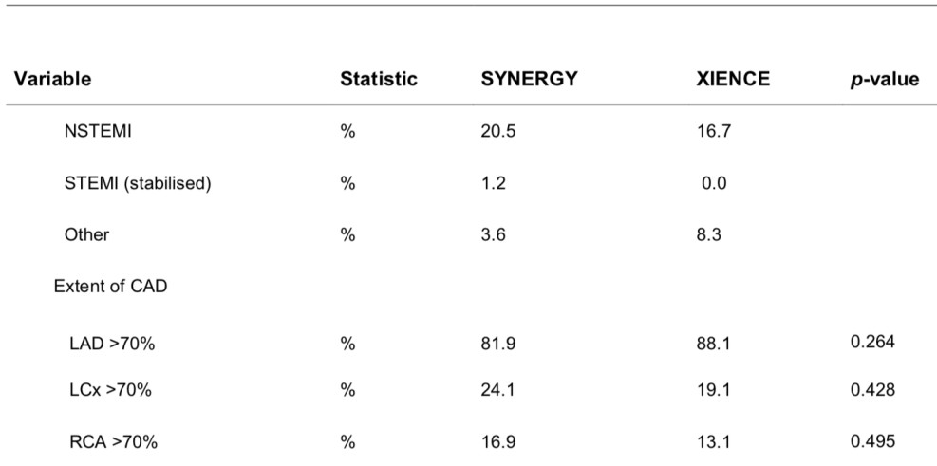
Study population well
matched

Slide 10
Key procedural data (1)
Radial approach almost universal (99% Synergy/93% Xience)
Majority LAD/Diagonal lesions (82% Synergy/85% Xience)
Mainly treated with 2 stents (67% Synergy/69% Xience)
Prox HP post –dil > 90% per step
Kissing inflation almost all cases (99% Synergy/95% Xience)
Supplementary data available online at EuroIntervention
http://www.pcronline.com/eurointervention/ahead_of_print/EIJ-D-18-00346

Slide 11
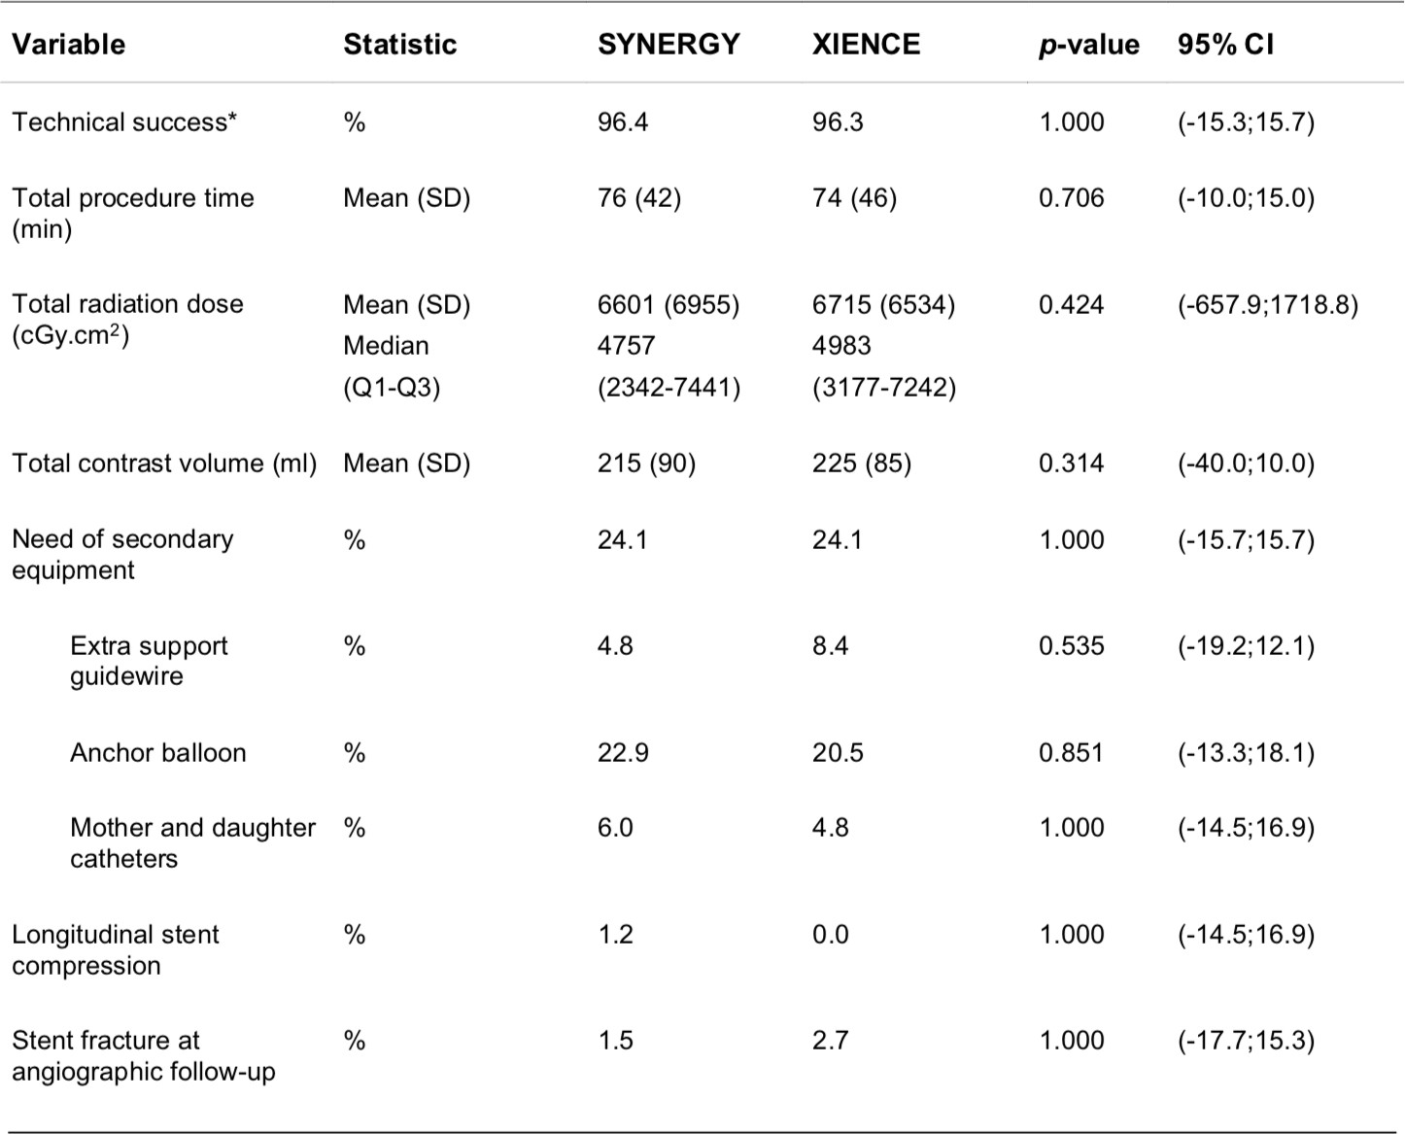
Key procedural data (2)

Slide 12
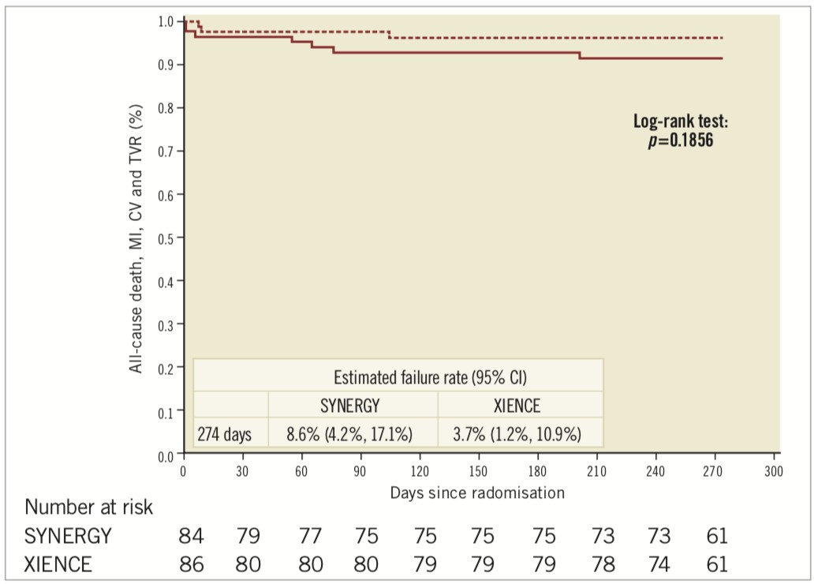
Study Results
OVERALL MACCE 5.9% for whole population
Manuscript available online at EuroIntervention
http://www.pcronline.com/eurointervention/ahead_of_print/EIJ-D-18-00346

Slide 13
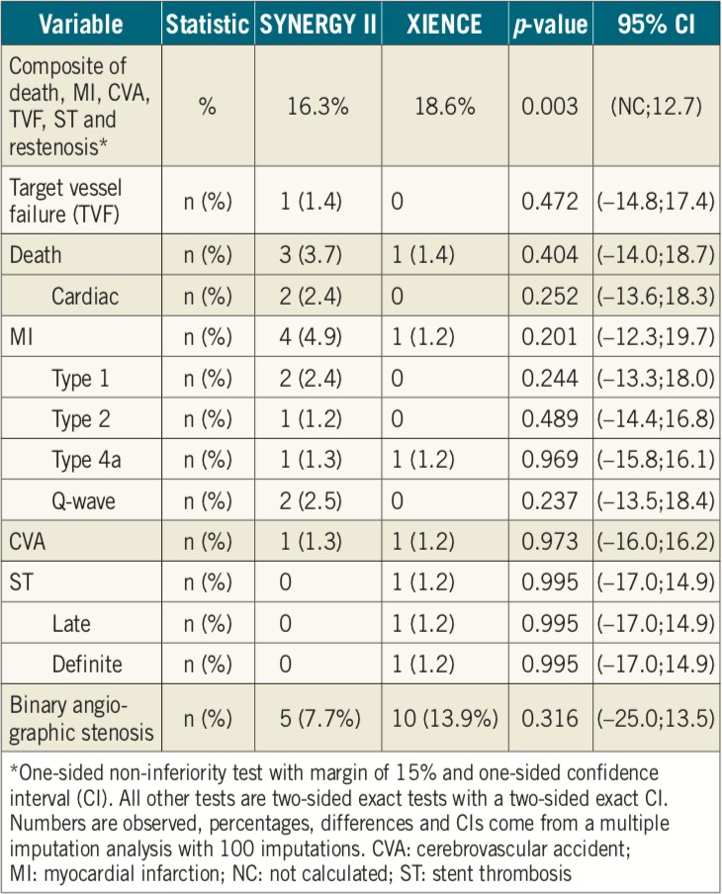
Primary Endpoint
Synergy stent strongly meets non-inferiority goal
Manuscript available online at EuroIntervention
http://www.pcronline.com/eurointervention/ahead_of_print/EIJ-D-18-00346

Slide 14
Conclusions
Excellent Culottes success with both stent platforms, minimal deviation from protocol in multi-operator randomized trial
Very low MACCE rates (5.9%) at 9 months
Transradial approach 6F feasible for almost all cases
No significant difference in Synergy and Xience performance overall
Culotte stenting with current generation Everolimus
eluting stents is safe and effective
Maybe we need to revisit the ‘guidelines for coronary bifurcation’ PCI
Supplementary data available online at EuroIntervention
http://www.pcronline.com/eurointervention/ahead_of_print/EIJ-D-18-00346

Slide 15
CLINICAL RESEARCH
CORONARY I NTE R V ENT I ON S
euro
PCR
2018 LATE
TRIALS
Culotte stenting for coronary bifurcation lesions with 2nd and 3rd generation everolimus-eluting stents: the CELTIC Bifurcation Study
Simon J. Walsh¹ *, MD; Colm G. Hanratty1, MD; Stuart Watkins2, MD; Keith G. Oldroyd2, MD; Niall T. Mulvihill 3, MD; Mark Hensey3, MD; Alex Chase4, MD; Dave Smith4, MD;
Nick Cruden5, MD; James C. Spratt⁵ ⁶
Jonathan Hill ⁹ MD; Hafiz M. Hussein 1°, MB BCh; Kris Bogaerts ¹¹ , PhD;
,
Marie-Claude Morice¹² MD; David P. Foley¹⁰, MD
,
BREAKING
, MD; Darren Mylotte7, MD; Tom Johnson⁸, MD;
1. Belfast Health & Social Care Trust, Belfast, Northern Ireland, United Kingdom; 2. Golden Jubilee National Hospital, Glasgow, Scotland, United Kingdom; 3. St. Vincent's Hospital, Dublin, Ireland; 4. Morriston Hospital, Swansea, Wales, United Kingdom;
5. Royal lrifirmary of Edinburgh, Edinbwgh, Scotland, United Kingdom; 6. St George's University Hospital, London, United Kingdom; 7. Galway University Hospitals, Galway, Ireland; 8. Bristol Heart Institute, Bristol, United Kingdom; 9. King's College Hospital, London, United Kingdom; 10. Beaumont Hospital, Dublin, Ireland; 11. University of Leuven, 1-BioStat, Leuven, and
University of Hassell, 1-BioStat, Hasselt, Belgium; 12. European Cardiovascular Research Center, Massy, France
Thi paper also includes supplementary data published on/ine at: http://www.pcron line.com/eurointervention/ahead_of_print/EIJ-D-18-00346

