Slide 1




Early goal-directed hemodynamic optimization in comatose survivors after cardiac arrest:
The Neuroprotect trial
Koen Ameloot, MD
For the Neuroprotect investigators
Notes:
On behalf of the steering committee and my co-investigators it is my pleasure to present the results of the Neuroprotect post-Cardiac arrest trial

Slide 2

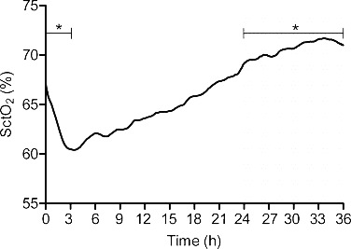
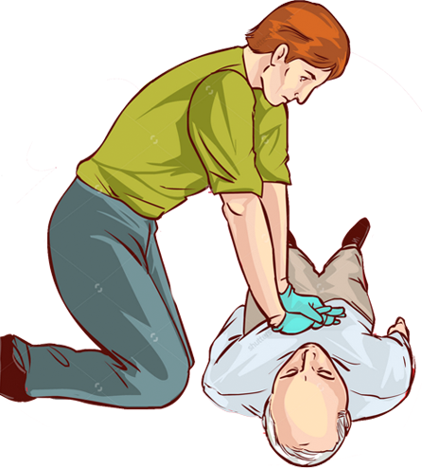

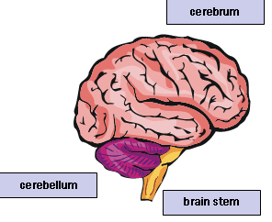
Background: 2-hit model
Post-ROSC survival 40%
70
Cerebral saturation
65
TTM 33-36ºC (class Ia)
60
Guidelines
MAP > 65mmHg (class Ib)
Meex, resuscitation 2013
Pre-hospital
ICU
80% post-anoxic encephalopathy
No flow
Low flow
Hypoperfusion
Reperfusion
1
2
Notes:
Even after resume of spontaneous circulation, prognosis in post-CA patients is poor with estimated survival rates of around 40%
The CAUSE of death is related to post-anoxic brain damage in 80% of the patients.
Pathofysiologically, this is best explained by a 2-hit model. The first hit being the no flow and low flow period before achieving ROSC. The second hit being hypoperfusion and reperfusion injury during ICU stay.
TTM at 33 or 36 degrees is the only intervention that has been shown in a randomized controlled trial to improve outcome of these patients
Besides TTM, current guidelines recommend targeting a MAP of 65mmHg
However, we previously showed that patients treated according to current guidelines with a MAP target of 65mmHg experience a profound drop of the cerebral oxygen saturation during the first 12 hours of ICU stay that may cause additional brain damage

Slide 3
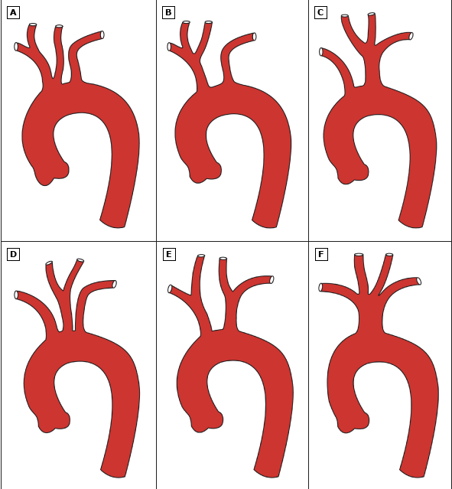
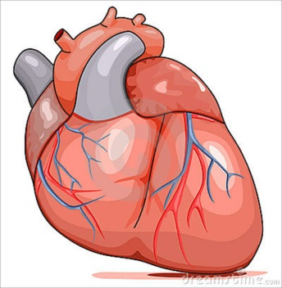
Background: optimal MAP post-CA?
Autoregulation
Cerebral saturation (%)
Afterload
Ameloot et al, Resuscitation 2015
Notes:
If 65mmHg is not enough to perfuse the brain, what then is the optimal MAP in post-CA patients? A subset of post-CA patients (mainly when on treatment for chronic hypertension) has right-shifting of cerebral autoregulation and these patients may benefit from resuscitation to higher MAPS for optimal brain perfusion.
The optimal MAP should maintain cerebral perfusion without exposing the damaged ventricle to excessive afterload
In an observational study, we showed that maximal brain oxygenation is achieved with a MAP of 100mmHg while lower MAP’s were associated with submaximal brain perfusion and higher MAP’s with excessive afterload, a reduction in stroke volume and suboptimal cerebral oxygenation

Slide 4
Aim
EGDHO
MAP 85-100mmHg
SVO₂ 65-75%
Control
MAP 65mmHg
Safe?
Improves cerebral oxygenation and perfusion?
Reduces anoxic brain damage on DW-MRI?
Improves functional outcome at 180 days?
70
Cerebral saturation
65
60
+
Meex, resuscitation 2013
36hrs
Fluids
Inotropes
Vasopressors
Notes:
The AIM of the study was to investigate whether
EGDHO which means targeting a MAP between 85-100mmHg and SVO2 65-75%
by additional fluids, inotropes and vasopressive agents during the first 36hrs of ICU stay
Is SAFE, able to improve ….

Slide 5
Methods: trial design
Investigator driven | Ziekenhuis Oost-Limburg, Genk, Belgium University Hospitals Gasthuisberg, Leuven, Belgium
Randomized | Stratified by presence of shockable rhythm
Parallel group | EGDHO (MAP 85-100mmHg, SVO₂ 65-75%) MAP65mmHg
Open Label | Responsible ICU team
Outcome Assessor blinded | Neurologists (➔ neuroprognostication at day 5) Radiologist (➔ MRI analysis) Statisticians
DSMB | Fabio Taccone (Chair), Karen Hirsch, Niklas Nielsen
Sponsored | IWT grant Flemish government Belgium
Notes:
Therefore we conducted a multicenter investigator driven trial in which patients were randomized as stratified by the presence of a shockable rhythm to either EGDHO or MAP 65mmHg.
Although the responsible ICU team was aware of treatment allocation, all outcome assessors including neurologists performing neuroprognostication, radiologists performing MRI analyses and statisticians were blinded.
The trial was monitored by the DSMB under supervision of Fabio Taccone and sponsored by the Flemish government.

Slide 6
Methods: study population
Inclusion
Exclusion
Out-of-hospital CA of presumed cardiac cause irrespective of the presenting rhythm
Unconsciousness (GCS < 8) at hospital admission
Age ≥ 18 years
Sustained return of spontaneous circulation (ROSC) (=when chest compressions have not been required for 20 consecutive minutes)
Systolic blood pressure < 90mmHg ⬄ NE > 1 mcg/kg/min
ECMO/ECLS
Previous major stroke
MRI incompatible cardiac or neurosurgical device
Notes:
Basically, This is an ALLCOMERS trial including unconscious post-CA survivors irrespective of their presenting rhythm with sustained ROSC for 20min excluding patients with refractory shock upon admission, history of major stroke and MRI incompatible devices

Slide 7
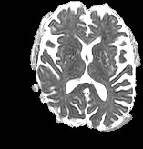
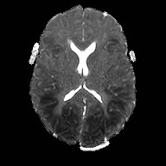
Methods: End-points
Primary
Secondary
DW-MRI at day 5:
% of irreversibly damaged anoxic voxels
(ADC score < 650.10⁻⁶ mm²/s)
Favorable outcome (CPC 1-2)
ICU discharge
180 days
ICU end-points
Length of ICU stay
Days on mechanical ventilator
Need for tracheostomy
Safety end-points
Re-arrest req ALS
Pulmonary edema req diuretics
Limb ischemia
New onset atrial fibrillation
6% 48%
If Β = 0.80 & α=0.05
40% relative reduction
112 patients
Notes:
The PRIMARY outcome was the percentage of irreversibly damaged anoxic brain voxels on DW-MRI performed at day 5
Please compare this example of a patient with 48% anoxic voxels with this near normal MRI
We estimated that we would need to enroll 112 patients to show a 40% relative reduction in the primary end-point
Key secondary outcomes included favorable neurological outcome defined as CPC score 1-2 at ICU discharge and 180 days, length of ICU stay, duration of mechanical ventilation and need for tracheostomy and safety end-points including…

Slide 8
Consort diagram
112 patients randomized
56 to EGDHO
56 to MAP65mmHg
4 were excluded
2 next of kin refused informed consent
2 asphyxia
1 was excluded
asphyxia
FAS
52 patients (42 with MRI)
55 patients (40 with MRI)
1 was excluded
Aortic dissection
4 were excluded
3 with GCS 15/15 at ICU admission
1 with pacemaker
PPS
51 patients (42 with MRI)
51 patients (37 with MRI)
Notes:
A total of 112 patients were randomly assigned to EGDHO (n=56) and a MAP65mmHg strategy (n=56). After exclusion of 2 patients initially included by the emergency procedure whose next of kin finally refused informed consent and 3 patients with clear asphyxia as cause of CA, the FAS consisted of 52 patients assigned to EGDHO and 55 patients to a MAP65mmHg strategy. After a blinded review of the protocol violations and exclusion of 3 patients who had been randomized in the emergency department but completely recovered at the time of ICU admission, 1 patient with a pacemaker and 1 patient with type A aortic dissection requiring immediate surgery, the PPS consisted of 51 patients in each arm of the trial

Slide 9
Neuroprotect: Baseline Characteristics
 | EGDHO | MAP65 | p
Number | 52 | 55
Demographics
Age (years) | 64±12 | 65±13 | 0.99
Male (%) | 39 (75%) | 42 (76%) | 0.75
Arrest characteristics
Basic life support | 31/52 (60%) | 29/53 (55%) | 0.45
Presenting rhythm |  |  | 0.63
Shockable | 36/52 (69%) | 35/54 (65%)
Non-shockable | 16/52 (31%) | 19/54 (35%)
Time-to-ROSC (min) | 18 (10; 25) | 17 (10; 25) | 0.42
Cause of arrest |  |  | 0.65
(n)STEMI | 29/52 (56%) | 33/54 (61%)
Arrhythmogenic | 14/52 (27%) | 13/54 (24%)
Hypoxic | 7/52 (13%) | 4/54 (7%)
Other/unclear | 2/52 (4%) | 4/54 (7%)
Admission
MAP (mmHg) | 88±21 | 85±25 | 0.55
Corneal reflex (presence) | 11/41 (27%) | 24/49 (49%) | 0.02
Angiography
Angio performed | 46/52 (88%) | 48/53 (91%) | 0.73
PCI performed | 27/52 (52%) | 30/54 (56%) | 0.62
56% received BLS
33% non-shockable
58% (n)STEMI
Notes:
Both groups had similar pre-randomization characteristics besides brain stem reflexes being more often present in the MAP65mmHg arm potentially indicating less severe baseline brain damage in these patients
The majority of the patients had an ACS
Only half of the patients received BLS and a third had a non-shockable presenting rhythm indicating that baseline brain damage caused by the first hit in our populatin was probably quit extensive

Slide 10
Neuroprotect: Hemodynamics & Cerebral oxygenation
MAP [mmHg]
Norepinephrine [m/kg/min]
P<0.001
0.5
P=0.02
100
0.4
80
0.3
0.2
60
0.1
Time [hours]
Time [hours]
0
Time [hours]
0
10
20
30
0
10
20
30
Cerebral saturation [%]
Flow MCA [cm/s]
80
P=0.04
P=0.30
P<0.001 (n=10)
100
70
75
50
60
25
50
Time [hours]
Time [hours]
0
10
20
30
1
3
6
12
24
36
Notes:
During the 36-hours interventional period, patients assigned to EGDHO received higher doses of norepinephrine and had higher MAP’s. This resulted in significant improvement of cerebral oxygenation during the first 12 hours and was paralleled by significantly higher cerebral perfusion (p<0.001) in the subset of patients in whom Doppler measurements were performed.

Slide 11
Neuroprotect primary end-point: % anoxic voxels DW-MRI
 | EGDHO | MAP65 | Ratio | p
Number | 42/52 (81%) | 40/55 (73%)
Observed (Median, (Q1,Q3)) | 11% (8;18) | 11% (8;15)
Imputation (Median, (95% CI)) | 16% (13;21) | 12% (9;16) | 1.37 (0.95;1.98) | 0.09
The % of anoxic voxels (ADC score < 650.10-⁶ mm²/s) was only a poor predictor of favorable neurological outcome (CPC 1-2) at 180 days (ROC AUC 0.60)
More patients assigned to EGDHO underwent MRI (Bias)
Notes:
However, this did not result in a reduction of the percentage of irreversibly damaged anoxic voxels on DW-MRI being 16% in the interventional arm and 12% in the control arm
However, the percentage of anoxic voxels was only a poor predictor of favorable neurological outcome at 180 days questioning the validity of the primary end-point
Moreover, MRI could not be performed in 23% of our trial patients since more than expected patients had already died in refractory cardiogenic shock before day 5. More patients in the EGDHO arm underwent MRI scanning and this may have biased DW-MRI findings in favor of the MAP65mmHg arm.

Slide 12
Neuroprotect: favorable neurological outcome (CPC 1-2)
MAP65
p=0.39
p=0.15
p=0.96
p=0.78
FAS
PPS
FAS
PPS
ICU discharge
180 days
Notes:
The percentage of patients with favorable neurological outcome tended to be somewhat higher in the interventional arm although this did not reach statistical signfiicance at ICU discharge and at 180days

Slide 13
Neuroprotect secondary end-points: ICU
 | EGDHO | MAP65 | Ratio | p
ICU stay (days) (Median, (Q1,Q3)) | 7 (5;11) | 8 (5;17) |  | 0.13
Mechanical ventilation (days) (Median, (Q1,Q3)) | 5 (3;9) | 7 (3;13) |  | 0.31
Tracheostomy | 2/52 (4%) | 10/55 (18%) | 0.18 (0.04;0.88) | 0.02
Notes:
Applying EGDHO did not reduce length of ICU stay or duration of mechanical ventilation
However, fewer patients assigned to EGDHO needed a tracheostomy

Slide 14
Neuroprotect safety end-points
Assessed hourly by study nurses
p=0.02
RRR 60%
Recurrent
arrest
Limb
ischemia
New AF
Pulmonary
edema
Any
Notes:
4 predefined safety end-points were assessed hourly by the study nurses.
Despite the use of higher doses of inotropes and vasopressive agents, the adverse event rate was significantly lower in patients assigned to EGDHO and this was mainly driven by a 60% RRR in the occurrence of recurrent CA.

Slide 15
Conclusion
EGDHO
MAP 85-100mmHg
SVO₂ 65-75%
Control
MAP 65mmHg
Safe: ⬇ Re-arrest & serious adverse events
Improves cerebral oxygenation and perfusion
No reduction anoxic brain damage on DW-MRI
No improvement functional outcome at 180 days
      ⬌ Poor accuracy DW-MRI to predict prognosis
      ⬌ Baseline brain damage: too extensive?
      ⬌ Brain stem reflexes: more present in the MAP65mmHg arm
80
P=0.04
P=0.30
X
70
60
50
Time [hours]
0
10
20
30
+
36hrs
Fluids
Inotropes
Vasopressors
Notes:
In conclusion:
Our EGDHO protocol was absolutely safe. Despite …. Future post-hoc analysis will eplore the hypothesis that higher BP ➔ improved coronary perfusion ➔ reduce infarct size ➔ improve prognosis
EGDHO clearly improved cerebral perfusion and oxygenation thereby for the first time providing the proof of concept for this therapy
However, this improvement of O en P did not result in a reduction of … and improvement of functional outcome
This may be related to the poor ability of DW to predict clinical outcome at 180 days thereby not only questioning the validity of the PE but also the added value of MRI for neuroprognostication in post-CA patients
Second, BBD by the 1st hit may have been to extensive to allow …
Finally, corneal reflexes were more often present suggesting that BBD by the 1st hit in the control arm was less extensive

Slide 16




Neuroprotect: Acknowledgements
- CCU attendings cardiology
  S. Janssens, MD, PhD
  T. Adriaenssens, MD, PhD
  J. Bennett, MD, PhD
  W. Desmet, MD, PhD
  C. Dubois, MD, PhD
  P. Sinnaeve, MD, PhD
  T. Vanassche, MD, PhD
- Nursing staff CCU
- T. Petit, MD
- P. Nuyens, MD
- M. Vanhaverbeke, MD
- R. Lemmens, MD, PhD, neurology
- P. Demaerel, MD, PhD, radiology
- R. Peeters, radiology
- CCU attendings dept of cardiology
- K. Ameloot, MD
- J. Dens, MD, PhD
- B. Ferdinande, MD
- M. Dupont, MD
- PJ. Palmers, MD
C. De Deyne, MD, PhD
W. Eertmans, PhD
J. Maeremans, PhD
J. Vundelinckx, MD
Nursing staff CCU
Leuven Coordinating
Center, KU- Leuven, BE
- A. Belmans, PhD
- K. Vandenberghe, PhD
- P. Van Rompaey
- A. Luyten, MD, PhD
- M. Beckx
- K. Broos
DSMB
F. Taccone MD, PhD
K. Hirsch MD, PhD
N. Nielsen MD, PhD

Slide 17
THANK YOU!

