Slide 1
Randomized comparison of an ultrathin strut cobalt-chromium biodegradable polymer sirolimus- eluting stent with a thin strut durable polymer everolimus-eluting stent for PCI –
final 5-year outcomes of the BIOSCIENCE trial
Thomas Pilgrim, MD; Raffaele Piccolo, MD, PhD; Dik Heg, PhD;
Marco Roffi, MD; David Tüller, MD; Olivier Muller, MD; Daniel Weilenmann, MD; Christoph Kaiser, MD; Peter Jüni, MD; Stephan Windecker, MD
Department of Cardiology and Clinical Trials Unit, Bern University Hospital, University of Bern, Switzerland

Slide 2
Declaration of interest
Others (Speaker fees from Biotronik and Boston Scientific)
Research contracts (Research grants to the institution from Biotronik, Boston Scientific and Edwards Lifesciences)
Research contracts (Research grants to the institution from Biotronik, Boston Scientific and Edwards Lifesciences)
Others (Speaker fees from Biotronik and Boston Scientific)
• •
ESC Congress
Munich 2018 •

Slide 3
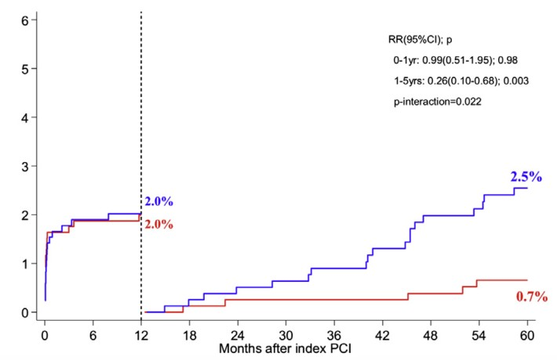
BIODEGRADABLE POLYMERS IN EARLIER GENERATION DES
Landmark Analysis for Definite Stent Thrombosis
Safety benefit of BP BES vs DP SES related to re- duction in very late stent thrombosis (1-5 years).
0-1 year: RR 0.99 (95% CI 0.51-1.95)
1-5 years: RR 0.26 (95% CI 0.10-0.68)
p for interaction = 0.022
LEADERS trial
Serruys PW et al, JACC Interv 2013

Slide 4
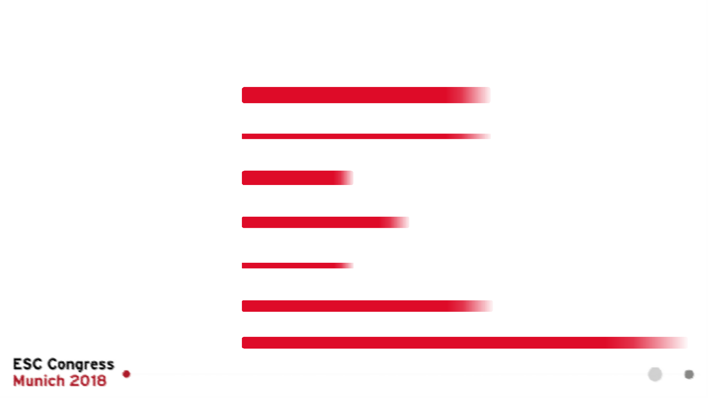
BIODEGRADABLE POLYMER DRUG-ELUTING STENTS
POLYMER/DRUG
Biolimus A9 (15.6 μg/mm)
PLATFORM
*List not comprehensive
BIOMATRIX NOBORI
Length of the bars represents time to biodegradation of the polymer/elution of the drug; bar thickness represents polymer thickness & drug dosage, respectively.
SS 112 μm
PLA
DESYNE BD
Novolimus (65 μg/14mm)
C
81 μm
PLA
Sirolimus (3.9 μg/mm) PDLLA/PCL
ULTIMASTER
C
80 μm
Sirolimus (8 μg/mm)
TIVOLI
C
80 μm
PLGA
SYNERGY
Everolimus (113 μg/ 20 mm; 56 μg/ 20 mm) PLGA
Sirolimus
PLGA
P
74-81 μm
MISTENT
C
64 μm
ORSIRO
Sirolimus (1.4 μg/mm²)
3 months 9 months
Time: drug relase kinetics / biodegradation of polymer
PLLA
C
60-80 μm

Slide 5
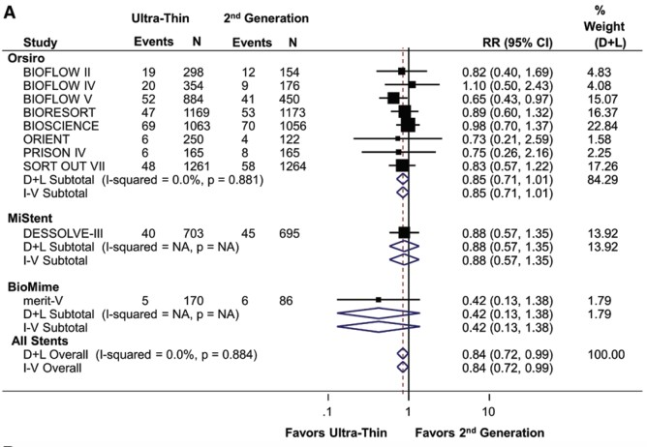
ULTRATHIN STRUT (≤65 μM) VERSUS THIN STRUT DES
Meta-Analysis of 10 RCTs including 11,658 patients
16% reduction of TLF (RR=0.84; 95% CI 0.72-
0.99) driven by lower rate of MI (RR=0.80; 95% CI 0.65-0.99).
Bangalore S et al, Circulation 2018

Slide 6
STENT PLATFORMS
ORSIRO – BP SES XIENCE – DP EES
Cobalt-Chromium, L-605 Cobalt-Chromium, L-605
PLATFORM
80 μm
60 μm 81 μm
≤3.0 mm >3.0 mm
Silicon carbide layer
Biodegradable
PLLA: poly-L-lactic acid
POLYMER
Durable
PBMA/PVDF-HFP
DRUG
Sirolimus
(1.4 μg/mm²)
Everolimus
(1.0 μg/mm²)

Slide 7
PATIENT FLOW CHART
2119 patients included
1063 patients allocated to BP SES (1594 lesions)
1056 patients allocated to DP EES (1545 lesions)
44 lost to follow up 25 refused follow-up
27 lost to follow up 15 refused follow-up
994 follow up information for clinical primary endpoint available up to 5 years
855 followed up and alive 139 followed up and died
1014 follow up information for clinical primary endpoint available up to 5 years
909 followed up and alive 105 followed up and died
1063 analysed for primary clinical endpoint 69 censored at time-point of refusal or loss to follow-up
1056 analysed for primary clinical endpoint 42 censored at time-point of refusal or loss to follow-up

Slide 8
BASELINE CHARACTERISTICS
BP SES (n=1,063) | DP EES (n=1,056)
Age (years) — mean ± SD ^{66.1 ± 11.6} | 65.9 ± 11.4
Male gender — n (%) 818 (77%) | 816 (77%)
Diabetes mellitus — n (%) 257 (24%) | 229 (22%)
Hypertension — n (%) 728 (69%) | 706 (67%)
Hypercholesterolemia — n (%) 712 (67%) | 716 (68%)
Renal failure (GFR<60 ml/min) — n (%) 151 (15%) | 130 (13%)
Left ventricular ejection fraction (%) — mean ± SD 55.7 ± 12.1 | 55.9 ± 12.6
Indication — n (%)
Unstable angina 78 (7%) | 74 (7%)
Non ST-segment elevation MI 288 (27%) | 284 (27%)
ST-segment elevation MI 211 (20%) | 196 (19%)
Stable angina 325 (31%) | 332 (31%)

Slide 9
DUAL ANTIPLATELET TREATMENT
BP SES DP EES
98
99
100
%
84
82
80
*differences between groups statistically not significant
60
40
20
15 15
8 8
0
At Discharge
At 1 Year
At 2 Years
At 5 Years

Slide 10
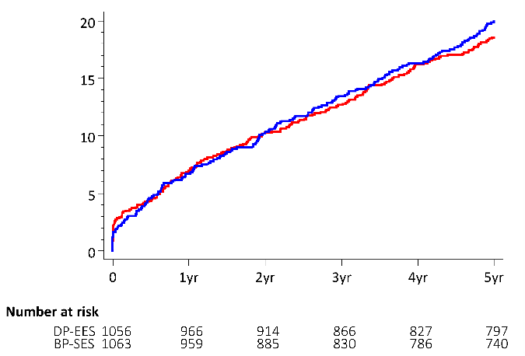
TARGET LESION FAILURE
RR (95% CI) = 1.07 (0.88-1.31)
P = 0.49
20.2% - BP SES
18.8% - DP EES
Target Lesion Failure (%)
^{P} noninferiority ^{= 0.0004}
RR (95% CI) = 0.99 (0.71-1.38)
Pilgrim T et al, Lancet 2014
6.7% - BP SES
6.7% - DP EES
Years since PCI

Slide 11
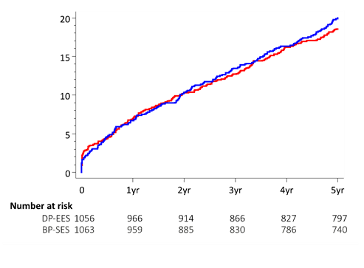
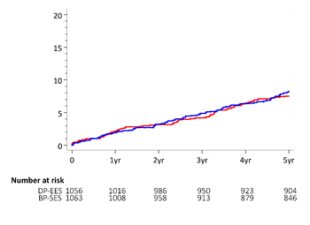
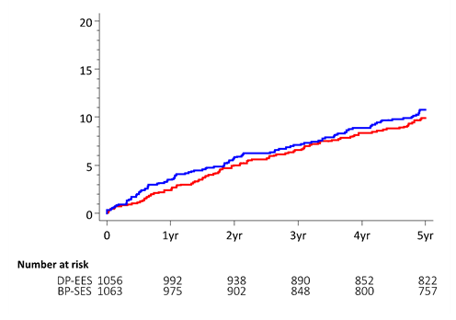
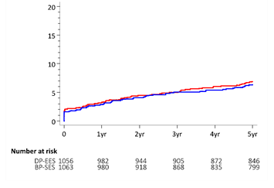
COMPONENTS OF THE PRIMARY ENDPOINT
TARGET LESION FAILURE CARDIAC DEATH
Target Lesion Failure (%)
BP SES DP EES
20.2%
Cardiac Death (%)
18.8%
RR (95% CI) = 1.10 (0.80-1.50)
8.6%
7.5%
RR (95% CI) = 1.07 (0.88-1.31)
TARGET VESSEL MI
RR (95% CI) = 0.91 (0.65-1.28)
Clinically dirven TLR (%)
CLINICALLY DRIVEN TLR
RR (95% CI) = 1.10 (0.83-1.45)
10.8%
10.0%
Target Vessel MI (%)
7.1%
6.3%

Slide 12
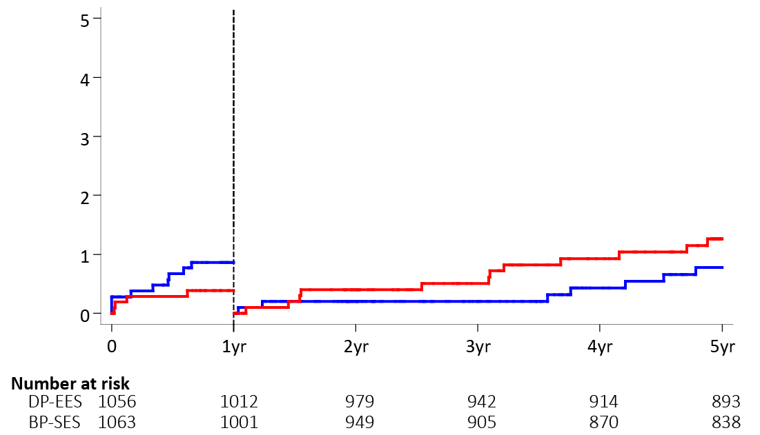
DEFINITE STENT THROMBOSIS
0-1 year: RR (95% CI) = 2.25 (0.69-7.32)
1-5 years: RR (95% CI) = 0.61 (0.24-1.54)
P for interaction = 0.08
Definite Stent Thrombosis (%)
0.7% - BP SES
1.2% - DP EES
0.9% - BP SES
0.4% - DP EES
Years since PCI

Slide 13
ALL-CAUSE &NON-CARDIOVASCULAR MORTALITY
16
14
12
10
8
6
4
2
0
14.1
%
HR (95% CI)
1.10 (0.80-1.50)
10.3
HR (95% CI)
8.6
1.93 (1.22-3.06) P=0.005
7.5
HR (95% CI)
5.3
1.36 (1.06-1.75)
HR (95% CI)
P=0.017
5.05 (0.59-42.97)
2.8
0.5
0.1
All-cause mortality
Cardiac death
Vascular, non-cardiac death
DP-EES
Non-cardiovascular death
BP-SES

Slide 14
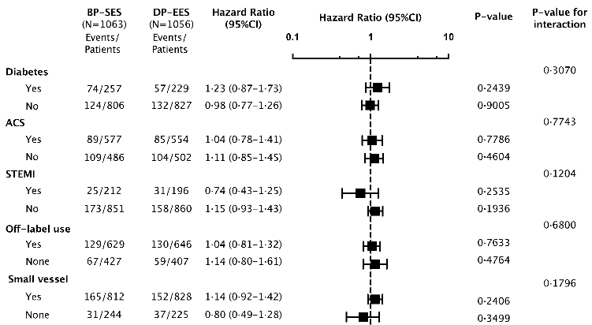
STRATIFIED ANALYSIS OF 1°EP - TARGET LESION FAILURE
Diabetes ACS STEMI Off-label
Small vessels

Slide 15
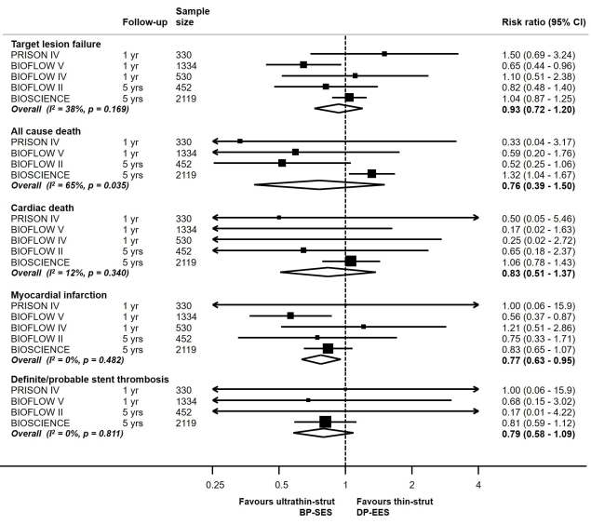
META-ANALYSIS OF FIVE RCTS COMPARING ORSIRO BP SES VS. XIENCE DP EES
n = 4765 patients
23% reduction of myocardial infarction in patients treated with BP SES compared with DP EES (RR=0.77; 95% CI 0.63
-0.95).
PRISON IV. Teeuven K et al, JACC Cardiovasc Interv 2017
BIOFLOW IV/V. Kandzari DE et al, Lancet 2017
BIOFLOW II. Lefèvre T et al, JACC Cardiovasc Interv 2018

Slide 16
CONCLUSION I
The final five-year outcomes of the randomized controlled BIOSCIENCE trial demonstrate comparable outcomes of ultrathin strut biodegradable polymer sirolimus-eluting stents and thin strut durable polymer everolimus-eluting stents with regards to the composite of target lesion failure.

Slide 17
CONCLUSION II
Higher rates of all-cause and non-cardiovascular mortality in patients treated with biodegradable polymer sirolimus-eluting stents warrant careful observation in ongoing studies.
A trend towards a differential in timing of definite stent thrombosis may reflect an effect of the biodegradable polymer.
Lower rates of myocardial infarction in a meta-analysis of BP SES versus DP EES may be related to the ultrathin strut thickness.

Slide 18
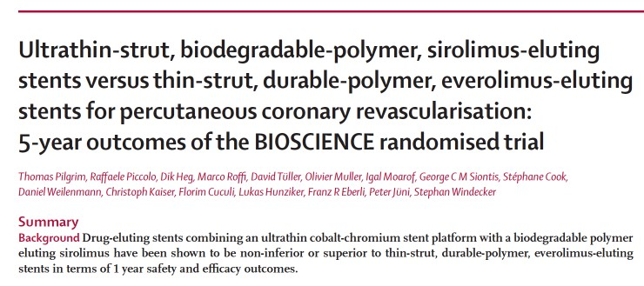
The Lancet, published online August 28, 2018

