Slide 1
Sustained Blood Pressure Reduction with the RNA Interference Therapeutic, Zilebesiran: Primary Results from KARDIA-1, a Phase 2 Study in Patients with Hypertension
George Bakris¹, Manish Saxena^{2,3}, Anil Gupta⁴, Fadi Chalhoub⁵, Maxwell Lasko⁶, Nune Makarova⁶, Nitender Goyal⁶, Weinong Guo⁶, Dion Zappe⁶, Akshay S Desai⁷
¹University of Chicago Medicine, Chicago, IL, USA; ²Barts Health NHS Trust, London, UK; ³Queen Mary University of London, UK; ⁴Albion Finch Medical Centre, Toronto, ON, Canada; ⁵Clinical Neuroscience Solutions, Jacksonville, FL, USA; ⁶Alnylam Pharmaceuticals, Cambridge, MA, USA; ⁷Cardiovascular Division, Brigham & Women’s Hospital, Boston, MA, USA
Presented at the American Heart Association Scientific Sessions, November 11–13, 2023, Philadelphia, PA, USA

Slide 2
Presenter disclosures
George Bakris, MD
FINANCIAL DISCLOSURE:
George Bakris has received consulting fees from Alnylam Pharmaceuticals, AstraZeneca, Bayer, GlaxoSmithKline, InREGEN, Ionis, Janssen, KBP Biosciences, and Novo Nordisk.
UNLABELED/UNAPPROVED USES DISCLOSURE:
Zilebesiran is an investigational product in development for treatment of patients with hypertension.

Slide 3
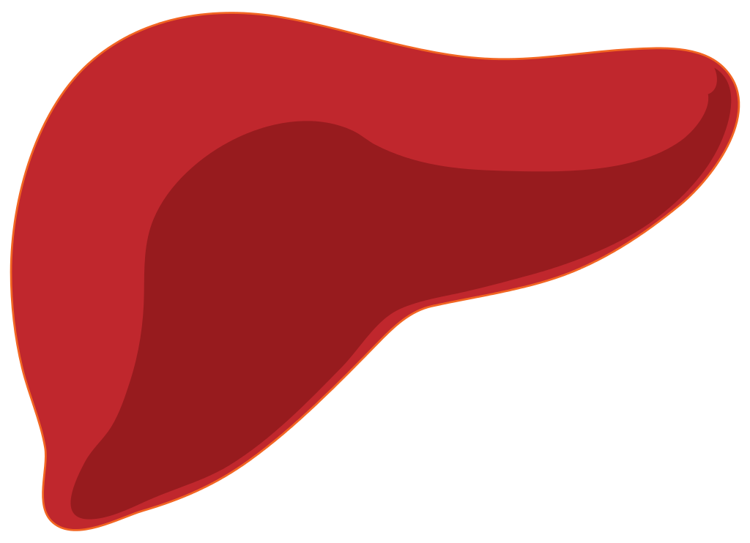
An Unmet Need for Novel Antihypertensive Therapeutics
Hypertension
Uncontrolled hypertension is a leading cause of morbidity and mortality^{1,2}
Despite availability of effective antihypertensives, many adults with hypertension are untreated and up to 80% have uncontrolled disease, both globally and in the USA^{3,4}
Zilebesiran
Zilebesiran is an investigational subcutaneous RNA interference therapeutic that targets hepatic AGT synthesis
Phase 1 study data have demonstrated sustained, dose-dependent reductions in serum AGT levels and blood pressure through 24 weeks after a single dose of zilebesiran in patients with mild-to-moderate hypertension⁵
Objective
To evaluate the efficacy and safety of different dosing regimens of zilebesiran monotherapy in patients with mild-to-moderate hypertension from the Phase 2 KARDIA-1 study
Zilebesiran Mediates Hepatic AGT Reduction
Zilebesiran siRNA
Liver-targeting ligand
AGT
Renin
Des(Ang1)AGT
Angiotensin peptides
AGT, angiotensinogen; des(Ang1)AGT, des(Ang1)angiotensinogen; GalNAc, N-acetylgalactosamine; RNA, ribonucleic acid; siRNA, small interfering ribonucleic acid.
1. Zhou B et al. Nat Rev Cardiol 2021;18:785–802; 2. Danaei G et al. PLoS Med 2009;6:e1000058; 3. World Health Organization. Hypertension. 2021. Available from: www.who.int/news-room/fact-sheets/detail/hypertension (Accessed September 14, 2023); 4. Centers for Disease Control and Prevention. Estimated hypertension prevalence, treatment, and control among U.S. adults. 2022. Available from: https://millionhearts.hhs.gov/data-reports/hypertension-prevalence.html (Accessed September 14, 2023); 5. Desai AS et al. N Engl J Med 2023;389:228–38.

Slide 4
: A Randomized, Double-Blind, Dose-Ranging Study of Zilebesiran in Patients with Mild-to-Moderate Hypertension
Primary Endpoint
Change from baseline at Month 3 in 24-hour mean ambulatory SBP^{b}
Key Secondary Endpoints
Change from baseline at Month 6 in 24-hour mean ambulatory SBP
Change from baseline at Month 3 in office SBP^{b}
Change from baseline at Month 6 in office SBP
Proportion of patients with 24-hour mean ambulatory SBP <130 mmHg and/or reduction ≥20 mmHg without additional antihypertensive medications at Month 6
Safety Endpoint
Frequency of AEs
Placebo Q3M SC
Patient Population (N=394)
Adults 18–75 years of age with daytime mean SBP ≥135 mmHg and ≤160 mmHg by ambulatory BPM, after washout of previous antihypertensive medication for 2–4 weeksª
OR
Zilebesiran 150 mg Q6M SC
OR
1:1:1:1:1 RANDOMIZATION
Zilebesiran 300 mg Q6M SC
OR
Zilebesiran 300 mg Q3M SC
OR
Zilebesiran 600 mg Q6M SC
Rescue antihypertensive medication was permitted after Month 3 assessments and was discontinued by Month 5 for Month 6 assessments
Assessments of patients receiving or within 2 weeks of stopping rescue antihypertensive medication were excluded from analysis to investigate effects of zilebesiran monotherapy
ClinicalTrials.gov registration number: NCT04936035. ªPatients previously taking medication for hypertension must have been without antihypertensives for ≥2 weeks before randomization. Four weeks of washout was required for long-acting antihypertensive medications, such as long-acting diuretics (e.g., chlorthalidone) or CCBs (e.g., amlodipine). ^{b}For analyses of Month 3 endpoints, zilebesiran 300 mg Q3M and Q6M data were pooled together.
AE, adverse event; BP, blood pressure; BPM, blood pressure monitoring; CCB, calcium channel blocker; Q3M, every 3 months; Q6M, every 6 months; SBP, systolic blood pressure; SC, subcutaneous.
Notes:
Notes for data check:
CSR
p 20, part D
P 22, 9.3.1 and p23 9.3.2
For endpoints: p 36
For placebo/dummy: p26/27

Slide 5
Baseline Demographics Were Balanced Across Groups
 |  | Placebo | Zilebesiran |  |  |  | Zilebesiran total
 |  |  | 150 mg Q6M | 300 mg Q6M | 300 mg Q3M | 600 mg Q6M
Disposition | Randomized, nª | 79 | 79 | 78 | 79 | 79 | 315
 | Included in analysis set, nª | 75 | 78 | 73 | 75 | 76 | 302
 | Completed 6-month DB period, n (%) | 70 (92) | 70 (90) | 70 (96) | 68 (91) | 69 (91) | 277 (92)
 | Discontinued study during 6-month DB period, n (%) | 5 (7) | 8 (10) | 3 (4) | 5 (7)^{b} | 5 (7)^{b} | 21 (7)^{b}
 | Discontinued study owing to AE, n | 0 | 1 | 0 | 0 | 0 | 1
Demographics and clinical characteristics | Analysis set, nª | 75 | 78 | 73 | 75 | 76 | 302
 | Mean age, years (SD) | 57 (11) | 56 (11) | 56 (10) | 58 (11) | 57 (10) | 57 (10)
 | Male sex, n (%) | 37 (49) | 39 (50) | 44 (60) | 45 (60) | 45 (59) | 173 (57)
 | BMI, ≥30 kg/m², n (%) | 37 (49) | 46 (59) | 46 (63) | 40 (53) | 45 (59) | 177 (59)
 | Race, n (%)^{c}
 | Asian | 5 (7) | 4 (5) | 2 (3) | 7 (9) | 5 (7) | 18 (6)
 | Black or African American | 18 (24) | 20 (26) | 17 (23) | 19 (25) | 19 (25) | 75 (25)
 | White | 52 (69) | 53 (68) | 54 (74) | 48 (64) | 52 (68) | 207 (69)
 | 24-hour mean ambulatory SBP/DBP, mmHg (SD) | 141 (8)/ 82 (8) | 141 (9)/ 82 (8) | 143 (9)/ 82 (9) | 142 (8)/ 82 (9) | 143 (9)/ 81 (8) | 142 (9)/ 82 (8)
 | Office SBP/DBP, mmHg (SD) | 143 (13)/ 88 (11) | 142 (11)/ 87 (10) | 143 (11)/ 89 (9) | 140 (11)/ 85 (9) | 141 (11)/ 86 (9) | 141 (11)/ 87 (9)
 | eGFR ≥60 mL/min/1.73 m², n (%) | 64 (85) | 68 (87) | 70 (96) | 69 (92) | 68 (90) | 275 (91)
ªDuring the study, 16 patients were randomized from Ukraine in January–February 2022 before geographic conflict started. Owing to the challenge of data collection and cleaning, these patients were excluded from the analyses. One patient in the placebo group was not dosed and was also excluded from analysis. ^{b}Two patients in the 300 mg Q3M group and two patients in the 600 mg Q6M group who discontinued from study treatment during the 6-month DB period are in the safety follow-up period at the time of data cut. These four patients do not have a Month 6 visit and are not considered to have completed the 6-month DB period. ^{c}One patient in the 150 mg Q6M group was American Indian or Alaska Native; one patient in the 300 mg Q3M group was Native Hawaiian or Other Pacific Islander.
AE, adverse event; BMI, body mass index; DB, double-blind; DBP, diastolic blood pressure; eGFR, estimated glomerular filtration rate; Q3M, every 3 months; Q6M, every 6 months; SBP, systolic blood pressure; SD, standard deviation.

Slide 6
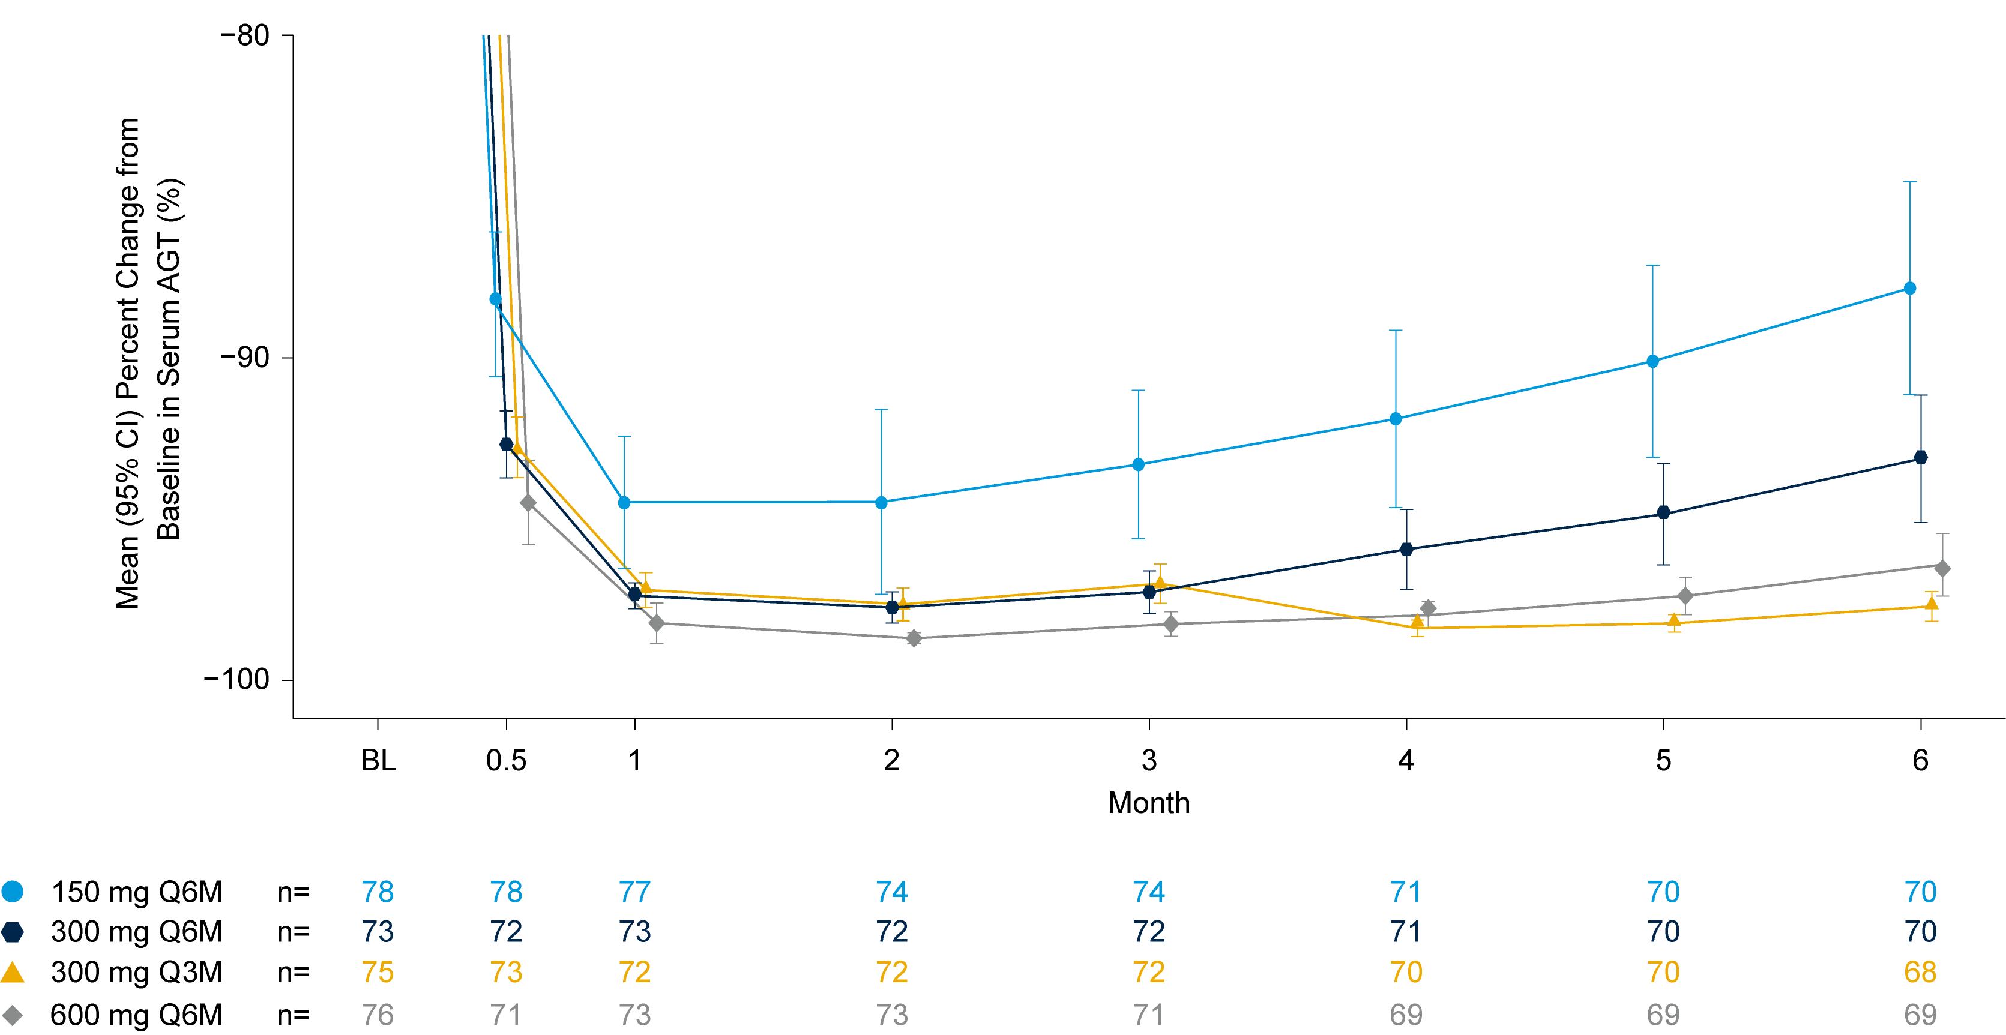
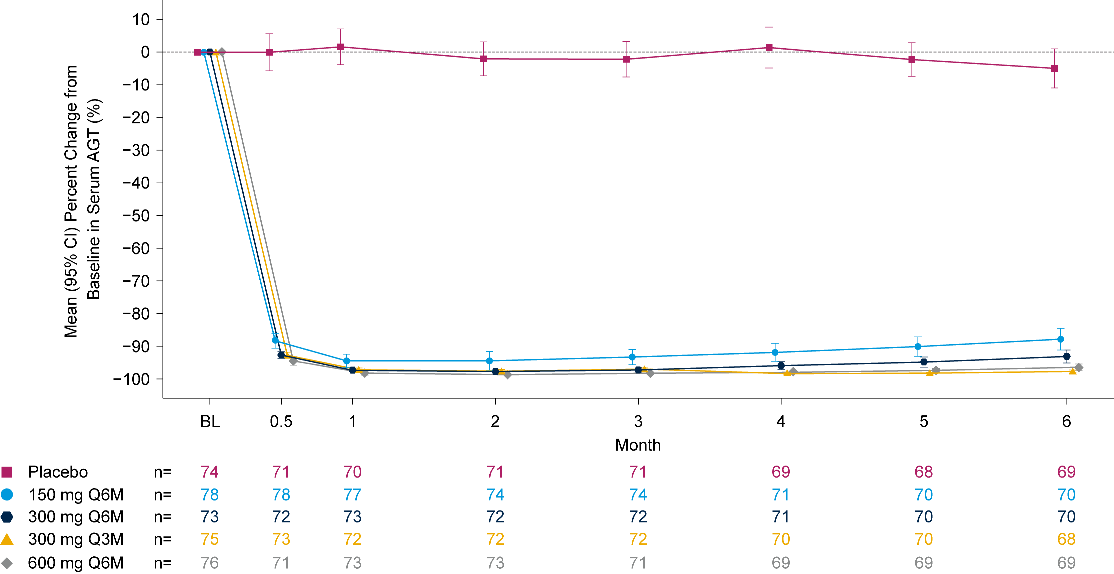
Dose-Dependent Reductions in AGT Observed Through 6 Months
Mean reductions in serum AGT were sustained, with reductions of 88% for 150 mg Q6M, 93% for 300 mg Q6M, 98% for 300 mg Q3M, and 96% for 600 mg doses of zilebesiran at Month 6
Through Month 6, AGT reduction was correlated with SBP change (r [95% CI]: 0.354 [0.298, 0.408]); data on file
Data points are staggered for visualization. AGT, angiotensinogen; BL, baseline; CI, confidence interval; Q3M, every 3 months; Q6M, every 6 months; SBP, systolic blood pressure.

Slide 7
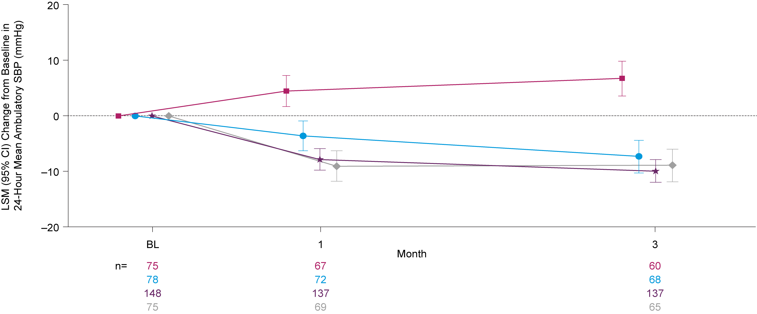
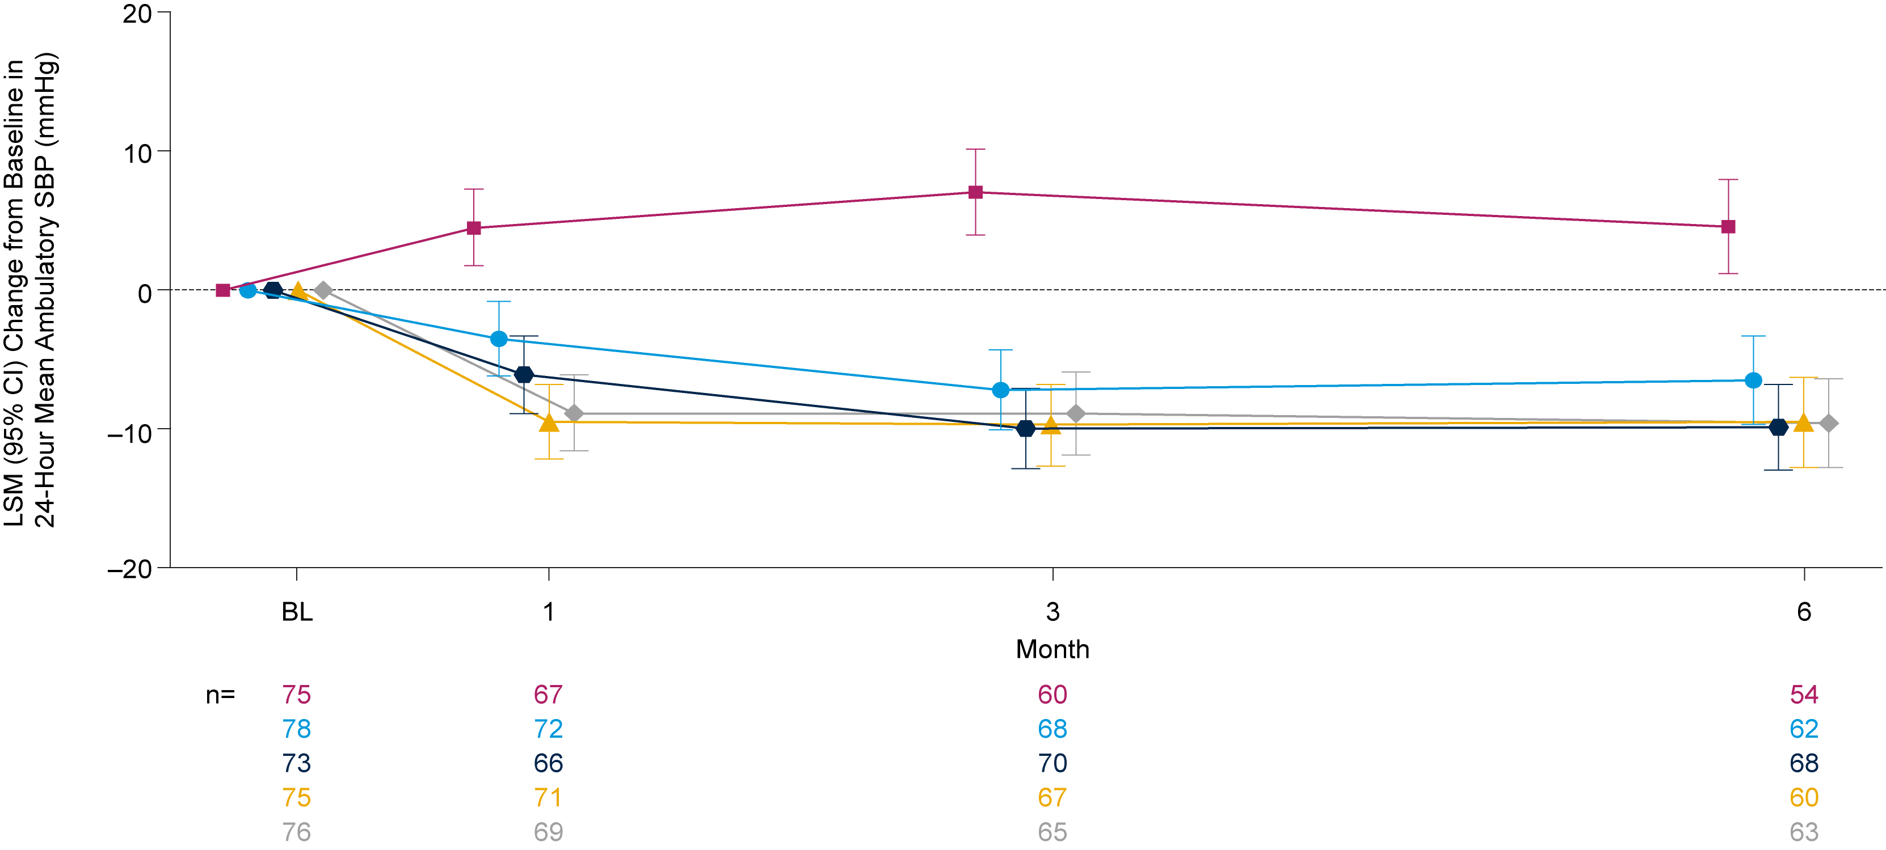
Significant Decreases in ABPM SBP with All Zilebesiran Regimens
Change from Baseline to Month 3 in 24-Hour Mean Ambulatory SBP
Change from Baseline to Month 6 in 24-Hour Mean Ambulatory SBP
Placebo
150 mg Q6M
300 mg Q6M and Q3M combined
600 mg Q6M
Placebo
150 mg Q6M
300 mg Q6M
300 mg Q3M
600 mg Q6M
Month 6 (Key Secondary Endpoint) | 150 mg Q6M | 300 mg Q6M | 300 mg Q3M | 600 mg Q6M
LSMD vs placebo, mmHg (95% CI) | −11.1 (−15.8, −6.4), p=4.5E−06 | −14.5 (−19.1, −9.9), p=1.8E−09 | −14.1 (−18.9, −9.4), p=9.1E−09 | −14.2 (−18.9, −9.5), p=5.8E−09
Month 3 (Primary Endpoint) | 150 mg Q6M | 300 mg Q3M and Q6M | 600 mg Q6M
LSMD vs placebo, mmHg (95% CI)ª | −14.1 (−19.2, −9.0), p=4.2E−10 | −16.7 (−21.2, −12.3), p=1.0E−12 | −15.7 (−20.8, −10.6), p=1.0E−12
Blood pressure assessments were censored if taken while patients were receiving or within 2 weeks after stopping any rescue medication. Data points are staggered for visualization. ªAdjusted 95% CIs and p values for the Month 3 primary analysis are based on Dunnett's test. ABPM, ambulatory blood pressure monitoring; BL, baseline; CI, confidence interval; LSM, least-squares mean; LSMD, LSM difference; Q3M, every 3 months; Q6M, every 6 months; SBP, systolic blood pressure.
Notes:
Notes for data check:
DBP: table 14.2.4.1
Office sbp
Office dbp t14.2.4.3

Slide 8
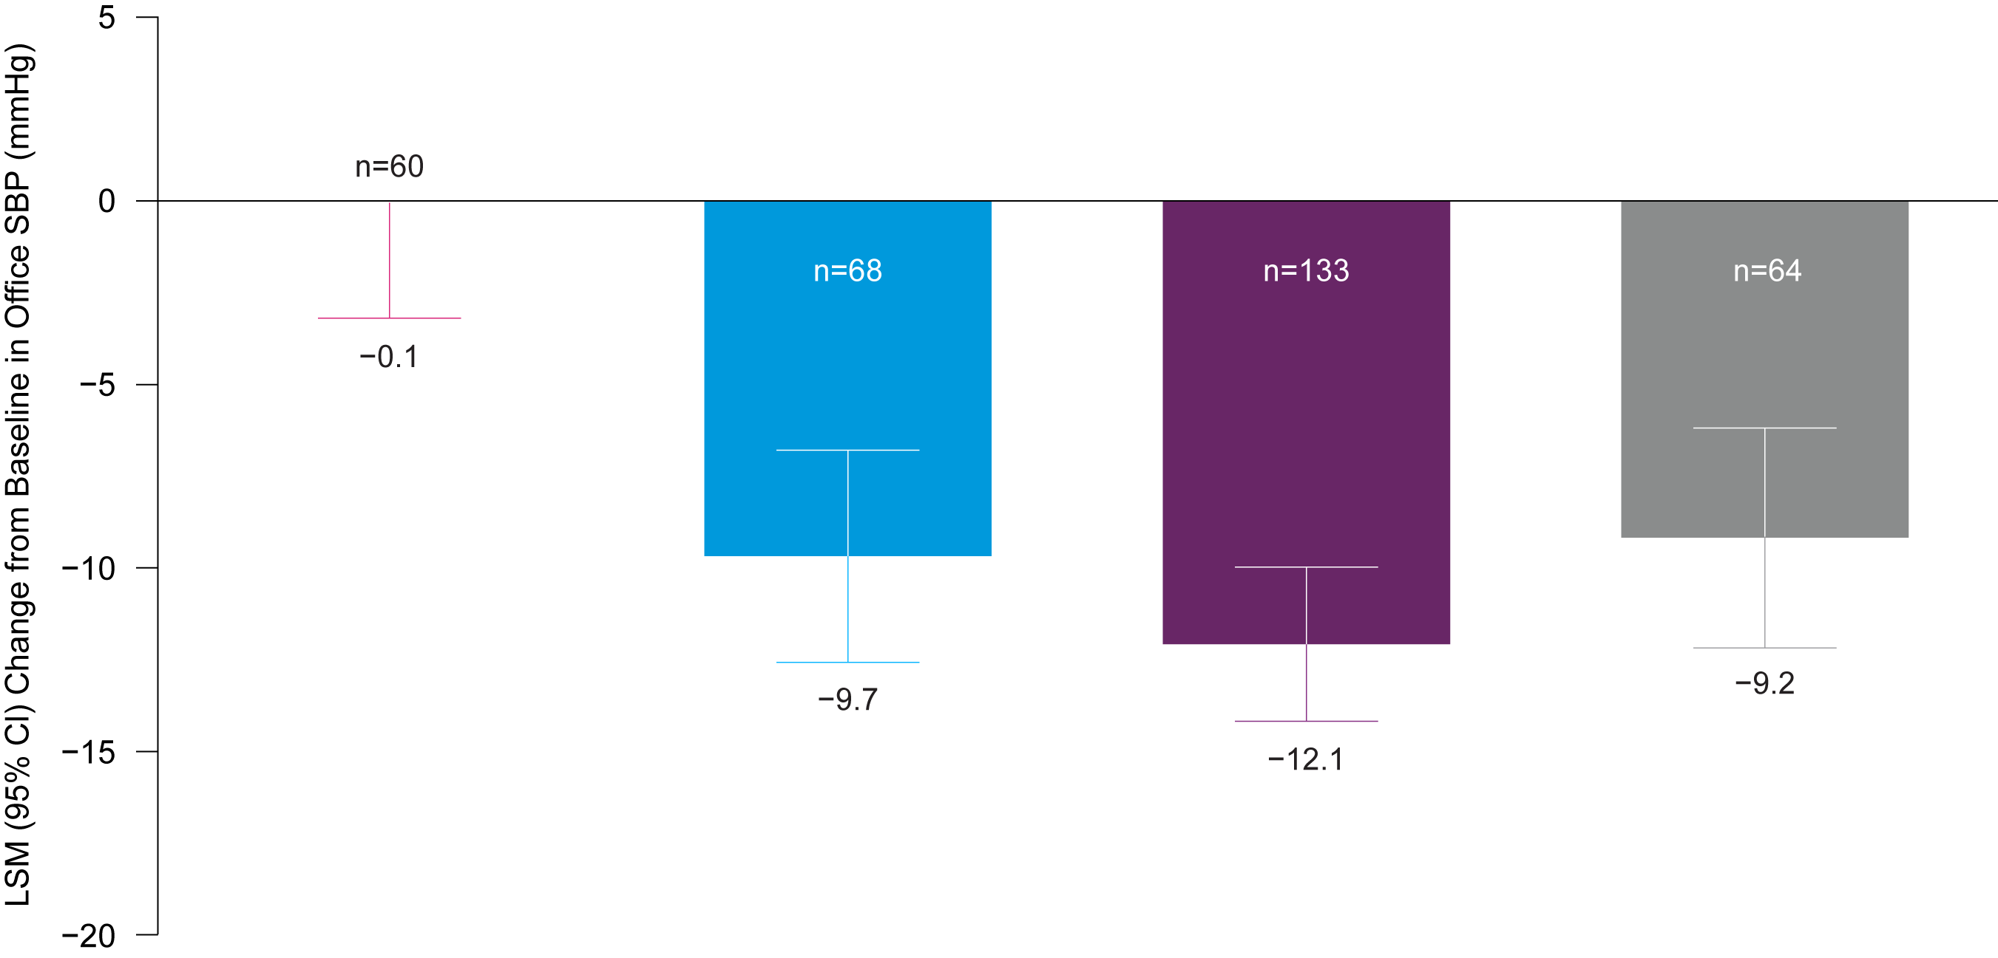
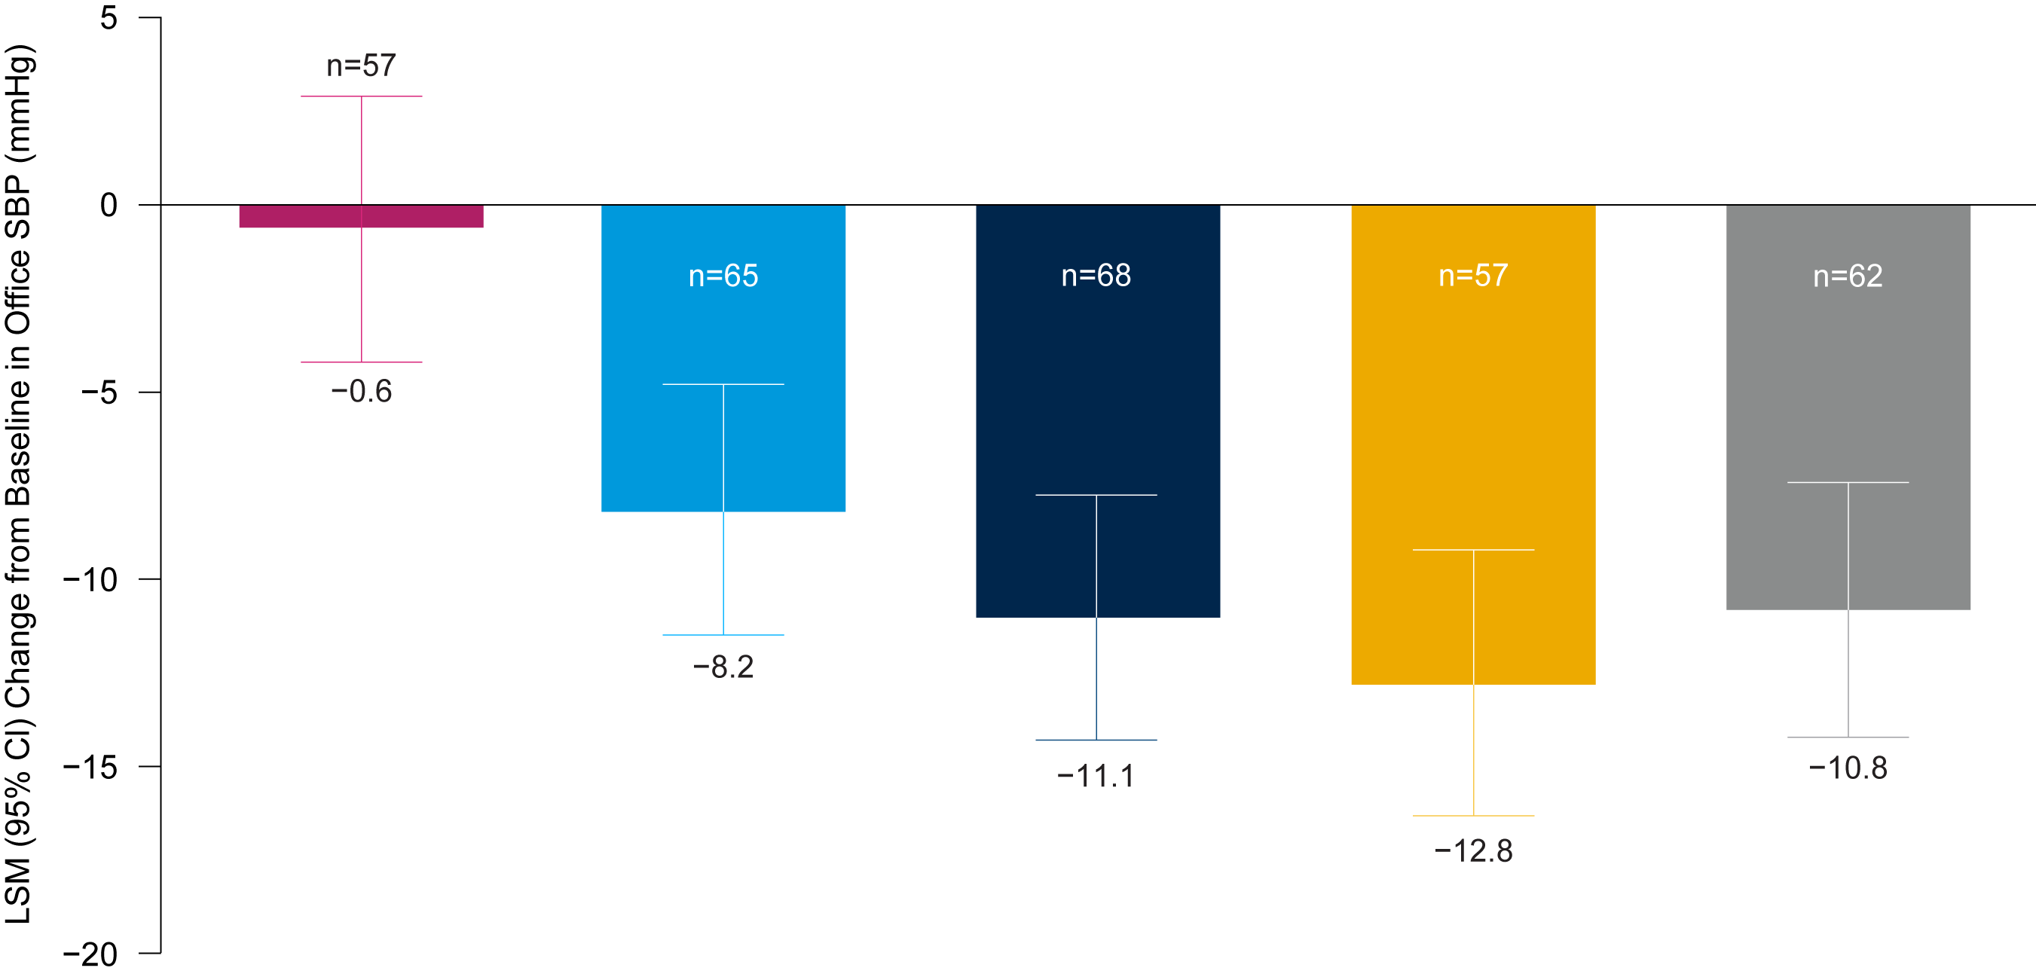
Significant Decreases in Office SBP with All Zilebesiran Regimens
Change from Baseline to Month 3 in Office SBP
Change from Baseline to Month 6 in Office SBP
Placebo
Placebo
150 mg Q6M
150 mg Q6M
300 mg Q6M and Q3M combined
300 mg Q6M and Q3M combined
600 mg Q6M
Placebo
150 mg Q6M
300 mg Q6M
300 mg Q3M
600 mg Q6M
600 mg Q6M
Month 3 (Key Secondary Endpoint) | 150 mg Q6M | 300 mg Q3M and Q6M | 600 mg Q6M
LSMD vs placebo, mmHg (95% CI) | −9.6 (−13.8, −5.3), p=1.3E−05 | −12.0 (−15.7, −8.3), p=8.0E−10 | −9.1 (−13.4, −4.8), p=3.8E−05
Month 6 (Key Secondary Endpoint) | 150 mg Q6M | 300 mg Q6M | 300 mg Q3M | 600 mg Q6M
LSMD vs placebo, mmHg (95% CI) | −7.5 (−12.4, −2.7), p=0.0025 | −10.5 (−15.3, −5.7), p=2.5E−05 | −12.1 (−17.2, −7.1), p=2.8E−06 | −10.2 (−15.1, −5.3), p=5.9E−05
Blood pressure assessments were censored if taken while patients were receiving or within 2 weeks after stopping any rescue medication.
CI, confidence interval; LSM, least-squares mean; LSMD, LSM difference; Q3M, every 3 months; Q6M, every 6 months; SBP, systolic blood pressure.
Notes:
Notes for data check:
DBP: table 14.2.4.4

Slide 9
Consistent Treatment Response Observed with Zilebesiran
The proportion of patients and odds of achieving 24-hour mean ambulatory SBP of <130 mmHg and/or reduction of ≥20 mmHg without additional antihypertensives at Month 6 were significantly higher with all zilebesiran regimens versus placebo
 | Placebo (N=75) | Zilebesiran
 | Placebo (N=75) | 150 mg Q6M (N=78) | 300 mg Q6M (N=73) | 300 mg Q3M (N=75) | 600 mg Q6M (N=76)
Response criteria met, n (%)ª | 5 (7) | 24 (31) | 37 (51) | 29 (39) | 36 (47)
Zilebesiran vs placebo
Odds ratio | – | 6.75 | 19.73 | 10.73 | 17.93
95% CI | – | 2.35, 19.37 | 6.84, 56.89 | 3.76, 30.64 | 6.24, 51.52
p value | – | 0.0004 | 3.4E−08 | 9.3E−06 | 8.4E−08
Treatment response rate defined as proportion of patients with 24-hour mean SBP assessed by ambulatory <130 mmHg and/or reduction ≥20 mmHg without additional antihypertensive medications at Month 6. ªAssessments are missing for 43 patients. CI, confidence interval; Q3M, every 3 months; Q6M, every 6 months; SBP, systolic blood pressure.
Notes:
DC: Table 14.2.1.5

Slide 10
Consistent 24-Hour SBP Control Observed Through Month 3
Hourly Mean SBP and Change from Baseline in Hourly Mean SBP Assessed by Ambulatory BPM over 24 Hours
Placebo (n=75)
150 mg Q6M (n=78)
300 mg Q6M (n=73)
300 mg Q3M (n=75)
600 mg Q3M (n=76)
SBP data to Month 6 were consistent with SBP data to Month 3
DBP data to Month 3 and Month 6 were consistent with SBP data
Daytime is from 6:00 a.m. to 9:59 p.m. Nighttime is from 10:00 p.m. to 5:59 a.m. BPM, blood pressure monitoring; CI, confidence interval; Q3M, every 3 months; Q6M, every 6 months; SBP, systolic blood pressure.

Slide 11
Zilebesiran Had a Favorable Safety Profile Over 6 Months
AE, n (%) | Placebo (N=75) | Zilebesiran |  |  |  | Zilebesiran total (N=302)
AE Category |  | 150 mg Q6M (N=78) | 300 mg Q6M (N=73) | 300 mg Q3M (N=75) | 600 mg Q6M (N=76) | Zilebesiran Total (N=302) n (%) [# events]
At least 1 serious AE | 5 (7) | 0 | 1 (1) | 4 (5) | 6 (8) | 11 (4)
At least 1 severe AE | 3 (4) | 0 | 1 (1) | 5 (7) | 4 (5) | 10 (3)
At least 1 study drug-related AE | 6 (8) | 12 (15) | 12 (16) | 14 (19) | 13 (17) | 51 (17)
Study drug-related AEs occurring in >5% of patients
Injection site reaction | 0 | 3 (4) | 4 (6) | 8 (11) | 4 (5) | 19 (6)
Hyperkalemia | 1 (1) | 4 (5) | 3 (4) | 4 (5) | 5 (7) | 16 (5)
Additional AEs of clinical interest (any relatedness)
Hyperkalemiaª | 2 (3) | 5 (6) | 4 (6) | 5 (7) | 5 (7) | 19 (6)
Hypotension | 1 (1) | 3 (4) | 3 (4) | 3 (4) | 4 (5) | 13 (4)
Hepatic AE^{b} | 1 (1) | 2 (3) | 2 (3) | 4 (5) | 1 (1) | 9 (3)
Acute renal failure^{c} | 0 | 1 (1) | 1 (1) | 1 (1) | 1 (1) | 4 (1)
No drug-related AEs were classified as serious or severe
Drug-related AEs leading to discontinuation of zilebesiran were orthostatic hypotension (n=2), BP elevation (n=1), and ISR (n=1)
Most hyperkalemia AEs were mild and did not require intervention; none were associated with AKI or led to study drug discontinuation
Analysis of serial laboratory testing suggested that most instances of hyperkalemia resolved upon repeat measurement
Hypotension AEs were mild or moderate, non-serious, and transient; a single event with zilebesiran 300 mg Q3M was treated with normal saline
One death due to cardiopulmonary arrest occurred in a patient receiving zilebesiran 300 mg Q3M; it was not classified as drug-related
Definitions based on MedDRA terminology. Potential hypotension AEs (including AEs of hypotension plus additional potentially related terms) were observed in 5 patients (7%) in the placebo group, 6 patients (8%) each in the 150 mg and 300 mg Q6M groups, 5 patients (7%) in the 300 mg Q3M group, and 7 patients (9%) in the 600 mg Q6M group (zilebesiran total, 24 patients [8%]). ªHyperkalemia AEs include AEs mapped to the customized query of hyperkalemia, blood potassium increased, and blood potassium abnormal. ^{b}Hepatic AEs include AEs mapped to the SMQ drug-related hepatic disorders, both narrow and broad terms. ^{c}Acute renal failure AEs include AEs mapped to the SMQ acute renal failure, both narrow and broad terms.
AE, adverse event; AKI, acute kidney injury; BP, blood pressure; ISR, injection site reaction; MedDRA, Medical Dictionary for Regulatory Activities; Q3M, every 3 months; Q6M, every 6 months; SMQ, Standardised MedDRA Query.
Notes:
Not included: AKI

Slide 12
Conclusions
In KARDIA-1, single subcutaneous doses of zilebesiran resulted in clinically meaningful and significant reductions in SBP compared with placebo at Month 3, that were sustained through Month 6
Tonic blood pressure control was demonstrated by consistent 24-hour mean SBP reductions throughout the dosing period across all zilebesiran regimens
Zilebesiran demonstrated an encouraging safety profile over 6 months; rates of serious or severe AEs were low, and only mild or moderate non-serious drug-related AEs were observed across all zilebesiran regimens
Most hyperkalemia AEs were mild, transient, and resolved without intervention, incidence of hypotension events was low, and no clinically relevant changes in renal or hepatic function were observed
These data further support the potential for quarterly or biannual dosing of subcutaneous zilebesiran in achieving a consistent pharmacodynamic effect and effective blood pressure reduction through 6 months
Zilebesiran is being further evaluated as an add-on therapy for treatment of hypertension in the ongoing KARDIA-2 (NCT05103332) Phase 2 study
Thank you to the patients, their families, investigators, study staff, and collaborators for their participation in the zilebesiran KARDIA-1 study​
AE, adverse event; ISR, injection site reaction; SBP, systolic blood pressure.

