Slide 1
Randomised evaluation of short-term DAPT in patients with ACS treated with new-generation DES. Final two-year results of the REDUCE trial
Giuseppe De Luca, MD PhD
Associate Professor of Cardiology Eastern Piedmont University Novara, Italy
On behalf of the REDUCE investigators

Slide 2
Disclosure statement
Speaker's name : Giuseppe De Luca
☑ I do not have any potential conflict of interest to declare

Slide 3
Why this study
Evidence to support routine 12-month DAPT strategy in ACS is still based on a 20-year old ACS trial (PCI CURE), in which only minor benefits in combined death and MI (0.7%) were observed during the randomized study phase ⁽¹⁾
Improvement in DES technology has contributed to a faster re- endothelization and solved all previous safety issues related to stent thrombosis with DES
The COMBO Dual Therapy Stent, which combines abluminal release of sirolimus (to prevent neointima formation) and capture of endothelial progenitor cells (to enhance stent re-endothelialization) ⁽²⁾ may be attractive in the context of ACS
1. Mehta et al. Lancet.2001;358:527-533
2. Granada et al. Circ Cardiovasc Interv 2010;3:257-266

Slide 4
What did we study?
The aim of the Randomised Evaluation of short-term DUal antiplatelet therapy in patients with acute Coronary syndromE treated with a new generation stent (REDUCE) trial was to evaluate
the safety and benefits of a short-term 3-month vs standard 12-month DAPT in ACS patients treated with new generation DES (Combo Dual
Therapy Stent)

Slide 5
How was the study executed?
Design: Investigator-initiated prospective, multicenter, randomized study with two randomization groups (3 versus 12 months DAPT) (NCT02118870)
Primary objective: To evaluate the non-inferiority of a combined safety and efficacy endpoint of a short-term 3 months DAPT, compared to standard 12-month DAPT strategy, in ACS patients treated with the COMBO stent
Key inclusion criteria: ACS patients undergoing successful COMBO stent implantation
Key exclusion criteria: Recent major bleeding, contraindication to DAPT, revascularization with other stent type, need for permanent DAPT due to comorbidities

Slide 6
How was the study executed?
Primary Endpoint: Composite of all cause death, MI, ST, stroke, TVR or bleeding (BARC II, III, V) at 1 year FU
Secondary Endpoints:
Pre-specified Landmark analysis of Primary Endpoint from 3 to 12 month
Individual components of the composite endpoint at 1 and 2 years FU
Sample Size: The calculation was based on a non-inferiority design, with a
1-sided test for differences in independent binomial
proportions at the 2.5% significance level, a power of 80%, and a non-
inferiority margin of 5% (assuming a counterbalance between thrombotic and bleeding complications)
Principal Investigators:
Harry Suryapranata (Radboud University Medical Center, Nijmegen, Netherlands)
Giuseppe De Luca (Eastern Piedmont University, Novara, Italy)
CRO: Diagram BV, Zwolle, Netherlands

Slide 7
What are the essential results?
1,500 ACS patients enrolled between June 2014 and May 2016
in 36 clinical sites in Europe and Asia
IC withdrawal soon after randomization (n=4)
1,496 patients were randomly assigned
3 month DAPT (n=751)
12 month DAPT (n=745)
Clinical follow-up at 12 months in
97.1% (n=729)
Clinical follow-up at 12 months in
98.5% (n=734)
Clinical follow-up at 24 months in
97.6% (n=733)
Clinical follow-up at 24 months in
97.6% (n=727)

Slide 8
What are the essential results?
Baseline Characteristics Angiographic Characteristics
 | 3 month DAPT n = 751 | 12 month DAPT n = 734 | P |  |  | 3 month DAPT n = 751 | 12 month DAPT n = 734 | P
Age (Mean ± SD) | 61.2 ± 11.6 | 60.5 ± 12.0 | NS |  | Radial access (%) | 76.1 | 76.9 | NS
Female Gender (%) | 17.4 | 22.7 | 0.01 |  | Multivessel disease (%) | 36.1 | 33.8 | NS
STEMI diagnosis | 49.3 | 45.2 | NS |  | Target vessel (%): - LAD RCA RCX | 48.0 31.2 19.5 | 44.2 33.0 22.0 | NS NS NS
Diabetes Mellitus (%) | 21.6 | 19.5 | NS
Smoking (%) | 42.1 | 42.7 | NS |  | Initial TIMI flow 3 (%) |  |  | NS
Hypercholesterolemia (%) | 46.3 | 44.9 | NS |  |  | 46.6 | 49.0
Hypertension (%) | 50.7 | 50.7 | NS |  | Thrombosuction (%) | 12.5 | 13.6 | NS
Family history of CAD (%) | 35.0 | 36.0 | NS |  | Total stent length (mm, mean ± SD) | 25.5 ± 12.8 | 25.2 ± 12.7 | NS
Previous ACS (%) | 12.5 | 11.8 | NS |  | Procedural success (%) | 99.3 | 99.7 | NS
Previous PCI (%) | 11.7 | 9.8 | NS |  | PCI additional segments (%) | 20.3 | 21.9 | NS

Slide 9
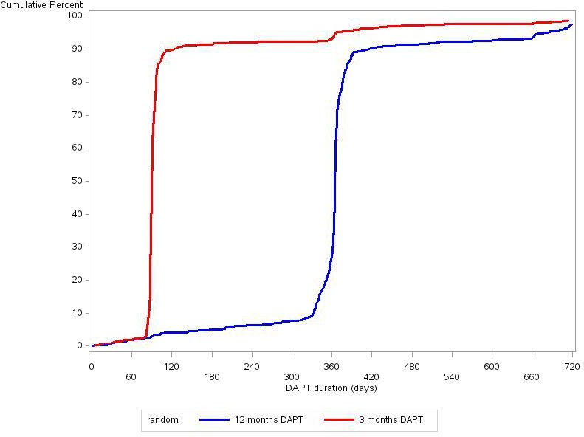
What are the essential results?
 | 3 month DAPT n = 751 | 12 month DAPT n = 734 | P Value
DAPT duration (days, median, Q1-Q3) | 91.0 (89.0-96.0) | 365.0 (363.0-369.0) | <0.001
P2Y₁₂ type (%): Prasugrel Ticagrelor Clopidogrel | 11.1 47.9 41.1 | 9.7 49.9 40.5 | NS

Slide 10
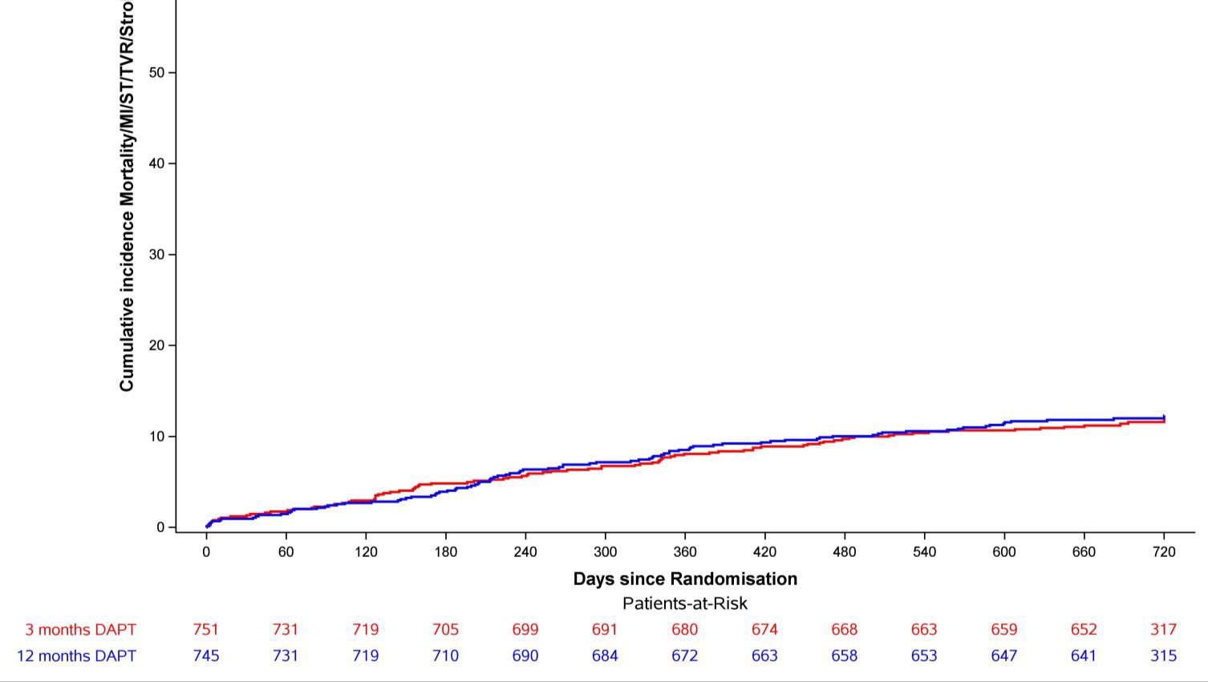
What are the essential results?
Composite of all cause death, MI, ST, stroke, TVR or bleeding (BARC II, III, V)
%

Slide 11
What are the essential results?
Secondary endpoints at 2 YR
2 year follow-up | Overall (N=1460) | 3 months DAPT (N=733) | 12 months DAPT (N=727) | ^{P}superiority logrank | HR [95% CI]
All cause mortality, MI, Stent thrombosis, Stroke, TVR or Bleeding (BARC II/III/V) | 173/1460 (11.8%) | 85/733 (11.6%) | 88/727 (12.1%) | 0.764 | 0.96 [0.71-1.29]
Bleeding (BARC II/III/V) | 53/1460 (3.6%) | 24/733 (3.3%) | 29/727 (4.0%) | 0.465 | 0.82 [0.48-1.41]
 | 130/1460 (8.9%) | 64/733 (8.7%) | 66/727 (9.1%) | 0.832 | 0.96 [0.68-1.36]
All cause mortality, Def/Prob ST, Stroke, MI, TVR
All cause mortality, Def/Prob ST, Stroke or MI | 86/1460 (5.9%) | 45/733 (6.1%) | 41/727 (5.6%) | 0.685 | 1.09 [0.72-1.67]
All cause mortality | 39/1460 (2.7%) | 23/733 (3.1%) | 16/727 (2.2%) | 0.267 | 1.44 [0.76-2.72]
Cardiac mortality | 21/1460 (1.4%) | 13/733 (1.8%) | 8/727 (1.1%) | 0.280 | 1.62 [0.67-3.92]
MI | 48/1460 (3.3%) | 26/733 (3.5%) | 22/727 (3.0%) | 0.577 | 1.18 [0.67-2.08]
Definite/Probable ST | 18/1460 (1.2%) | 12/733 (1.6%) | 6/727 (0.8%) | 0.160 | 2.00 [0.75-5.32]
TVR | 70/1460 (4.8%) | 36/733 (4.9%) | 34/727 (4.7%) | 0.834 | 1.06 [0.66-1.69]
Stroke | 6/1460 (0.4%) | 2/733 (0.3%) | 4/727 (0.6%) | 0.450 | 0.50 [0.09-2.71]
BARC: Bleeding Academic Research Consortium, MI; Myocardial infarction, ST; Stent thrombosis, TVR: Target Vessel Revascularisation

Slide 12
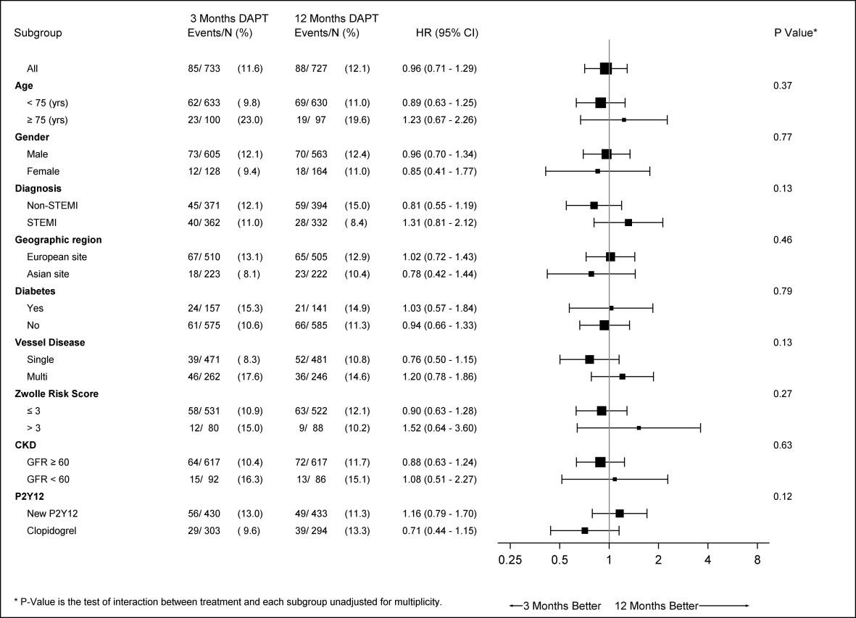
What are the essential results?
Subgroup Analysis of composite endpoint at 2YR
Consistent results across all subgroups, without any significant statistical interaction

Slide 13
Limitations
The lower than expected event rates observed in our study may be due to randomisation strategy after successful stenting → selection bias
Although the non-inferiority margin of 5% may appear relatively large, especially in comparison with an actual primary endpoint event rate of 8.3%, our study should be placed in the context of other non-inferiority
stent studies
Sample size estimation was based on a postulated event rate of 12%, which was higher than the actual rate of 8.3% at 1 year follow-up, but consistent with the rate observed at 2 years follow-up showing a similar outcome between the groups (11.6% vs. 12.1%)
Significant difference in gender between the two groups
Study was performed unblinded, with no placebo control
Use of P2Y12 inhibitors was heterogeneous, reflecting real world practice.

Slide 14
Why is this important?
The REDUCE trial is the first study restricted to ACS patients, comparing a short 3-month vs a standard 12-month DAPT
The results of the REDUCE trial show that among ACS patients treated with
COMBO, 3 months is non-inferior to 12 months DAPT
However, given the numerically higher rates of mortality and ST in the 3 months DAPT group, 1-year DAPT should still be recommended in ACS until more information becomes available
Short-term DAPT may be considered only if clinically mandated such as in
high-risk bleeding patients

Slide 15
The essentials to remember
Why?
Evidence to support routine 12-month DAPT strategy in ACS is still based on a 20-year old ACS trial (PCI CURE)
What?
To evaluate the safety and benefits of a short-term 3-month vs standard 12-month DAPT in ACS patients treated with new generation DES
How?
1,496 patients treated with COMBO stent were randomly assigned to 3 vs 12 months DAPT
What are the results?
3 months is non-inferior to 12 months DAPT. However, numerically higher rates of mortality and ST were observed in the 3 months DAPT group
Why is important?
Until more information becomes available, 1-year DAPT should still be recommended in ACS. Short-term DAPT may be considered only if clinically mandated such as in high-risk bleeding patients

