Slide 1
Effects of Pitavastatin on Coronary Artery Disease and Inflammatory Biomarkers: Mechanistic Substudy of the REPRIEVE Primary Prevention Trial in HIV
Michael T. Lu, MD, MPH
MGH Cardiovascular Imaging Research Center
For the REPRIEVE Trial Investigators

Slide 2
Disclosures
REPRIEVE is funded by the NHLBI, NIAID, Kowa Pharmaceuticals, Gilead, ViiV Healthcare
Support from the AIDS Clinical Trials Group (ACTG) and DAIDS
MTL reports unrelated research funding to the Massachusetts General Hospital: American Heart Association, AstraZeneca, Ionis, Johnson & Johnson Innovation, NHLBI, National Academy of Medicine, and the Risk Management Foundation of the Harvard Medical Institutions Incorporated.

Slide 3
Background
People with HIV (PWH) have 1.5-2x risk of cardiovascular disease relative to general population
HIV characterized by inflammation and a higher burden of noncalcified coronary plaque
Statins have pleiotropic effects on LDL, inflammation, immune activation, and plaque remodeling
Pitavastatin is a moderate intensity statin which has minimal interaction with antiretroviral therapy in HIV
Triant VA et al. JCEM 2007.
Frieberg MS et al. JAMA IM 2013.
Hsue PY, Waters DD. Nat Rev Cardiol 2019.

Slide 4
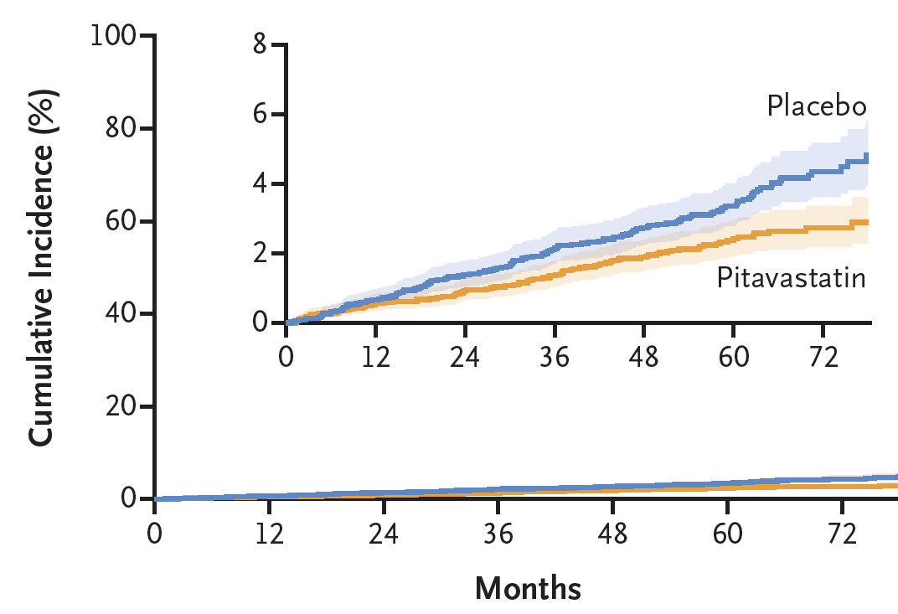
REPRIEVE Design & Overall Results
REPRIEVE enrolled 7,769 PWH on ART with low-moderate 10-year ASCVD risk, in 145 sites from 12 countries
1:1 randomization to 4 mg pitavastatin calcium PO QD vs matched placebo
Pitavastatin reduced MACE by 35% over median 5.1 years of follow-up (CV Death, MI, Stroke, UA, Stroke, TIA, Arterial Revasc)
MACE ↓ of 35% beyond the 17% anticipated for LDL ↓ alone (median 107 to 74 mg/dL) based on meta regression data from the CTT Collaboration (Lancet 2010)
Grinspoon SK et al. NEJM 2023.
www.reprievetrial.org

Slide 5
REPRIEVE Mechanistic Substudy
AIM: To identify pitavastatin effect on noncalcified coronary plaque and inflammatory & immune biomarkers, as mechanisms for prevention of MACE
PRIMARY HYPOTHESIS: Pitavastatin will decrease noncalcified plaque volume and reduce plaque progression over 24 months vs placebo
SECONDARY & EXPLORATORY:
↓ in inflammatory biomarkers
↓ low attenuation plaque volume
Parent study enrolled 7,769 with MACE as primary endpoint. Substudy enrolled 804 from 31 US sites and was powered to assess changes in noncalcified plaque.
Randomization stratified by mechanistic substudy participation
Screening
and
Consent
Asymptomatic PWH on ART, with low-moderate ASCVD risk
R
N=7,769
Randomization
Placebo
Pitavastatin
Intervention
Mechanistic
N=804
Substudy
Noncalcified coronary plaque,
Mechanistic
Inflammation,
immune activation
Endpoints
Unstable Angina
Arterial Revasc
Clinical Primary
Endpoint
CVD Death
MI
TIA & Stroke
PAD
Hoffmann U, Lu MT, et al. Am Heart J 2019.

Slide 6
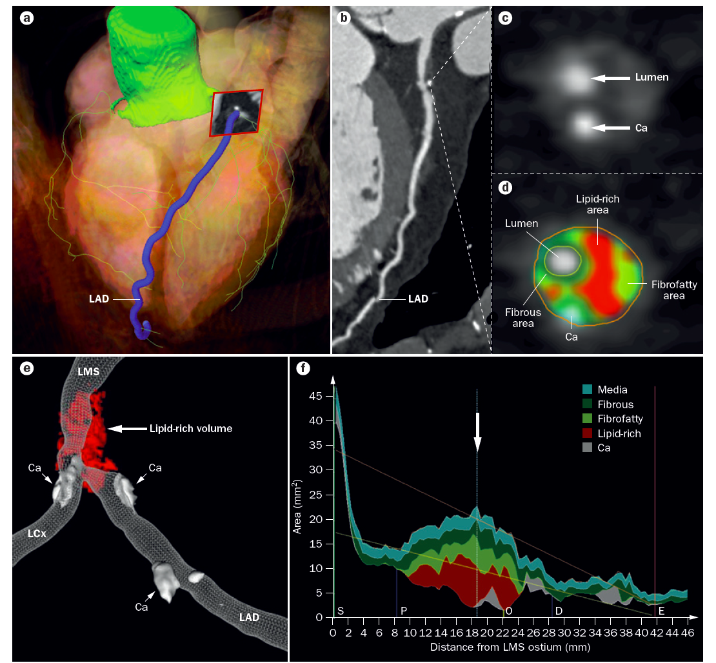
Coronary CTA Endpoints
Noninvasive quantification of $∆$coronary plaque volume & composition
Primary Outcome:
$∆$ noncalcified plaque (<350 HU) volume in mm³
Noncalcified plaque progression (any increase or new plaque)
Secondary and Exploratory:
$∆$ low attenuation plaque (<30 HU) volume
90% power to detect 6% difference in $∆$ noncalcified plaque volume.
Intention to treat analysis in participants completing CCTA
Maurovich-Horvat P. Nat Rev Cardiol 2014

Slide 7
Baseline Characteristics
Characteristic |  | Pitavastatin (N=402) | Placebo (N=402)
Age (years) | Mean (SD) | 51 (6) | 51 (6)
Natal sex* | Female | 70 (17%) | 69 (17%)
Race* | White | 210 (52%) | 215 (53%)
 | Black | 137 (34%) | 155 (39%)
 | Asian | 5 (1%) | 5 (1%)
 | Other | 50 (12%) | 27 (7%)
Ethnicity* | Hispanic or Latino | 103 (26%) | 89 (22%)
 | Not Hispanic | 294 (73%) | 307 (76%)
Time since HIV diagnosis (years) | Median (Q1,Q3) | 15 (9,21) | 15 (9,22)
ASCVD risk score (%) | Median (Q1,Q3) | 4.5 (2.6,6.8) | 4.6 (2.6,7.0)
LDL cholesterol (mg/dL) | Median (Q1,Q3) | 105 (88,124) | 107 (90,129)
Noncalcified coronary plaque volume (mm³) | Mean (SD) | 52.3 (193.5) | 57.7 (109.2)
*Similar natal sex (23% female), race (40% Black), and ethnicity (29% Hispanic) reported across USA. UNAIDS Data 2021. Geneva: Joint United Nations Programme on HIV/AIDS, 2021 and https://www.hiv.gov/hiv-basics/overview/data-and-trends/statistics/

Slide 8
2-Year Change in Noncalcified Plaque Volume
Pitavastatin arm:
-4.3 mm³ (-7%) decrease in noncalcified plaque volume vs placebo
-8.8 mm³ (-12%) in subgroup with plaque at baseline
33% lower risk of noncalcified plaque progression
Similar in per protocol and multiple imputation analyses
 | Treatment arm |  | Treatment effect*
Outcome | Pitavastatin (N=386) | Placebo (N=388) | Difference (95% CI) | P
Noncalcified plaque volume, mm³
Change from baseline, mean (SD) | -1.7 (25.2) | 2.62 (27.1) | -4.3 (-8.6, -0.1) | 0.044
Fold-change from baseline (95% CI) | 0.95 (0.91, 1.0) | 1.02 (0.99, 1.05) | 0.93 (0.88, 0.99) | 0.024
Progression of NCP, N (%) | 53 (18%) | 85 (28%) | 0.67 (0.52, 0.88) | 0.003
Low attenuation plaque volume, mm³
Change from baseline, mean (SD) | -0.9 (9.97) | -0.1 (8.16) | -1.2 (-2.2, -0.1) | 0.026
* Adjusted for baseline value

Slide 9
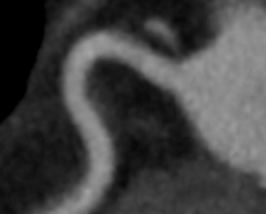
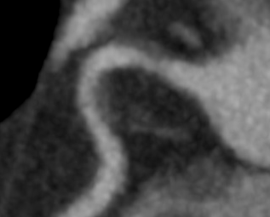
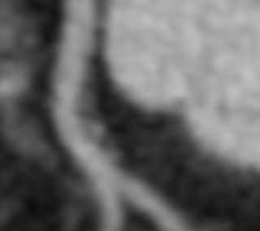
Examples: Plaque Progression & Regression
ENTRY
YEAR 2
PLACEBO
PITAVASTATIN

Slide 10
LDL & Non-HDL Cholesterol
 | Entry |  | Year 2
 | Pitavastatin (N=402) | Placebo (N=402) | Pitavastatin (N=402) | Placebo (N=402)
LDL Cholesterol, mg/dL | 105 (88, 124) | 107 (90, 129) | 74 (59, 93) | 108 (87, 128)
Change from Baseline |  |  | -29 (-49, -11) | 0 (-15, 16)
Non-HDL Cholesterol, mg/dL | 130 (111, 156) | 132 (111, 161) | 99 (81, 124) | 133 (109, 159)
Change from Baseline |  |  | -35 (-54, -12) | 2 (-16, 18)
Values are median (Q1, Q3)
Mean ↓ LDL: Pitavastatin -28.5 mg/dL vs placebo -0.8 mg/dL

Slide 11
Inflammatory Biomarkers
 | Entry |  | Year 2
 | Pitavastatin (N=402) | Placebo (N=402) | Pitavastatin (N=402) | Placebo (N=402) | P*
Lp-PLA2 (ng/mL) | 126 (94.8, 169) | 131 (89.6, 163) | 118 (83.5, 158) | 142 (103, 185) | <0.001
Change from Baseline |  |  | -10.1 (-33.6, 16.2) | 19.3 (-6.41, 42.2) | <0.001
oxLDL (U/L) | 53.0 (42.2, 69.8) | 53.6 (41.7, 69.9) | 37.6 (30.0, 47.3) | 48.2 (38.9, 58.4) | <0.001
Change from Baseline |  |  | -14.9 (-28.9, -3.93) | -6.45 (-20.2, 5.26) | <0.001
hs-CRP (mg/L) | 1.80 (0.80, 3.90) | 1.80 (0.90, 3.30) | 1.70 (0.70, 3.60) | 1.90 (1.00, 4.00) | 0.021
Change from Baseline |  |  | -0.10 (-1.00, 0.80) | 0.10 (-0.90, 1.10) | 0.09
*P for between arm difference at year 2 or change from baseline
Significant ↓ in Lp-PLA2 and oxLDL vs placebo
Trend towards ↓ in hs-CRP
No significant relative ↓ in other biomarkers (MCP-1, sCD14, sCD163, IL-6, IL-1 Beta, IL-18, UL-10, and Caspase-1)

Slide 12
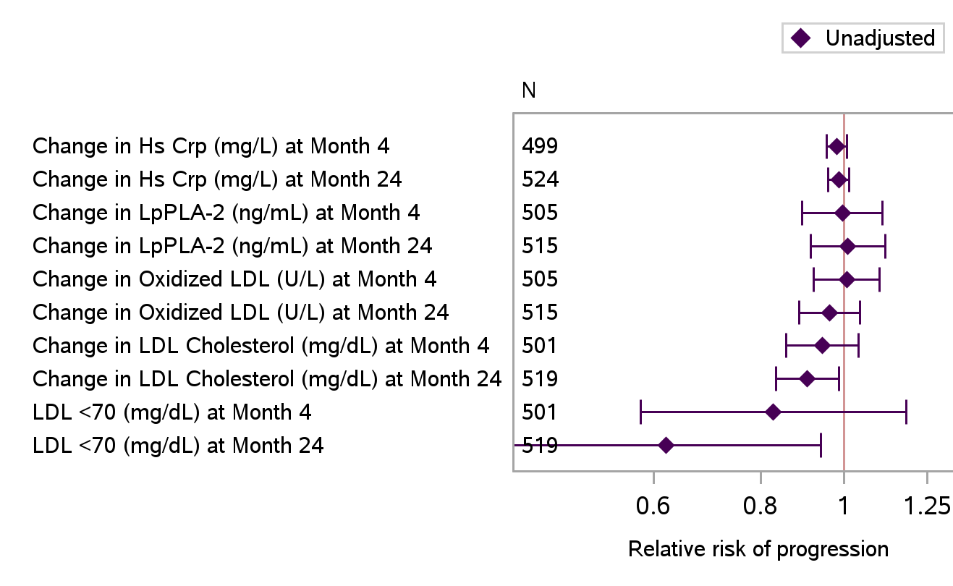
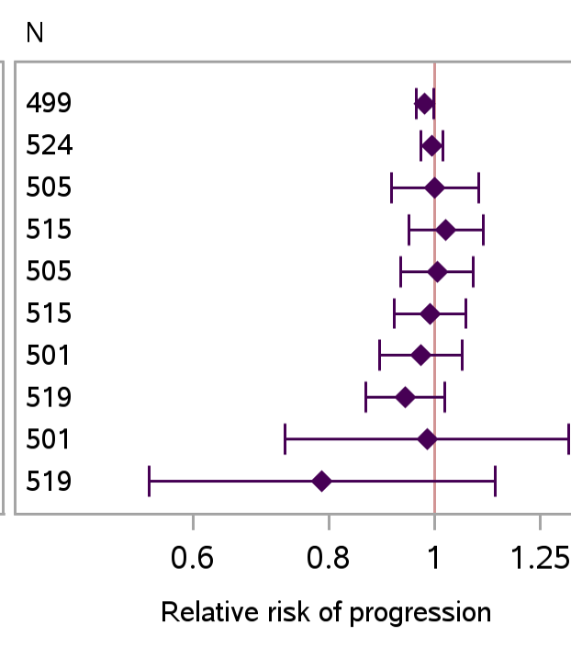
$∆$Biomarkers and Plaque Progression
Relative risk per 25% reduction or achieved LDL <70 mg/dL
∆LDL and achieved LDL <70 mg/dL associated with lower risk of noncalcified plaque progression, but confidence intervals cross 1 after adjusting for baseline plaque

Slide 13
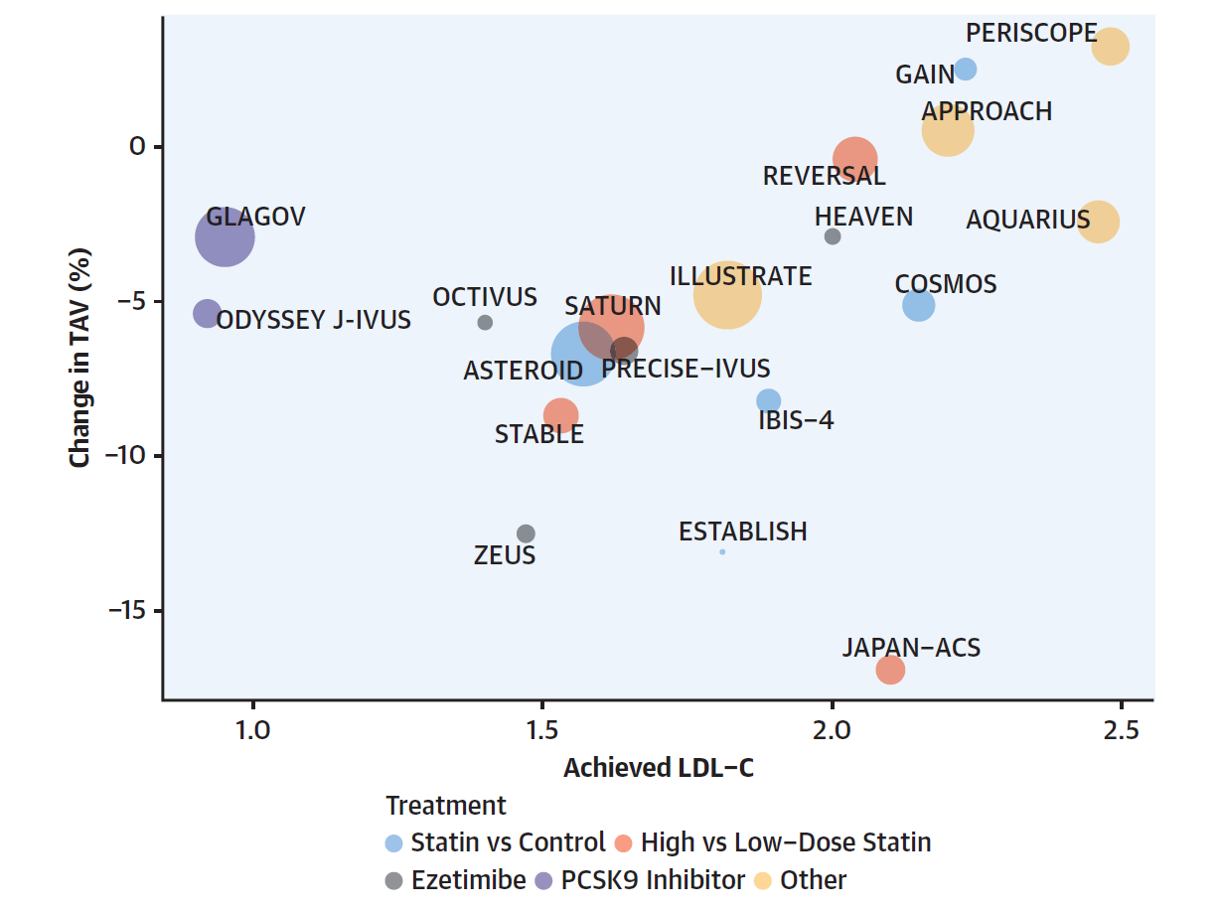
Comparison to Plaque Changes and Achieved LDL on IVUS
REPRIEVE achieved year 2 median LDL 74 mg/dL (1.9 mmol/L)
Overall, -7% NCP volume
In subgroup with plaque at baseline, -12% NCP volume
Change in NCP (%) or
REPRIEVE
Pitavastatin vs Control in PWH
Modified from Dawson LP et al. JACC 2022

Slide 14
Conclusions
In this primary prevention PWH population at low-moderate CVD risk, 24 months of pitavastatin led to:
Relative ↓ noncalcified plaque volume by 7% and ↓ risk of plaque progression by 33%
↓ lipid oxidation and arterial inflammation (oxLDL, Lp-PLA2)
These changes may contribute to 35% reduction in MACE with pitavastatin observed in the parent REPRIEVE trial
eg: 1%↓ in plaque associated with 25% ↓ odds of MACE in meta-analysis of IVUS studies
Iatan I et al. JAMA Cardiol 2023.

Slide 15
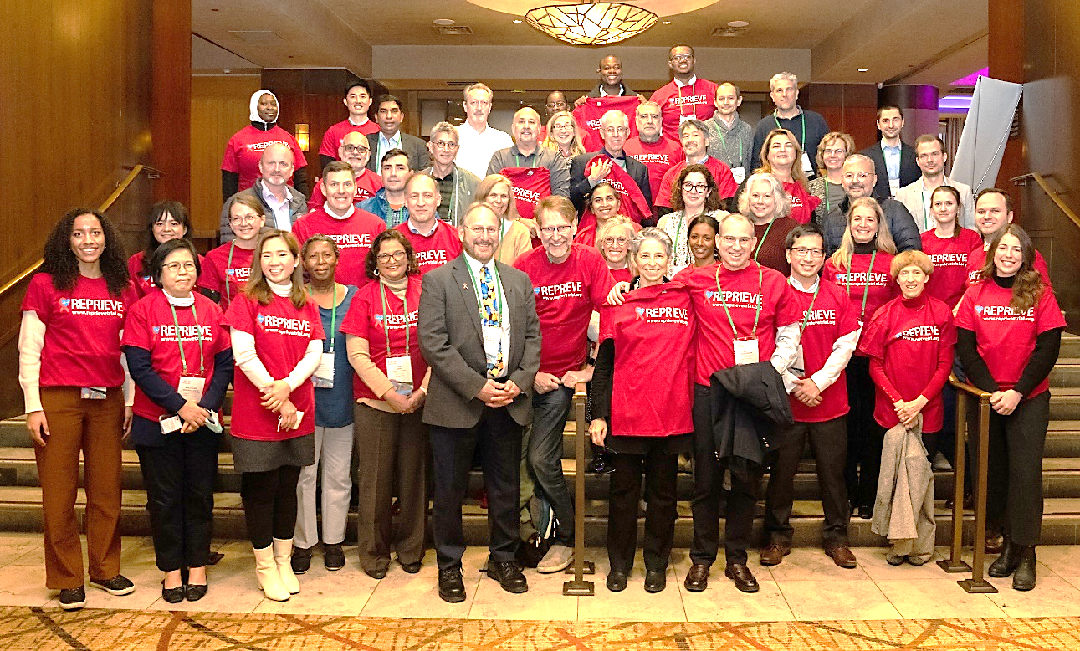
Thank You!!
Participants
31 Substudy Sites
REPRIEVE Data Coordinating Center
HSPH CBAR statistics
FSTRF data management
TIMI event adjudication
MGH events & CT core lab
REPRIEVE Clinical Coordinating Center
NHLBI, ACTG, DAIDS
Authors: Michael T. Lu, MD, MPH; Heather Ribaudo, PhD; Borek Foldyna, MD; Markella V. Zanni, MD; Thomas Mayrhofer, PhD; Julia Karady, MD, PhD; Jana Taron, MD; Kathleen V. Fitch, MSN; Sara McCallum, MPH; Tricia H. Burdo, PhD; Kayla Paradis, MBA; Sandeep S. Hedgire, MD; Nandini M. Meyersohn, MD; Christopher DeFilippi, MD; Carlos D. Malvestutto, MD, MPH; Audra Sturniolo, MS; Marissa Diggs, BA; Sue Siminski, MBA; Gerald S. Bloomfield, MD; Beverly Alston-Smith, MD; Patrice Desvigne-Nickens, MD; Edgar T. Overton, MD; Judith S. Currier, MD; Judith A. Aberg, MD; Carl J. Fichtenbaum, MD; Udo Hoffmann, MD, MPH; Pamela S. Douglas, MD; and Steven K. Grinspoon, MD for the REPRIEVE trial writing group

