Slide 1
Benefit of a target LDL cholesterol of less than 70 mg/dL after an ischemic stroke of atherosclerotic origin Results of the Treat Stroke to Target trial*
TST
Charles Foix Group for Clinical Trial in Stroke
Embargoed for 9 a.m. ET, 11-18-2019
Amarenco P, Kim JS, Labreuche J, Charles H, Giroud M, Mahagne M-H, Nighoghossian N, Steg PG, Touboul PJ, Vicaut E, Bruckert E on behalf of the Treat Stroke to Target investigators
*Investigator intiated RCT
Conducted by the Charles Foix Group for Clinical Trial in Stroke (ARO) at Bichat hospital – University of Paris
Supported by the French Neurovascular Society
Funding : PHRC (French government), SOS-ATTAQUE CEERBRALE Association (NPO)
Unrestricted grant : Pfizer Europe, Astra-Zeneca, Merck, Pfizer global (Korea)

Slide 2
Background
TST
The SPARCL trial¹ found a 16% relative risk reduction in stroke with atorvastatin 80 mg per day as compared to placebo in patients with stroke and no known coronary heart disease
In the group with carotid stenosis² the relative risk reduction was 33%
In SPARCL, patients achieving a LDL cholesterol of less than 70 mg/dL (1.8 mmol/L) had a 28% relative risk reduction as compared to patients who achieved 100 mg/dL (2.4 mmol/L) or above³
Current AHA/ASA guidelines⁴ recommend “intense” statin therapy after an ischemic stroke of atherosclerotic origin but does not stipulate a target level of LDL cholesterol because there is limited data on outcomes with different LDL-cholesterol lowering targets
Therefore, there is uncertainty about the target level of LDL cholesterol is appropriate to reduce cardiovascular events after stroke
1.SPARCL investigators. N Engl J Med. 2006;355:549-59
2. Sillesen H, Amarenco P, Hennerici MG et al. Stroke. 2008 Dec;39(12):3297-302
3. Amarenco P, Goldstein LB, Szarek M, et al. Stroke. 2007;38:3198-3204
4. Kernan WN, Ovbiagele B, Black HR, et at. Stroke. 2014 ;45:2160-2236

Slide 3
Study Design
TST
LDL cholesterol 100 ±10 mg/dL (2.5 mmol/L)
Patients with ischemic
stroke or TIA
with evidence of atherosclerosis
1:1
Titration of lipid lowering treatment
LDL cholesterol <70 mg/dL (1.8 mmol/L)
≥3 years
Investigators used statin and dose of their choice in monotherapy or in combination with ezetimide or other drugs
CRAs in the trial unit contacted with patients 3 months before the next visit, making sure they were treated to the assigned target
Patients and investigators were not maintained blinded but the adjudication committee was fully blinded

Slide 4
Primary End-Point
TST
Composite of :
non fatal ischemic stroke or undetermined stroke
non fatal MI
Unstable angina followed by urgent coronary revascularization
TIA followed by urgent carotid revascularization
and vascular death including sudden death

Slide 5
Study specifications
TST
Patients were enrolled between March 15, 2010 to December 31, 2018
We followed-up the patients until one year after last patients included
It was an event driven trial until an accrual of 385 primary endpoints
Follow-up visits occurred every 6 months
The number of center was 61 in France, 16 in Korea (joined the trial in late 2015)
Trial was stopped on May 25, 2019 after allocated funds have been used, with 277 primary endpoints accrued
Median follow-up 3.5 years (5.3 years in France, 2.0 years in Korea)

Slide 6
TST
Allocation
Follow-up
Primary Analysis

Slide 7
TST
Baseline characteristics
Characteristics | LDL-c <70 mg/dL (N=1430) | LDLc 100±10 mg/dL (N=1430)
Age, years | 66.4 (11.3) | 67.0 (11.1)
Male sex, no/total no, (%) | 971/1430 (67.9) | 963/1430 (67.3)
Body-mass index, median (IQR) | 25.6 (23.3-28.6) | 25.5 (23.2-28.4)
Entry event
Ischemic stroke | 1220/1425 (85.6) | 1229/1429 (86.0)
TIA | 205/1425 (14.4) | 200 /1429 (14.0)
Time since entry event, days, median (IQR) | 6.0 (4.0-10.0) | 6.0 (4.0-11.0)
Medical history
Hypertension, no/total no, (%) | 909/1422 (63.9) | 959/1424 (67.3)
Diabetes, no/total no, (%) | 328/1420 (23.1) | 315/1421 (22.2)
Dyslipidemia, no/total no, (%) | 878/1418 (61.9) | 862/1420 (60.7)
Former smoker, no/total no, (%) | 349/1420 (24.6) | 306/1421 (21.5)
Current smoker, no/total no, (%) | 446/1420 (31.4) | 413/1421 (29.1)
Stroke or TIA, no/total no, (%) | 169/1419 (11.9) | 153/1420 (10.8)
Coronary artery disease, no/total no, (%) | 263/1418 (18.5) | 227/1419 (16.0)
Statin naïve (%) | 800/1418 (56.4) | 769/1420 (54.2)

Slide 8
TST
136 mg/dL (3.5 mmol/L)
135 mg/dL (3.5 mmol/L)
<
Statin only 94%
Statin+Ezetimibe 5%
96 mg/dL (2.4 mmol/L)
Statin only 66%
Statin+Ezetimibe 33%
65 mg/dL (1.7 mmol/L)

Slide 9
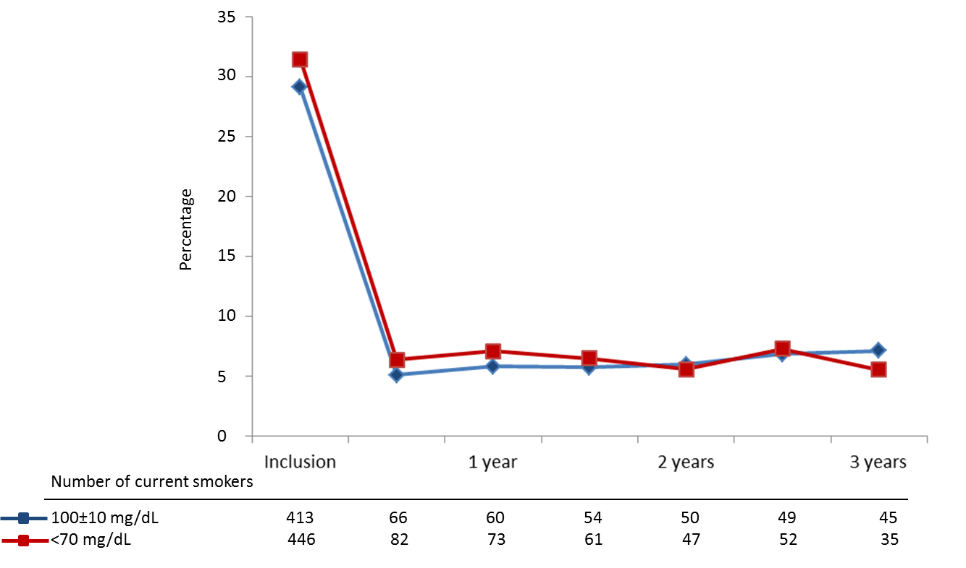
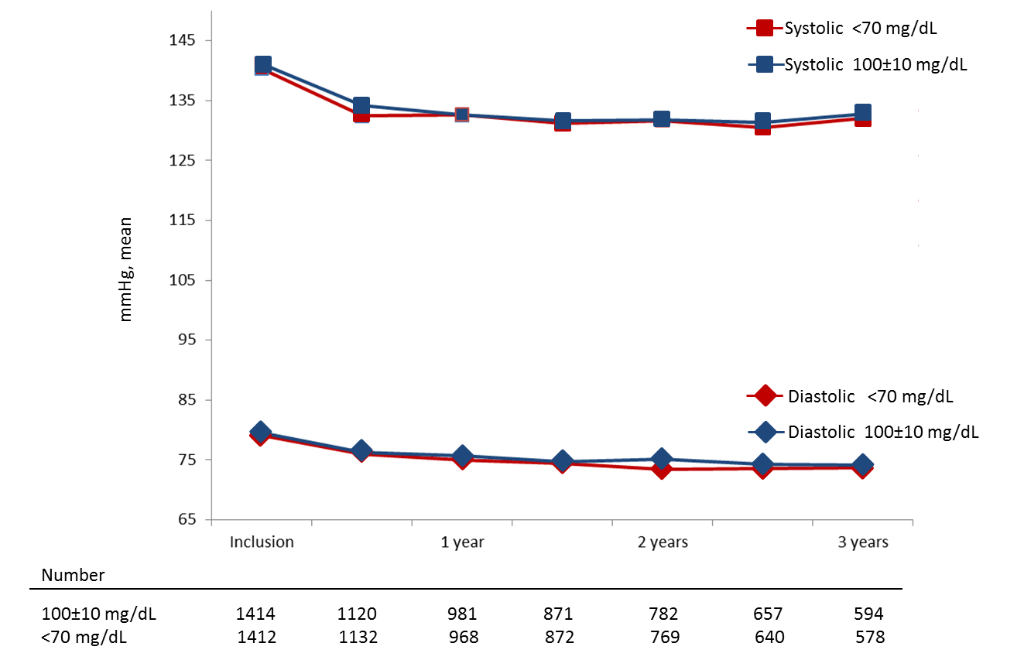
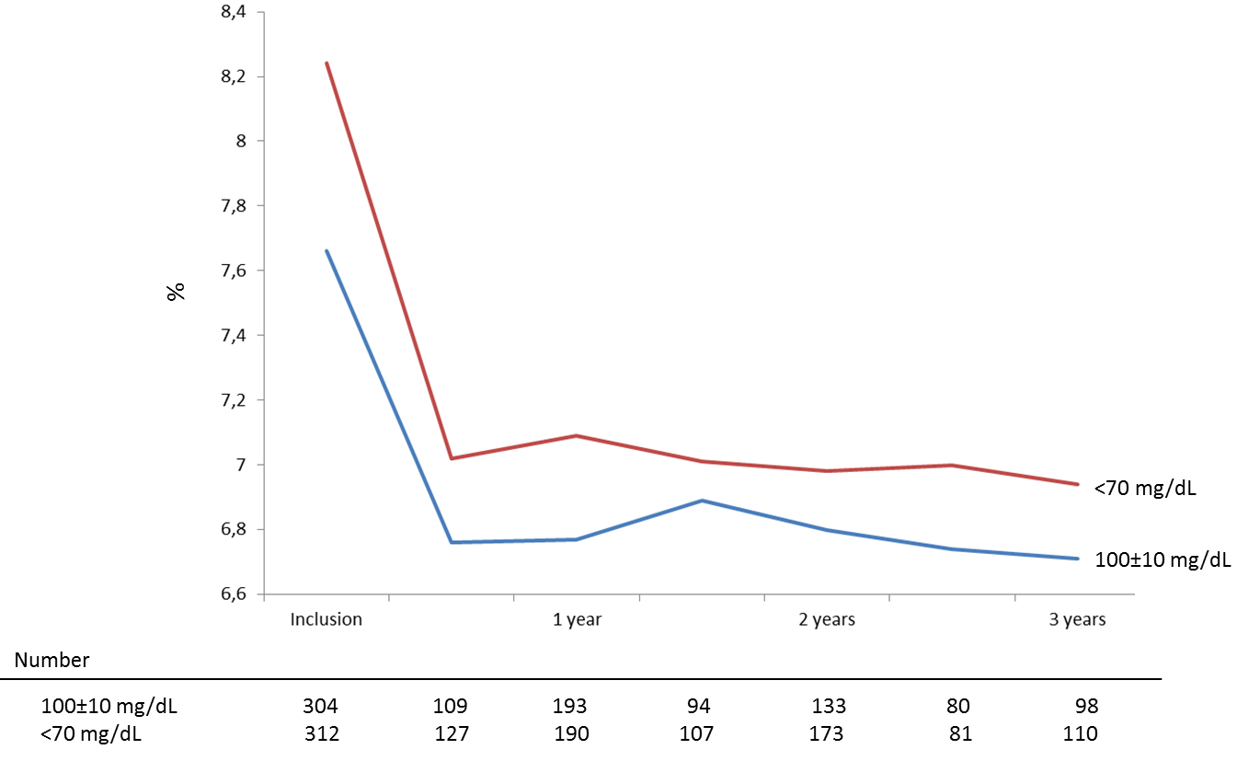
Achievement of prevention targets in the two treatment arms
TST
Active smokers
140 mm Hg
135 mm Hg
-75%
Smoking cessation
80 mm Hg
Hb A1C 8.1%
75 mm Hg
Hb A1C 7.8%
Blood pressure lowering
Hb A1C 7.2%
Diabetes control
Hb A1C 7.0%
23% Diabetics

Slide 10
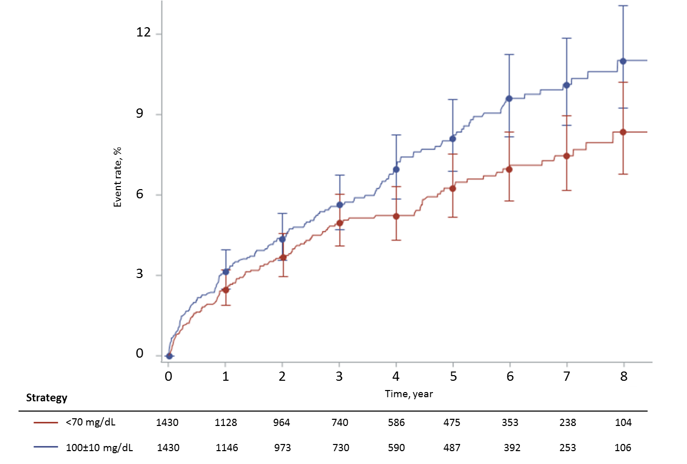
PRIMARY OUTCOME
TST
Ischemic stroke or undetermined stroke, myocardial infarction, urgent coronary revascularization following unstable angina, urgent carotid revascularization following TIA, vascular death
10.9%
PRE SPECIFIED COVARIATES ADJUSTMENTS
. Age
. Sex
. Entry event (ischemic stroke vs. TIA)
. Time from symptom onset to randomization
. Geographical region (France vs Korea)
(SPARCL trial adjustment)
22% RRR
8.5%
Adjusted HR = 0.78 [95% CI : 0.61 to 0.98; P value = 0.036]
Non adjusted HR = 0.77 [95% CI; 0.61-0.97; P value = 0.029]

Slide 11
TST
Secondary Outcomes | LDL <70 mg/dL (N=1430) | LDL 100±10 mg/dL (N=1430) | Hazard Ratio (95% CI) | P Value
myocardial infarction and urgent coronary revascularization | 20/1430 (1.4) | 31/1430 (2.2) | 0.64 (0.37-1.13) | 0.12*
cerebral infarction and urgent carotid and cerebral artery revascularization | 88/1430 (6.2) | 109/1430 (7.6) | 0.81 (0.61-1.07)
cerebral infarction or TIA | 120/1430 (8.4) | 139/1430 (9.7) | 0.87 (0.68-1.11)
any revascularization procedure (both urgent and elective) | 94/1430 (6.6) | 99/1430 (6.9) | 0.93 (0.70-1.24)
Carotid | 17/94 | 23/99
Coronary | 44/94 | 51/99
Peripheral | 33/94 | 25/99
vascular death | 22/1430 (1.5) | 32/1430 (2.2) | 0.69 (0.40-1.18)
all cause death | 88/1430 (6.2) | 93/1430 (6.5) | 0.97 (0.73-1.30)
Cerebral infarction or intracranial hemorrhage | 103/1430 (7.2) | 126/1430 (8.8) | 0.82 (0.63-1.07)
Intracranial hemorrhage | 18/1430 (1.3) | 13/1430 (0.9) | 1.38 (0.68-2.82)
Newly diagnosed diabetes | 103/1460 (7.2) | 82/14 | 1.27 (0.95-1.70)
* Hierarchical testing stopped
Primary outcome or intracranial hemorrhage | 133/1430 (9.3) | 165/1430 (11.5) | 0.80 (0.63-1.00)

Slide 12
TST
Key subgroups
Nominal interaction P Value
0.26
0.003
0.16
0.76

Slide 13
Conclusions
TST
With the limitation that we had to stop the trial when 277 primary endpoints were accrued whereas 385 were requested
This trial shows that after an ischemic stroke with evidence of atherosclerosis, a target LDL cholesterol of less than 70 mg/dL (1.8 mmol/L) compared to 100±10 mg/dL (2.5 mmol/L), reduced the risk of subsequent cardiovascular events
With no significant increase in intracranial hemorrhage
And no increase in newly diagnosed diabetes

